Slide 1
Market Credit Working Group update to the Wholesale Market Subcommittee
Brenden Sager, Austin Energy, Chair
Seth Cochran, DC Energy, Vice Chair
01 February 2023

Slide 2
MCWG to be terminated
We’ll have our regular meeting Feb 15 to discuss TAC’s Jan 24 direction to create a new credit group.
Creating new (voting) structure, charter and group name
We expect to present that to TAC Feb 20 so they can vote on eliminating MCWG and establishing the new committee that will report directly to TAC (and no longer to F&A and WMS).
For good order, WMS can dissolve the MCWG at the Mar 1 meeting.

Slide 3
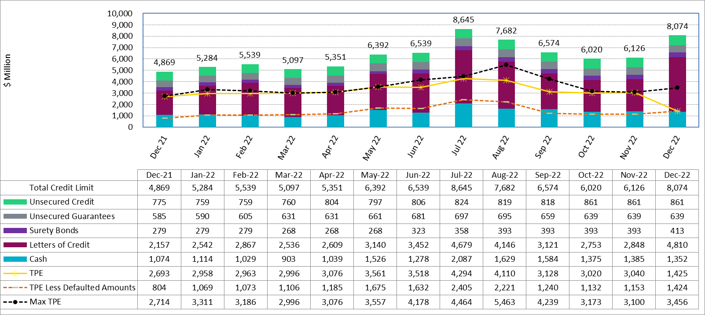
Available Credit by Type Compared to Total Potential Exposure (TPE) Dec 2021- Dec 2022

Slide 4
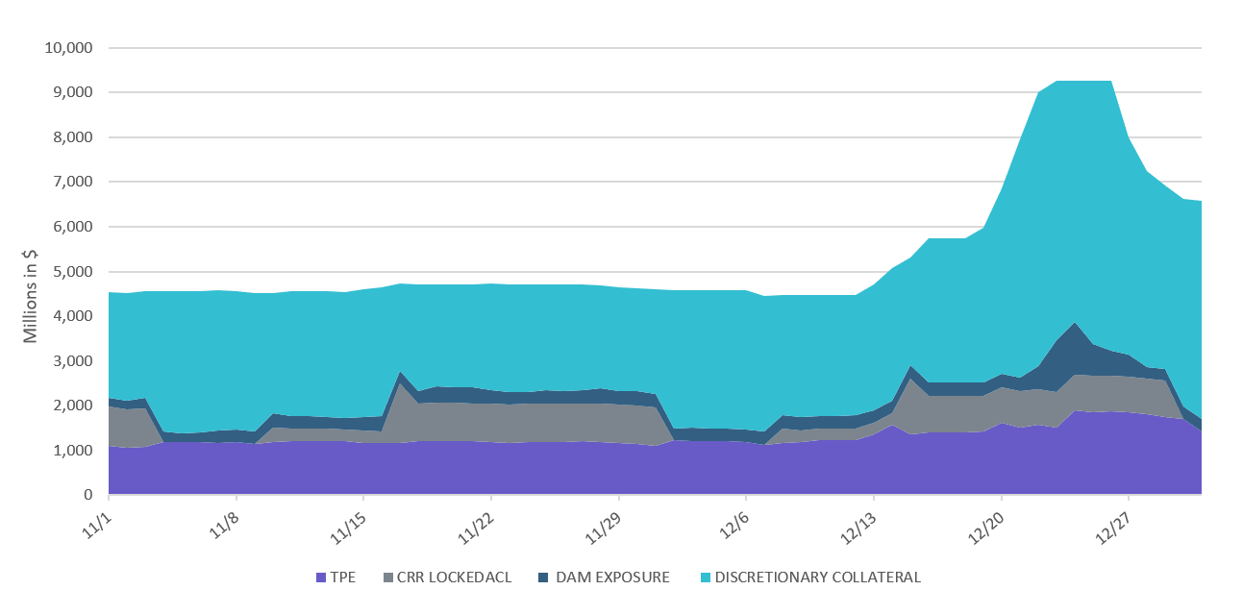
Discretionary Collateral Nov 2022 - Dec 2022

Slide 5
Questions?

