Slide 1
CRR Activity Calendar Update
Samantha Findley
Supervisor, CRR
WMS
February 1, 2023

Slide 2
CRR activity calendar – overview
Protocol 7.5.1(4)(c) requires ERCOT to post an updated calendar no later than April 1 of each calendar year
  Each calendar includes auction activity dates for the remainder of the current calendar year and for the two subsequent calendar years
  The calendar must be approved by WMS prior to the annual posting
Calendar was shared with CMWG on January 9, 2023
  No revisions were requested
Seeking final approval today from WMS

Slide 3
CRR activity calendar – general reminders
The model build process begins 2 weeks prior to the model posting date (get outages and Common Information Model snapshot)
We hold a monthly auction and a long-term auction every month of the year
  Typical pattern is monthly auction bid window in the first half of the month followed by the long-term auction bid window the very next week (occasionally, there will be a one-week gap to avoid holidays)
  Monthly auction results are posted one week after the bid window closes; long-term auction results are posted two weeks after the bid window closes
  Monthly auction credit is usually released 1 day after the long-term auction credit is locked (SCR816 will remove this overlap)

Slide 4
CRR activity calendar – general reminders
There are two additional tabs on the calendar
  “Calendar Protocol References” includes any specific protocol sections related to the selection of dates
  “PCRRs” gives activity dates and protocol sections related to the annual PCRR allocation process

Slide 5
CRR activity calendar – description of changes
Current calendar goes through the 2025.MAR.Monthly.Auction
Draft dates cover CRR activities through the 2026.MAR.Monthly.Auction
  Applied the same patterns to assign the dates as have been used for previous calendars to maintain Protocol requirements and consistency
PCRR-eligible NOIEs are encouraged to view the dates on the “PCRRs” tab of the calendar

Slide 6
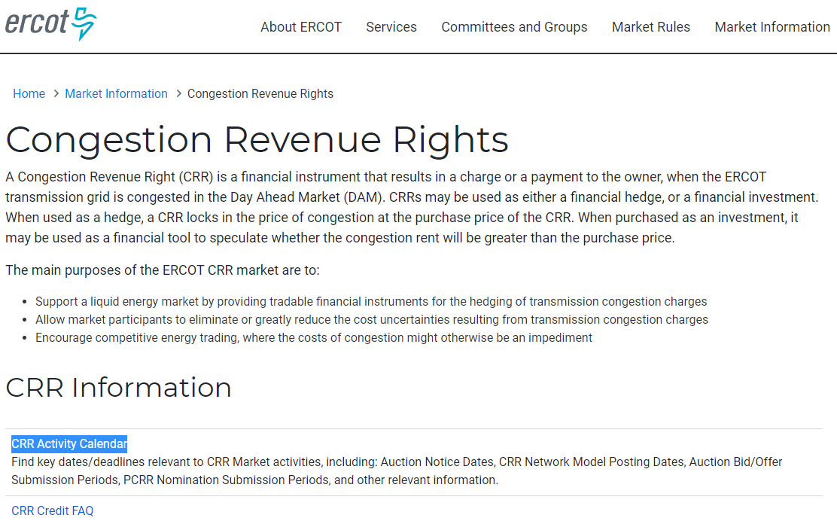
CRR activity calendar – next steps
ERCOT is seeking final approval today from WMS
  Last chance to get WMS approval will be on March 1
Approved calendar will be posted on the CRR webpage by April 1

Slide 7
CRR activity calendar – next update upon SCR816 implementation
After SCR816 is implemented, locked credit will be released the same day that auction results are posted. This will eliminate the one day of locked credit overlap that occurs most months.
    Currently, locked credit is released the day auction invoices are issued, the next business day after auction results are posted.
    Targeting SCR816 implementation in Q4
Calendar dates themselves will not change in the SCR816 calendar update; only column headers will change.

Slide 8
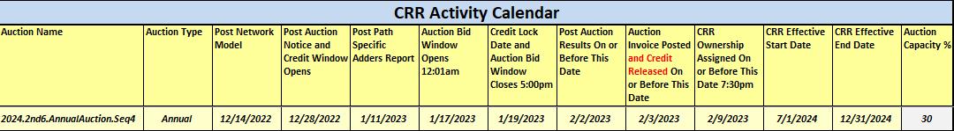
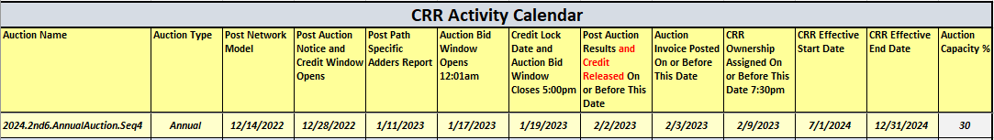
CRR activity calendar – next update upon SCR816 implementation
Current calendar column headers:
Calendar column headers after SCR816 is implemented:

Slide 9
CRR activity calendar – next update upon SCR816 implementation
ERCOT will send a Market Notice with the next updated calendar in advance of SCR816 implementation, in accordance with Protocol 7.5.1(4)(c)(ii)

