Slide 1
Unregistered Distributed Generation Report:
2022 Q4 Update
Fred Khodabakhsh
Resource Adequacy
2/1/2023

Slide 2
2022 Q4 Unregistered Distributed Generation Report
Totals may not match the sum of their columns/rows due to rounding
Notes:
Competitive vs. NOIE breakdown:
Competitive: 1,123 MW
NOIE: 849 MW
NOIE data is submitted through surveys. Competitive TDSP data is submitted through load profile codes.

Slide 3
2022 Q3 → Q4 Change
Totals may not match the sum of their columns/rows due to rounding
Notes:
- Wind capacity drop due to unit retirements and data correction.

Slide 4
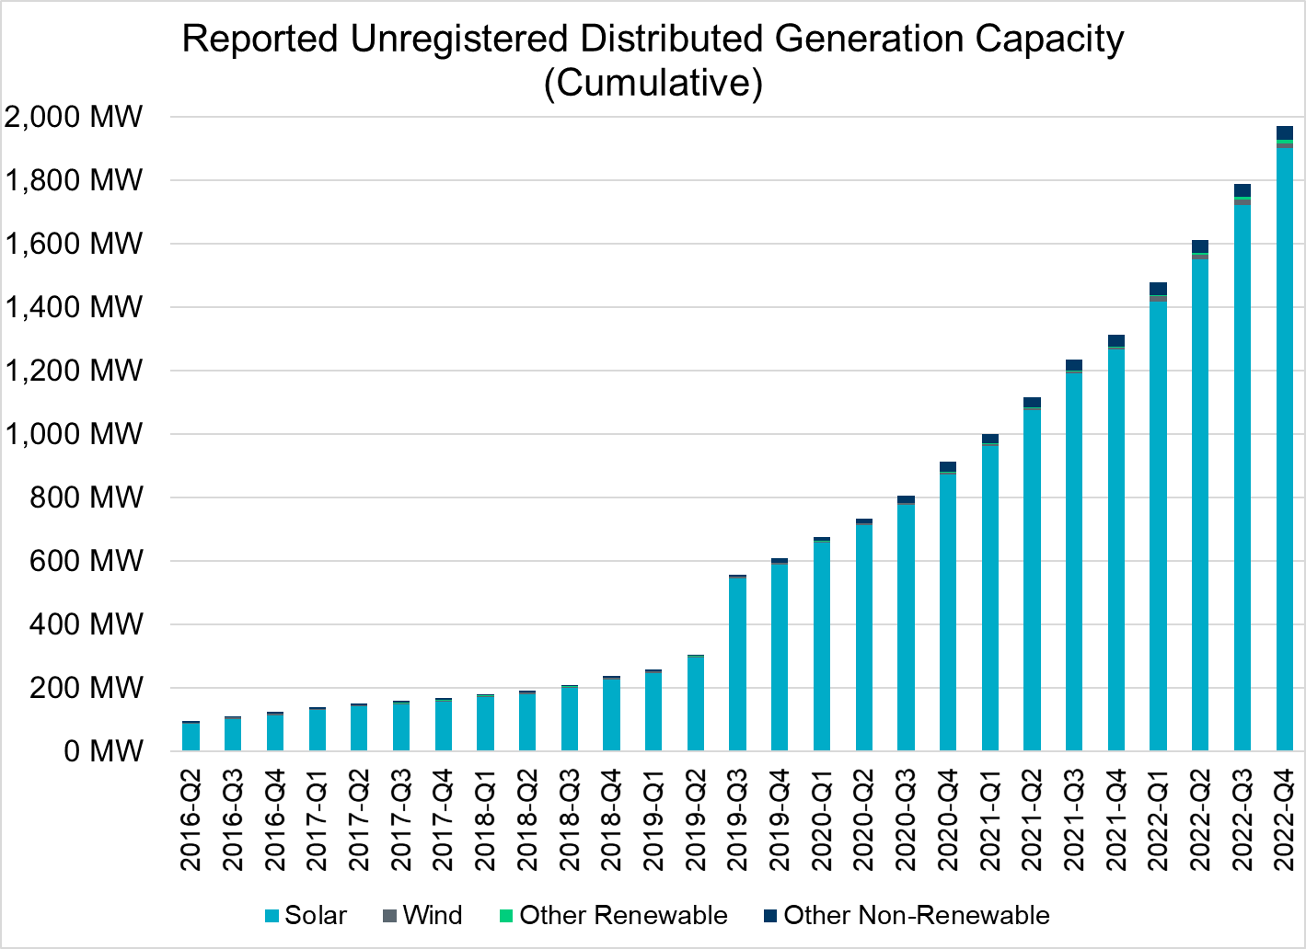
Unregistered DG Growth: 2016-Q2* to 2022-Q4
Large increase due to reporting requirement change**
* 2016-Q2 was the first report published after implementation of report changes per NPRR794/COPMGR044
** 2019-Q3 was the first report published after implementation of report changes per NPRR891

