Slide 1
Fuel Supply Risk Desk
What it is.
Why it’s needed.
Gas Electric Working Group
ERCOT — Public
January 25, 2022

Slide 2
Contents
ERCOT Overview – 3-4
ISOs with Fuel Supply Resource Desks – 5
How We Plan – 6
What We Don’t Know – 7
Requests for Additional Information – 8
Details: Current-Day Planning vs. Desired Outcomes – 9-18

Slide 3
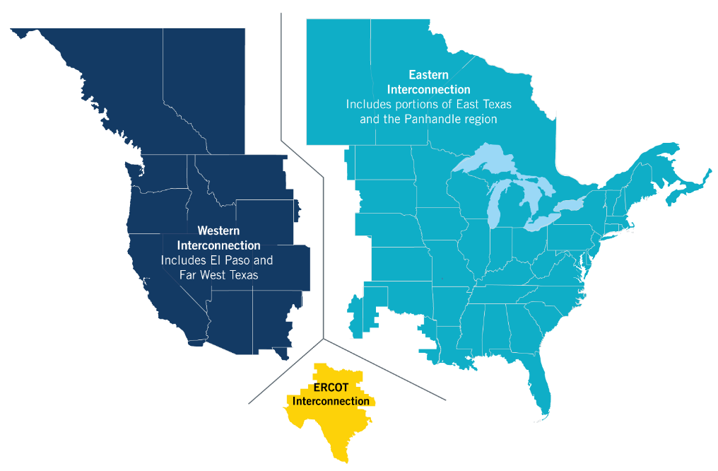
ERCOT Overview – We Keep the Lights On
Does not own generation or transmission assets
Ensures reliability of the electric system
Provides non-discriminatory access to transmission
Coordinates power generation, dispatch and transmission
Independent operation of the wholesale and retail electric markets

Slide 4
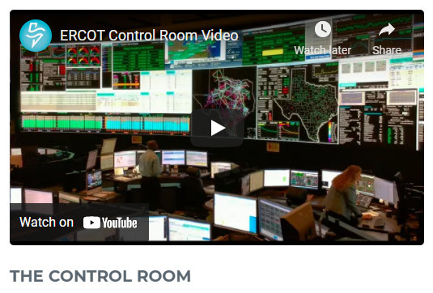
Current ERCOT Control Room Operations
24 x 7 x 365 operation of the ERCOT grid
Six crews of seven operators and one shift supervisor work 12-hour shifts
Eight defined “desks” per shift, each with specific reliability duties
Two Transmission Desks
Resource Desk
Real-Time Desk
Reliability Unit Commitment Desk
Reliability Risk Desk
DC Tie Desk
Shift Supervisor Desk
CONTROL ROOM VIDEO
Three control rooms; primary control room typically at Taylor, backup at Bastrop, and the training control room can be converted into a tertiary control room
Control Room video on ERCOT.com gives good overview

Slide 5
ISOs / RTOs With Fuel Supply Risk Desks
ISO New England
New York ISO
MISO – Midwest System Operator
PJM
Southwest Power Pool (in progress)

Slide 6
How We Plan
Seasonal Assessment of Resource Adequacy (SARA)
Outage Coordination
7-Day Risk Assessment
Day Ahead and Operating Day Studies
Real-Time Monitoring and Analysis
Quarterly analysis of expected demand and resources
Includes base and risk scenarios
Provides guidance to state leadership and other stakeholders on seasonal risk of load shed
Process to facilitate and approve transmission and generation maintenance outages
Identification of reliability risk and mitigation for forced outages
Rolling 168-hour assessment of resource adequacy based on known outages and weather forecasts
Includes 90-, 45-, 9-, 4-, and 3-Day Ahead reliability studies
May result in rescheduling transmission or generation outages
Used to inform state leadership of impending reliability threats
Next-day and intra-day analysis of reliability risks
May result in bringing online additional generation to maintain demand-resource balance plus reserves
Used to inform state leadership of impending reliability threats
Ongoing situational awareness of transmission system reliability and resource adequacy
Includes real-time analysis of unexpected system changes, such as the outage of generation
Notes:
These are the things we do daily to keep the grid reliable – short term, medium term, long term.
These are data sets ERCOT needs to ensure reliability.

Slide 7
What We Don’t Know
Short-term and long-term status of fuel supplies or pipeline availability
Impending curtailments or other issues on the gas system until they happen
Coal stockpiles
Coal supply chain interruptions
Notes:
Explain the Fuel Supply Resource Desk.
What will this desk do and why it’s additive and needed

Slide 8
Gas Info Needed to Improve Reliability & Planning
ERCOT currently has no visibility into real-time gas operations or planned outages which could potentially impact a generator’s ability to operate as expected. To better maintain grid reliability and operations, as well as to facilitate proper planning, ERCOT needs the following information:
Emergency contact information for when real-time issues arise
Is Supply Chain Map contact the correct person for this?
Real-Time, Medium-Term (7-days), and Long-Term (>30-days) pipeline outage and restriction information that can be used to assess potential impacts on generators
Need assistance from pipeline companies:
To determine which outage and restriction information is relevant to ERCOT
To what extent do existing EBBs provide needed info?
Contact info for personnel who can assist with data relevance, fidelity, and content questions
Telemetry that would allow ERCOT to monitor for gas system issues that may impact generators
Pipeline pressure information would be ideal, but flow information may also work
Need assistance from pipeline companies:
To determine which telemetry is relevant to ERCOT
Contact info for personnel who can assist with telemetry questions and issues

Slide 9
QSE Info Needed to Improve Reliability and Planning
ERCOT is engaging with Generator Operators (QSEs) to obtain other information needed for the Fuel Supply Risk Desk:
Gas pressure/flow telemetry at the generator site
Day ahead gas nomination/supply information to assess potential gas availability shortfalls
Coal stockpile information

Slide 10
Current-Day Planning vs. Desired Outcomes: Seasonal Assessment of Resource Adequacy
Current Day
Process
Prepare seasonal assessment of resource adequacy
Deficiency
Current process does not account for fuel supply outages affecting generators.
Current Outcome
Incomplete data for resource adequacy – limits planning outcomes

Slide 11
Current-Day Planning vs. Desired Outcomes: Seasonal Assessment of Resource Adequacy
Desired Outcome
Better data for resource adequacy. Better planning. Better reliability.
From Generators: None
From Solar: None
From Wind: None
From Coal: Update on-site reserves and contingency supply chain faults
From Gas Pipelines: Planned pipeline outages affecting generators with pipelines to identify outages affecting multiple generators. Establish collaborative relationship between ERCOT and pipelines
Handled by current process
New Data Needed
New Process
Review planned pipeline outages affecting generators with pipelines to identify any pipeline outages affecting multiple generators. Quarterly analysis of expected demand and resources

Slide 12
Current-Day Planning vs. Desired Outcomes: Outage Coordination
Current Day
Evaluate combinations of requested transmission and generation outages for system reliability
Process
The current analyses only includes generation outages or derates due to pipeline outages that are known to generators. Pipeline outages that are not known to the generator, may cause ERCOT to approve transmission or generation outages that would not be reliable in the event of a pipeline outage. Some information is posted for interstate pipelines but not for in-state.
Deficiency
Current Outcome
Incomplete data for fuel adequacy – Risk for reliability increases

Slide 13
Current-Day Planning vs. Desired Outcomes: Outage Coordination
Desired Outcome
Better data for fuel adequacy. Better planning. Better reliability.
From Generators: None
From Solar: None
From Wind: None
From Nuclear: None
From Coal: Update on-site reserves and contingency supply chain faults
From Gas Pipelines: Review planned pipeline outages affecting generators with pipelines to identify any pipeline outages affecting multiple generators. Establish collaborative relationship between ERCOT and pipelines
Handled by current outage process
New Data Needed
ERCOT coordinates with pipelines to ensure pipeline outages are accounted for in generation outage scheduling
New Process

Slide 14
Current-Day Planning vs. Desired Outcomes: 7-Day Risk Assessment
Current Day
Evaluate, mitigate, and communicate resource adequacy risks for the next seven days
Process
The current analysis only includes generation outages or derates due to pipeline outages that are known to generator; if there are planned pipeline outages or other limitations that are not known to the generator, ERCOT may have a false sense of resource adequacy and fail to take appropriate mitigation actions or communicate risks to state leadership and other stakeholders. Some information is posted for interstate pipelines but not for intrastate
Deficiency
Current Outcome
Incomplete data for 7-Day Risk Planning – limits planning outcomes

Slide 15
Current-Day Planning vs. Desired Outcomes: 7-Day Risk Assessment
Desired Outcome
Better data for fuel adequacy. Better planning. Better reliability.
From Generators: None
From Solar: None
From Wind: None
From Coal: Update on-site reserves and contingency supply chain faults
From Gas Pipelines: Review planned pipeline outages affecting generators with pipelines to identify any pipeline outages affecting multiple generators. Establish collaborative relationship between ERCOT and pipelines
Handled by current process
New Data Needed
ERCOT to coordinate with pipelines to ensure pipeline outages and other limitations are accounted for in generation outage scheduling and Current Operation Plan (COP) submission.
New Process

Slide 16
Current-Day Planning vs. Desired Outcomes: Day Ahead and Operating Day Studies
Current Day
Transmission security studies, studies of the need to commit additional generation for reliability, resource adequacy assessment for next and current day
Process
The current analysis only includes generation outages or derates due to pipeline outages that are known to generator and assumes that generators not on outage can obtain the gas needed to produce power at their maximum capability. If gas is not available due to either insufficient nomination or a pipeline outage it can lead to unforeseen resource adequacy problems
Deficiency
Current Outcome
Incomplete data for Day Ahead and Operating Day Studies

Slide 17
Current-Day Planning vs. Desired Outcomes: Day Ahead and Operating Day Studies
Desired Outcome
Better data for fuel adequacy. Better planning. Better reliability.
From Generators: Nominated gas quantities
From Solar: None
From Wind: None
From Coal: Projected fuel supply interruption
From Gas Pipelines: Day ahead and real-time pipeline outage, constraint, and available capacity information
Handled by current process
New Data Needed
Similar new process for outage coordination and a process to identify and mitigate risk due to insufficient gas nominations and/or pipeline available capacity
New Process

Slide 18
Current-Day Planning vs. Desired Outcomes: Real-Time Monitoring and Analysis
Current Day
Process
Various situational awareness and system study processes
Currently, ERCOT operators are unaware of real-time pipeline issues that may prevent generators from being able to produce power until they become acute and result in generator outages. The lack of situational awareness means that critical decisions that could avoid electric system reliability problems may be delayed
Deficiency
Current Outcome
Incomplete data means inaccurate real-time monitoring and delayed implementation of solutions to reliability problems that could be avoided with more complete and timely information on fuel availability

Slide 19
Current-Day Planning vs. Desired Outcomes: Real-Time Monitoring and Analysis
Desired Outcome
Better data for real-time monitoring and analysis. Better real-time. Better reliability.
New Tools Needed
Gas monitoring visualization tool
From Generators: Real-time gas pipeline pressure telemetry and minimum pressure requirements for units
From Gas Pipelines: Pipeline “health” information and control room contact information for ERCOT operators. Establish collaborative relationship between ERCOT and pipelines. Advance notice of curtailments and other potential issues affecting fuel availability.
New Data Needed
Similar new process for outage coordination and a process to identify and mitigate risk due to insufficient gas nominations and/or pipeline available capacity
New Process

Slide 20
Questions?

