Slide 1
IBRTF - NOGRR245 - Inverter-Based Resource (IBR) Ride-Through Requirements
Stephen Solis – Principal, System Operations Improvement
January 20th, 2023

Slide 2
Overview
ERCOT has experienced multiple events where Inverter Based Resources (IBRs) have failed to ride-through the disturbance. The magnitude of these events have increased as the levels of IBRs synchronized to the ERCOT System have increased.
ERCOT received a recommendation as part of the 2021 Odessa Disturbance Report. “ERCOT should ensure that the recommendations contained within the NERC reliability guidelines are comprehensively reviewed and adopted to ensure mitigating actions are put in place to prevent these types of issues in the future. Many of the performance issues in this event could have been mitigated if appropriate performance requirements were established for these resources and interconnection studies were performed to ensure conformance with those requirements”
EPRI gap assessment of IEEE 2800 vs ERCOT Protocols and Guides recommended that ERCOT improve Inverter Based Resource (IBR) Ride-Through requirements to align with IEEE 2800 ride-through requirements which could mitigate some recent failure mode causes.
Feedback at ERCOT IBRTF was to prioritize ride through requirement changes over other changes.
NOGRR enhances clarity and specificity of frequency and voltage ride through requirement sections for IBRs while aligning with most relevant IEEE 2800 standard and NERC Reliability Guidelines.

Slide 3
High-Level Gap Assessment of ERCOT Nodal Protocols
Indicates current priority of sets of rule changes
Sec 4
Sec 6&7
1
1
1
1
1
4
Sec 11
1
Sec 9
Sec 5
3
Sec 8
4
2
NOGRR enhancing high resolution data capture requirements (PMU, DFR, inverter oscillography)

Slide 4
IBR – Frequency ride-through requirements
Proposed changes address the following:
  Maintains frequency ride-through curve while requiring more restrictive portions of the curve from IEEE 2800
  Clarifies that being outside of a no trip zone does not require the unit to trip
  Clarifies that protection should be set based on IBR capability rather than the minimum ride-through requirement
  Clarifies that anti-islanding protection is not required to be enabled unless needed to prevent equipment damage or ensure proper operation of the IBR
  Specifies minimum Rate of Change of Frequency (ROCOF) if protection needed to be enabled
  Specifies options to prevent unnecessary failures due to poor frequency measurements

Slide 5
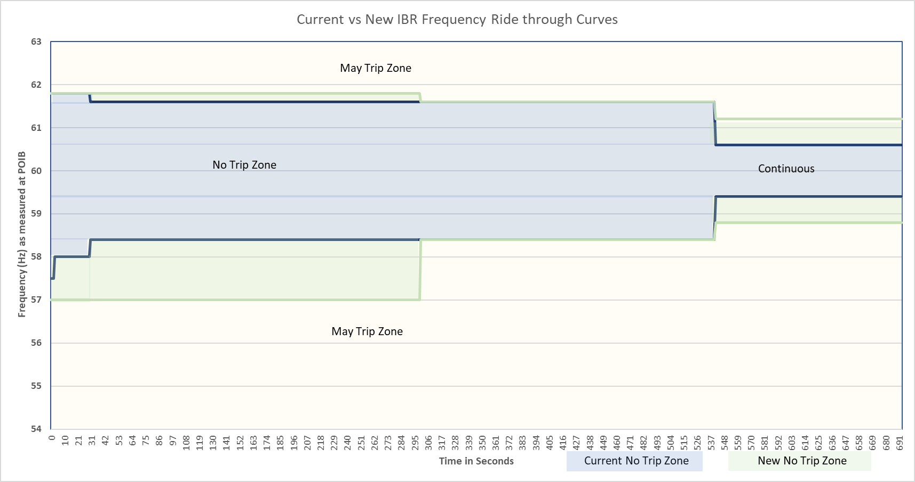
Current vs New IBR Frequency Ride-Through Curves

Slide 6
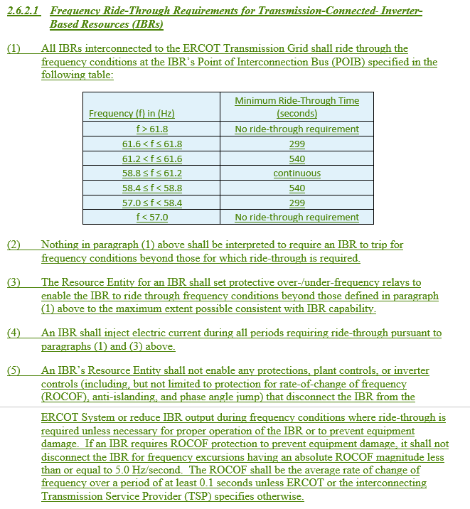
IBR – Frequency ride-through requirements

Slide 7
IBR – Voltage Ride-through requirements
Proposed changes address the following:
  Enhances existing voltage ride-through requirement to align required ride-through profile with capability specified in IEEE 2800 Table 11
  Adds ride-through requirements for instantaneous overvoltage conditions
  Clarifies that being outside of a no trip zone does not require the unit to trip
  Clarifies that protection should be set based on IBR capability rather than the minimum ride-through requirement
  Specifies minimum phase angle jump requirement if protection needed to be enabled
  Specifies Q priority mode requirements to minimize active power current reduction
  Clarifies that other systems like the power plant controller cannot unnecessarily reduce capability while riding through
  Specifies options to prevent unnecessary failures due to poor voltage measurements

Slide 8
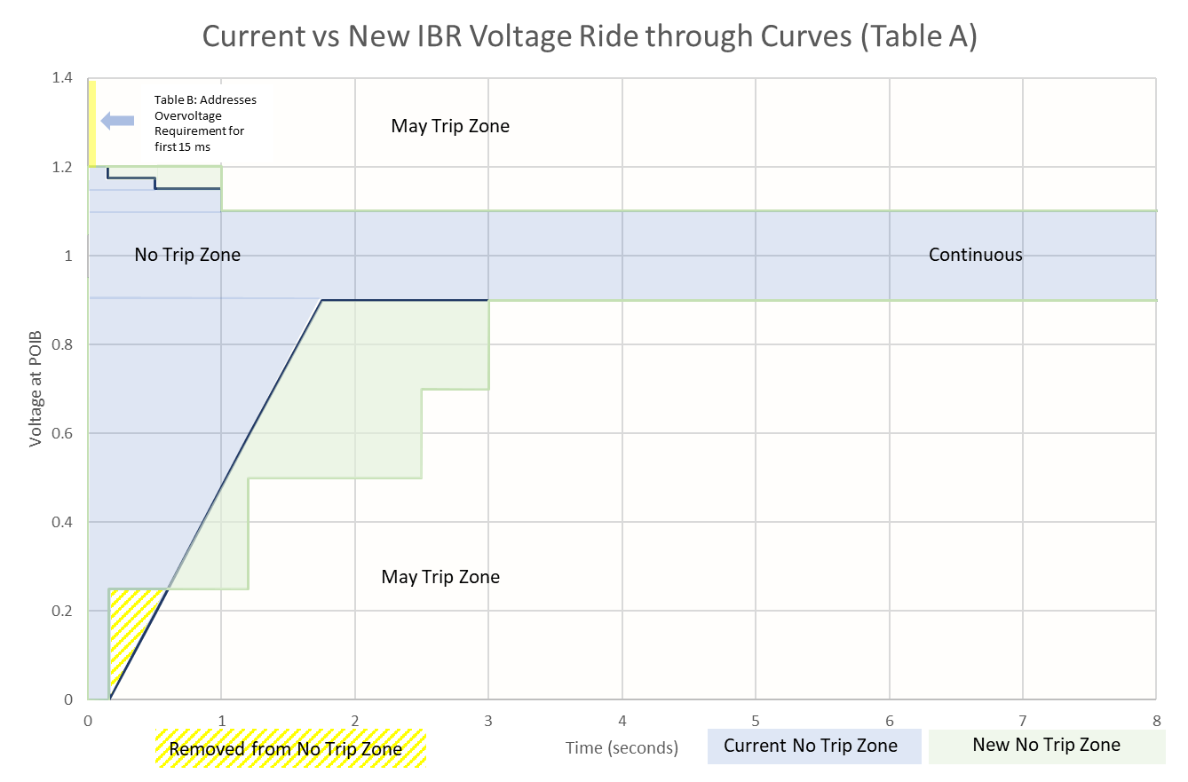
Current vs New IBR Voltage Ride-Through Curves

Slide 9
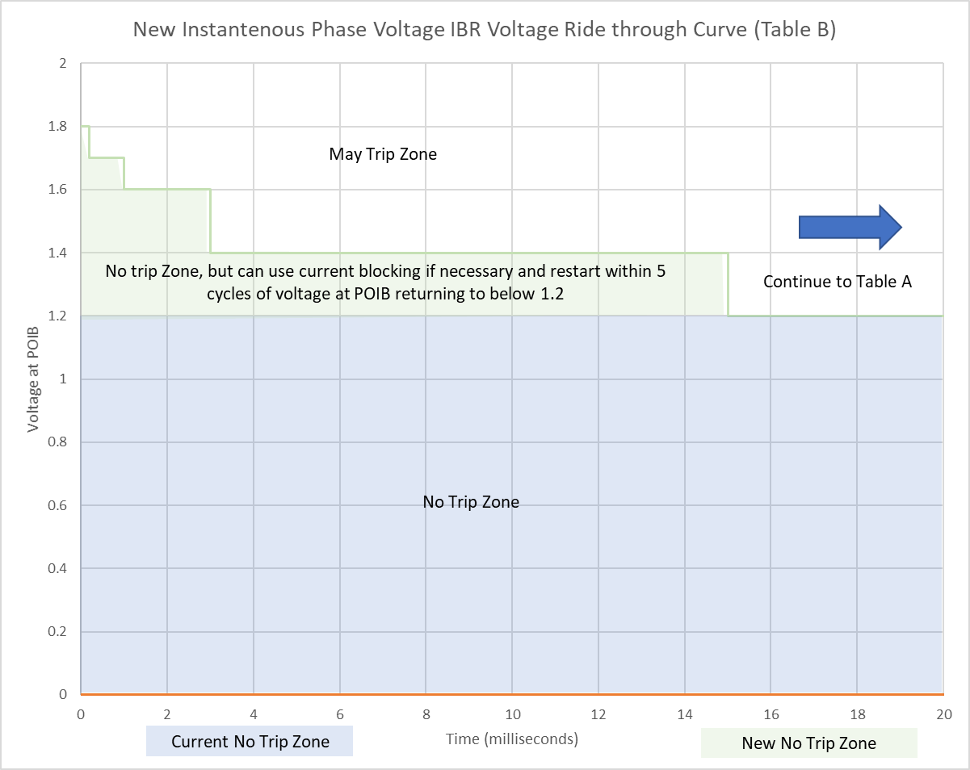
New IBR Voltage Instantaneous Ride-Through Curve

Slide 10
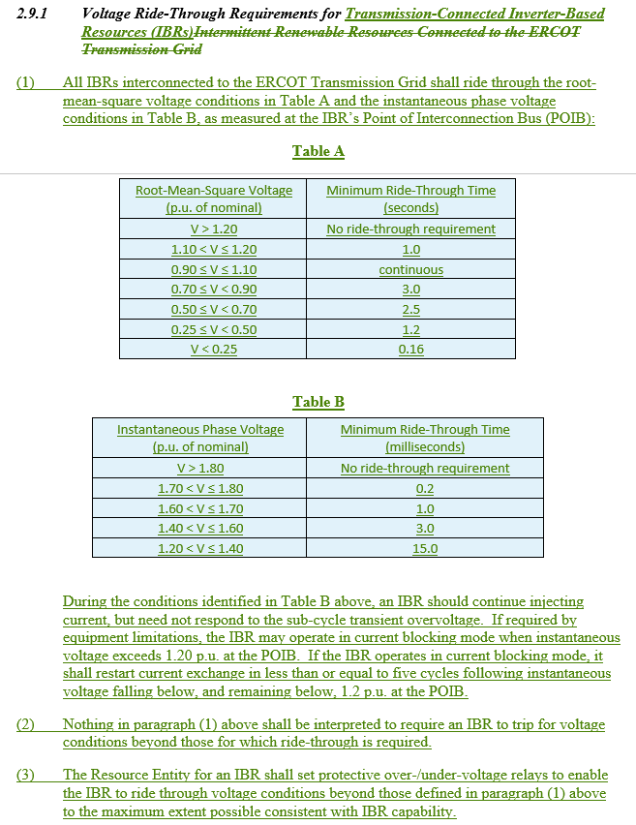
IBR – Voltage Ride-through requirements

Slide 11
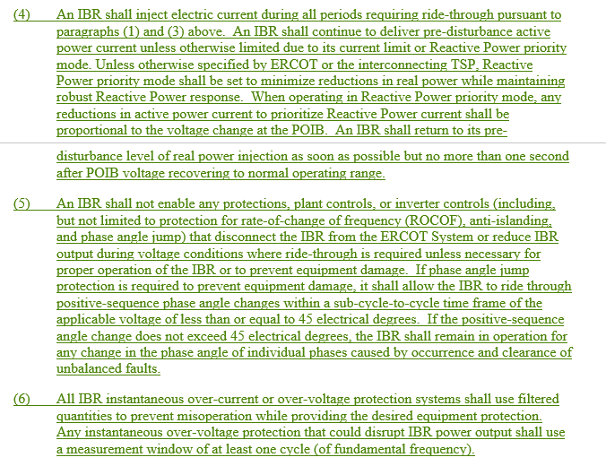
IBR – Voltage Ride-through requirements

Slide 12
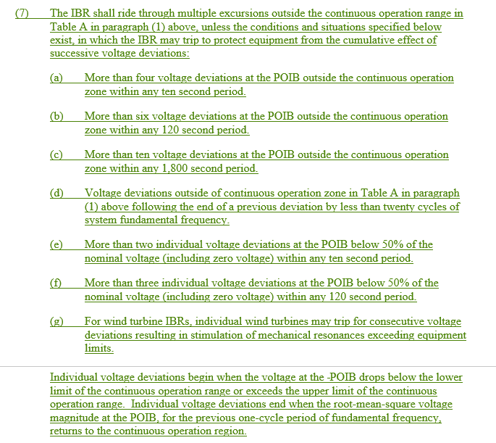
IBR – Voltage Ride-through requirements

Slide 13
Implementation
All transmission connected IBRs with an SGIA executed on or after January 1, 2023 must be compliant.
All other transmission connected IBRs must be compliant within 12 months of the NOGRR being approved.
  Within 6 months of the NOGRR being approved, if the Resource Entity can demonstrate a valid reason for needing additional time (up to an additional 12 months) to implement changes to allow the IBR to be fully compliant, the RE must submit a request for a temporary exemption to ERCOT.
  ERCOT may approve an exemption for the minimum amount of time necessary to implement the changes.
  If an IBR receives an exemption, they still must implement any changes possible to get as close to the requirements as soon as practicable.
After 24 months all transmission connected IBRs must be fully compliant, or they will only be allowed to operate when instructed on for reliability needs.
  Table B of VRT requirements are only required for transmission connected IBRs with an SGIA executed on or after January 1, 2023.
  Restrictions will be removed when the IBR mitigates all issues preventing them from being fully compliant.
New rules do not remove the obligation to meet current FRT/VRT requirements.
Models must be updated for all entities making modifications.

Slide 14
Implementation
*Timeline represents a reasonable example timeline to reduce reliability risk as quickly as possible.
*To support such a timeline, any comments would need to be submitted within the next 14-30 calendar days.

Slide 15
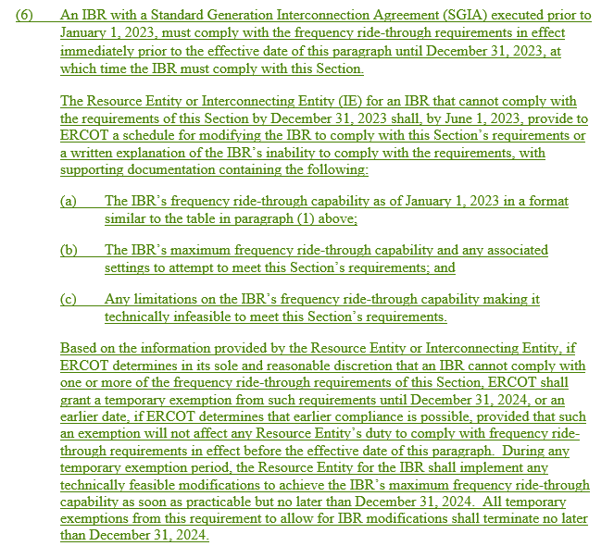
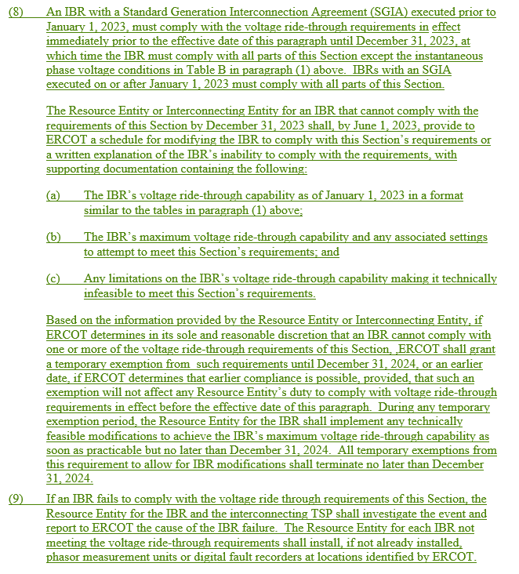
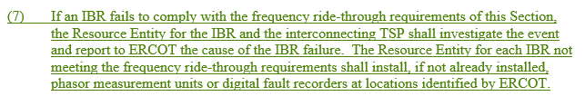
Implementation
Frequency ride-through
Voltage ride-through

Slide 16
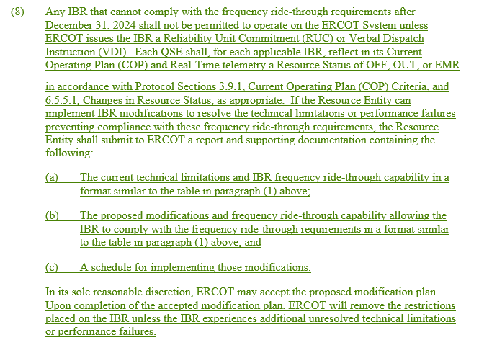
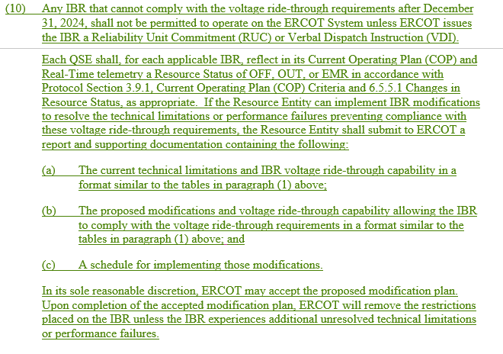
Implementation
Frequency ride-through
Voltage ride-through

Slide 17
Questions?

