Slide 1
2022 Odessa Disturbance Update
NERC Recommendations and ERCOT Activities
Patrick Gravois
Operations Engineer – Operations Analysis
IBRTF Meeting
January 20, 2023

Slide 2
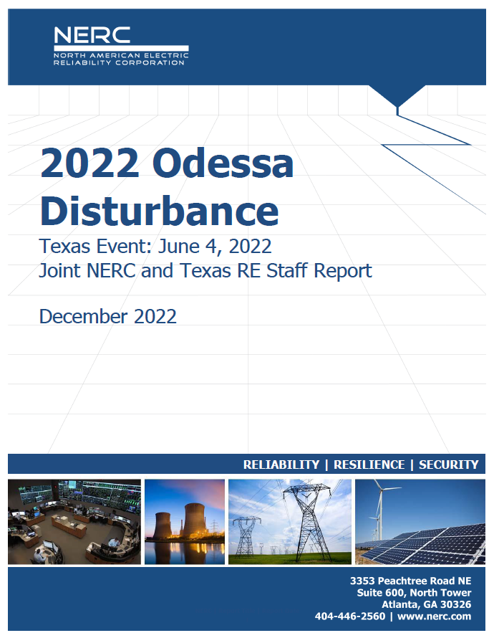
NERC Odessa Report and Webinar
NERC published 2022 Odessa Disturbance Report in December 2022
NERC held Webinar on January 4, 2023
  Panelists from NERC, TRE, and ERCOT

Slide 3
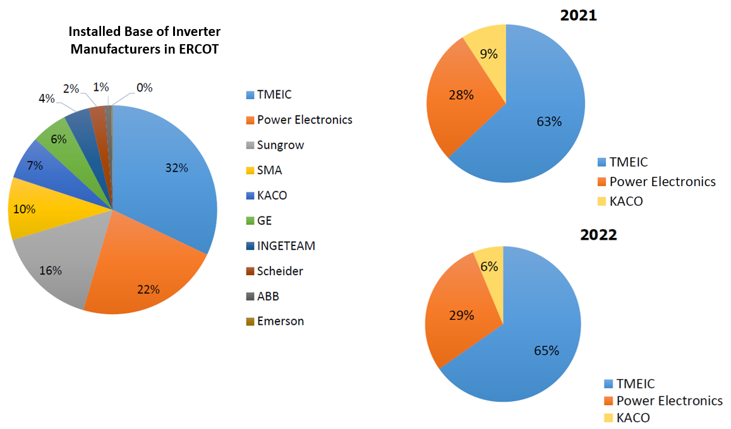
Affected Solar PV Inverter OEMS

Slide 4
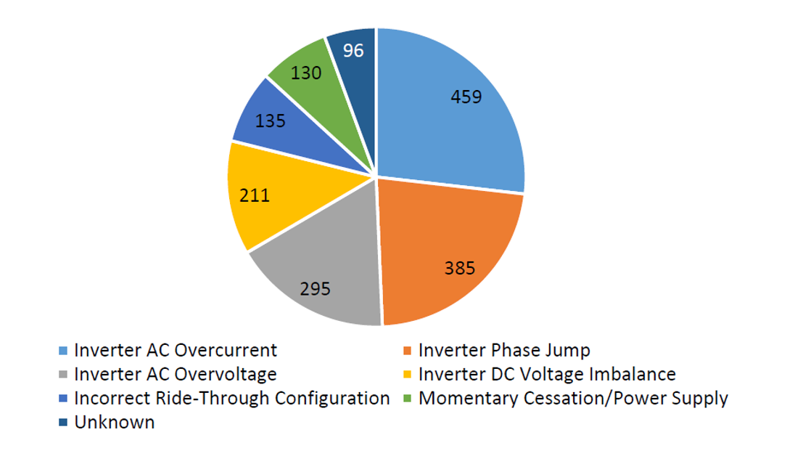
Cause of Solar PV Reduction - 2022

Slide 5
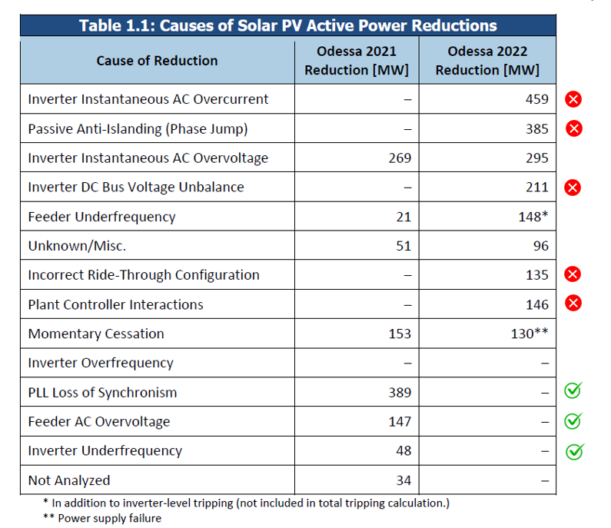
Cause of Solar PV Reduction – 2021 and 2022 Comparison

Slide 6
NERC Recommendations – TOs, GOs, GOPs, Developers, OEMs
NERC Assurance of Inverter-Based Resource Performance
  Will issue alert for recommendations for mitigating possible performance issues
  Will encompass all past performance issues identified in previous IBR events
NERC Assurance of Model Quality
  Will issue alert to all GOs to provide adequate proof that dynamic models match actual equipment controls, settings, and protections
  Model verification reports will be required to ensure models match field settings
  Discrepancies shall be reported to ERO Enterprise
Model Quality and Model Validation
  Significant enhancements to modeling requirements with model quality checks and model validation practices recommended
  NERC MOD-026 updates in progress

Slide 7
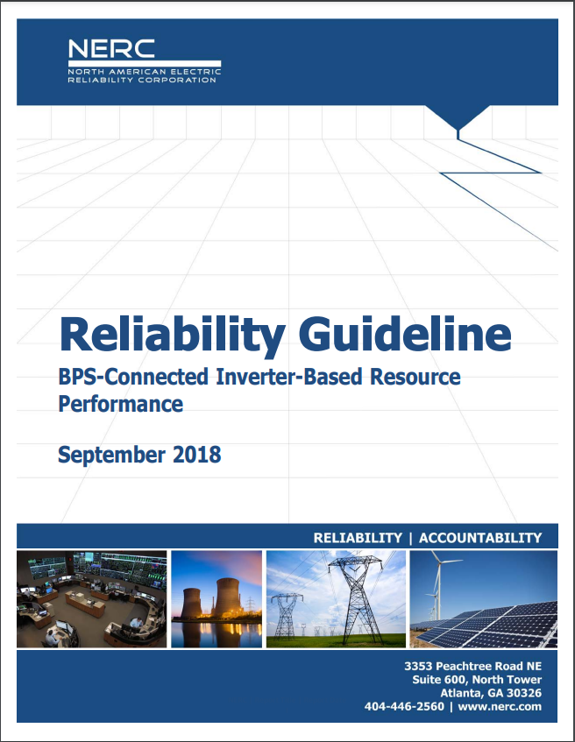
NERC Recommendations – TOs, GOs, TPs, PCs, Developers, OEMs
Study Qualified Changes Prior to Implementation
  TPs and PCs should identify qualified changes that should be studied before implementation in field
  For example - DVC k-factor adjustments
  Identify potential adverse system response through simulation
Adoption of Reliability Guidelines
  BPS-Connected Inverter-Based Resource Performance
  https://www.nerc.com/pa/rrm/ea/Pages/Major-Event-Reports.aspx

Slide 8
NERC Recommendations - ERCOT
ERCOT Improvement to Interconnection Process
  Focus on using user-defined EMT and positive sequence models verified by OEM
  EMT and positive sequence models verified against designed parameters and identify any gaps and/or model limitations
  Verify commissioned equipment settings and protections match those that are modeled prior to commercial operation
ERCOT Adoption of Reliability Guideline Content
  ERCOT should adopt applicable recommendations to ensure mitigating actions are put in place to prevent these types of events in the future
  Enforcement of modeling and performance requirements

Slide 9
NERC Recommendations - ERCOT
ERCOT Follow-Up with all Inverter-Based Resources in Texas Interconnection
  Stakeholder outreach and education programs to ensure all REs and QSEs of IBRs in Texas Interconnection are implementing mitigating actions
  Enforcement of ride-through requirements and model quality checks
ERCOT System Model Validation Effort
  Recommends ERCOT conduct a system model validation using both positive sequence and EMT models
  Ensure models reflect as-commissioned equipment and can accurately recreate system events
  Will improve model quality and identify future performance issues

Slide 10
ERCOT Activities to Mitigate IBR Risks - 2023
Send out formal requests in January to REs of affected facilities in Odessa events that models will need to updated and resubmitted
  Per ERCOT Planning Guides: REs are required to submit a Verification Report, updated dynamic models, and model quality test reports within 30 days of implementing a settings change or after observing a model update is needed to accurately represent the facility.
  Initial requests went out to some facilities this week with due date of 2/10
  Some facilities still in process of implementing corrective actions
Reach out to all facilities (Operational or Commissioning) with TMEIC, Power Electronics, or KACO inverters
  TMEIC: Extending VRT settings, Volt Phase Jump adjustment/disabling, overcurrent mitigation (when approved by TMEIC)
  Power Electronics: Implement DC regulation firmware update; check that correct LVRT/OVRT mode is enabled
  KACO: Check that VRT and FRT settings are set to actual equipment tolerances and not loosely based on NOG and PRC ride-through curves

Slide 11
ERCOT Activities to Mitigate IBR Risks - 2023
Improve high resolution data requirements in NOG for PMU and DME (DFR, DDR, relay event data, etc.)
  Will work with MPs to develop language
  Extend data retention and location requirements
  Establish maintenance requirements so data is available when needed
Continue process for implementing new VRT and FRT language in NOGRR
Improve Interconnection Process to check for known issues during Commissioning and improving model accuracy
Automate tools to search for smaller events and identify performance issues
Continue to develop and implement process to implement corrective actions and update models from abnormal IBR performance discovered in future events
Run system wide validation on updated models
  Needs further internal discussion and allocation of resources

Slide 12
Questions?

