Slide 1
ERCOT Frequency Control Report
December 2022
ERCOT
Operations Planning
PDCWG | January 18th, 2023

Slide 2
Summary of December 2022
CPS1: 175.41%
Current CPS1 12-Month Rolling Average: 173.42%
0 BAAL Exceedance(s)
0 hourly CPS1 score below 100%
BAAL-003 Events have updated through 2020
2020 BAAL-003 FRM Performance: -789.34
2022 RMS1 Statistics
  Mean: 15.48 mHz
  Min: 12.43 mHz
  Max: 19.70 mHz
Energy Statistics
  Total Energy: 33,862,352 MWh
  Wind Energy: 8,586,488 MWh
  Percent Energy from Wind: 25.36%
  Solar Energy: 1,171,432 MWh
  Percent Energy from Solar: 3.46%
Minimum System Inertia
  Mean: 209,794 MW*s
  Max: 342,396 MW*s on Dec 23rd
  Min: 144,718 MW*s on Dec 13th
Notes:
Data:
Mean: 260,395 MW*s
Max: 302,440 MW*s on Sep 22th
Min: 218,205 MW*s on Sep 30th

Slide 3
Frequency Control
CPS1, BAAL, & RMS1

Slide 4
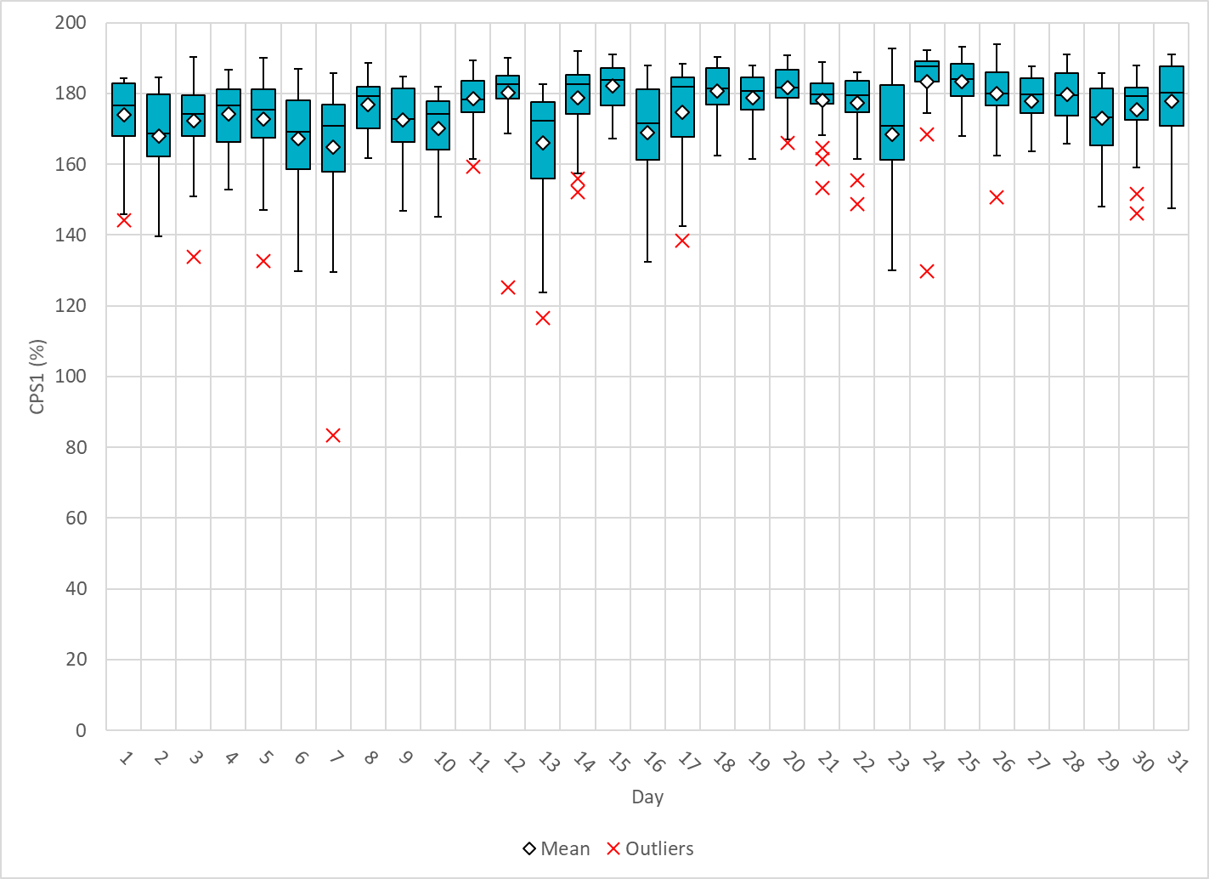
Hourly CPS1 by Day
Dec-22 CPS1 (%): 175.41
Notes:
83.51%@ 12/7/2022 HE 4:00
Between 3:00-4:00 there was a significant loss of load event (~1,600 MW) in ERCOT. Frequency recovery time was extended for this event due to low amounts of IRR generation
being online and able to respond quickly to such a significant frequency excursion, along with the fact that this significant amount of load was even more significant due to the time of day,
where load was close to its minimum, therefore amplifying the frequency excursion.
Regulation: Regulation down was exhausted for most of this hour. A manual SCED offset of -500 MW was applied.

Slide 5
BAAL Exceedances & Violations
There were 0 BAAL exceedance(s) in December.

Slide 6
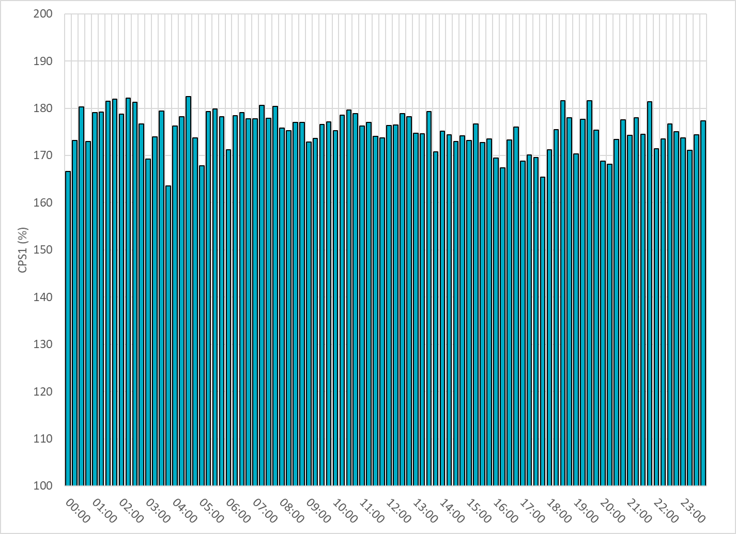
15-Minute Average CPS1%
Dec-22 CPS1 (%): 175.41
Notes:
Overall the 15 min CPS1 score is consistently above 160

Slide 7
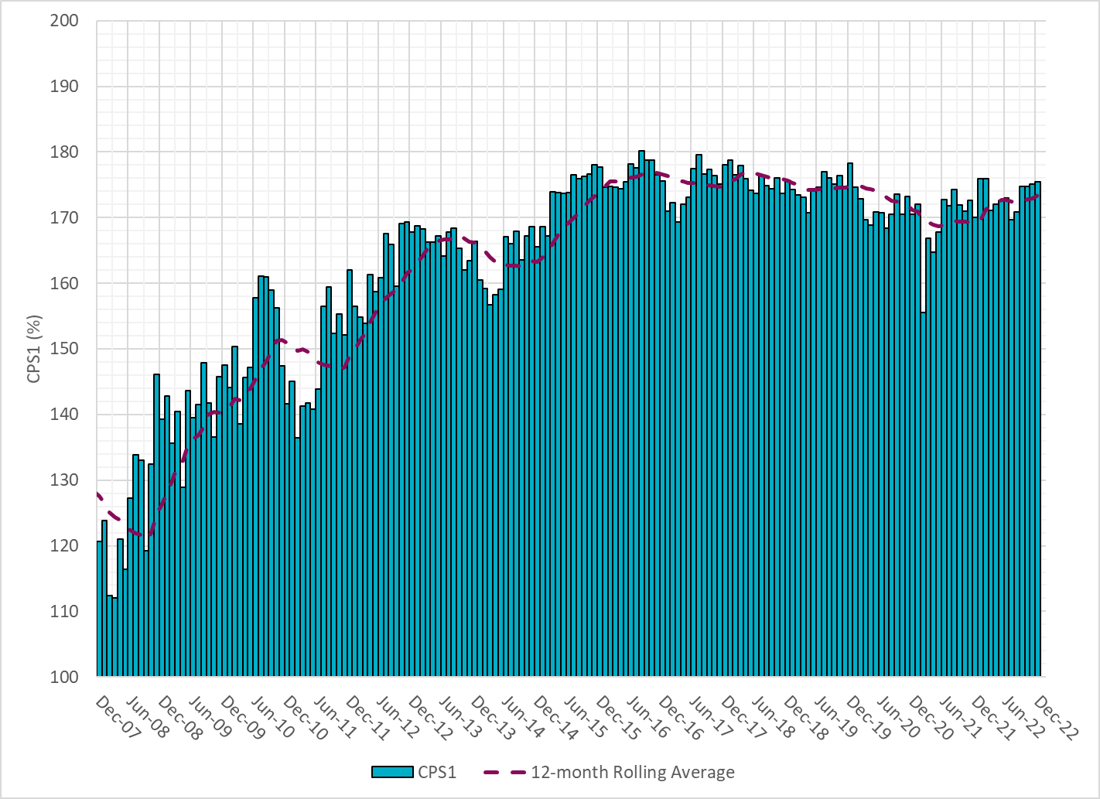
12-Month Rolling Average CPS1
Current 12-Month Rolling Average: 173.42%
Notes:
12 month rolling average CPS1 score is 173.42, which is in line with expectations, and the CPS1 score for Dec is slightly higher than the last month.

Slide 8
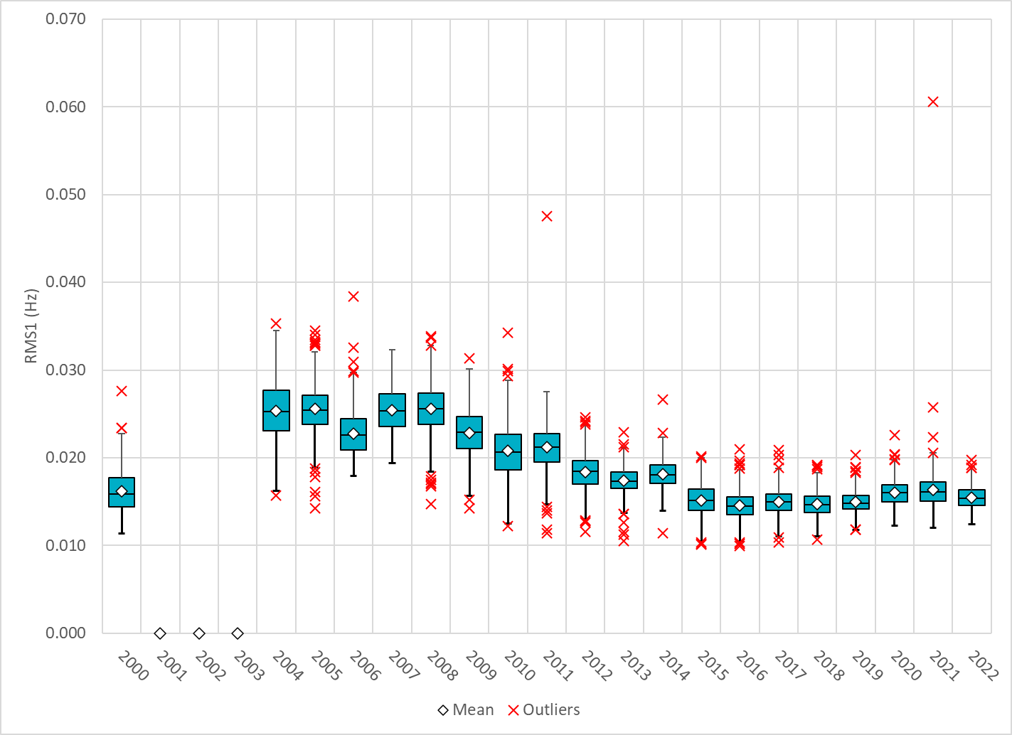
Daily RMS1 of ERCOT Frequency by Year
Notes:
Daily RMS1 frequency by year is so far slightly smaller overall compared with the 2021.
Mean: 15.48 mHz
Min: 12.43 mHz
Max: 19.7 mHz

Slide 9
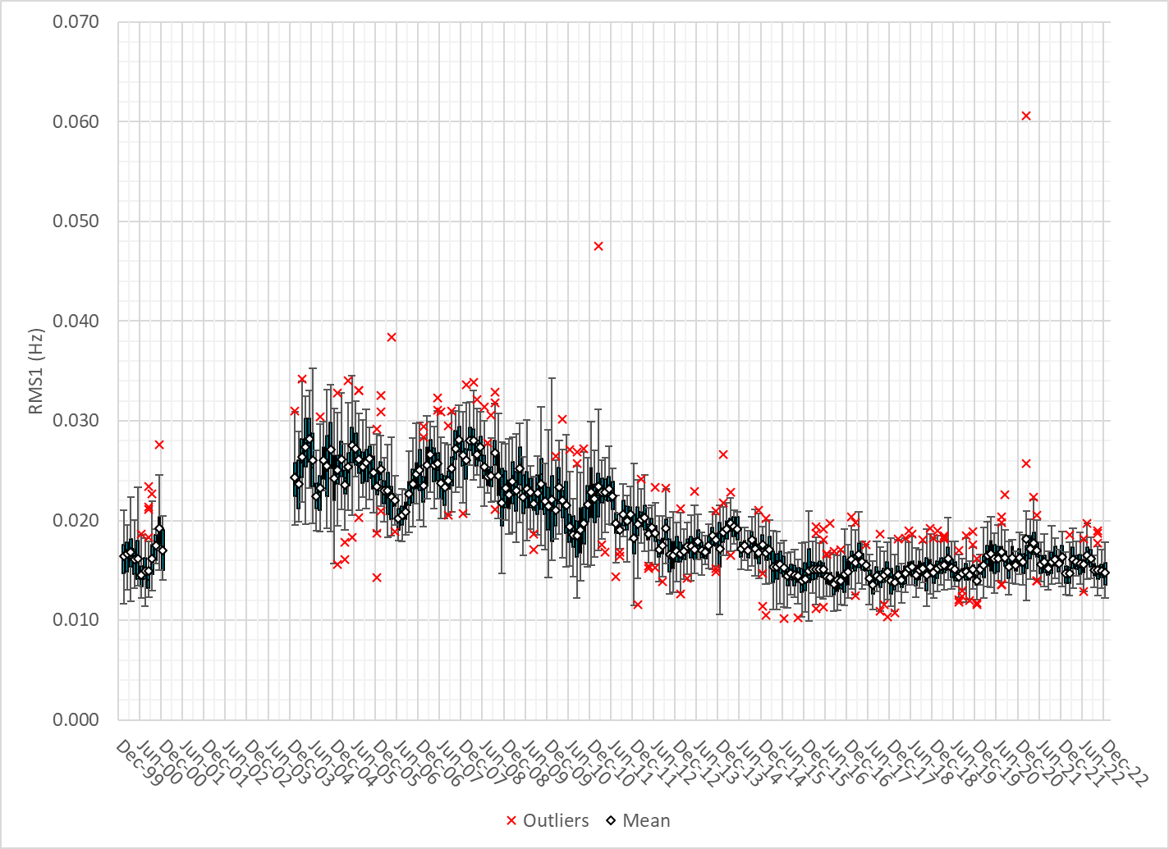
Daily RMS1 of ERCOT Frequency by Month
Notes:
A More granular look at last 15 years of RMS1 by month
14.80Mhz on avg for Dec 2022

Slide 10
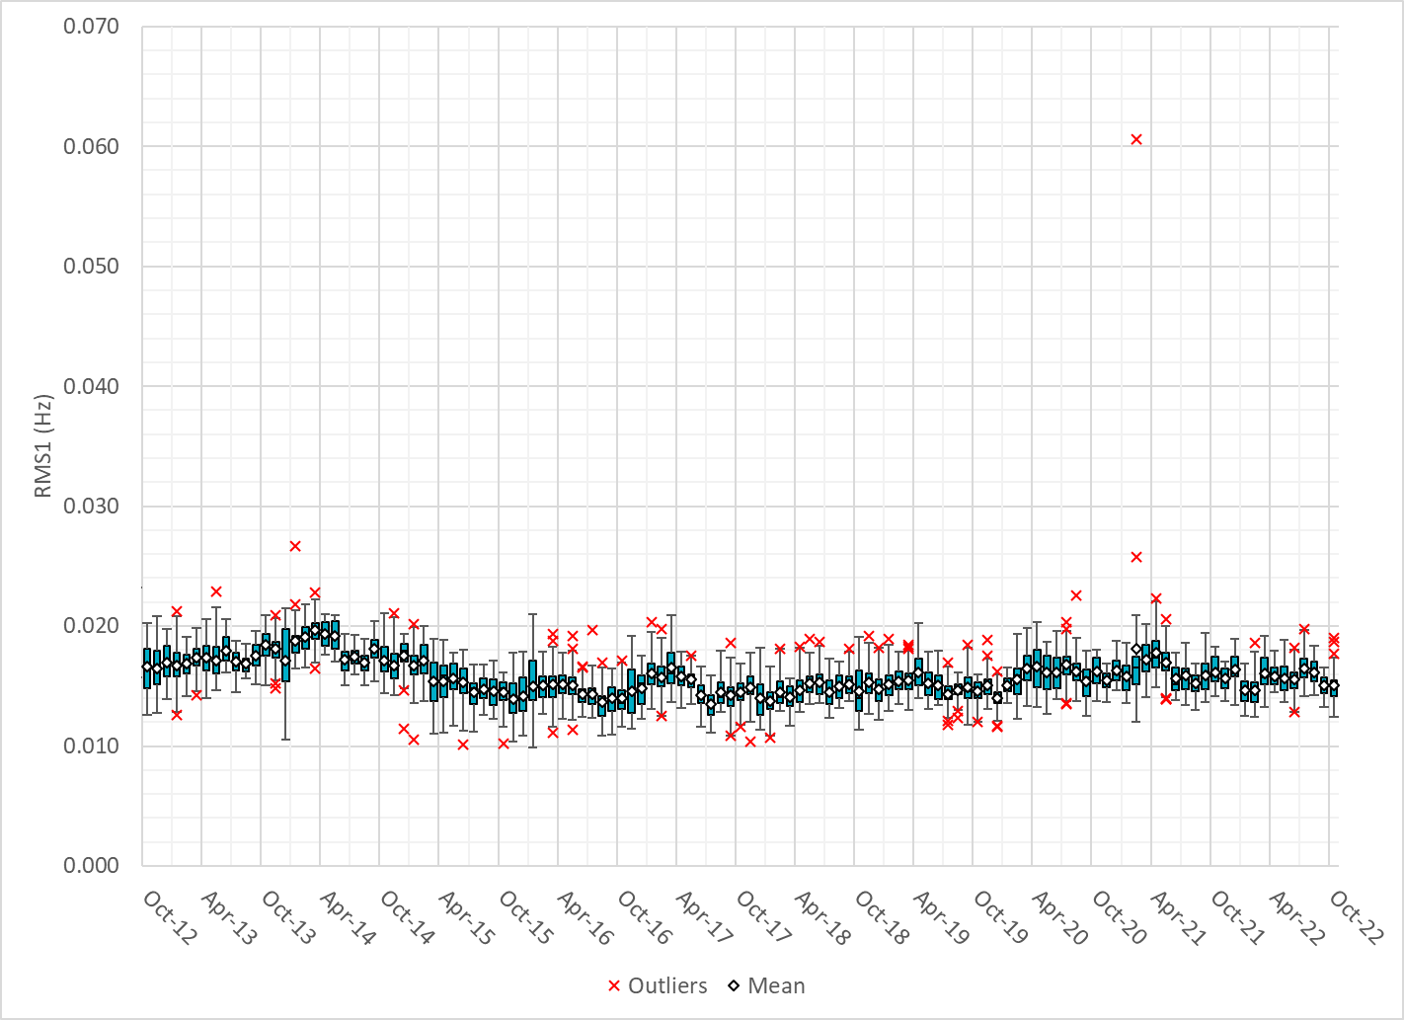
Daily RMS1 of ERCOT Frequency by Month
Notes:
Same data with 10 years shown instead of 15

Slide 11
Frequency Profile Comparison

Slide 12
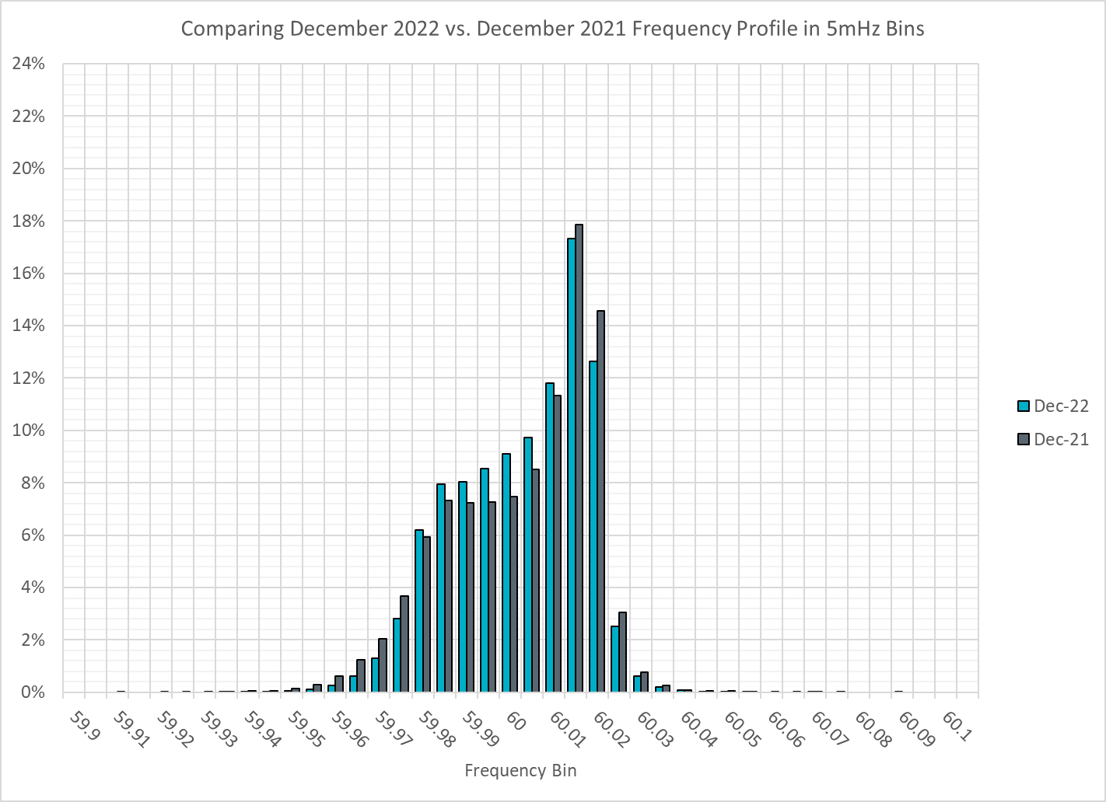
Frequency Profile Comparison
Notes:
Comparison of frequency profile between Dec 2021 and Dec 2022, we see fewer instances of frequency hovering at or below the lower deadband in Dec 2022.

Slide 13
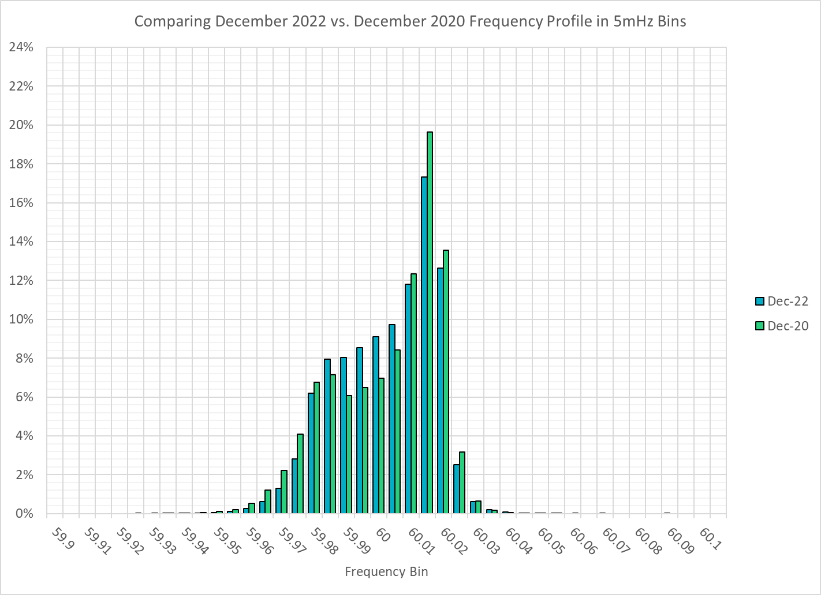
Frequency Profile Comparison
Notes:
Some story when you compare frequency profile between Dec 2020 and Dec 2022, we see fewer instances of frequency hovering at or below the lower deadband in Dec 2022.

Slide 14
Time Error Correction

Slide 15
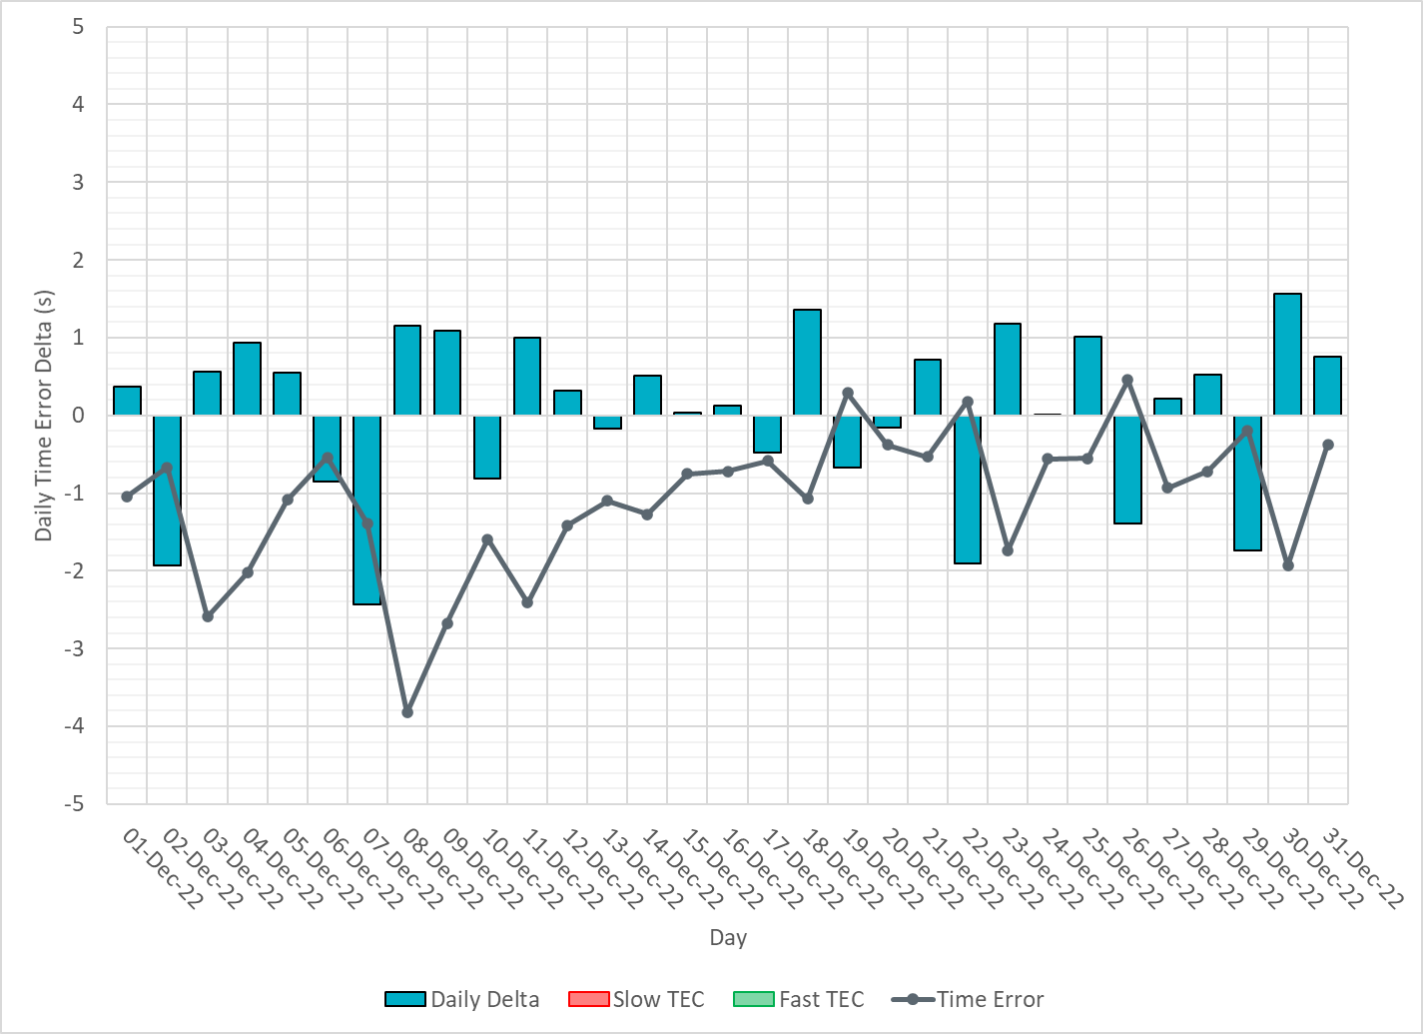
ERCOT Daily Time Error
Notes:
We did not make time error corrections and the time error was fairly small during the entire month of Dec.

Slide 16
Time Error Corrections Log Summary
There have been no time error corrections since December 2016

Slide 17
BAL-003 Performance

Slide 18
Op. Year 2020 BAL-003 Selected Events – Update
Notes:
BAL-003

Slide 19
Op. Year 2020 BAL-003 FRM Performance - Update
Notes:
OP2018: FRO = -381.0, FRM_median = -843.17, FRM_average = -959.7
OP2019: FRO = -381.0, FRM_median = -811.14, FRM_average = -892.5
OP2020: FRO = -425.0, FRM median = -789.34, FRM average = -879.0
OP2021: FRO =

Slide 20
ERCOT Energy Statistics

Slide 21
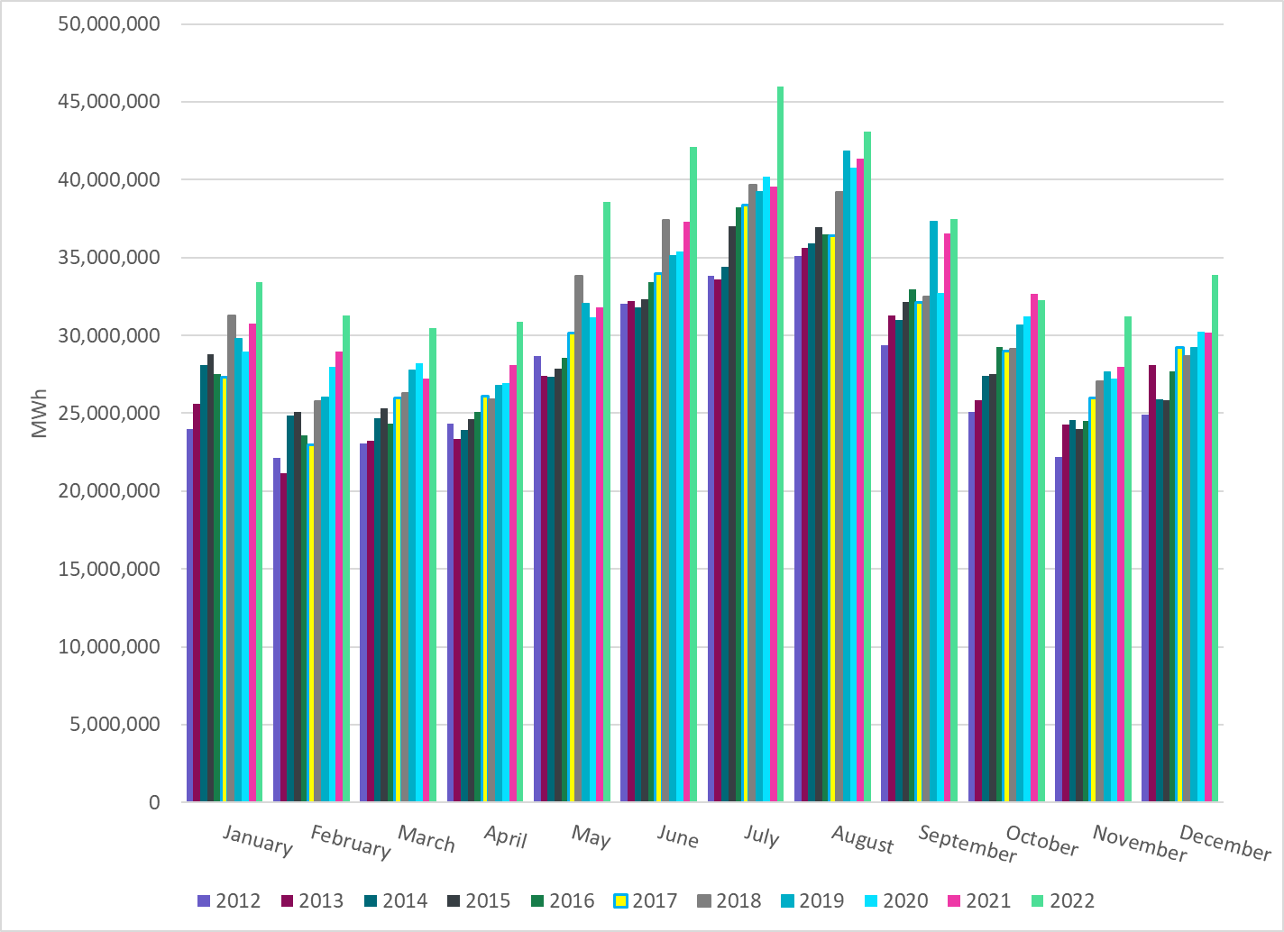
Total Energy
Notes:
33,862,352 MWh

Slide 22
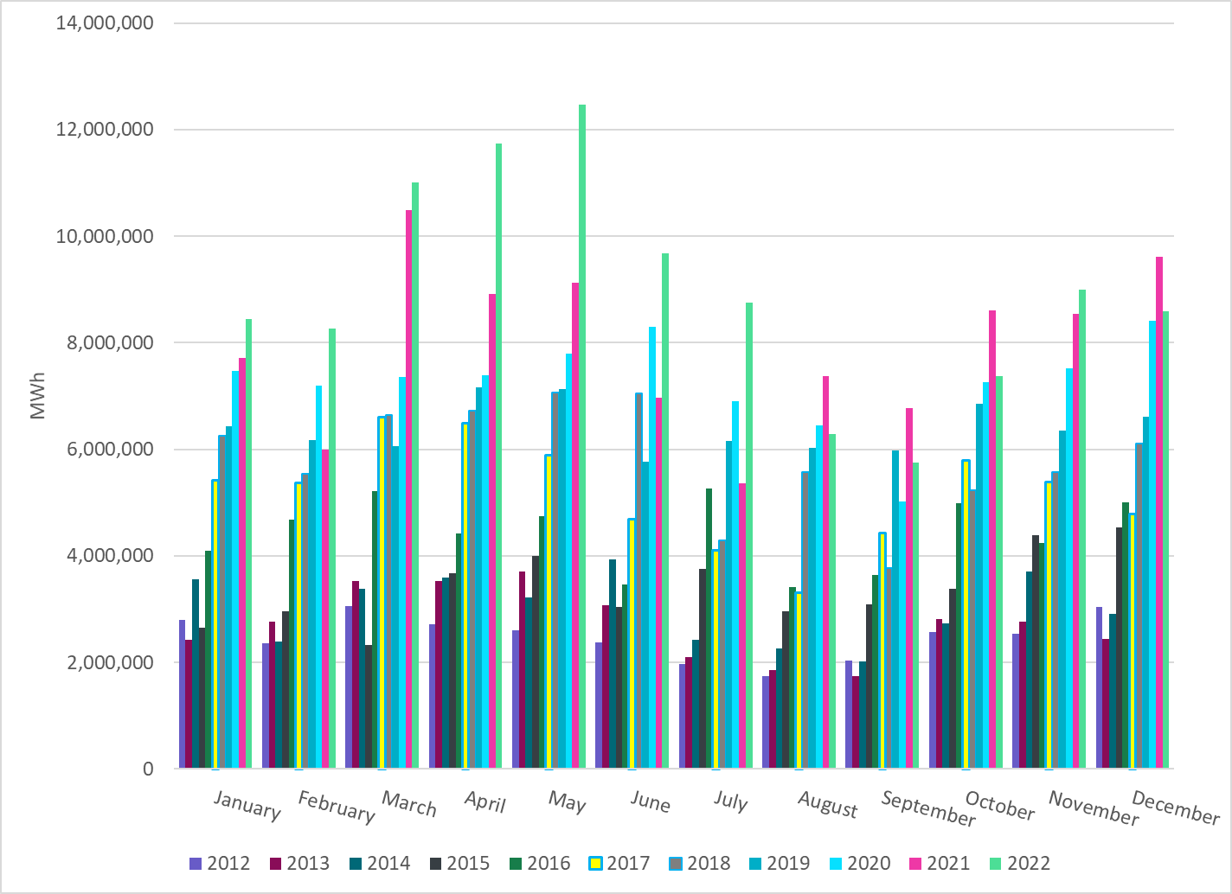
Total Energy from Wind Generation
Notes:
8,586,488 MWH

Slide 23
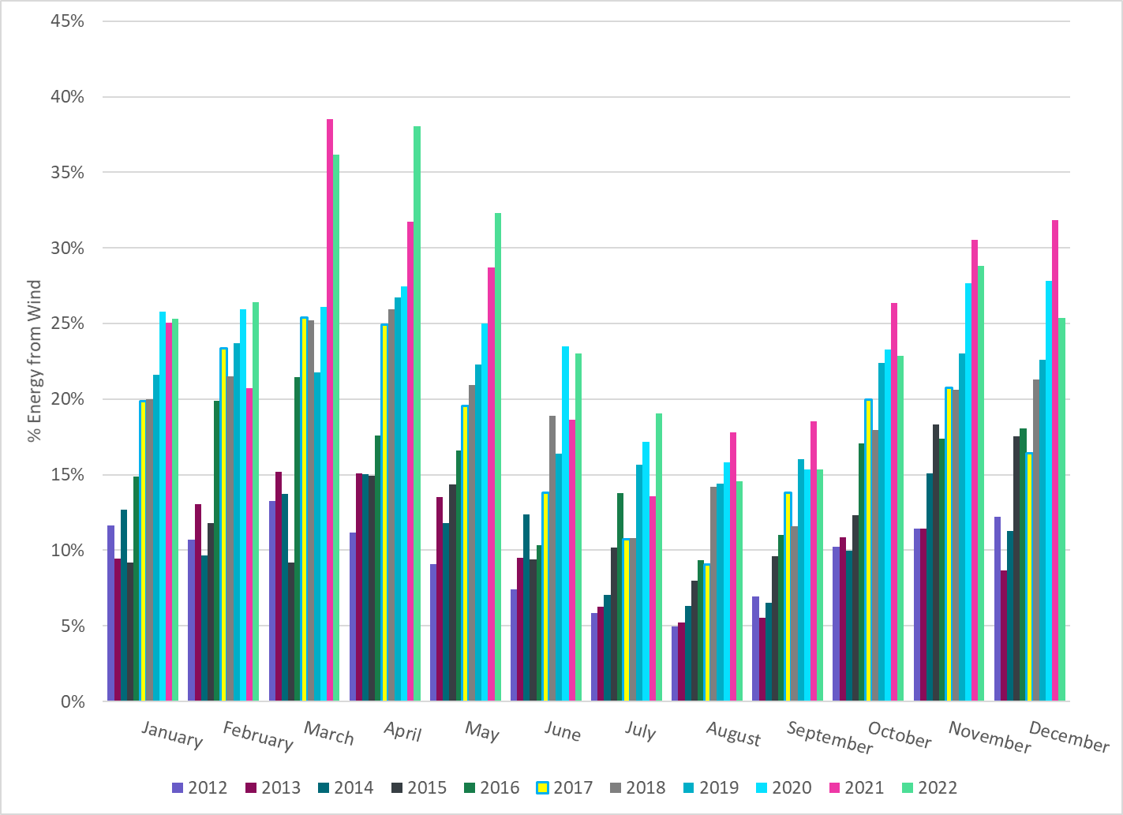
% Energy from Wind Generation
Notes:
25.36%
of total energy was provided by wind generation

Slide 24
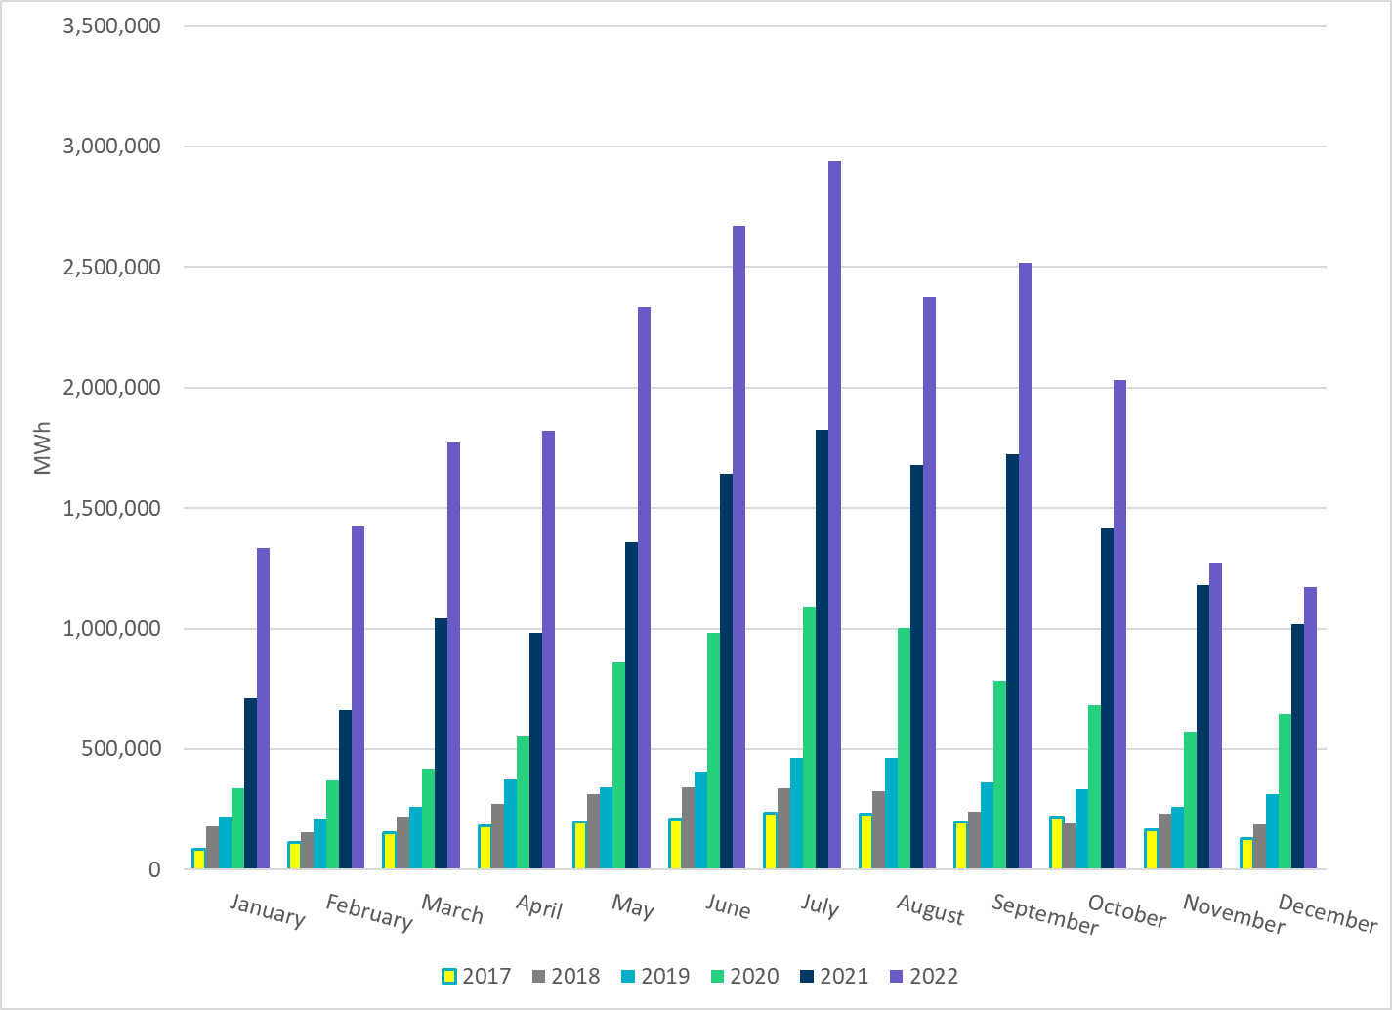
Total Energy From Solar Generation
Notes:
1,171,432 MWh

Slide 25
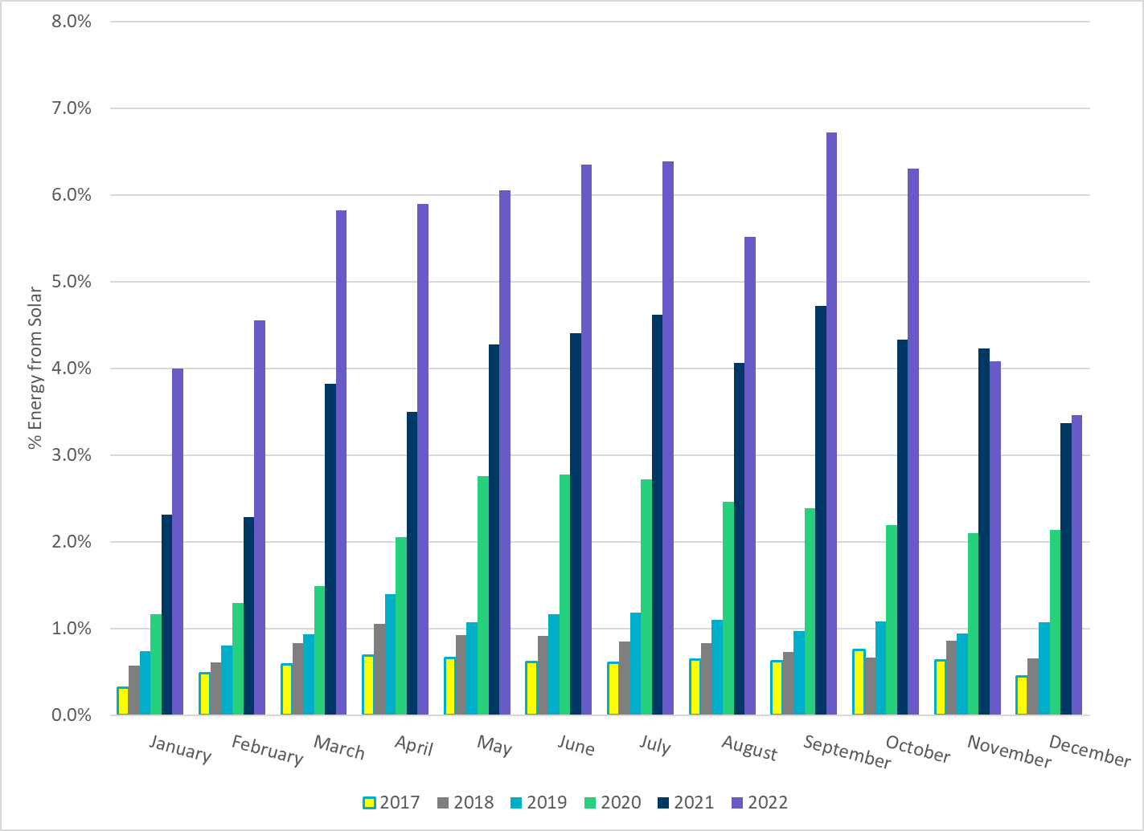
% Energy from Solar Generation
Notes:
3.46% of total
energy was provided by solar generation, which is highest solar penetration level so far.

Slide 26
ERCOT System Inertia

Slide 27
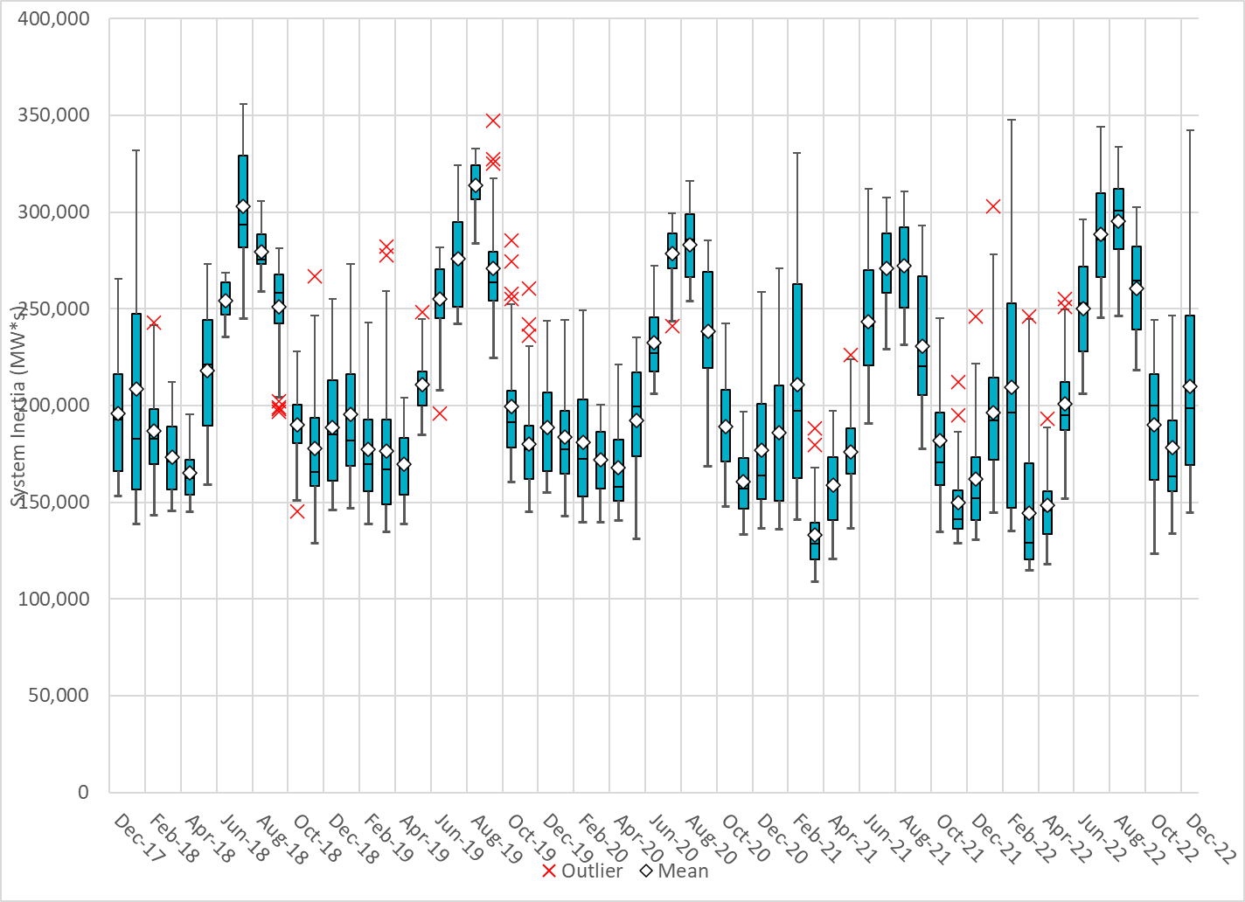
Daily Minimum System Inertia
Notes:
Minimum Inertia =123,509 MW*s on 10/22/2022
Previous Minimum was 109,029 MW*s on 3/22/2021
Data:
Mean: 209,794 MW*s
Max: 342,396 MW*s on Dec 23rd
Min: 144,718 MW*s on Dec 13th

Slide 28
ERCOT Inertia 2013-2022
Date and Time | 2013 3/10 3:00 AM | 2014 3/30 3:00 AM | 2015 11/25 2:00 AM | 2016 4/10 2:00 AM | 2017 10/27 4:00 AM | 2018 11/03 3:30 AM | 2019 3/27 1:00 AM | 2020 05/01 2:00 AM | 2021 03/22 00:00 AM | 2022 03/21 01:00 AM
Min synch. Inertia (GW*s) | 132 | 135 | 152 | 143 | 130 | 128.8 | 134.5 | 131.1 | 109 | 115
System load at minimum synch. Inertia (MW) | 24,726 | 24,540 | 27,190 | 27,831 | 28,425 | 28,397 | 29,883 | 30,679 | 32,599 | 33,365
Non-synch. Gen. in % of System Load | 31 | 34 | 42 | 47 | 54 | 53 | 50 | 57 | 65 | 66
Notes:
For each box, the central mark (red line) is the median, the edges of the box (in blue) are the 25th and 75th percentiles, the whiskers correspond to +/- 2.7 sigma (i.e., represent 99.3% coverage, assuming the data are normally distributed. The corresponding lowest inertia in each year is given in the table.
The circle on each boxplot is showing inertia during time when highest portion of load was served by wind/solar generation in that year.

Slide 29
Questions?
Thank you!

