Slide 1
ERCOT Frequency Events
November/December 2022
ERCOT
Operations Planning
PDCWG | January 18th, 2023

Slide 2
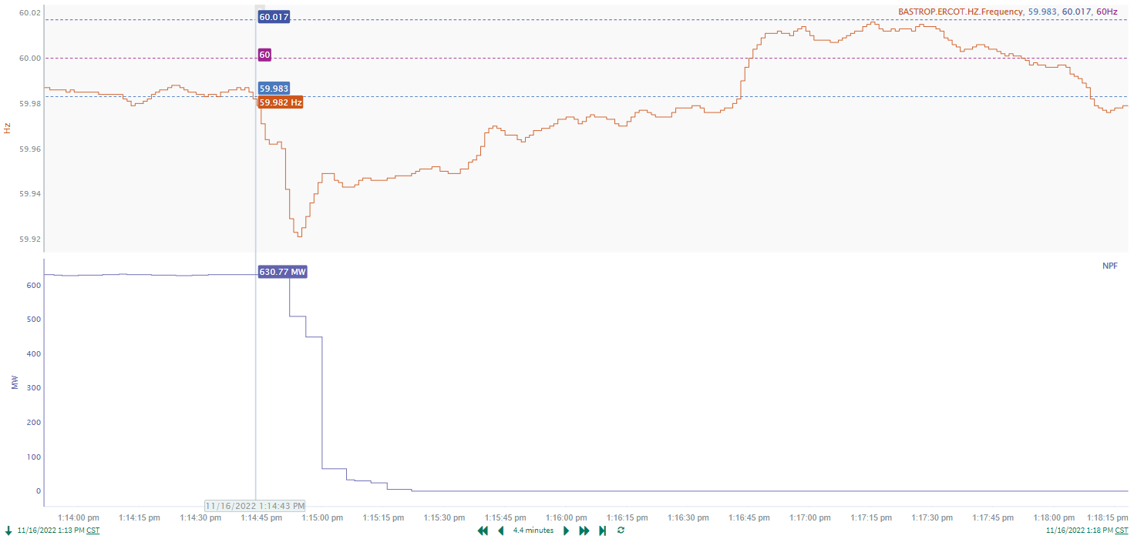
11/16/2022 13:14:43(Non-FME)
Notes:
The unit tripped offline while carrying approximately 631 MW
Starting Frequency: 59.983 Hz
Minimum Frequency: 59.921 Hz
A-C Time : 11 seconds
Recovery Time(back to deadband): 1 minutes 50 seconds
RRS Released: 0 MW
Trip Reason: Unknown at this time
Contextual Information: A total of 286 MW of regulation up was deployed during the event
No Selection Reason : The unit trip is not clean

Slide 3
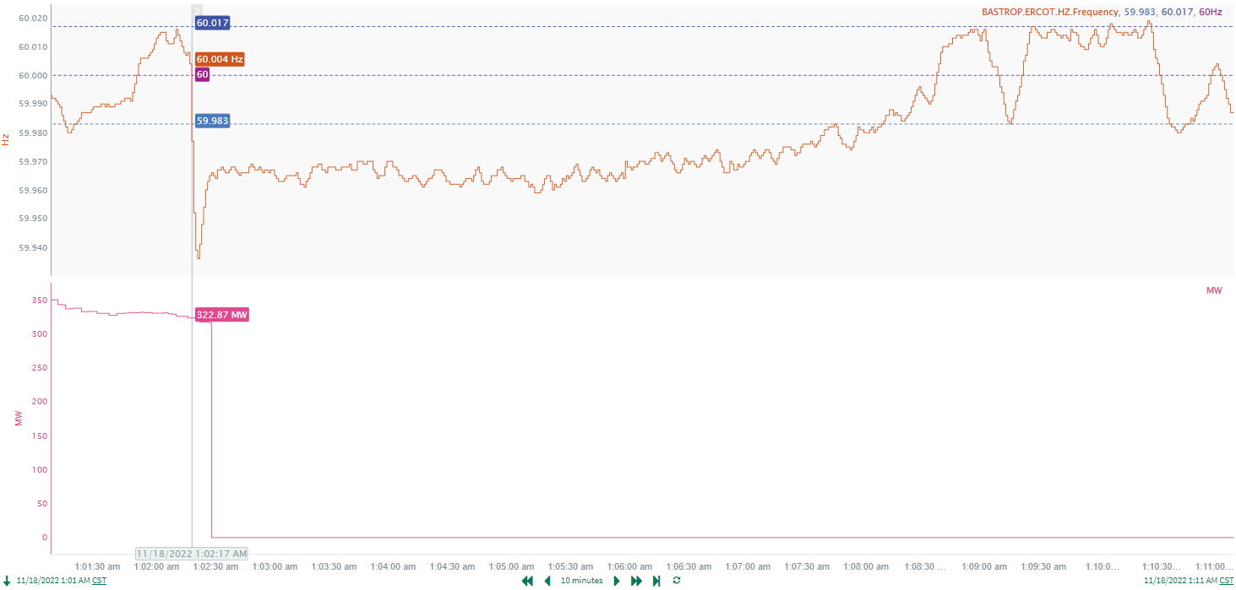
11/18/2022 1:02:17 (Non-FME)
Notes:
The unit experienced runback and tripped offline while carrying approximately 316 MW
Starting Frequency: 60.004 Hz
Minimum Frequency: 59.936 Hz
A-C Time : 4 seconds
Recovery Time(back to deadband): 5 minutes 47 seconds
RRS Released: 0 MW
Trip Reason: Back pressure
Contextual Information: A total of 163 MW of regulation up was deployed during this time
No Selection Reason: Small event(MW loss = 316 MW)

Slide 4
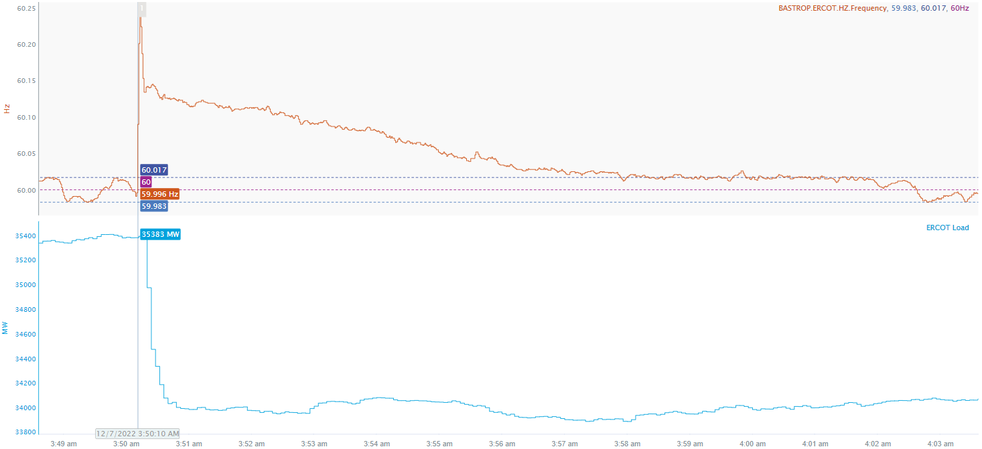
12/7/2022 3:50:10(FME)
Notes:
Load reduction of approximately 1400 MW in the West Texas area
Starting Frequency: 59.991 Hz
Maximum Frequency: 60.24 Hz
A-C Time : 3 seconds
Recovery Time(back to deadband): 7 minutes 44 seconds
RRS Released: 0 MW
Reason: Loss of 3 138 kV Transmission lines in the area
Contextual Information: A total of 146 MW of regulation down was deployed and manual offset of -500 MW was applied during the event.

Slide 5
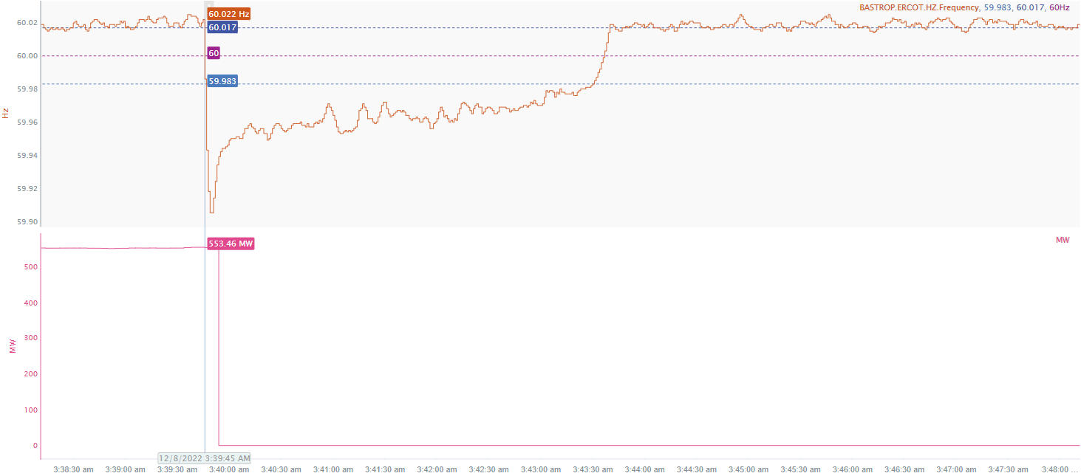
12/8/2022 3:39:45(NON-FME)
Notes:
The unit tripped offline while carrying approximately 553 MW
Starting Frequency: 60.022 Hz
Minimum Frequency: 59.905 Hz
A-C Time : 5 seconds
Recovery Time(back to deadband): 3 minutes 45 seconds
RRS Released: 484 MW
Trip Reason: Unknown at this time
Contextual Information: A total of 187 MW of regulation up was deployed during the event.
No Selection Reason: The starting frequency was outside the high deadband prior to the event

Slide 6
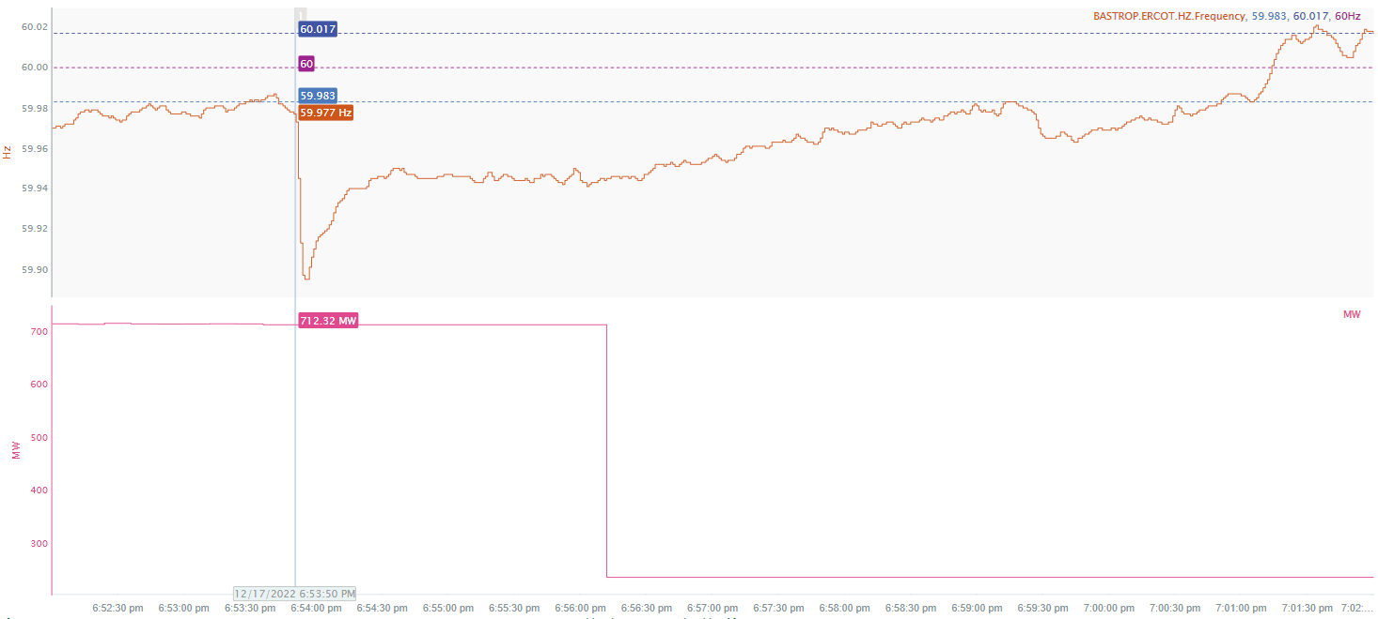
12/17/2022 18:53:50(NON-FME)
Notes:
The unit tripped offline while carrying approximately 712 MW
Starting Frequency: 59.977 Hz
Minimum Frequency: 59.895 Hz
A-C Time : 5 seconds
Recovery Time(back to deadband): 7 minutes 00 seconds
RRS Released: 648 MW
Trip Reason: Unknown at this time
Contextual Information: A total of 220 MW of regulation up was deployed during the event.
No Selection Reason: The starting frequency is outside the low deadband

Slide 7
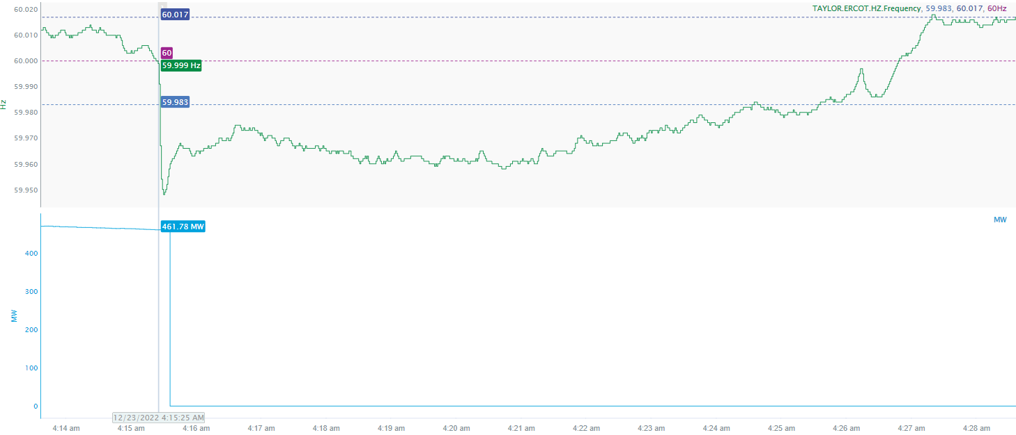
12/23/2022 4:15:25(NON-FME)
Notes:
The unit tripped offline while carrying approximately 462 MW
Starting Frequency: 59.999 Hz
Minimum Frequency: 59.948 Hz
A-C Time : 5 seconds
Recovery Time(back to deadband): 9 minutes 10 seconds
RRS Released: 0 MW
Trip Reason: Unknown currently
Contextual Information: A total of 240 MW of regulation up was deployed and 300 MW of manual offset was applied during this event.
No Selection Reason: delta A-C and C point is too small (small event)

Slide 8
Questions?
Thank you!

