Slide 1
ERCOT Updates
NDSWG January 2023
Koepke
1/17/2023

Slide 2
Topics
NMMS “Tech Health” Project
Recap
Upcoming releases
Defects
MOTE
RIOO Access
Annual Double-Circuit Contingency Review
Kickoff in February

Slide 3
NMMS Tech Health Project - Deployments
Initial deployment was in early December
Performance issues experienced
Defects identified
Upcoming deployments
January deployment to fix critical defects
February deployment
(tentative) March deployment

Slide 4
NMMS Tech Health Project – January Release
January release targets critical defects including:
General stability enhancements
DORA Exception
Fixes inability to modify saved association changes
Additional quality-of-life improvements include:
Enhancements to comment formatting
Corrections to CR searching

Slide 5
NMMS Tech Health Project – February and March Releases
Future releases will be made addressing additional defects. Potential items include:
Additional stability improvements
Email notification stability
Ownership/Operatorship issues
Inability to drag and drop ownership/operatorship between companies
Inability to have same ownership on PowerSystemResource and OwnerShareRatings instances
Colors
Substation diagram background
User preferences

Slide 6
Other Topics

Slide 7
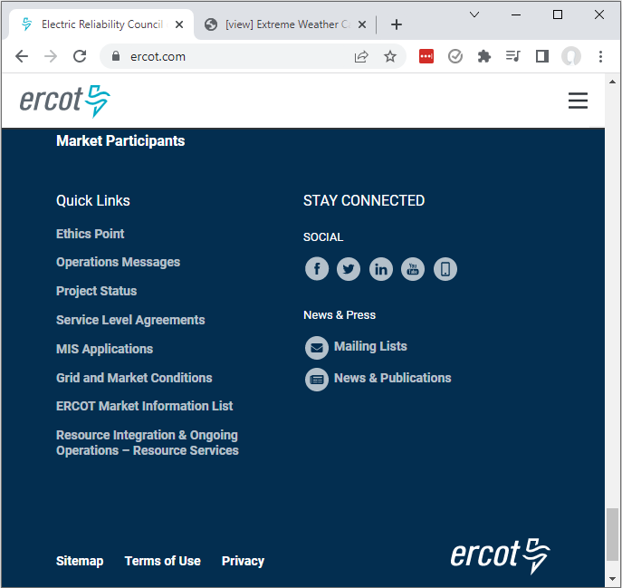
RIOO Access – View Generation Submission Data
Latest RIOO release gives TSPs the ability to access RIOO
Users will be able to view current modeling data as well as upcoming submissions
This is the same visibility as ERCOT
Access is managed via the TSP’s USA
A signup guide can be found (here)

Slide 8
Double Element Contingency – Annual Review
ERCOT will initiate the yearly review of double-element contingencies in February
An email will be sent to each TSP with instructions
TSP-specific files will be posted to the Citrix NMMS Postings folder
Changes will be proposed via a CAMR
Target PLD is TBD. Last year submissions were for April ML3

