Slide 1
Monthly Review of Reliability Unit Commitment Market Impacts – December 2022
Wholesale Market Working Group
ERCOT Staff

Slide 2
RUC Resource-Hours
December 2022 | Total | Opt-Out | Non-Opt-Out
Instructed Resource-Hours
Total Count | 428.0 | 20.0 | 408.0
Effective Resource-Hours*
Total Count | 399.9 | 18.6 | 381.3
Average LSL | 88.3 | 52.9 | 90.1
Average LDL | 92.7 | 87.6 | 92.9
Average BP | 94.6 | 101.9 | 94.3
Average HSL | 284.4 | 293.5 | 284.0
* The difference between “Instructed” and “Effective” values is a result of Resources starting up, shutting down, receiving partial hour instructions, or otherwise not being dispatchable by SCED.

Slide 3
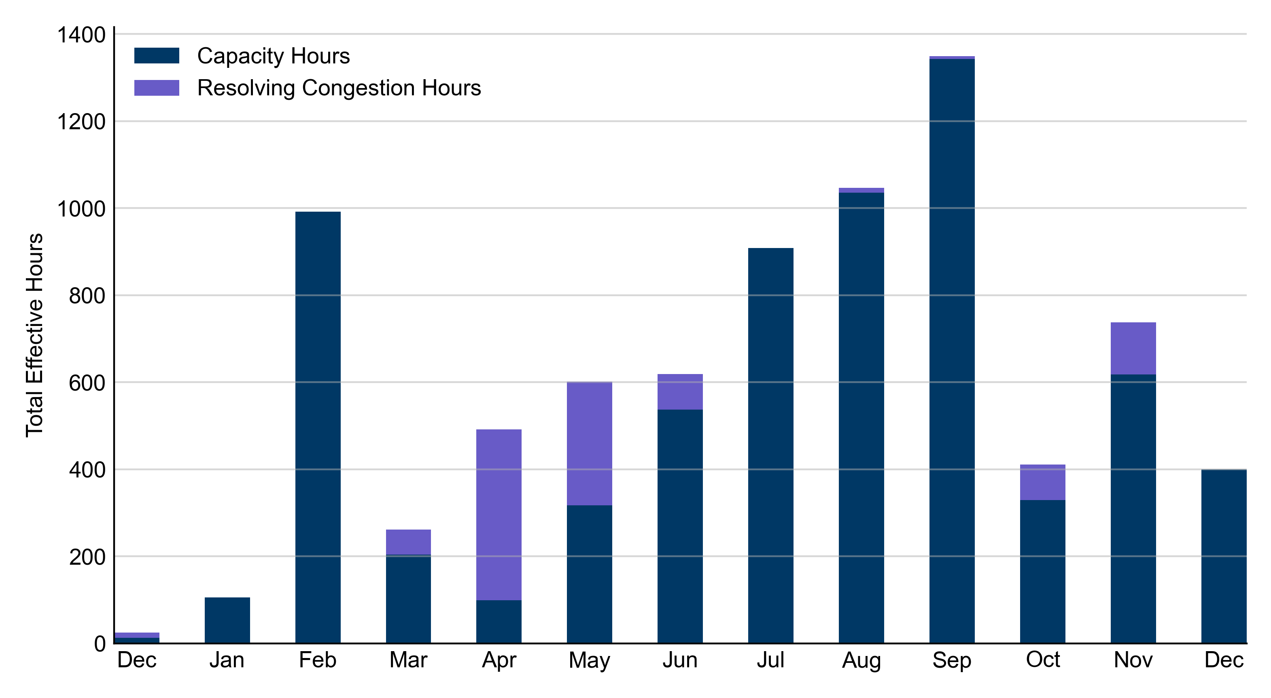
RUC Instruction Reasons: Last 13 Months RUCs in December 2022 were primarily driven by system-wide capacity concerns.

Slide 4
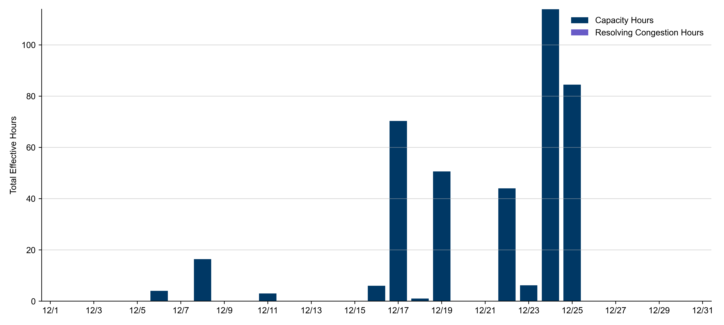
RUC Instruction Reasons
December 2022
399.9 effective RUC Resource-hours.
399.9 hours (100%) for capacity concerns.

Slide 5
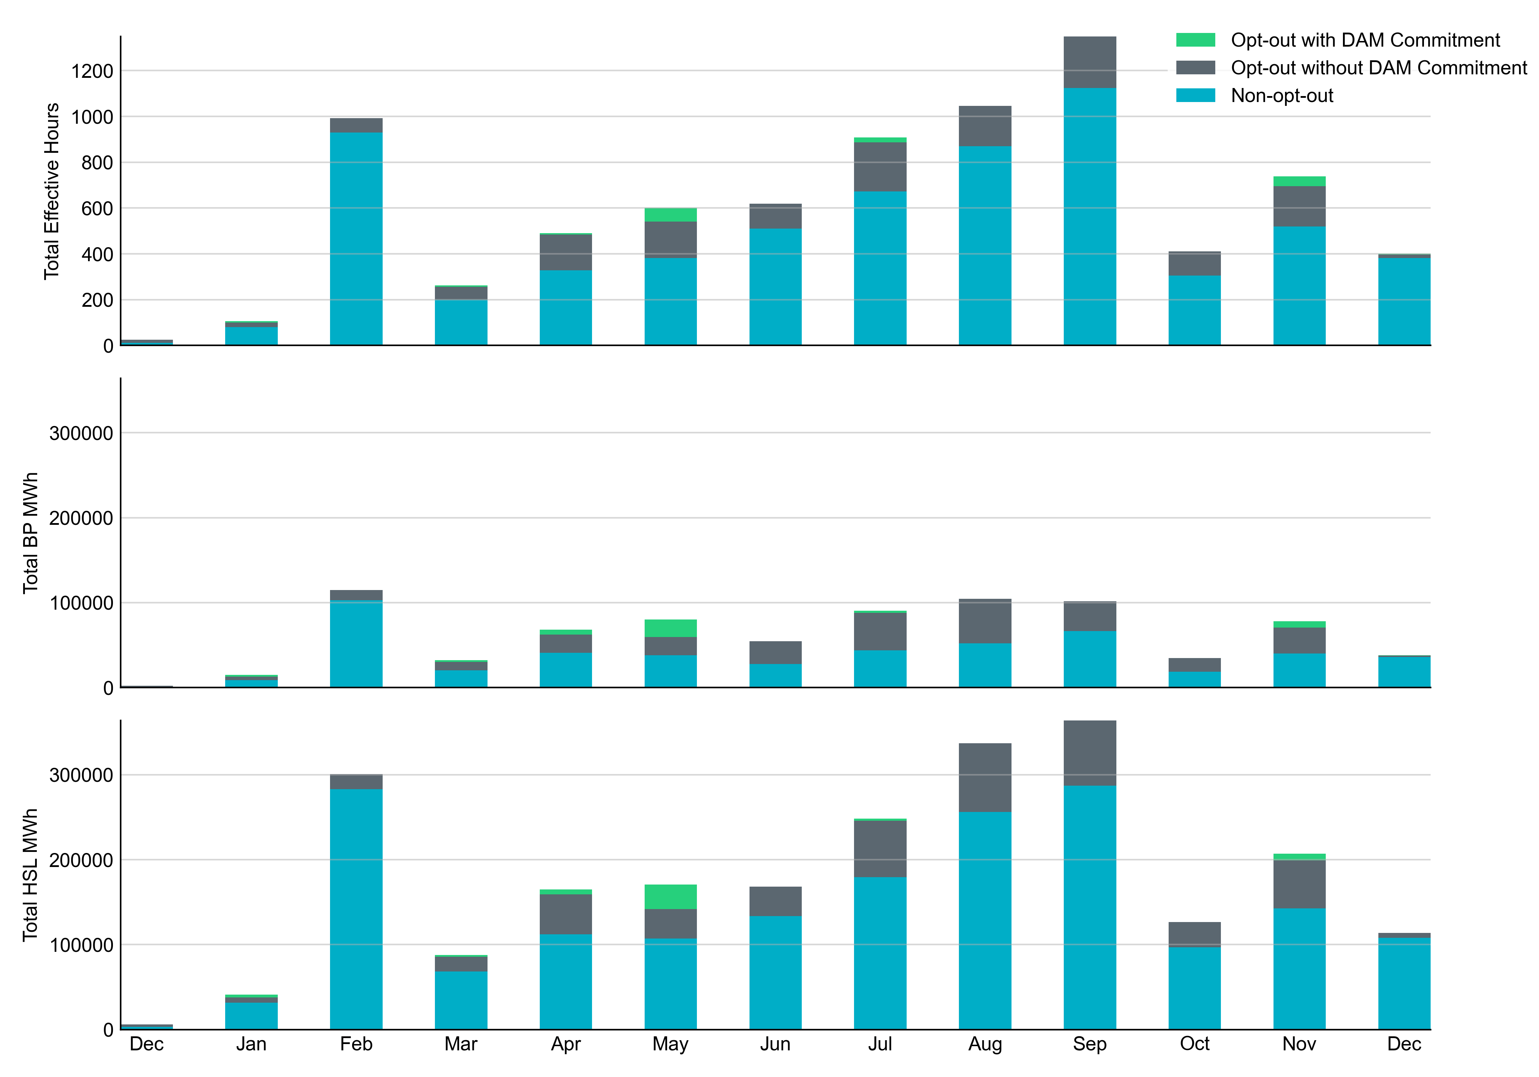
Non-opt-out and Opt-out Totals: Last 13 Months December 2022 had a total of 381.3 non-opt-out effective Resource-hours (95.35%) and 18.6 opt-out effective Resource-hours (4.65%).

Slide 6
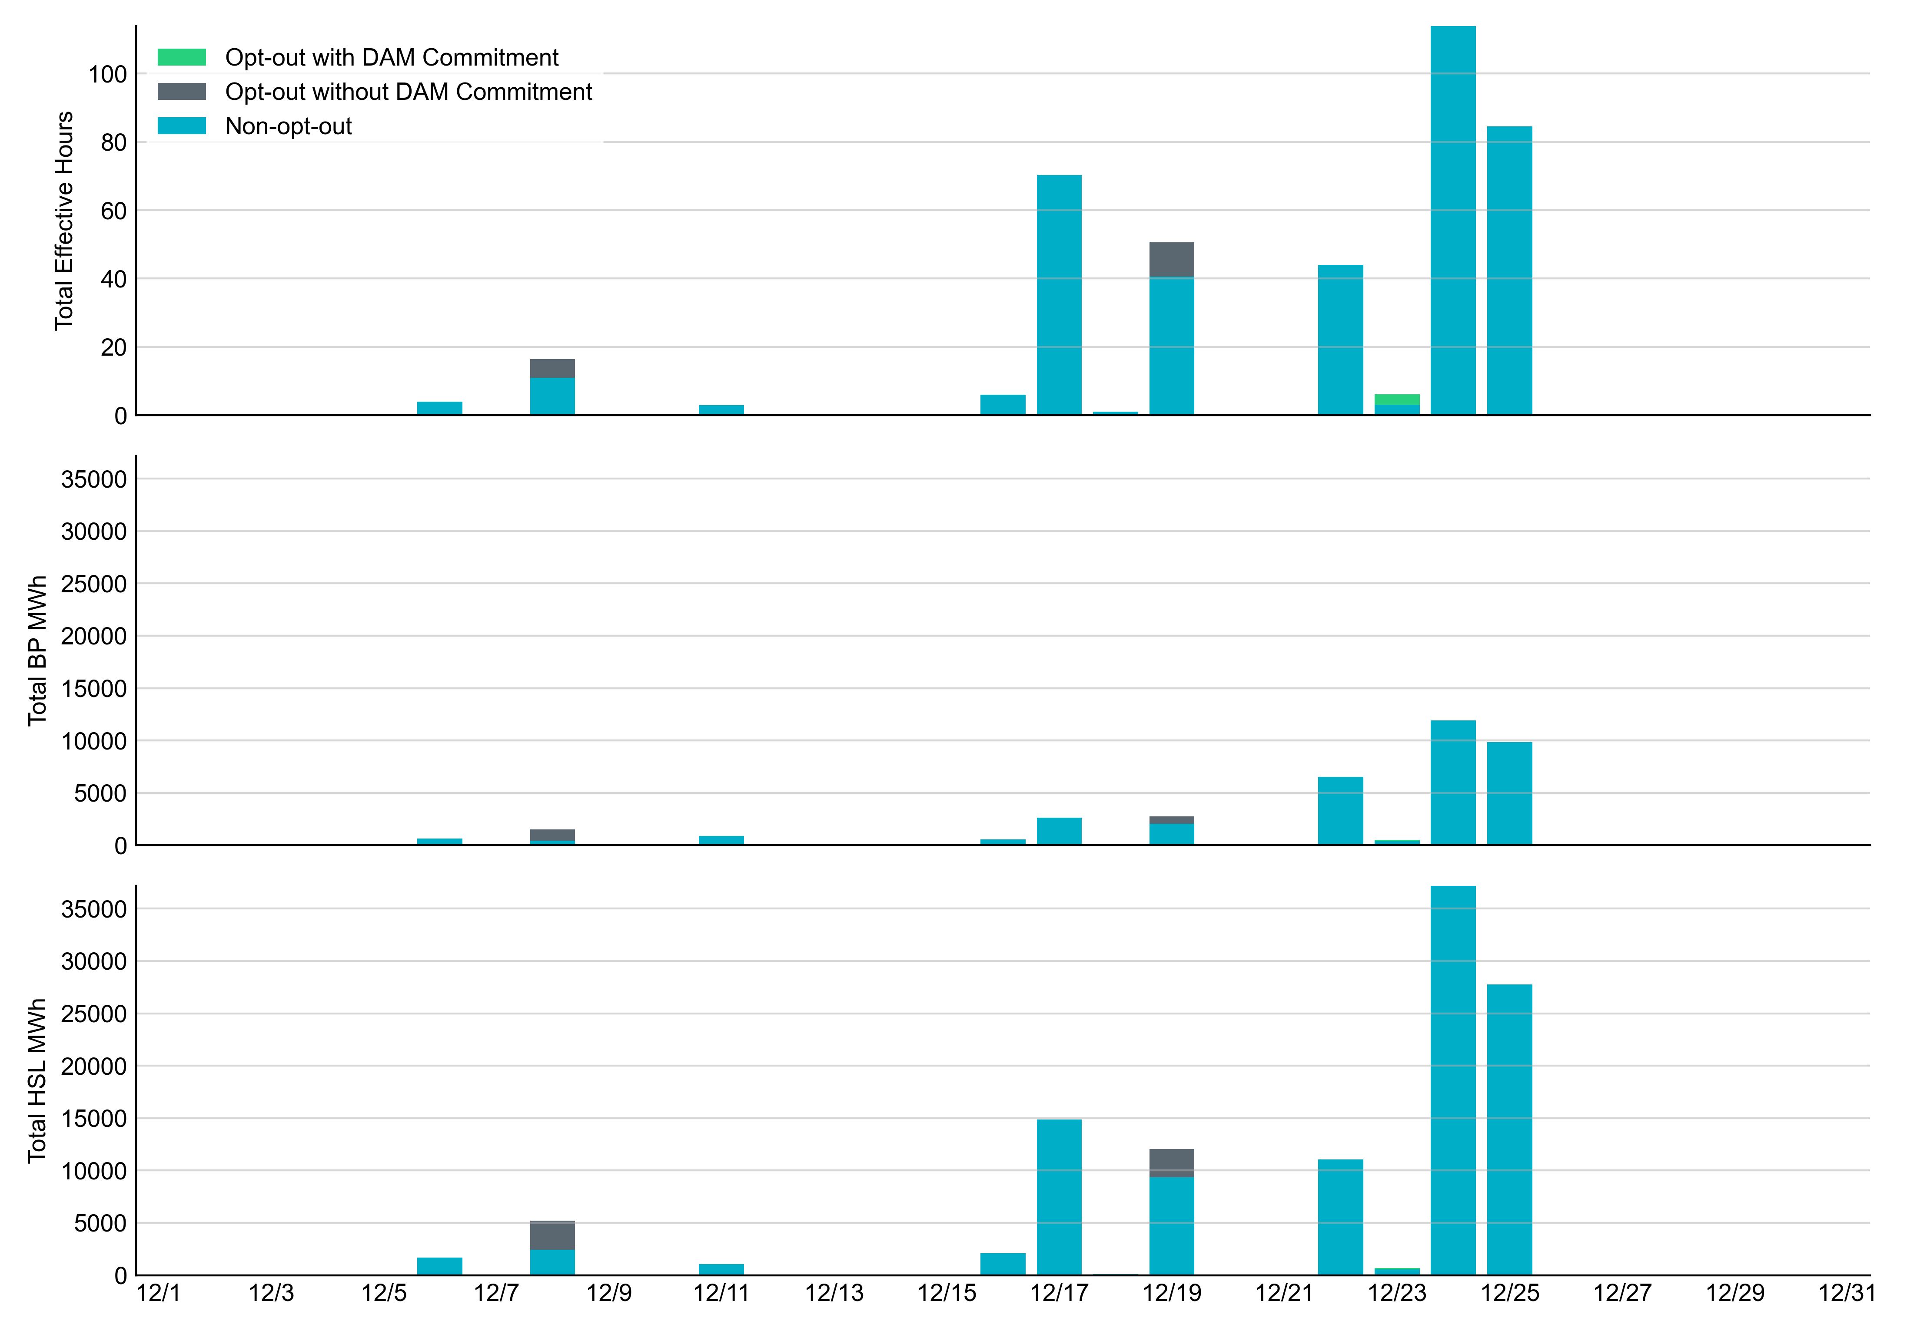
Non-opt-out and Opt-out Totals: December 2022

Slide 7
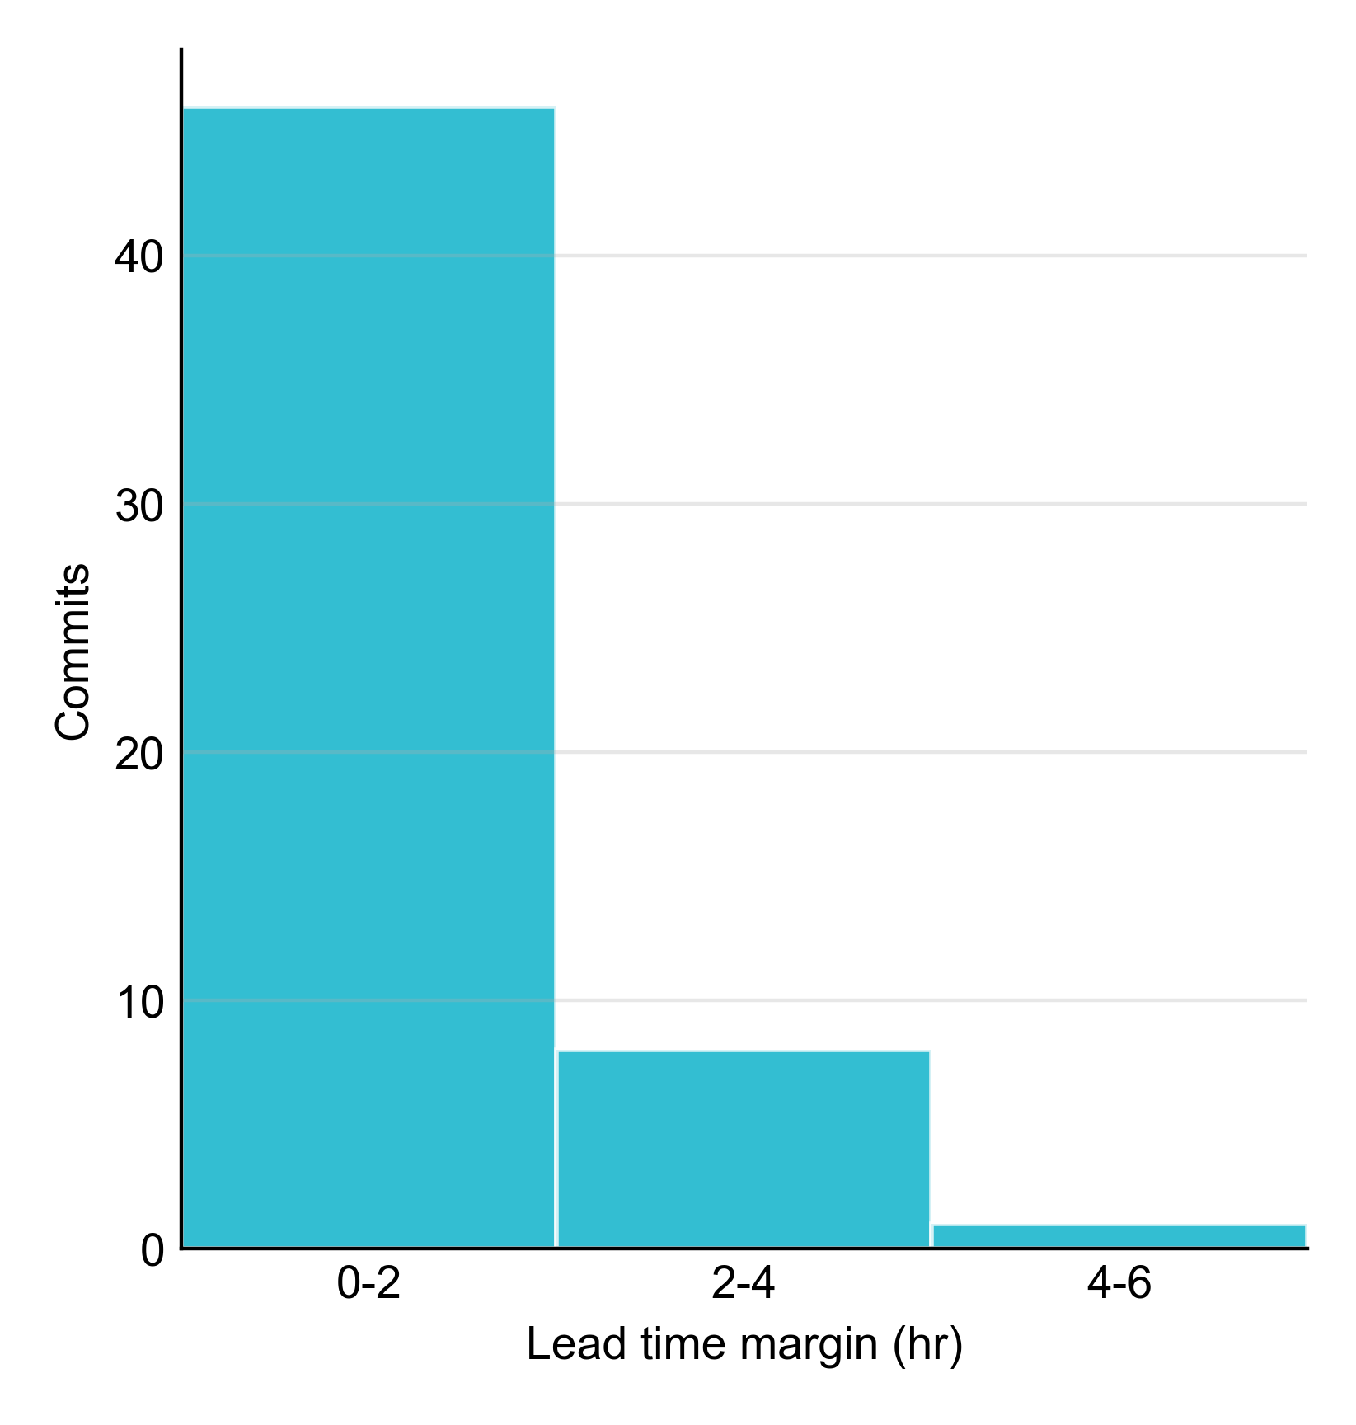
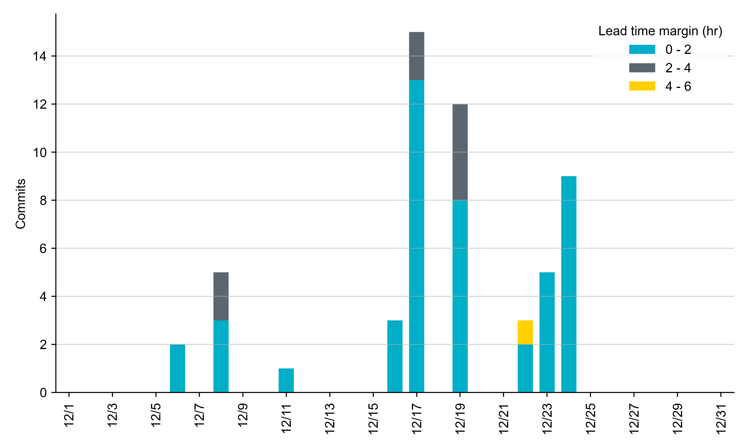
RUC Lead Time Margin: December 2022
Most RUC commit windows had lead time margin at or below 4 hours.
Lead time refers to the length of time between a RUC instruction and the start of the commitment window.
Lead time margin is the difference between lead time and the Resource’s startup time.
In cases where a Resource is committed for multiple back-to-back time blocks, lead time margin is calculated from the first instruction.
Notes:
The first bin is both-inclusive (i.e. [0, 2] ), while subsequent bins are left-inclusive (i.e. [2, 3), [3, 4), etc.).

Slide 8
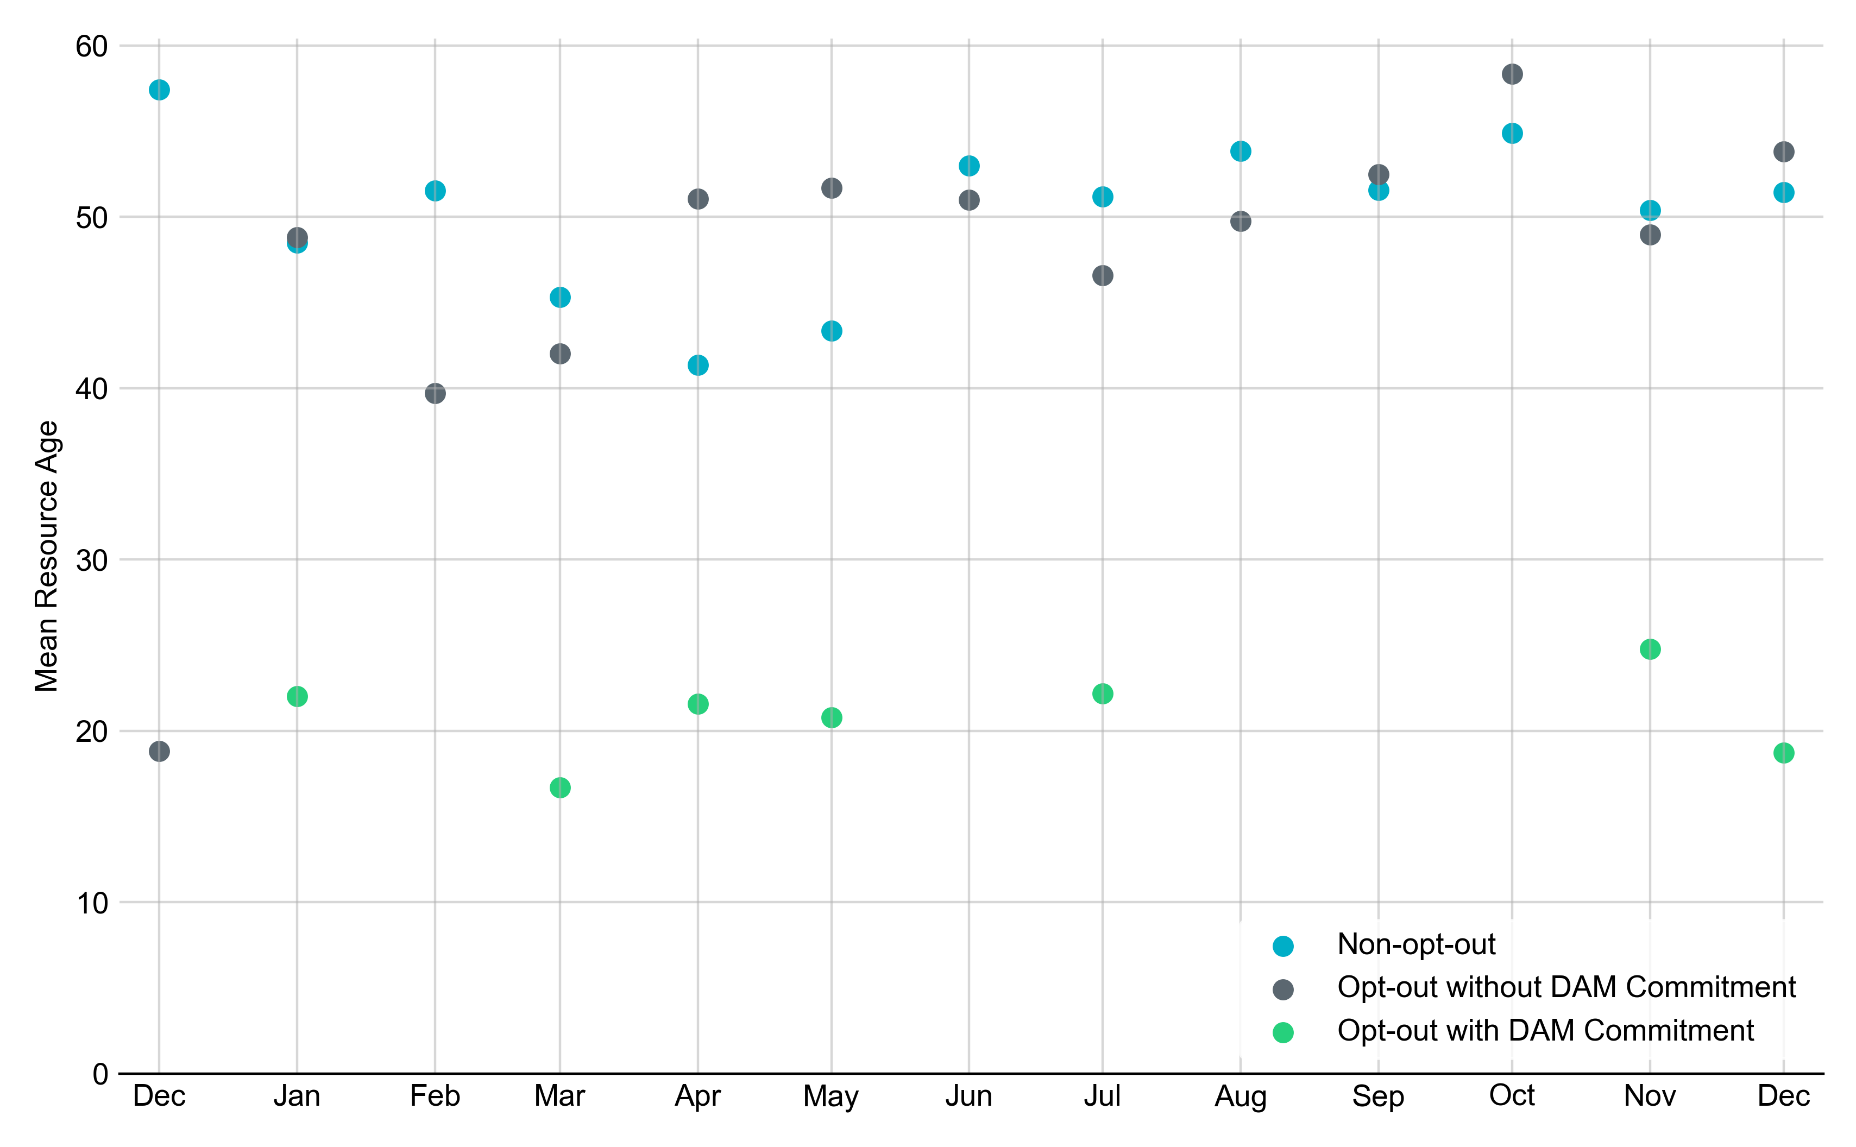
Average Resource Age In December 2022, the mean age of RUC-committed Resources was 51.4 years for Non-Opt-Out Resource-hours, 53.8 years for Opt-Out Resource-hours without DAM Commitments and 18.7 years for Opt-Out Resource-hours with DAM Commitments .
Note: For Resource configurations with multiple physical generators, the age of the oldest generator is used.

Slide 9
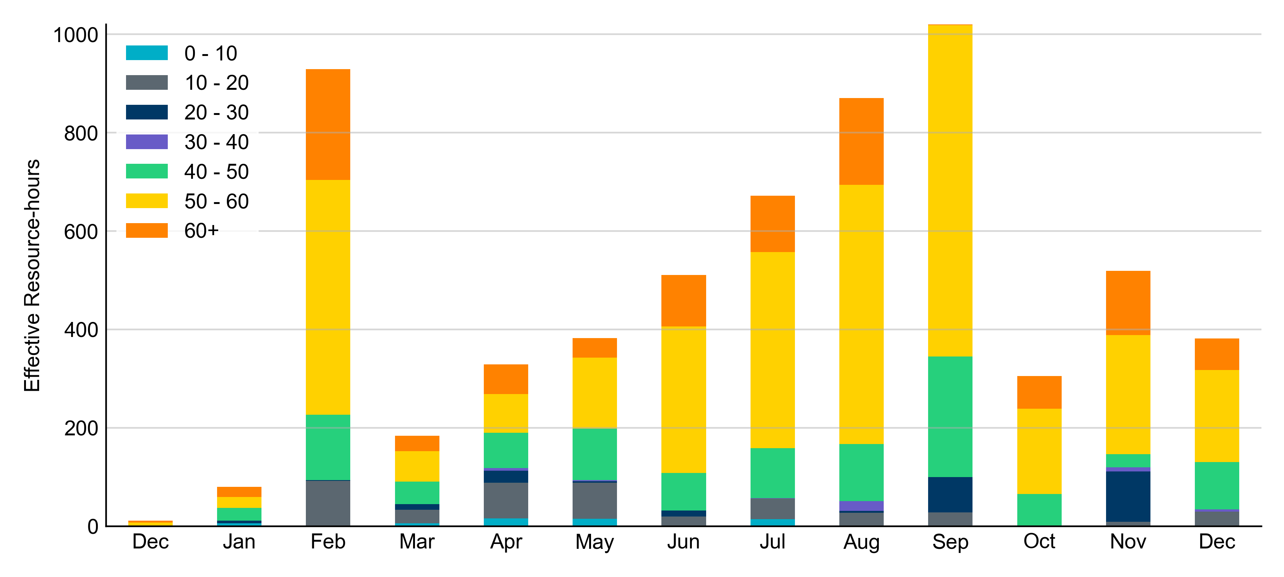
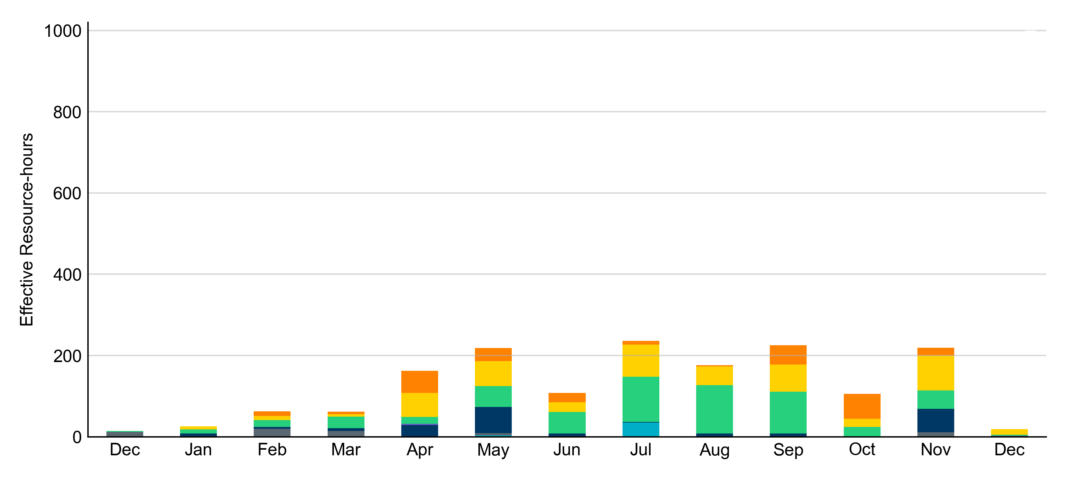
Age Category Most RUC-Committed Resources in December 2022 were older than 40 years.
Non-opt-out
Opt-out

Slide 10
RUC-Instructed Resource Dispatch above LDL
December 2022
When Resources did not successfully opt out, there were 10 effective Resource-hours for which the Resource was dispatched above its LDL.
For 1.0 of these Resource-hours, the LMP for the RUC-instructed Resource was above the RUC offer floor.
For 9.0 of these Resource-hours, the LMP for the RUC-instructed Resource was below the RUC offer floor.
For all these Resource-hours, the RUC-instructed Resource was mitigated.
There were no Exceptional Fuel Cost submissions for any RUC-Committed Resources in December 2022.

Slide 11
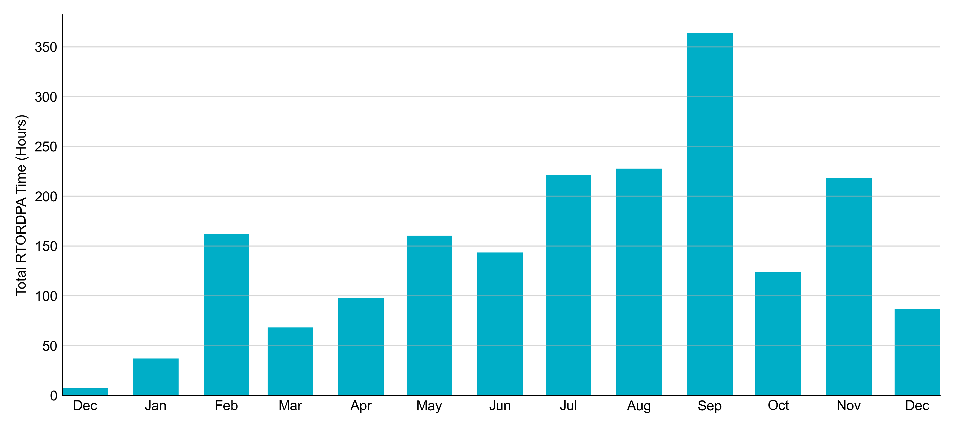
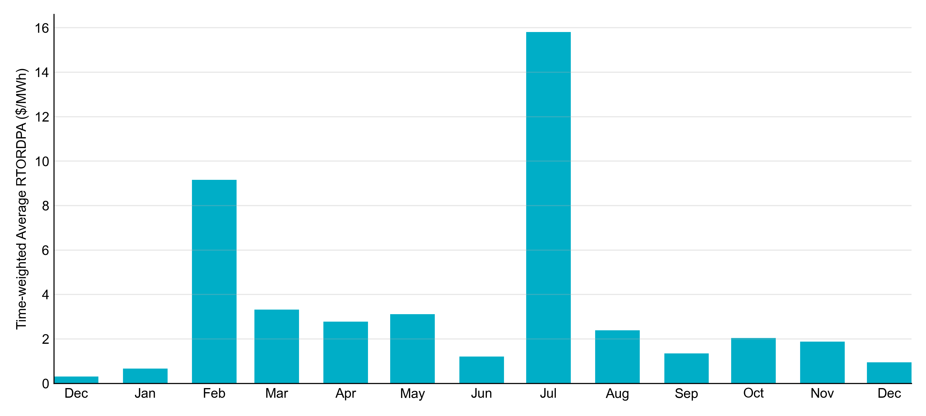
Reliability Deployment Price Adder: Last 13 Months December 2022 had a total of 86.67 RTORDPA hours with an average value of $0.95/MWh.

Slide 12
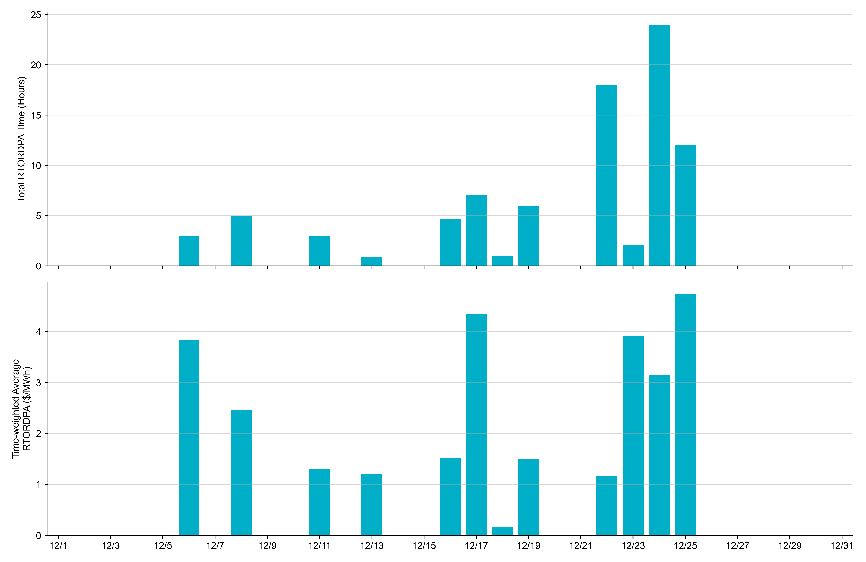
Reliability Deployment Price Adder: December 2022 OD 12/25 had the highest daily time-weighted average RTORDPA: $4.74/MWh.

Slide 13
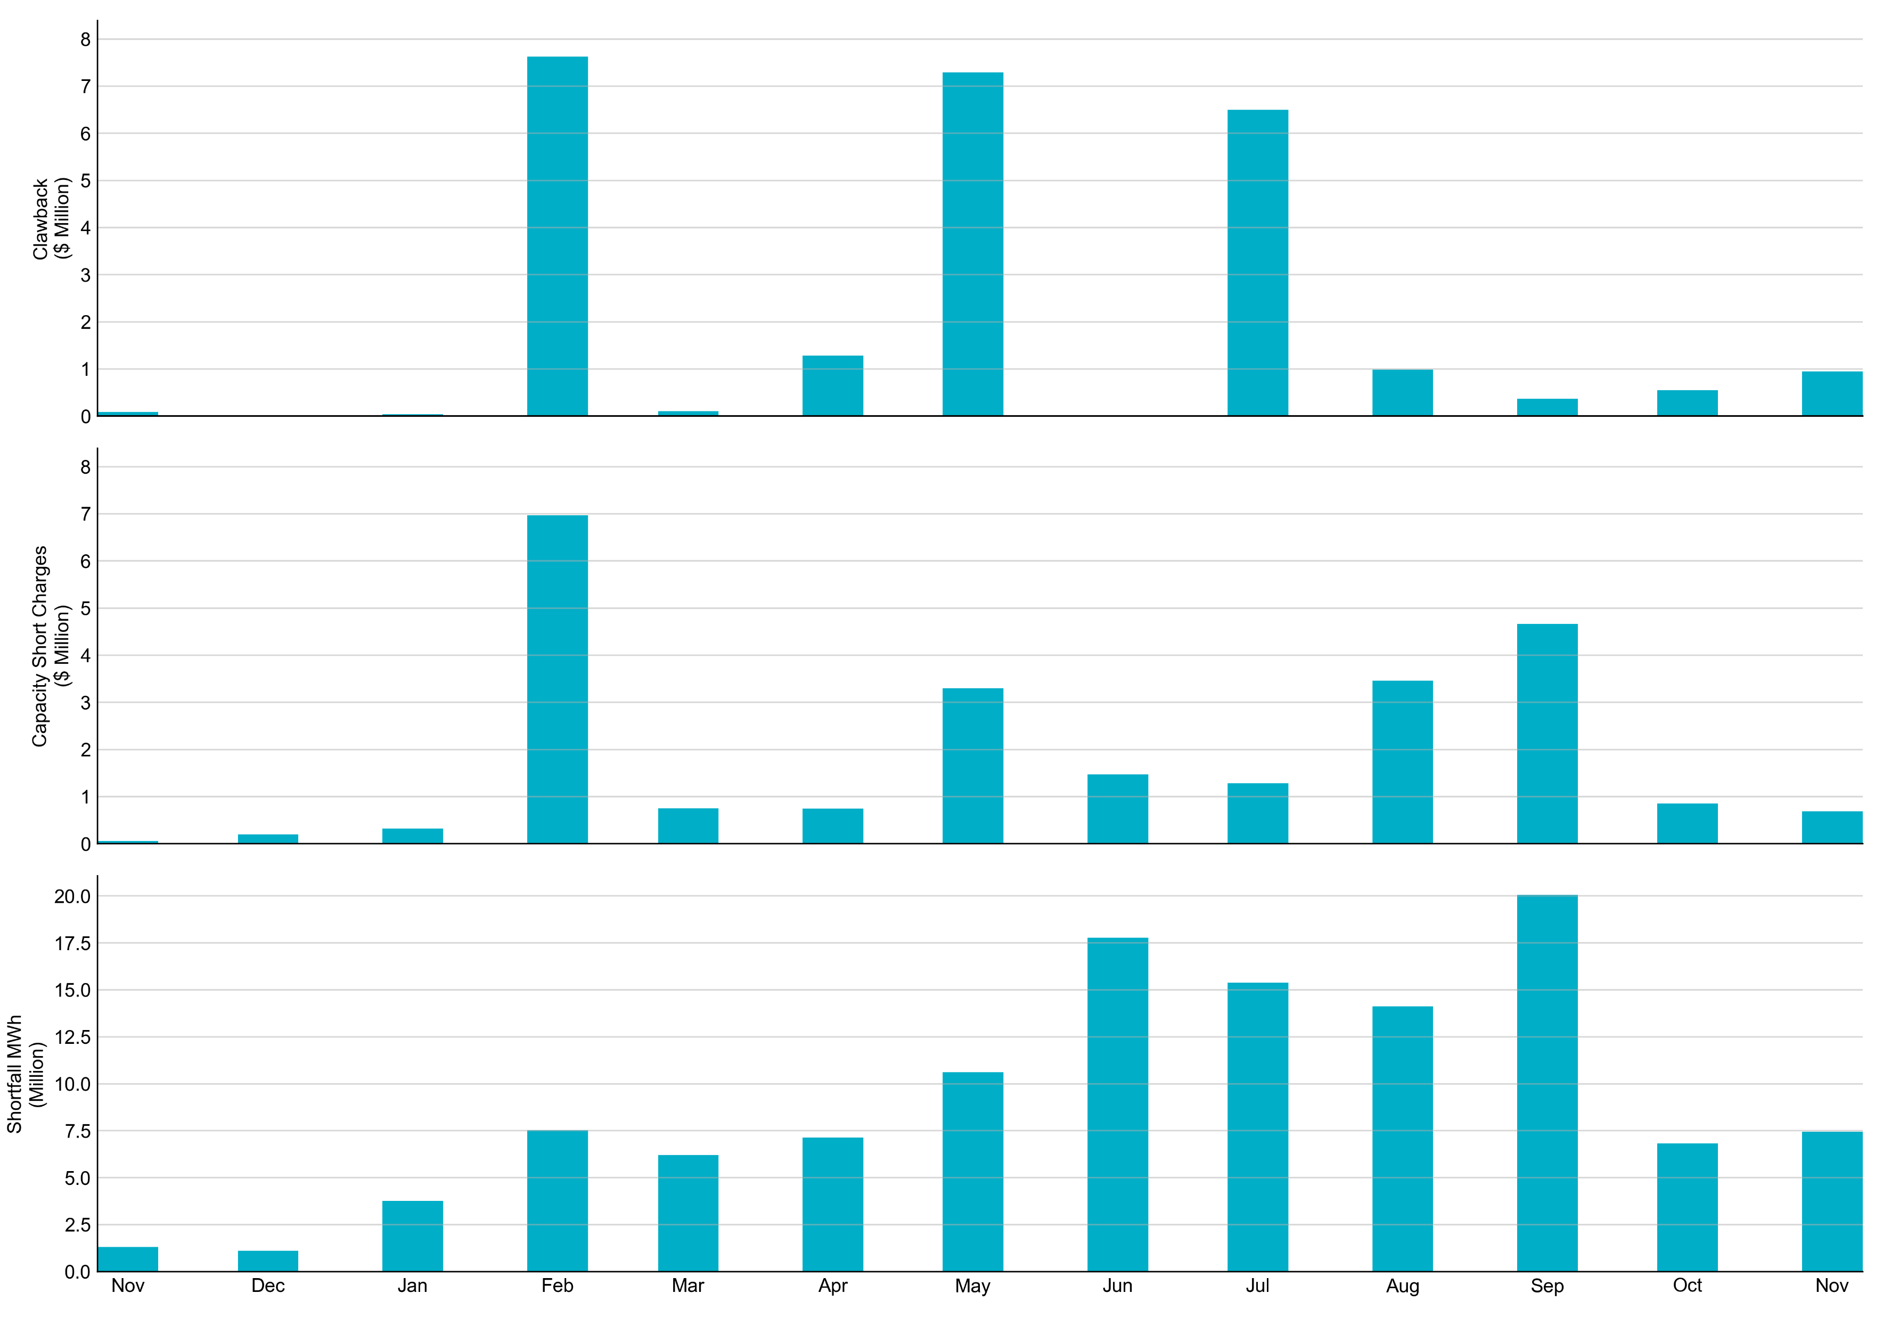
RUC Clawback, Capacity Short Charges, and Shortfall For December 2022, the total Clawback charge was $0.148M. The total Make-Whole payment was $1.479M, which was almost entirely covered through capacity-short charges.
In December 2022, $1.479M in Make-Whole was paid out. There was a total amount of $2.33 uplifted to load this month.

