Slide 1
Credit Exposure Update
Credit Work Group
ERCOT Public
January18, 2023

Slide 2
Monthly Highlights Nov 2022 – Dec 2022
Market-wide average TPE increased from $1,173.1 million in November to $1,437.4 million in December
TPE increased mainly due to higher Real-Time and Day-Ahead Settlement Point prices
Discretionary Collateral is defined as Secured Collateral in excess of TPE,CRR Locked ACL and DAM Exposure
Average Discretionary Collateral increased from $2,602.8 million in November to $3,783.3 million
in December
The increase in Discretionary Collateral is largely due to increase in Secured Collateral
No unusual collateral call activity

Slide 3
TPE and Forward Adjustment Factors Dec 2021- Dec 2022
*TPE adjusted to exclude short pay entities eliminating data skew

Slide 4
TPE/Real-Time & Day-Ahead Daily Average Settlement Point Prices for HB_NORTH December 2021- December 2022
* TPE adjusted to exclude short pay entities eliminating data skew

Slide 5
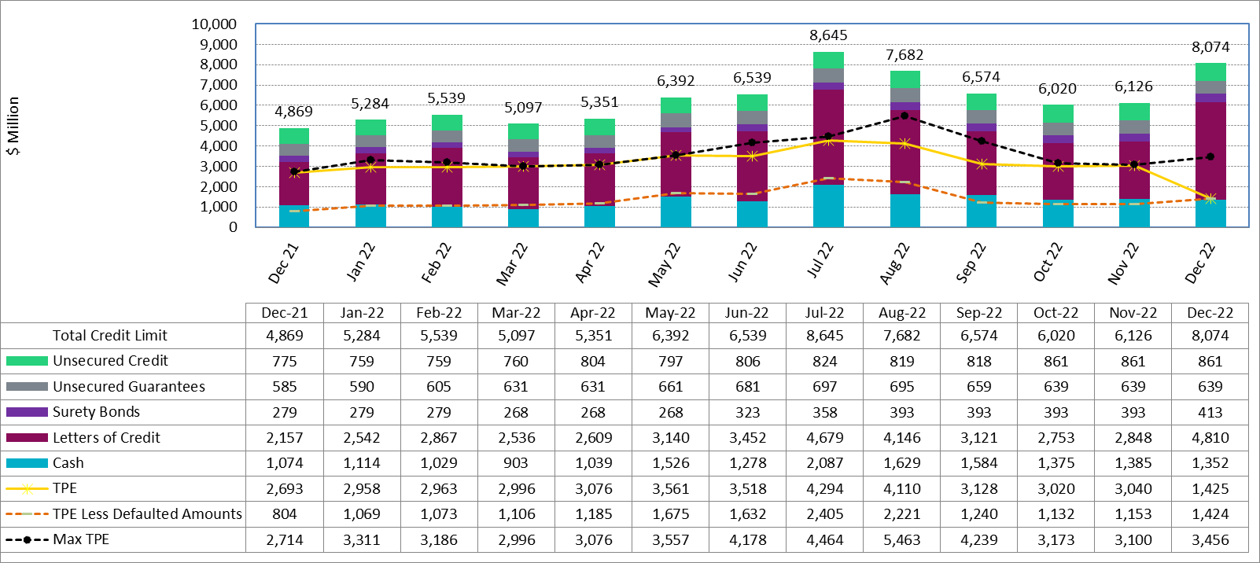
Available Credit by Type Compared to Total Potential Exposure (TPE) Jun 2021- Jun 2022
Numbers are as of month-end except for Max TPE
Max TPE is the highest TPE for the corresponding month
TPE less Defaulted Amounts: TPE – Short-Paid Invoices

Slide 6
Discretionary Collateral November 2022 - December 2022
* Discretionary collateral doesn’t include Unsecured Credit Limit or parent guarantees
* TPE adjusted to exclude short pay entities eliminating data skew

Slide 7
TPE and Discretionary Collateral by Market Segment- December 2022*
Load and Generation entities accounted for the largest portion of discretionary collateral
*Discretionary collateral doesn’t include Unsecured Credit Limit or parent guarantees
* TPE adjusted to exclude short pay amounts eliminating data skew

Slide 8
Discretionary Collateral by Market Segment December 2020 - December 2022
* Discretionary Collateral adjusted to exclude short pay amounts eliminating data skew

Slide 9
TPEA Coverage of Settlements November 2021– November 2022
*TPEA exceeds invoice exposure
*TPEA adjusted to exclude short pay entities eliminating data skew

Slide 10
TPEA Coverage of Settlements November 2021– November 2022
*TPEA generally exceeds invoice exposure

Slide 11
TPEA Coverage of Settlements November 2021– November 2022
Invoice exposure generally exceeds TPEA
TPEA adjusted to exclude short pay entities eliminating data skew

Slide 12
TPEA Coverage of Settlements November 2021– November 2022
* TPEA generally exceeds Invoice exposure

Slide 13
TPES Coverage of Settlements November 2021– November 2022
*TPES exceeds actual/invoice exposure

Slide 14
TPEA Coverage of Settlements November 2021– November 2022
*TPEA closely approximates actual/invoice exposure
*TPEA adjusted to exclude short pay entities eliminating data skew

