Slide 1
NPRR 1146 – Impact on TPE of Eliminating URTA
CWG
ERCOT Public
January 18, 2023

Slide 2
TPE/EAL Impact of Eliminating URTA
The group requested ERCOT staff to determine the impact of eliminating URTA from exposure calculations/TPE.
The period covered extends back only to July 2021. TPE in the first semester of 2021 were excluded as these were largely distorted by adjustments to various TPE parameters made in response to Winter Uri events.
This was only applied to market participants classified as “Trade-only” entities.

Slide 3
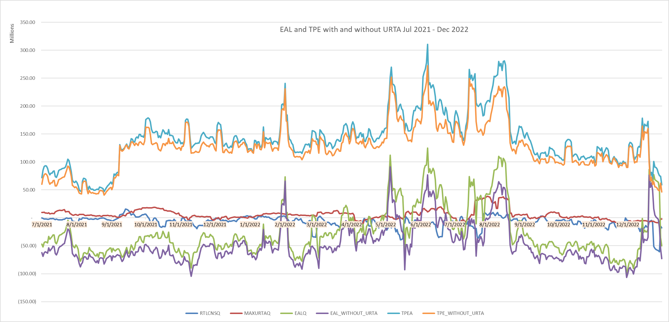
TPE/EAL Impact of Removal of MaxURTA (for Trade-Only entities)

Slide 4
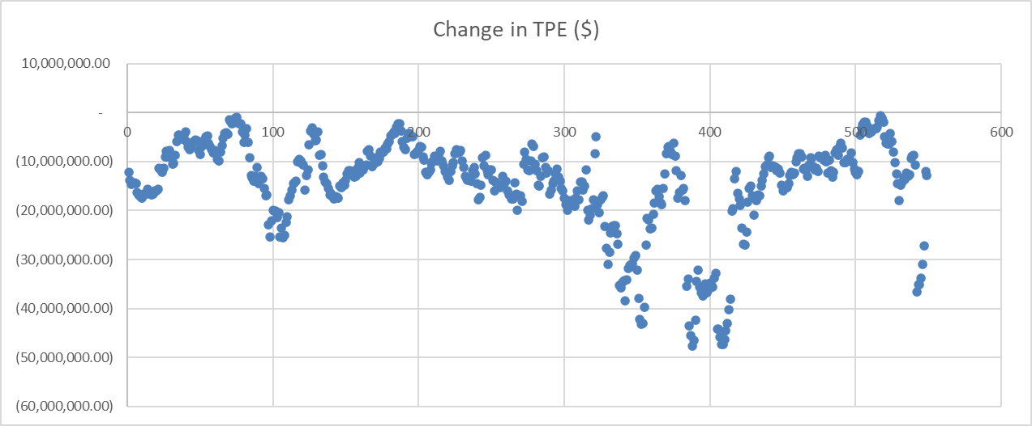
TPE/EAL Impact of Eliminating URTA (for Trade-Only entities)

Slide 5
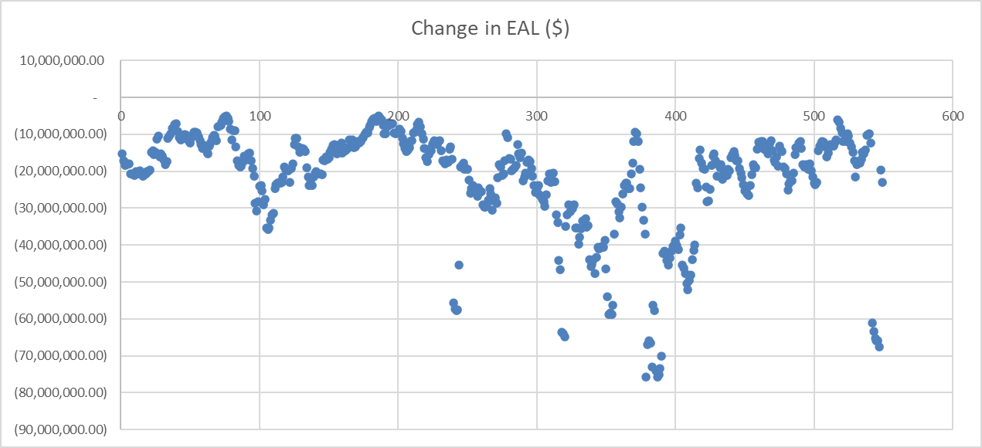
TPE/EAL Impact of Eliminating URTA (for Trade-Only entities)

