Slide 1
Supply Analysis Working Group Update
Caitlin Smith, Chair
Pete Warnken, Co-Vice Chair
Ian Haley, Co-Vice Chair
January 11, 2023

Slide 2
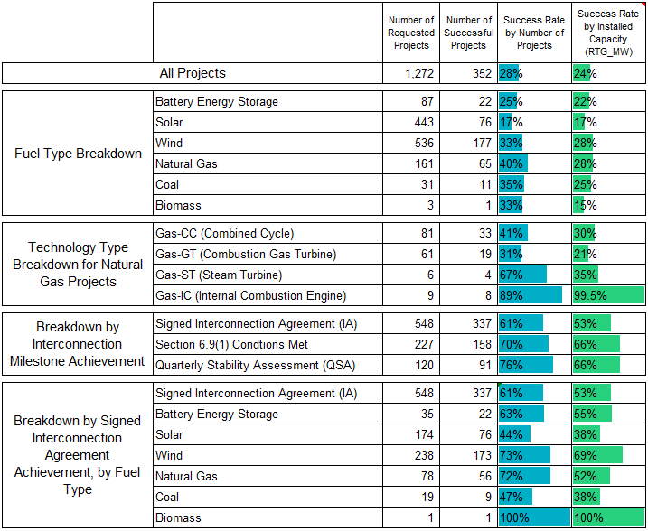
Planned Project Success Analysis, Year-end Update
Statistics based on:
project requests during 2002 through 2019
projects for which a Full Interconnection Study was requested
projects that have at least been approved for grid synchronization
Excludes upgrade projects and Battery Storage DGRs

Slide 3
Planned Project Success Analysis, Year-end Update
Development Cycle for Planned Projects: Average Duration in Years for Successful Projects (from Interconnection Request to ERCOT Commercial Operations or Synchronization Approval)

Slide 4
Planned Project Success Analysis, Year-end Update
Planned natural gas requests by technology type % of planned capacity
“Other Gas Technologies” include Internal Combustion Turbines, Gas Steam Boiler, and Compressed Air Energy Storage. Combined Cycle upgrade projects represent between 5-10% of requested Combined Cycle projects since 2019.

Slide 5
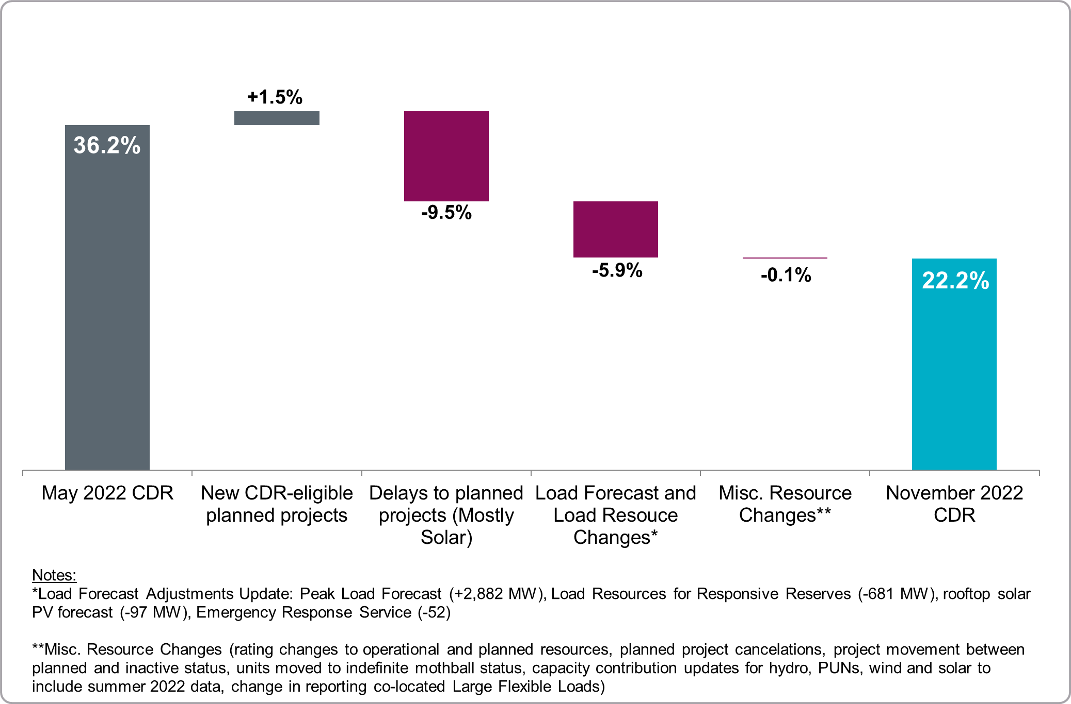
CDR/SARA Report Overview and Q&A
Summarized the CDR and SARA report highlights, including derivation of an interim battery storage capacity contribution for the winter SARA
Presented the following waterfall chart showing changes in the summer 2023 Reserve Margin forecast relative to the one from the May CDR

Slide 6
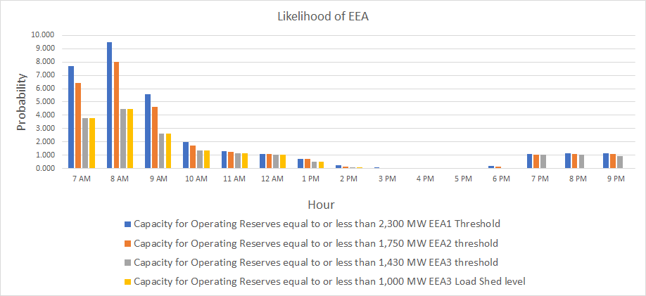
Winter 2022-23 Probabilistic Risk Assessment
Summarized the main winter assessment enhancements to the Operating Reserve Risk Model (aka probabilistic SARA model), and presented simulation results for winter 2022-23

Slide 7
SAWG Meeting Scheduling and Leadership Changes
Working on scheduling monthly SAWG meetings for February through December 2023 (No January meeting)
SAWG leadership nominations will be handled through SAWG Listserv messaging during January
Replacement for Caitlin Smith, who is retiring as SAWG Chair
A volunteer for the Chair has already come forward

