Slide 1
TDTMS Update
RMS
January 10th, 2023

Slide 2
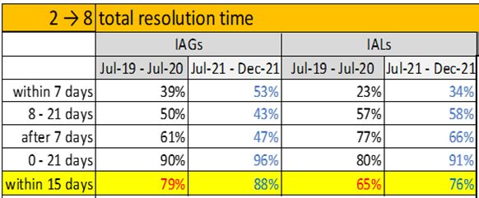
TDTMS
Update
ERCOT Updates
SCR 817 – developers are finalizing design and writing test scripts. SCR817 will remain standing agenda item to address any questions. Discussed Usage & Billing –Dispute radio button and Meter Cycle Change requests process flow.
SCR815 – implemented December 10th- 11th – REMINDER: MarkeTrak Admins are to update Rolodex with escalation contact information. New rolodex categories were set to default with MT Admins.
RMGRR170 – Inadvertent Gain Process Update – approved and effective 1/1/23.
PUCT Project 52796 – proposed docket to shorten the timelines for complaints in 25.495 from 21 days down to 15 days. This timeline has served as a guideline for the expected completion of an IAG issue. Data from last analysis revealed the following performance:

Slide 3
TDTMS
RMGRR170 - Inadvertent Gain Process Updates – Effective 1/1/23
Clearly define an Inadvertent Gain
Clarify the appropriate use of the Inadvertent Gain Process – not to be used for early termination fees, non-payment, nor identity theft
Limit the use of the Bulk Insert template for IAGs
Requiring a CR who experienced a system processing issue resulting in inadvertently gaining greater than 100 ESIs, who uses the IAG process to resolve, to inform impacted Market Participants and detail the cause of the issue
Adding a Valid Reject/Unexecutable Reason for the losing CR referencing the new subsection on the Invalid Use of the IAG Process
Introduce the commonly referred to “No Current Occupant” process supported by PUCT Subst. Rule 25.488 - Procedures for a Premise with No Service Agreement for scenarios where the losing CR no longer has a valid service agreement with the Customer and must regain an ESI ID

Slide 4
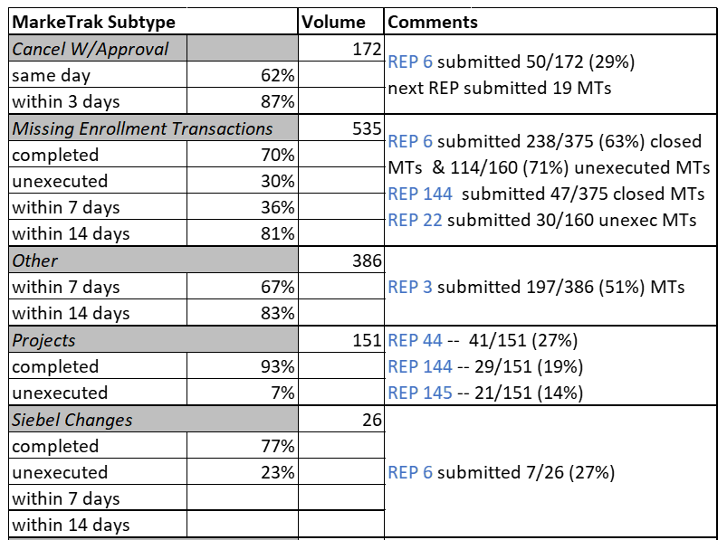
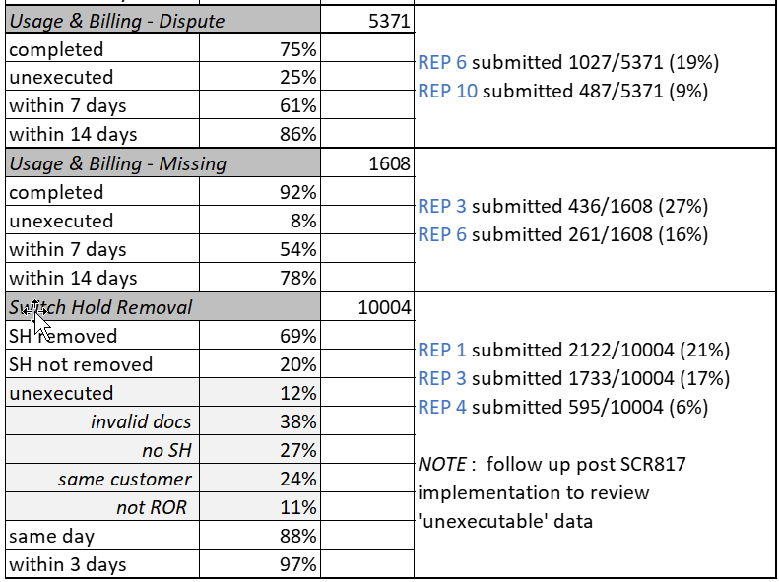
TDTMS
MarkeTrak Subtype Analysis – Jul21 to Dec21 Data

Slide 5
TDTMS
Next Meeting
Wednesday, January 18th, 1:00 PM, WebEx only
On the Agenda:
System Instances & MT Performance
Listserv
MarkeTrak SCR815 Follow Up
SCR817 Business Requirements discussion, if needed
MarkeTrak Volume Subtype Analysis Discussion –
Any follow up items to be addressed
ERCOT Updates
Goals 2023/Accomplishments 2022

