Slide 1
Monthly Review of Reliability Unit Commitment Market Impacts – November 2022
Wholesale Market Working Group
ERCOT Staff

Slide 2
RUC Resource-Hours
November 2022 | Total | Opt-Out | Non-Opt-Out
Instructed Resource-Hours
Total Count | 756.0 | 211.0 | 545.0
Effective Resource-Hours*
Total Count | 725.7 | 208.8 | 516.8
Average LSL | 79.1 | 95.3 | 72.6
Average LDL | 95.3 | 147.3 | 74.3
Average BP | 103.2 | 169.2 | 76.6
Average HSL | 281.2 | 297.2 | 274.8
* The difference between “Instructed” and “Effective” values is a result of Resources starting up, shutting down, receiving partial hour instructions, or otherwise not being dispatchable by SCED.

Slide 3
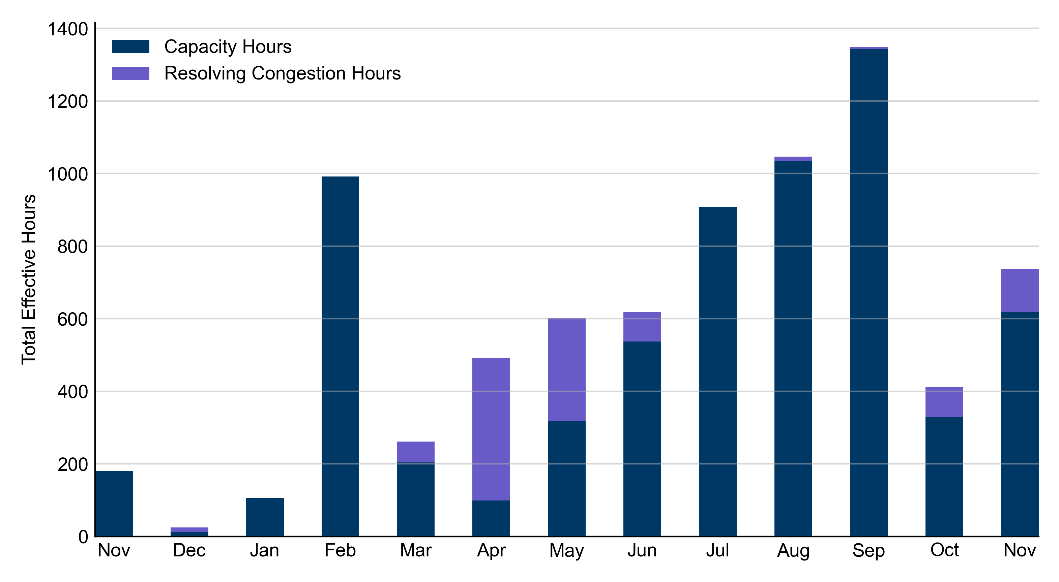
RUC Instruction Reasons: Last 13 Months
RUCs in November 2022 were primarily driven by system-wide capacity concerns.

Slide 4
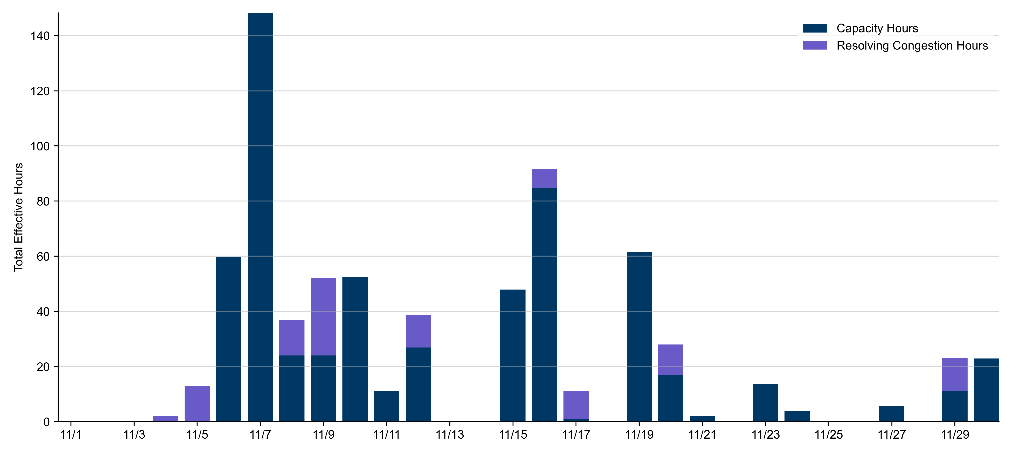
RUC Instruction Reasons
November 2022
725.8 effective RUC Resource-hours.
  617.9 hours (85.15%) for capacity concerns.
  107.8 hours (14.85%) for resolving congestion concerns.

Slide 5
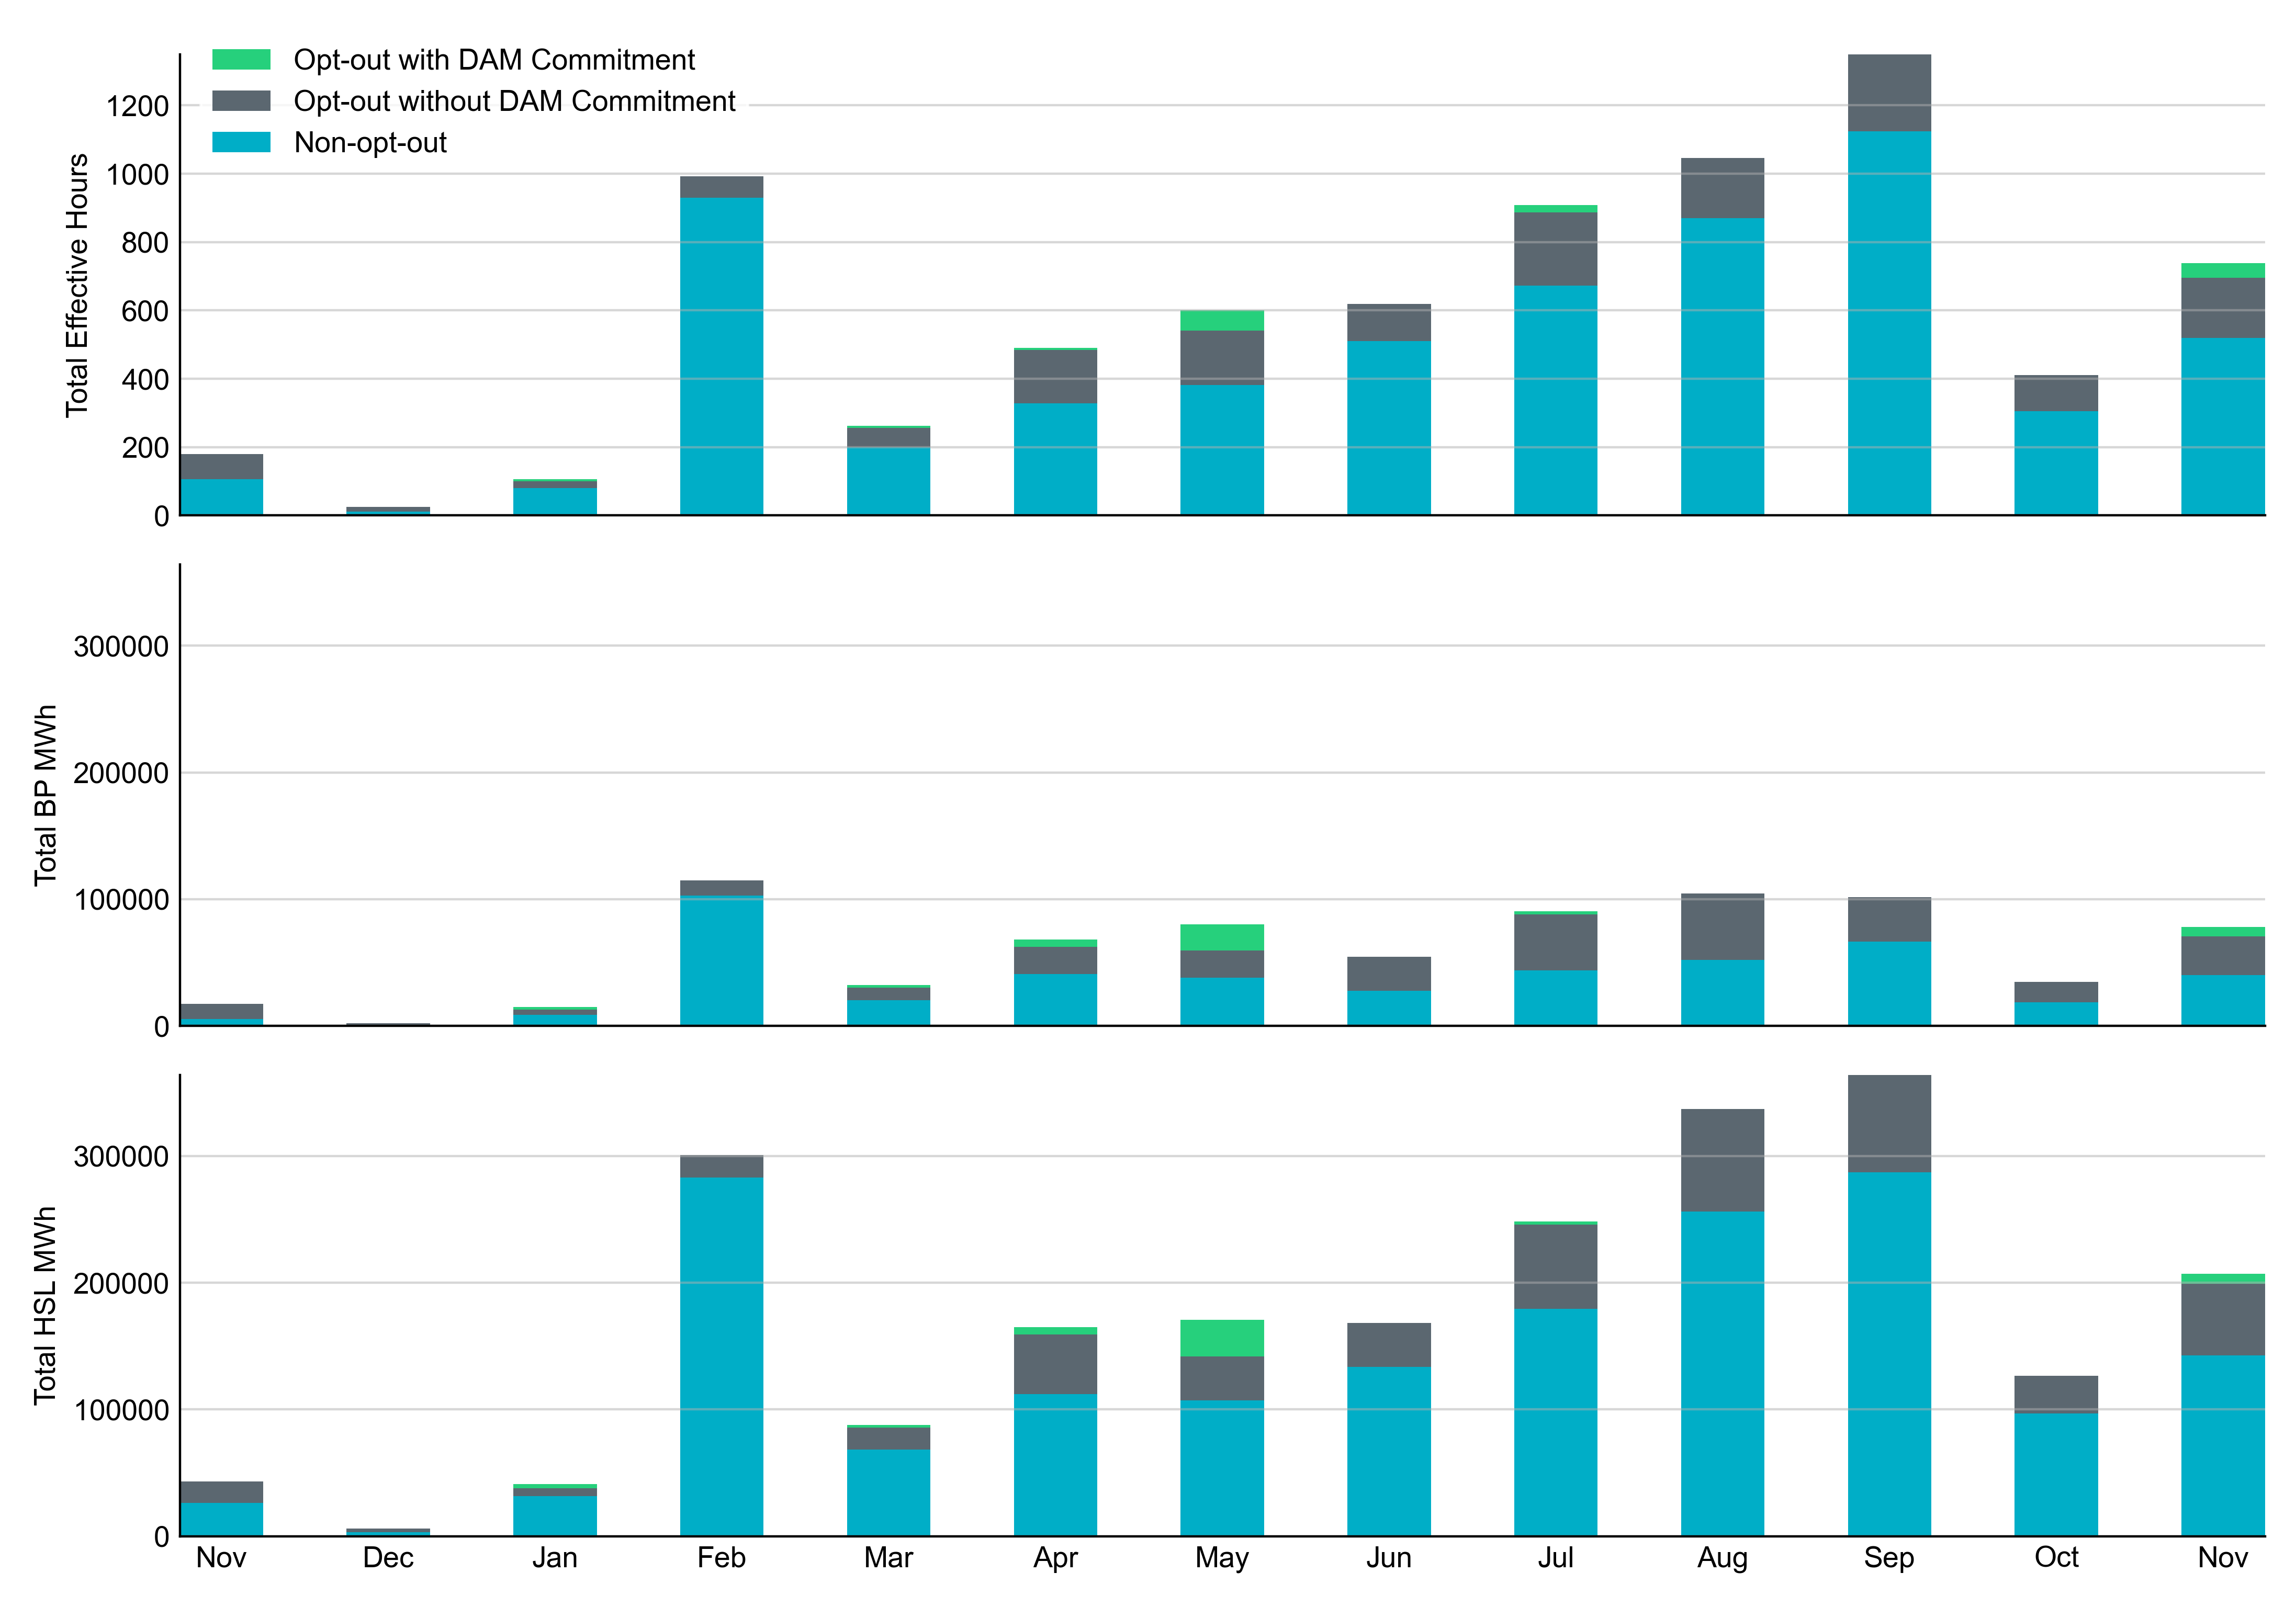
Non-opt-out and Opt-out Totals: Last 13 Months
November 2022 had a total of 516.8 non-opt-out effective Resource-hours (71.22%) and 208.8 opt-out effective Resource-hours (28.78%).

Slide 6
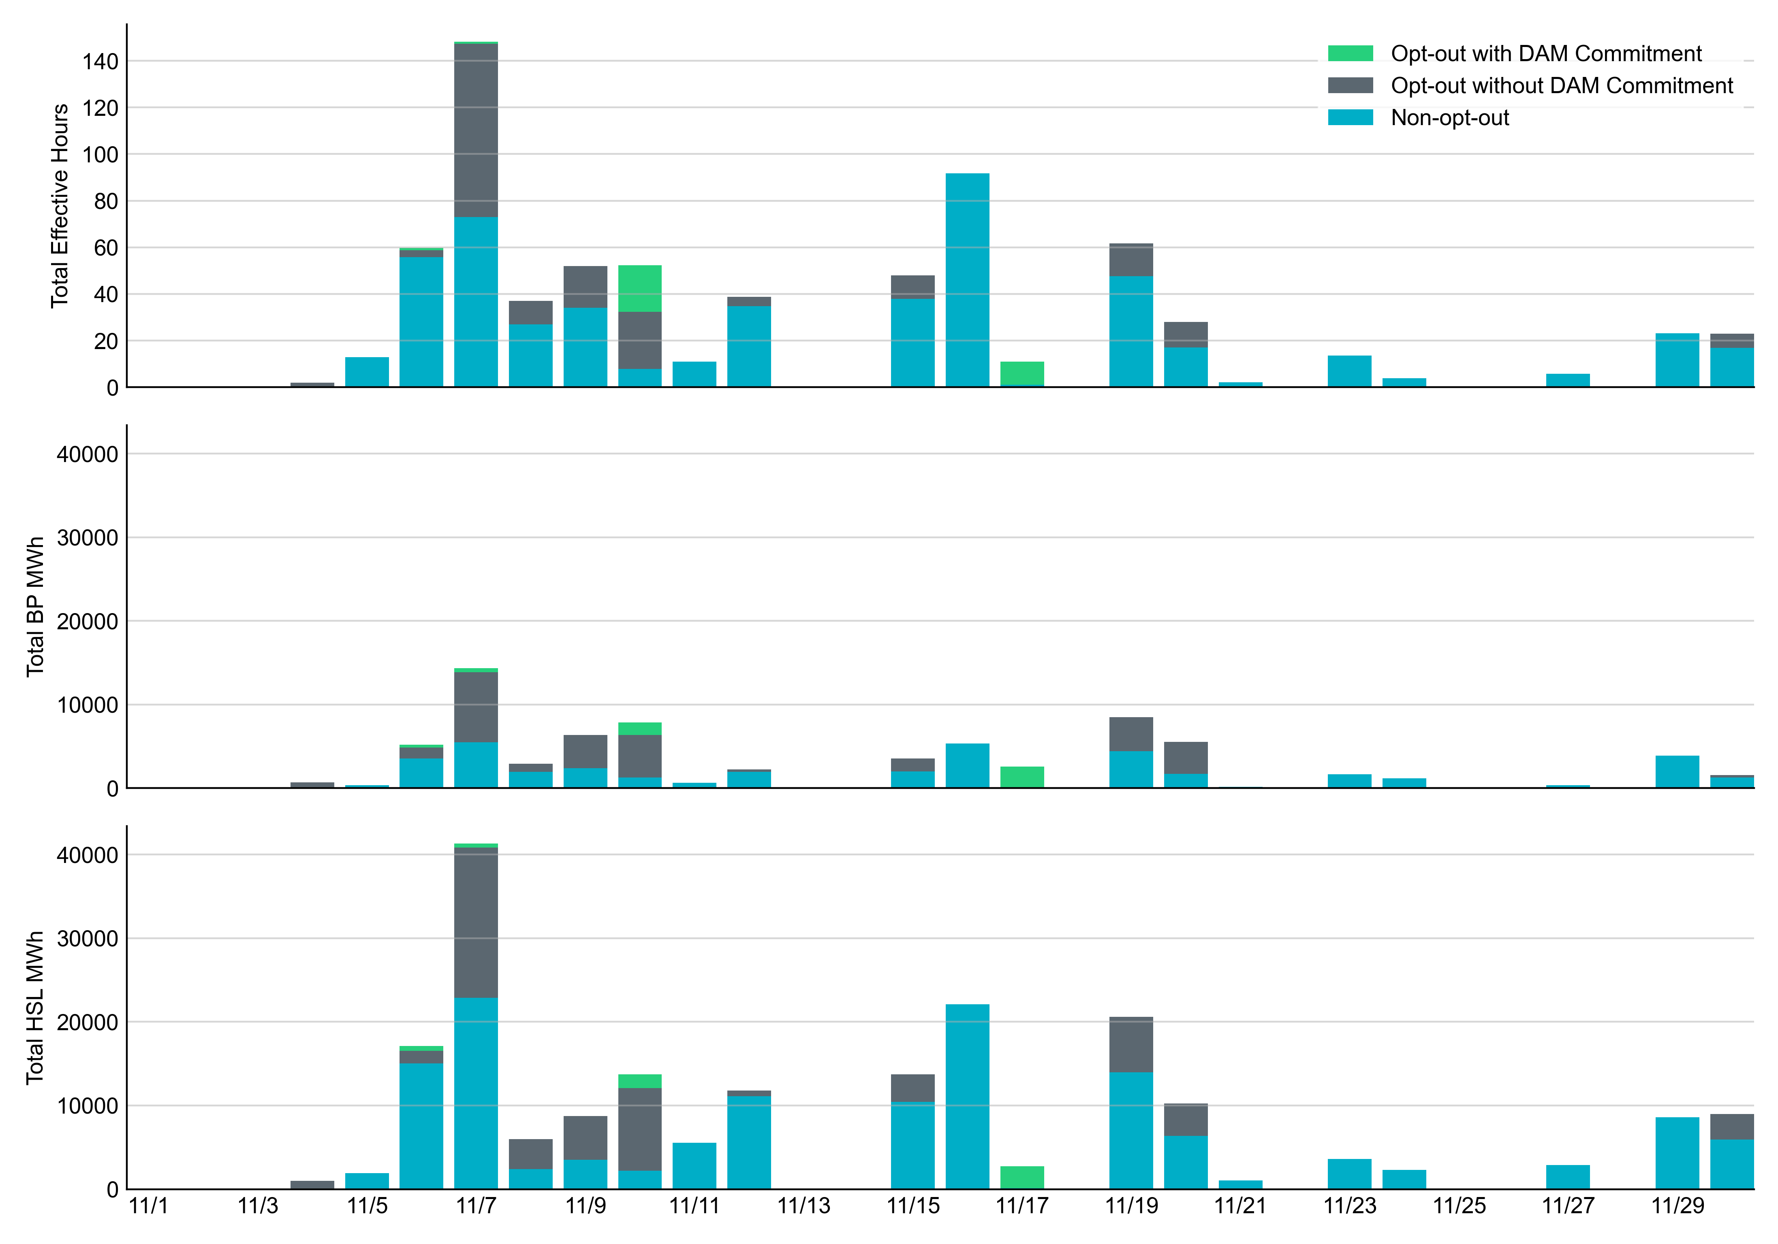
Non-opt-out and Opt-out Totals: November 2022

Slide 7
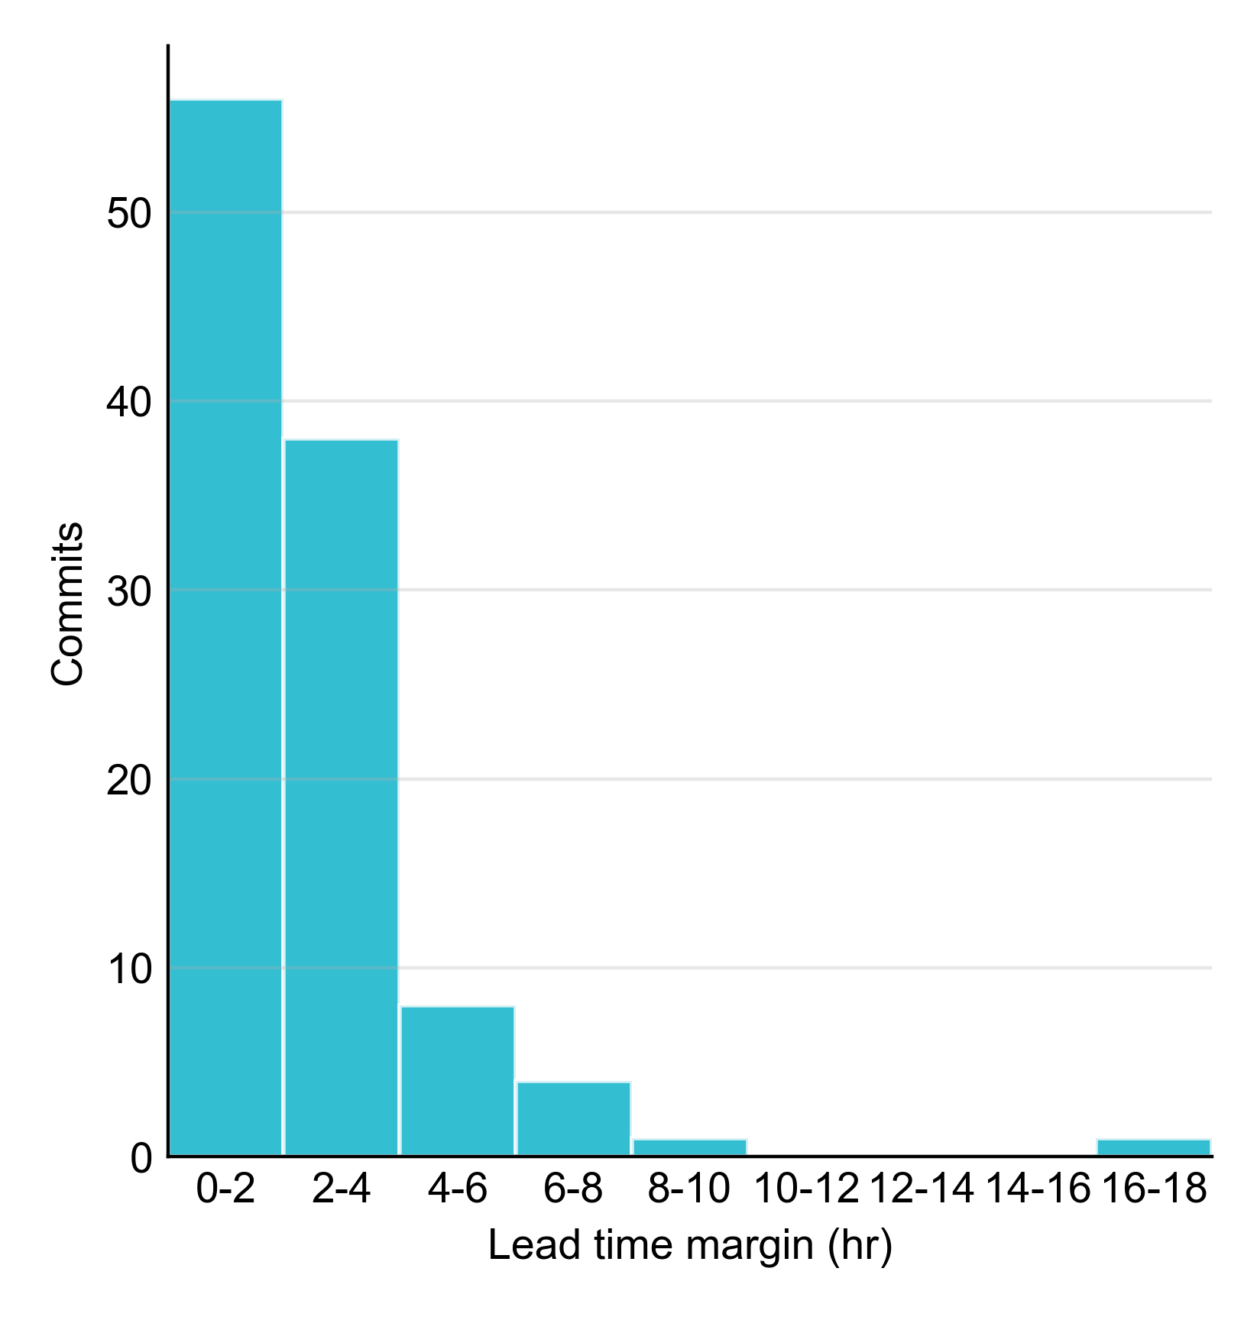
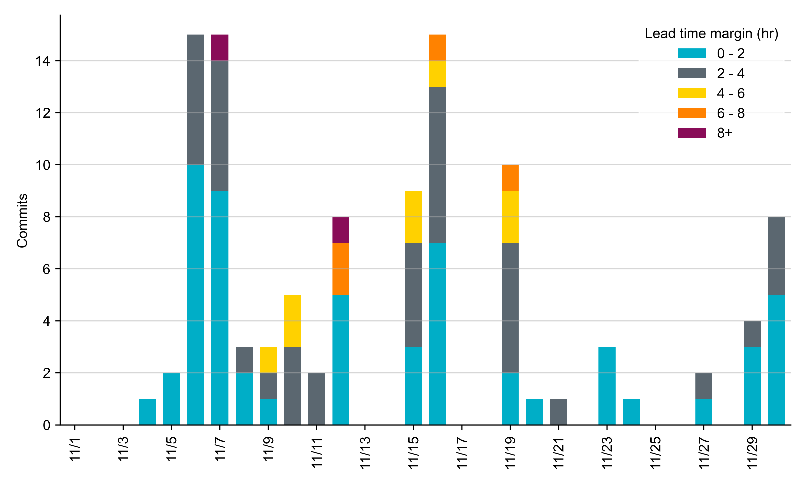
RUC Lead Time Margin: November 2022
Most RUC commit windows had lead time margin at or below 4 hours.
Lead time refers to the length of time between a RUC instruction and the start of the commitment window.
Lead time margin is the difference between lead time and the Resource’s startup time.
In cases where a Resource is committed for multiple back-to-back time blocks, lead time margin is calculated from the first instruction.
Notes:
The first bin is both-inclusive (i.e. [0, 2] ), while subsequent bins are left-inclusive (i.e. [2, 3), [3, 4), etc.).

Slide 8
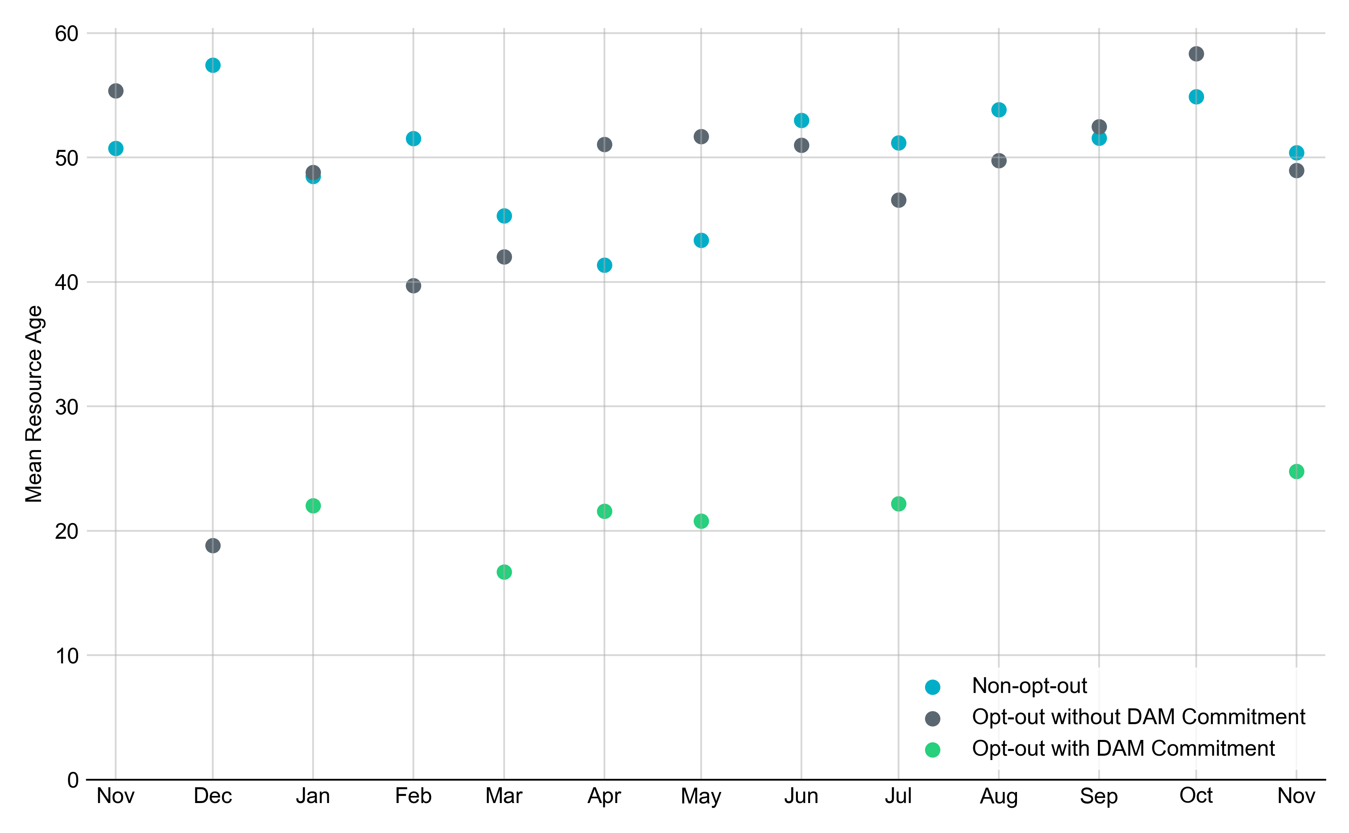
Average Resource Age
In November 2022, the mean age of RUC-committed Resources was 50.4 years for Non-Opt-Out Resource-hours, 49.0 years for Opt-Out Resource-hours without DAM Commitments.
Note: For Resource configurations with multiple physical generators, the age of the oldest generator is used.

Slide 9
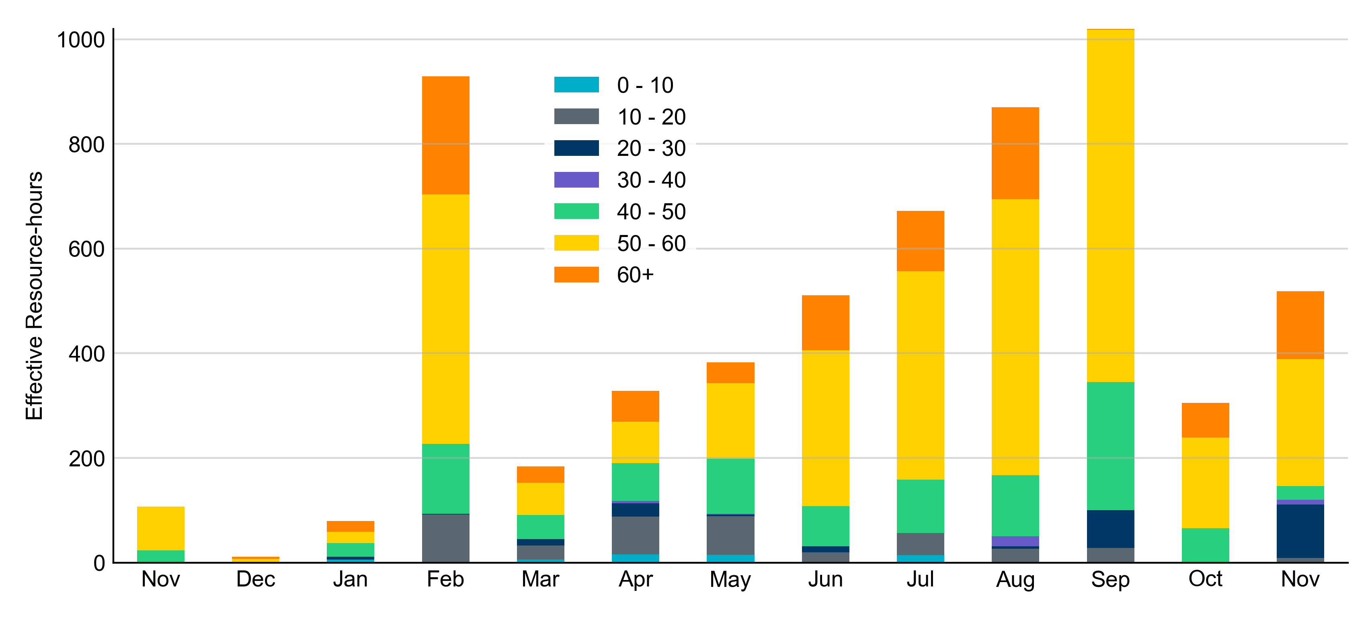
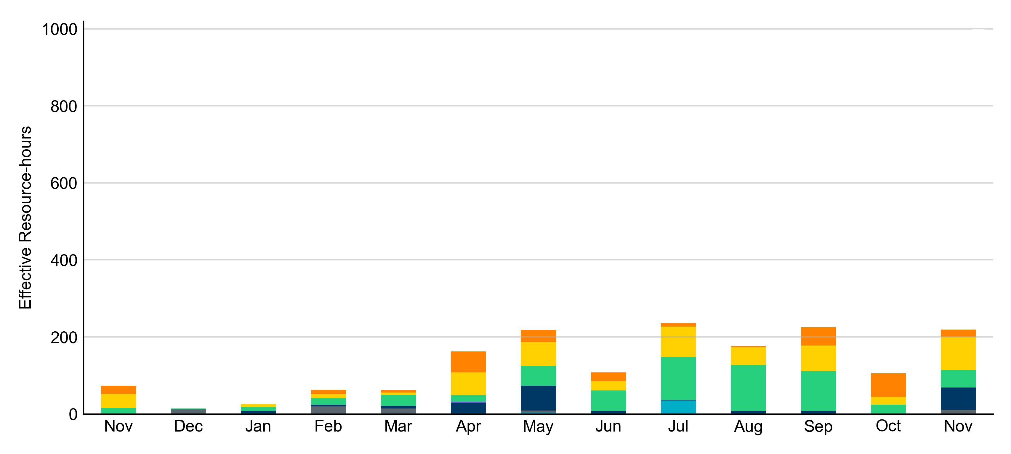
Age Category
Most RUC-Committed Resources in November 2022 were older than 40 years.
Non-opt-out
Opt-out

Slide 10
RUC-Instructed Resource Dispatch above LDL
November 2022
When Resources did not successfully opt out, there were 56.3 effective Resource-hours for which the Resource was dispatched above its LDL.
  For 6.7 of these Resource-hours, the LMP for the RUC-instructed Resource was above the RUC offer floor.
  For 49.6 of these Resource-hours, the LMP for the RUC-instructed Resource was below the RUC offer floor.
    For all these Resource-hours, the RUC-instructed Resource was mitigated.
There were no Exceptional Fuel Cost submissions for any RUC-Committed Resources in November 2022.

Slide 11
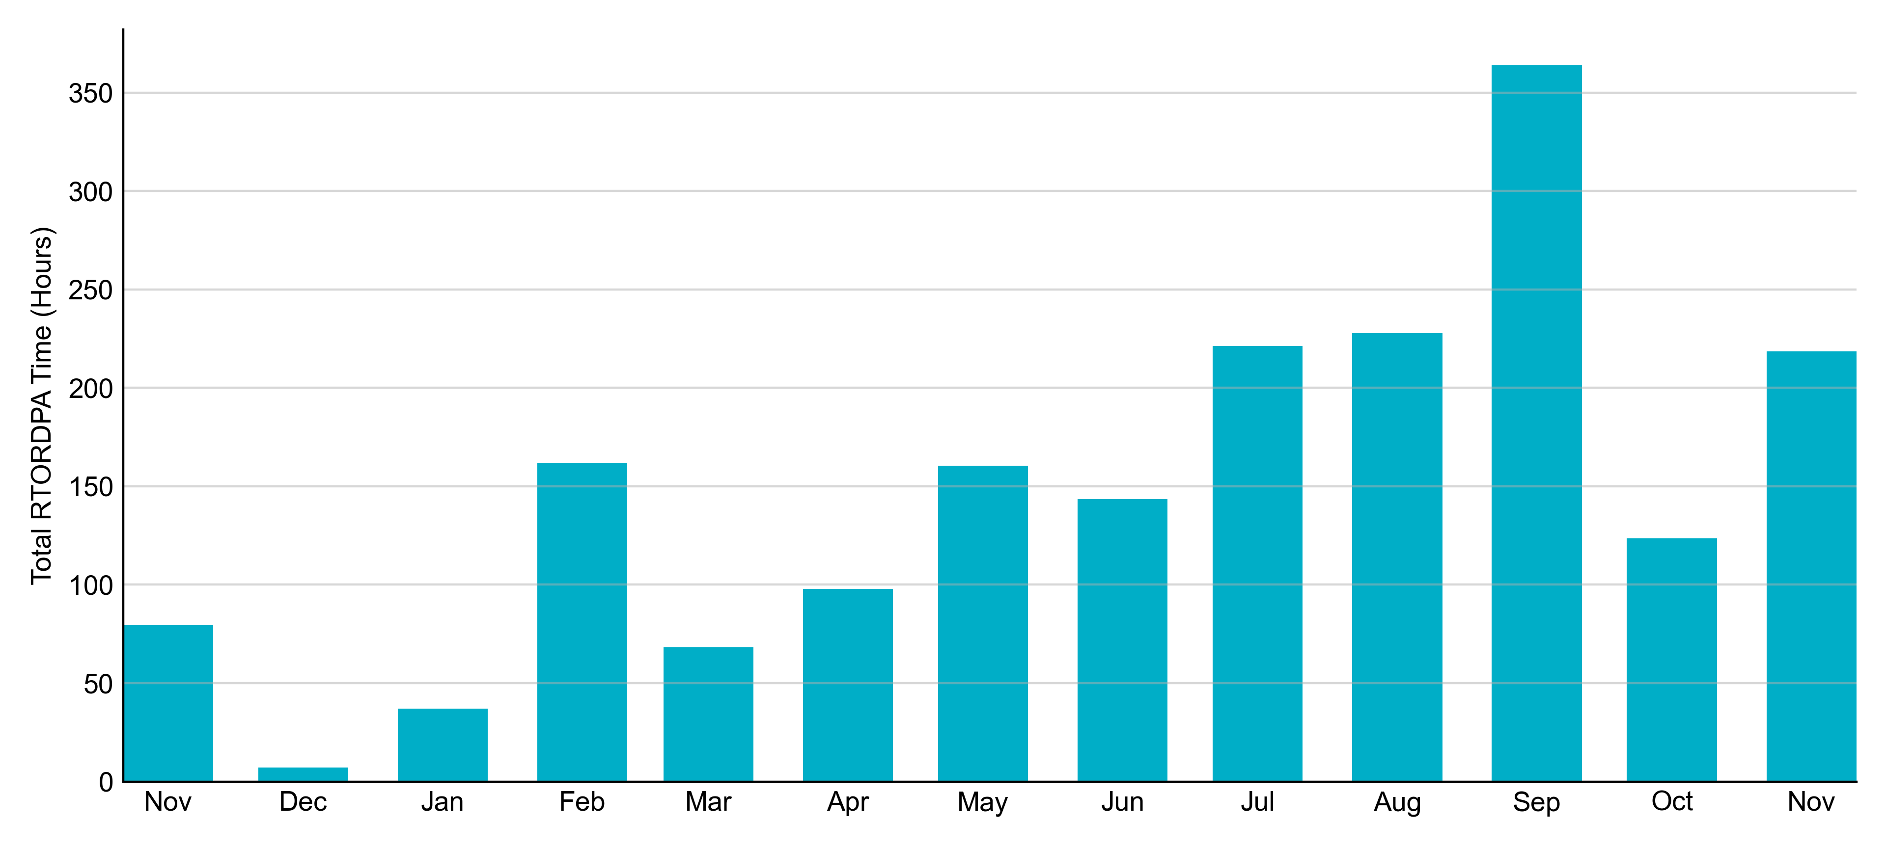
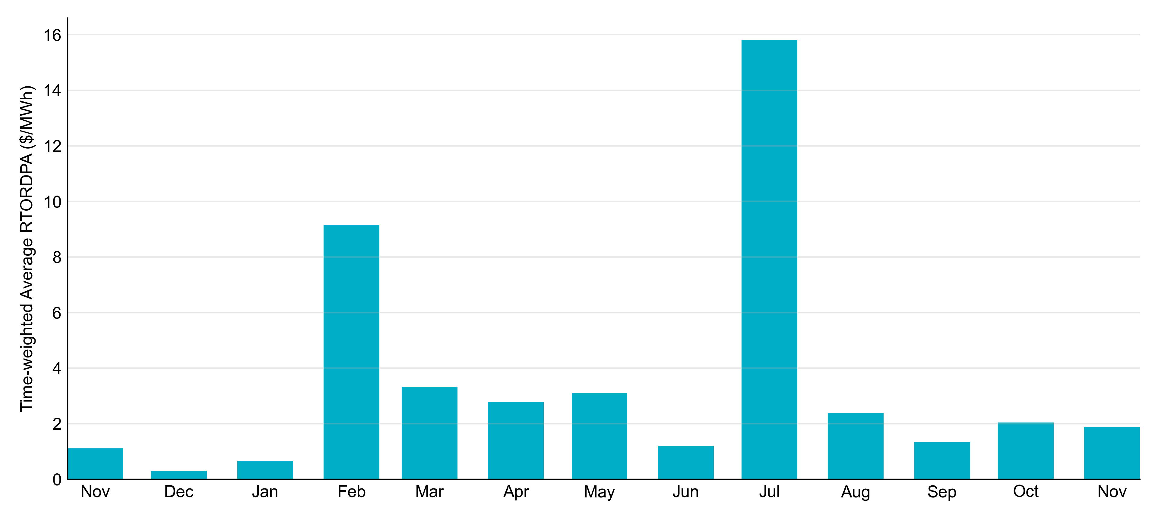
Reliability Deployment Price Adder: Last 13 Months
November 2022 had a total of 218.6 RTORDPA hours with an average value of $1.88/MWh.

Slide 12
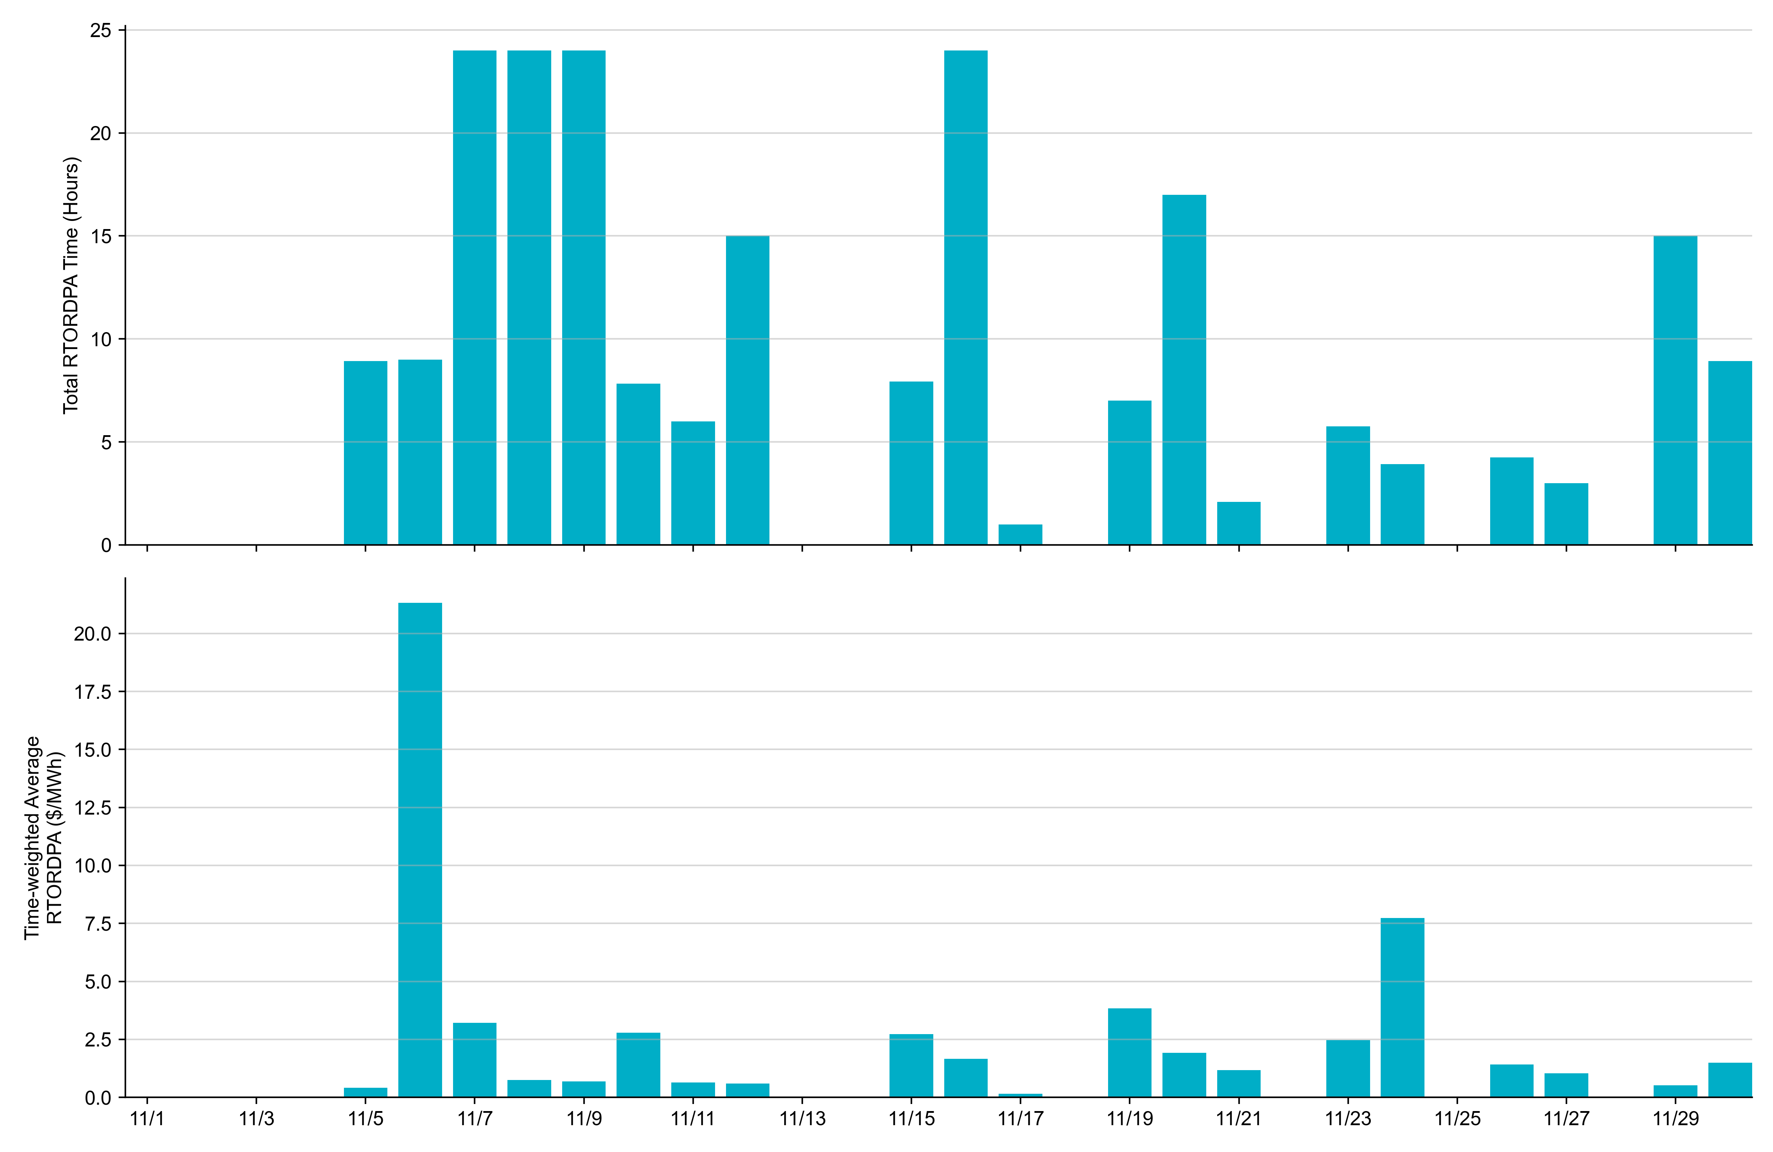
Reliability Deployment Price Adder: November 2022
OD 11/6 had the highest daily time-weighted average RTORDPA: $21.32/MWh.

Slide 13
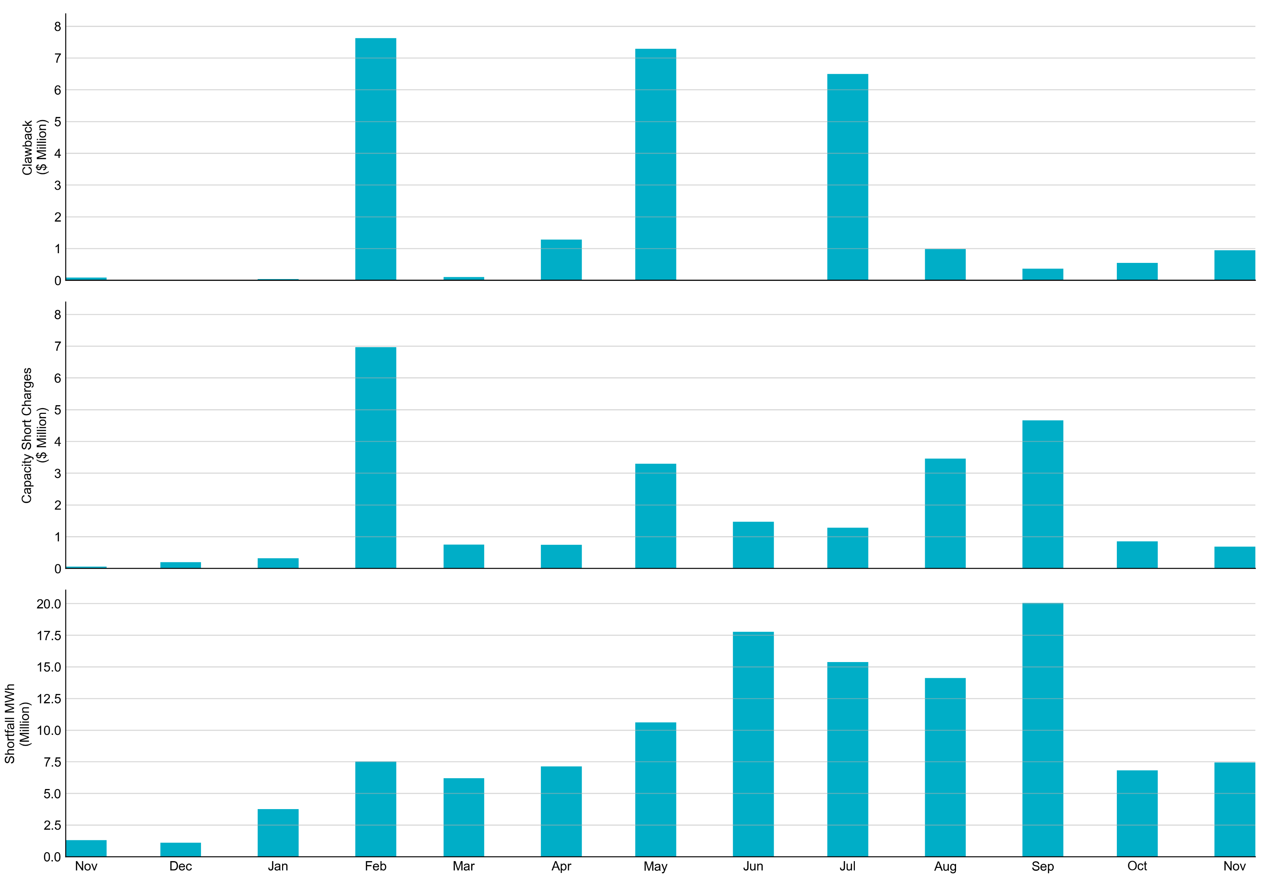
RUC Clawback, Capacity Short Charges, and Shortfall
For November 2022, the total Clawback charge was $0.952M. The total Make-Whole payment was $0.688M, which was almost entirely covered through capacity-short charges.
In November 2022, $0.688M in Make-Whole was paid out. There was a total amount of $0.83 uplifted to load this month.

