Slide 1
Regulation Bias Analysis Post SCR-773
November 2022
ERCOT
Operations Planning
PDCWG | December 15th, 2022

Slide 2
Discussion Points
Current GTBD Parameters & References
Metric to measure Regulation bias and performance
Regulation Deployed comparison for last three months.
Total Regulation (net) Deployed Comparison
Regulation Deployed 15-minute interval comparison by each hour for 2020, 2021, and 2022 months
Regulation Exhaustion Rate
Regulation bias for consecutive 5-min SCED intervals
Time Error & Contributing Factors
Summary

Slide 3
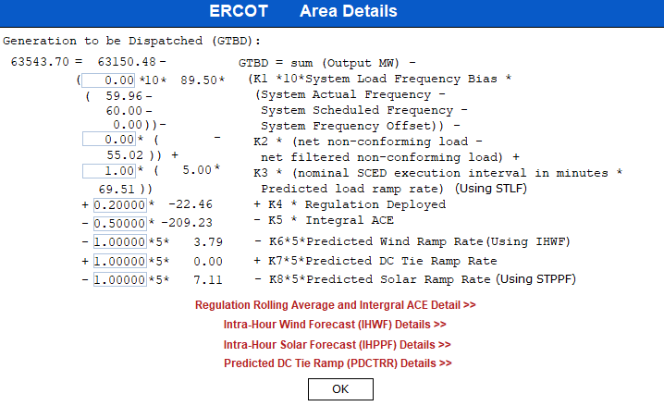
Current GTBD Parameters
Notes:
3/12/18 – Integral ACE Time Constant Changed from 60 min to 45 min
5/17/18 – K4 Changed from 0.3 to 0.2 and K5 Changed from 0.4 to 0.5
12/4/18 – 10:05 AM – K6 Changed from 0 to 0.5
2/12/19 – 2:15 PM – K6 changed from 0.5 to 1.0
3/12/19 – 2:10 PM – PWRR Threshold from 10 to 15 MW/min
3/19/19 – 2:15 PM – PWRR Threshold from 15 to 20 MW/min
4/01/19 – 10:00 AM – K5 changed from 0.5 to 0.4 and Max. Integral ACE Feedback changed from 250 to 150
4/24/19 – 1:15 PM – Max. Integral ACE Feedback changed from 150 to 160. PWRR Threshold changed from 20 to 25.
5/22/19 – 1:10 PM – K5 changed from 0.4 to 0.5, Max Integral ACE feedback changed from 160 to 200, PWRR Threshold changed from 25 to 30
6/17/20 – 10 AM - PWRR Calculation method changed from Direct to Interpolated
9/1/20 – 11 AM - Max Integral ACE Feedback changed from 200 to 250
9/3/20 – 3 PM - Max Integral ACE Feedback changed from 250 to 300
9/4/20 – 3 PM - Max Integral ACE Feedback changed from 300 to 250
6/1/21 – 10:00 AM – K8 Changed from 0 to 0.5, PSRR Threshold changed to 10
6/2/21 – 10:00 AM – PSRR Threshold changed from 10 to 20
6/3/21 – 10:00 AM – K8 Changed from 0.5 to 0.75
6/4/21 – 10:00 AM – K8 Changed from 0.75 to 1
9/2/21 – 10:00 AM – PSRR Threshold changed to 30
6/7/22 – 10:30 AM – K7 Changed from 0 to 0.5, PDCTRR Min/Max Threshold changed to 10 MW/min
6/8/22 – 10:30 AM – PDCTRR Min/Max Threshold changed from 10 to 20 MW/min
6/9/22 – 10:30 AM – K7 Changed from 0.5 to 0.75
6/10/22 – 10:30 AM – K7 Changed from 0.07 to 1.0
7/21/22 – 10:00 AM–Max Integral ACE Feedback changed from 250 to 350
7/21/22 – 05:10 PM – K5 Changed from 0.5 to 1
7/22/22 – 09:40 PM – K5 Changed from 1 to 0.5
7/27/22 – 08:40 AM – PSRR Threshold changed to 40 MW/min

Slide 4
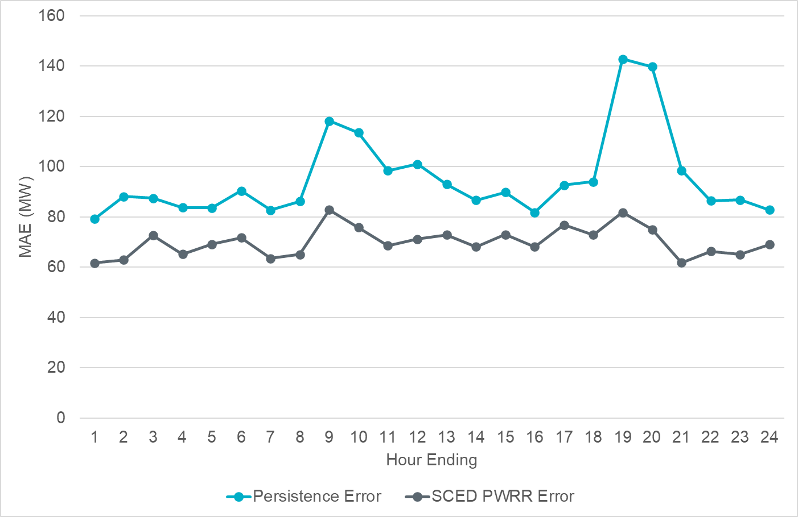
Projected Wind Ramp Rate MAE
Notes:
For intra-hour wind ramp forecast, SCED PWRR MAE is fairly consistent and smaller than the persistence forecast across the board.

Slide 5
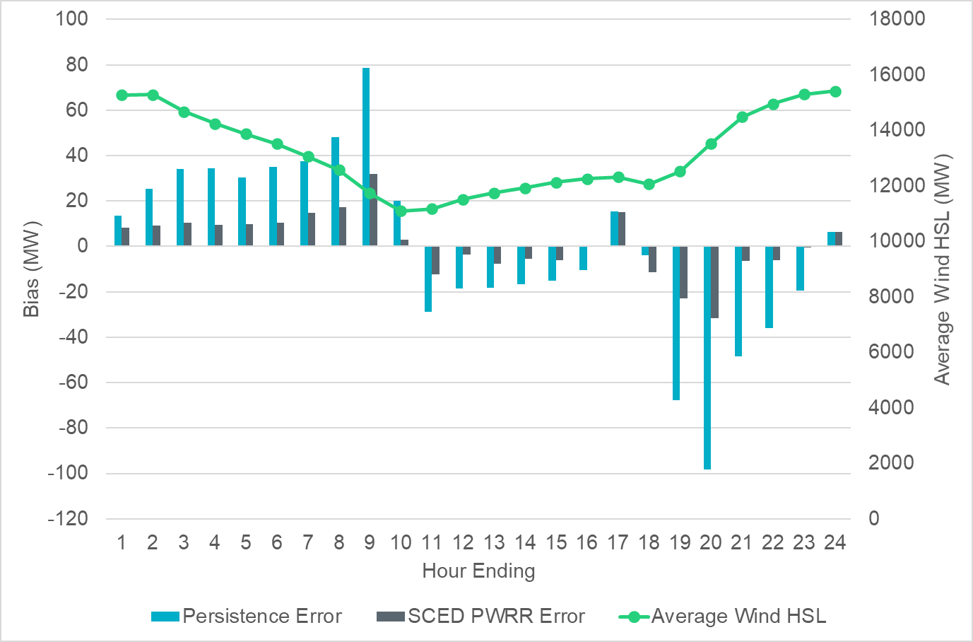
Projected Wind Ramp Rate Error
Notes:
PWRR error is higher during the ramp up and ramp down hours. Regardless of the ramping magnitude, SCED PWRR is consistent and performing significantly better than the persistence forecast

Slide 6
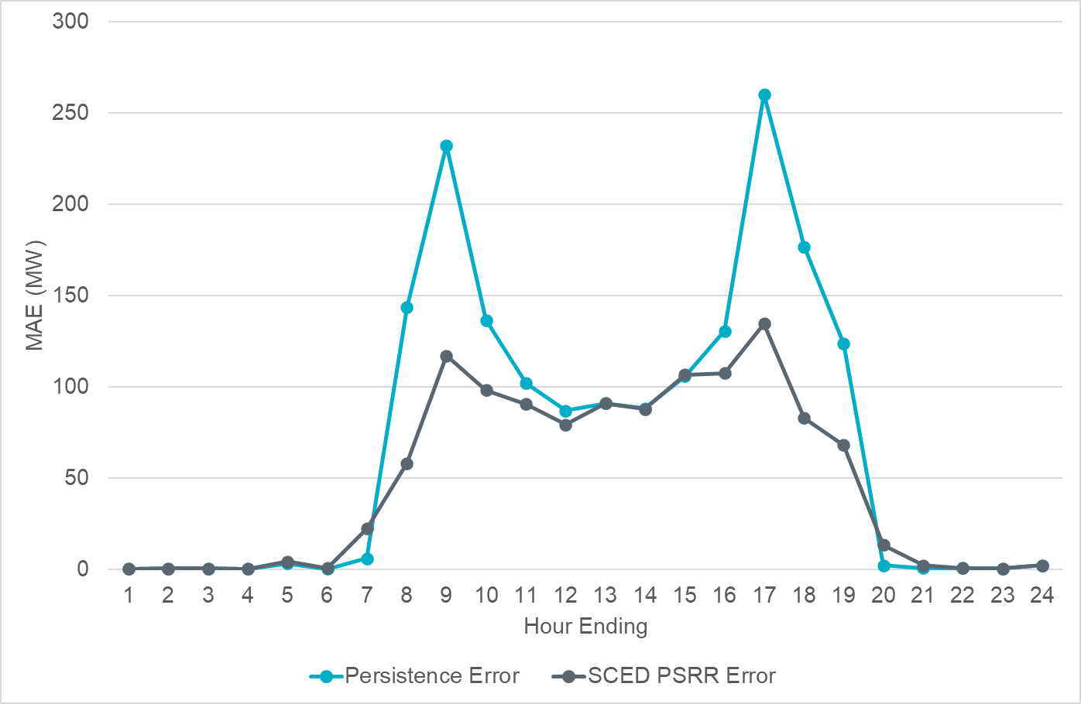
Projected Solar Ramp Rate MAE
Notes:
For intra-hour solar ramp forecast, SCED PSRR is performing significantly better especially during the solar up ramp and down ramp hours compared to the persistence forecast

Slide 7
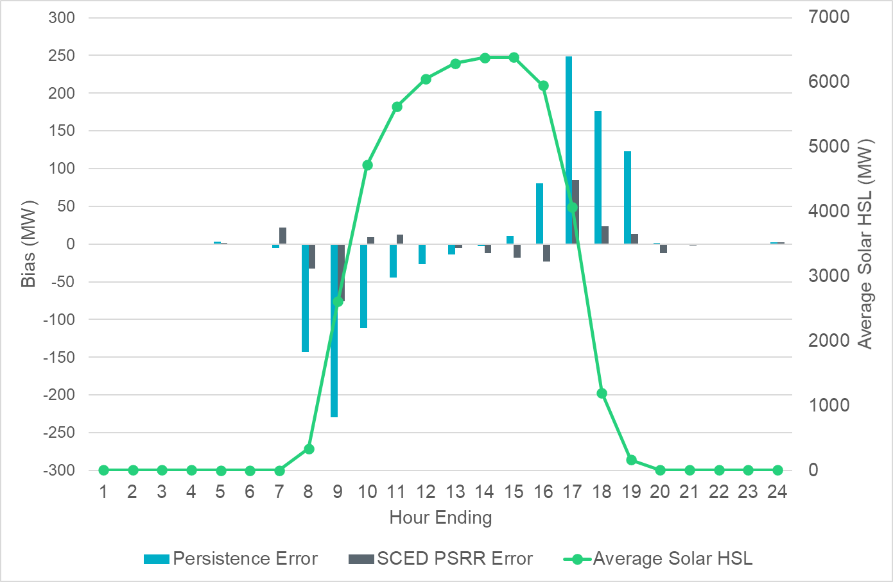
Projected Solar Ramp Rate Error
Notes:
Similar to wind, generally we see bigger forecast errors during ramping periods.

Slide 8
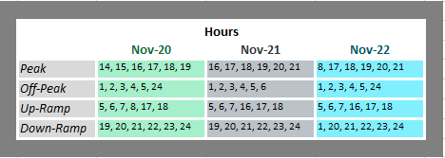
References

Slide 9
Metrics to Measure SCR-773 Performance
Trend and monitor the regulation deployed by hour.
Set target of 50 MW for total regulation deployed by hour for peak hours.
Set target of 85% for the number of intervals where regulation deployment was both up and down for peak hours.
Track the Regulation exhaustion rate for all hours (not to exceed 5%).
Using a 50MW filter, target 15 occurrences or less per month for regulation bias of six or more consecutive 5 minute intervals for peak hours.

Slide 10
Total Regulation Deployed Comparison
Total regulation deployed for the last three months.

Slide 11
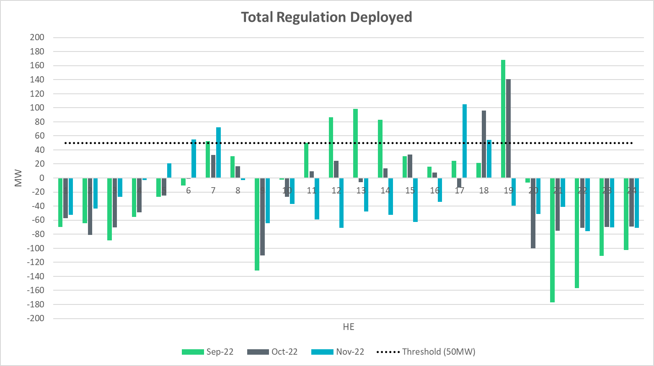
Total Regulation Deployed Comparison - Monthly
Notes:
Total regulation deployed comparison in the last 3 months: Overall the trends have been very similar. The most reg reg up deployment occurs during HE 17 instead of HE19 due to sunset shifting.

Slide 12
Metric 1: Regulation Deployed Comparisons
Trend and monitor the regulation deployed by hour.

Slide 13
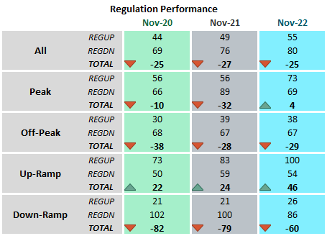
Regulation Deployed Comparison

Slide 14
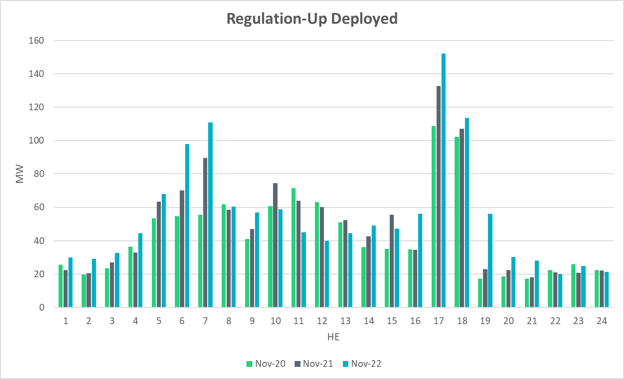
Regulation Deployed Comparison
Notes:
Overall Regulation up deployment in November is consistent with that of previous two years. More deployment in the morning and evening due to solar ramps.

Slide 15
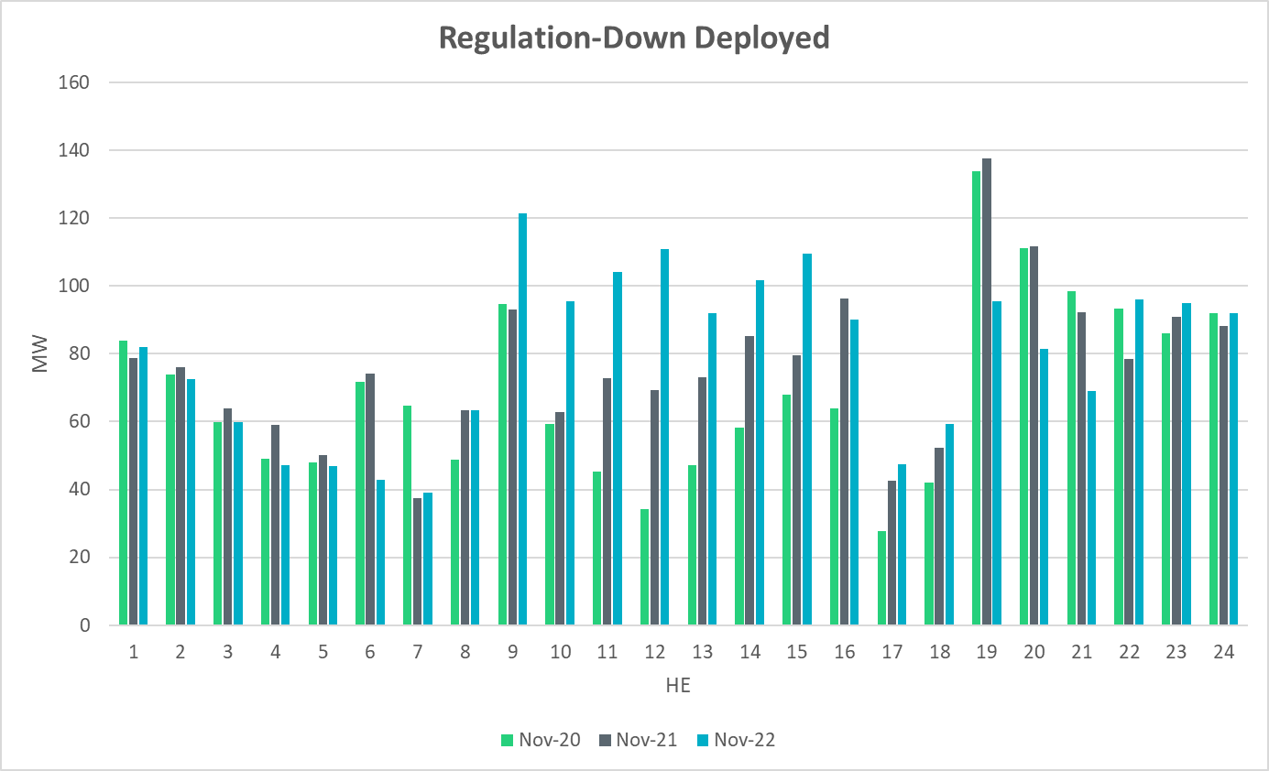
Regulation Deployed Comparison
Notes:
The increase in reg-down deployment in the middle hours of the day is due to higher than normal hourly wind generation, primarily.

Slide 16
Metric 2: Total Regulation Deployed Comparisons
Set target of 50MW for total regulation deployed by hour for peak hours.

Slide 17
Total Regulation Deployed Comparison
Notes:
Total regulation deployed compared with pervious two years. More reg up deployed during sunrise/sunset and more reg down deployed during the day.

Slide 18
Metric 3: 15-min Intervals Where Both REGUP/REGDN Were Deployed
Set target of 85% for the number of intervals where regulation deployment was both up and down.

Slide 19
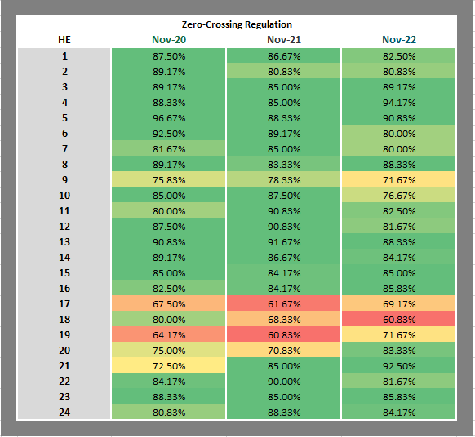
“Zero” Crossing Regulation
Notes:
For zero crossing regulation usage, the smaller zero-crossing reg percentages occurred during large solar/wind ramp hours., particularly in the evening, remaining consistent with prior years.

Slide 20
“Zero” Crossing Regulation
Notes:
Overall, generally very consistent with the previous two years.

Slide 21
Metric 4: Regulation Exhaustion Rate
Track the regulation exhaustion rate for all hours (not to exceed 5%.)

Slide 22
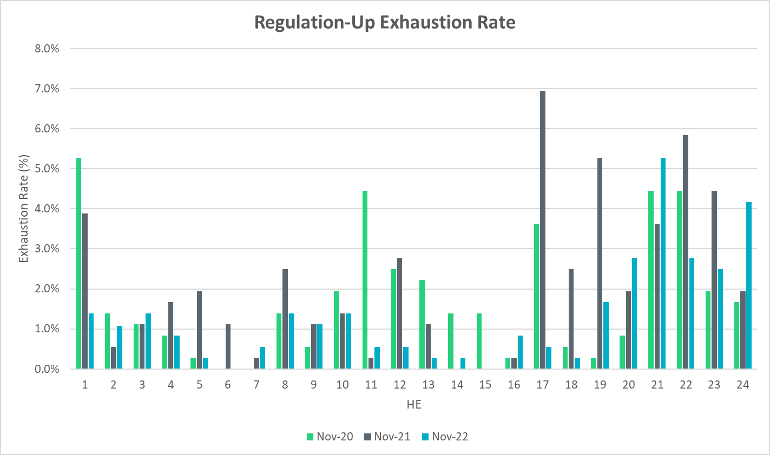
Regulation Exhaustion Rate
Notes:
Average regulation up exhaustion rate for all hours is 1.33%

Slide 23
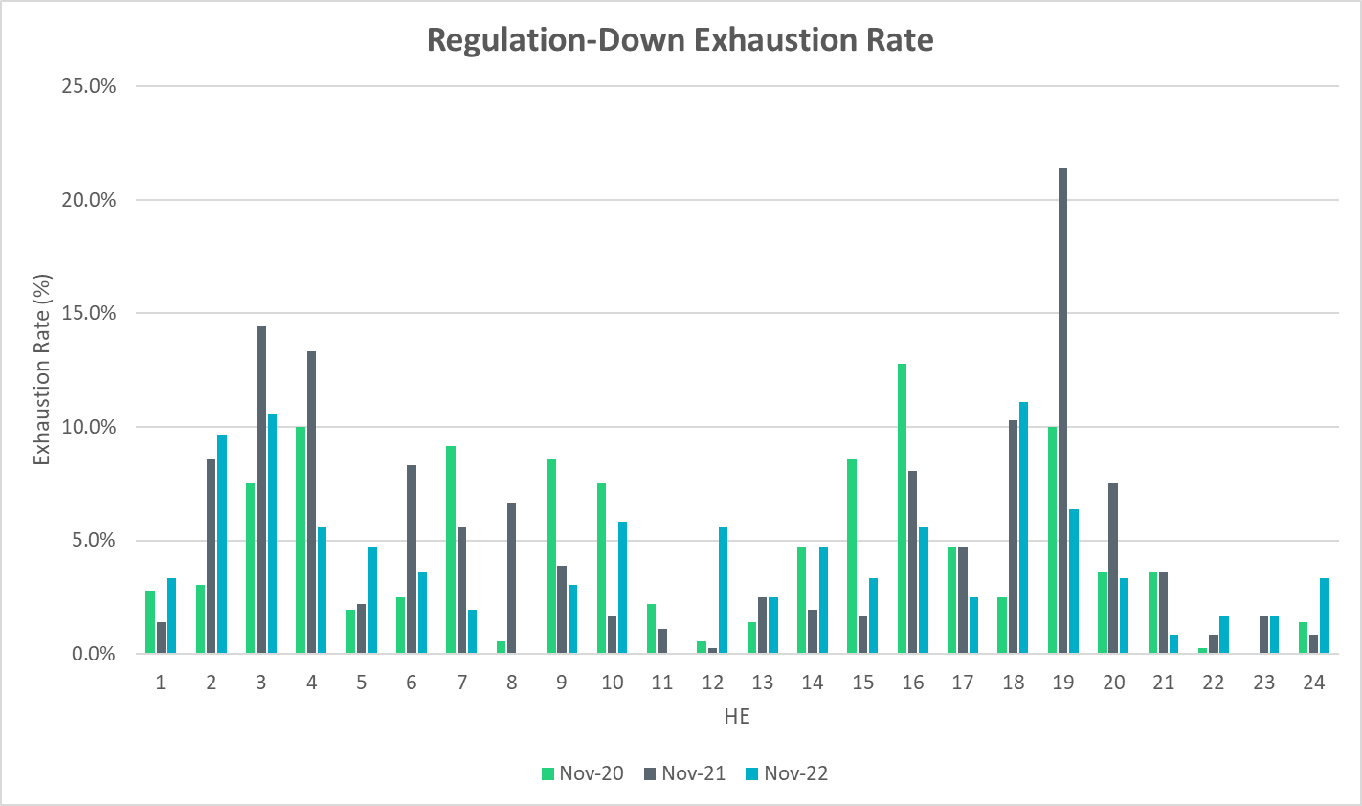
Regulation Exhaustion Rate
Notes:
Average regulation down exhaustion rate for all hours is 4.20 %

Slide 24
Metric 5: Stats on REGUP Bias for Consecutive 5-min Intervals
Using a 50MW filter, target 15 occurrences or less per month for regulation bias of six or more consecutive 5-minute intervals for peak hours.

Slide 25
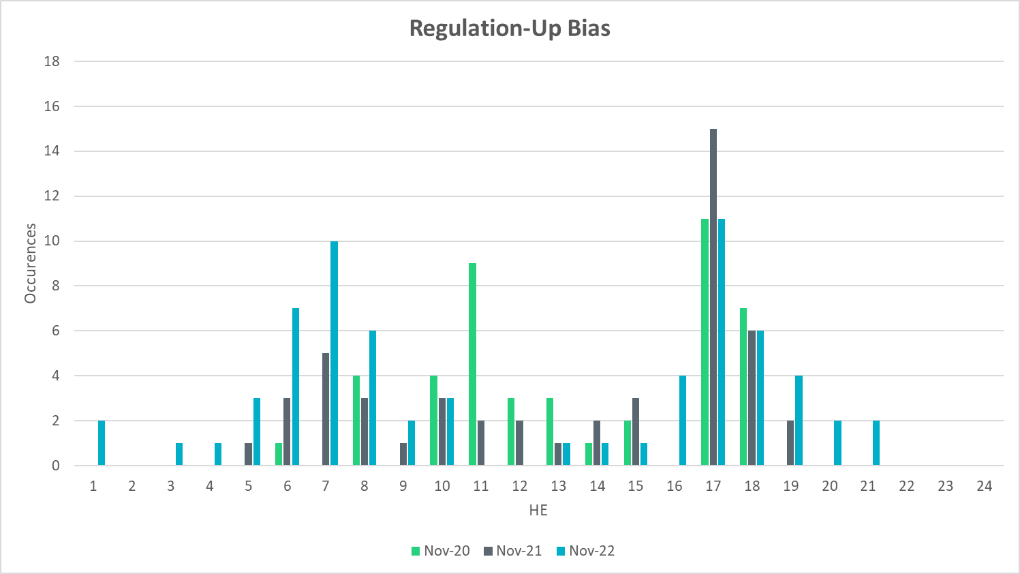
Regulation Bias for Consecutive SCED Intervals
Notes:
Regulation up bias occurrence for consecutive SCED intervals for all hour is 67 and 31 for peak hours.

Slide 26
Regulation Bias for Consecutive SCED Intervals
Notes:
Regulation down bias occurrence for consecutive SCED intervals for all hour is 129 and 36 for peak hours.

Slide 27
Time Error and Contributing Factors
Accumulated Time Error, Load and Wind Ramp, PWRR Error, Start-Up/Shut-Down Hours, STLF Error, and Expected Generation Deviation.

Slide 28
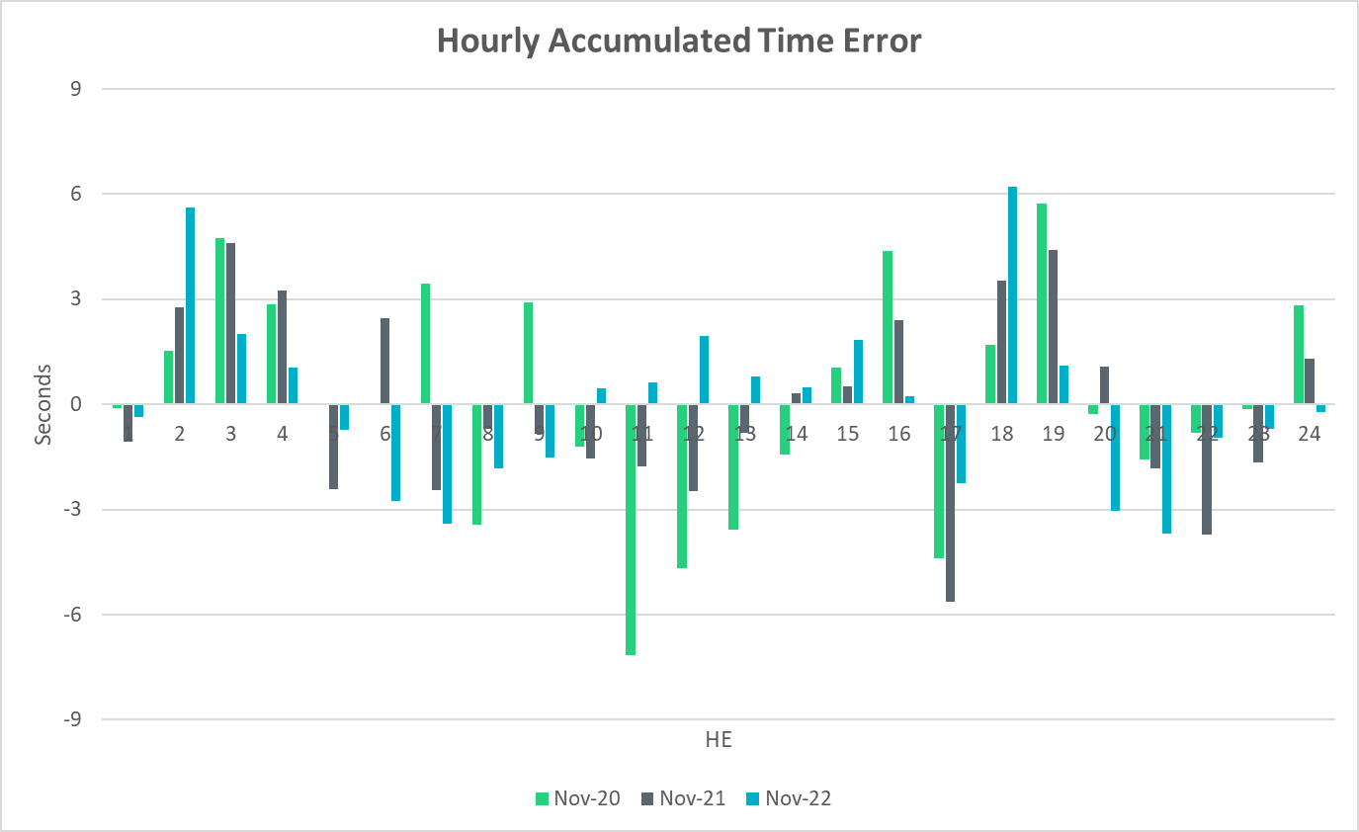
Time Error Accumulation
Notes:
The trend of hourly time error accumulation is fairly similar compared with last years, with overall no significant amount being accumulated.

Slide 29
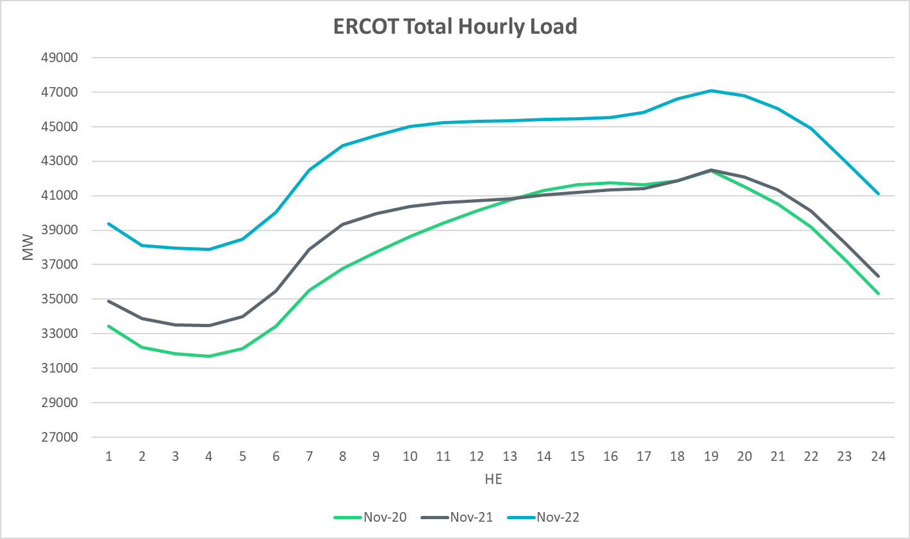
Load Profile
Notes:
Nov load this year is consistently higher than that of the last two years.

Slide 30
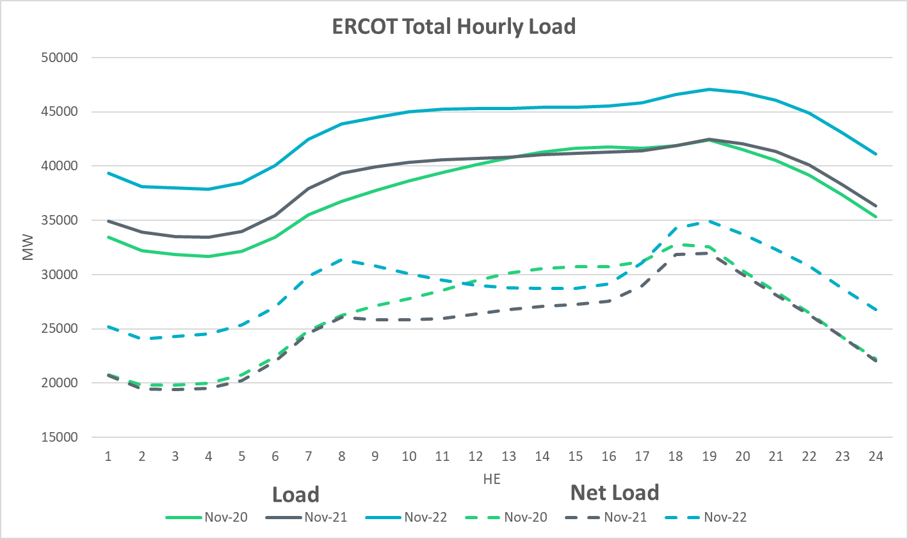
Net Load Profile
Notes:
Nov net load is close to that of last year during the day and during the evening hours, and a bit higher overnight and prior to sunrise.

Slide 31
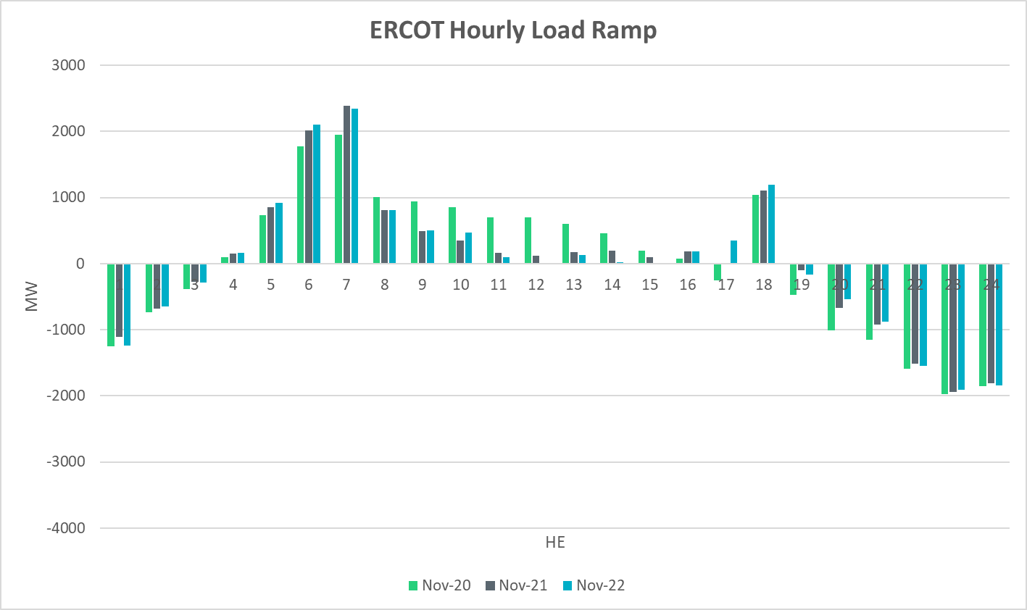
Load Ramp
Notes:
Hourly load ramp is on par with last years’.

Slide 32
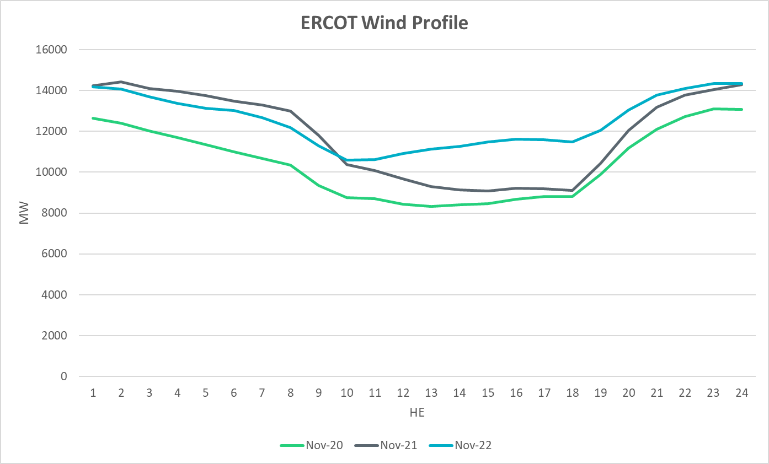
Wind Profile
Notes:
Hourly wind generation is fairly consistent with last year’s, with an increase during the day time hours.

Slide 33
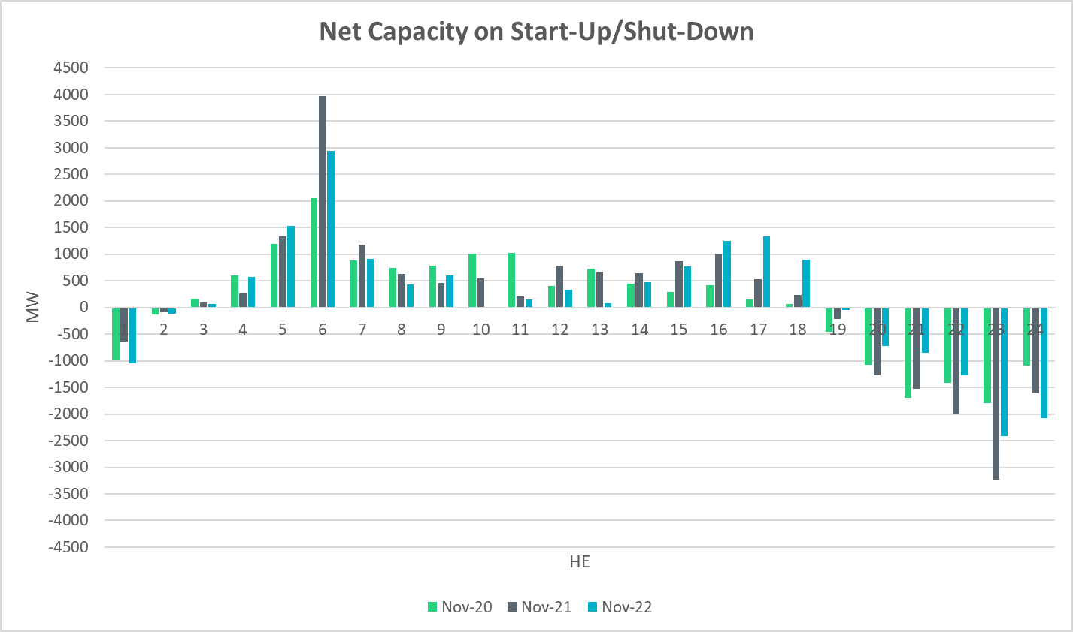
Start-Up & Shut-Down Hours
Notes:
Net capacity on start up and shut down is fairly consistent with last two years, with an increase in the late afternoon hours in anticipation of the solar down-ramp.

Slide 34
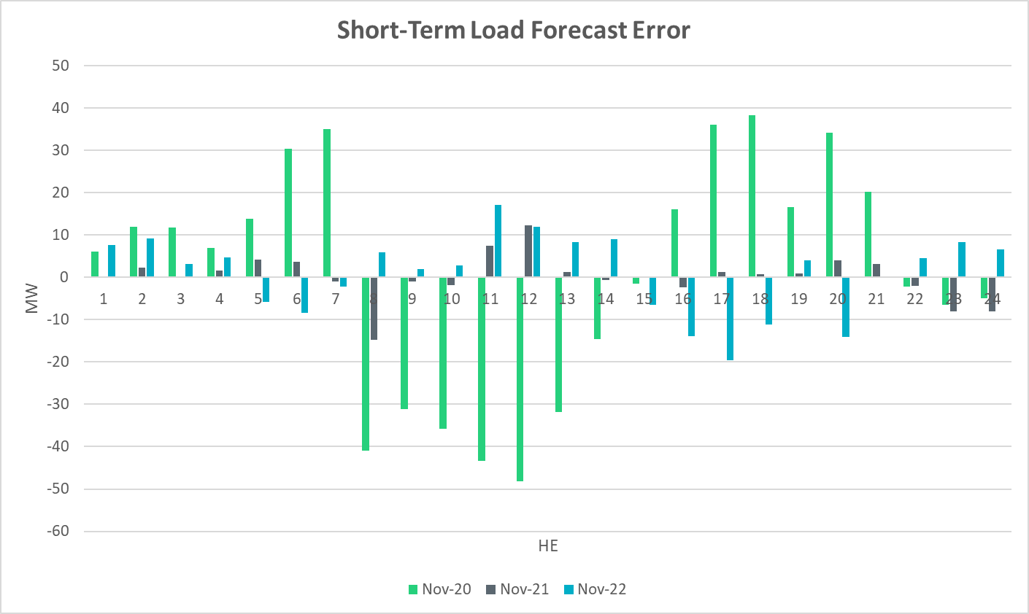
Short-Term Load Forecast Error
Notes:
Forecast – Actual
+ve Error => Over forecasted load
-ve Error +> Under forecasted load
STLF error this month is in the same range of last years’.

Slide 35
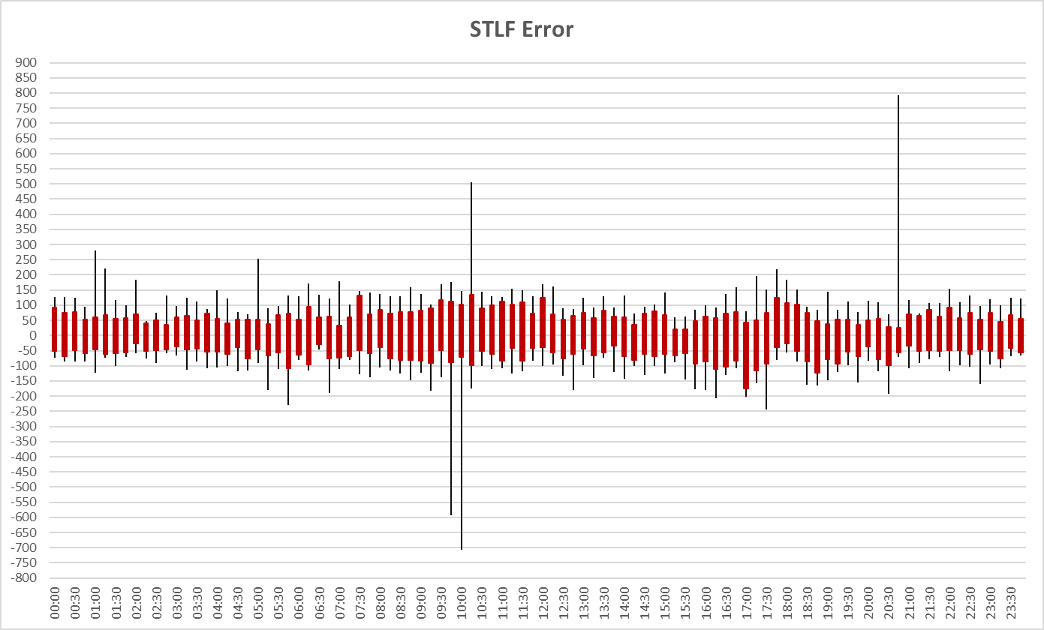
STLF Error Chart
Notes:
Error = Forecast – Actual
Min,Max, 10th, 90th percentile
15 minute intervals
Max Positive Forecast Error:
11/20/2022 20:45 -> 791.60 MW
Max Negative Forecast Error:
11/4/2022 10:00 -> -708 MW

Slide 36
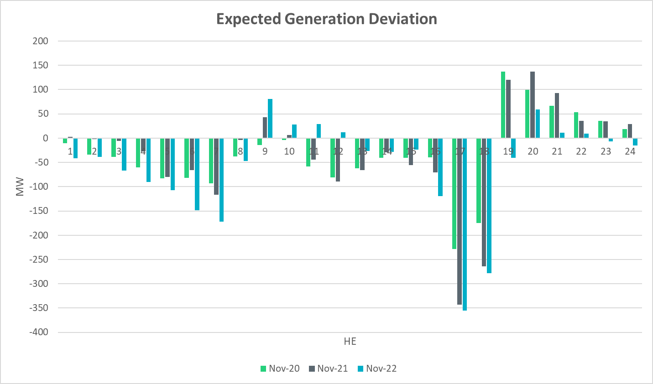
Expected Generation Deviation
Notes:
A Breakdown by resource type and we see significant contribution from wind and solar during the ramping hours

Slide 37
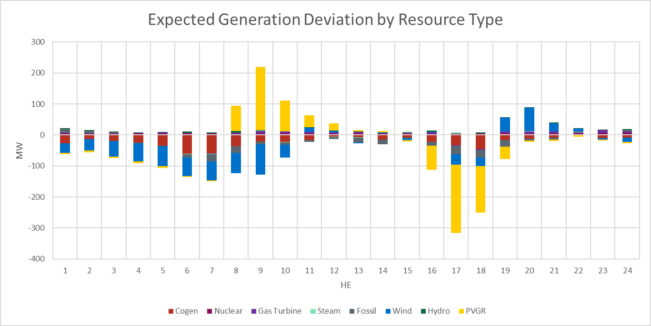
Expected Generation Deviation
Notes:
A Breakdown by resource type and we see significant contribution from wind and solar during the ramping hours

Slide 38
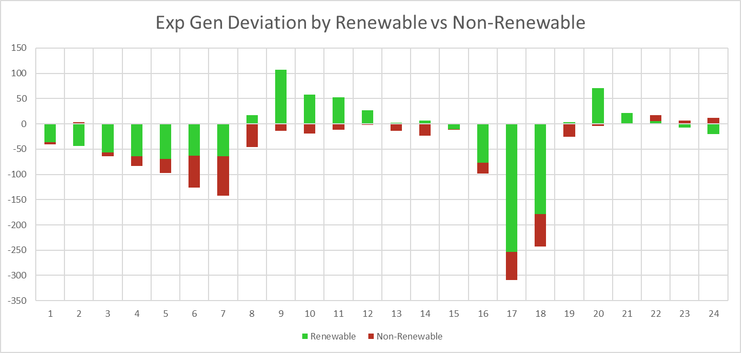
Expected Generation Deviation
Notes:
Comparing renewables vs non-renewables. Again, IRR resources are the main contributor for most part of the day.

Slide 39
Questions?
Thank you!

