Slide 1
Resource Integration & On-going Operations - Resources Services
(RIOO-RS)
Project Update
15 December 2022

Slide 2
RIOO-RS & RIOO-IS Updates - 2022
02/04 RIOO-IS Release – added payment feature for Small Generators & DGRs in the system
3/11 RIOO-IS Release – added missing Additional Generation flow
6/03 RIOO-IS and RIOO-RS Releases – Defect fixes
RIOO-IS – Payment issues, RARF attestation
RIOO-RS – Updated validation rules
12/09 RIOO-IS and RIOO-RS Releases
Add create screens to RIOO-IS, this eliminates the need to attach RARF spreadsheets
Add SODG and LRs to RIOO-IS and RIOO-RS
Defect fixes for RIOO-RS
12/16 RIOO-IS and RIOO-RS Releases – Defect fixes

Slide 3
Future Effort
1Q2023 Release
ESR
Generator modifications (Repowers)
Defects

Slide 4
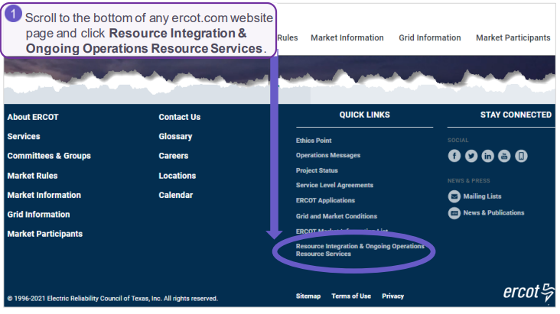
RIOO- RS FAQ
What is the link to RIOO-RS?
The link for RIOO-RS is located on ercot.com and is: https://sa.ercot.com/rioo-rs/

Slide 5
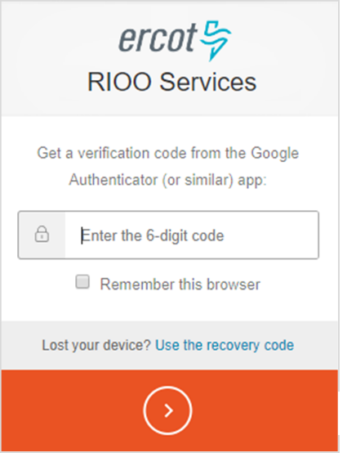
RIOO-RS FAQ
Does RIOO-RS use a digital certificate?
No.
What role do I need and how do I get it?
Your company USA should provide the RIOORS_M_Operator in order to gain access to RIOO-RS for every DUNs.
This role is for Resources only; do not use it if not a Resource.
Getting prompted to log-in, circular problem?
Make sure that the “Remember this browser” box is checked.
Do not use the incognito feature.

Slide 6
RIOO-RS FAQ
Why do I have errors on things I did not change?
May have errors on first Change Request in the system
Caused by update validation rules and migrated data
What do I do if I can’t see my resources?
Check with your USA, ensure RIOORS_M_Operator role has been added to desired DUNS
May need to use two emails if have more than 15-20 DUNs numbers
Still can’t see? Send info to RIOO-HELP@ercot.com
Email used for accessing RIOO-RS
DUNS number of missing resource
We can also set up a WebEx to trouble-shoot the issue
New generators will not see their information in RIOO-RS until the model date

Slide 7
RIOO-RS FAQ
How do I know if I have access?
This user only has access to RIOO-RS since RIOO-IS is greyed out.
I have multiple email addresses, how should my access be set up?
If you intend to use multiple addresses then your USA has to provide the RIOO_M_Operator for each email address in addition to associating the DUNs for each Resource with the email address. Once this is done, each email account must go through the verification process.
Can Dynamic Model files be submitted via RIOO?
Yes, RIOO has a section that accepts attachments.

Slide 8
RIOO-RS FAQ
I have not been able to set up access, what do I do?
Can’t access the system: Contact the Help Desk
Questions: RIOO-HELP@ercot.com
We can also set up a WebEx to trouble-shoot the issue
My phone number has changed, what do I do?
Send an email to RIOO-HELP@ercot.com; let us know your number has changed. You may also reach out to your account manager.
The Multi-Factor Authentication (MFA) associated with your phone number will need to be re-set.
Once MFA is reset, you will receive an email with an ENROLL YOUR DEVICE button that you click to display the ERCOT Authentication Method page and set up your MFA app and device again.
I’m getting a weird error?
Please send a screen shot to RIOO-HELP@ercot.com.

Slide 9
RIOO Demo
Demo

Slide 10
Discussion
or
Questions
Backup slides follow

Slide 11
RIOO-IS and RIOO-RS
RIOO-IS – Interconnection Services (sa.ercot.com/ginr/)
Allows users to start the interconnection process.
Access – email / password and MFA
Interconnecting Entities (IEs) must self-register
RIOO-RS – Resource Service (sa.ercot.com/rioo-rs/)
Allows REs to update data for generators that are already interconnected to the ERCOT grid.
Access - email / password and MFA (NOT a digital certificate)
REs – Role from USA: RIOORS_M_Operator

Slide 12
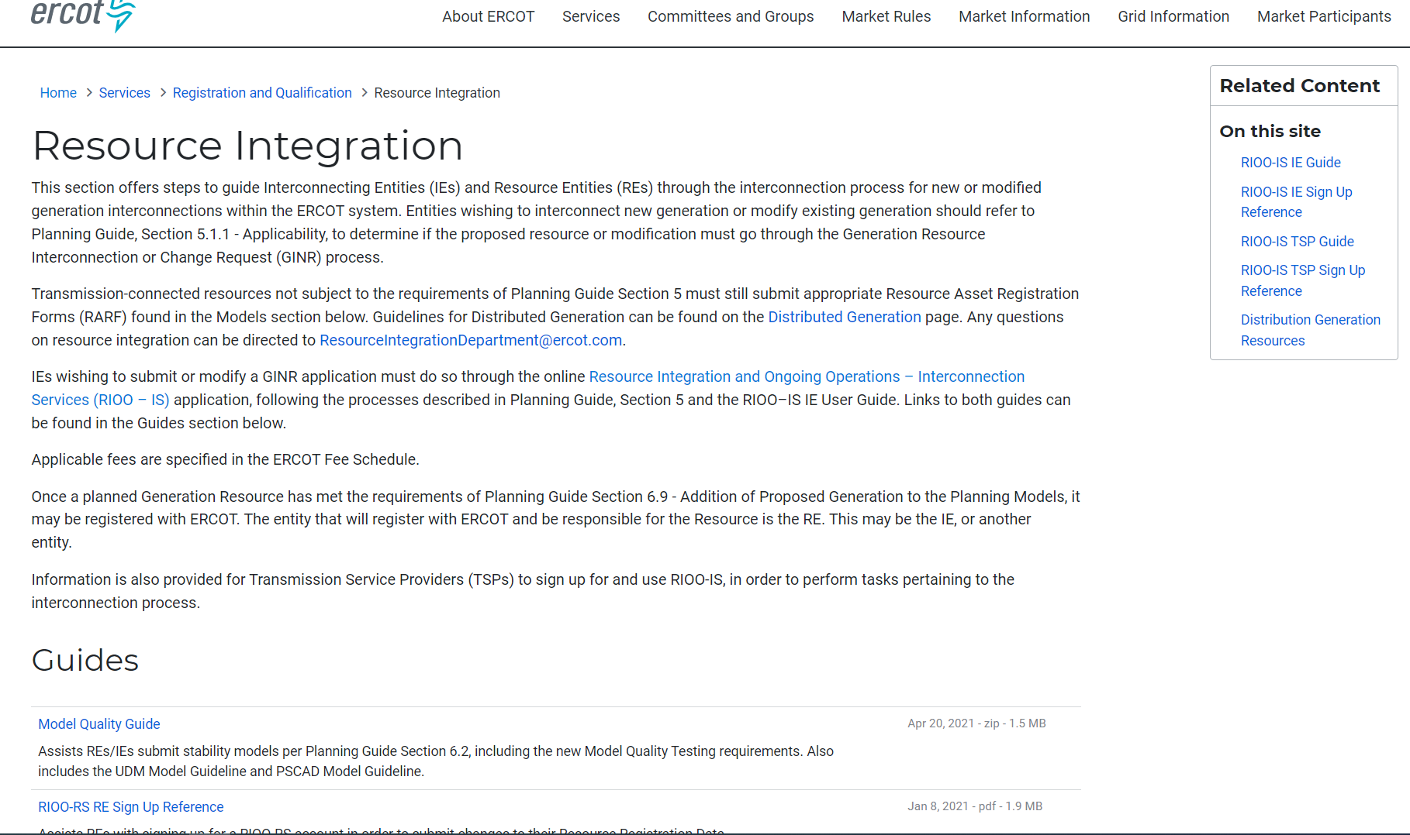
RIOO- RS is live – how do I get access?
The RIOO-RS sign-up reference is available here: http://www.ercot.com/services/rq/integration

Slide 13
How to get access - Checklist
The user:
Gets the role “RIOORS_M_OPERATOR” from his/her USA
Gets an email
Clicks on “Verify my account” button
Types in URL for the system
Clicks “Don’t remember your password” button
Gets a change password email
Clicks on change my password button
Changes his/her password
Types in URL for the system, sign with user-id / password
Setups authentication
Scans code or enter mobile phone for SMS
Saves Recovery code
Confirms authorization method (Google Authenticator/ Auth0 guardian/SMS)
Get an email
Click on verify my account button
Access the RIOO-RS, sign with user-id / password

