Slide 1
ERCOT Frequency Control Report
November 2022
ERCOT
Operations Planning
PDCWG | December 15th, 2022

Slide 2
Summary of November 2022
CPS1: 175.14%
Current CPS1 12-Month Rolling Average: 172.97%
0 BAAL Exceedance(s)
0 hourly CPS1 score below 100%
BAAL-003 Events have updated through 2020
2020 BAAL-003 FRM Performance: -789.34
2022 RMS1 Statistics
  Mean: 15.48 mHz
  Min: 12.43 mHz
  Max: 19.70 mHz
Energy Statistics
  Total Energy: 31,237,812 MWh
  Wind Energy: 8,999,066 MWh
  Percent Energy from Wind: 28.81%
  Solar Energy: 1,275,242 MWh
  Percent Energy from Solar: 4.08%
Minimum System Inertia
  Mean: 178,124 MW*s
  Max: 257,666 MW*s on Nov 20th
  Min: 133,918 MW*s on Nov 29th

Slide 3
Frequency Control
CPS1, BAAL, & RMS1

Slide 4
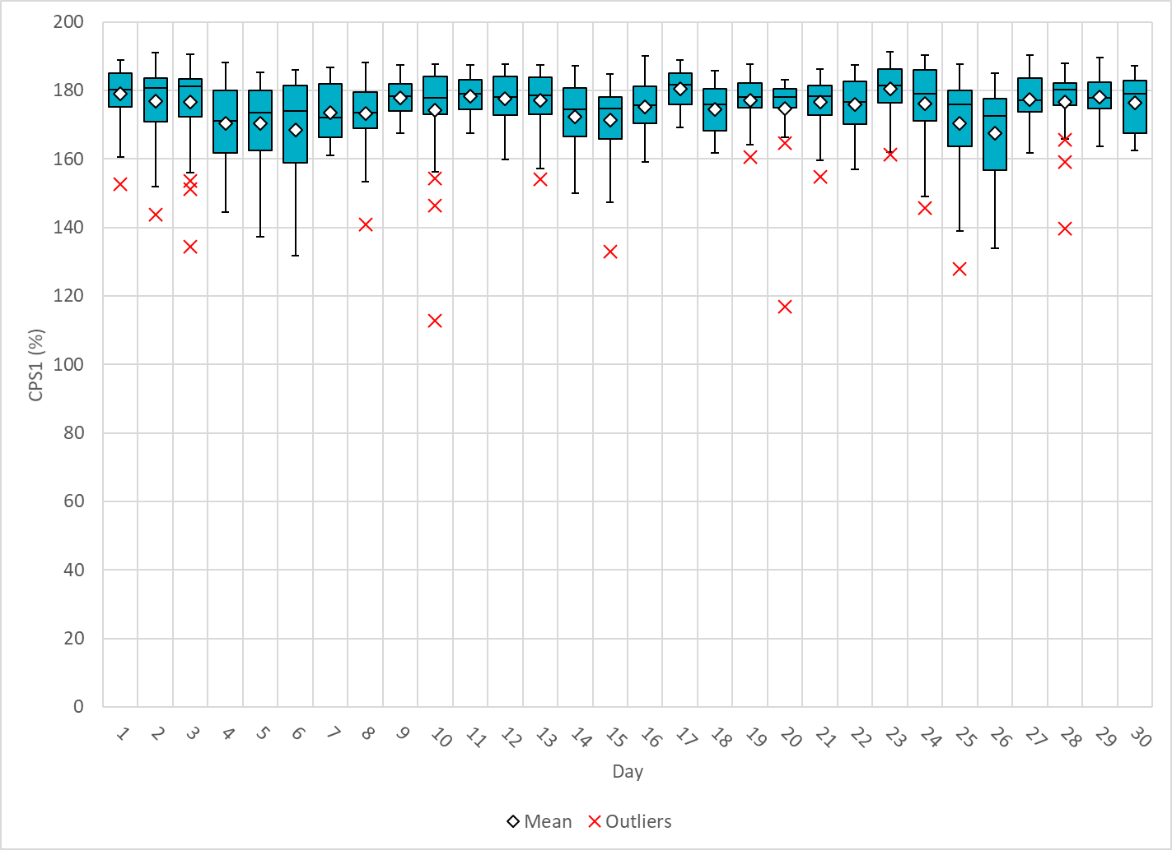
Hourly CPS1 by Day
Nov-22 CPS1 (%): 175.14

Slide 5
BAAL Exceedances & Violations
There were 0 BAAL exceedance(s) in November.

Slide 6
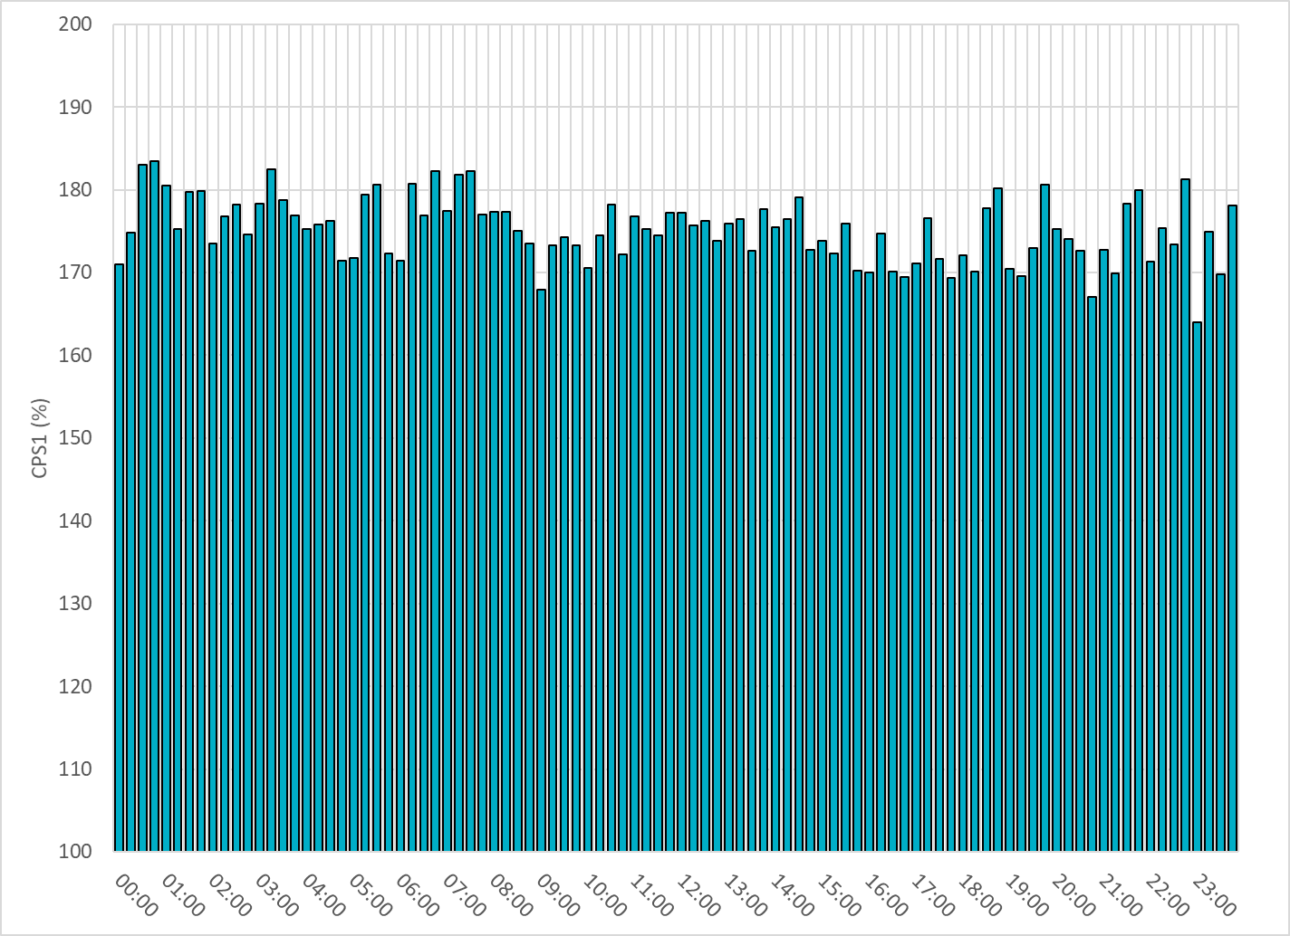
15-Minute Average CPS1%
Nov-22 CPS1 (%): 175.14
Notes:
Overall the 15 min CPS1 score is above 160, Between 18:00 and 19:00 ,the CPS1 is between 130 to 150 due to solar down ramps.

Slide 7
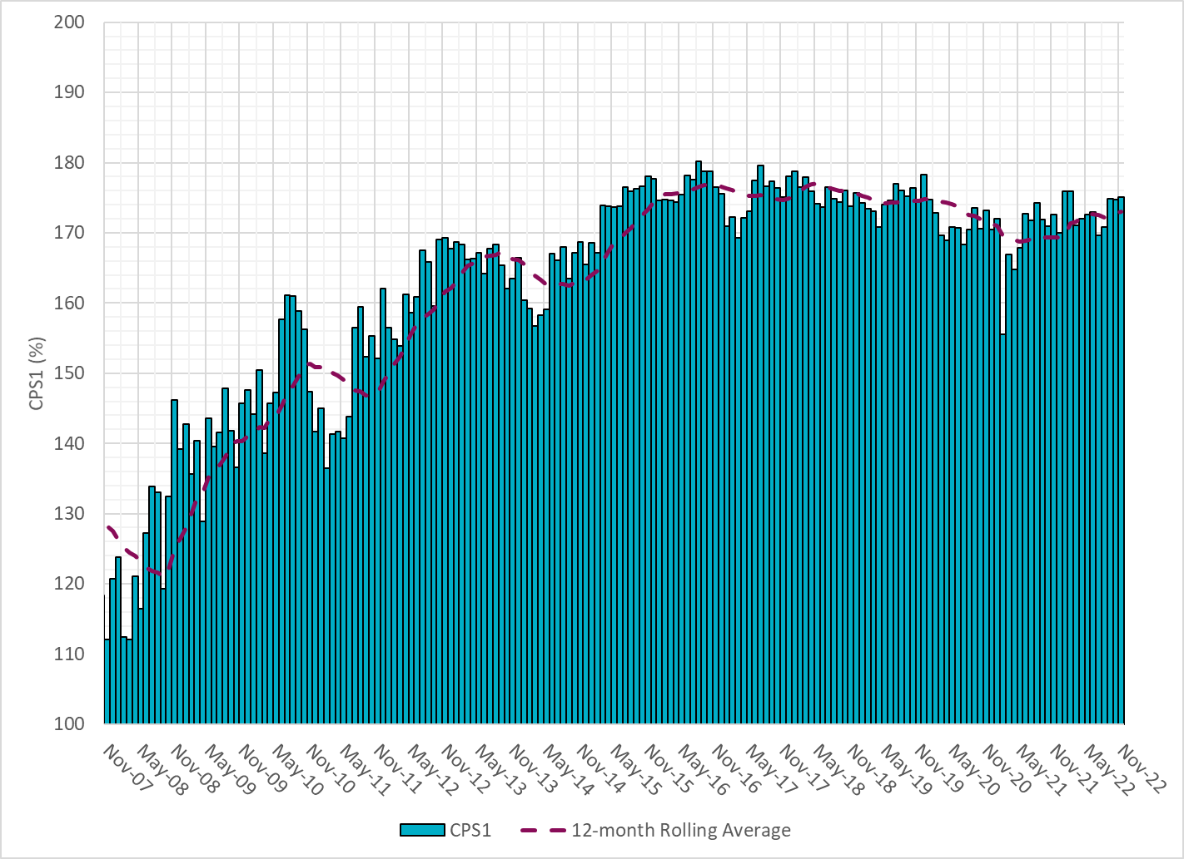
12-Month Rolling Average CPS1
Current 12-Month Rolling Average: 172.97%
Notes:
12 month rolling average CPS1 score is 172.97, which is good and CPS1 score for Sep is slightly higher than the last month.

Slide 8
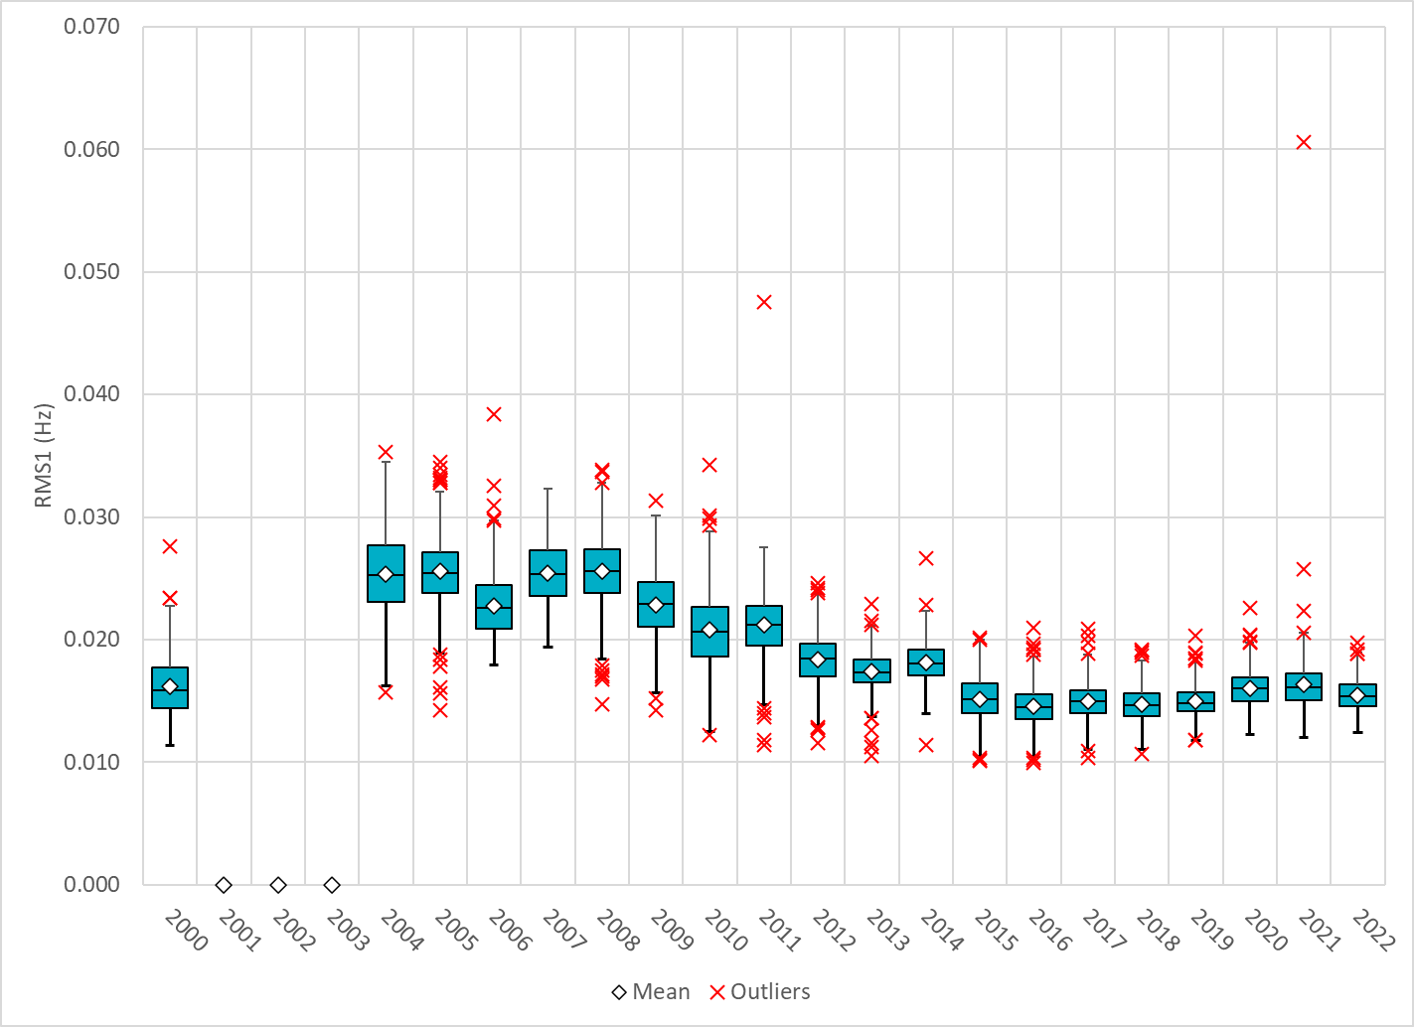
Daily RMS1 of ERCOT Frequency by Year
Notes:
Daily RMS1 frequency by year is so far slightly smaller overall compared with the 2021.
Mean: 15.48 mHz
Min: 12.43 mHz
Max: 19.7 mHz

Slide 9
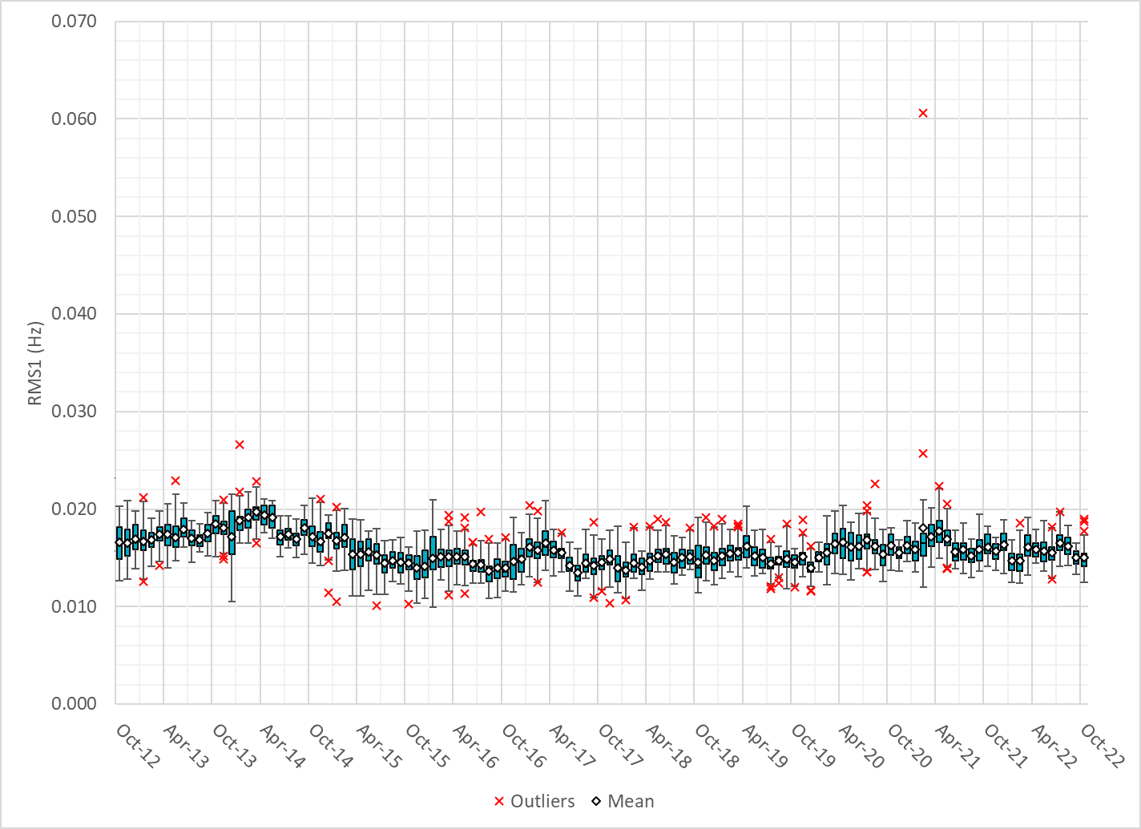
Daily RMS1 of ERCOT Frequency by Month
Notes:
A More granular look at last 10 years of RMS1 by month
14.92Mhz on avg for Nov 2022

Slide 10
Frequency Profile Comparison

Slide 11
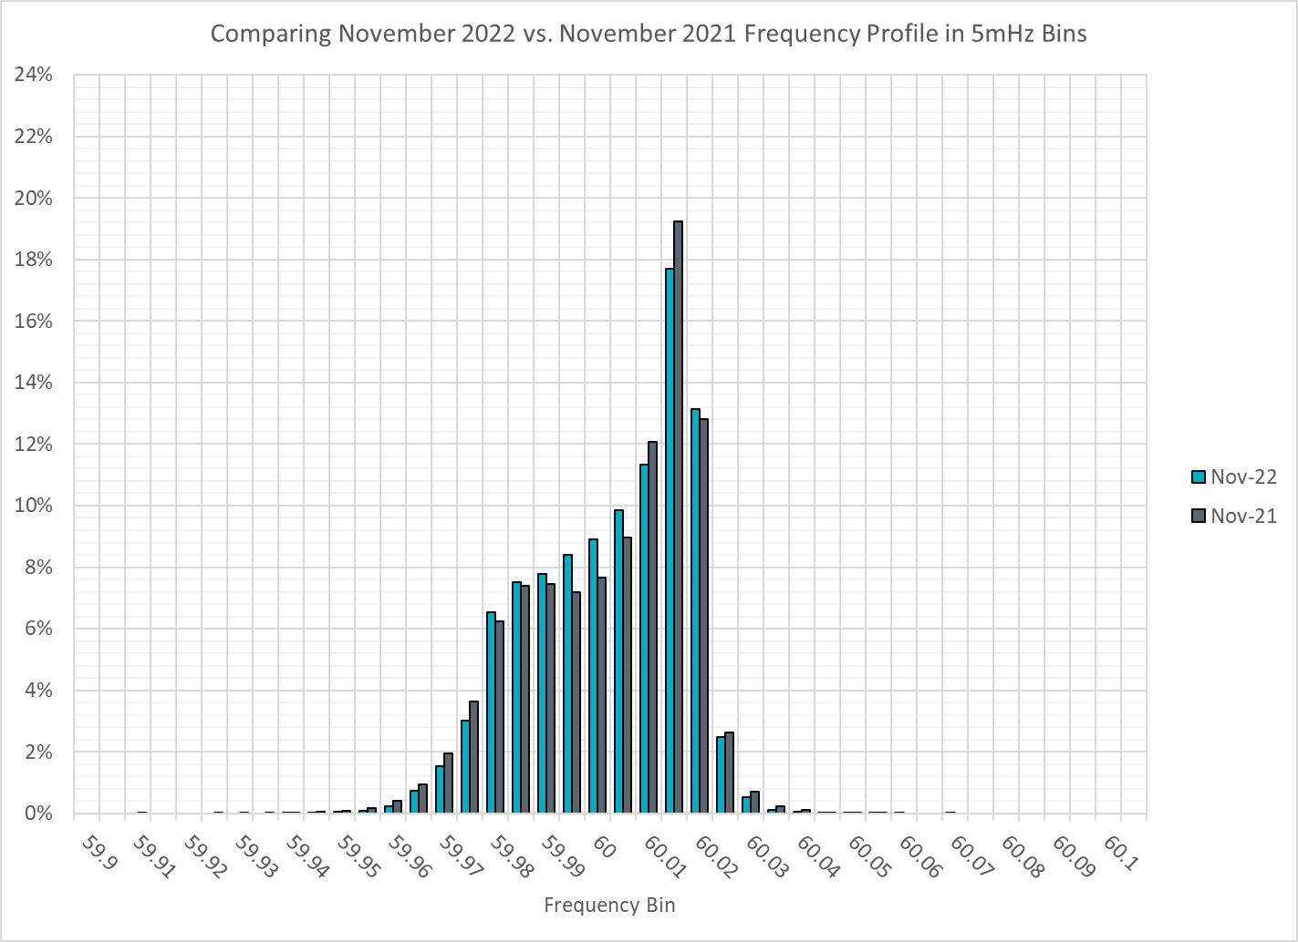
Frequency Profile Comparison
Notes:
Comparison of frequency profile between Nov 2021 and Nov 2022, we see a similar number of instances of frequency hovering at or below the lower deadband in Nov 2022.

Slide 12

Frequency Profile Comparison
Notes:
Some story when you compare frequency profile between Nov 2020 and Nov 2022, we see slightly fewer instances of frequency hovering at or below the lower deadband in Nov 2022.

Slide 13
Time Error Correction

Slide 14
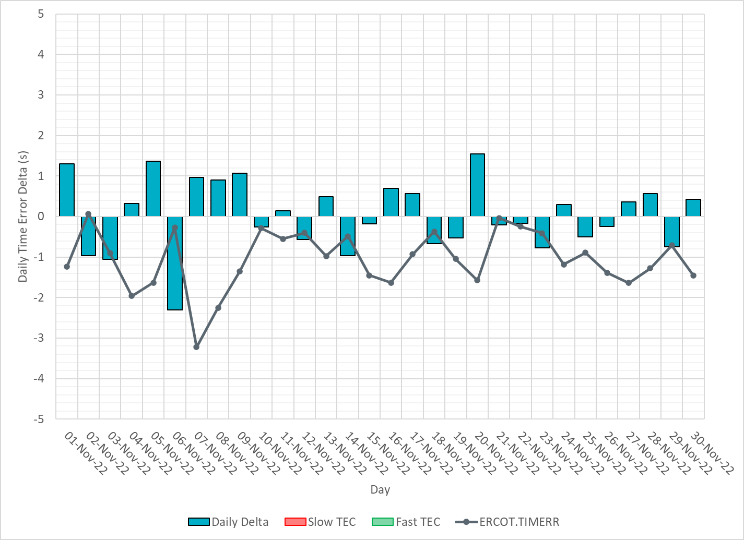
ERCOT Daily Time Error
Notes:
We did not make time error corrections and the time error was fairly small during the entire month of Sep.

Slide 15
Time Error Corrections Log Summary
There have been no time error corrections since December 2016

Slide 16
BAL-003 Performance

Slide 17
Op. Year 2020 BAL-003 Selected Events – Update
Notes:
BAL-003

Slide 18
Op. Year 2020 BAL-003 FRM Performance - Update
Notes:
OP2018: FRO = -381.0, FRM_median = -843.17, FRM_average = -959.7
OP2019: FRO = -381.0, FRM_median = -811.14, FRM_average = -892.5
OP2020: FRO = -425.0, FRM median = -789.34, FRM average = -879.0
OP2021: FRO =

Slide 19
ERCOT Energy Statistics

Slide 20
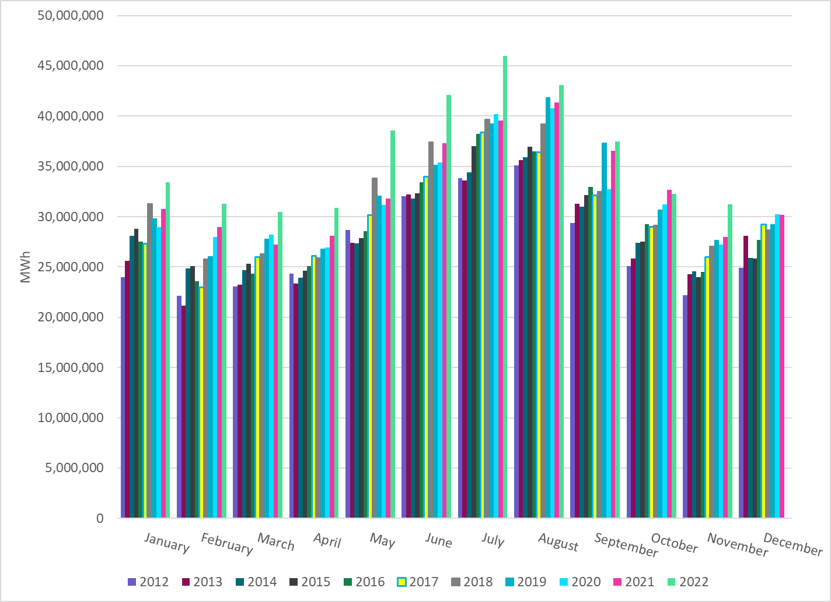
Total Energy
Notes:
31,237,812 MWh

Slide 21
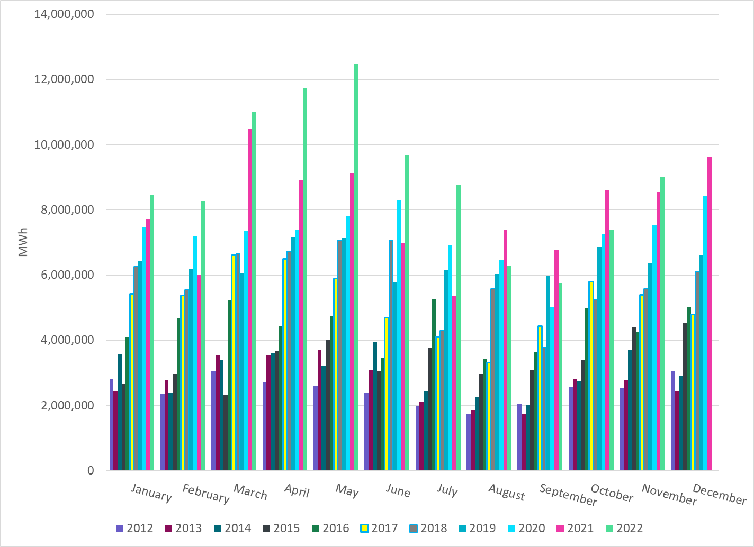
Total Energy from Wind Generation
Notes:
8,999,066 MWH

Slide 22
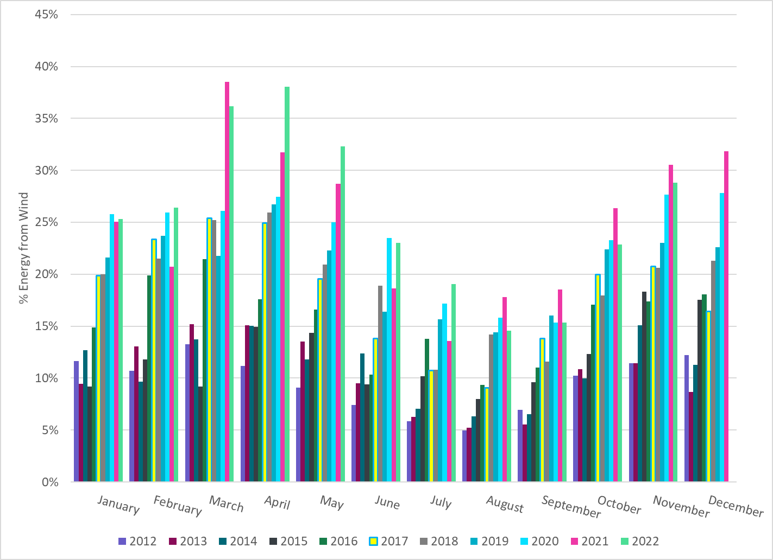
% Energy from Wind Generation
Notes:
28.81% of total energy was provided by wind generation

Slide 23
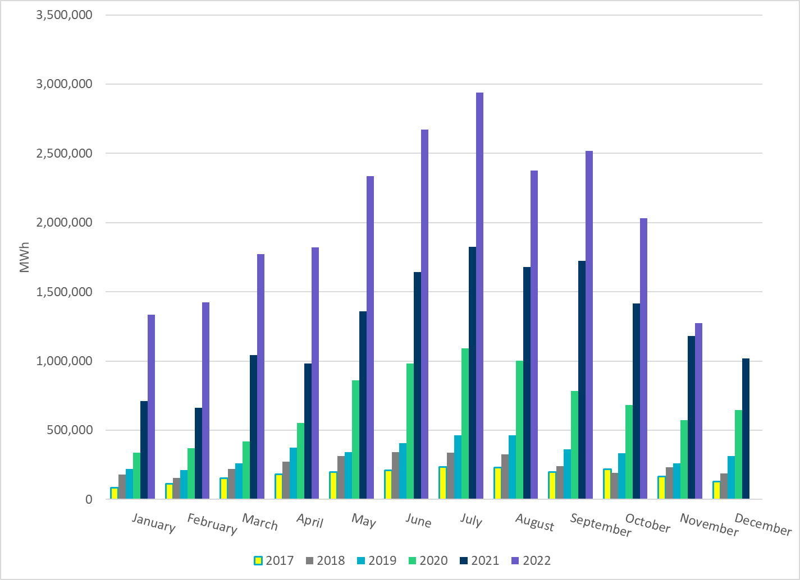
Total Energy From Solar Generation
Notes:
1,275,242 MWh

Slide 24
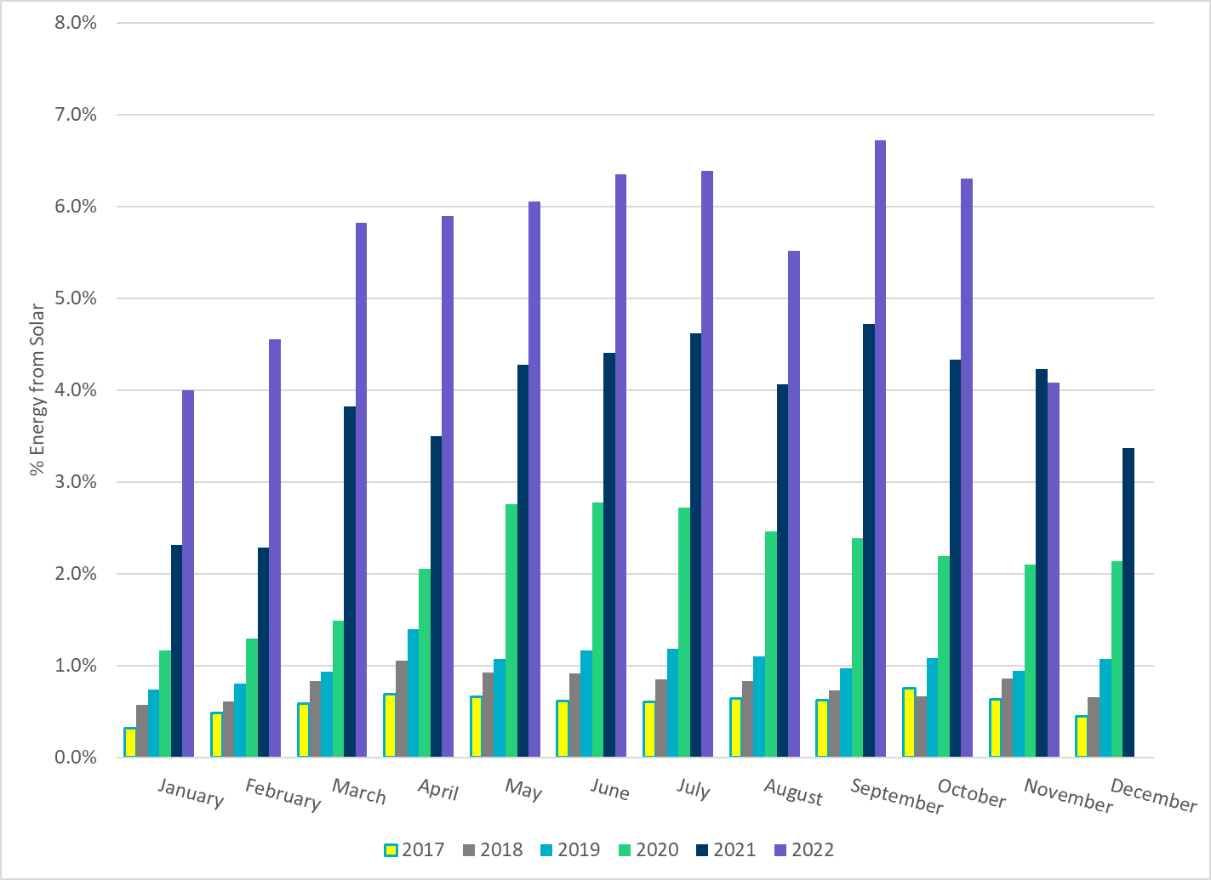
% Energy from Solar Generation
Notes:
4.08% of total energy was provided by solar generation.

Slide 25
ERCOT System Inertia

Slide 26
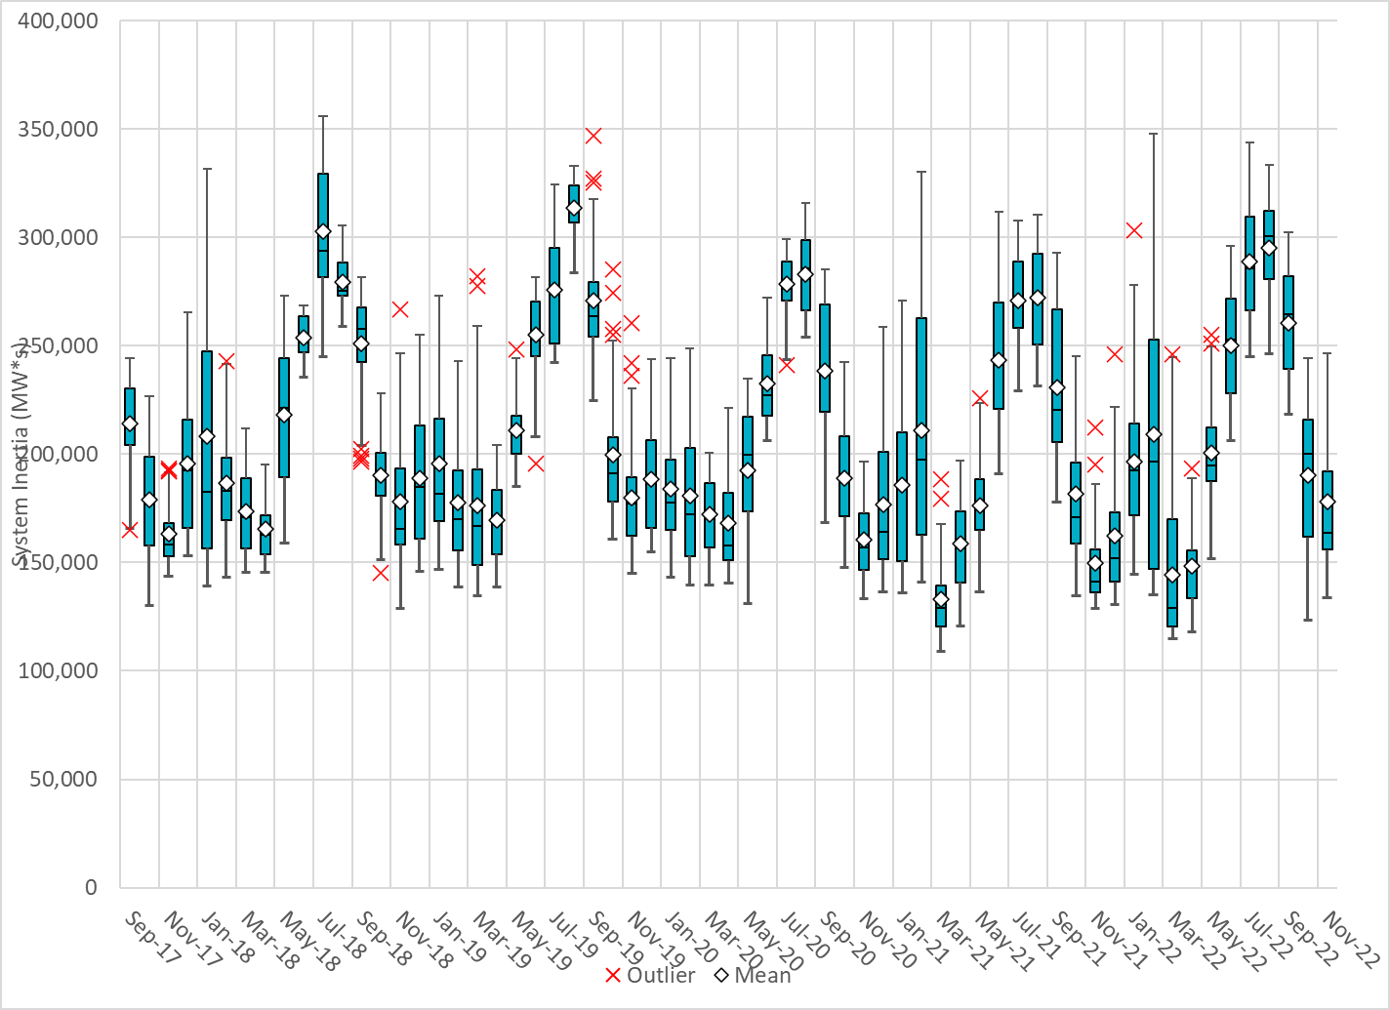
Daily Minimum System Inertia
Notes:
Minimum Inertia =133,918 MW*s on 11/29/2022
Previous Minimum was 109,029 MW*s on 3/22/2021
Data:
Mean: 178,124 MW*s
Max: 257,666 MW*s on Nov 20th
Min: 133,918 MW*s on Nov 29th

Slide 27
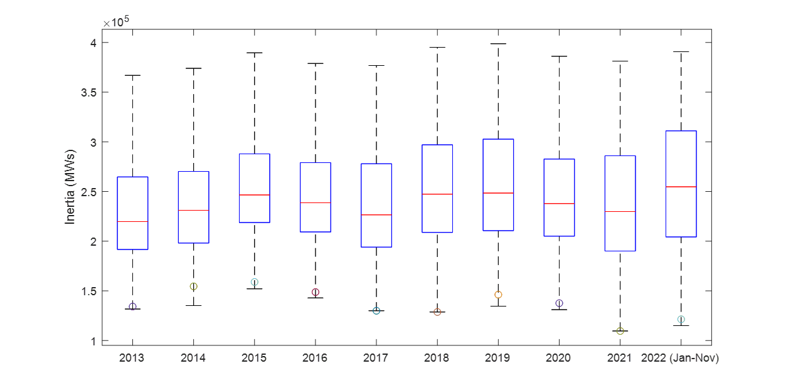
ERCOT Inertia 2013-2022(Jan-Nov)
Date and Time | 2013 3/10 3:00 AM | 2014 3/30 3:00 AM | 2015 11/25 2:00 AM | 2016 4/10 2:00 AM | 2017 10/27 4:00 AM | 2018 11/03 3:30 AM | 2019 3/27 1:00 AM | 2020 05/01 2:00 AM | 2021 03/22 00:00 AM | 2022 03/21 01:00 AM
Min synch. Inertia (GW*s) | 132 | 135 | 152 | 143 | 130 | 128.8 | 134.5 | 131.1 | 109 | 115
System load at minimum synch. Inertia (MW) | 24,726 | 24,540 | 27,190 | 27,831 | 28,425 | 28,397 | 29,883 | 30,679 | 32,599 | 33,365
Non-synch. Gen. in % of System Load | 31 | 34 | 42 | 47 | 54 | 53 | 50 | 57 | 65 | 66
Notes:
For each box, the central mark (red line) is the median, the edges of the box (in blue) are the 25th and 75th percentiles, the whiskers correspond to +/- 2.7 sigma (i.e., represent 99.3% coverage, assuming the data are normally distributed. The corresponding lowest inertia in each year is given in the table.
The circle on each boxplot is showing inertia during time when highest portion of load was served by wind/solar generation in that year.

Slide 28
Questions?
Thank you!

