Slide 1
ERCOT Frequency Events
November 2022
ERCOT
Operations Planning
PDCWG | December 15th, 2022

Slide 2
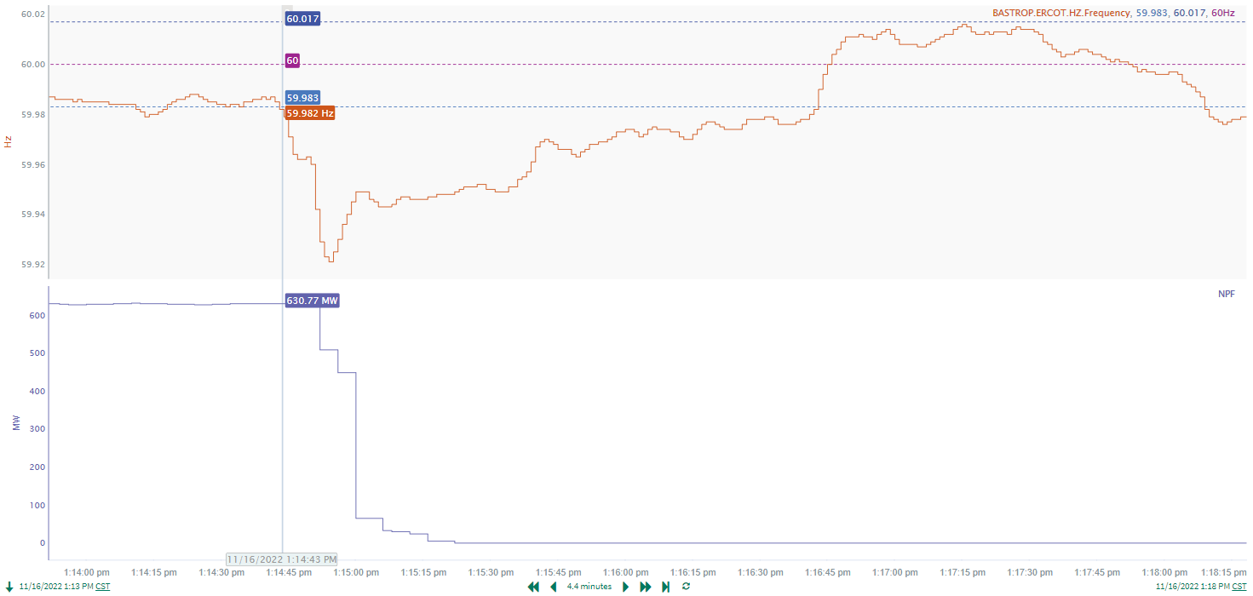
11/16/2022 13:14:43(Non-FME)
Notes:
The unit tripped offline while carrying approximately 631 MW
Starting Frequency: 59.983 Hz
Minimum Frequency: 59.921 Hz
A-C Time : 11 seconds
Recovery Time(back to deadband): 1 minutes 50 seconds
RRS Released: 0 MW
Trip Reason: Unknown at this time
Contextual Information: A total of 286 MW of regulation up was deployed during the event
No Selection Reason : The unit trip is not clean

Slide 3
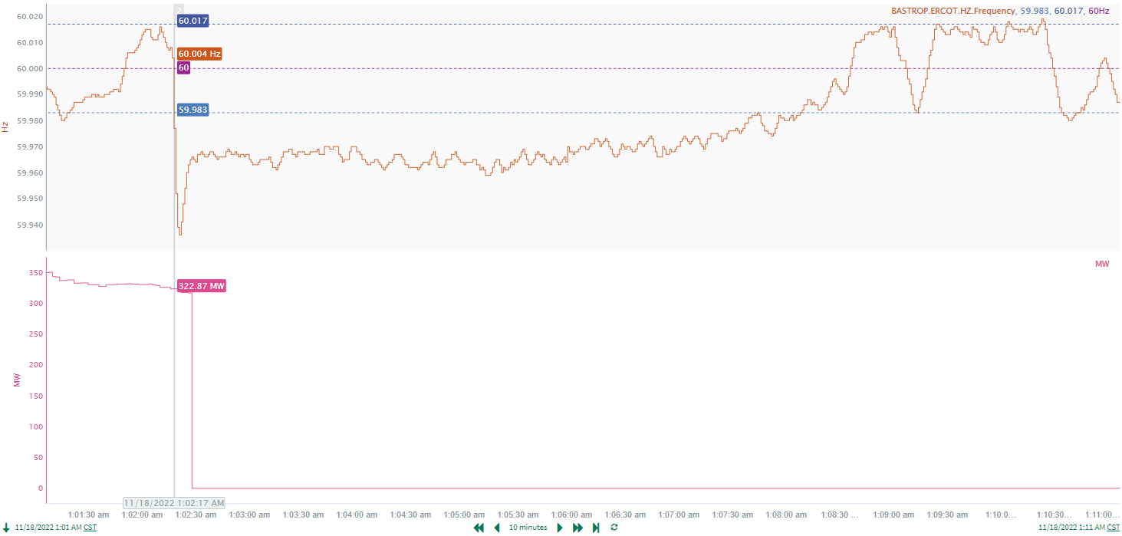
11/18/2022 1:02:17 (Non-FME)
Notes:
The unit experienced runback and tripped offline while carrying approximately 316 MW
Starting Frequency: 60.004 Hz
Minimum Frequency: 59.936 Hz
A-C Time : 4 seconds
Recovery Time(back to deadband): 5 minutes 47 seconds
RRS Released: 0 MW
Trip Reason: Back pressure
Contextual Information: A total of 163 MW of regulation up was deployed during this time
No Selection Reason: The unit trip is only 316 MW, Small event.

Slide 4
Questions?
Thank you!

