Slide 1
Operating Reserve Risk Model, Winter 2022-23 Results
Supply Analysis Working Group
Pete Warnken
Resource Adequacy
December 13, 2022
Notes:
Welcome to

Slide 2
EEA Risk Measure: Capacity Available for Operating Reserves (CAFOR)
CAFOR Formula:
  = Seasonal Maximum Expected Resource Generation Capability
  – Demand
  – Uses of Reserves*
  + Pre-EEA Resources if CAFOR < 3,000 MW
  + EEA Resources if CAFOR < 2,300 MW
* Uses of Reserves:
  Higher-than-expected peak demand
  Thermal unit outages
  Renewable generation below expected values

Slide 3
Model Updates

Slide 4
Model and Data Changes
Reflects resources in the Winter 2022-2023 SARA report
  Accounts for Battery Energy Storage capacity contribution
  Accounts for Large Flexible Load available as a curtailable resource (pre-EEA resource); co-located resource derate
Updated with wind and solar profiles developed this year (includes new 2021 weather-year profiles)
Added probability distribution for successful reduction of weather-related thermal outages due to weatherization standards
  Triangular distribution: likeliest reduction weight = 90%, minimum weight = 80%, maximum weight = 95%
  For the base amount of thermal unplanned outages (the amount not attributable to a Uri-type event), assumed that 10% were due to localized weather conditions, and therefore the outages can be reduced because of weatherization improvements

Slide 5
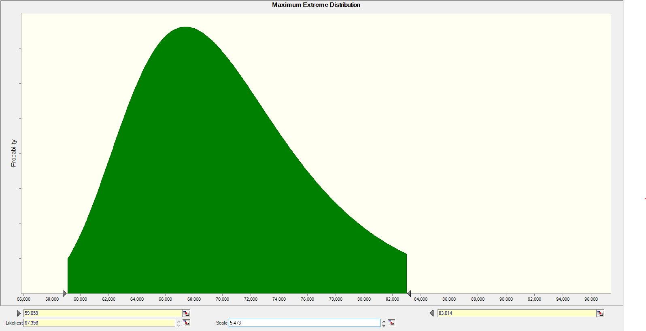
Model and Data Changes, Load Uncertainty
Load Forecast Probability Distribution for HE 8:00 AM
  Maximum Extreme Fitted Probability Distribution with likeliest value = 67,398 MW
Model selects a value from this 8:00 AM distribution; depending on the load level, one of three hourly patterns for 2/1/2023 forecast is used to determine load values for the remaining hours
Likeliest
Average

Slide 6
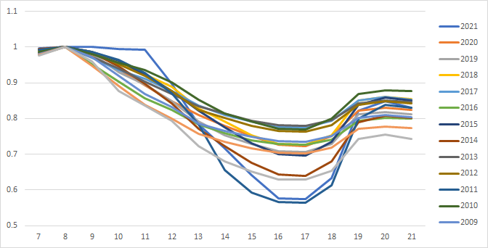
Model and Data Changes, Load Uncertainty
Load range thresholds determined from HE 8:00 AM values for 2009, 2011 and 2021 weather-year forecasts
  2021 weather for Uri-type event
  2011 weather for less severe winter storm or widespread extreme cold temps
  2009 weather for typical winter conditions
2009
2011
2021

Slide 7
Model and Data Changes, Price-Responsive Demand
Winter model updated to reflect incremental price-responsive demand reduction supply schedule approach adopted for the 2022 summer model (based on load level rather than CAFOR level)
  Data comes from 2021 Annual Report of Demand Response in the ERCOT Region (December 2021)
PRD Supply Schedule

Slide 8
Simulation Results

Slide 9
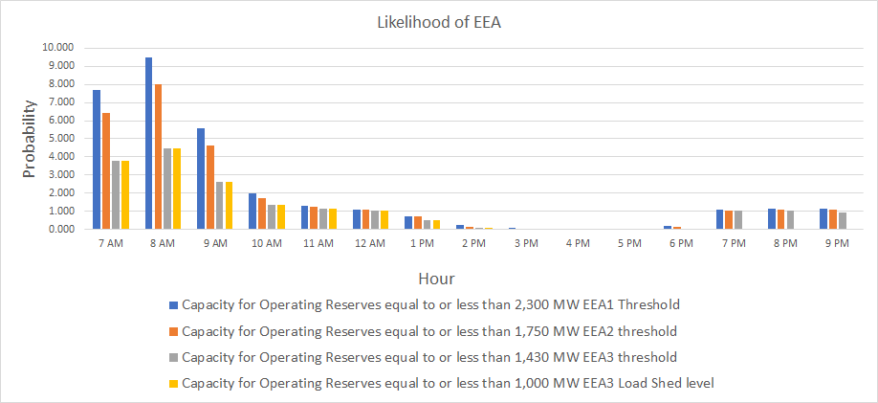
Hourly EEA Risk Profile, Winter 2022-23

Slide 10
Hourly EEA Risk Profile, Winter 2022-23

Slide 11
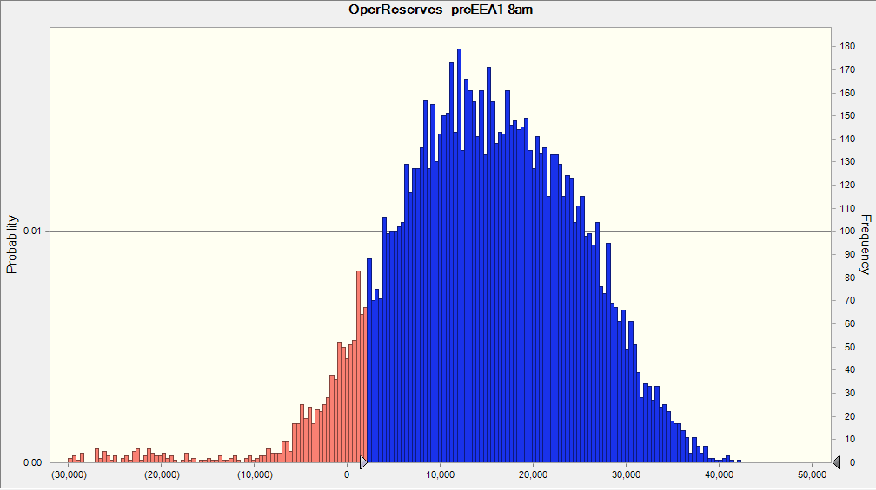
“Capacity Avail. for Operating Reserves” Outcome Distribution, HE 8:00 PM, Pre-EEA Level
Energy Emergency Alert outcomes,
N = 946
Simulation Outcome Range: 42,252 MW to -34,290 MW
Pre-Load Shed Range: 44,174 MW to -32,245 MW (Accounts for LRRS, TDSP load mgmt., 10-min ERS and available SWGRs/DC tie transfers)

Slide 12
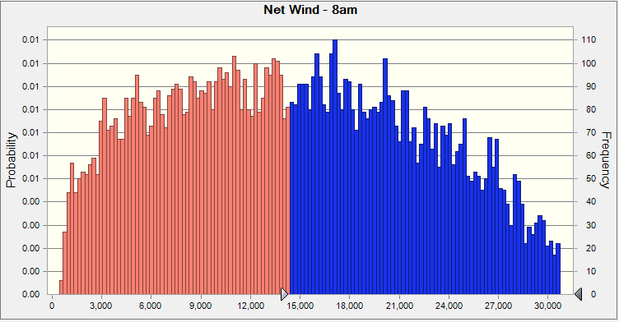
Outcome Distribution for Wind Output, HE 8:00 AM
14,342 MW
Net Wind accounts for an additional capacity contribution derating for trials associated with a Uri-type storm event (One percent of the 10,000 simulation trials)

