Slide 1
November CDR and Winter SARA Review
Supply Analysis Working Group
Pete Warnken
Resource Adequacy
December 13, 2022
Notes:
Welcome to

Slide 2
Capacity, Demand and Reserves Report

Slide 3
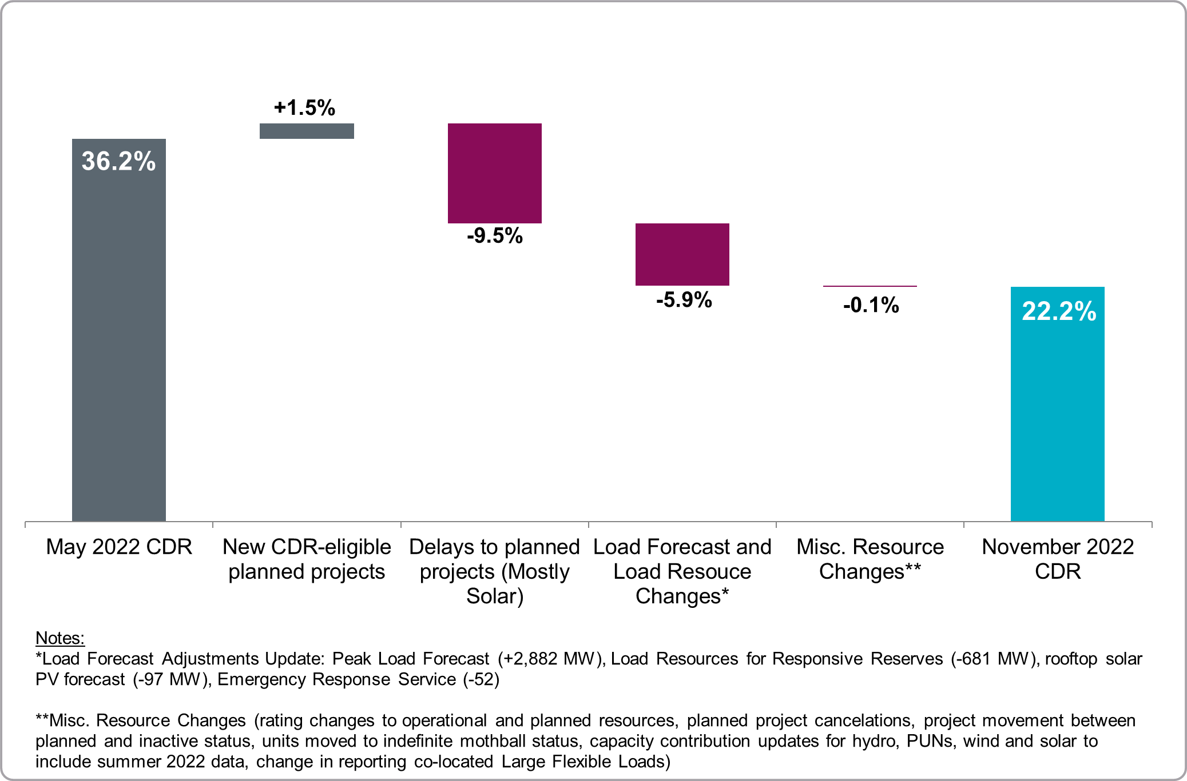
Summer 2023 Reserve Margin, Component Changes May 2022 CDR to November 2022 CDR

Slide 4
Winter 2022-23 Seasonal Assessment of Resource Adequacy (SARA) Report

Slide 5
Winter SARA: Risk Scenarios and Main Year-on-Year Changes
Main changes relative to last year’s winter SARA:
Increased peak load forecast, ~5.4 GW
Increased operational solar, ~0.8 GW winter capacity contribution
Increased EEA resources available during reserve scarcity conditions, ~0.9 GW from distribution voltage reduction and curtailable Large Flexible Loads (LFLs)

Slide 6
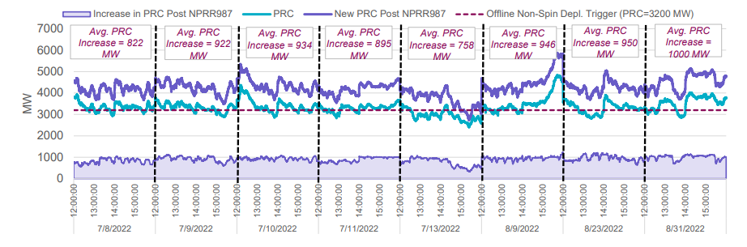
Battery Energy Storage Contribution (Interim)
947 MW is the average real-time contribution of battery ESRs to Physical Responsive Capability (PRC) during the hour with the tightest reserves on July 13, 2022, accounting for NPRR987
NPRR987 incorporated an ESR contribution into PRC effective October 14, 2022
Excludes ESR capacity providing Fast Frequency Response service
Source: System Operations Update for Board Reliability and Markets Committee, October 17, 2022
https://www.ercot.com/files/docs/2022/10/10/9.2%20System%20Operations%20Update.pdf

