Slide 1
TWG Discussion on: NOGRR 230
NPRR 1150
WAN Security Enhancements
December 2022

Slide 2
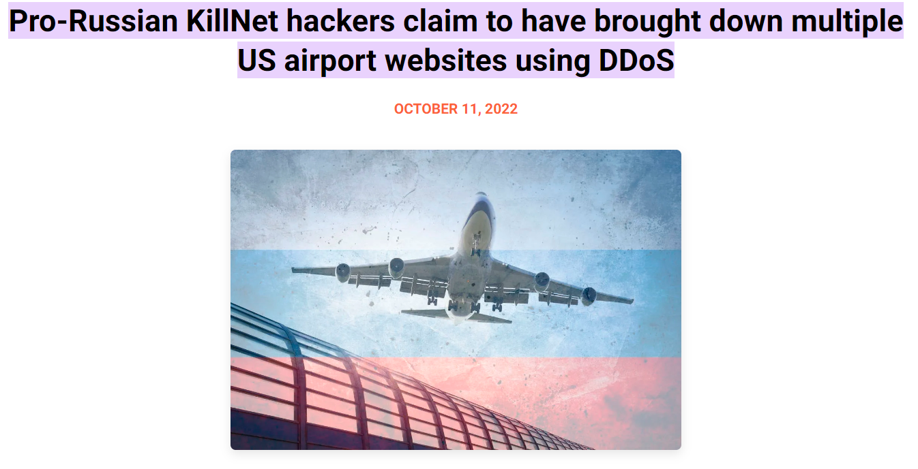
What Are We Trying to Address
Internet Based Distributed Denial of Service (DDoS) Attacks
We need to ensure the ERCOT interconnection is resilient to this type of attack

Slide 3
Background: Two Use Cases
There are two areas that should be addressed:
Ensuring that no one uses shared internet infrastructure for current ERCOT WAN
Scenario: Ensures that ERCOT connectivity to QSEs and TSPs remains available if a company undergoes a DDoS
Ensuring that QSE to RE connectivity is resilient to a targeted internet-based DDoS
Scenario: QSE undergoes a DDoS attack and they lose dispatch/connectivity with their REs

Slide 4
Options
A standard way to protect against this risk is to leverage point-to-point connections, such as MPLS
Such as the current ERCOT WAN
Adopted by other ISO/RTOs
Rationale: Multiple internet-based connections do not guarantee protection against DDoS attacks as they likely connect through the same “Super PoP” for the geographic area.
What other ideas do people have????
(Recommend speaking to technologies before getting into NPRR/NOGRR language)

