Slide 1
Creation of Smaller Load Zones
RMS Meeting – DECEMBER 2022

Slide 2
Background
Beginning in June, CMWG took up discussions on a stakeholder proposal to subdivide existing load zones into smaller load zones for improved Aggregated DER participation
CMWG has reached a decision point on whether to pursue a study on the creation of smaller load zones
Given the retail market impacts of changing LZs and no prior discussion at RMS, WMS leadership is bringing awareness to, and seeking feedback from, RMS before determining next steps

Slide 3
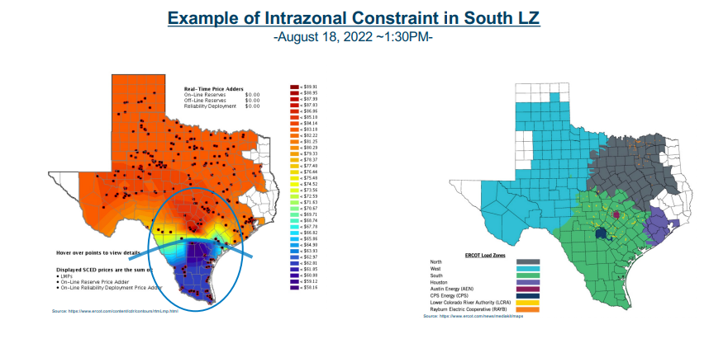
*From Sept. 19 DC Energy presentation to CMWG https://www.ercot.com/files/docs/2022/09/15/DC%20Energy%20Smaller%20Load%20Zones.pdf

Slide 4
*From July 18 CMWG Presentation: https://www.ercot.com/files/docs/2022/07/18/Creation%20of%20New%20Load%20Zones.pptx

Slide 5
Stakeholder Feedback
Retail market impacts and implementation timelines
Improved pricing signals and congestion management efficiency
Ongoing ADER pilot program
Prior IMM recommendation
ERCOT resource requirements and prioritization with other initiatives
Do RMS members have additional considerations or feedback on this proposal and/or next steps?

