Slide 1
PDCWG Report to ROS
Chair: Jimmy Jackson, CPS
Vice Chair: Vacant
ROS
Dec 1st , 2022

Slide 2
Report Overview & Notes
Report Overview
  Meeting Minutes
  BAL-001-TRE-2 FMEs and IMFR
    2 FME’s in the month of Oct
  Frequency Control Report

Slide 3
Meeting Minutes
PDCWG Meeting 11/16/2022
  2023 A/S Methodology Follow-up
  Forward Looking A/S Methodology Process
  Overview of ESR Performance Issues During Real Time
  ERCOT Reports
  TRE Report

Slide 4
Frequency Measurable Events Performance

Slide 5
Frequency Measurable Events
There were 2 FME’s in October
  10/6/2022 11:54:34
    Loss of 782 MW of generation
    Interconnection Frequency Response: 2172 MW/0.1 Hz
    88 Resources were evaluated. These includes,
      40 Generation Resources
      1 Controllable Load Resource
      47 Energy Storage Resources
    6 of 88 Evaluated Resources had less than 75% of their expected Initial Primary Frequency Response.
    8 of 88 Evaluated Resources had less than 75% of their expected Sustained Primary Frequency Response.

Slide 6
Frequency Measurable Events
  10/8/2022 6:47:42
    Loss of 685 MW of generation
    Interconnection Frequency Response: 1054 MW/0.1 Hz
    88 Resources were evaluated. These includes,
      37 Generation Resources
      1 Controllable Load Resource
      1 Wind Resource
      49 Energy Storage Resources
    6 of 88 Evaluated Resources had less than 75% of their expected Initial Primary Frequency Response.
    5 of 88 Evaluated Resources had less than 75% of their expected Sustained Primary Frequency Response.

Slide 7
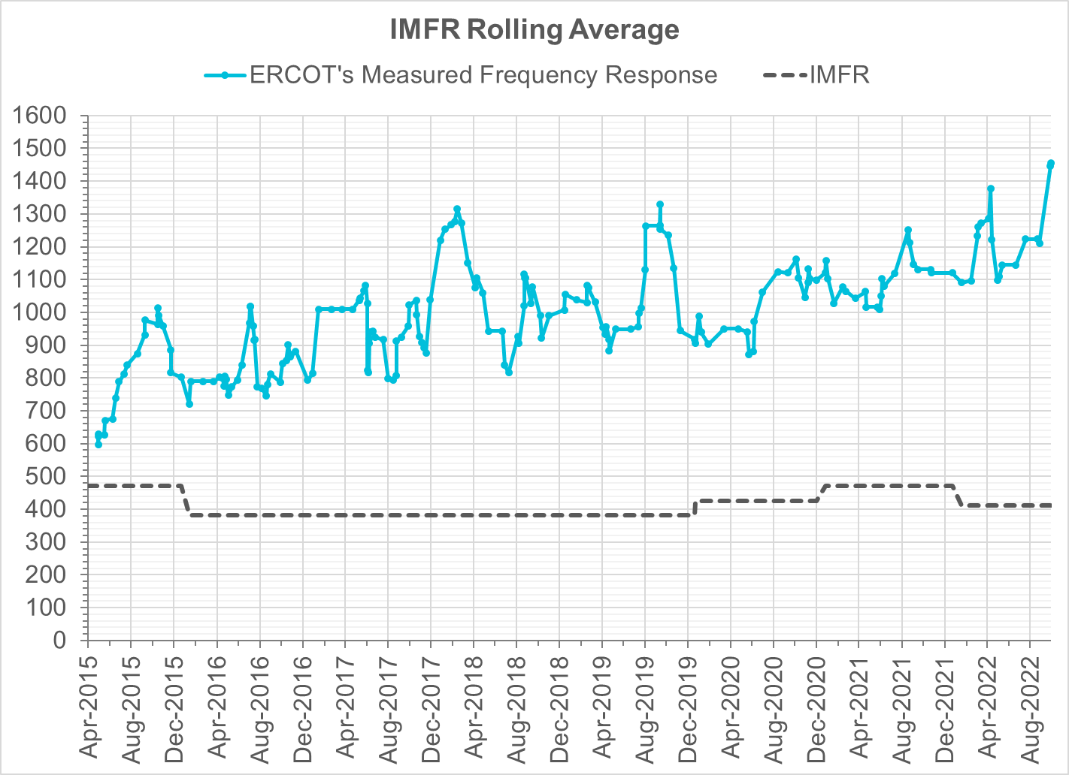
Interconnection Minimum Frequency Response (IMFR) Performance
IMFR Performance currently
1455.77 MW/0.1HZ
Frequency Response Obligation (FRO): 412 MW/0.1 Hz

Slide 8
Questions?

Slide 9
Frequency Control Report
Sep 2022

Slide 10
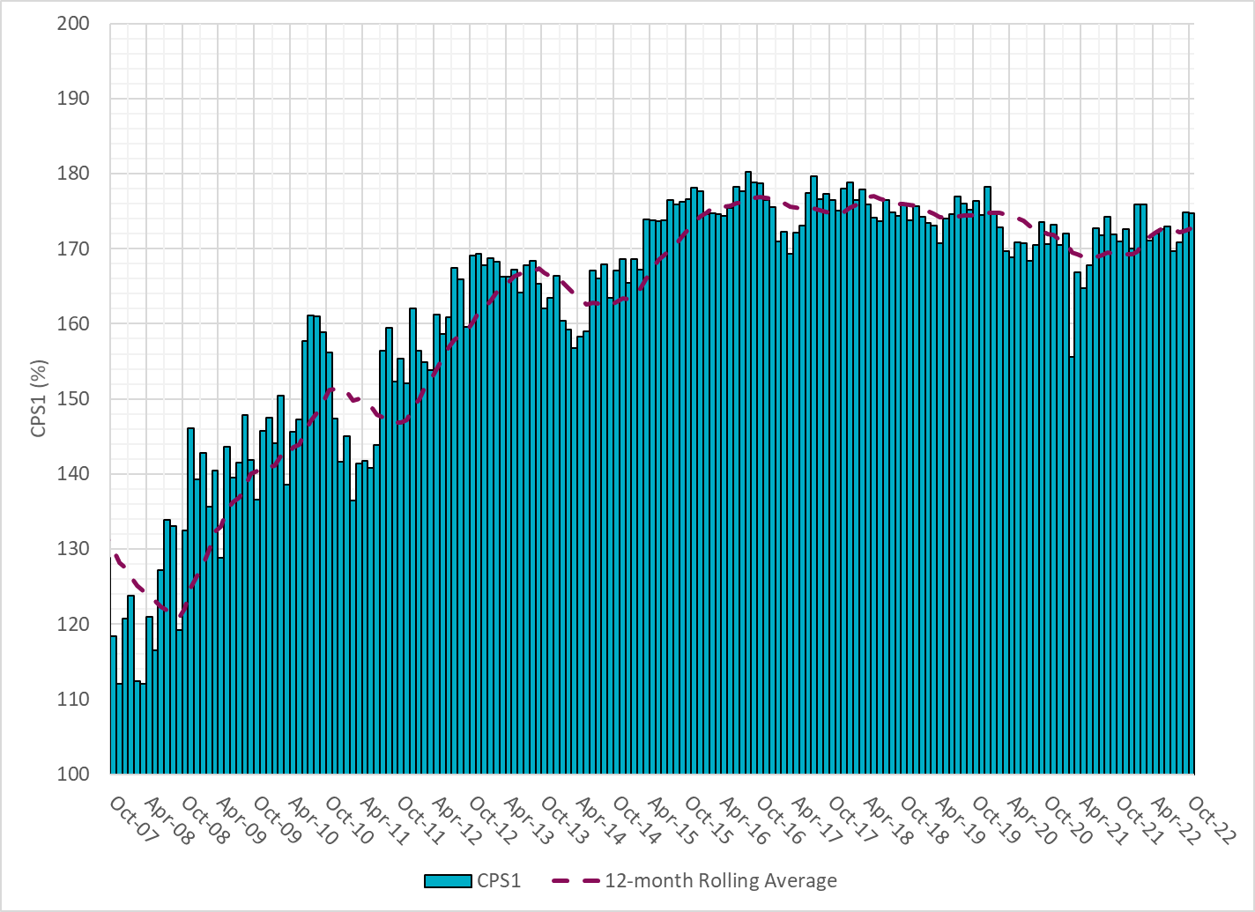
CPS1 Performance
Current 12-Month Rolling Average: 172.76%

Slide 11
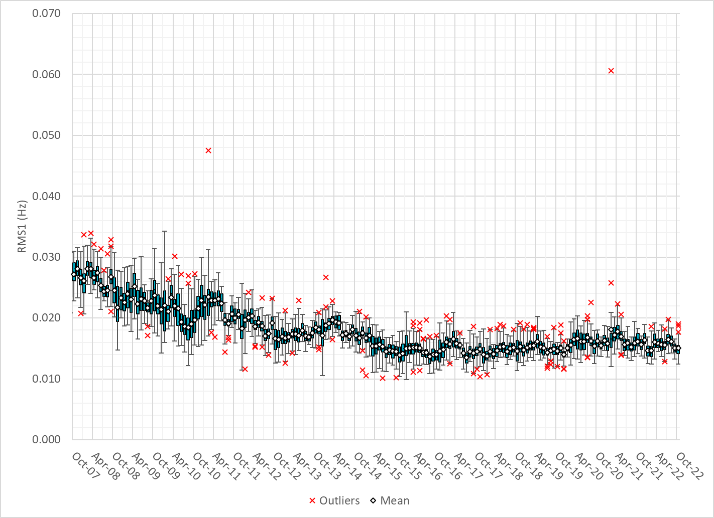
RMS1 Performance of ERCOT Frequency
Notes:
15.03Mhz on avg for Oct 2022

Slide 12
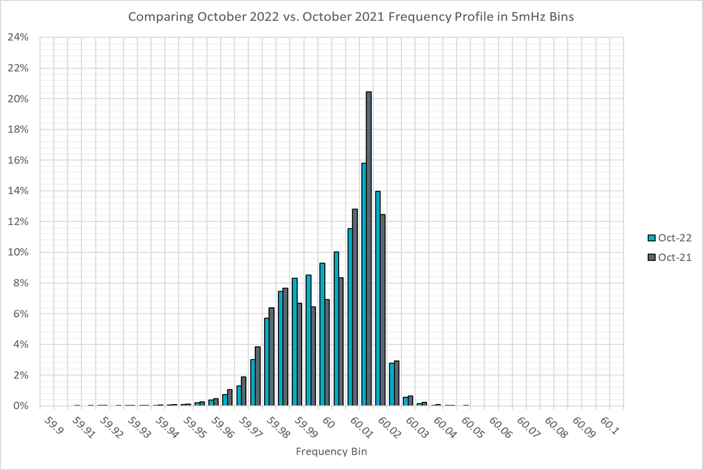
Frequency Profile Analysis

Slide 13
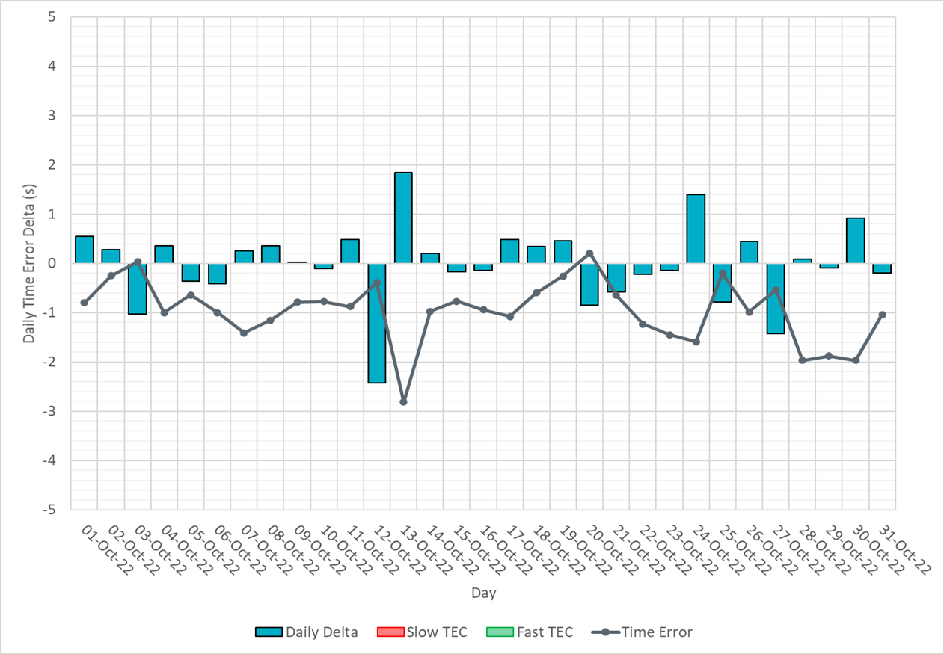
Time Error Corrections

Slide 14
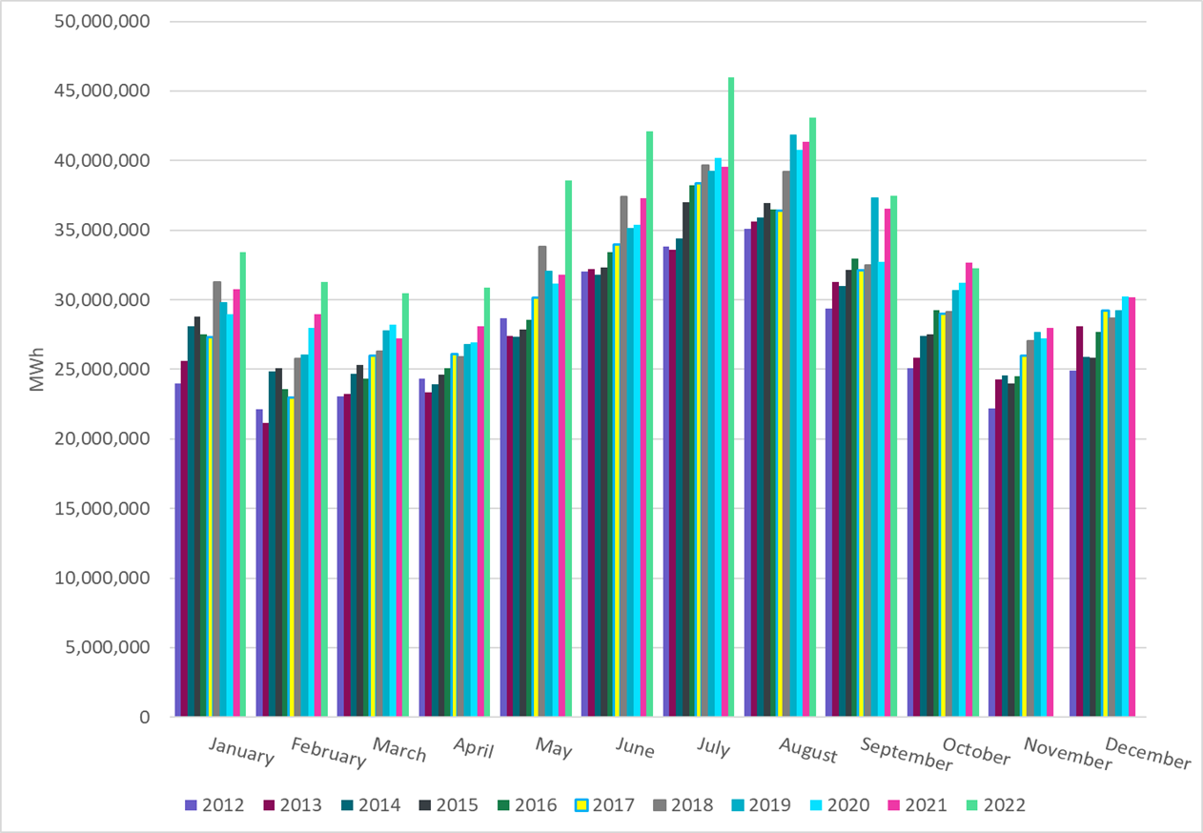
ERCOT Total Energy
Notes:
32,239,191 MWh

Slide 15
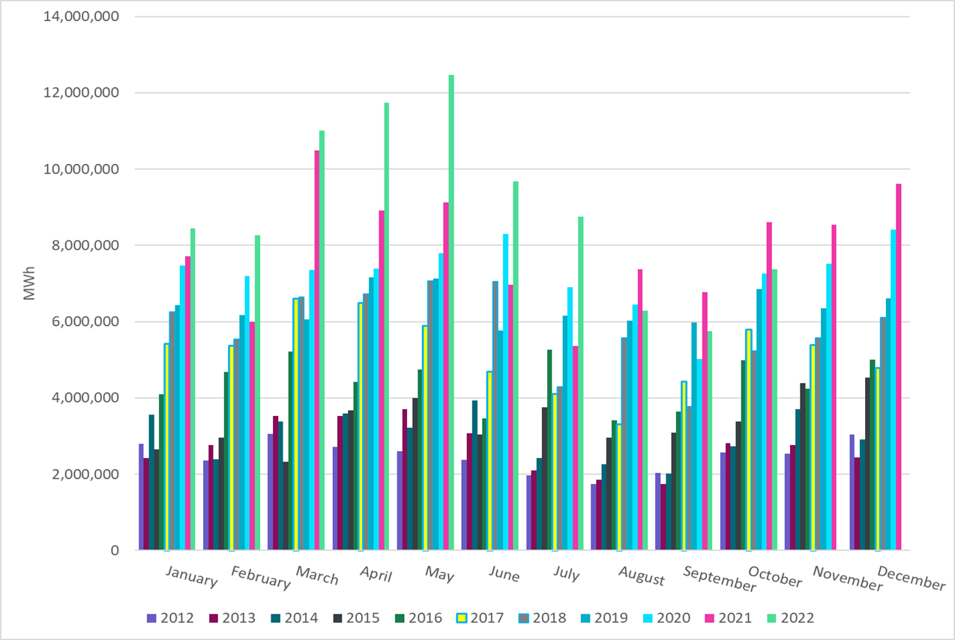
ERCOT Total Energy from Wind Generation
Notes:
7,377,412 MWH

Slide 16
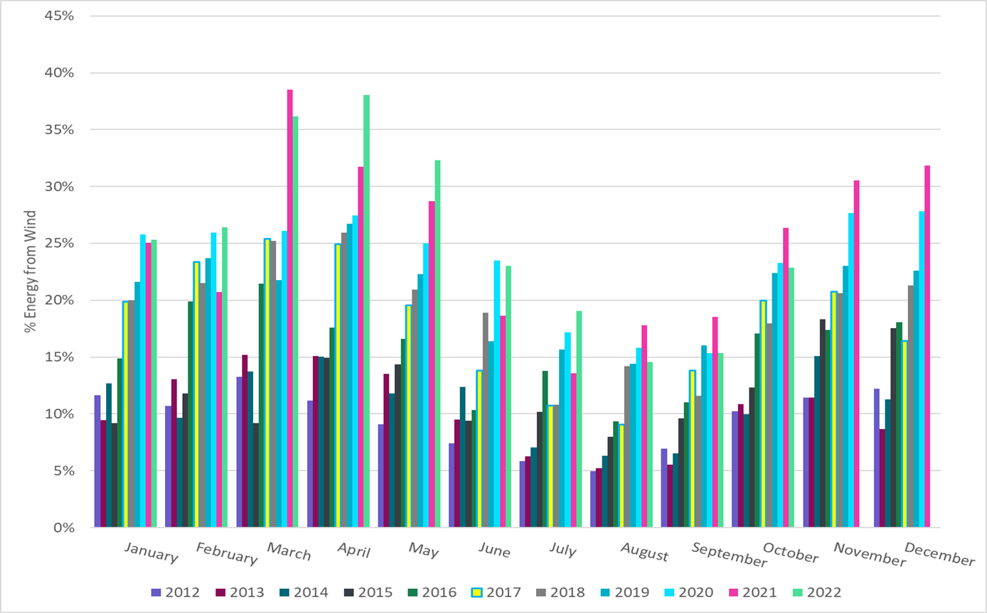
ERCOT % Energy from Wind Generation
Notes:
22.88%

Slide 17
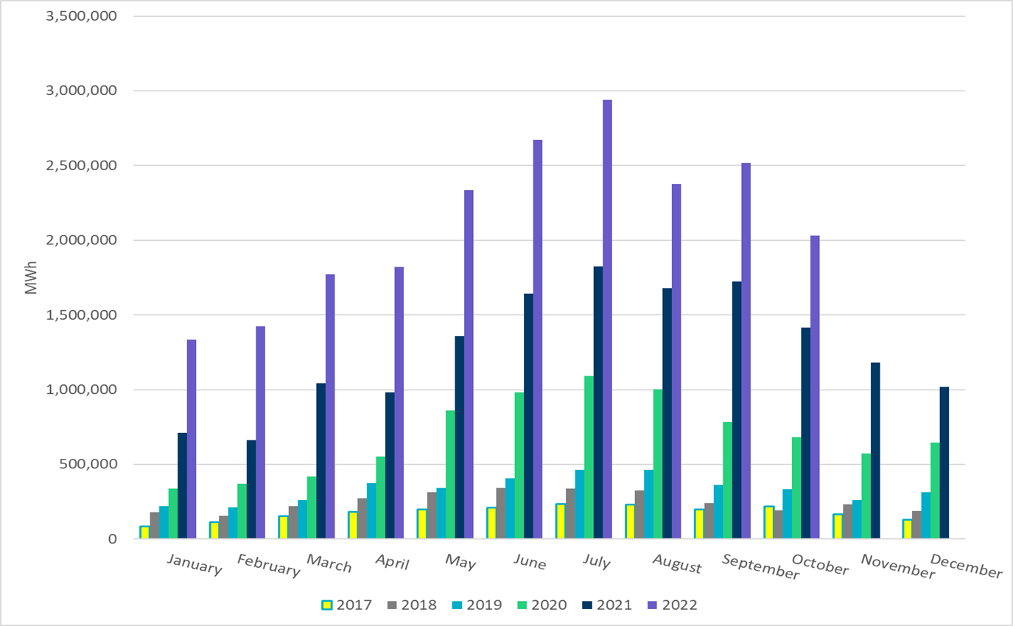
ERCOT Total Energy from Solar Generation
Notes:
2,031,912 MWh

Slide 18
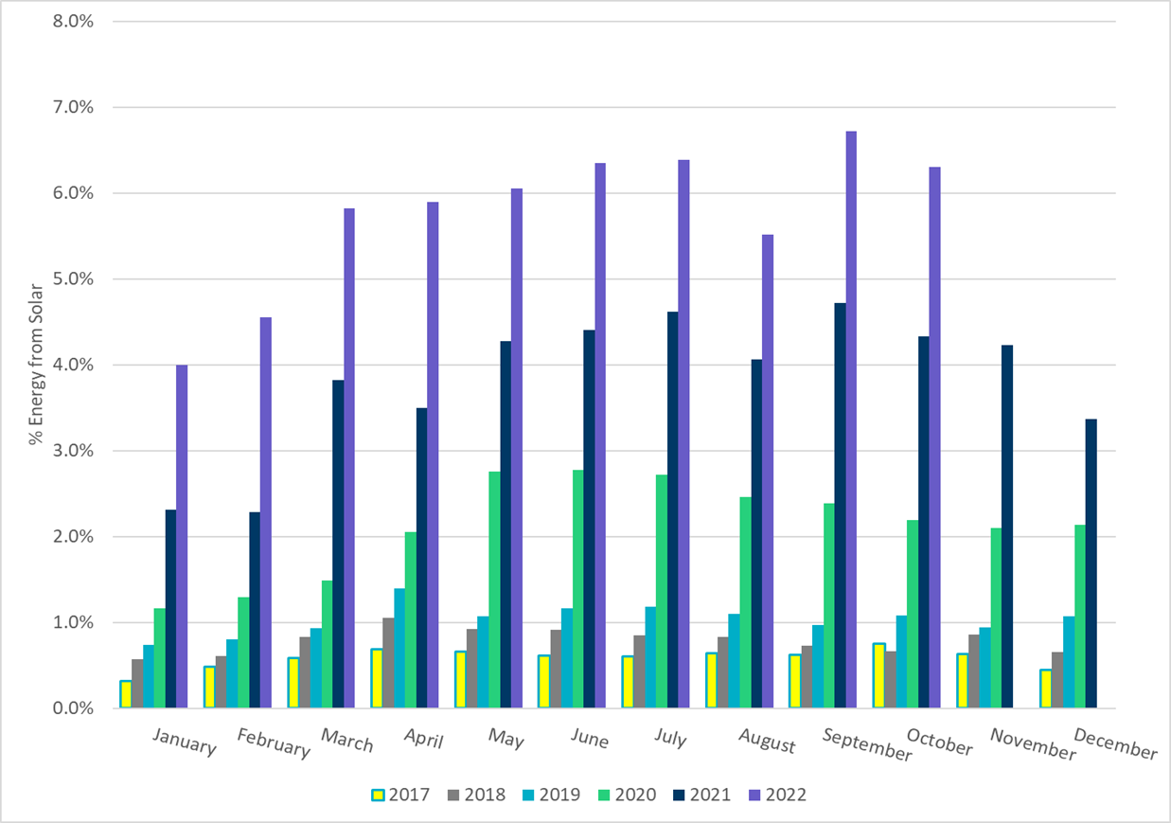
ERCOT % Energy from Solar Generation
Notes:
6.30%

Slide 19
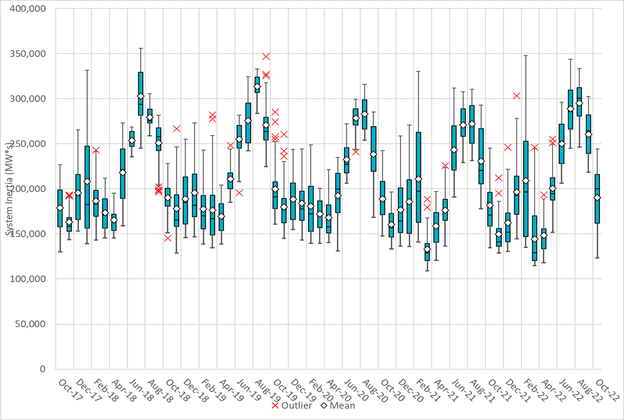
ERCOT Daily Minimum System Inertia
Notes:
Minimum Inertia =123,509 MW*s on 10/22/2022
Previous Minimum was 109,029 MW*s on 3/22/2021
Data:
Mean: 190,225 MW*s
Max: 244,459 MW*s on Oct 13th
Min: 123,509 MW*s on Oct 22nd

Slide 20
ERCOT Inertia Trend
Date and Time | 2013 3/10 3:00 AM | 2014 3/30 3:00 AM | 2015 11/25 2:00 AM | 2016 4/10 2:00 AM | 2017 10/27 4:00 AM | 2018 11/03 3:30 AM | 2019 3/27 1:00 AM | 2020 05/01 2:00 AM | 2021 03/22 00:00 AM | 2022 03/21 01:00 AM
Min synch. Inertia (GW*s) | 132 | 135 | 152 | 143 | 130 | 128.8 | 134.5 | 131.1 | 109 | 115
System load at minimum synch. Inertia (MW) | 24,726 | 24,540 | 27,190 | 27,831 | 28,425 | 28,397 | 29,883 | 30,679 | 32,599 | 33,365
Non-synch. Gen. in % of System Load | 31 | 34 | 42 | 47 | 54 | 53 | 50 | 57 | 65 | 66
Notes:
For each box, the central mark (red line) is the median, the edges of the box (in blue) are the 25th and 75th percentiles, the whiskers correspond to +/- 2.7 sigma (i.e., represent 99.3% coverage, assuming the data are normally distributed. The corresponding lowest inertia in each year is given in the table.
The circle on each boxplot is showing inertia during time when highest portion of load was served by wind/solar generation in that year.

