Slide 1


TDTMS Update
RMS
December 6th, 2022

Slide 2
TDTMS
Update
ERCOT Updates
MarkeTrak Upgrade and Stabilization: 1 issue undergoing testing and plans to move to production – new users and search functionality
SCR 817 – approved business requirements are now with developers and writing test scripts. Summary of changes for SCR817 are posted to 11/16 meeting page here
SCR815 - GO LIVE December 12th ! TRAINING DATES:
November 30th – 1:00 PM
December 7th – 9:30 AM during TDTMS
Changes include: drop downs to track unexecutable reasons, downsizing rolodex, escalation emails for non-activity (IAGs/Rescission), removing unused subtypes, clarity on reporting dates
RMGRR170 – Inadvertent Gain Process Update – set for PUCT Open Meeting 12/15. If approved, changes will be effective 1/1/23

Slide 3
TDTMS
RMGRR170 - Inadvertent Gain Process Updates – Awaiting Approval
Clearly define an Inadvertent Gain
Clarify the appropriate use of the Inadvertent Gain Process
Limit the use of the Bulk Insert template for IAGs
Requiring a CR who experienced a system processing issue resulting in inadvertently gaining greater than 100 ESIs, who uses the IAG process to resolve, to inform impacted Market Participants and detail the cause of the issue
Adding a Valid Reject/Unexecutable Reason for the losing CR referencing the new subsection on the Invalid Use of the IAG Process
Introduce the commonly referred to “No Current Occupant” process supported by PUCT Subst. Rule 25.488 - Procedures for a Premise with No Service Agreement for scenarios where the losing CR no longer has a valid service agreement with the Customer and must regain an ESI ID
If approved at 12/15 PUCT Open Meeting, changes will be effective 1/1/23.

Slide 4
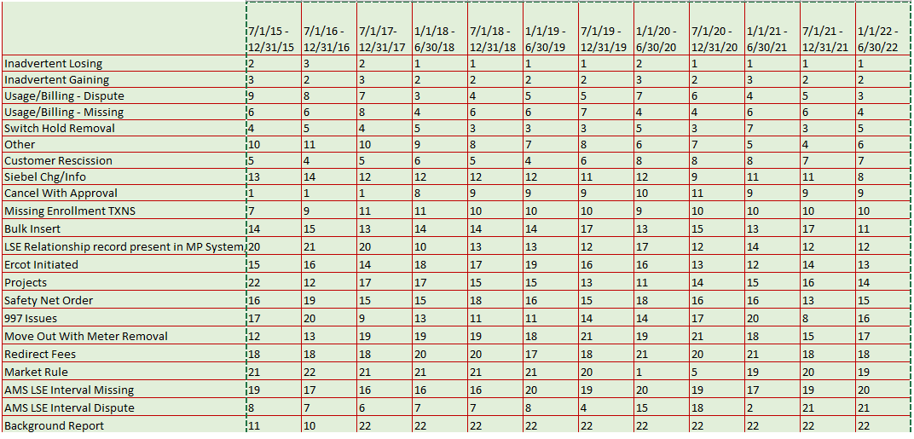
TDTMS
MarkeTrak Subtype Volume Analysis – Mid Year 2022
Rankings were reviewed with Mid Year 2022 data as a reference. IAG family of MTs remains in top position, representing nearly 50% of MTs submitted.

Slide 5
TDTMS
Next Meeting
Wednesday, December 7th , 2022, 9:30 AM , WebEx only
On the Agenda:
SCR815 Training
System Instances & MT Performance
Listserv
MarkeTrak Upgrade Stabilization
SCR817 Business Requirements discussion, if needed
MarkeTrak Volume Subtype Analysis Discussion –
Time Spent on Issues of Various Subtypes
ERCOT Updates
PUCT Project 52796 – Shortening of timeline for complaints in 25.495 from 21 days down to 15 days – impacts on IGL process

