Slide 1
MarkeTrak Training
SCR 815

Slide 2
Antitrust Admonition
To avoid raising concerns about antitrust liability, participants in ERCOT activities should refrain from proposing any action or measure that would exceed ERCOT’s authority under federal or state law. For additional information, stakeholders should consult the Statement of Position on Antitrust Issues for Members of ERCOT Committees, Subcommittees, and Working Groups, which is posted on the ERCOT website.

Slide 3
Marketrak SCR 815 Enhancements
Revise drop down choices for Inadvertent Gaining, Inadvertent Losing and Customer Rescission Unexecutable reasons.
Develop a list of Unexecutable Reasons for Usage and Billing and Missing Enrollment TXNs subtypes.
Downsize rolodex contacts from 24 categories to 6 categories.
Create automated escalation email for Inadvertent issues not transitioned within 7 days after ‘Begin Working’.
Create automated escalation email for Customer Rescission issues not transitioned after 2 days and no BDMI within 2 days of ‘Ready To Receive’.
Revise automated nightly escalation email report to include ESIID.
Use the Last Modified Date as the Close Date for the ‘Average Days Open’ background report.
Archive 11 subtypes not used since 2018.

Slide 4
Marketrak SCR 815 Enhancement 1 – Revise drop down choices for Inadvertent Gaining, Inadvertent Losing and Customer Rescission Unexecutable reasons.
Revise the choices in the dropdown field on the Unexecutable transition for IAG/IAL/Customer Rescission workflows to match the Retail Market Guide and the MarkeTrak Users Guide. New values per workflow are as follows:
Inadvertent Gaining | Inadvertent Losing | Customer Rescission
(None)* | (None)* | (None)*
Duplicate Issue | Duplicate Issue | Duplicate Issue
New Transaction Completed | New Transaction Completed | New Transaction Completed
 | Authorized Enrollment Confirmed*
 | Customer Rescission – MT linked
* If the default selection of ‘(None)’ is made, or if ‘Authorized Enrollment Confirmed’ is selected, comments are required.

Slide 5
Marketrak SCR 815 Enhancement 1 – Revise drop down choices for Inadvertent Gaining, Inadvertent Losing and Customer Rescission Unexecutable reasons.

Slide 6
Marketrak SCR 815 Enhancement 2 – Develop a list of Unexecutable Reasons for Usage and Billing and Missing Enrollment TXNs subtypes.
Add an Unexecutable Reason drop down field to the Unexecutable transition for Usage & Billing and Missing Enrollment TXNs subtypes. Providing common unexecutable reasons will improve the resolution time and reduce unnecessary comments. New Unexecutable Reasons per workflow are as follows:
Usage & Billing – Missing | Usage & Billing – Dispute | AMS LSE Missing | AMS LSE Dispute | Missing Enrollment TXNs
(None)* | (None)* | (None)* | (None)* | (None)*
Invalid StartTime/TimeStamp Formatting | Submitter is Not the REP of Record | Submitter is Not the REP of Record | Non-consecutive Bill Cycles | Enrollment TXNS on Construction Hold or Permit Pending
Cycle Date Not Scheduled | Inaccurate SubType Submitted* | Inaccurate SubType Submitted* | Variance Due to Inadvertent Gain/Loss | Enrollment TXNS was Cancelled
Submitter is Not the REP of Record |  |  | Invalid StartTime/TimeStamp Formatting | Enrollment TXNS is Future Dated
Inaccurate SubType Submitted* |  |  | Submitter is Not the REP of Record
 |  |  | Inaccurate SubType Submitted*
* If the default selection of ‘(None)’ is made, or if ‘Inaccurate SubType Submitted’ is selected, comments are required.

Slide 7
Marketrak SCR 815 Enhancement 2 – Develop a list of Unexecutable Reasons for Usage and Billing and Missing Enrollment TXNs subtypes.

Slide 8
Marketrak SCR 815 Enhancement 3 - Downsize rolodex contacts from 24 categories to 6 categories.
The current rolodex is not maintained by Market Participants due to cumbersome process and multiple inputs. Escalation contact emails bounce back or go unanswered. Downsizing the escalation contacts from 24 categories to 6 categories will streamline the rolodex maintenance for MP Admins. New rolodex categories are as follows:
Inadvertent | Service/Transaction Issues | Usage & Billing | DEV | Switch Hold Removal | LPA
-Inadvertent Gaining | -997 Issues | -Usage & Billing - Missing | -In ERCOT system not MP | -Switch Hold Removal | -LPA
-Inadvertent Losing | -Cancel with Approval | -Usage & Billing - Dispute | -In ERCOT system with start date issues
-Customer Rescission | -Cancel without Approval | -AMS LSE Interval - Missing | In MP system not ERCOT
-Redirect Fees | -ERCOT Initiated | -AMS LSE Interval - Dispute | -LSE date change: StartTime
 | -Market Rule |  | -LSE date change: StopTime
 | -Missing Enrollment TXNS |  | -LSE in ERCOT system not MP
 | -Move Out With Meter Removal |  | -LSE in MP system not ERCOT: active
 | -Other |  | -LSE in MP system not ERCOT: de-engz
 | -Premise Type |  | -Status Assignment
 | -Projects |  | -Un-Retire ESIID
 | -Reject TXNs |  | -Zip Assignment
 | -Rep of Record
 | -Safety Net Order
 | -Service Address
 | -Service Order - 650
 | -Siebel CHG/Info

Slide 9
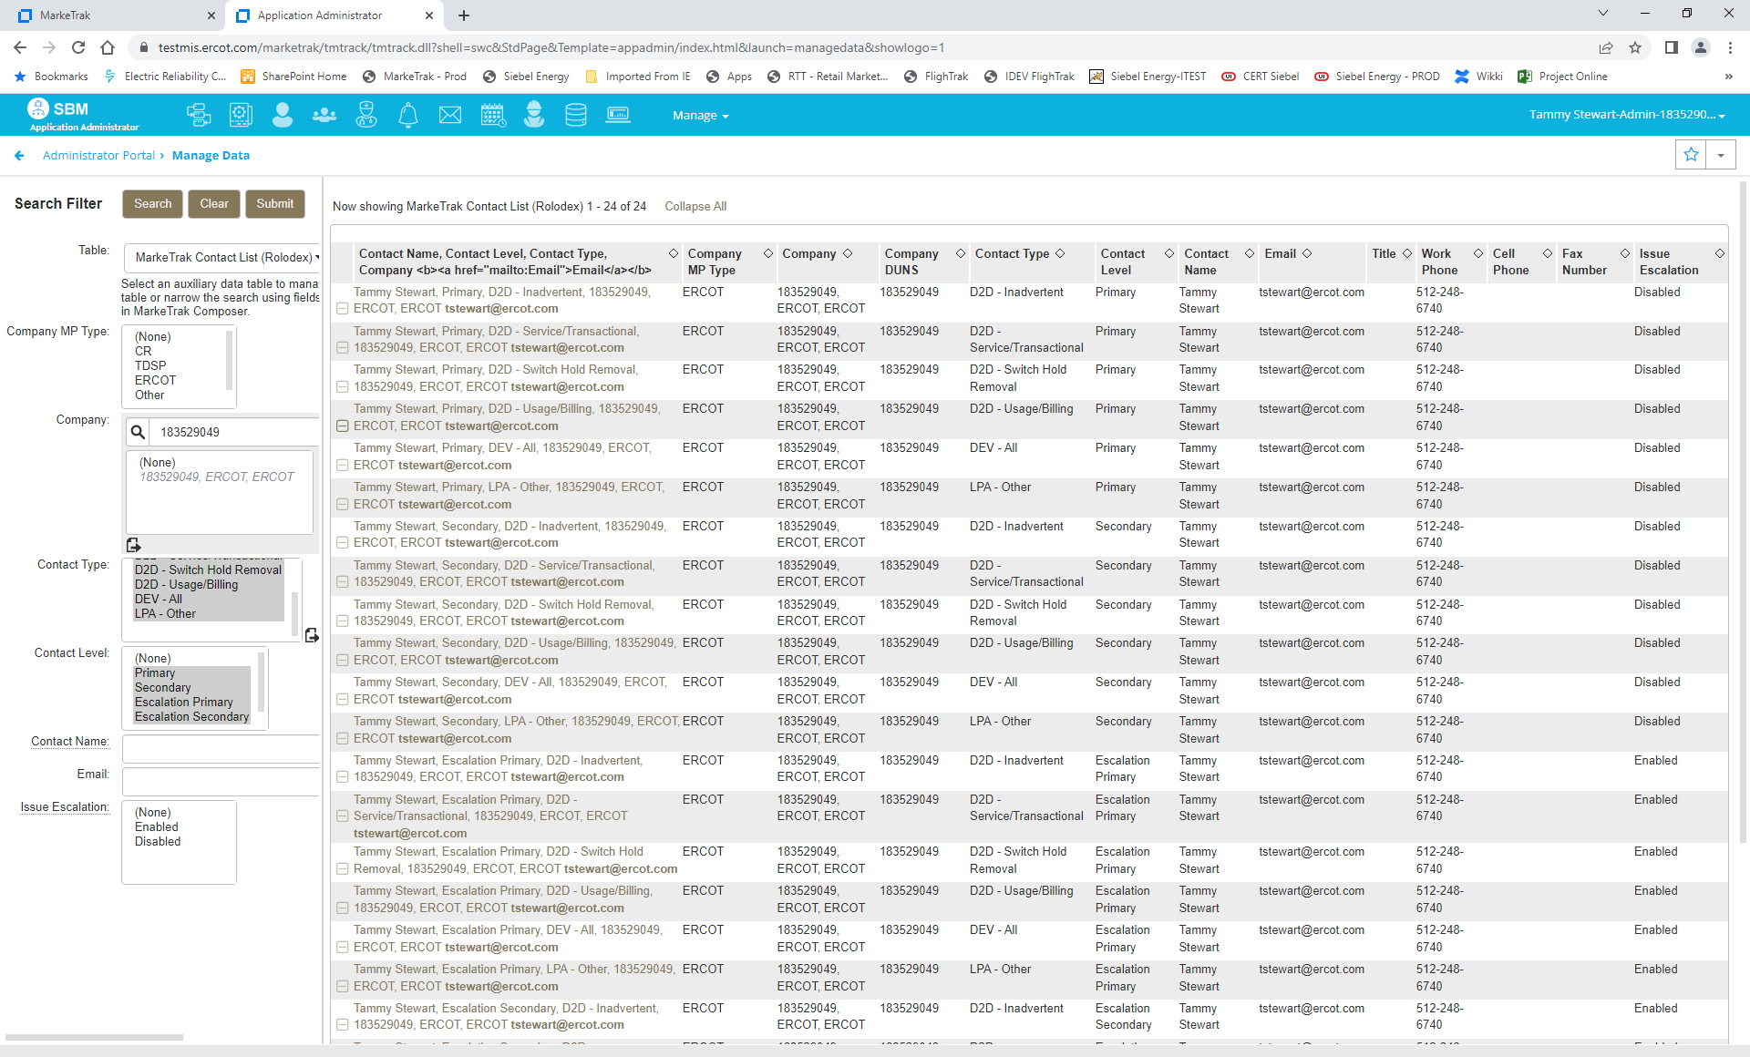
Marketrak SCR 815 Enhancement 3 - Downsize rolodex contacts from 24 categories to 6 categories.
MP Admins are responsible for maintaining the Primary, Secondary, Escalation Primary, and Escalation Secondary contacts for each category.
For the initial implementation in Production, one MP Admin from each company will be assigned as the rolodex contact for all 6 categories for each contact type. The MP Admin will need to update each rolodex contact with the appropriate contact person after go-live.

Slide 10
Marketrak SCR 815 Enhancement 3 - Downsize rolodex contacts from 24 categories to 6 categories – updating contacts:
Click on the contact record to be updated
Click Update
Update Contact Information and click OK

Slide 11
Marketrak SCR 815 Enhancement 4 - Create automated escalation email for Inadvertent issues not transitioned within 7 days after ‘Begin Working’.
Inadvertent Gain: If an Inadvertent Gaining issue remains in a state of ‘In Progress (Losing CR)’ for more than 7 days without transition, the sample email escalation below will automatically be sent to the Losing CR’s Primary and Secondary contacts for the Inadvertent rolodex category as well as the Losing CR owner.
Inadvertent Loss: If an Inadvertent Losing issue remains in a state of ‘In Progress (Gaining CR)’ for more than 7 days without transition, the sample email escalation below will automatically be sent to the Gaining CR’s Primary and Secondary contacts for the Inadvertent rolodex category as well as the Gaining CR owner.
This escalation email will continue to be sent every 7 days until the issue is transitioned.

Slide 12
Marketrak SCR 815 Enhancement 5 - Create automated escalation email for Customer Rescission issues not transitioned after 2 days and no BDMI within 2 days of ‘Ready To Receive’.
Customer Rescission Escalation 1: If a Customer Rescission issue remains in a state of ‘In Progress (Losing CR)’ for more than 2 days without transition, the sample email escalation below will automatically be sent to the Losing CR’s Primary and Secondary contacts for the Inadvertent rolodex category as well as the Losing CR owner:
This escalation email will continue to be sent every 2 days until the issue is transitioned.

Slide 13
Marketrak SCR 815 Enhancement 5 - Create automated escalation email for Customer Rescission issues not transitioned after 2 days and no BDMI within 2 days of ‘Ready To Receive’.
Customer Rescission Escalation 2: If a Customer Rescission issue remains in a state of ‘New (Losing CR Submit)’ or ‘In Progress (Submit Regaining)’ for more than 2 days after the TDSP has selected the ‘Ready To Receive’ transition, the following email escalation will automatically be sent to the Losing CR’s Primary and Secondary contacts for the Inadvertent rolodex category as well as the Losing CR owner:
This escalation email will continue to be sent every 2 days until the issue is transitioned.

Slide 14
Marketrak SCR 815 Enhancement 6 - Revise automated nightly escalation email report to include ESIID.
A column has been added to the nightly escalation email report to capture the ESIID if it is populated on the MarkeTrak issue. These nightly emails are automatically sent to the Escalation Primary and Escalation Secondary contacts to advise of issues that have not been transitioned in a timely manner and require attention.

Slide 15
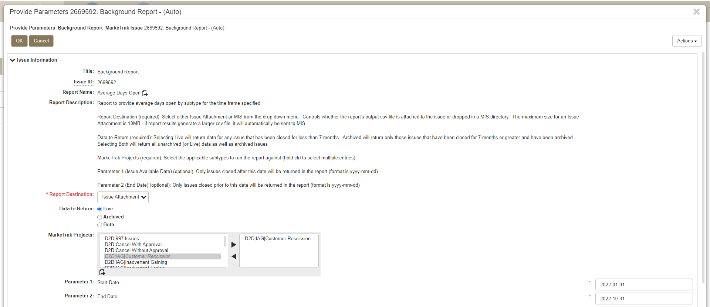
Marketrak SCR 815 Enhancement 7 - Use the Last Modified Date as the Close Date for the ‘Average Days Open’ background report.
Average Days Open Background Report has been modified to return averages that are calculated based on when an issue was transitioned to some form of ‘Pending Complete’ and not when it was transitioned by the system to ‘Auto Complete’. For issues directly transitioned to Complete by a user, that timestamp is used to calculate the average days open.
Eliminating the time an issue remains in some form of ‘Pending Complete’ provides a more accurate number when calculating average days open.

Slide 16
Marketrak SCR 815 Enhancement 8 - Archive 11 subtypes not used since 2018.
Archived Subtypes
Region Code Assignment
Inactive record has date issues
In TDSP system not ERCOT
In both systems with date issues (IDR)
In both systems with date issues (Non-IDR)
In both with kWh or kW issues
In ERCOT system not TDSP
LSE date change: Start and Stop
Station Code Assignment
Loss Code Assignment
Profile Code Assignment
These subtypes have been removed from the Submit Tree in the GUI and can no longer be submitted.
Submit attempts thru the API
will result in a permissions error advising the user that they do not have submit privileges.
Archived data for these subtypes can be obtained via the Background Reports or an ‘Other’ issue can be submitted to ERCOT for an adhoc report.

Slide 17
MarkeTrak Training

