Slide 1
System Protection Working Group
(SPWG)
Update to ROS
November 2022
Chair: Bret Burford, P.E.

Slide 2
SPWG Meeting Overview
3rd SPWG Meeting of 2022 was held on November 9, 2022
2023 Chair = Jon Snellgrove (AEP)
2023 Vice Chair = Andrew Mattei (Brazos EC) – pending approval
Topics Discussed:
  Lack of DME data for June 2022 Odessa Event
  Texas RE 2022 Q2 Misoperation Data (included)
  Reviewed NERC SPCWG Activities
  Reviewed status of NOGRR226 – UFLS change for 59.4 Hz issue

Slide 3
Lack of DME data for June 2022 Odessa Event
PRC-002-4 is coming out soon regarding Notifications to Other Owners
PRC-002-5 will be under draft by SDT to include revisions for IBRs
ERCOT is wanting revisions to Nodal Operating Guide, Section 6.0.
There is confusion in the DDR/PMU sections, etc.
ERCOT Nodal Operating Guide, Section 6.0 is due for review by SPWG in 2023.
SPWG will work with ERCOT, etc. on revisions to ERCOT Nodal Operating Guide, Section 6.0 for alignment with PRC-002 revisions, etc. (future NOGRR)

Slide 4
Protection System Misoperations
2022 Q2

Slide 5
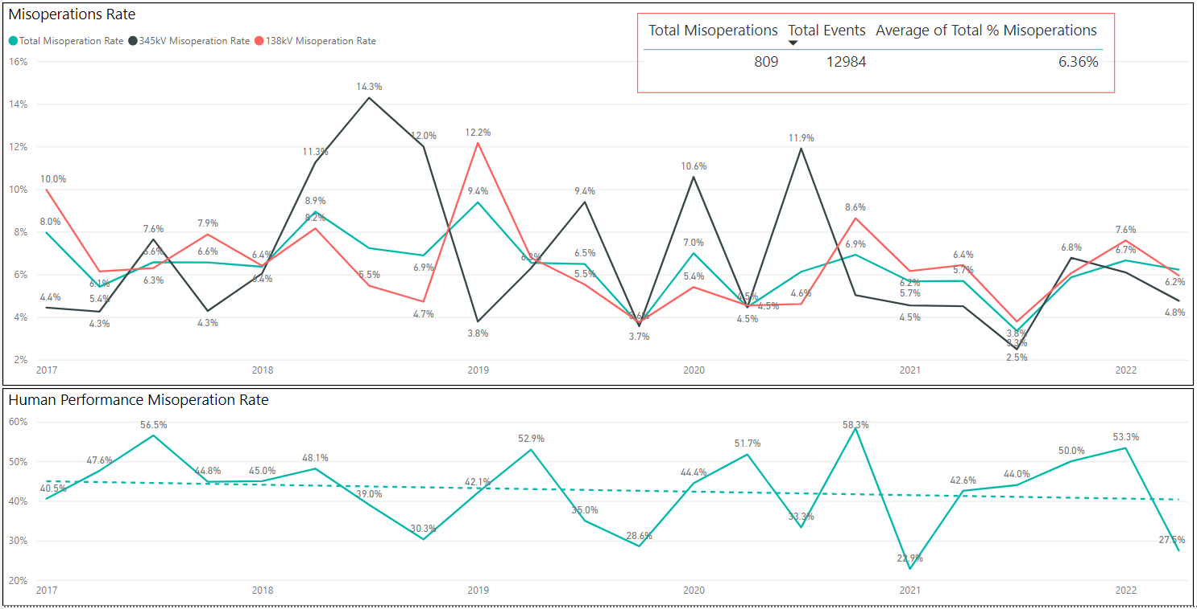
Protection System Misoperations: 2017-2022 Q2

Slide 6
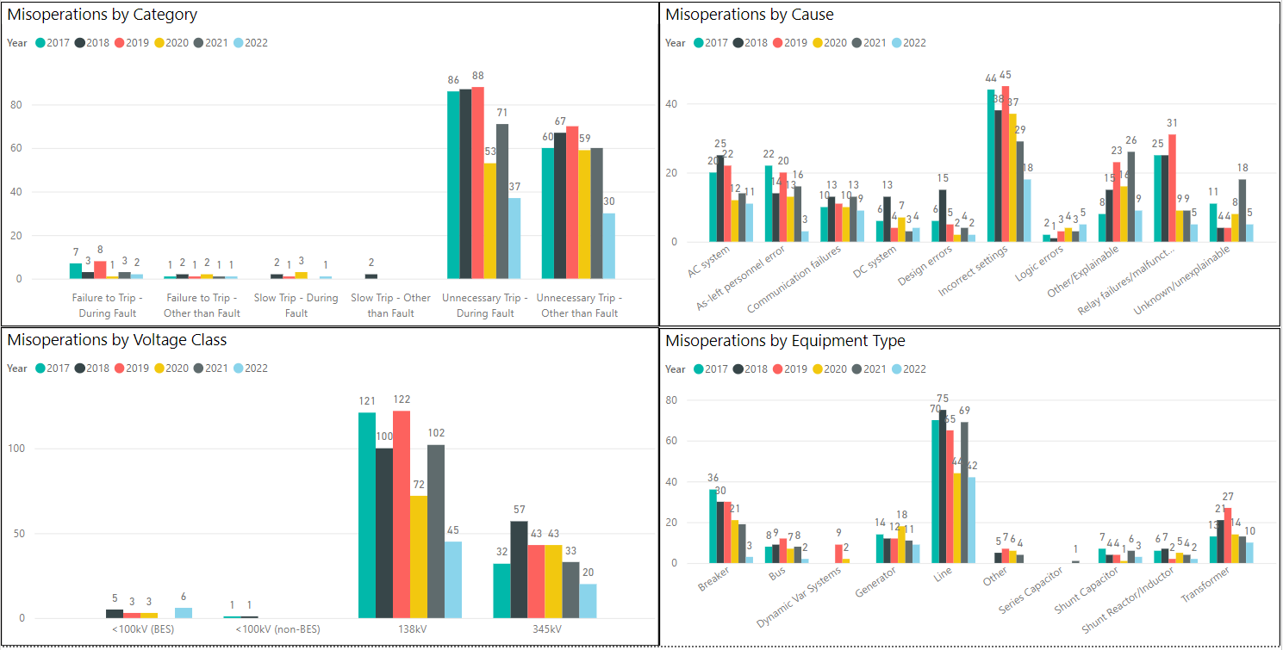
Protection System Misoperations: 2017-2022 Q2

Slide 7
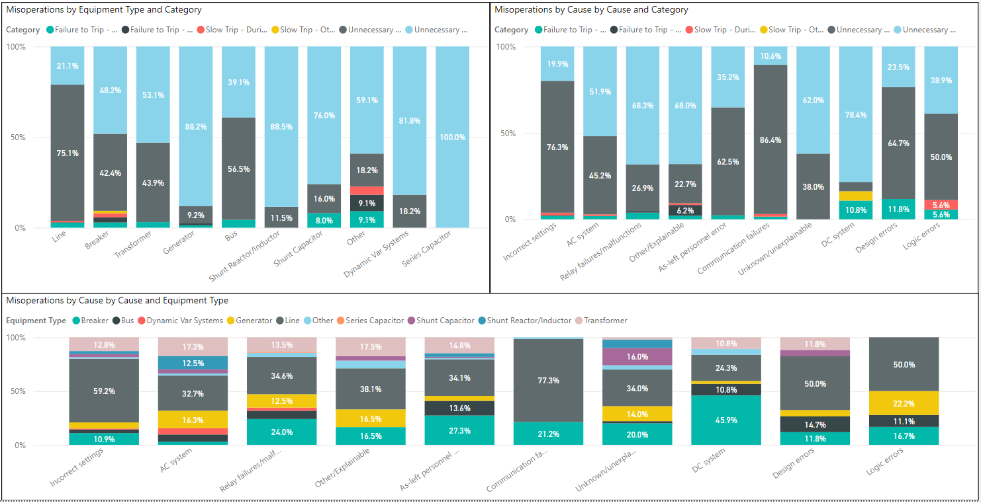
Protection System Misoperations: 2017-2022 Q2

Slide 8
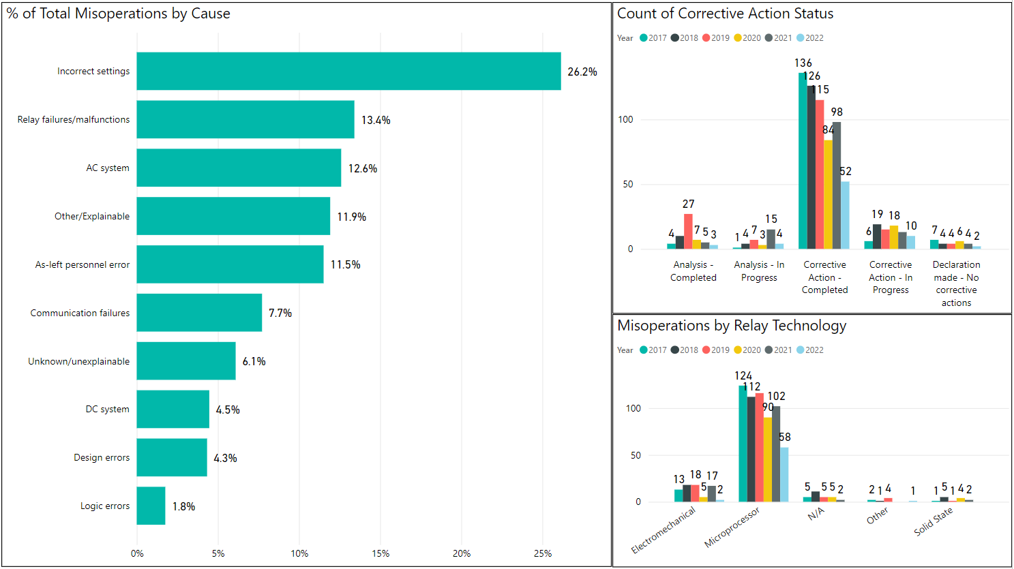
Protection System Misoperations: 2017-2022 Q2

Slide 9
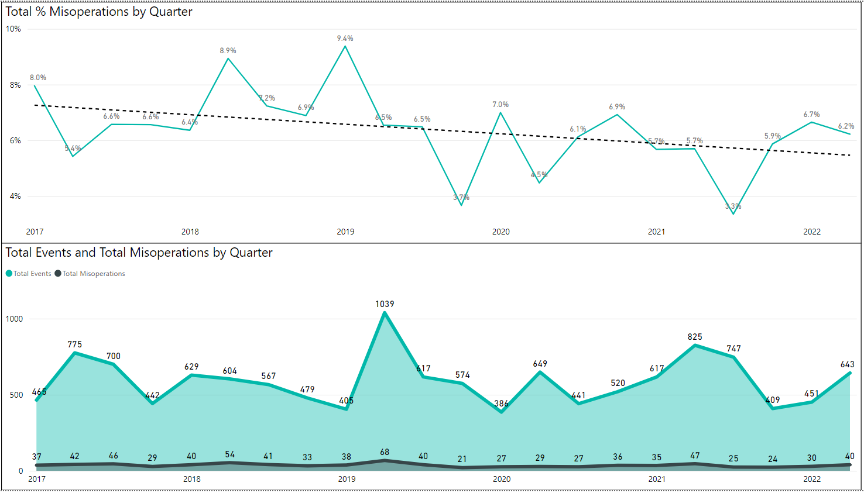
Protection System Misoperations: 2017-2022 Q2

Slide 10
Protection System Misoperations – 2022 Q2
 |  | Q2 | 2022 YTD
# of Misoperations | Total | 40 | 70
 | 345 kV | 8 | 20
 | 138 kV | 26 | 44
 | < 100 kV | 6 | 6
By Category | Failure to Trip | 2 | 3
 | Slow Trip | 0 | 1
 | Unnecessary Trip during Fault | 15 | 36
 | Unnecessary Trip – Non Fault | 23 | 30
 | RAS | 0 | 0
By Relay System Type | Electromechanical | 1 | 2
 | Solid State | 0 | 0
 | Microprocessor | 34 | 57
 | Other/ N/A | 5 | 11
By Equipment Protected | Line | 23 | 41
 | Transformer | 3 | 10
 | Generator | 8 | 9
 | Shunt/Series Capacitor | 2 | 3
 | Shunt/Series Reactor | 1 | 2
 | Dynamic VAR system | 0 | 0
 | Bus | 1 | 2
 | Breaker | 2 | 3
 | Other | 0 | 0

Slide 11
Protection System Misoperations 2022 Q2
Summary of Human Performance Issues noted for 2022 Q2:
Generator tripped during startup after relay upgrade. Stator earth fault detection was set to trip instead of monitor only.
138kV line operated for an external fault due to incorrect settings on 67G1 element.
138kV line operated for an external fault due to overreach of the Z1G element.
345kV reactor tripped during energization due to an open CT circuit.
138kV line overtripped due to a timing miscoordination of the Zone 2 elements.
138kV line operated for an external fault due to a setting error for the time-overcurrent ground element.
Failure to Trip/Slow Trip Misoperations in 2022 Q2:
Generator plant insulator shorted to ground. Relaying failed to isolate the fault due to programming errors associated with the communication-assisted protection. Relay outputs were misprogrammed following a station upgrade that removed one of the interconnecting lines.
Generator breaker failed to open during normal shutdown due to a failed trip coil.

Slide 12
End of SPWG Presentation
Next Meeting Scheduled for March 1-2, 2023
Next ERCOT ROS Update will be Provided in April 2023
Thank You
Any Questions?

Slide 13
Definitions
Protection System –
  Protective relays which respond to electrical quantities,
  Communications systems necessary for correct operation of protective functions
  Voltage and current sensing devices providing inputs to protective relays,
  Station dc supply associated with protective functions (including station batteries, battery chargers, and non-battery-based dc supply), and
  Control circuitry associated with protective functions through the trip coil(s) of the circuit breakers or other interrupting devices

Slide 14
Definitions
Composite Protection System - The total complement of Protection System(s) that function collectively to protect an Element. Backup protection provided by a different Element’s Protection System(s) is excluded.
Misoperation – The failure a Composite Protection System to operate as intended for protection purposes. Any of the following is a Misoperation:
  Failure to Trip – During Fault – A failure of a Composite Protection system to operate for a Fault condition for which it is designed.
  Failure to Trip – Other than Fault - A failure of a Composite Protection system to operate for a non-Fault condition for which it is designed, such as a power swing, undervoltage, overexcitation, or loss of excitation.

Slide 15
Definitions
Misoperation – The failure a Composite Protection System to operate as intended for protection purposes. Any of the following is a Misoperation:
  Slow Trip – During Fault – A Composite Protection system that is slower than required for a Fault condition if the duration of its operating time resulted in the operation of at least one other Element’s Composite Protection System.
  Slow Trip – Other than Fault - A Composite Protection system that is slower than required for a non-Fault condition, such as a power swing, undervoltage, overexcitation, or loss of excitation, if the duration of its operating time resulted in the operation of at least one other Element’s Composite Protection System.

Slide 16
Definitions
Misoperation – The failure a Composite Protection System to operate as intended for protection purposes. Any of the following is a Misoperation:
  Unnecessary Trip – During Fault – An unnecessary Composite Protection system operation for a Fault condition on another Element.
  Unnecessary Trip – Other than Fault - An unnecessary Composite Protection system operation for a non-Fault condition. A Composite Protection System operation that is caused by personnel during on-site maintenance, testing, inspection, construction, or commissioning activities is not a Misoperation.

