Slide 1
Energy Storage Resource – Common Operational Performance Issues
Nov PDCWG
Nov WMWG

Slide 2
Overview
There is a steady growth in the amount of Energy Storage Resources (ESRs) that have interconnected into the ERCOT Grid.
ERCOT has been monitoring ESR performance in their ability to follow BPs, provide Ancillary Service (AS) (specifically Regulation and Responsive Reserve Service) and maintain State-Of-Charge (SOC) for the AS responsibility being carried.
This slide deck shares some of the common issues that were identified as a part of ERCOT’s analysis. Specifically, examples relating to the following issues will be shared
  Insufficient/No PFR during frequency events
  Inadequate Headroom and/or SOC for AS Responsibility
  Transitioning AS responsibility from discharging to Charging when deployment is active

Slide 3
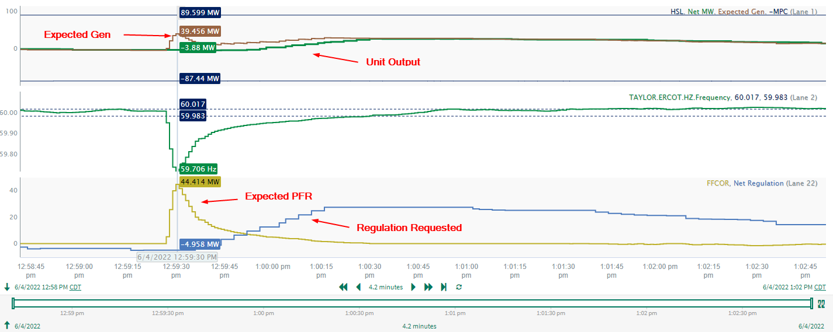
Limited/No PFR – Example 1
Unit output matches the regulation request but does not provide the expected PFR

Slide 4
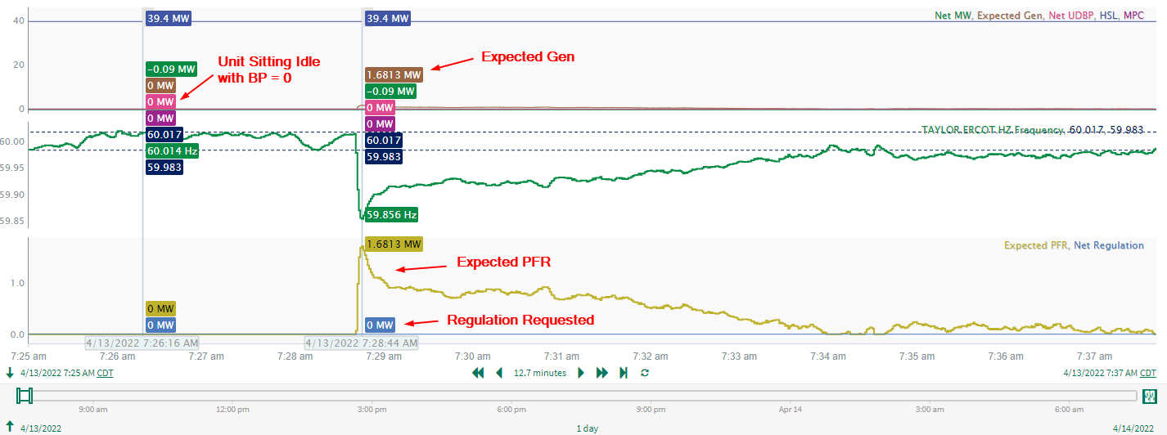
Limited/No PFR – Example 2
Unit has BP = 0 and the unit remains idle rather than provide PFR.

Slide 5
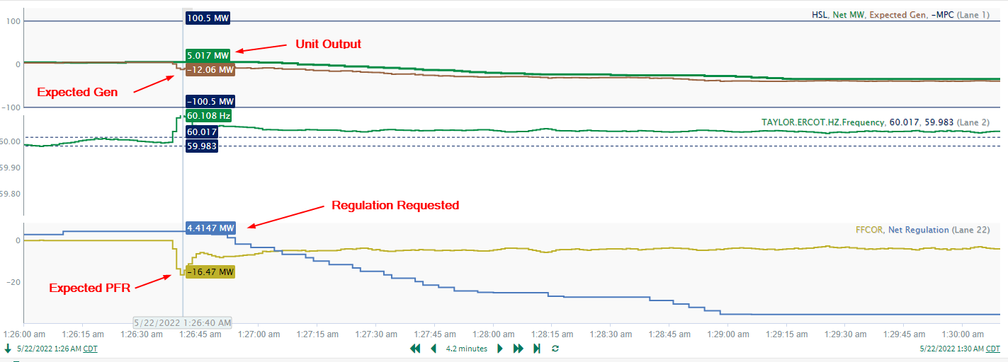
Limited/No PFR – Example 3
Unit output matches the regulation request but does not provide the expected PFR.

Slide 6
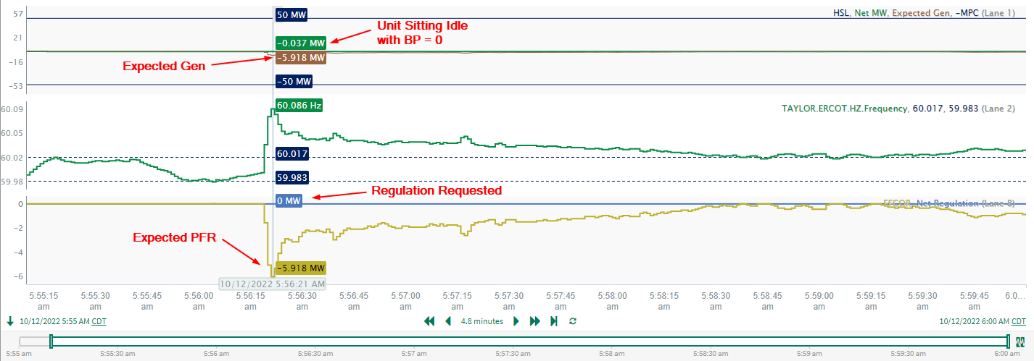
Limited/No PFR – Example 4
Unit has BP = 0 and the unit does not provide PFR.

Slide 7
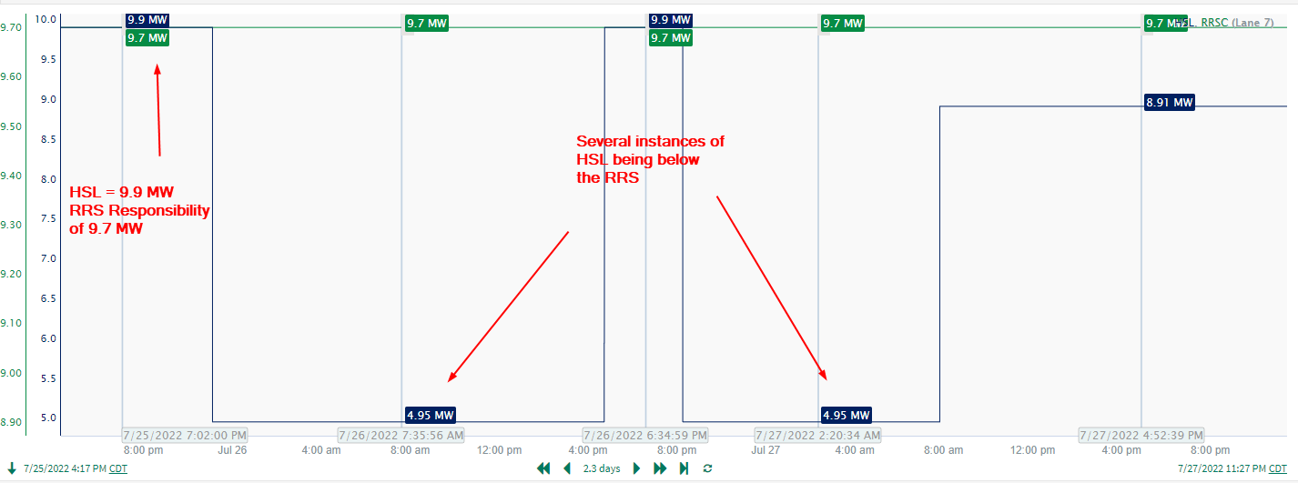
Insufficient Headroom for RRS Obligation – Example 1
Unit has RRS responsibility of 9.7 MWs but there are several instances where HSL dropped to 4.95 MW causing insufficient headroom for RRS Responsibility

Slide 8
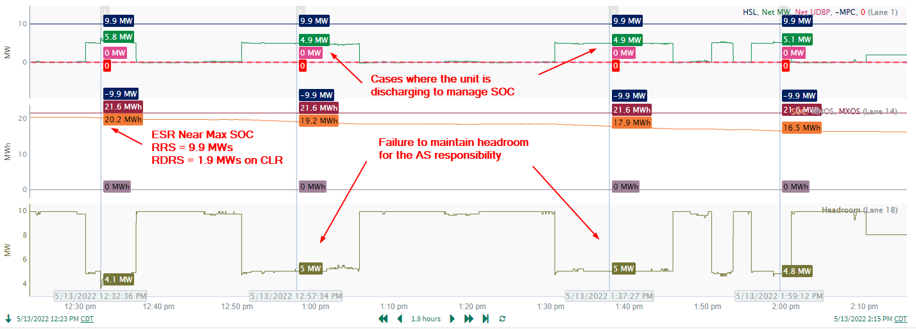
Insufficient Headroom for RRS Obligation – Example 2
This 9.9 MW ESR was carrying 9.9 MW of RRS and discharging while no RRS deployment was active and its was BP = 0. As a result, the ESR was short on meeting its RRS obligation.
During the same timeframe the ESR also had 1.9 MW of Reg Down obligation and its State-of-Charge (SOC) was fairly high (near 95% of its Max limit).

Slide 9
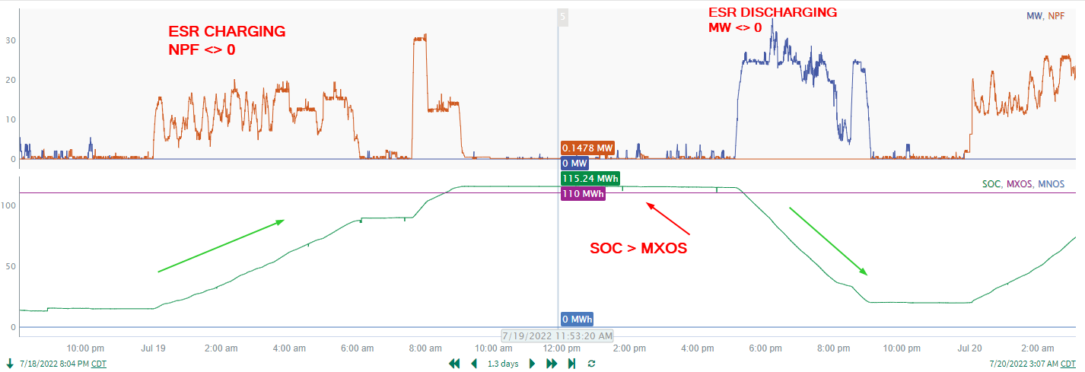
ESRs suspect SOC Telemetry Issues
ERCOT receives SOC telemetry from ESRs.
  SOC is being used since mid-October 2022 in calculating PRC contribution from ESRs (NPRR 987).
  SOC is also used in monitoring an ESR’s capability in meeting its up AS obligations.
Common issues with SOC Telemetry include:
  SOC, MXOS, MNOS, MXDP, MXCP do not exist or are incorrect
  SOC does not correlate to charging/discharging of ESR
  SOC > MXOS (See example below)

Slide 10
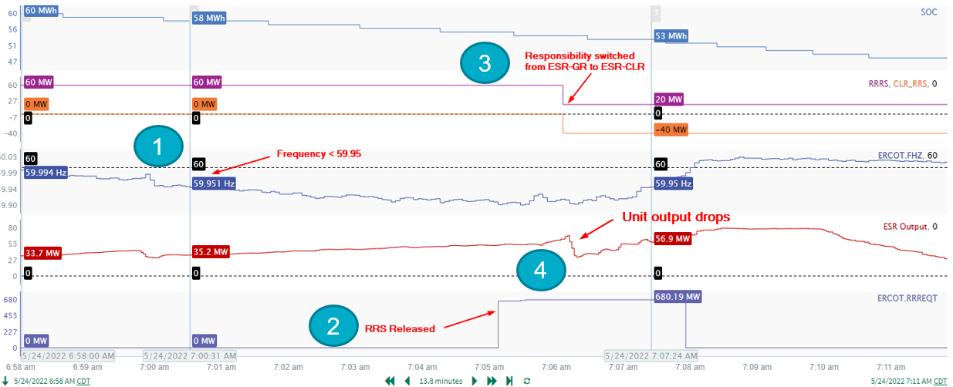
AS Responsibility Transitioned to Charging side During Deployment – Example 1
  Expectation: RRS Responsibility should not be moved between discharging to charging side of an ESR while frequency is below 59.95 Hz*
Business Practice Manual – ERCOT and QSE Operations Practices During the Operating Hour Section 3.6 Responsive Reserve Ancillary Service

Slide 11
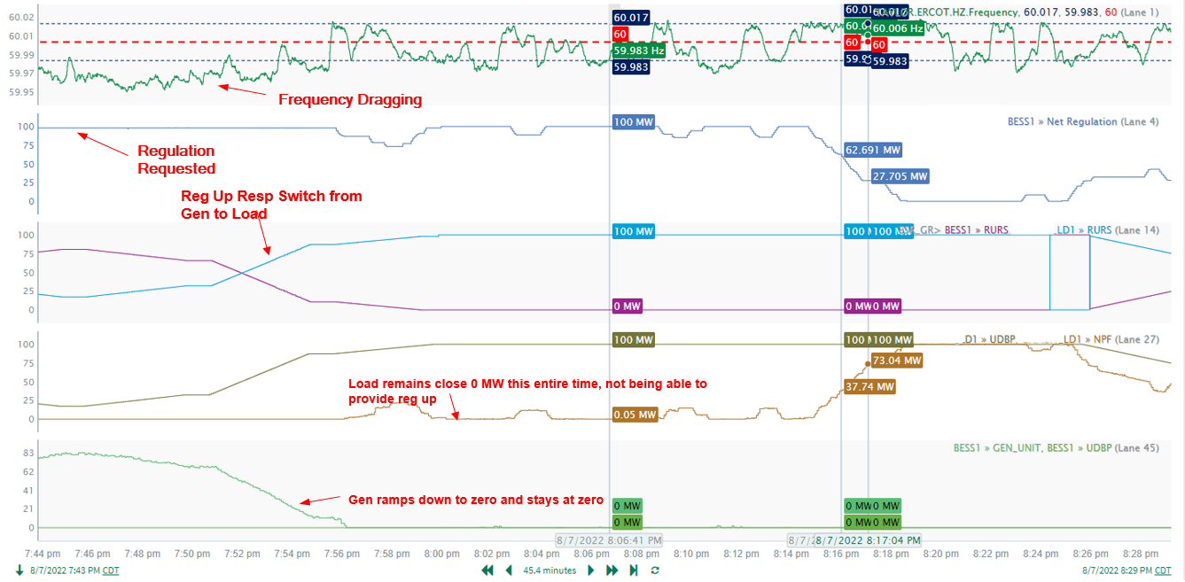
AS Responsibility Transitioned to Charging side During Deployment – Example 2
  Expectation: Regulation Up Responsibility should not be moved between discharging to charging side of an ESR while Regulation Up is being actively deployed.
1
2
3
4

Slide 12
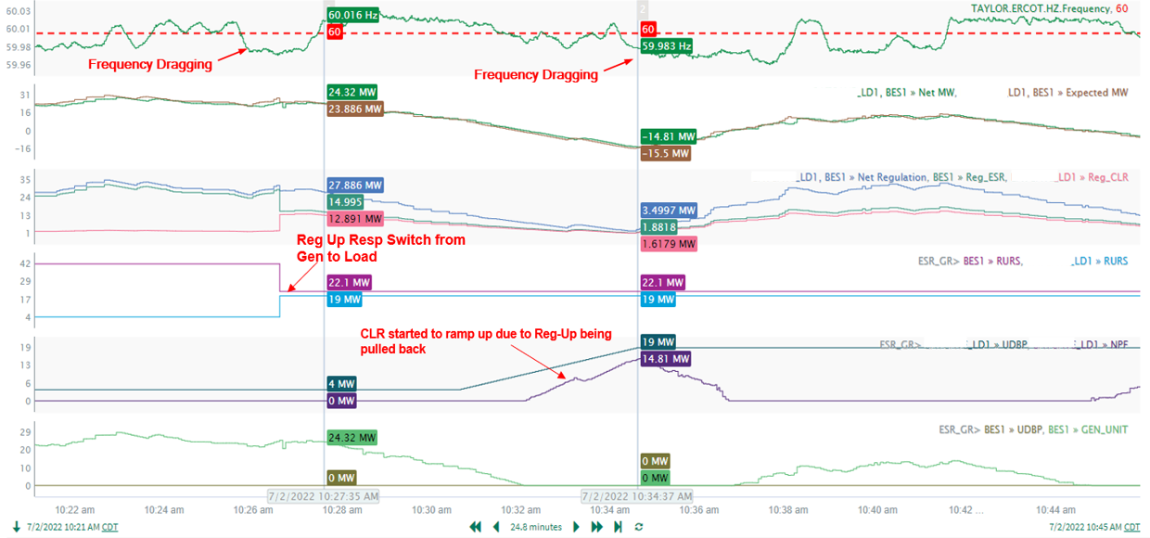
AS Responsibility Transitioned to Charging side During Deployment – Example 3
  Expectation: Regulation Up Responsibility should not be moved between discharging to charging side of an ESR while Regulation Up is being actively deployed.
1
4
2
3

Slide 13
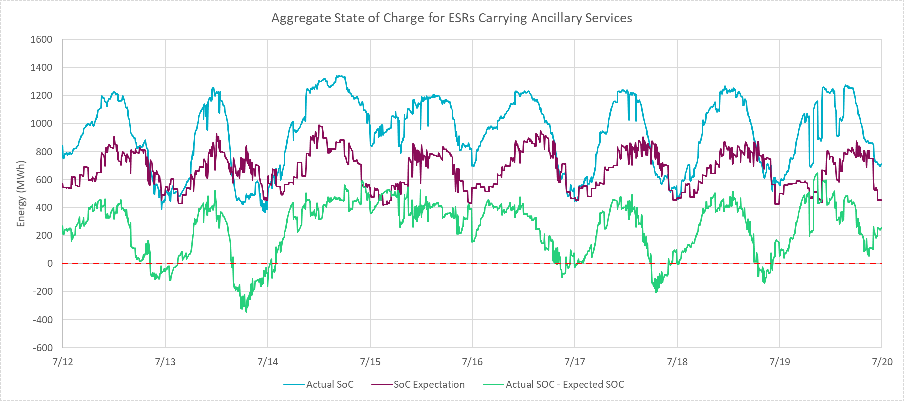
Insufficient SOC for total up AS Obligation
There is a steady growth in the amount of up AS (Specifically Reg and RRS) Energy Storage Resources (ESRs) have been carrying.
ERCOT has been monitoring if ESRs are reserving sufficient amount of SOC for the up AS obligation being carried on the injection side and has identified several cases where the expected SOC wasn’t met.
Below is an example from the week of July 12th that demonstrates SOC performance on ESRs that were carrying up AS
SOC Expectation = Total Up AS Obligation * duration requirement - cumulative energy deployed through the hour.

Slide 14
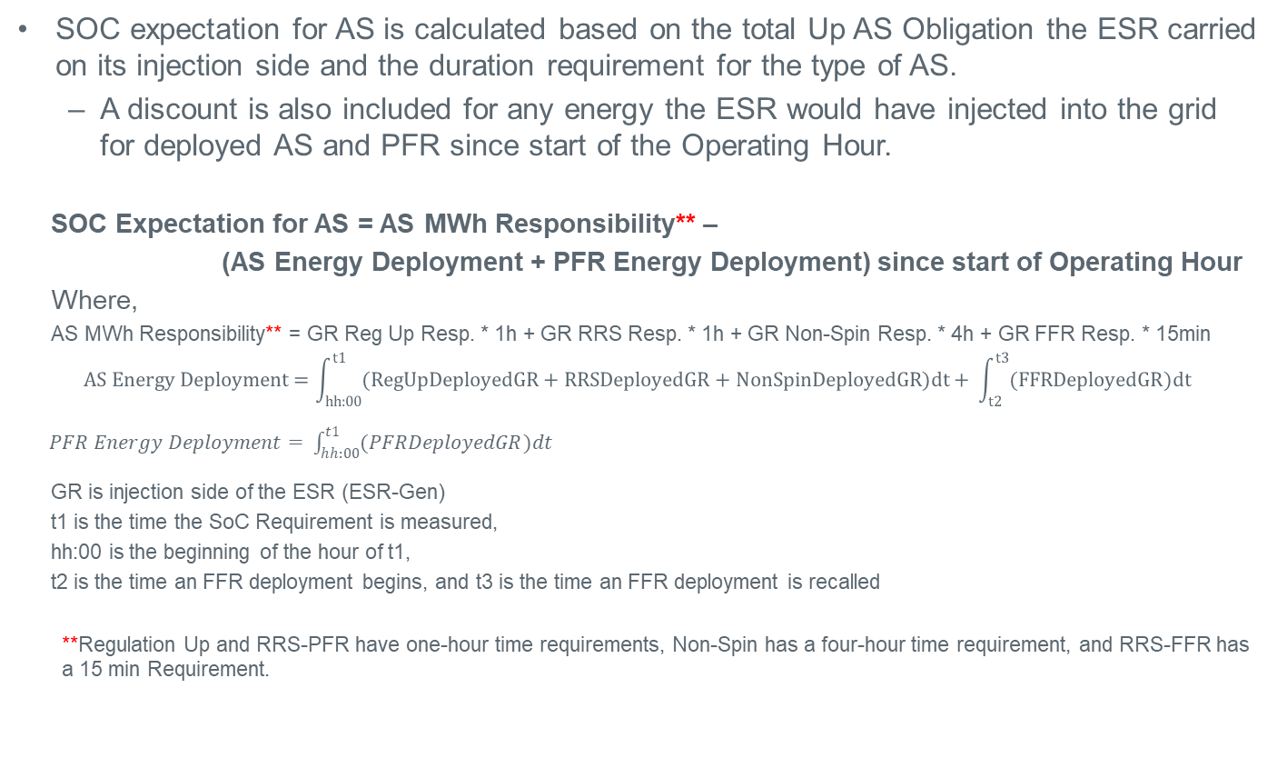
SoC Monitoring for AS Responsibility
SOC expectation for AS is calculated based on the total Up AS Obligation the ESR carried on its injection side and the duration requirement for the type of AS.
  A discount is also included for any energy the ESR would have injected into the grid for deployed AS and PFR since start of the Operating Hour.
  SOC Expectation for AS = AS MWh Responsibility** –
  (AS Energy Deployment + PFR Energy Deployment) since start of Operating Hour
  Where,
  AS MWh Responsibility** = GR Reg Up Resp. * 1h + GR RRS Resp. * 1h + GR Non-Spin Resp. * 4h + GR FFR Resp. * 15min
$$AS Energy Deployment=\int_{hh:00}^{t1}{(RegUpDeployedGR+RRSDeployedGR+NonSpinDeployedGR})dt+ \int_{t2}^{t3}{(FFRDeployedGR})dt$$
$PFR Energy Deployment= \int_{hh:00}^{t1}{(PFRDeployedGR)dt}$
GR is injection side of the ESR (ESR-Gen)
t1 is the time the SoC Requirement is measured,
hh:00 is the beginning of the hour of t1,
t2 is the time an FFR deployment begins, and t3 is the time an FFR deployment is recalled
  **Regulation Up and RRS-PFR have one-hour time requirements, Non-Spin has a four-hour time requirement, and RRS-FFR has a 15 min Requirement.

Slide 15
SOC Monitoring Chart Details
Following is a legend for the charts that are plotted in Slide 16 through Slide 22.
Total Up AS Responsibility (converted to MWh) shown in dotted red
SoC Requirement (including discounts for deployment) shown in solid red
SoC shown in green
All intervals where SoC < Requirement are highlighted
Additional lanes showing AS Responsibility and deployments

Slide 16
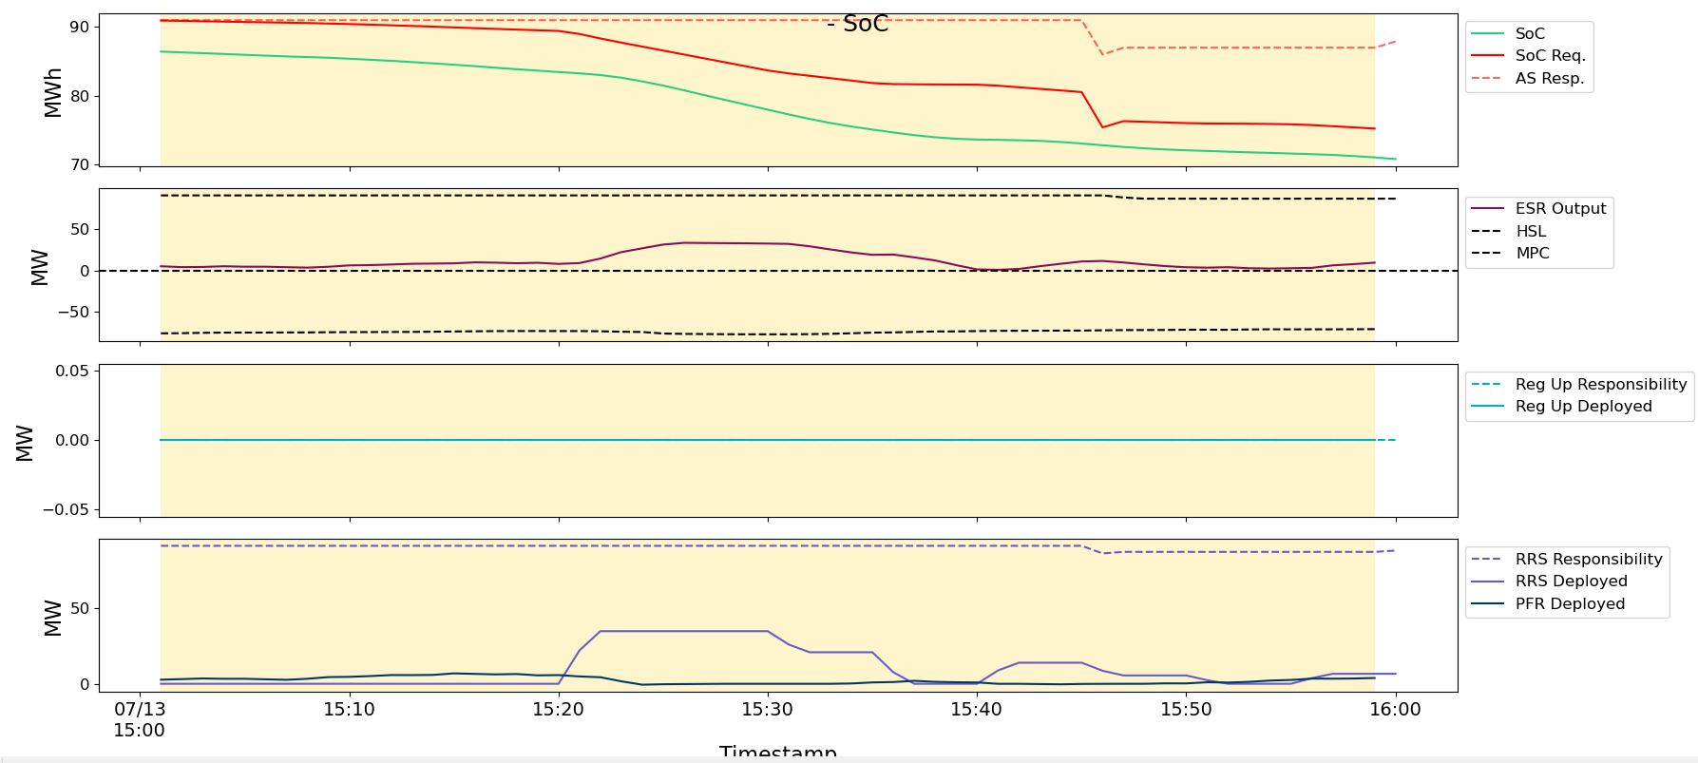
Insufficient SoC Monitoring for AS Responsibility - Example
In HE16, this ESR is carrying 90 MW RRS. Therefore, the SOC requirement at the start of the hour is 90 MWh. However, the ESR does not have or maintain sufficient SOC throughout the hour.
  At around 15:20 RRS is released, the ESR’s output increases and it provides energy in response to the RRS deployment (visible through reduction in SOC).
    The ESR’s SOC expectation also adjusts to account for the RRS energy deployment.

Slide 17
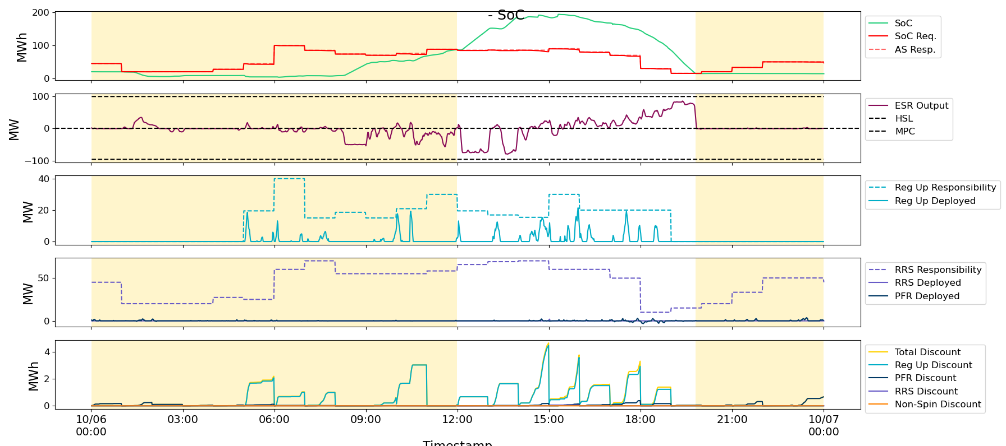
Insufficient SOC for total up AS Obligation – Example 1
For the timeframe below this ESR was carrying up to 100 MW Reg Up + RRS on the injection side and was short up to 90 MWh in SOC for the AS obligation.

Slide 18
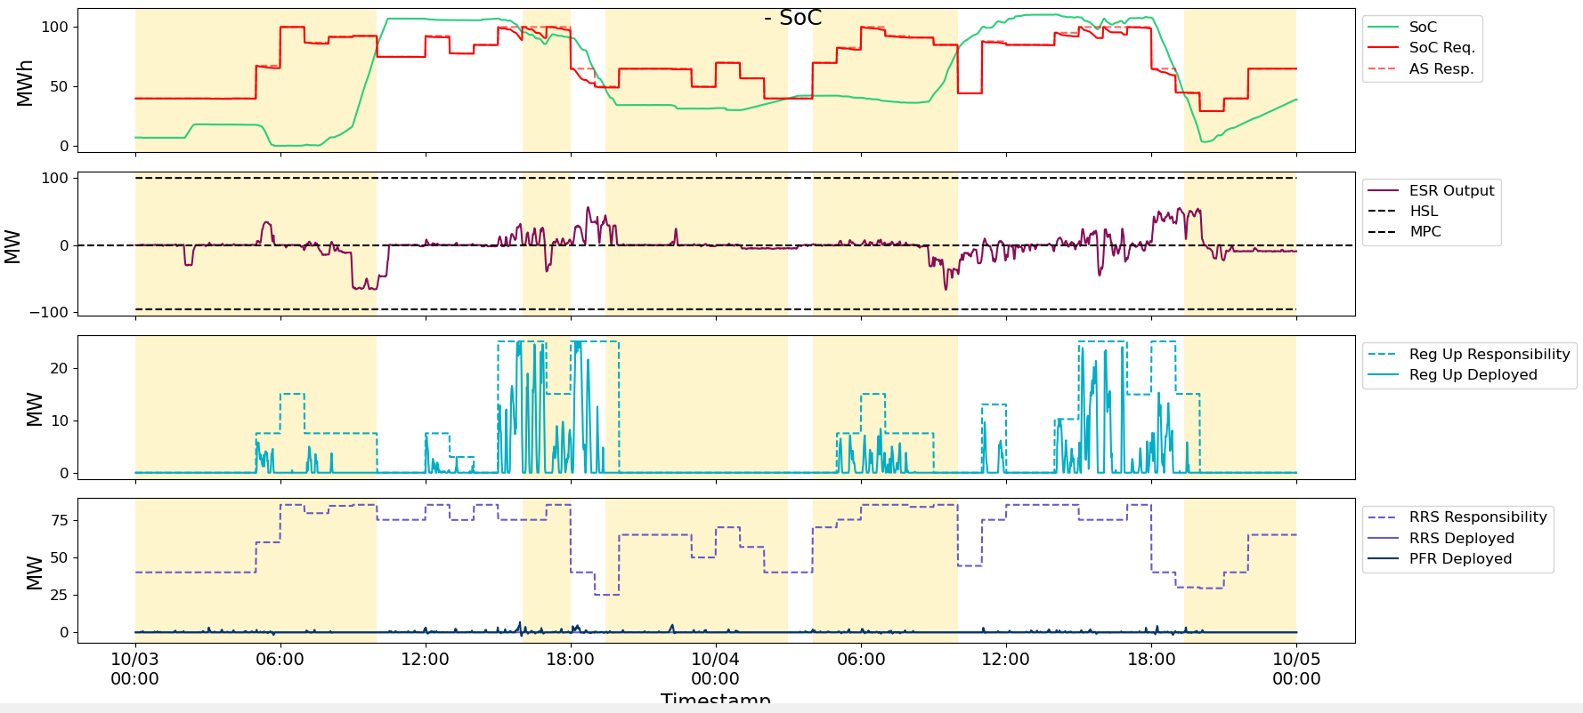
Insufficient SOC for total up AS Obligation – Example 2
For the timeframe below this ESR was carrying up to 100 MW Reg Up + RRS on the injection side and was short up to 50 MWh in SOC for the AS obligation.

Slide 19
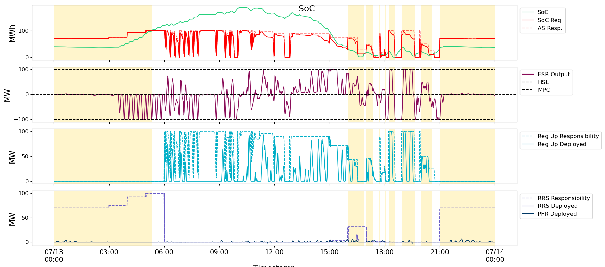
Insufficient SOC for total up AS Obligation – Example 3
For the timeframe below this ESR was carrying up to 100 MW of Reg Up and + RRS on the injection side and was short up to 90 MWh in SOC for the AS obligation.

Slide 20
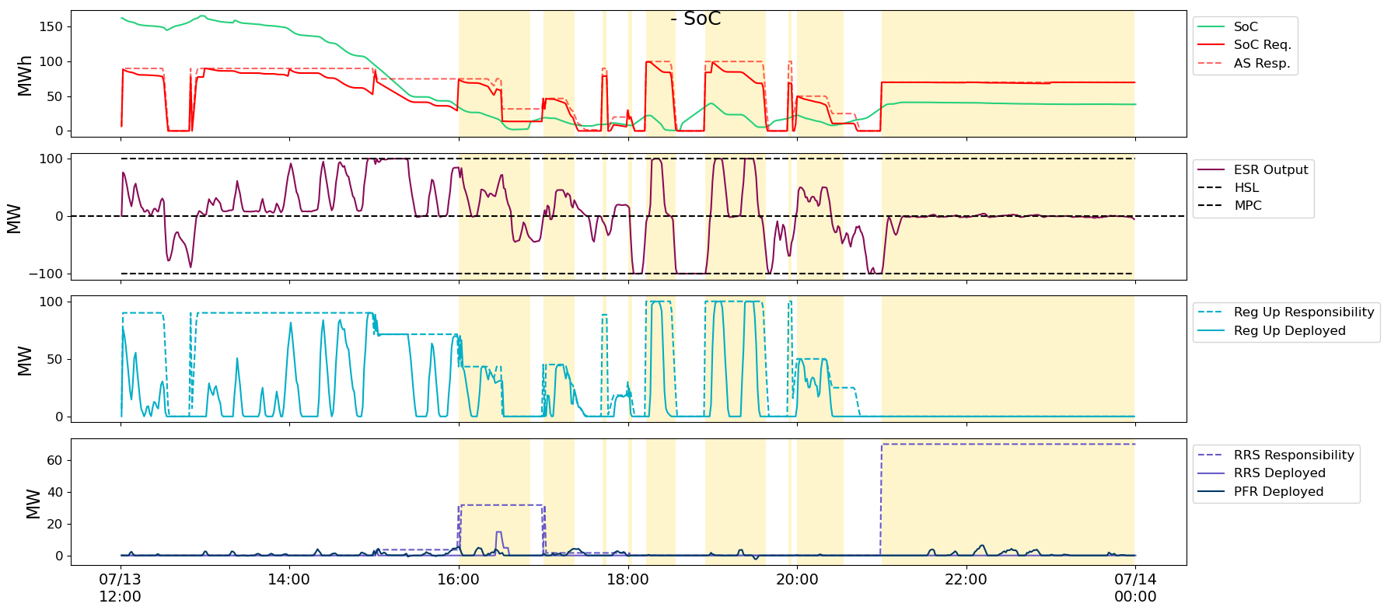
Insufficient SOC for total up AS Obligation – Example 3 (Zoom In)
Same GR Focus on hours after evening ramp and high regulation deployment

Slide 21
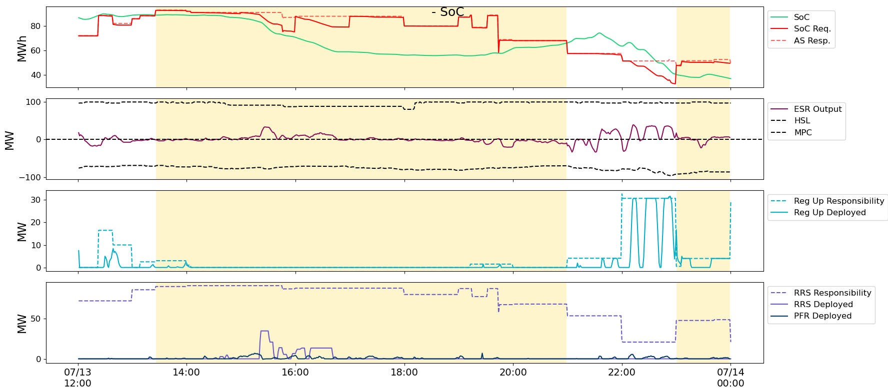
Insufficient SOC for total up AS Obligation – Example 4
For the timeframe below this ESR was carrying up to 80 MW of Reg Up + RRS on the injection side and was short up to 30 MWh in SOC for the AS obligation.

Slide 22
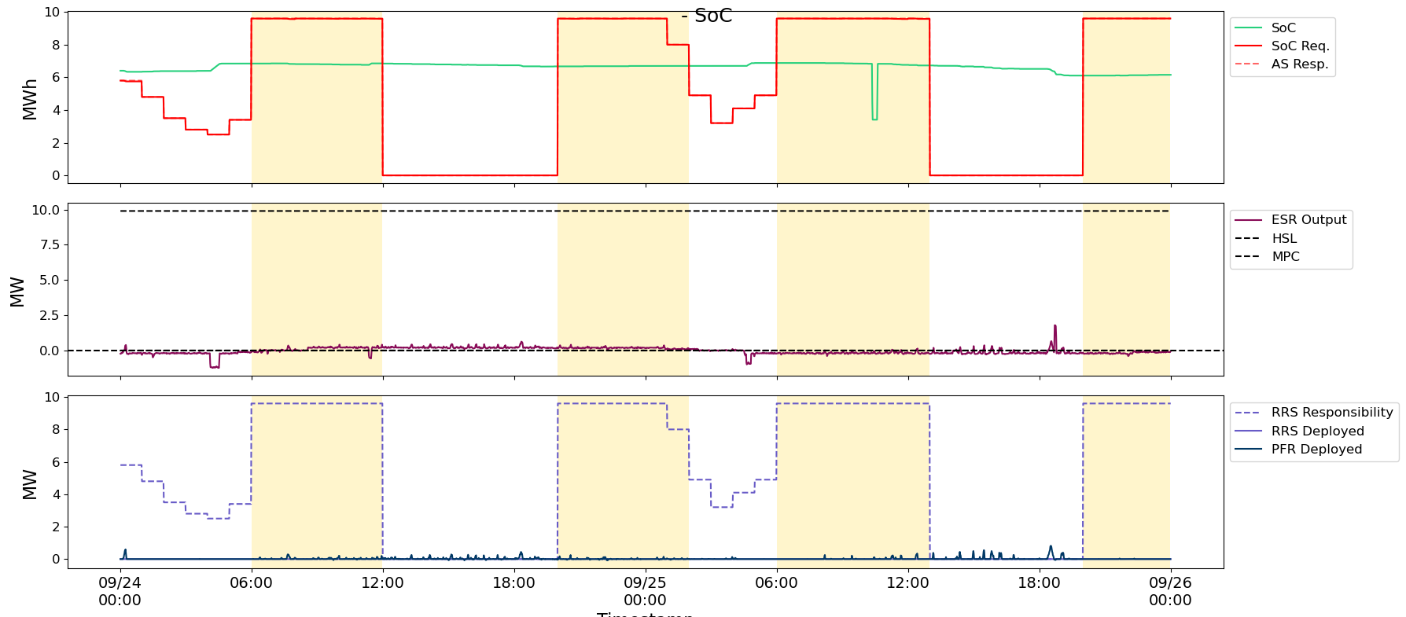
Insufficient SOC for total up AS Obligation – Example 5
For the timeframe below this ESR was carrying up to 9.9 MW of Reg Up + RRS on the injection side and was short up to 3.3 MWh in SOC for the AS obligation.

Slide 23
Recap of Key Expectations
Below is a Recap on some key expectations
  PFR response is expected when frequency is outside of the 17mHz dead-band and the ESR has frequency responsive headroom/legroom.
  ESRs are expected to reserve sufficient headroom/legroom for the AS Obligation being carried.
  When ramping from current BP to next BP ESRs are expected to follow an Updated Desired Base Point (UDBP) like signal.
    When measuring an ESR’s ability to following BP, an expected output requirement is built as sum of UDBP, regulation instruction and expected PFR.
  SOC related telemetry (SOC, MXOS, MNOS, MXDP, MXCP) should be provided.
    MNOS <= SOC <= MXOS
  Transition of AS
    Regulation Up Responsibility should not be moved between discharging and charging side of an ESR while Regulation Up is being actively deployed.
    RRS Responsibility should not be moved between discharging and charging side of an ESR while frequency is below 59.95 Hz.
    Non-Spin Responsibility should not be moved between discharging and charging side of an ESR while PRC is below 3,200 MW.
  SOC for AS
    An ESR that is carrying AS on the injection side must have SOC equal to or greater than its SOC Expectation. SOC expectation is computed based on the total Up AS Obligation the ESR carries on its injection side, the duration requirement for the type of AS and includes a discount for any AS energy deployed through the operating hour.
    Note that post NPRR1096 implementation for Non-Spin in the December 2022 timeframe, ERCOT may conduct unannounced tests to verify sufficient SOC is available for the Non-Spin being carried.

Slide 24
Summary & Next Steps
There is a steady growth in the amount of Energy Storage Resources (ESRs) that have interconnected into the ERCOT Grid.
ERCOT has identified several issues with ESR performance in their ability to follow BPs/Expected Gen, provide AS including inappropriate transitions of up AS responsibilities between discharging and charging sides and maintain state-of-charge for the AS responsibility being carried.
ERCOT has been conducting active outreach with QSEs on these and expects to continue these outreach as more issues are identified.
ERCOT is in the process of refreshing the Business Practice Manual – ERCOT and QSE Operations Practices During the Operating Hour to ensure it covers telemetry expectations as applicable to ESRs.

Slide 25
Appendix

Slide 26
Expectations for SOC, MXOS, MNOS Telemetry
Maximum Operating State of Charge (MXOS) – telemetry represents the maximum amount of stored energy capability in MWh that can be delivered at the POI and cannot be exceeded.
  For example, if the ESR currently has the capability of storing a maximum of 10 MWh and the discharge efficiency is 0.94, then this telemetered value (SOC_Max) = 0.94*10=9.4 MWh
State of Charge (SOC) – telemetry represents the amount of energy in MWh that can be delivered to the POI.
  For example, if the ESR is currently storing 6 MWh and the discharge efficiency is 0.94, then this telemetered value (SOC) = 0.94*6=5.64 MWh
Minimum Operating State of Charge (MNOS) – telemetry represents the required minimum amount of stored energy in MWh that can be delivered at the POI and cannot be go below.
  For example, if the ESR is required to store a minimum of 2 MWh and the discharge efficiency is 0.94, then this telemetered value (SOC_Min) = 0.94*2=1.88 MWh

Slide 27
Expectations for SOC, MXOS, MNOS Telemetry
With minimum, maximum, and current state of charge telemetry points, Operators can visualize the ESRs current charge with respect to the charging range.
Notes:
General check:
Values should be in MWh
MXOS > 0.00 MWh
MNOS<=SOC<=MXOS
MNOS >= 0.00 MWh
Telemetry is utilized for situational awareness tools for the ERCOT Operators.

Slide 28
Expectations for MXCP and MXDP Telemetry
Maximum Operating Discharge Power Limit (MXDP) – telemetry represents the true inverter discharge capability in MW. This point should account for derates for operational issues. Ideally this would be close to ESR-GR HSL.
  For Example, if a +-10 MW ESR is telemetering a HSL of 3 MW for the ESR-GR, the MXDP should be +10 MW unless there is a derate for operational reason. One can look at the values of HSL and MXDP and if there are differences, one can deduce that the ESR is running out of SOC and is trying to show less MW to SCED for discharge purpose.
Maximum Operating Charge Power Limit (MXCP) – telemetry represents the true inverter charging capability in MW. This point should account for derates for operational issues, but ideally this would be close to ESR-CLR MPC.
  For example, a +-10 MW ESR is telemetering a MPC of 3 MW for the ESR-CLR, the MXCP should be +10 MW unless there is a derate for operational reason. One can look at the values of MPC and MXCP and if there are differences, one can deduce that the ESR is almost full SOC and is trying to show less MW to SCED for charge purpose.

Slide 29
Charge/Discharge Duration
MXDP – Maximum Operating Discharge Power Limit
MXCP – Maximum Operating Charge Power Limit
Min. Discharge Time
Min. Charge Time
With the current state of charge and the maximum discharge/charge rates, ERCOT can calculate the minimum times to reach MXOS and MNOS.

