Slide 1
NPRR 1143 – Benefits of ESR Charging During EEA3
11/14/2022
ERCOT Staff

Slide 2
Background on NPRR 1143
NPRR 1143 will provide the Control Room the flexibility to allow SCED to dispatch the charging side of ESRs during an extended EEA3 (such as Winter Storm Uri) in order to build up state of charge in ESRs and enhance the resilience of ERCOT system operations.
The operational perspective:
  ERCOT’s default posture when entering an EEA3 will be to suspend charging on ESRs and set ESR-CLR Base Point (BP) = 0 MW.
  When operating in an extended EEA3, as the situation improves and available reserves increase, ERCOT’s approach will be to restore as much firm load shed as can be reliably supported.
    However, knowing that load restoration is “blocky” in nature, during times while load is being restored, there may be opportunity to let ESRs to charge in order to build up their state of charge. NPRR1143 will provide ERCOT flexibility to let SCED consider ESR-CLR bids as a part of its optimization and send non-zero BPs.
    Note that following a decision to allow charging, ERCOT will actively monitor evolving grid conditions and if they expect ESR charging to negatively impact reliability, ERCOT may toggle back to not allowing non-zero charging BPs.

Slide 3
Background on NPRR 1143
Potential reliability benefits of allowing charging and thus having ESR’s with non-zero State of Charge during EEA3 include:
  Increased available frequency responsive capability and enhanced operational PRC.
  Additional available capability, which may also help reduce any additional amount of firm load shed needed meet subsequent peak net load period.
  Maximize generation in export constrained local area by charging ESRs that are behind the export constraint.
This slide deck will use mock-ups of illustrative scenarios to demonstrate situations wherein charging ESRs may provide reliability benefits during an EEA3, in some cases utilizing data from Winter Storm Uri.

Slide 4
Assumptions for the Mockups
Fictional Fleet of 25 ESRs:
  HSL and MPC of 100 MW with 1% droop
  One hour duration, so MXOS is 100 MWh
  Total of 2500 MW HSL and MPC, along with 2500 MWh MXOS
All ESRs in the fleet are operating with the same energy offer/bid curve:
  2/14 – 2/17 HE 12, they charge below $2000/MWh, and discharge above $7500/MWh
  2/17 HE 13 and beyond, they charge when their settlement price is below $1000/MWh, while discharging above $1500/MWh
  Note that this is with Winter Storm Uri data and the scenario is build with a $9000/MWh price cap in mind
None of the ESRs are impacted by constraints that would cause their LMP to differ from their System Lambda. It’s also assumed that System Lambda will be from the dispatch run of SCED rather than the pricing run, and as such there are no price adders, etc.
ESRs can only charge when system conditions match ERCOT control room-determined ‘charging windows’. For these mock-ups, charging was considered acceptable anytime when available Headroom (ERCOT HSL-GEN) is greater than 3,500 MW. Note:
  This is not necessarily a reflection of the procedure the ERCOT control room would use in this scenario.
Note that because of the way the energy offer & bid curves for this fictional fleet are setup, the fleet’s dispatch & response in the subsequent slides will functionally look like a single resource.

Slide 5
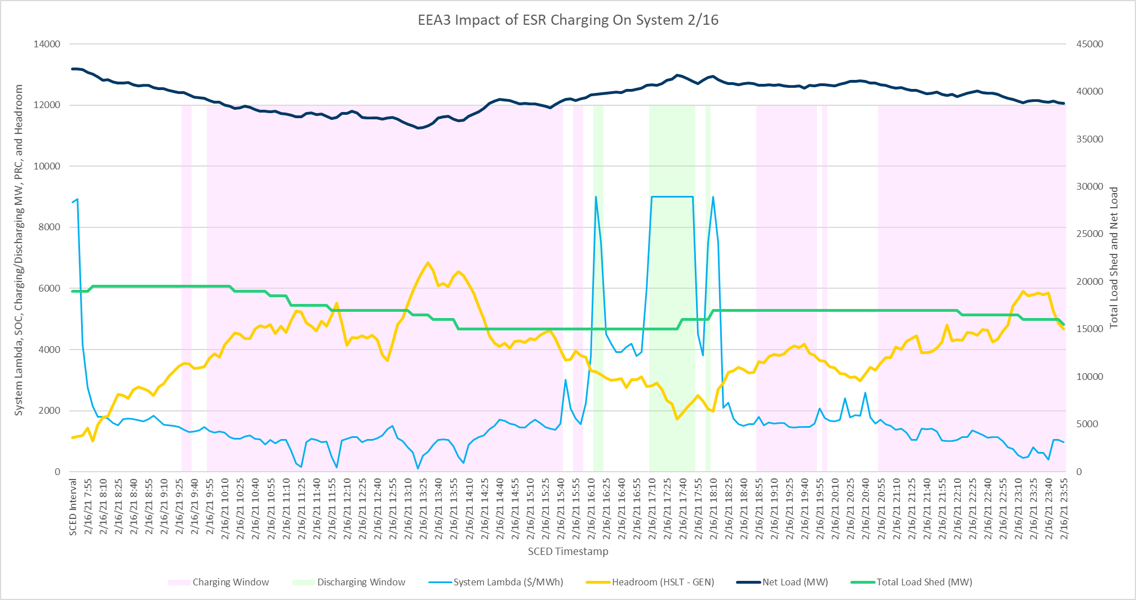
February 16th System Snapshot with ESR Charging Enabled

Slide 6
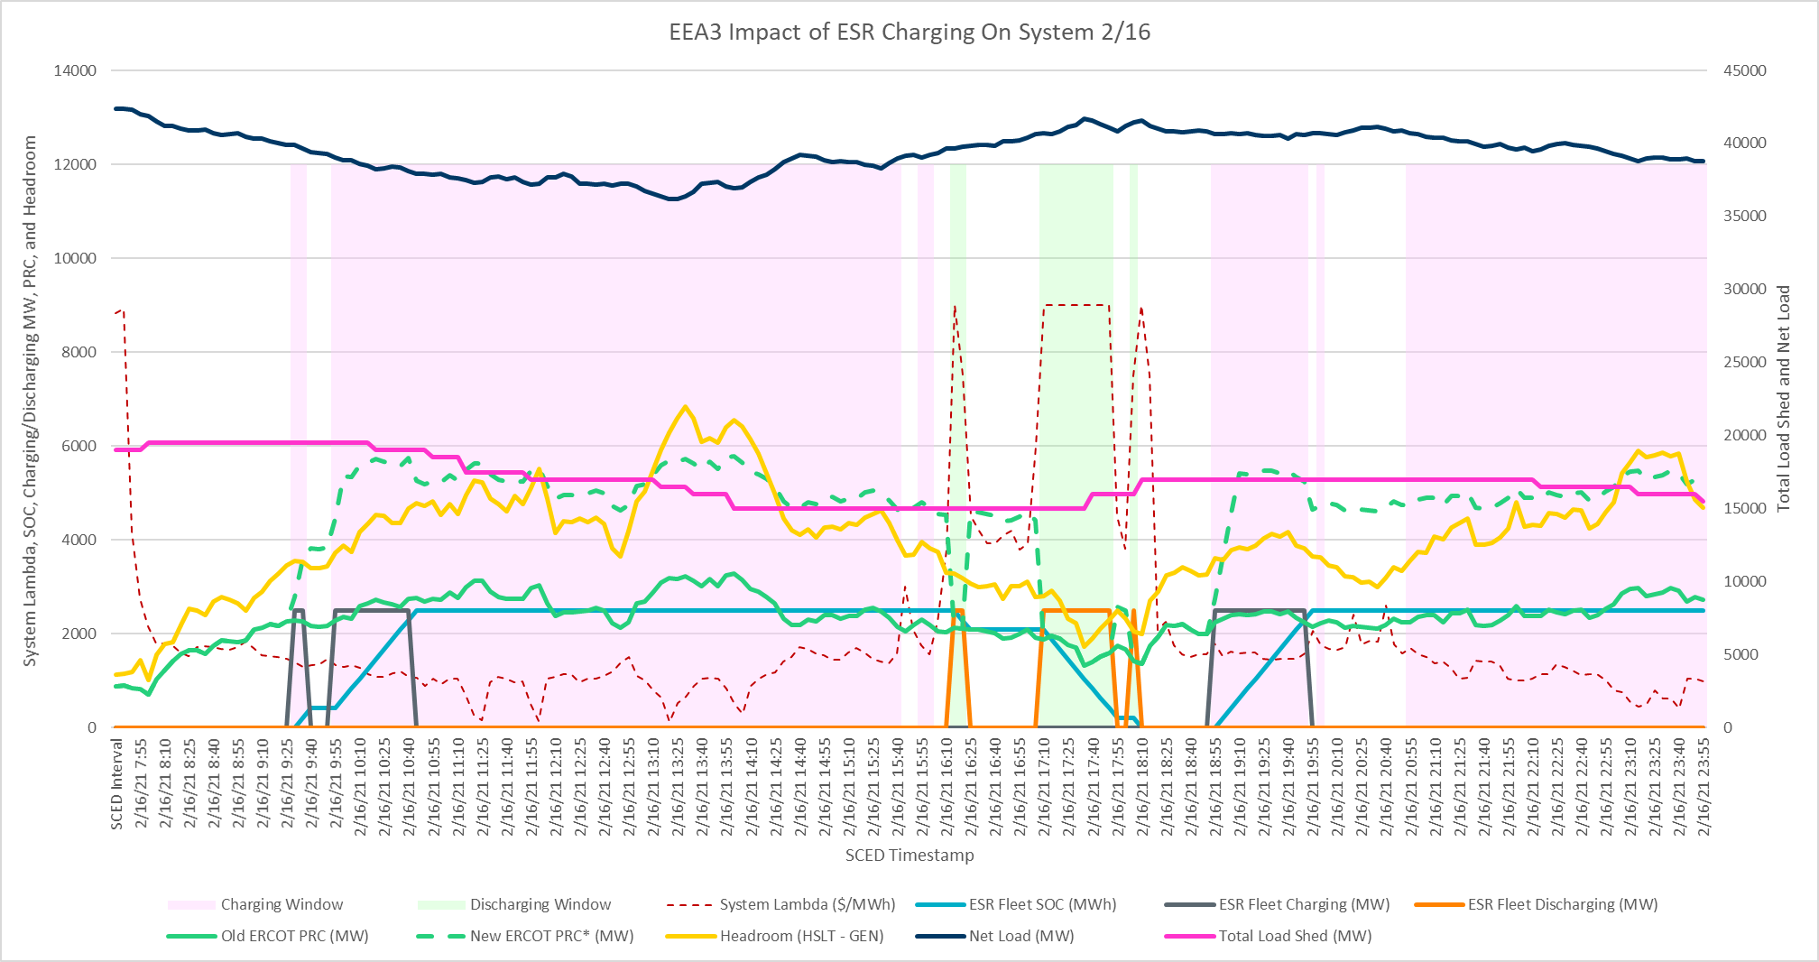
February 16th System Snapshot with ESR Charging Enabled
*Note that for the purposes of this mock-up, charging displaced 80% of previously available PRC. ESRs contribute to PRC while charging, sitting idle, and injecting.
**Note that SCED was not re-run in any of the proceeding slides in instances where charging or discharging is occurring. The Power Balance Penalty Curve is expected to constrain charging in instances where there is insufficient generation to continue charging.

Slide 7
February 16th System Snapshot with ESR Charging Enabled
ESRs begin charging as System Lambda falls and Headroom rises
PRC increases according to PRC8 formula
*Note that for the purposes of this mock-up, charging displaced 80% of previously available PRC. ESRs contribute to PRC while charging, sitting idle, and injecting.

Slide 8
February 16th System Snapshot with ESR Charging Enabled
ESRs discharge as System Lambda rises
*Note that for the purposes of this mock-up, charging displaced 80% of previously available PRC. ESRs contribute to PRC while charging, sitting idle, and injecting.

Slide 9
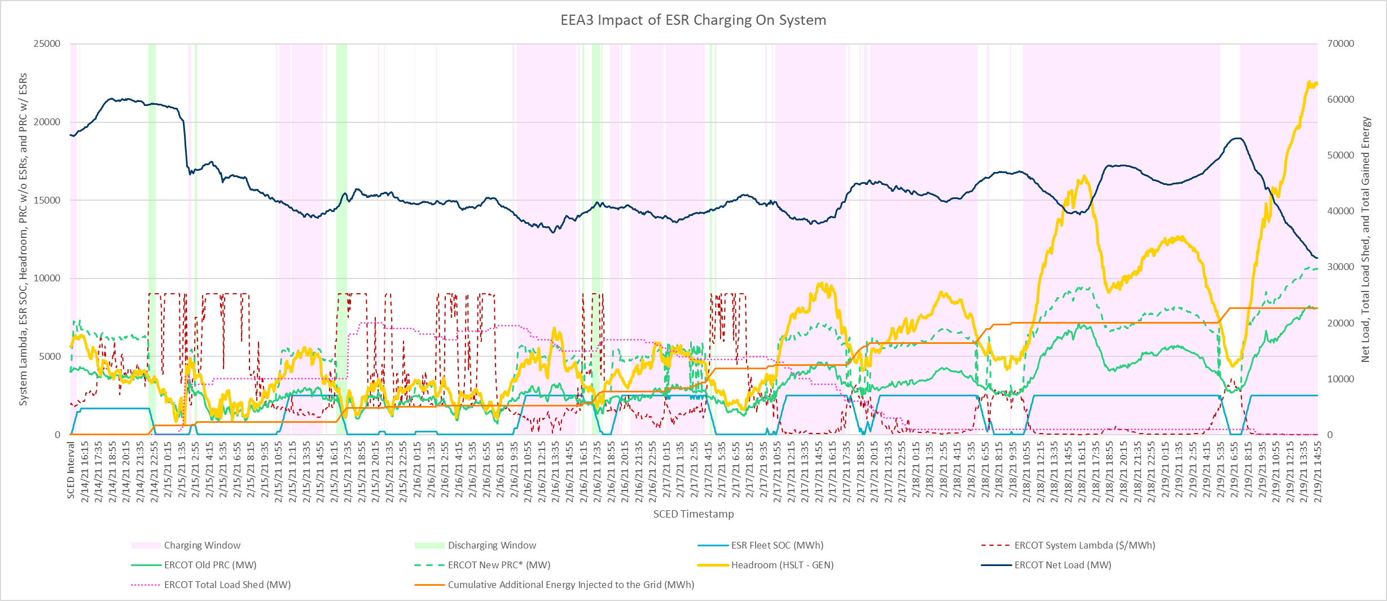
Winter Storm Uri System Snapshot with ESR Charging Enabled
Over 20,000 MWh of additional energy was injected to the grid by ESRs in this hypothetical example
Assumed offer/bid changes
*Note that for the purposes of this mock-up, the ESR fleet consists of identical energy offer/bid curves. In actuality, this would not be the case, and the dispatch and response of the ESR fleet would be much more granular and staggered throughout charging and discharging windows, due to the variations in individual bid/offer curves.

Slide 10
ESR and Solar Unit Behind Constraint Case Assumptions
Settlement price is at the LMP.
System Lambda will be above the ESR’s offer for discharging (and therefore the LMP is high enough when respecting the constraint for the ESR to discharge) when the solar unit’s HSL is below the value of the export constraint.
The LMP will also be low enough when the solar unit is curtailed below its HSL in order to respect the transmission constraint for the ESR’s offer curve to lead them to be dispatched by SCED to charge.
  This case essentially assumes the ESR will have tailored their offer curve to hit the ‘sweet spot’ of prices throughout the day such that they are able to be dispatched by SCED to charge and discharge whenever the congestion dictates.
The two generators are radially connected to a POI that given transmission conditions has only two export feeds. Thus, the only way for the generators to contribute to the system is by exporting out of the local area. It is assumed that System Operations prefers not to perform a remedial switching action due to a lack of fault interrupting devices on each of the two export feeds and the presence of load on each feed.

Slide 11
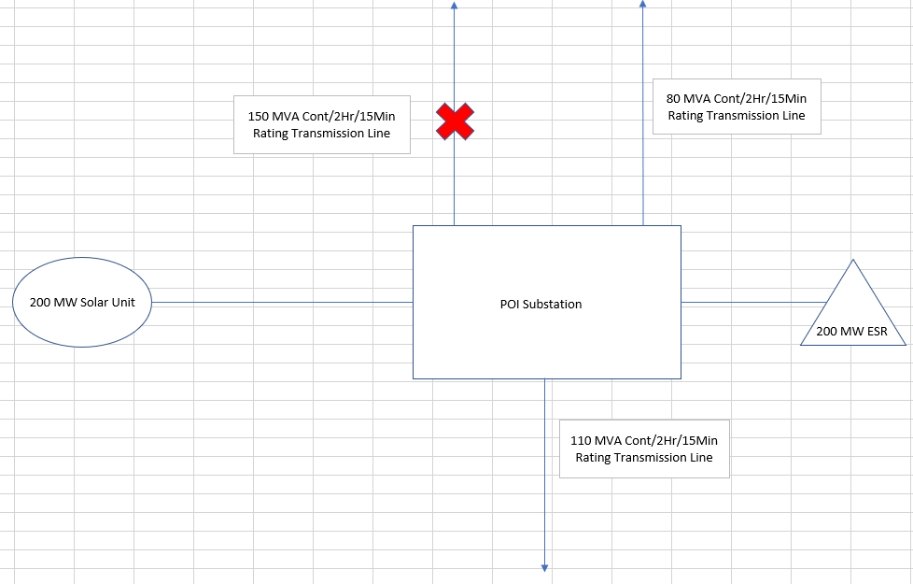
ESR and Solar Unit Behind Constraint Setup

Slide 12
ESR and Solar Unit Behind Constraint Snapshot

Slide 13
ESR and Solar Unit Behind Constraint Snapshot
Local generation export is curtailed to 80 MWs despite the solar resource’s HSL reaching 200 MW.

Slide 14
ESR and Solar Unit Behind Constraint Snapshot
The ESR begins to charge at 120 MW to utilize the additional generation not currently deployed due to the constraint.

Slide 15
ESR and Solar Unit Behind Constraint Snapshot
The ESR eventually reaches its maximum SOC of 200 MWh, then discharges when cloud cover causes the solar resource’s HSL to fall below the level of the transmission constraint.

Slide 16
ESR and Solar Unit Behind Constraint Snapshot
The cloud cover dissipates, and the ESR goes back to charging when the solar resource’s HSL climbs back above 80 MW.

Slide 17
ESR and Solar Unit Behind Constraint Snapshot
The solar follows its typical evening ramp downward, but in this scenario, we have a fully charged ESR able to sustain the local area’s 80 MW export to the system across peak.

Slide 18
ESR and Solar Unit Behind Constraint Snapshot
Nearly 250 MWh of additional energy was exported to the grid by one ESR in this hypothetical example.

Slide 19
Summary
ERCOT’s default posture when at the onset of an EEA3 will still be to suspend charging on ESRs.
However, there may be times during an EEA3 wherein allowing ESRs to charge may provide reliability benefits, particularly when said EEA3 is over an extended period (multiple net load peaks).
NPRR1143 will provide ERCOT the flexibility in determining when to let SCED consider ESR-CLR bids as a part of its optimization and send non-zero BPs to ESR-CLRs.

Slide 20
Questions?

Slide 21
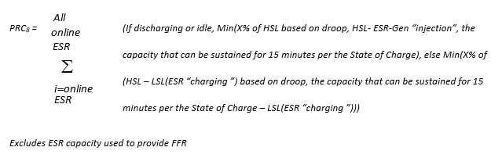
Calculating ‘New’ PRC with Inclusion of ESR PRC Component

