Slide 1
ERCOT Frequency Events
October 2022
ERCOT
Operations Planning
PDCWG | November 16th, 2022

Slide 2
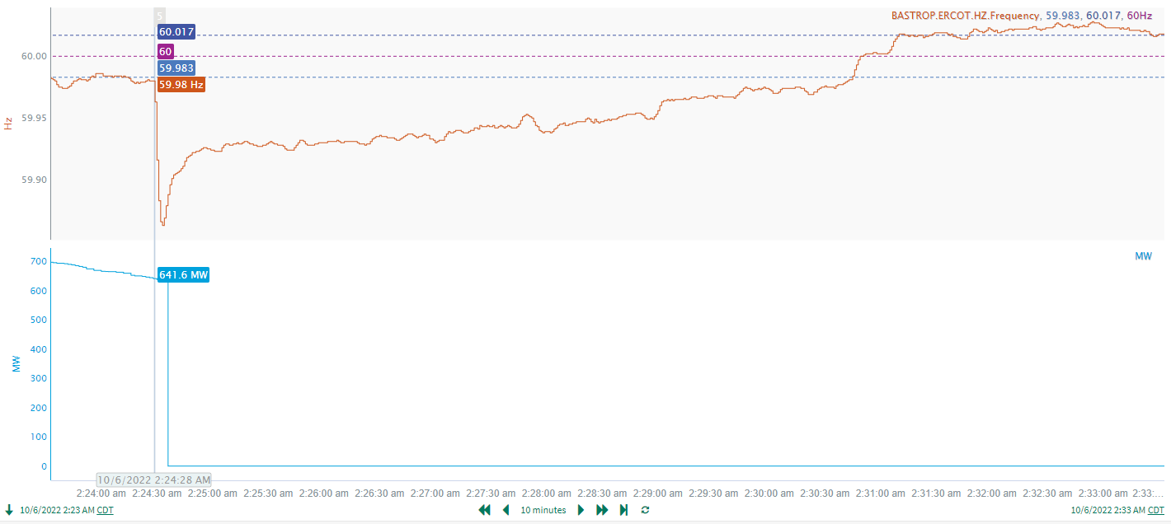
10/6/2022 2:24:28(Non-FME)
Notes:
The unit tripped offline while carrying approximately 656 MW
Starting Frequency: 60.002 Hz
Minimum Frequency: 59.81 Hz
A-C Time : 5 seconds
Recovery Time(back to deadband): 4 minutes 33 seconds
RRS Released: 1219 MW
Trip Reason: Unknown at this time
Contextual Information: A total of 150 MW of regulation up was deployed and manual offset of 350 MW was applied during this time

Slide 3
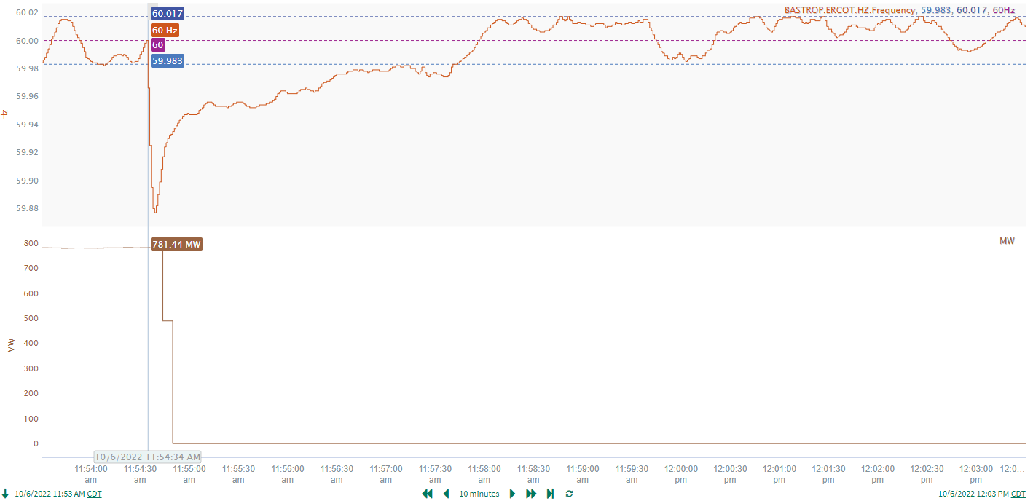
10/6/2022 11:54:34 (FME)
Notes:
The unit tripped offline while carrying approximately 656 MW
Starting Frequency: 60.000 Hz
Minimum Frequency: 59.877 Hz
A-C Time : 5 seconds
Recovery Time(back to deadband): 3 minutes 7 seconds
RRS Released: 557 MW
Trip Reason: Generator Operator indicated there was an arcing
Contextual Information: A total of 451 MW of regulation up was deployed during this time

Slide 4
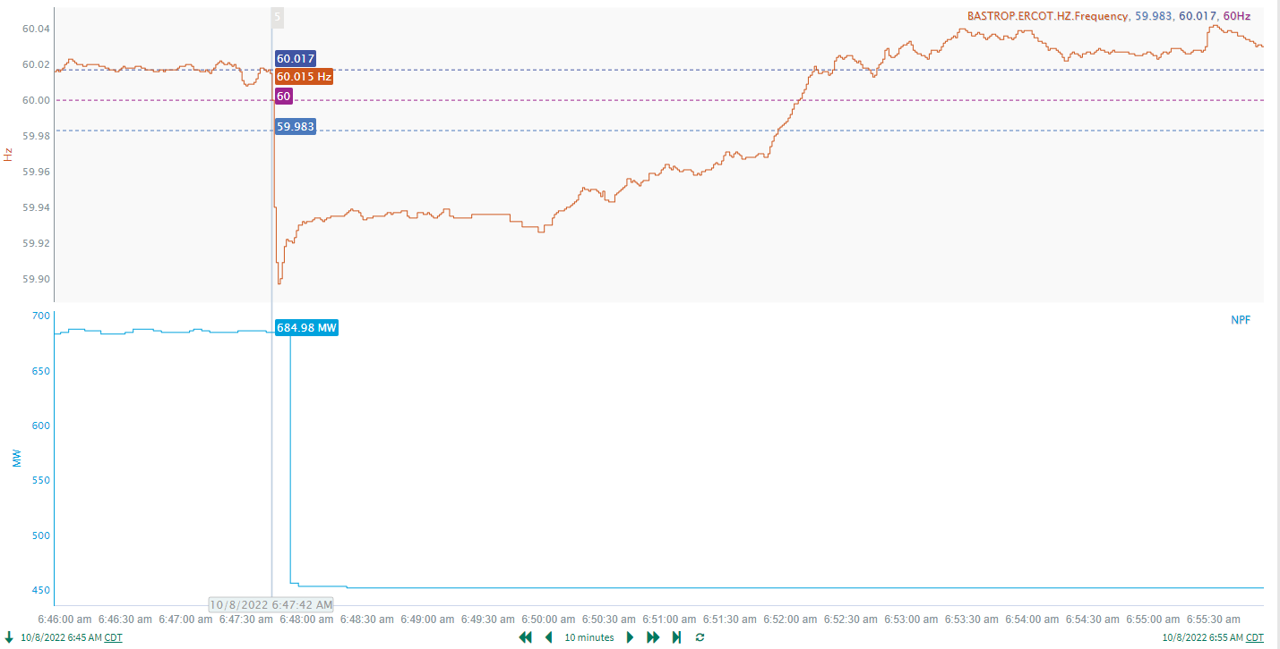
10/8/2022 6:47:42(FME)
Notes:
The unit tripped offline while carrying approximately 685 MW
Starting Frequency: 60.015 Hz
Minimum Frequency: 59.8970 Hz
A-C Time : 4 seconds
Recovery Time(back to deadband): 4 minutes 12 seconds
RRS Released: 251 MW
Trip Reason: Unknown at this time
Contextual Information: A total of 491 MW of regulation up was deployed and manual offset of 350 MW was applied during this time

Slide 5
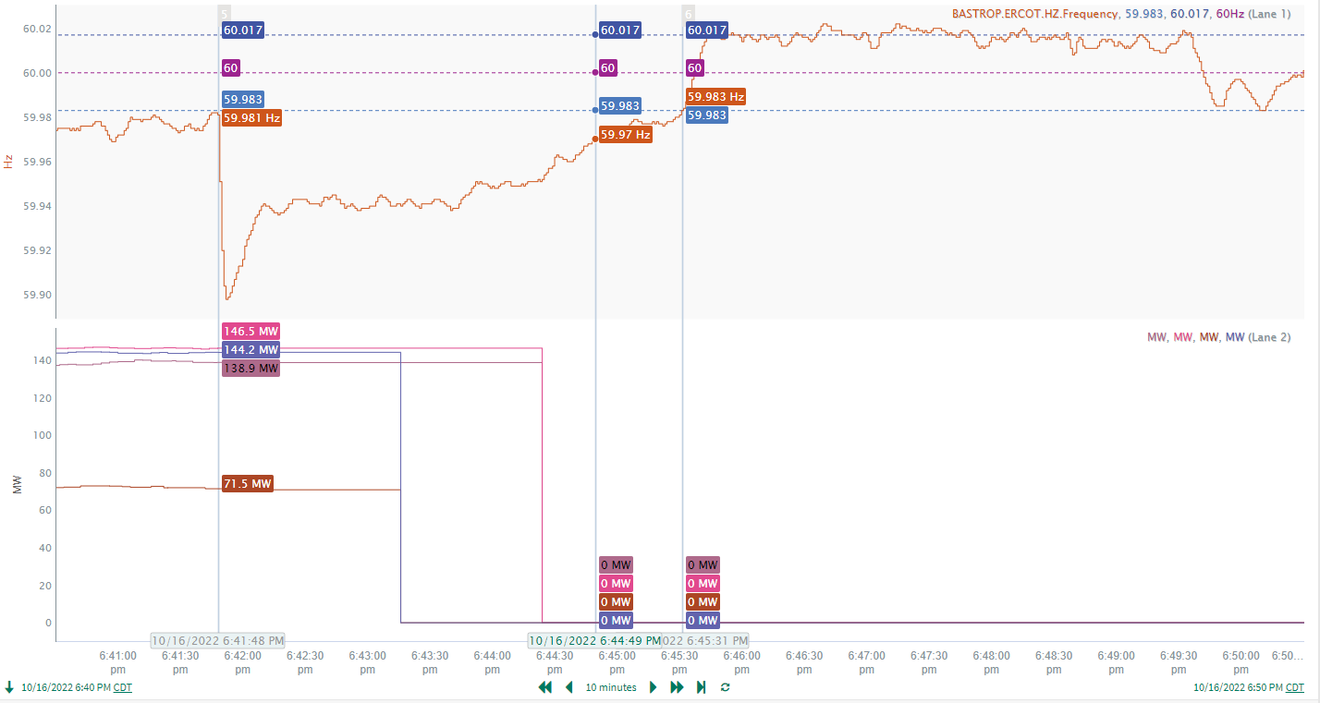
10/16/2022 18:41:48(Non-FME)
Notes:
The unit tripped offline while carrying approximately 656 MW
Starting Frequency: 59.981 Hz
Minimum Frequency: 59.8980 Hz
A-C Time : 4 seconds
Recovery Time(back to deadband): 3 minutes 43 seconds
RRS Released: 576 MW
Trip Reason: Weather in the area
Contextual Information: A total of 482 MW of regulation up was deployed and manual offset of 350 MW was applied during this time

Slide 6
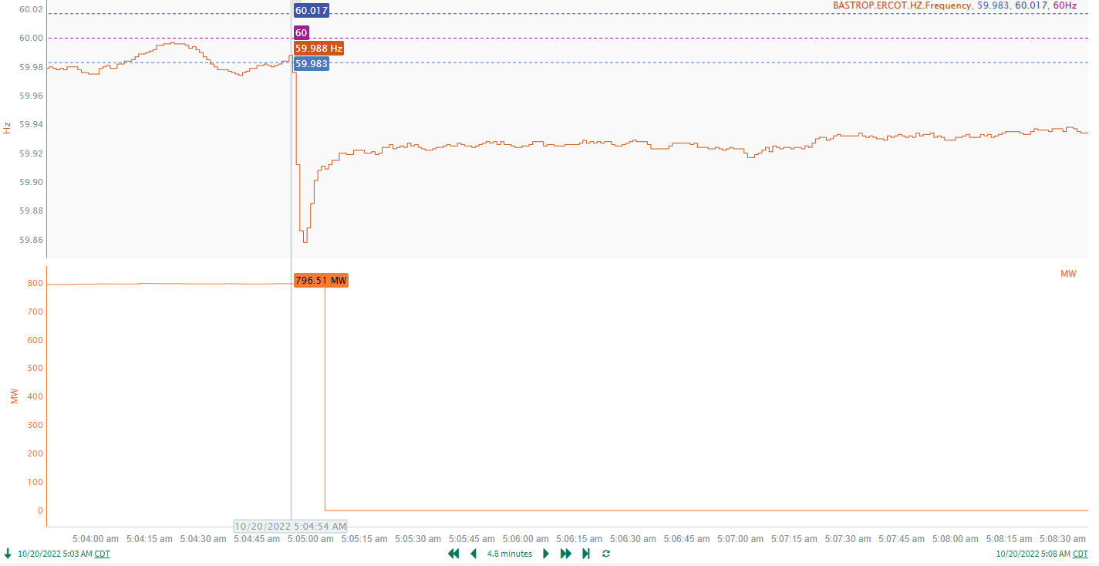
10/20/2022 5:04:54(Non-FME)
Notes:
The unit tripped offline while carrying approximately 796 MW
Starting Frequency: 59.988 Hz
Minimum Frequency: 59.8580 Hz
A-C Time : 4 seconds
Recovery Time(back to deadband): 7 minutes 25 seconds
RRS Released: 849 MW
Trip Reason: Unknown at this time
Contextual Information: A total of 312 MW of regulation up was deployed and manual offset of 300 MW was applied during this time

Slide 7
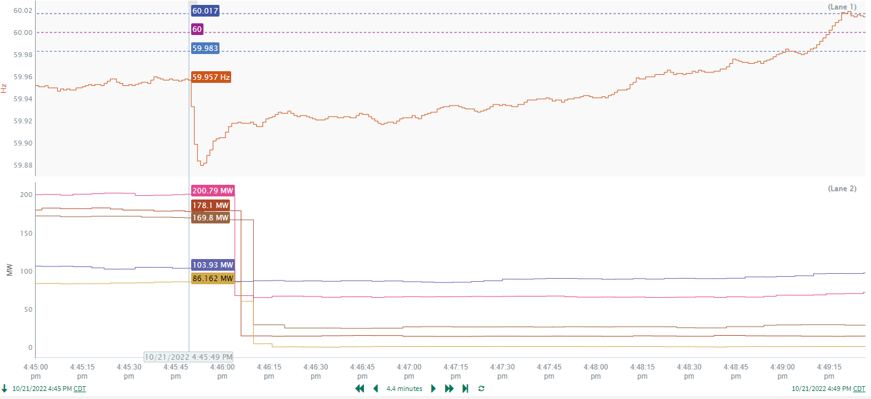
10/21/2022 16:45:49(Non-FME)
Notes:
The unit tripped offline while carrying approximately 505 MW
Starting Frequency: 59.957 Hz
Minimum Frequency: 59.88 Hz
A-C Time : 4 seconds
Recovery Time(back to deadband): 3 minutes 12 seconds
RRS Released: 769 MW
Trip Reason: Blown up lightening arrestor at substation
Contextual Information: A total of 334 MW of regulation up was deployed and manual offset of 350 MW was applied during this time

Slide 8
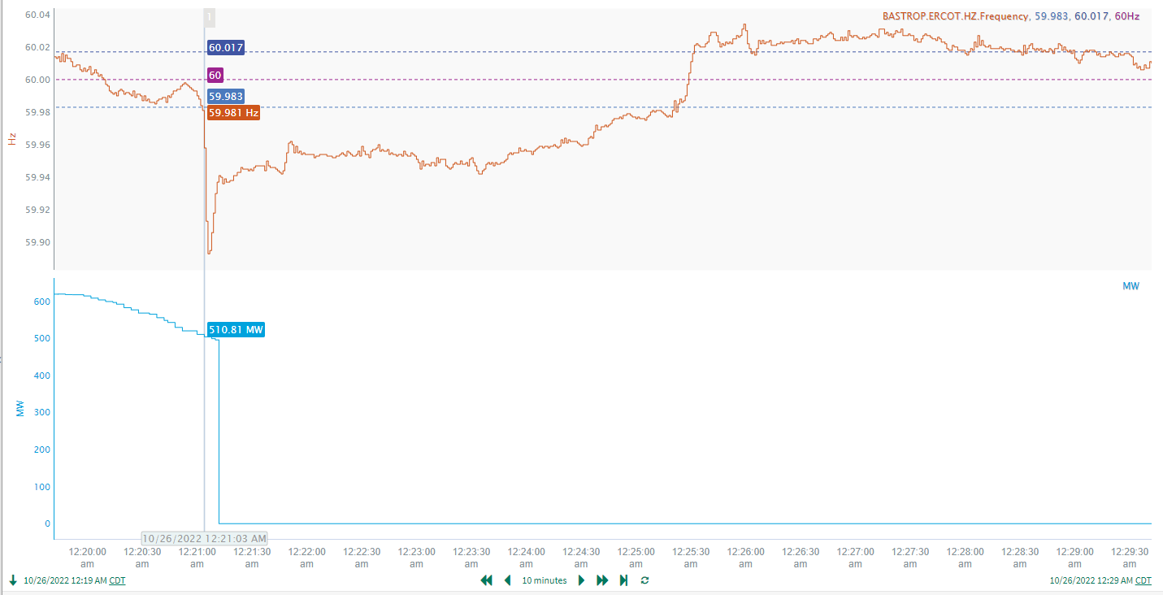
10/26/2022 0:21:03(Non-FME)
Notes:
The unit tripped offline while carrying approximately 510 MW
Starting Frequency: 59.981 Hz
Minimum Frequency: 59.893 Hz
A-C Time : 3 seconds
Recovery Time(back to deadband): 4 minutes 18 seconds
RRS Released: 540 MW
Trip Reason: Boiler tube leak
Contextual Information: A total of 141 MW of regulation up was deployed during this time

Slide 9
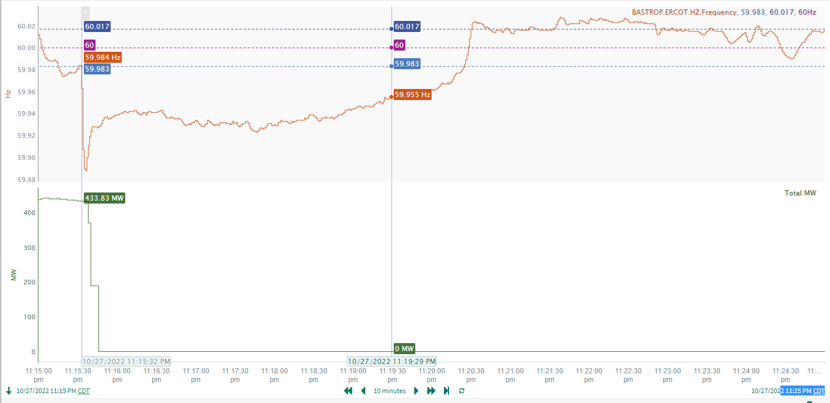
10/27/2022 23:15:32(Non-FME)
Notes:
The unit tripped offline while carrying approximately 433 MW
Starting Frequency: 59.984 Hz
Minimum Frequency: 59.8880 Hz
A-C Time : 4 seconds
Recovery Time(back to deadband): 4 minutes 53 seconds
RRS Released: 704 MW
Trip Reason: Unknown at this time
Contextual Information: A total of 115 MW of regulation up was deployed and manual offset of 400 MW was applied during this time

Slide 10
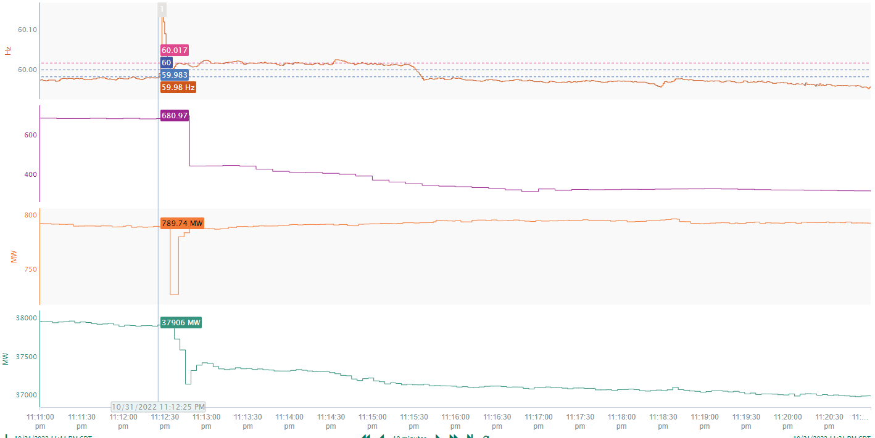
10/31/2022 23:12:25(Non-FME)
Unit1
Unit2
ERCOT Load
Notes:
Approximately 764 MW of load was lost, while a unit carrying 237 MW tripped offline and a unit had a 63 MW runback
Starting Frequency: 59.98 Hz
Minimum Frequency: 60.14 Hz
A-C Time : 3 seconds
Recovery Time(back to deadband): 7 seconds
RRS Released: 0 MW
Trip Reason: A blown transformer that caused faults in the area which caused load reduction
Contextual Information: A total of 81 MW of regulation down was deployed during this time

Slide 11
Questions?
Thank you!

