Slide 1
ERCOT Updates

Slide 2
Topics
NMMS Tech Health Project
  Dec 5th production deployment
  Test system via Citrix
  Changes to incremental XML format – TSP Action Needed
Weatherization Attestations
NPRR1063 - New Ratings Report
Other Updates
  SSWG Model Changes for Node/Breaker Case
  FERC Order 881

Slide 3
NMMS Tech Health Project

Slide 4
NMMS Tech Health Project
Scope:
  Update backend hardware
  Upgrade database version
    No changes to “grid” data
  (due to the above) Upgrade SGEM
NMMS unavailable from
  Friday, 12-02-2022 17:00 to
  Monday, 12-05-2022 08:00
Users will be Prompted to Install the Update

Slide 5
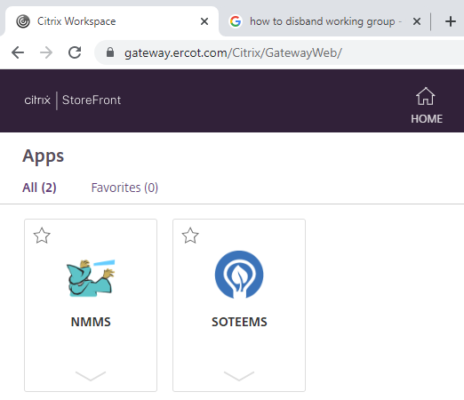
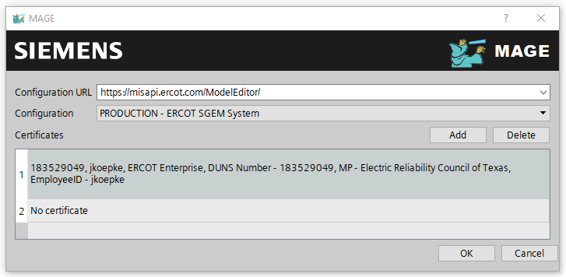
NMMS Tech Health Project – Test System on Citrix
ERCOT continues to work towards completing a test NMMS system
The MOTE system will be accessed via the gateway.ercot.com URL
A MOTE-specific Digital Certificate will be needed to access the system

Slide 6
NMMS Tech Health Project – Incremental XML Format Change
NMMS will no longer accept incremental files which delete instances using the rdf:Description syntax
Currently there are two methods to delete an instance:
RDF Description:
  <rdf:Description rdf:about="#_{3722E7DD-2C38-41D9-B975-002116EB6EB4}“/>
Namespace and Instance Type:
<cim:Bay rdf:ID="_{3722E7DD-2C38-41D9-B975-002116EB6EB4}“/>
Both entries above will delete the instance with an RDFID of “3722E7DD…”

Slide 7
NMMS Tech Health Project – Incremental XML Format Change
NMMS will no longer accept incremental files which delete instances using the rdf:Description syntax
TSP Action: Review custom software to ensure RDF Description deletion is not used
Note: NMMS has not produced deletions with this syntax since NMMS 1.0 (pre-2018)
The “New NMMS”, to be deployed 12/5/22, will only consume deletions via the Namespace and Instance method

Slide 8
Weatherization Attestation – Appendix A

Slide 9
Weatherization Attestations – Appendix A
Substations are associated to TSPs based on the ownership and operatorship of equipment within the station.
A substation will be associated if any equipment (a Transmission Facility) is owned or operated by the TSP
Transmission Facility = transmission voltage element inside the fence owned or operated by the TSP
A substation may require a response from multiple TSPs
Example: A response for substation ABC will be required by Company A, Company B, Company C, and Company D

Slide 10

Company, Operatorship, and Ownership Instances
Substations were added to Appendix A based on the Company instance.
Company
Operatorship
Ownership
Ownership
Ownership and Operatorship instances must be under the company which submits the model changes and is contained within the Digital Certificate

Slide 11
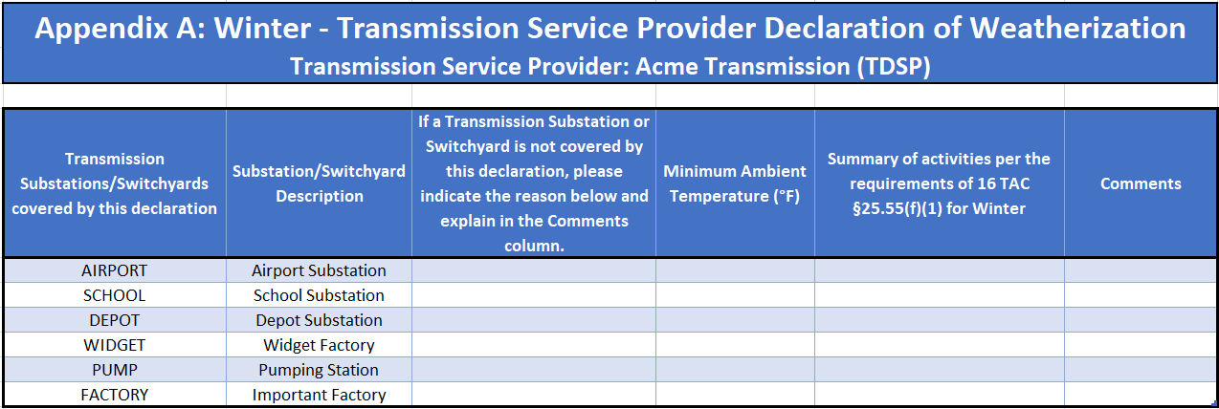
Appendix A – Which Substations Require a Response?
Every substation in Appendix A requires a response. Rows cannot be deleted.
Reason substation is not covered by the declaration
Brief summary of activities or references to supplemental files
Minimum experienced temperature value

Slide 12
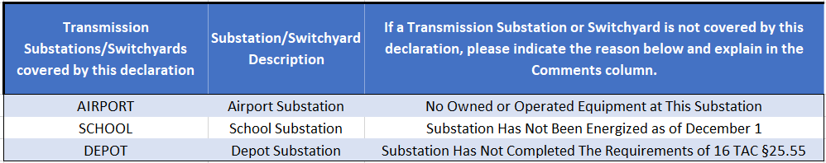
Appendix A – Excluding Substations from the Declaration
To exclude a substation from the Declaration, a reason from a pre-defined list must be selected.
Reasons for excluding the substation can be selected via a drop down in Excel

Slide 13
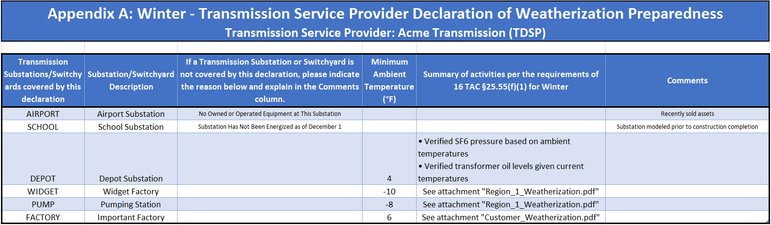
Appendix A – Summary of Activities
A summary of weatherization activities must be provided within the Excel file.
Activities can be listed within the cell…
…or supplemental attachments can be referenced

Slide 14
New MIS Posting – Ratings Report

Slide 15
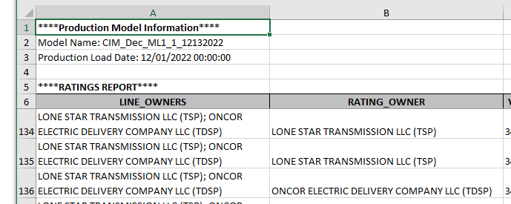
New MIS “Ratings Report”
ERCOT will begin posting a “Ratings Report” to the MIS in early December
Key Points:
Created as a result of NPRR1063
Improves upon existing “AC Line Ratings” report
  Lines and “series-compensators” together
  From/To station names
  Jointly-rated column
  Owners column
Posted as model is built; not when active in real-time

Slide 16
Other Updates

Slide 17
Upcoming Model Change Requests for SSWG
SSWG will be starting the process to add node-breaker detail to SSWG cases.
“Bus-Branch” detail of a ring bus for Planning
“Node-Breaker” detail of a ring bus for Operations
SSWG members will be asked to correct and add new information to the model.

Slide 18
FERC Order 881 – Dynamic Ratings Related
Overview:
  FERC Order 881, which amended rule 18 CFR 35.28, recently passed
  The order, amongst other things, requires:
    Use of ambient-adjusted ratings for near-term studies
    Use of day/night ratings sets
ERCOT conclusions:
  ERCOT will not be adjusting dynamic ratings functionality in response to FERC Order 881
  The order and rule only apply to “public utilities” and ERCOT and its participants are not public utilities under the Federal Power Act

