Slide 1
Energy Storage Resource (ESR)
Dispatch and Settlement
Blake Holt
Market Design
11.18.2022

Slide 2
Goals for today’s presentation
High level overview of current ESR modeling, energy offer and bid curves, and dispatch
High level overview of meter price composition
Fundamentals of Energy and Ancillary Service Imbalance
ESR settlement examples
Changes to this process coming with NPRR987 and OBDRR017

Slide 3
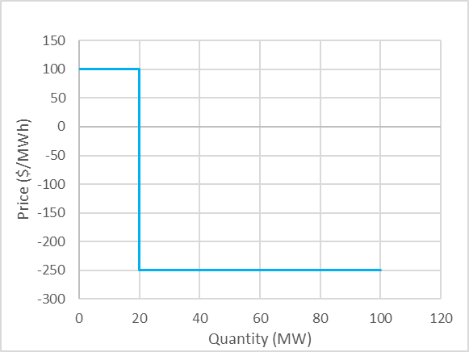
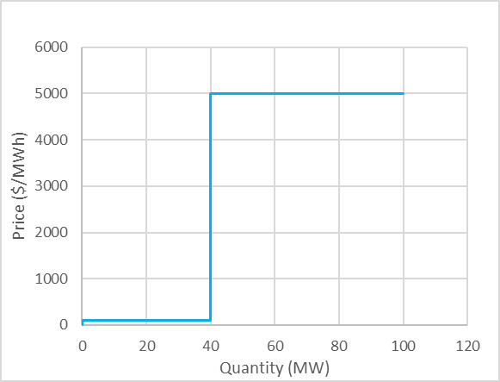
ESR Modeling Today
Energy Storage Resources (ESRs) are currently modeled as two distinct units.
The Controllable Load Resource (ESR-CLR) and the battery (ESR-Gen) are dispatched and settled separately in the ERCOT systems.
This separation means that the two sides of the ESR must submit separate curves to indicate their willingness to charge from or dispatch energy into the grid.
The dispatch is based on the LMP at the electrical bus.
ESR-CLR bid curve
ESR-Gen energy offer curve

Slide 4
Energy paid/charged meter prices, not “SPP”
ESR-CLR
ESR-Gen
RTRDP (RDPA)
RTRSVPOR (ORDC)
Meter Price
RTLMP (LMP)

Slide 5
Energy and AS Imbalance settlement – Generator

Slide 6
Energy and AS Imbalance settlement – Generator
MCPC
Notes:
MCPC = Market Clearing Price for Capacity ($/MWh)

Slide 7
Energy and AS Imbalance settlement – Generator
MCPC
Meter Price = LMP + ORDC + RDPA
Notes:
MCPC = Market Clearing Price for Capacity ($/MWh)
LMP = Locational Marginal Price ($/MWh)
ORDC = stands for the online reserve price adder ($/MWh)
RDAP = stands for the reliability deployment price adder ($/MWh)

Slide 8
Energy and AS Imbalance settlement – Generator
MCPC
ORDC + RDPA
Meter Price = LMP + ORDC + RDPA
Notes:
MCPC = Market Clearing Price for Capacity ($/MWh)
LMP = Locational Marginal Price ($/MWh)
ORDC = stands for the online reserve price adder ($/MWh)
RDAP = stands for the reliability deployment price adder ($/MWh)

Slide 9
Energy and AS Imbalance settlement – Generator
MCPC
ORDC + RDPA
Meter Price = LMP + ORDC + RDPA
Notes:
MCPC = Market Clearing Price for Capacity ($/MWh)
LMP = Locational Marginal Price ($/MWh)
ORDC = stands for the online reserve price adder ($/MWh)
RDAP = stands for the reliability deployment price adder ($/MWh)

Slide 10
Energy and AS Imbalance settlement – Generator
ORDC+
RDPA
MCPC
ORDC + RDPA
Meter Price = LMP + ORDC + RDPA
Notes:
MCPC = Market Clearing Price for Capacity ($/MWh)
LMP = Locational Marginal Price ($/MWh)
ORDC = stands for the online reserve price adder ($/MWh)
RDAP = stands for the reliability deployment price adder ($/MWh)

Slide 11
Energy and AS Imbalance settlement – Generator
Ancillary Service Imbalance Charge
(RTASIAMT)
DAM payment for Procured Capacity for RRS
(PCRRAMT)
ORDC+
RDPA
MCPC
ORDC + RDPA
Meter Price = LMP + ORDC + RDPA
Energy Imbalance Payment
(RTEIAMT)
Ancillary Service Imbalance Payment
(RTASIAMT)
Key Take-Away:
When AS is deployed, a generator is only paid LMP + MCPC for the AS capacity that was reserved and deployed.
Notes:
MCPC = Market Clearing Price for Capacity ($/MWh)
LMP = Locational Marginal Price ($/MWh)
ORDC = stands for the online reserve price adder ($/MWh)
RDAP = stands for the reliability deployment price adder ($/MWh)

Slide 12
Energy and AS Imbalance settlement – CLR

Slide 13
Energy and AS Imbalance settlement – CLR
MCPC

Slide 14
Energy and AS Imbalance settlement – CLR
MCPC
ORDC + RDPA

Slide 15
Energy and AS Imbalance settlement – CLR
MCPC
Meter Price = LMP + ORDC + RDPA
ORDC + RDPA

Slide 16
Energy and AS Imbalance settlement – CLR
DAM payment for Procured Capacity for RRS
(PCRRAMT)
Energy Imbalance Charge
(RTEIAMT)
MCPC
Meter Price = LMP + ORDC + RDPA
ORDC + RDPA
Ancillary Service Imbalance Payment
(RTASIAMT)
Key Take-Away:
A CLR is only charged LMP when consuming.

Slide 17
ESR dispatch and settlement - normal
When the LMP drops below $40 the ESR-CLR is willing to charge. It gets a dispatch instruction of 15MW.
When the LMP rises above $60 the ESR-Gen is willing to generate. It gets a dispatch instruction of 10 to 20MW.
 | ESR-CLR
Energy Imbalance (LMP) | (2,888)
Energy Imbalance (ORDC) | (825)
Energy Imbalance (RDPA) | (413)
 | ESR-Gen
Energy Imbalance (LMP) | 4,175
Energy Imbalance (ORDC) | 575
Energy Imbalance (RDPA) | 288
* positive dollars = payment, negative dollars = charge

Slide 18
ESR dispatch and settlement - normal
 | ESR-Gen
AS Imbalance (ORDC) | 2,750
AS Imbalance (RDPA) | 1,375
Net | 4,125
100 HSL
ESR-Gen Online Reserve
50 HSL
ESR-Gen Online Reserve
ESR-CLR Online Reserve
When the ESR-CLR is charging, the load is treated as online reserve. The ESR-Gen is also online (at a reduced state of charge) and providing online reserve with its dispatchable range.
When the ESR-Gen is online and generating below its HSL, the dispatchable range is treated as online reserve.
 | ESR-CLR
Energy Imbalance (LMP) | (2,888)
Energy Imbalance (ORDC) | (825)
Energy Imbalance (RDPA) | (413)
AS Imbalance (ORDC) | 825
AS Imbalance (RDPA) | 413
Net | (2,888)
 | ESR-Gen
Energy Imbalance (LMP) | 4,175
Energy Imbalance (ORDC) | 575
Energy Imbalance (RDPA) | 288
AS Imbalance (ORDC) | 2,925
AS Imbalance (RDPA) | 1,463
Net | 9,425
* positive dollars = payment, negative dollars = charge

Slide 19
ESR dispatch and settlement - normal
 | ESR-Gen
AS Imbalance (ORDC) | 2,750
AS Imbalance (RDPA) | 1,375
Net | 4,125
100 HSL
ESR-Gen Online Reserve
50 HSL
ESR-Gen Online Reserve
ESR-CLR Online Reserve
The ESR-CLR is essentially only charged LMP for consuming. The payments & charges from the ORDC and RDPA adders cancel out.
The ESR-Gen gets paid LMP+ORDC+RDPA for generation, and ORDC+RDPA for any headroom while online.
 | ESR-CLR
Energy Imbalance (LMP) | (2,888)
Energy Imbalance (ORDC) | (825)
Energy Imbalance (RDPA) | (413)
AS Imbalance (ORDC) | 825
AS Imbalance (RDPA) | 413
Net | (2,888)
 | ESR-Gen
Energy Imbalance (LMP) | 4,175
Energy Imbalance (ORDC) | 575
Energy Imbalance (RDPA) | 288
AS Imbalance (ORDC) | 2,925
AS Imbalance (RDPA) | 1,463
Net | 9,425
* positive dollars = payment, negative dollars = charge

Slide 20
ESR dispatch and settlement - extreme
When the LMP drops below $2000 the ESR-CLR is willing to charge. It gets a dispatch instruction of 15MW.
When the LMP rises above $2000 the ESR-Gen is willing to generate. It gets a dispatch instruction of 100MW.
 | ESR-CLR
Energy Imbalance (LMP) | (79,290)
Energy Imbalance (ORDC) | (9,956)
Energy Imbalance (RDPA) | (192,004)
 | ESR-Gen
Energy Imbalance (LMP) | 769,373
Energy Imbalance (ORDC) | 18,465
Energy Imbalance (RDPA) | 212,162
* positive dollars = payment, negative dollars = charge

Slide 21
ESR dispatch and settlement - extreme
 | ESR-Gen
AS Imbalance (ORDC) | 26,549
AS Imbalance (RDPA) | 512,010
Net | 538,559
40 HSL
ESR-Gen On Rsv
ESR-CLR On Rsv
When the ESR-CLR is charging, the load is treated as online reserve. The ESR-Gen is also online (at a reduced state of charge) and providing online reserve with its dispatchable range.
The ESR-Gen is dispatched up to its HSL and does not receive any additional payments for providing online reserve. The entire unit is being used for energy.
 | ESR-CLR
Energy Imbalance (LMP) | (79,290)
Energy Imbalance (ORDC) | (9,956)
Energy Imbalance (RDPA) | (192,004)
AS Imbalance (ORDC) | 9,956
AS Imbalance (RDPA) | 192,004
Net | (79,290)
 | ESR-Gen
Energy Imbalance (LMP) | 769,373
Energy Imbalance (ORDC) | 18,465
Energy Imbalance (RDPA) | 212,162
AS Imbalance (ORDC) | 0
AS Imbalance (RDPA) | 0
Net | 1,000,000
* positive dollars = payment, negative dollars = charge

Slide 22
ESR dispatch and settlement - extreme
 | ESR-Gen
AS Imbalance (ORDC) | 26,549
AS Imbalance (RDPA) | 512,010
Net | 538,559
40 HSL
ESR-Gen On Rsv
ESR-CLR On Rsv
The ESR-CLR is essentially only charged LMP for consuming. The payments & charges from the ORDC and RDPA adders cancel out.
The ESR-Gen gets paid LMP+ORDC+RDPA for generation, and ORDC+RDPA for any headroom while online.
 | ESR-CLR
Energy Imbalance (LMP) | (79,290)
Energy Imbalance (ORDC) | (9,956)
Energy Imbalance (RDPA) | (192,004)
AS Imbalance (ORDC) | 9,956
AS Imbalance (RDPA) | 192,004
Net | (79,290)
 | ESR-Gen
Energy Imbalance (LMP) | 769,373
Energy Imbalance (ORDC) | 18,465
Energy Imbalance (RDPA) | 212,162
AS Imbalance (ORDC) | 0
AS Imbalance (RDPA) | 0
Net | 1,000,000
* positive dollars = payment, negative dollars = charge

Slide 23
ESR dispatch and settlement – post NPRR987 and OBDRR017
The remaining portions of NPRR987 and ODBRR017 will be implemented at a future date and will incorporate an ESR state of charge into the ORDC pricing and AS Imbalance settlement
Real-Time Energy Imbalance pricing and settlement will remain the same
OBDRR017 changes
R_{s} = RTOLCAP = RTOLHSL – RTBP + RTCLRCAP + RTNCLRCAP + RTESRCAP – RTOLNSRS – RTPBPC
RTESRCAP = Min(ESR Gen HSL – ESR Gen Base Point, SOC Telem – SOC OperMin) + ESR CLR Base Point

