Slide 1
Monthly Review of Reliability Unit Commitment Market Impacts – October 2022
Wholesale Market Working Group
ERCOT Staff
November 18, 2022

Slide 2
RUC Resource-Hours
October 2022 | Total | Opt-Out | Non-Opt-Out
Instructed Resource-Hours
Total Count | 425.0 | 107.0 | 318.0
Effective Resource-Hours*
Total Count | 410.9 | 105.9 | 304.9
Average LSL | 64.1 | 77.7 | 59.3
Average LDL | 77.2 | 125.0 | 60.5
Average BP | 84.9 | 151.1 | 61.6
Average HSL | 308.1 | 279.9 | 317.9
* The difference between “Instructed” and “Effective” values is a result of Resources starting up, shutting down, receiving partial hour instructions, or otherwise not being dispatchable by SCED.

Slide 3
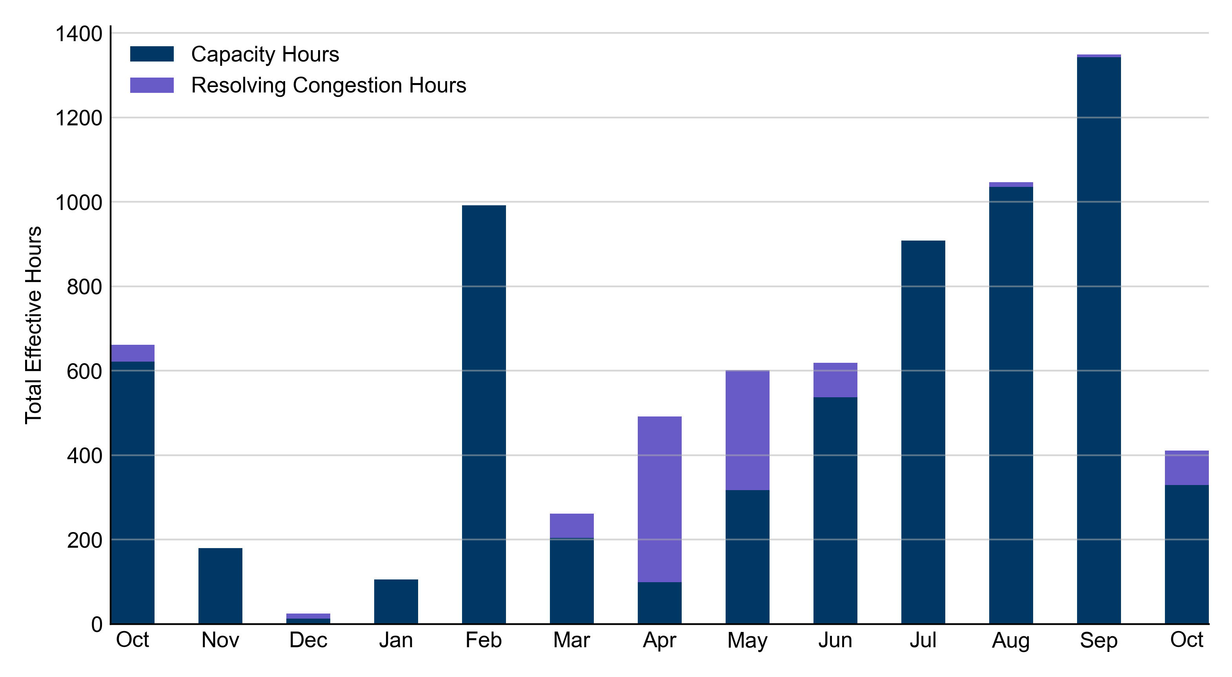
RUC Instruction Reasons: Last 13 Months
RUCs in October 2022 were primarily driven by system-wide capacity concerns.

Slide 4
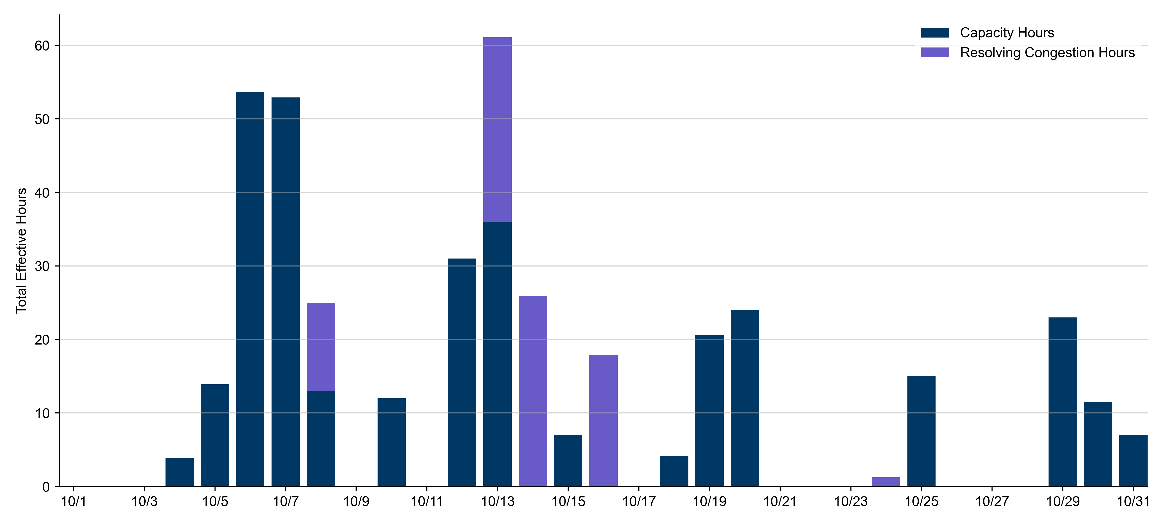
RUC Instruction Reasons
October 2022
410.9 effective RUC Resource-hours.
  328 hours (80%) for capacity concerns.
  82.2 hours (20%) for resolving congestion concerns.

Slide 5
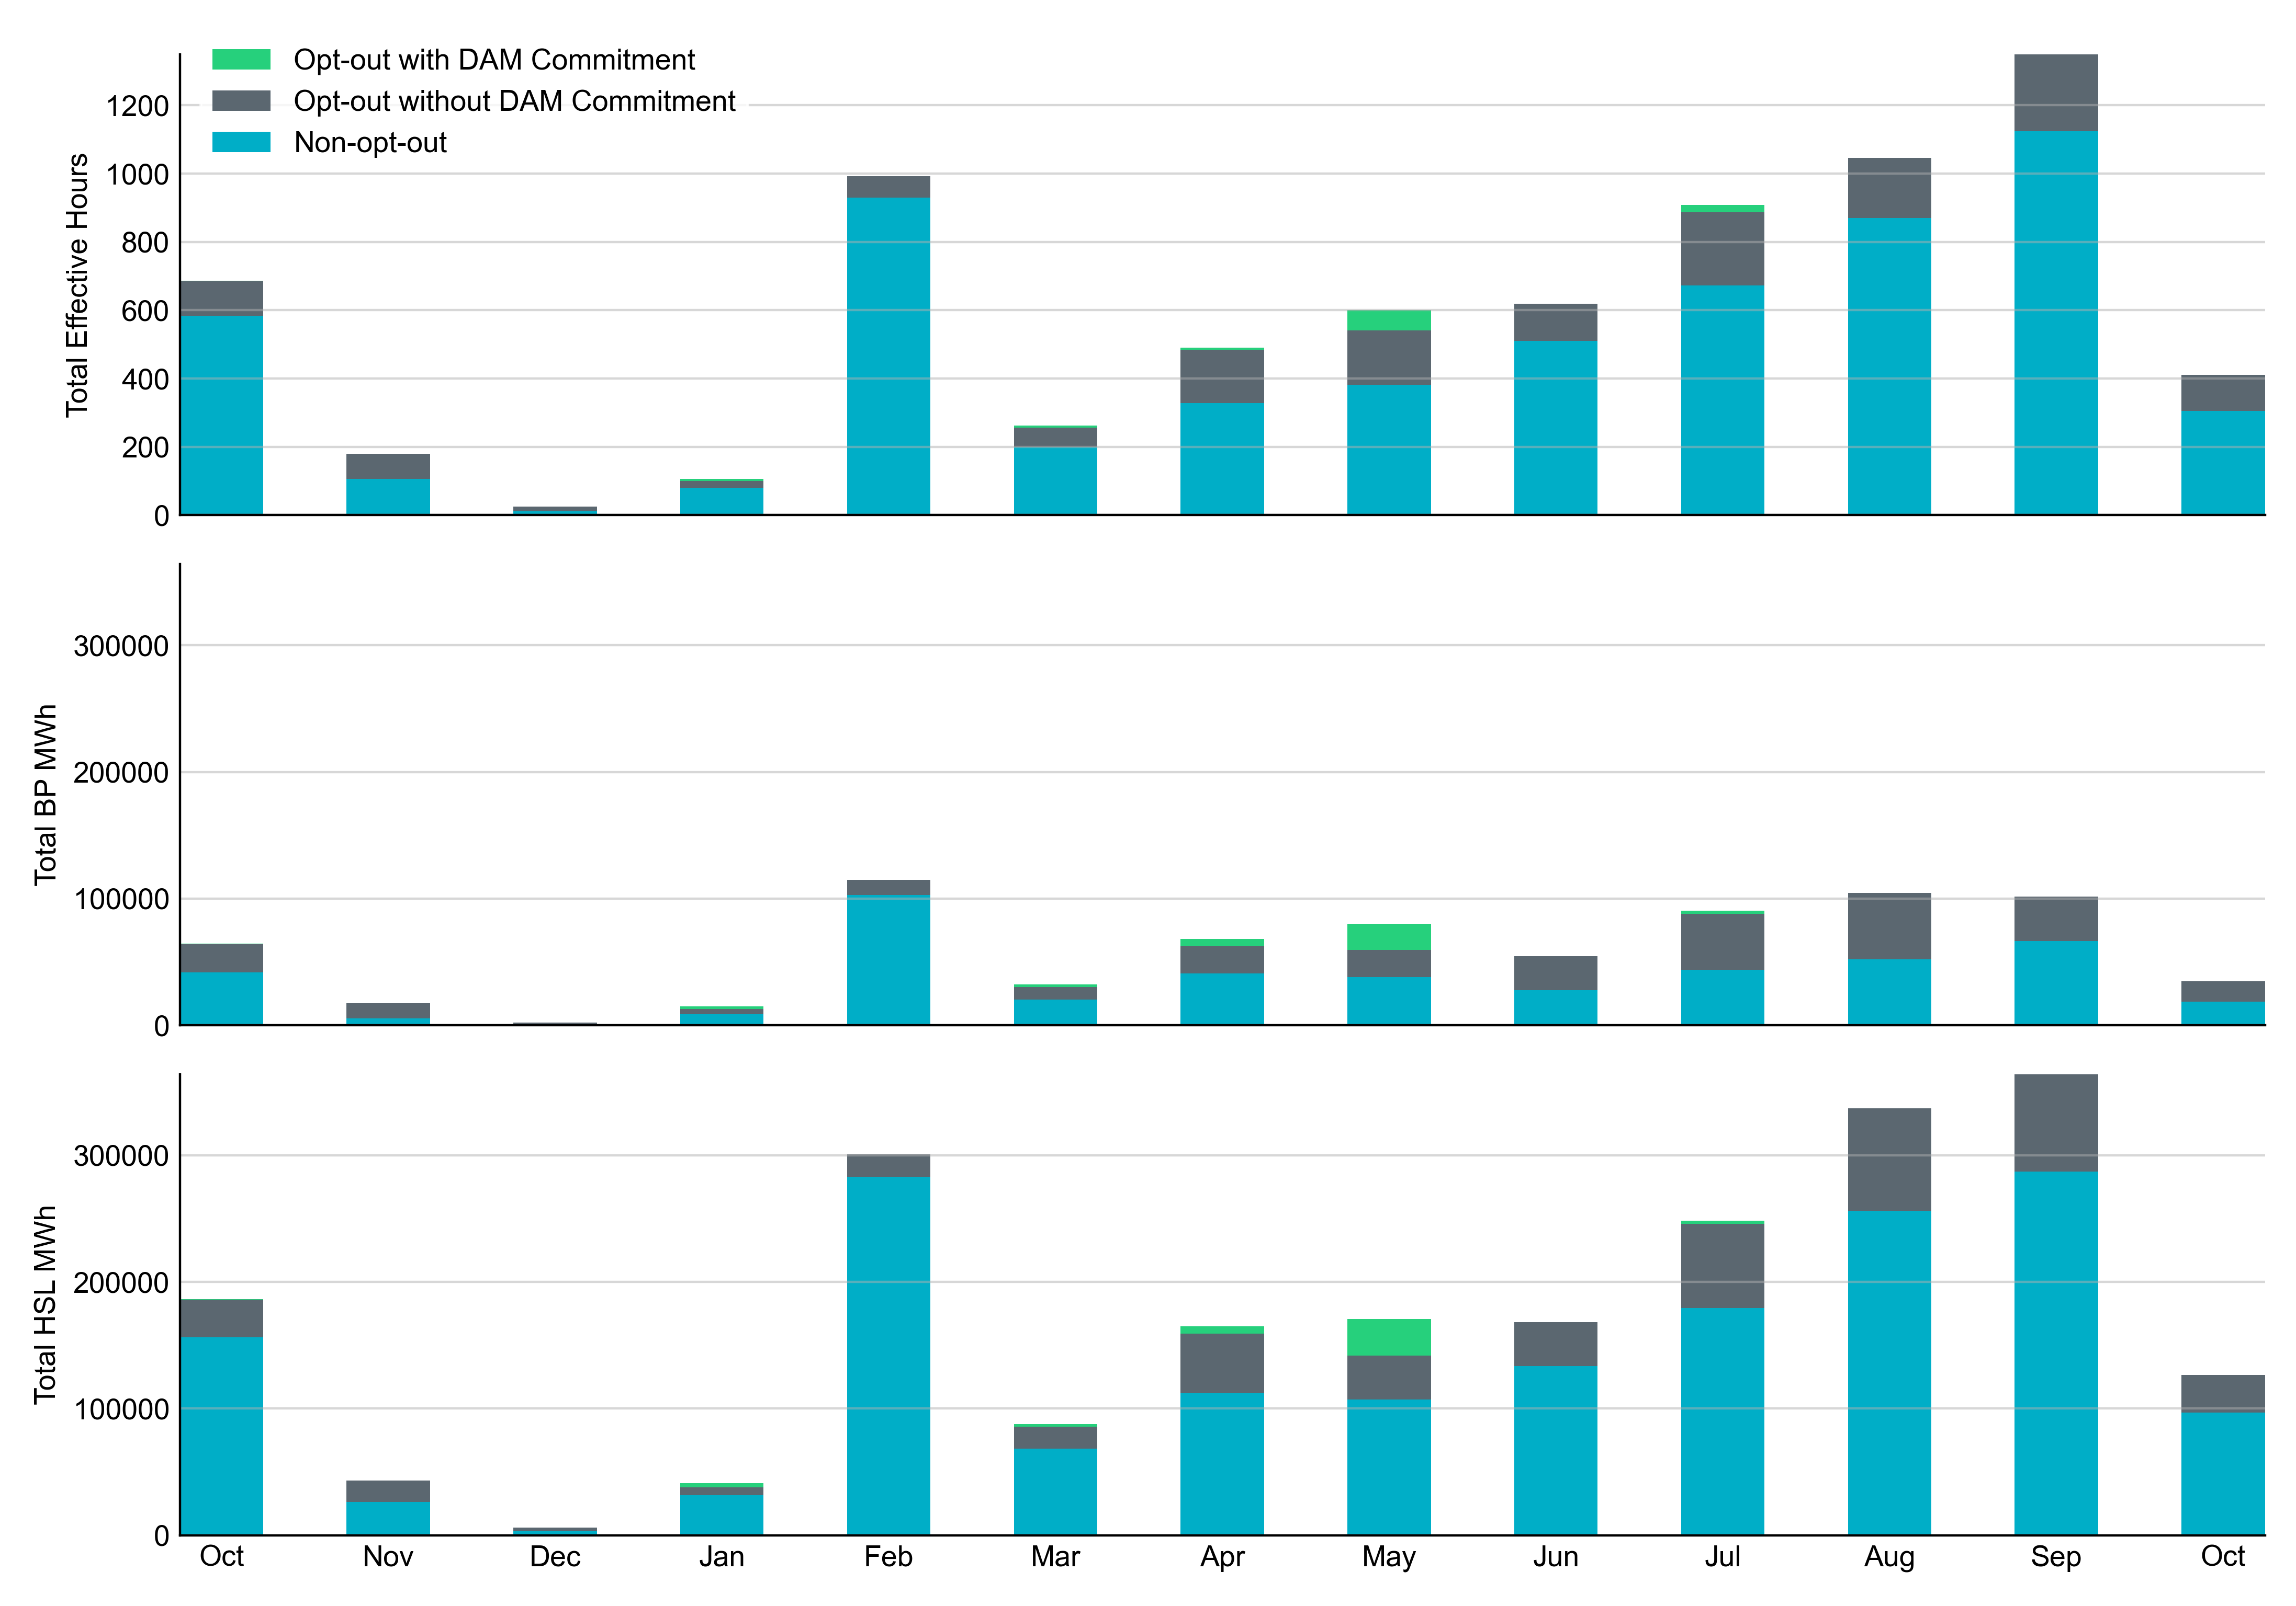
Non-opt-out and Opt-out Totals: Last 13 Months
October 2022 had a total of 304.9 non-opt-out effective Resource-hours (74.22%) and 105.9 opt-out effective Resource-hours (25.78%).

Slide 6
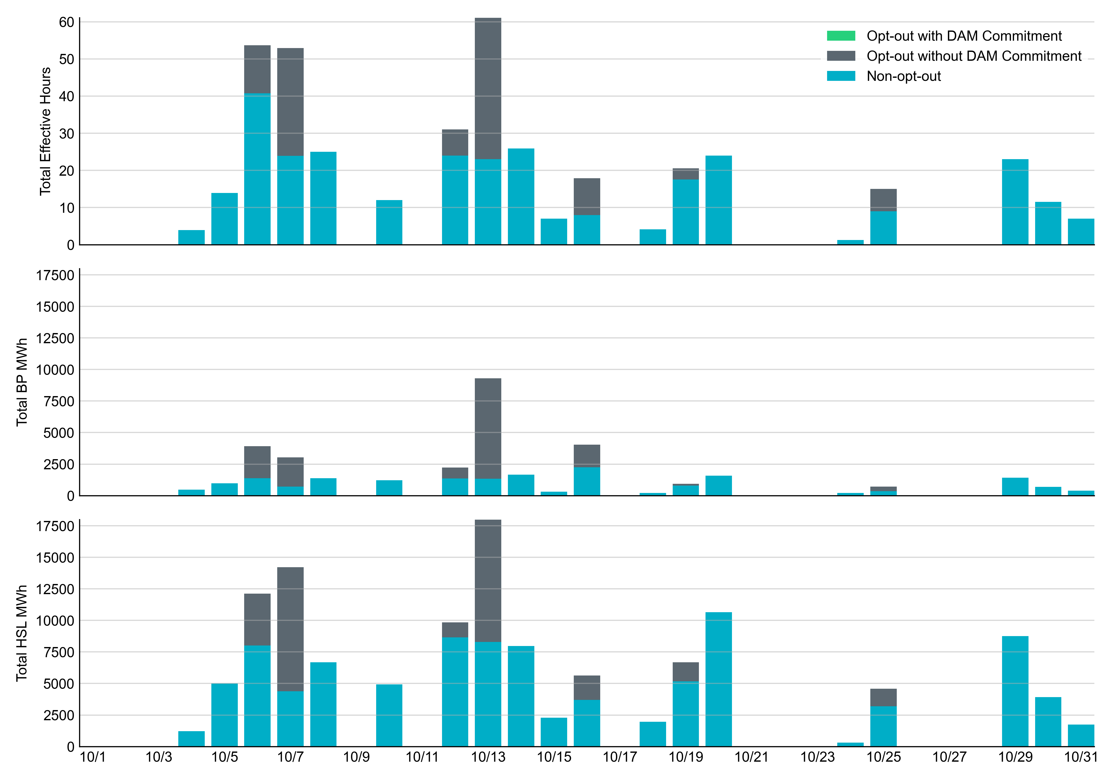
Non-opt-out and Opt-out Totals: October 2022

Slide 7
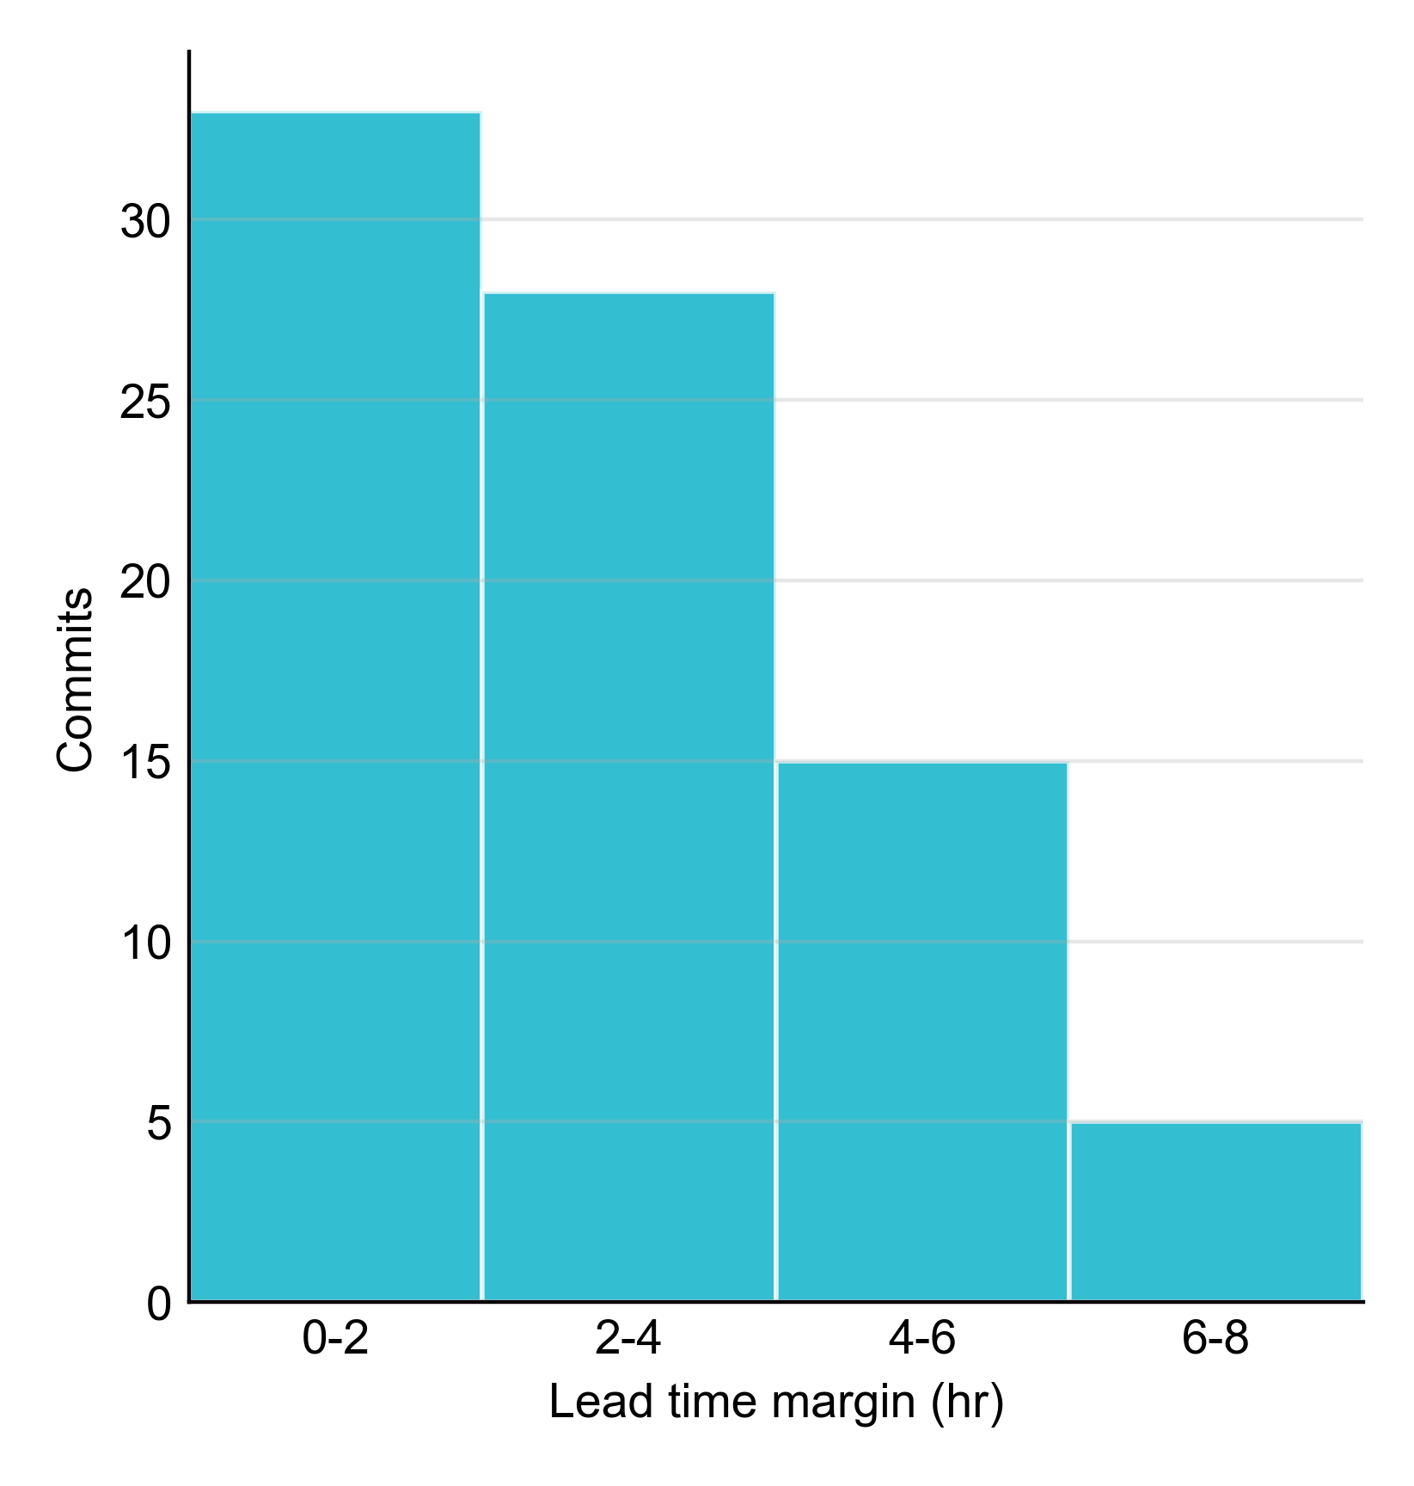
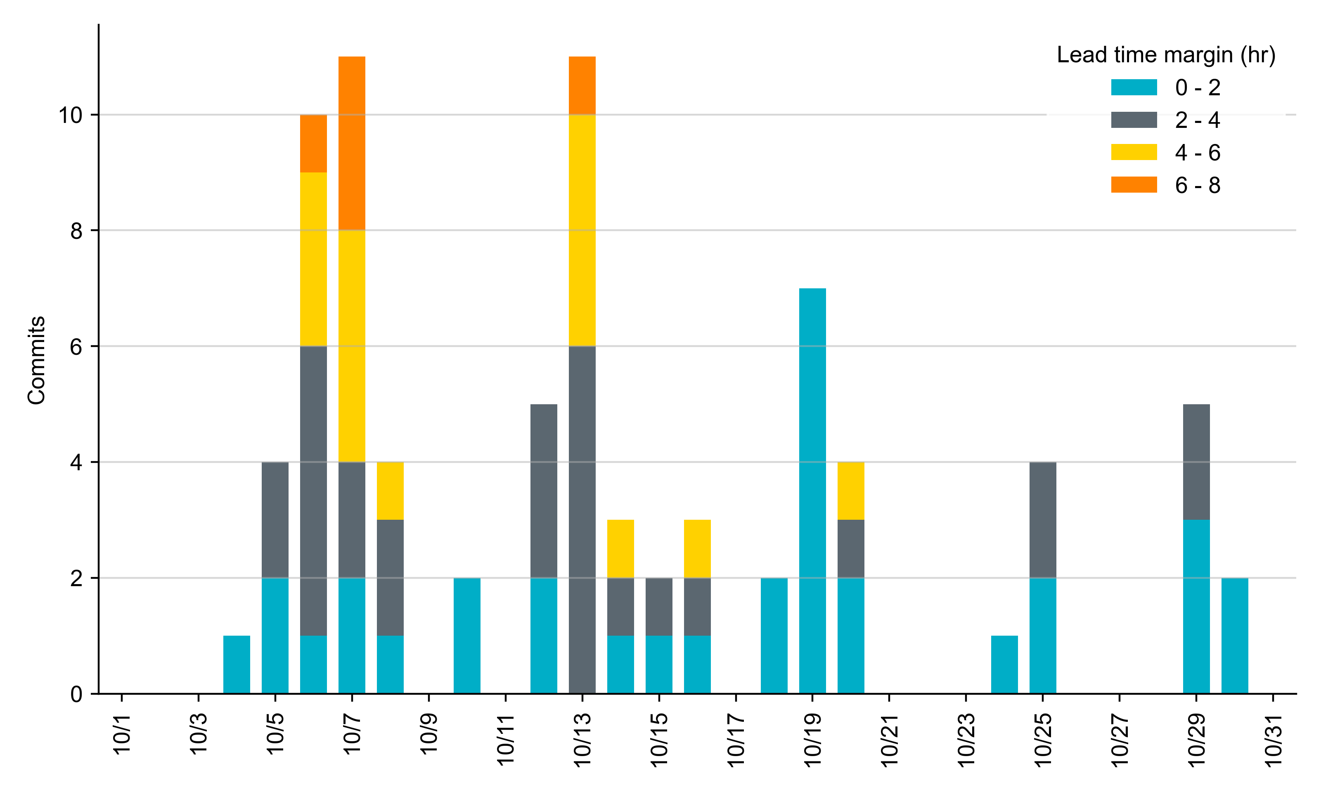
RUC Lead Time Margin: October 2022
Most RUC commit windows had lead time margin at or below 4 hours.
Lead time refers to the length of time between a RUC instruction and the start of the commitment window.
Lead time margin is the difference between lead time and the Resource’s startup time.
In cases where a Resource is committed for multiple back-to-back time blocks, lead time margin is calculated from the first instruction.
Notes:
The first bin is both-inclusive (i.e. [0, 2] ), while subsequent bins are left-inclusive (i.e. [2, 3), [3, 4), etc.).

Slide 8
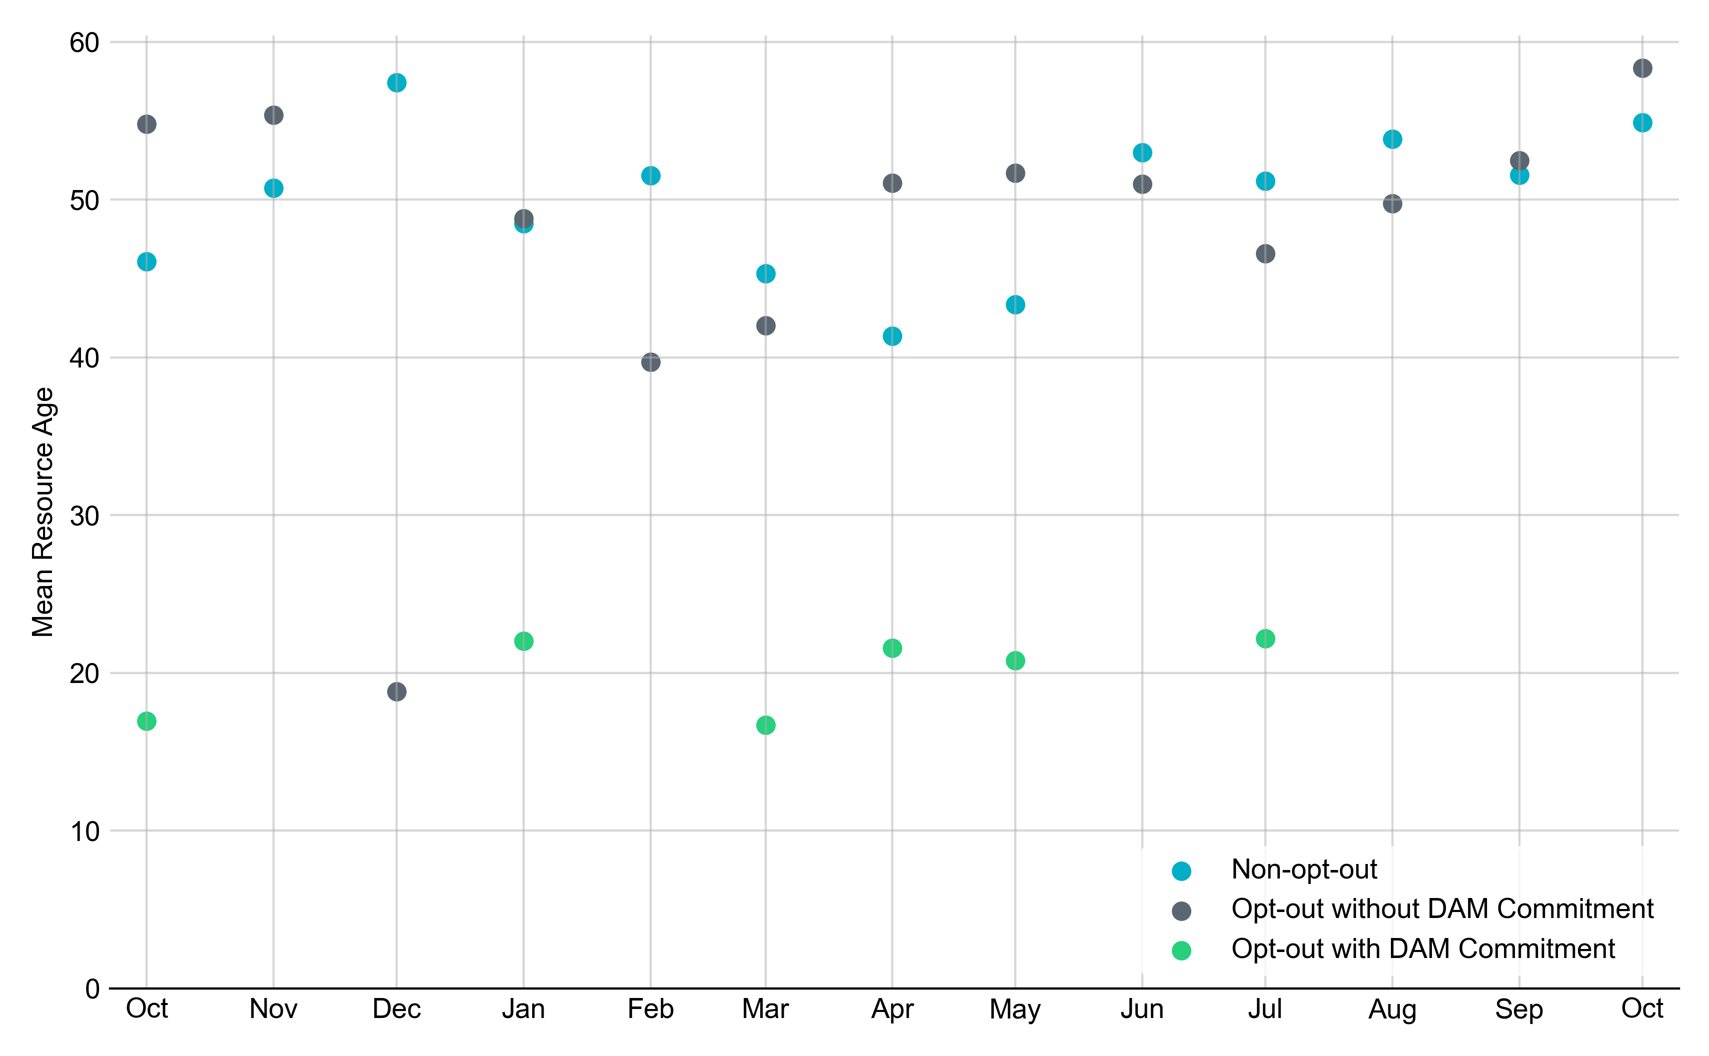
Average Resource Age
In October 2022, the mean age of RUC-committed Resources was 54.9 years for Non-Opt-Out Resource-hours, 58.3 years for Opt-Out Resource-hours without DAM Commitments.
Note: For Resource configurations with multiple physical generators, the age of the oldest generator is used.

Slide 9
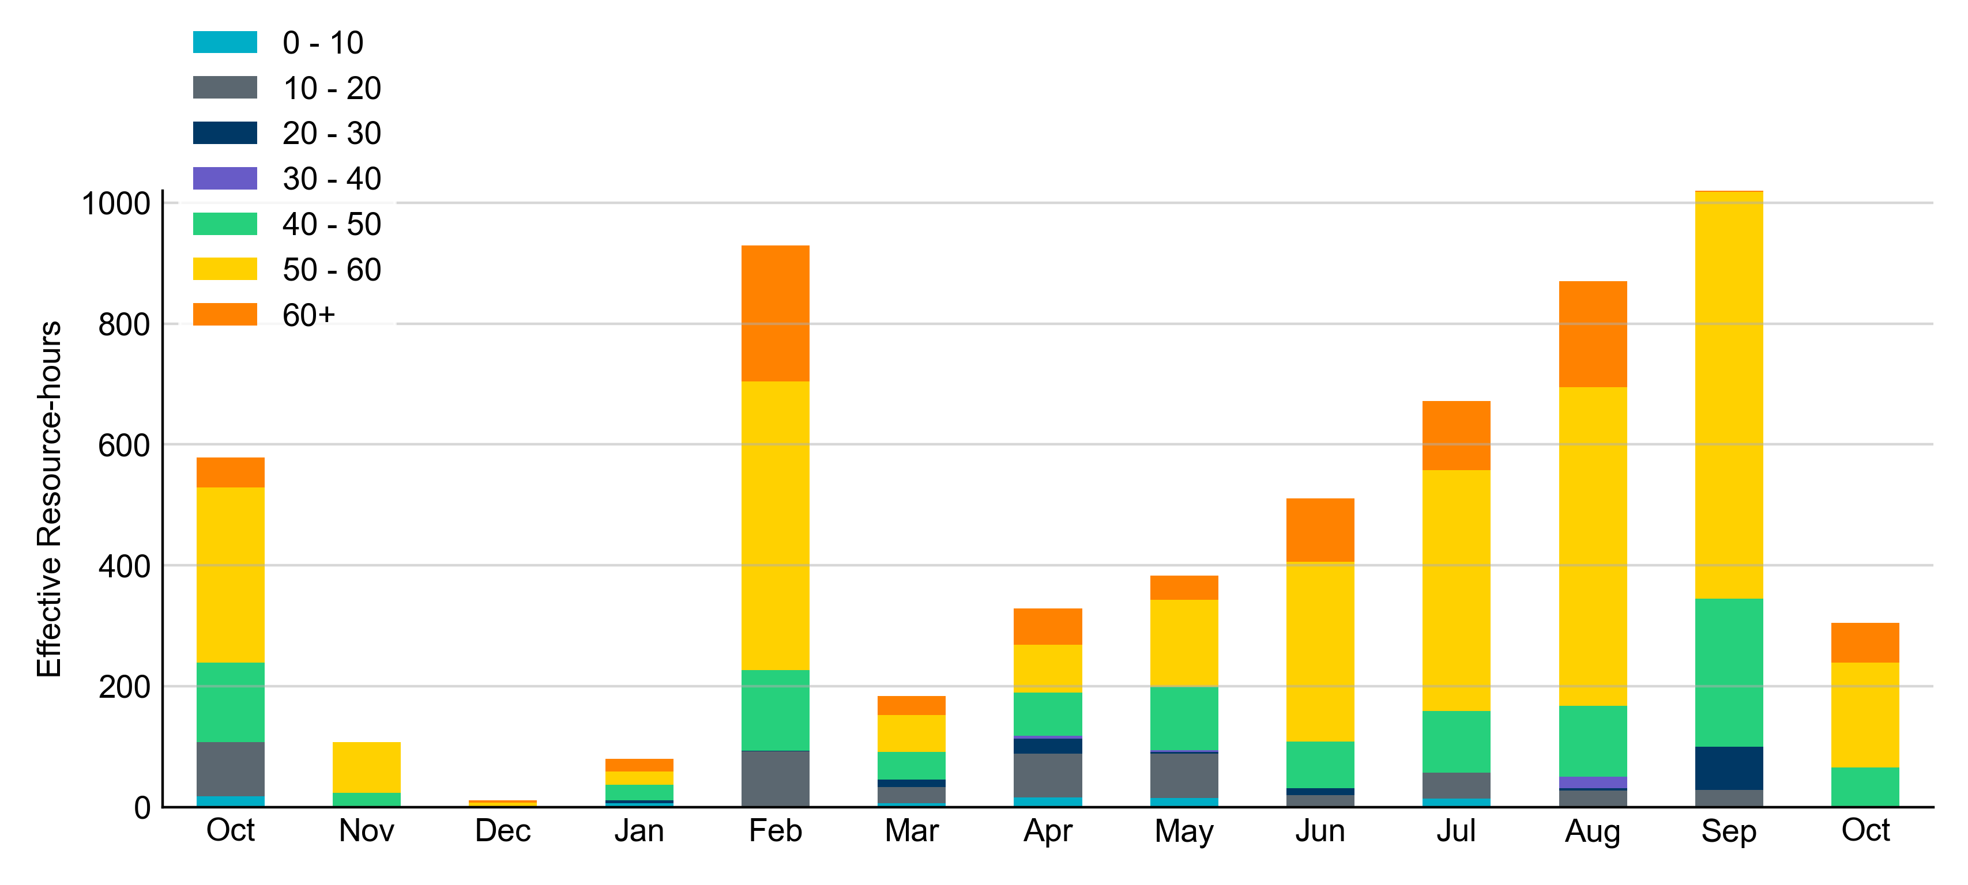
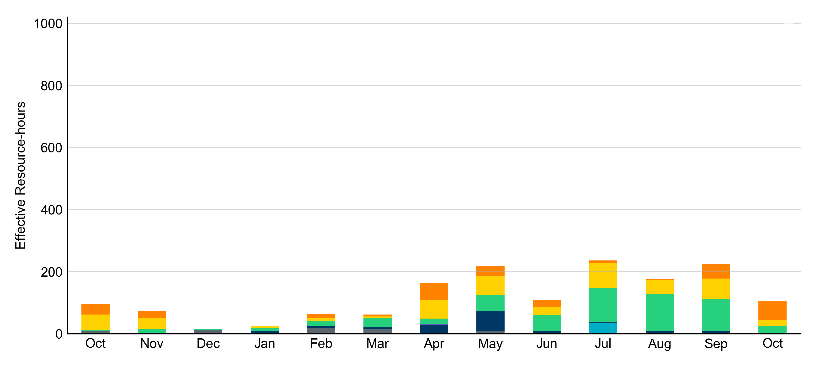
Age Category
All RUC-Committed Resources in October 2022 were older than 40 years.
Non-opt-out
Opt-out

Slide 10
RUC-Instructed Resource Dispatch above LDL
October 2022
When Resources did not successfully opt out, there were 8.5 effective Resource-hours for which the Resource was dispatched above its LDL.
  For 3.0 of these Resource-hours, the LMP for the RUC-instructed Resource was above the RUC offer floor.
  For 5.5 of these Resource-hours, the LMP for the RUC-instructed Resource was below the RUC offer floor.
    For all these Resource-hours, the RUC-instructed Resource was mitigated.
There was no RUC-Committed Resource with Exceptional Fuel Cost submissions in October 2022.

Slide 11
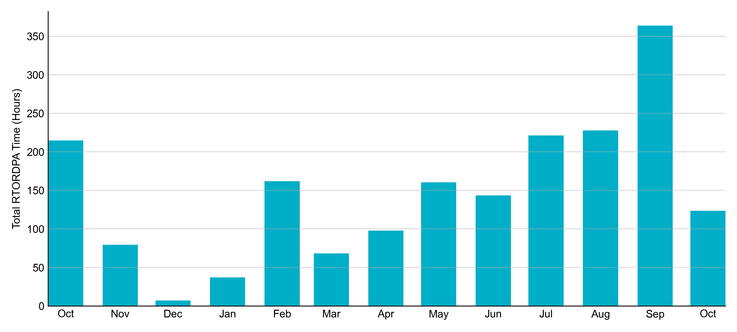
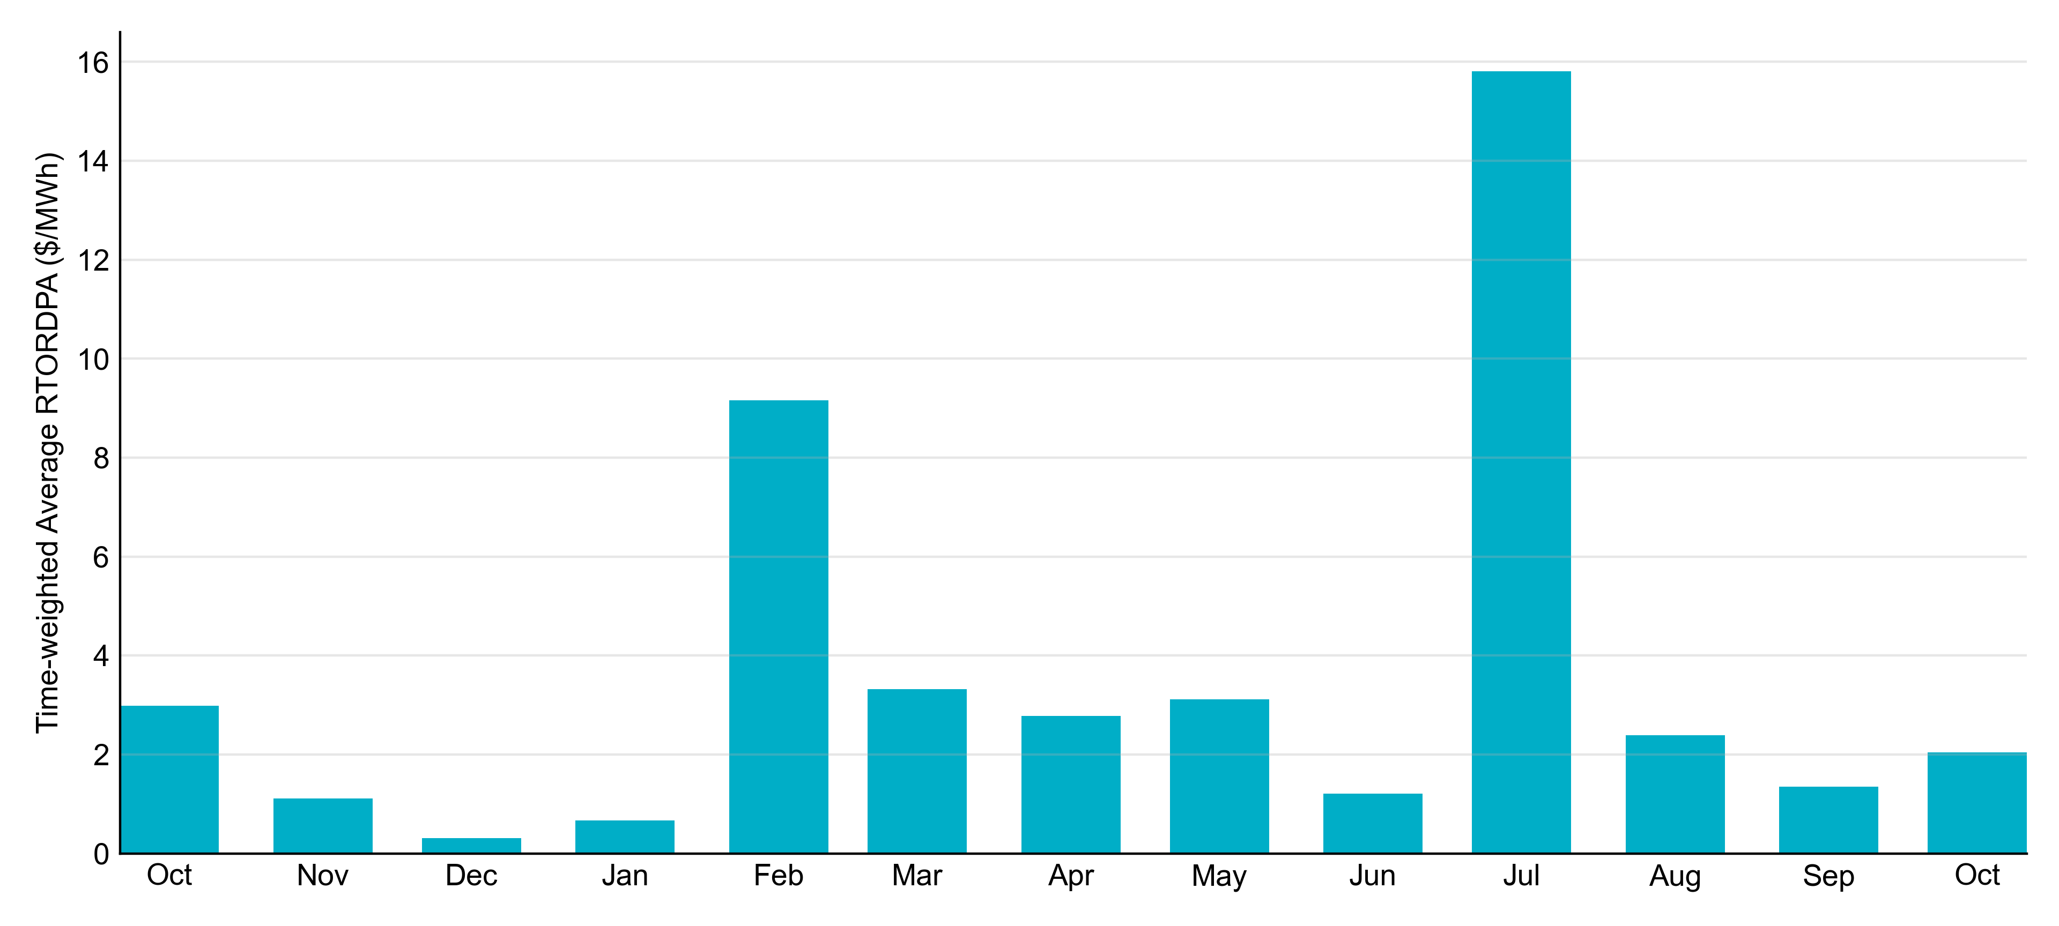
Reliability Deployment Price Adder: Last 13 Months
October 2022 had a total of 123.50 RTORDPA hours with an average value of $2.04/MWh.

Slide 12
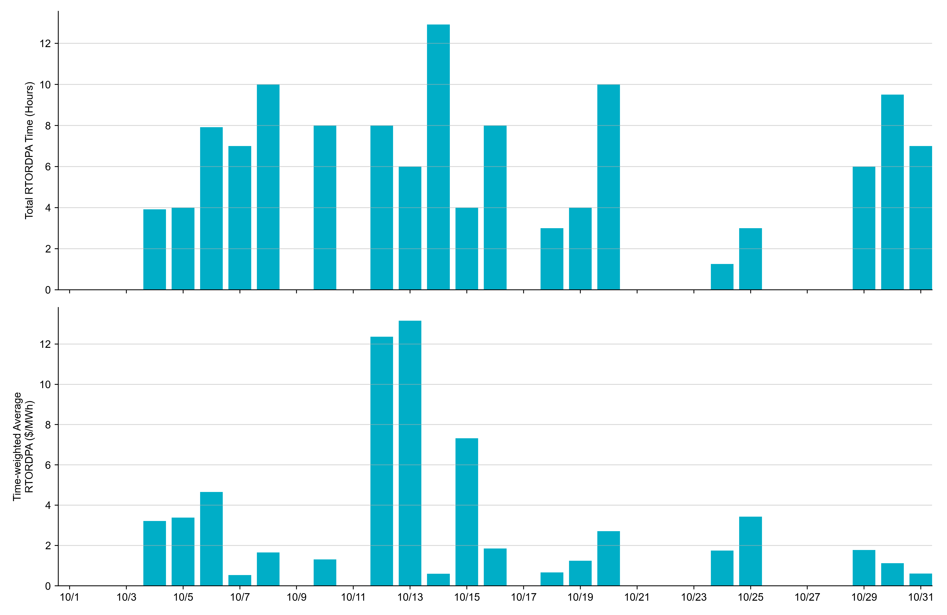
Reliability Deployment Price Adder: October 2022
OD 10/13 had the highest daily time-weighted average RTORDPA: $13.16/MWh.

Slide 13
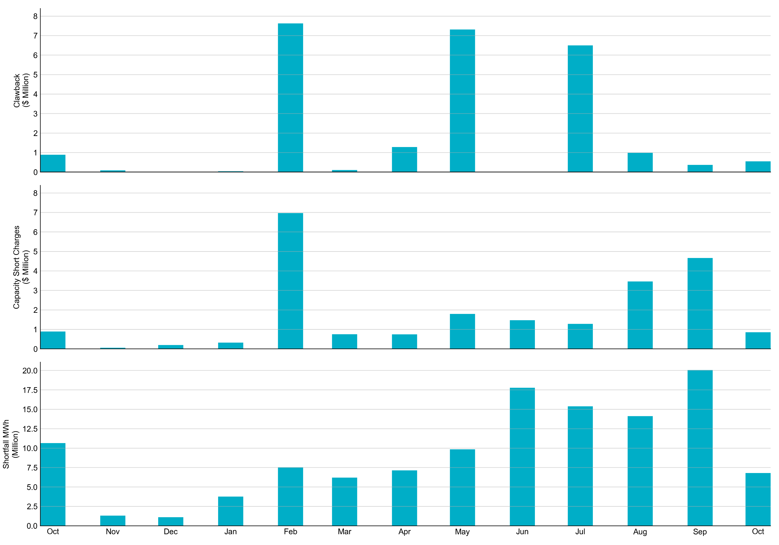
RUC Clawback, Capacity Short Charges, and Shortfall
For October 2022, the total Clawback charge was $0.852M. The total Make-Whole payment was $0.545M, which was almost entirely covered through capacity-short charges.
In October 2022, $0.852M in Make-Whole was paid out. There was a total amount of $1.35 uplifted to load due to rounding.

