Slide 1
ERCOT IBRTF: NERC and Other Industry Updates
Julia Matevosyan
Chief Engineer
ESIG
11/15/2022

Slide 2
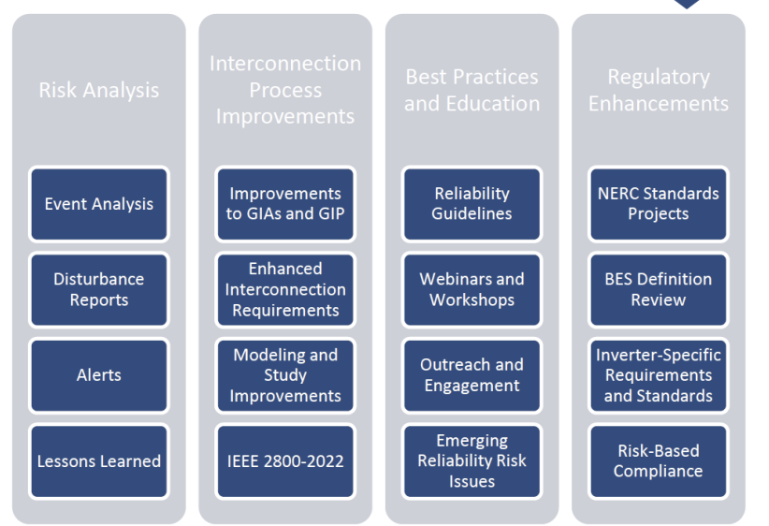
NERC IBR Strategy Paper
NERC IBR Strategy

Slide 3
2022 NERC-NATF-EPRI Annual Transmission Planning and Modeling Workshop
NERC, NATF and EPRI held a joint workshop focusing on topics related to power system planning, modeling, and system analysis on November 2-3, 2022. Key focus areas included: A discussion with industry experts on the future of dynamic simulations in a dual platform world Industry experiences with inverter-based resource planning and modeling including evaluating ride-through performance, EMT analysis, and interconnection challenges Leveraging cloud computing to run grid planning software Latest EPRI research on extreme events and impact of extreme planning Overview of how NERC standards and guidelines are filling reliability gaps
Presentations: 2022 NERC-NATF-EPRI Annual Transmission Planning and Modeling Workshop Presentations
Recording Day 1: 2022 NERC-NATF-EPRI Annual Transmission Planning and Modeling Workshop Day 1
Recording Day 2: 2022 NERC-NATF-EPRI Annual Transmission Planning and Modeling Workshop Day 2
Notes:
Discussed challenges with models and model accuracy, need for model validation, model quality checks and model benchmarking between EMT and positive sequence,
need for EMT simulations and issues with doing system-wide EMT studies.
Current practice for assuring system stability is becoming, in varying degrees, inadequate • Improvements are needed in the constituent tools, including phasor, EMT and state-space programs. This is necessary, but not sufficient. • Further, improvements are needed in how these tools interact with each other, how inputs are created, how simulation results are interpreted.

Slide 4
AEP TO/TP Actions
Beginning to screen IBR PSCAD models for ride-through hang-ups, even if lacking protection & control details that exhibit the sort of ride-through issues seen in events (doing this in ERCOT wherein TPs run GI impact studies)
First testing to check control & protection content of EMT models by pushing POI V, Hz, angle trajectories to extremes so as to cause trips
Then run POI through various less drastic trajectories while varying SCR
Beginning to help promote REGC_C as replacement for REGC_A
Participating in IEEE 2800.2 IBR Testing and Verification Procedures for evaluating conformity with 2800-2022, including ride-through
Continuing case studies looking into stability benefits of Grid-Forming IBRs now with new positive sequence prototype modeling developed by EPRI
Staff education / training of AEP personnel on EMT skills by Electranix
SME participation in / nominations to serve on NERC standard drafting teams relevant to the afore-described ride-through and stability issues

Slide 5
Entergy IBR Requirements

Slide 6
NERC Standards Under Development
Inverter-Based Resource Performance Enhancements:
Project 2021-04 Modifications to PRC-002-2
Project 2020-02 Modifications to PRC-024 (Generator Ride-Through)
Project 2020-06 Verification of Models and Data for Generators
Project 2021-01 Modifications to MOD-025 and PRC-019
Project 2022-04 EMT Modeling
Project 2021-02 Modification to VAR-002
(Future Project) Updates to EOP-004
(Future Project) IBR Performance Issues

Slide 7
Electranix: EMT Model Constraints and Limits

Slide 8
Electranix: EMT Model Constraints and Limits

Slide 9
ESIG Fall Technical Workshop, October
Tutorial: Evolution and Effectiveness of Flexibility Products
Introduction & Keynote Comments
Opening Panel: High VRE Futures – 100% Clean Electricity
Session 1: Congestion Management Practices, Challenges and Potential Mitigation Solutions
Session 2: IEEE 2800 and IBR Modeling
Session 3: Planning and Deployment Implications with Storage and IBRs
Session 4: Aligning Retail Pricing with Grid Needs
Session 5: Future Market Design for Resource Adequacy
Session 6: IBR Stability and Control
Session 7: Topics in Power Systems Operations
Session 8: Closing Plenary: Inter-regional Transmission Planning
https://www.esig.energy/event/2022-fall-technical-workshop/

Slide 10
EPRI: Gap Analysis Between IEEE 2800 and Existing Interconnection Requirements

Slide 11
NERC IRPS: IEEE 2800 OEM Readiness

Slide 12
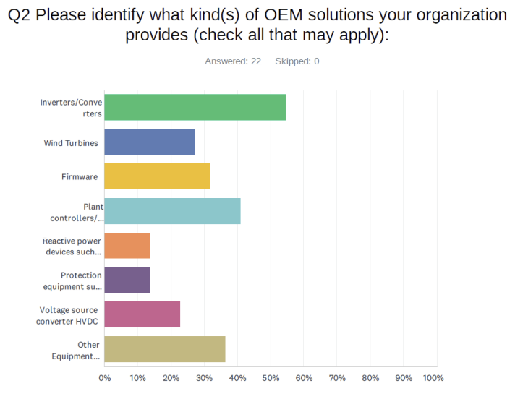
NERC IRPS: IEEE2800 OEM Readiness Survey
Need 2800.2 for
Clear criteria and methodology
Clarity on unit level tests as well as plant level tests
In the meantime, need guidance on self-certification
Need adoption in interconnection requirements to drive “demand” and “push” within OEMs’ product teams
OEMs need to analyze their inverter capability, address any gaps, possible engineering changes, clarify tech details along the way
OEMs preparation for 2800 varies with their product life cycle
OEMs want to avoid re-testing when 2800.2 arrives
OEMs alone does not solve for all of 2800
OEM + Developer
Notes:
o

Slide 13
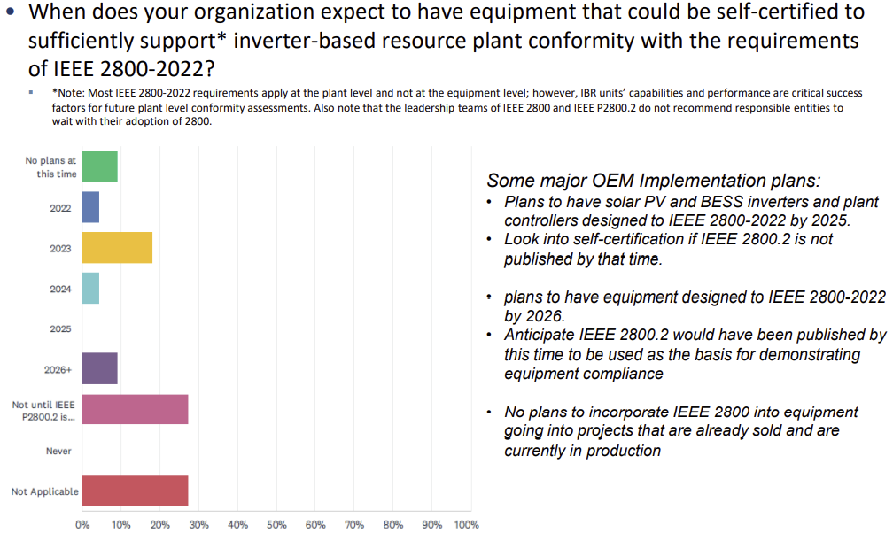
NERC IRPS: IEEE2800 OEM Readiness Survey

Slide 14
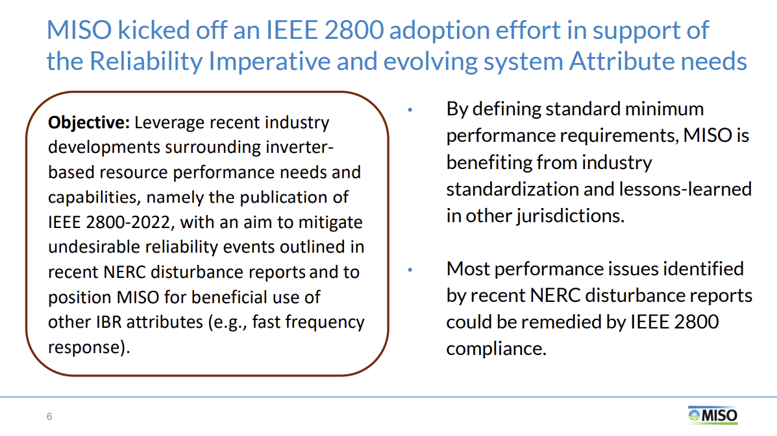
MISO Interconnection Requirements

Slide 15
MISO Interconnection Requirements
Notes:
In early 2023 MISO plans to gather stakeholder input on IBR requirement prioritization, implications and timing

Slide 16
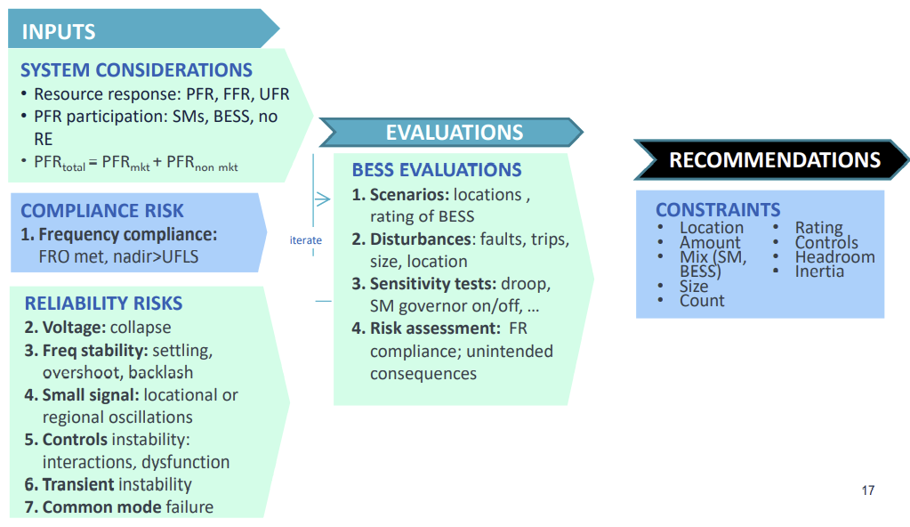
ERCOT/GE: Stability Impacts of Providing Frequency Response from IBRs in Lower Inertia Regions
Investigate whether there is a reliability reason to establish one or more types of limits on Resources providing RRS-PFR limit per:
Resource, group, and/or at system level
For different technologies
the limit on the number of Resources providing RRS-PFR
Limits dependent on system conditions
Source: ERCOT & GE
Notes:
The project was kicked off on Dec. 14, 2021 and planned to be completed later this year
The GE project team presented the proposed work at Feb 2022 PDCWG and provided the responses to the comments received.

Slide 17
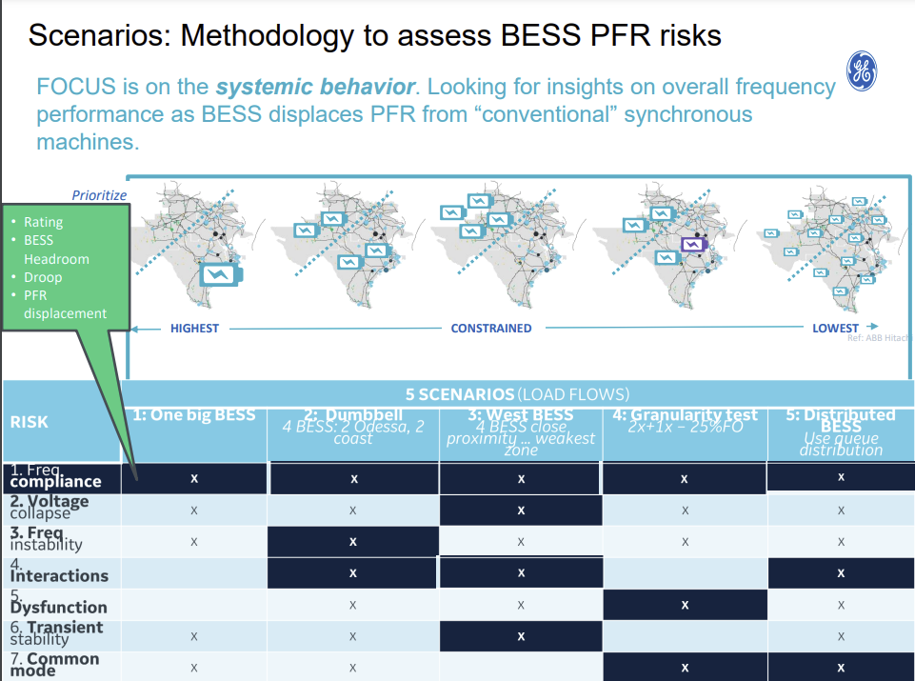
Notes:
The “X” are in boxes where project team expected those type of issues for the given configuration.
Note: there should also be an “X” for interactions in the Granularity test column too. However, the focus should not be too much on the “X”s.
The dark blue color is what the project team was really wanting to focus on in that configuration and so they studied disturbances that would stress the system in that direction. This entire table was constructed or hypothesized before they ran the tests, to give them a direction for the design of experiments.

Slide 18
Comparison of Current Grid Forming IBR Specs
Response to voltage phase angle step
Response to voltage magnitude step
Active/Reactive Power Sharing
Provide Damping
Counter Harmonics
Response to RoCoF event (MW loss)
Response to Faults (balanced and unbalanced)
NG ESO GC0137 (Great Britain)
VDE/FNN (Germany)
OSMOSE (EU)
HECO (Hawaii)
UNIFI (U.S.)
Island Operation
Black Start
Low SCR Operation

Slide 19
OSMOSE: Types of grid forming units
Synchronous Machine
Type 4:
Services provided: Type 3 + high fault current (> 2 pu)
Criticality: if protection fail to detect faults
Cost: high for converters (oversizing), null for synchronous machines
Type 3:
Services provided: Type 2 + inertial response
Criticality: when system inertia decreases system-wide
Cost: limited due to the need of an energy buffer from a few seconds to 1 minute
Type 2:
Services provided: Type 1 + synchronizing power
Criticality: when system inertia decreases locally
Cost: very limited due to the need of an energy buffer < 1 s (other FFR resources can then take over)
Type 1
Services provided: Stand alone + System Strength+ fault current (within ratings), wide range of SCR operation
Criticality: when system strength decreases locally
Cost: null, only software changes
GFM Battery
Source: Carmen Cardozo, OSMOSE presentation at ESIG GFM Workshop https://www.esig.energy/event/2022-special-topic-workshop-grid-forming-ibrs/
Notes:
Synchronising power is defined here as the response of a grid-connected unit to a phase jump.

Slide 20
Julia Matevosyan
julia@esig.energy

Slide 21
Comparison at Glance
Specs | GC0137 | OSMOSE | VDE/FNN | UNIFI (draft) | HECO
Response to phase-jump | Yes, defines response time (< 5ms) and size of phase-jump angle (5 deg) | Yes, similar to GC0137 | Yes, Provides a time-dependent profile with a minimum sustain time | Yes | Yes, high level
Inertial Response / Immediate Active Power | Yes, defines response time (< 5ms) | Yes, defines response time (< 5 ms) and proposes to set min sustain time | Yes (implicit), frequency change test | Yes | Yes, high level
System Strength/ Immediate Reactive Power / Response to voltage Step | Yes, defines response time (< 5 ms) | Yes, defines response time (< 5 ms) | Yes, verified through voltage step tests | Yes (improve system strength) | Yes, high level
Fast Fault Current (balanced and unbalanced) | Yes, defines response time (<5 ms) and time to full response (<30 ms) | Yes, defines response time (< 5 ms) , discusses active/reactive current share and pos/negative sequence prioritization | TBC | Yes, at high level and by definition | Yes, high level
This specification generally apply within equipment limits and all requirements applicable to GFL IBRs also apply (unless conflicts with GFM requirements above)

Slide 22
Comparison at Glance
Specs | GC0137 | OSMOSE | VDE/FNN | UNIFI (draft) | HECO
Low SCR operation | Yes | Yes, by definition | Yes | Yes | Yes, high level
Active/Reactive power sharing | Yes (implicit in other req.) | Yes (implicit in islanded test) | Yes (implicit in islanded test) | Yes | Yes, high level
Damping of voltage and frequency oscillations | Yes, defines response time (<5 ms) | May be | Yes | Yes | Yes, high level
Islanded operation | Yes | Yes | Yes | Yes | Yes, high level
Counter Harmonics | No (existing requirements for GFL apply, additional requirements may be agreed bilaterally) | No (requirement not to contribute to harmonics as applied to GFL is already challenging) | Yes | Yes | Yes, high level
Black start | Yes, if applicable | Yes, if applicable | Yes, if applicable | Yes, if applicable | Yes, if applicable
These specifications generally apply within equipment limits and all requirements applicable to GFL IBRs also apply (unless conflicts with GFM requirements above)

