Slide 1
Credit Exposure Update
Credit Work Group
ERCOT Public
November 16, 2022

Slide 2
Monthly Highlights Sep 2022 – Oct 2022
Market-wide average TPE decreased from $1,611.8 million in September to $1,172.5 million in October.
  TPE decreased mainly due to lower Real-Time and Day-Ahead Settlement Point prices
    Discretionary Collateral is defined as Secured Collateral in excess of TPE,CRR Locked ACL and DAM Exposure
  Average Discretionary Collateral decreased from $3,252.4 million in September to $2,844.6 million in October
  The decrease in Discretionary Collateral is largely due to decrease in Secured Collateral
No unusual collateral call activity

Slide 3
TPE and Forward Adjustment Factors Oct 2021- Oct 2022
*TPE adjusted to exclude short pay entities eliminating data skew

Slide 4
TPE/Real-Time & Day-Ahead Daily Average Settlement Point Prices for HB_NORTH October 2021- October 2022
* TPE adjusted to exclude short pay entities eliminating data skew

Slide 5
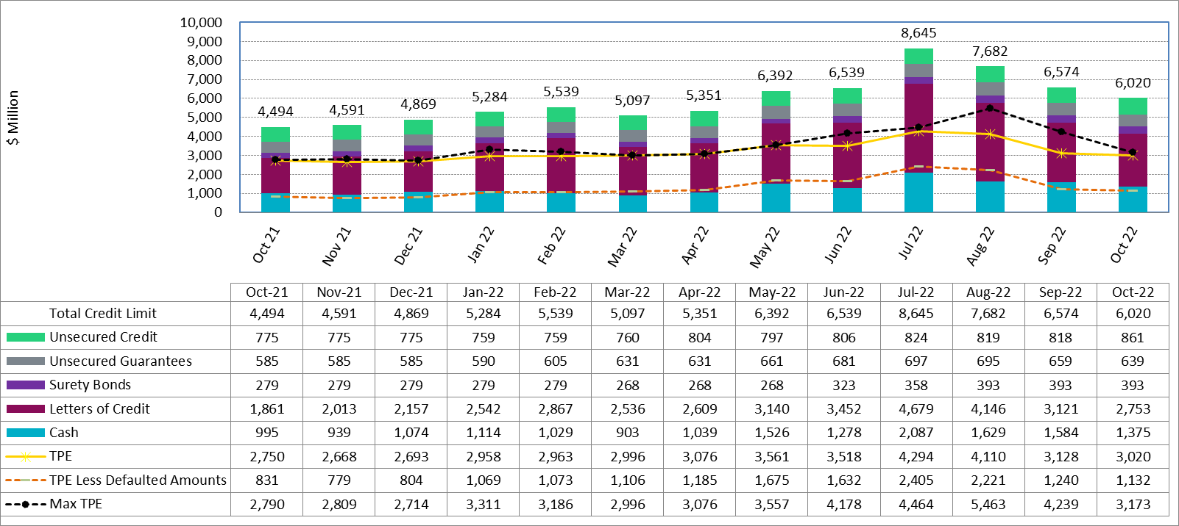
Available Credit by Type Compared to Total Potential Exposure (TPE) Oct 2021- Oct 2022
Numbers are as of month-end except for Max TPE
Max TPE is the highest TPE for the corresponding month
TPE less Defaulted Amounts: TPE – Short-Paid Invoices

Slide 6
Discretionary Collateral September 2022 - October 2022
* Discretionary collateral doesn’t include Unsecured Credit Limit or parent guarantees
* TPE adjusted to exclude short pay entities eliminating data skew

Slide 7
TPE and Discretionary Collateral by Market Segment - October 2022*
Load and Generation entities accounted for the largest portion of discretionary collateral
*Discretionary collateral doesn’t include Unsecured Credit Limit or parent guarantees
* TPE adjusted to exclude short pay amounts eliminating data skew

Slide 8
Discretionary Collateral by Market Segment October 2020 - October 2022
* Discretionary Collateral adjusted to exclude short pay amounts eliminating data skew

Slide 9
TPEA Coverage of Settlements September 2021– September 2022
*TPEA closely approximates actual/invoice exposure
*TPEA adjusted to exclude short pay entities eliminating data skew

Slide 10
TPEA Coverage of Settlements September 2021– September 2022
*TPEA exceeds invoice exposure
*TPEA adjusted to exclude short pay entities eliminating data skew

Slide 11
TPEA Coverage of Settlements September 2021– September 2022
*TPEA generally exceeds invoice exposure

Slide 12
TPEA Coverage of Settlements September 2021– September 2022
Invoice exposure generally exceeds TPEA
TPEA adjusted to exclude short pay entities eliminating data skew

Slide 13
TPEA Coverage of Settlements September 2021– September 2022
* TPEA generally exceeds Invoice exposure

Slide 14
TPES Coverage of Settlements September 2021– September 2022
*TPES exceeds actual/invoice exposure

Slide 15
Questions

Slide 16
TPEA Coverage of Settlements
  TPEA covers Settlement/Invoice exposure and estimated Real-Time and Day- Ahead completed but not settled activity (RTLCNS and UDAA)
  The analysis was performed for the period, Sep 2021 - Sep 2022
  Only Settlement invoices due to ERCOT are considered in the calculation
  Example
  For business date 9/1/2022, if a Counter-Party has M1 value of 20, then all the charge invoices till 9/21/2022 including RTLCNS and UDAA as of 9/1/2022 is summed up to arrive at “Invoice Exposure”

