Slide 1
Public API URL Discussion
Presented by: Omar Soberanis and Michael Ackermann
Date: 11/10/2022

Slide 2
ERCOT REST API Approach
Simplify Development
Provide an Abstraction for Technical Details
Use of Industry Standards and Popular API architecture
Compatibility with messages like XML, CSV, JSON
Lighter than SOAP

Slide 3
ERCOT API URL Pattern
The standard API URL pattern will be as follows:
<tenant uri>/[context root]/api/[v#]/resource-group[/resource[/[identifier[/resource]]]][?query parameters...]
Examples:
/api/v1/reports/NP6-787-CD?sort=desc&limit=10
HTTP/1.1 200 OK
Vary: Accept
Content-Type: application/json;charset=UTF-8
{
"metadata": {
"resultset": {
"count": 10,
"offset": 0,
"limit": 10
},
"emil" : {
"emilid": "NP6-787-CD",
"reportTypeId" : 11485
"name": "LMPs_By_Electrical_Bus"
... etc - rest of EMIL model values
},
"reports": [
{"friendlyName": "LMPSELECTBUSNP6787_20220818_162018_csv",
"reportId": 103324,
"posted" : "20220818T162026"
"fileType" : "zip"
... etc - any other relative instance data
},
{"friendlyName": "LMPSELECTBUSNP6787_20220818_161515_csv",
"reportId": 103323,
"posted": "20220818T161529"
"fileType" : "zip"
... etc - rest of EMIL model values
},
... etc (8 more report instances)
]
}

Slide 4
ERCOT API Versioning
Version identifier after the context root. Example:
https://apihost.ercot.com/api/v1/employee-manager/employees/13245
Content Negotiation / Media Type. The version is only passed in the HTTP request header as a standard content type. Example
HTTP GET:
https://apihost.ercot.com/api/employee-manager/employees/13245
Accept: application/vnd.ercot.pubapi.v1+json
Or
Accept: application/vnd.ercot.pubapi.employee+json; version=1
Default. If no version is included in the URL or in the header the system will always default to latest version.

Slide 5
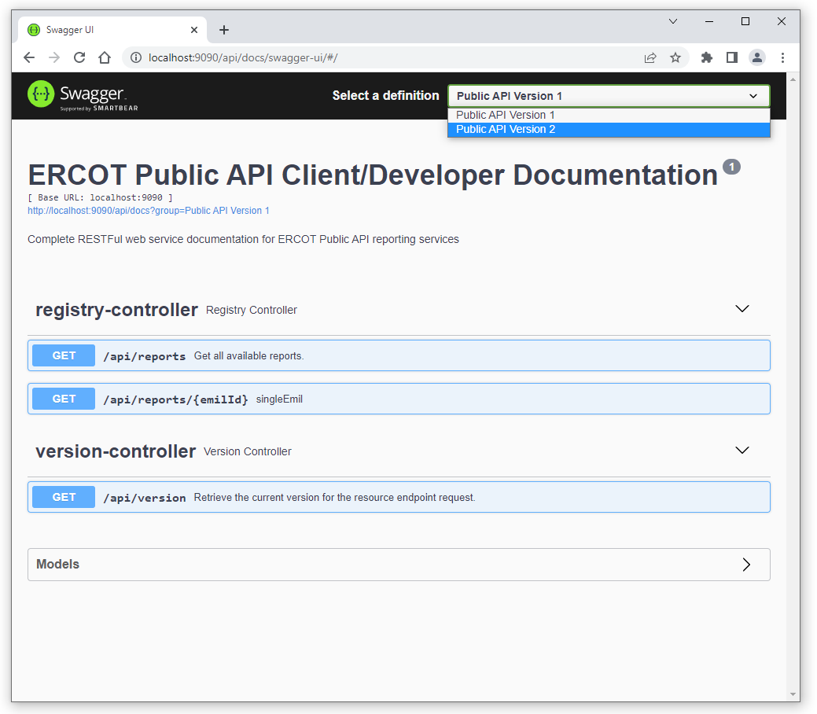
ERCOT API Documentation

Slide 6
Q&A

