Slide 1
Projects with Interface Change Requirements
FFRA, Firm-Fuel, ECRS
Matt Mereness
November 10, 2022

Slide 2
Outline
Lessons learned from October 13th release
  NPRR863/FFRA
  NPRR1120 Firm Fuel Supply Service
Protocol Projects with Upcoming Market Facing Changes
  NPRR863/ECRS- Discuss any question on interface changes
Wrap-Up

Slide 3
Reminder of scope of October 13 Release
NPRR863/FFRA and NPRR1120 Firm Fuel Supply Service
  FFRA Go-Live October 13, 2022
    After hours upgrade on Oct 13 (approx 7:30pm-9pm)
    QSEs will be asked to update COP with RRS new subtypes as soon as possible after upgrade
    Avoid submissions for OD 10/15 and forward before upgrade for these transactions:
      AS Self Arrangement containing RRS
      AS Trade containing RRS
      AS Offer containing RRS
    October 14 becomes transition day, using new RRS sub-types in real-time and day-ahead transactions
  Firm Fuel Service Market :
    Firm Fuel software deployment is October 13, 2022
    November 14 submissions begin
    November 15 first Operating Day
  Weekly Readiness details:
    Most recent materials for today’s discussion:
      https://www.ercot.com/calendar/event?id=1661527762344
      Open to review latest Market Readiness materials

Slide 4
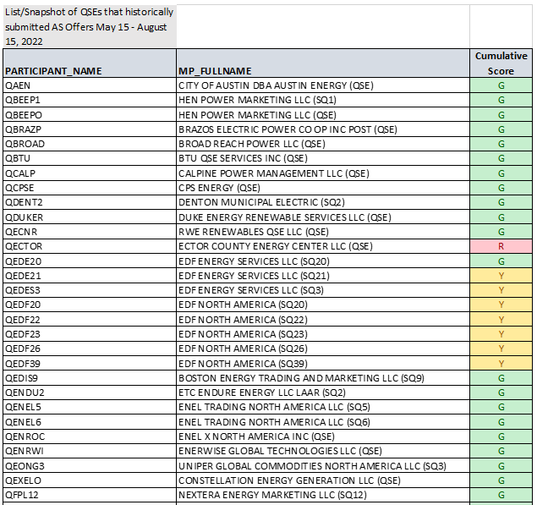
Required testing and scorecard for QSEs in MOTE
Goal was 95%, achieved 98%
Weekly posting on TAC homepage: https://www.ercot.com/committees/tac

Slide 5
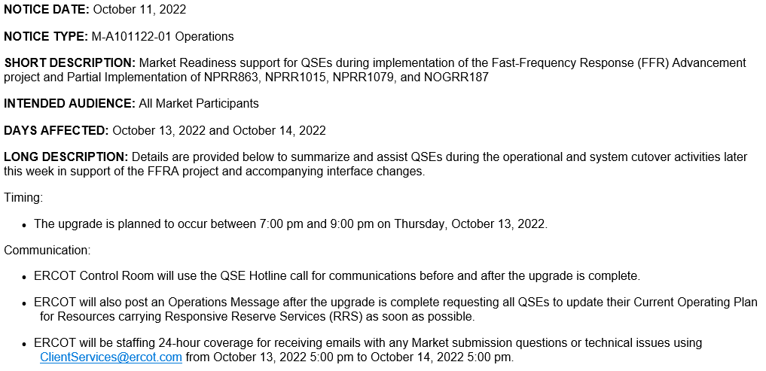
Market Notice detailing cutover

Slide 6
Market Notice detailing cutover (continued)

Slide 7
Summary of Cutover: How did it go?
From ERCOT’s perspective:
  10/13- On-site war room to support market issues (Client Services & SMEs)
  10/13- Morning of upgrade significant number of QSE submissions for OD+2 (AS Offers and AS Self-Arrangement)
    Outreach via Client Services was effective in mitigating issue to zero by evening
  10/13- Evening upgrade completed at approximately 9:07pm
    Initial COP errors emailed in were false alarms (had submitted between 9:00-9:07pm)
  10/13- Evening observation of AS Trade retrieval issues, but ERCOT resolved with system change by morning.
  10/14- Morning submissions errors identified transition issue with qualification, ERCOT rectified, and DAM submissions extended to 10:30am
    Also some (only a few) QSEs surprised by changes in RRS types on AS Trades
    No AS trades were requested to be cancelled
  10/14- Day-Ahead Market cleared and published successfully, however, an error occurred in MMS-UI AS Awards retrieval (API worked, but MMS-UI display issue).
    Workaround created to publish AS Awards on alternate ERCOT secure posting for QSEs
    Market Notice sent along with Hotline call and Operations message to highlight alternate posting
    Operations messages continued after each DAM, and Market Notice to be sent when resolved
In summary, no show-stoppers during cutover and less than 20 emails.
Communication was effective in identifying and resolving issues quickly.

Slide 8
Initial Lessons Learned
Early and frequent communication is best mitigation for significant implementations
Technology Work Group will continue to be key in review of interface changes and impacts.
Business implementation support was key leading up to implementation
When system interfaces not backward-compatible:
  Increase communications
  Extend MOTE duration
  Leverage QSE metrics to provide readiness transparency
  Focus on and share Data Cutover plan
  Mitigation of issues before they happen
ERCOT has created new Market Readiness criteria risks within project planning to help identify similar project risk in future projects.
  ERCOT is currently evaluating ECRS implementation details for applying lessons learned.

Slide 9
ECRS (in NPRR863)
ERCOT Contingency Reserve Service
High-priority PUCT project
Incorporates new 10-minute Ancillary Service (ERCOT Contingency Reserve Service).
Project completing planning and “potential dates” are:
  Posted interface changes 9/29/2022: (https://www.ercot.com/calendar/event?id=1663684278483)
  Potentially 7-8 weeks of MOTE availability before go-live
  May 2023 Go-Live
Project Impacts
  Leveraging lessons-learned from FFRA to minimize impact on submissions.
  ECRS interface changes posted
    EIP External Interfaces Specification ECRS.doc
    ERCOT Common Types ECRS.xsd
    ERCOT Transaction Types ECRS .xsd
    ECRS ICCP telemetry handbook update.doc (list of new points, not the ICCP handbook)
Any questions on ECRS?

Slide 10
Feedback for next TWG Meeting
Current plan for next TWG meeting:
  Continue discuss of changes and/or additional details for:
    NPRR863/ECRS (detailed review of interface changes)
    If needed, discussion of Market Readiness and new projects on horizon
ERCOT open to feedback/questions for next TWG meeting
  Feedback can be directed to Matt.Mereness@ercot.com

