Slide 1
ERCOT Technology Working Group (TWG)
November 10, 2022

Slide 2
ERCOT TWG – Venkat Tirupati
WELCOME

Slide 3
ERCOT TWG

Slide 4
ERCOT TWG Agenda
Item # | Item Description | Presenter
1 | Antitrust admonition
2 | Project Update | Troy Anderson
3 | Lessons learned from FFRA Review of ECRS changes posted last month | Matt Mereness
4 | ERCOT Learning Management System Update | Kristee Watts
5 | Wind and Solar Forecast MIS Report Changes | Pengwei/Jackson
6 | NERC EMSWG update | Wei Qiu - NERC
7 | Public API and API improvements | Omar S./Ajay M.
8 | Developer.ercot.com initiative | Brandon/Ajay M.
9 | Updates for Awareness CIM 16 Upgrade ERCOT EMS Upgrade Project Operator Real-Time Messaging SCR820 TEXAS SET 5.0 & MarkeTrak Project Updates NMMS Upgrade | Venkat Tirupati
10 | Future topics of interest | Open Forum
 | Adjourn | Venkat Tirupati

Slide 5
ERCOT TWG – Troy Anderson
Project Update

Slide 6
ERCOT TWG – Matt Mereness
Lessons learned from FFRA
Review of ECRS changes posted last month

Slide 7
ERCOT TWG – Kristee Watts
Learning Management System

Slide 8
ERCOT TWG – Pengwei/Jackson/Jamie
Wind and Solar Forecast MIS Report Changes
Unplanned Outages Report

Slide 9
ERCOT TWG – Wei Qiu - NERC
2023 Work Plan for NERC EMSWG

Slide 10
ERCOT TWG – Omar Soberanis/Ajay Mannepalli
Public API & API Improvements

Slide 11
ERCOT TWG – Ajay Mannepalli/Brandon Johnson
Developer.ercot.com Initiative

Slide 12
ERCOT TWG – Venkat Tirupati
CIM 16 Upgrade
ERCOT EMS Upgrade Project
Operator Real-Time Messaging SCR820
TEXAS SET 5.0 & MarkeTrak Project Updates
NMMS Upgrade
NOGRR230 WAN Participant Security

Slide 13
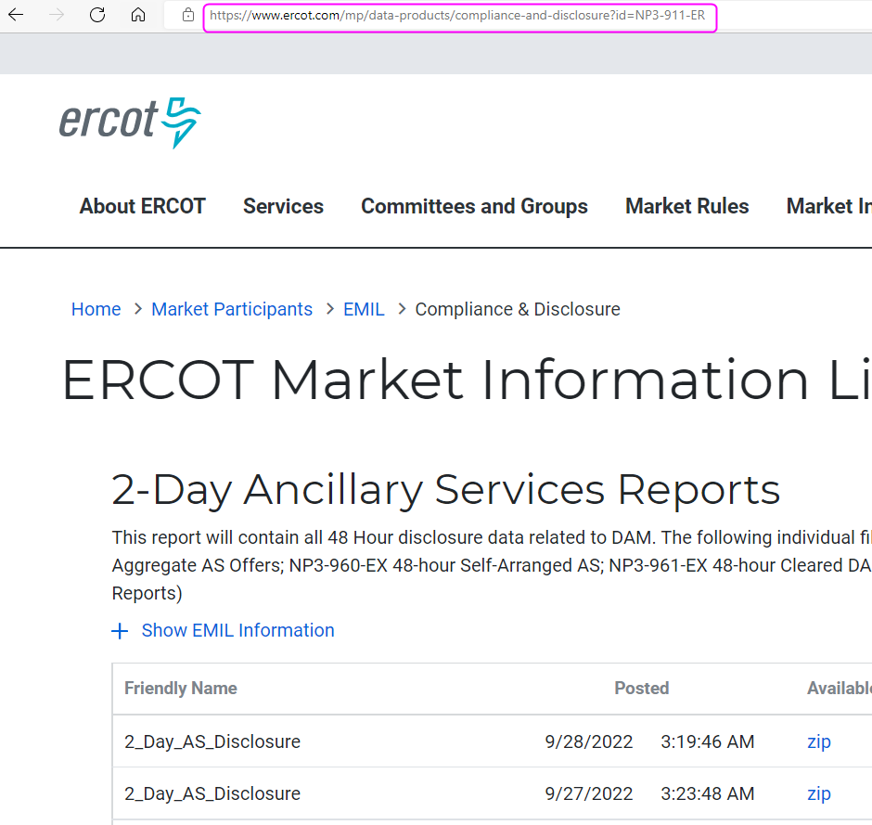
TWG - Public Reports & Extracts on MIS – Priyanka/Amy

Slide 14
ERCOT TWG – Open Forum
Q & A

Slide 15
ERCOT TWG
Thank You

