Slide 1
2023 NERC EMSWG
Work Plan
Wei Qiu, Lead Engineer, NERC
ERCOT TWG Conference Call
November 09, 2022

Slide 2
2023 Work Plan
2023 Monitoring and Situational Awareness Conference
2023 Q3, Virtual or In Person
Renewable resources
Lessons Learned
EMS best practice
Definition of “monitoring and control”
To revise definition of 1h with use cases.
Cloud Computing

Slide 3
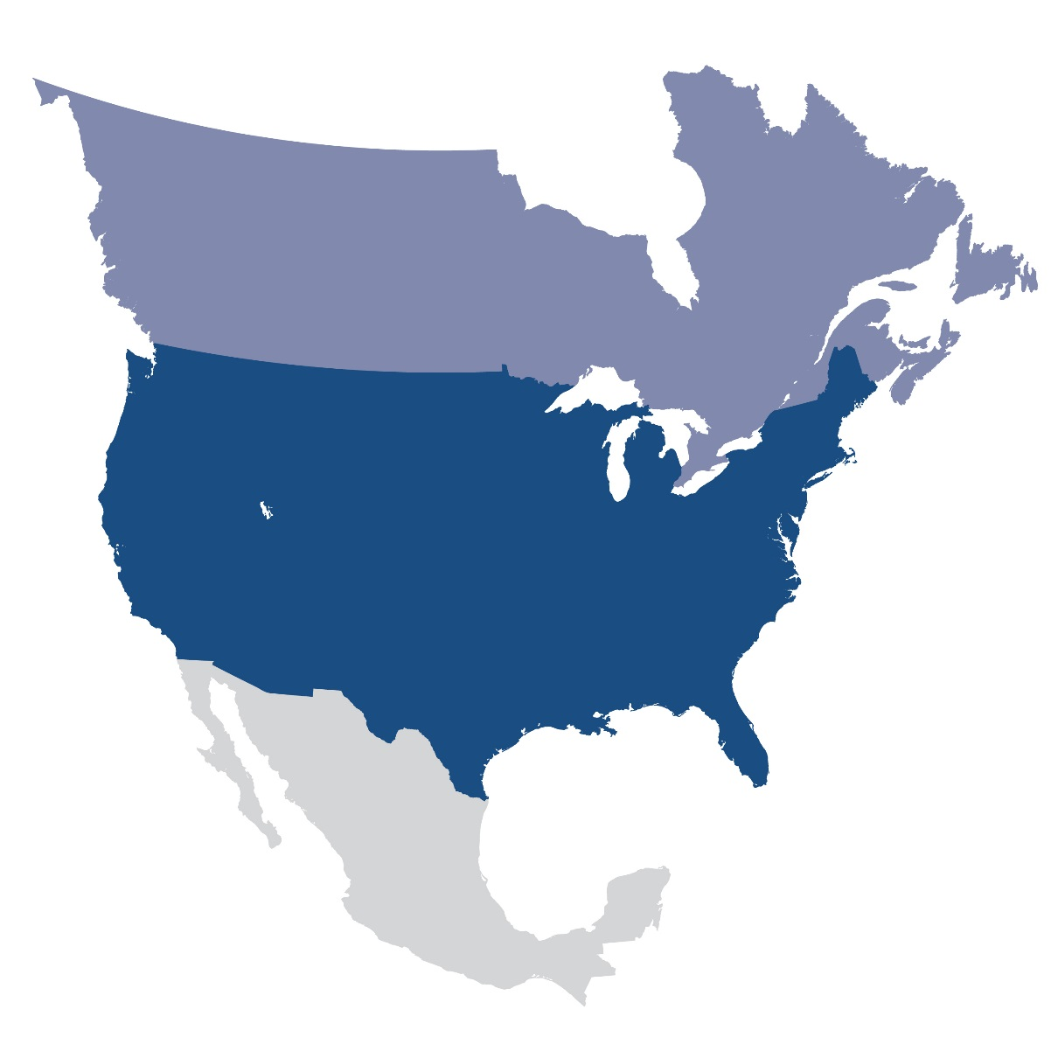
Questions and Answers
Contact Information:
wei.qiu@nerc.net

