Slide 1
11/9/2022 Thermal ELCC Study Results
Prepared for Electric Reliability Council of Texas
Notes:
1

Slide 2
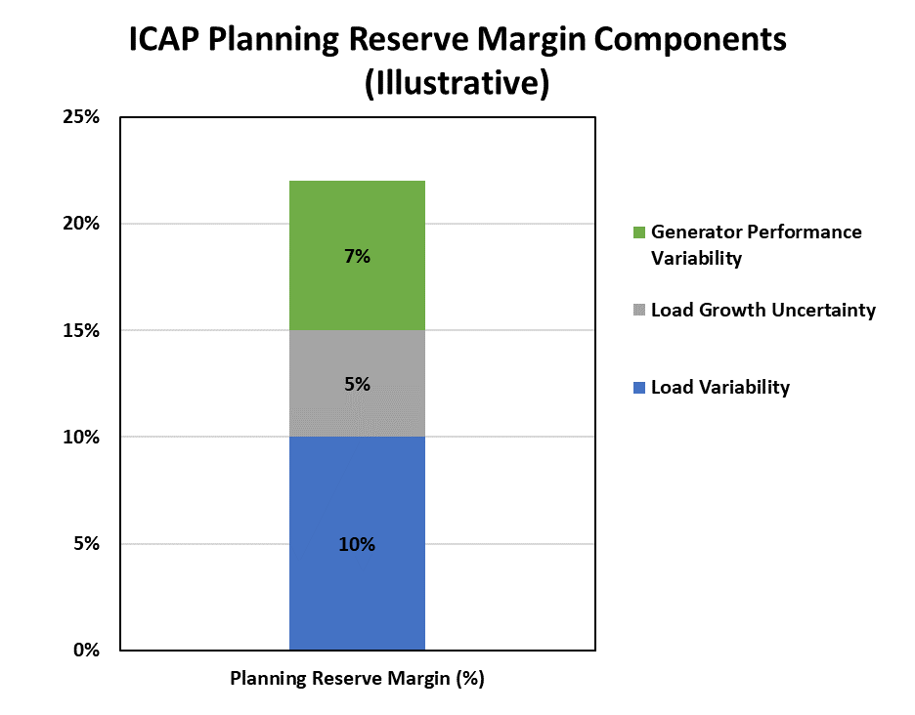
Resource Accreditation
Planning Reserve Margin (PRM) to maintain 0.1 LOLE based on three main uncertainty factors
Load variability (weather/customer usage patterns)
Load growth uncertainty
Generator outage variability
Disconnect: Generator performance variability included in PRM while renewable variability addressed via ELCC analysis

Slide 3
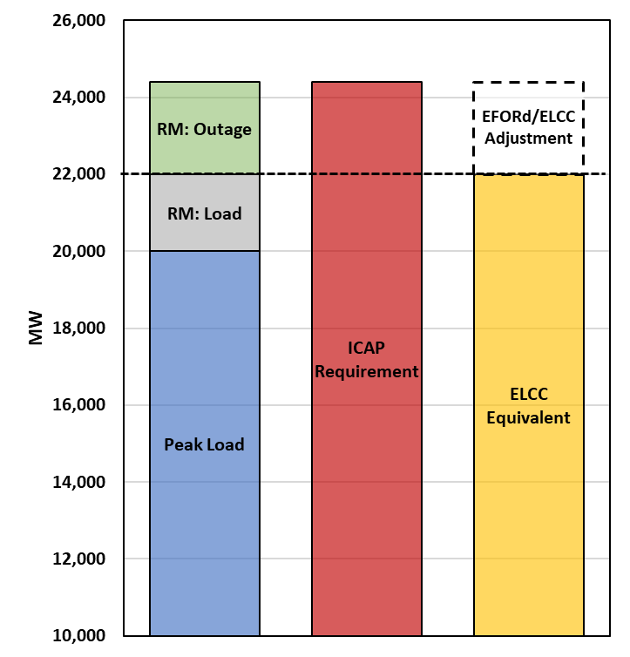
Resource Accreditation and Thermal ELCCs
Under a UCAP accreditation market, resource accreditation is converted to a perfectly available capacity equivalent value
Thermal resources: UCAP = ICAP * (1-EFORd)
Renewable/energy limited resources: Effective Load Carrying Capability (ELCC)
In theory, when normalizing for perfectly available capacity, only load uncertainty drives the UCAP RM

Slide 4
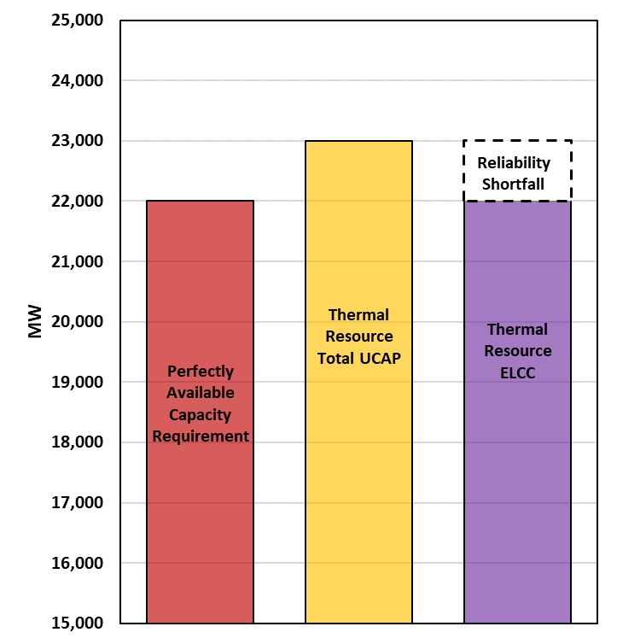
Resource Accreditation and Thermal ELCCs
However, UCAP accreditation may not be a good proxy for perfectly available capacity when accounting for fleet wide interactions of thermal resources
Sum of all individual thermal resource UCAP values may be greater than the actual fleet wide contribution towards reliability (i.e., the thermal resource ELCC)
May or may not affect PRM
Key fleet wide interactive outage effect categories include:
Outage variability
Common mode failures
Weather dependent outages
Fuel availability outages

Slide 5
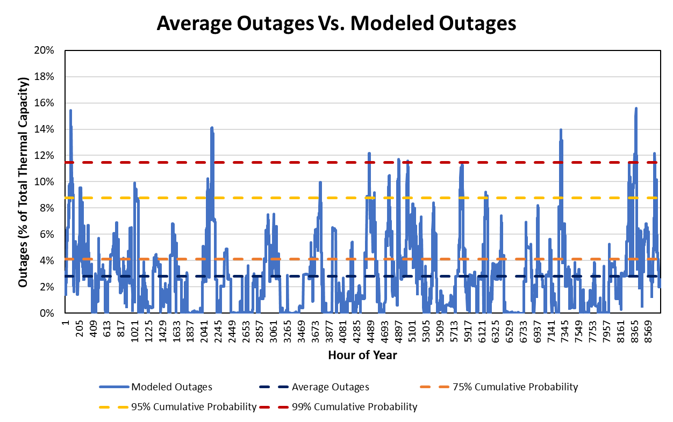
Outage Variability
What level of reserves are needed to cover the impact of outages?
UCAP accounting using EFORd presumes only average outages need to be addressed.

Slide 6
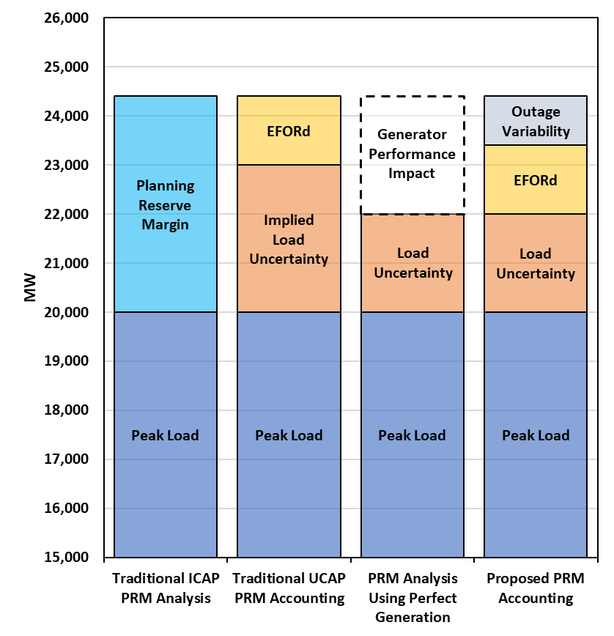
Outage Variability
Outage variability is generally hidden in the PRM assessment.
This issue would not be expected to affect PRM, only resource accreditation

Slide 7
ELCC Matrix
ELCC Scenario | Battery Penetration (GW) | Solar Penetration (GW) | Wind Penetration (GW) | Thermal Penetration (GW) | Cold Weather Outage Assumption | Fuel Availability Assumption
1 | 2024 Portfolio | 2024 Portfolio | 2024 Portfolio | 0 | Exclude 2021 | Exclude 2021
2 |  |  |  | 2024 Portfolio
3 | 0 | 0 | 0
4 | 2024 Portfolio | 2024 Portfolio | 2024 Portfolio | 0 | Exclude 2011 and 2021
5 |  |  |  | 2024 Portfolio
6 | 0 | 0 | 0
7 | 2024 Portfolio | 2024 Portfolio | 2024 Portfolio | 0 | Include 2011 and 2021
8 |  |  |  | 2024 Portfolio
9 | 0 | 0 | 0
10 | 2024 Portfolio | 2024 Portfolio | 2024 Portfolio | 0 | Exclude 2021 | Include 2021
11 |  |  |  | 2024 Portfolio
12 | 0 | 0 | 0
13 | 2024 Portfolio | 2024 Portfolio | 2024 Portfolio | 0 | Exclude 2011 and 2021
14 |  |  |  | 2024 Portfolio
15 | 0 | 0 | 0
16 | 2024 Portfolio | 2024 Portfolio | 2024 Portfolio | 0 | Include 2011 and 2021
17 |  |  |  | 2024 Portfolio
18 | 0 | 0 | 0

Slide 8
ERCOT Resource Mix as Modeled within SERVM for 2024
Unit Type | Capacity (MW)
4CP | 900
BIOMASS | 163
COAL | 13,568
ERS | 0
GAS-CC | 31,132
GAS-GT | 6,085
GAS-IC | 922
GAS-ST | 10,717
HYDRO | 475
LRs | 1,591
NUCLEAR | 4,973
PBPC | 200
PRD | 1,500
PUNS | 4,262
Reserve Shed | 2,800
SOLAR | 34,951
STORAGE | 7,620
TDSP | 0
WIND-C | 5,900
WIND-O | 29,233
WIND-P | 4,903
Total | 156,563

Slide 9
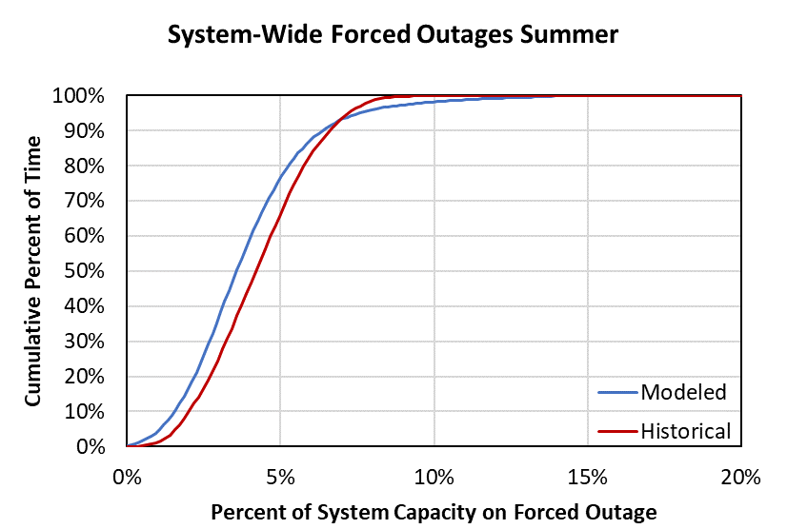
Conventional Generator Outages
Model individual unit outages stochastically, including:
Full Outages: mean time to fail, mean time to repair
Partial Outages: derate percentage, mean time to fail, mean time to repair
Startup Failure: rate
Maintenance Outages: average outage rate with random occurrence and limited scheduling flexibility
Planned Outages: average outage rate with known occurrence and substantial scheduling flexibility in fleet
Distributions of outage parameters created from:
Historical GADS data provided by ERCOT for most of the fleet (2018-2021 excluding Yuri events)
Units without historical GADS data are linked to units with data by unit class and size
Batteries were modeled with a 5% forced outage rate

Slide 10
Cold Weather and Fuel Availability Outages
Additional forced outage probabilities were modeled for temperatures below 20°F
Forced outages from 2018-2021 as a function of temperature were analyzed while excluding winter storm Uri. A trend was added to the graph below 20°F and extrapolated to 0°F
A linear probability was assigned with an increased incremental hourly forced outage probability
The base extrapolated value of 5,000 MW was not as extreme as the 2011 outages (14.7 GW forced offline when system temperatures were roughly 14°F)
The impacts of the new weatherization requirements are not being considered in the temperature outage correlation modeling
https://www.ferc.gov/sites/default/files/2020-05/ReportontheSouthwestColdWeatherEventfromFebruary2011 Report.pdf

Slide 11
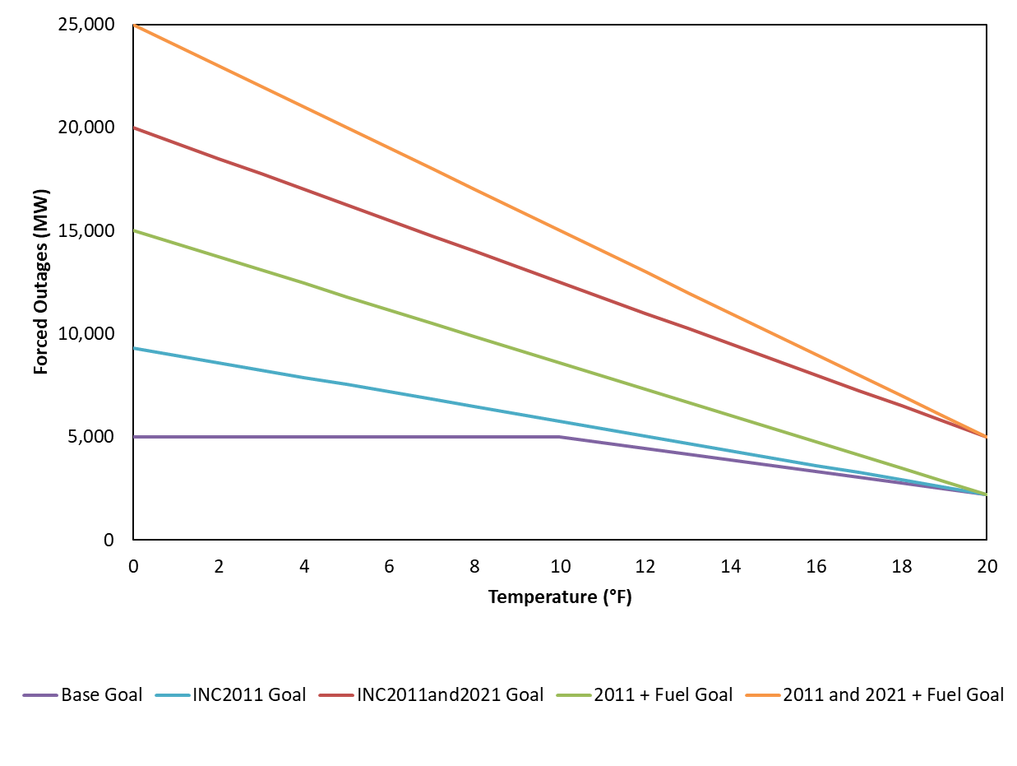
Cold Weather Forced Outages by Scenario

Slide 12
Thermal ELCC Results
Battery | Solar | Wind | Thermal | Cold Weather | Fuel | Winter ELCC (%) | Summer ELCC (%) | Winter UCAP/ Winter CDR Rating (%) | Summer UCAP/ Summer CDR Rating (%)
0 | 0 | 0 | 2024 | Base | None | 89.6% | 89.8% | 94.6% | 93.9%
0 | 0 | 0 | 2024 | Base | Include Fuel | 87.5% | 89.8% | 94.9% | 93.9%
0 | 0 | 0 | 2024 | 2011 | None | 87.5% | 89.8% | 94.9% | 93.9%
0 | 0 | 0 | 2024 | 2011 | Include Fuel | 83.5% | 89.5% | 95.0% | 94.0%
0 | 0 | 0 | 2024 | 2011 and 2021 | None | 78.0% | 89.6% | 95.1% | 94.0%
0 | 0 | 0 | 2024 | 2011 and 2021 | Include Fuel | 67.7% | 89.6% | 95.1% | 94.0%
2024 | 2024 | 2024 | 2024 | Base | None | 89.9% | 90.8% | 96.1% | 94.4%
2024 | 2024 | 2024 | 2024 | Base | Include Fuel | 87.9% | 90.7% | 96.3% | 94.4%
2024 | 2024 | 2024 | 2024 | 2011 | None | 87.9% | 90.7% | 96.3% | 94.4%
2024 | 2024 | 2024 | 2024 | 2011 | Include Fuel | 83.4% | 90.7% | 96.6% | 94.4%
2024 | 2024 | 2024 | 2024 | 2011 and 2021 | None | 78.9% | 90.8% | 96.9% | 94.4%
2024 | 2024 | 2024 | 2024 | 2011 and 2021 | Include Fuel | 69.3% | 90.8% | 97.1% | 94.4%

Slide 13
Appendix
Notes:
13

Slide 14
ERCOT Resource Mix as Modeled within SERVM for 2024
Unit Type | Capacity (MW)
4CP | 900
BIOMASS | 163
COAL | 13,568
ERS | 0
GAS-CC | 31,132
GAS-GT | 6,085
GAS-IC | 922
GAS-ST | 10,717
HYDRO | 475
LRs | 1,591
NUCLEAR | 4,973
PBPC | 200
PRD | 1,500
PUNS | 4,262
Reserve Shed | 2,800
SOLAR | 34,951
STORAGE | 7,620
TDSP | 0
WIND-C | 5,900
WIND-O | 29,233
WIND-P | 4,903
Total | 156,563

Slide 15
Overview
Strategic Energy and Risk Valuation Model (SERVM) is a probabilistic multi-area reliability and economic modeling tool, representing:
Demand in ERCOT and external regions
Generation with randomized outages
Demand response of several types with differing availability and emergency or economic triggers
Emergency procedures that ERCOT triggers in shortage conditions
Monte Carlo simulation of 20,500 different annual hourly-sequential simulations at each reserve margin
Primary outputs are reported at each reserve margin, including:
Reliability metrics such as LOLE
Economic costs such as production costs, DR curtailment costs, and emergency intervention costs
Market results including prices and energy margins
41
Weather Years
5
Forecast Error Points
100
Unit Outage Draws
20,500 Simulations per Reserve Margin

Slide 16
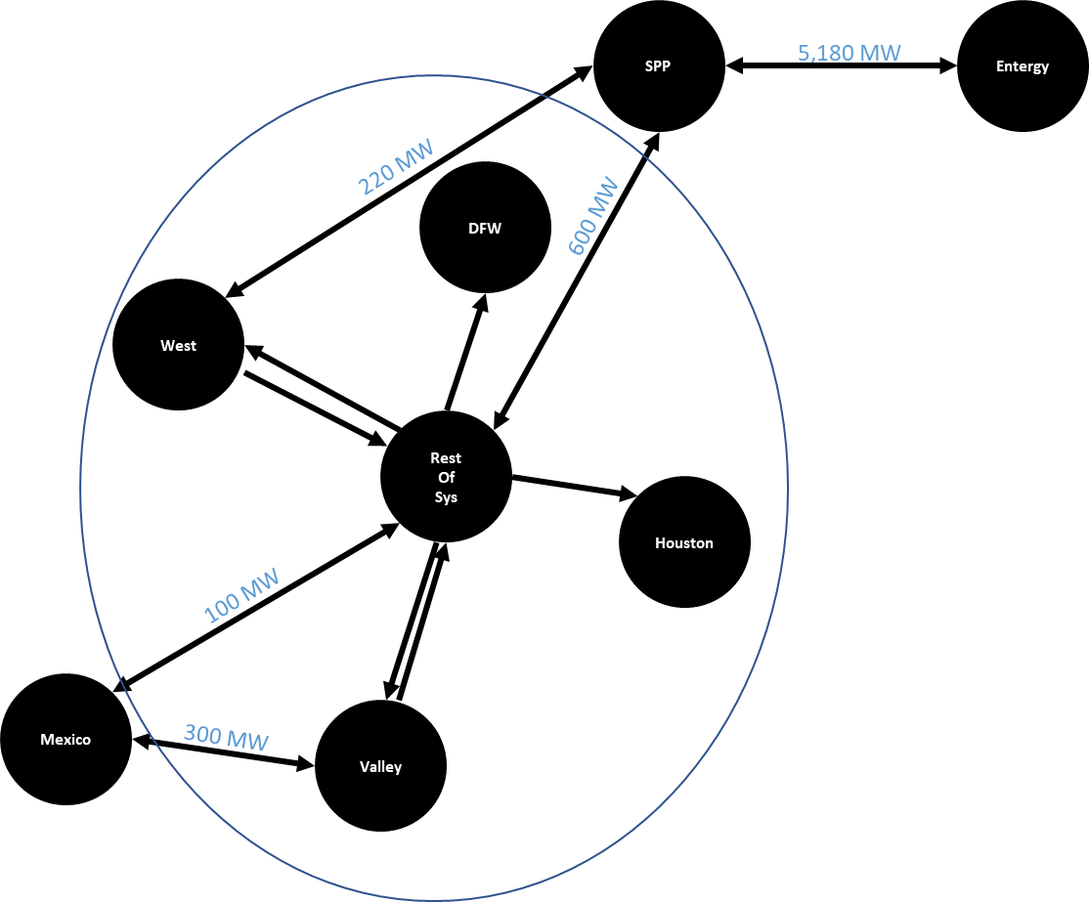
Modeled Interconnection Topology

Slide 17
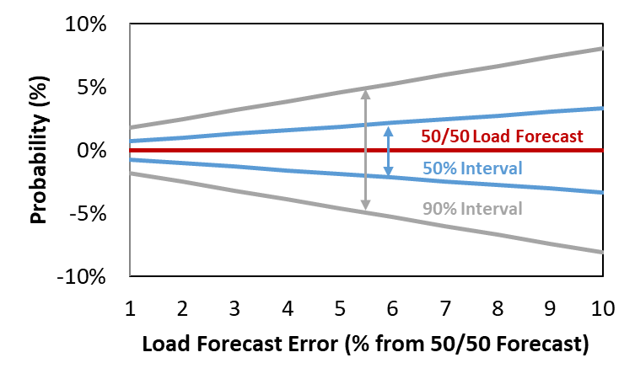
Load Modeling Load Forecast Uncertainty and Forward Period
Non-Weather Forecast Error
With Increasing Forward Period
Non-weather load forecast error increases with forward period:
Assume electric load growth increases at 40% the rate of GDP growth (approximately consistent with ERCOT forecast and national average)
Economic forecast uncertainty increases with forward period, consistent with uncertainty distribution around 28 years of CBO economic forecasts
Modeling approach:
Assume resource decisions and reserve margin must be “locked in” 2 years forward
2-Year Forward LFE
Discrete LFE Error Points Modeled
-4% | -2% | 0% | 2% | 4%
2.3% | 23.0% | 49.4% | 23.0% | 2.3%

Slide 18
Generation Resources Fuel Prices
ERCOT Fuel Forecast | ERCOT Fuel Forecast
Study Year | Coal Fuel Price ($/MMBtu) | Gas Fuel Price ($/MMBtu) | Diesel Fuel Price ($/MMBtu)
2024 | 2.52 | 3.38 | 11.14
NG Price Source: https://www.cmegroup.com/markets/energy/natural-gas/natural-gas.quotes.html

Slide 19
Generation Resources Conventional Generation Outages
Model individual unit outages stochastically, including:
Full Outages: mean time to fail, mean time to repair
Partial Outages: derate percentage, mean time to fail, mean time to repair
Startup Failure: rate
Maintenance Outages: average outage rate with random occurrence and limited scheduling flexibility
Planned Outages: average outage rate with known occurrence and substantial scheduling flexibility in fleet
Distributions of outage parameters created from:
Historical GADS data provided by ERCOT for most of the fleet (2018-2021 excluding Yuri events)
Units without historical GADS data are linked to units with data by unit class and size
Batteries were modeled with a 5% forced outage rate

Slide 20
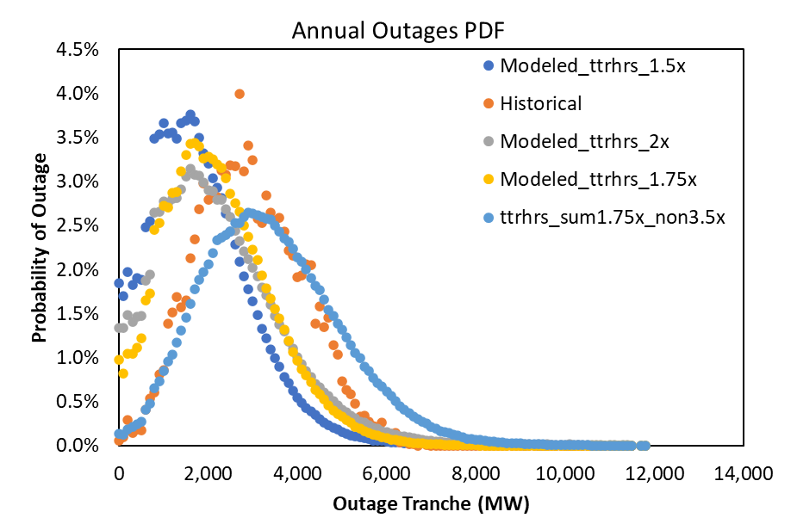
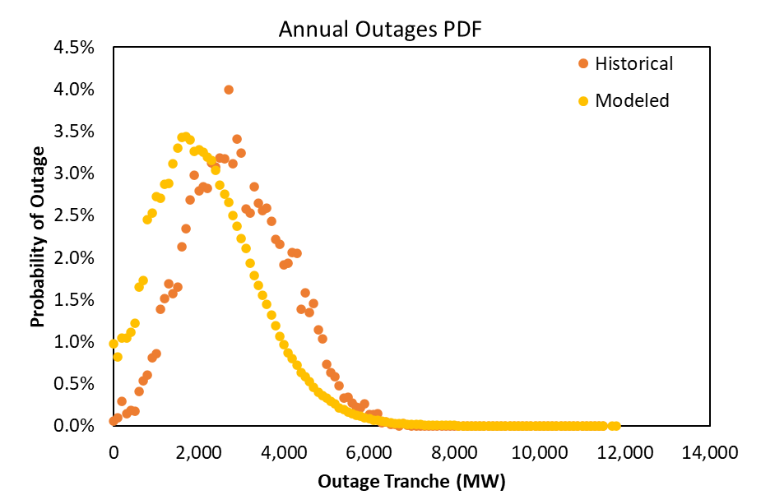
Generation Resources Conventional Generation Outages

Slide 21
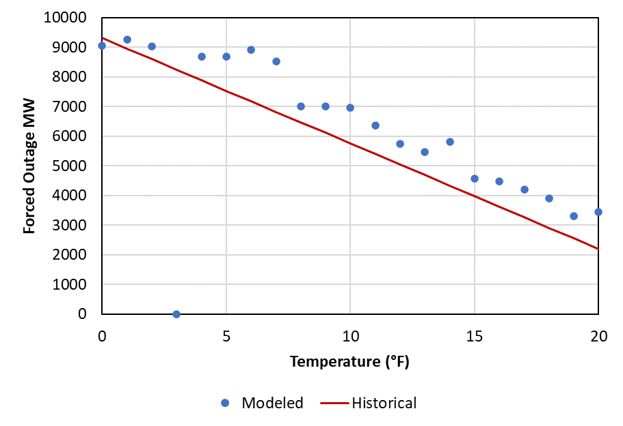
Generation Resources Conventional Generation Outages – Cold Weather
Additional probabilities were modeled for forced outages at temperatures below 20°F
A linear probability was assigned with an hourly incremental forced outage probability of 1.07% at 0°F down to 0% at 20°F leading to an average of ~9,000 total MW being forced offline at 0°F
The impacts of the new weatherization requirements are not being considered in the temperature outage correlation modeling

Slide 22
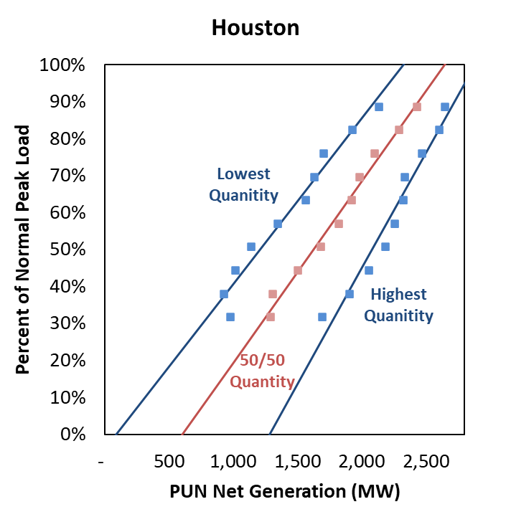
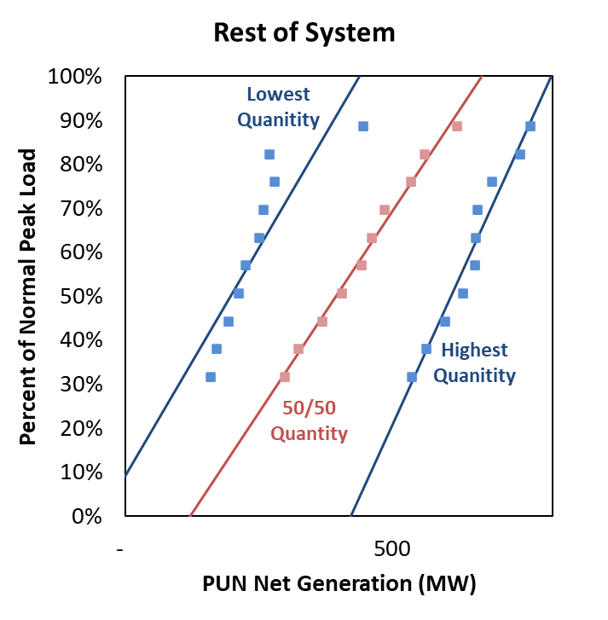
Generation Resources Private Use Networks
Net Gen Supply Curve
Modeled as probabilistic quantity of net output, with 10 different possible quantities at any given load level
Expected quantity increases with load level, based on realized net generation levels at normalized load levels in 2019
West modeled as a 9 MW generator

Slide 23
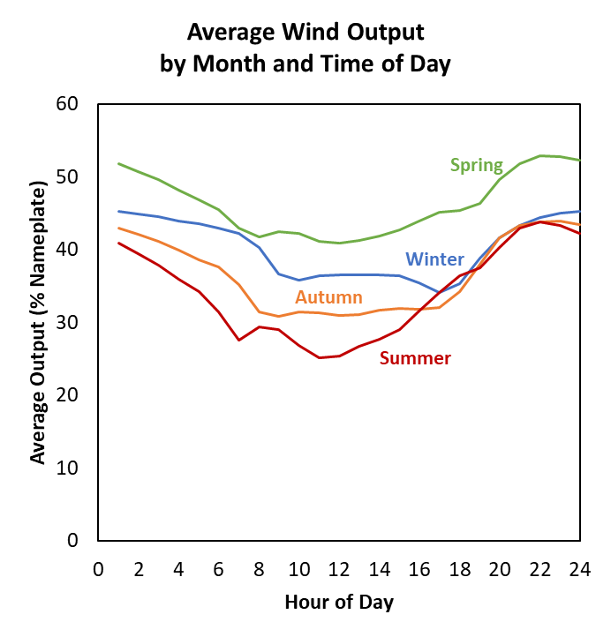
Generation Resources Wind and Solar
Wind
42 years of hourly local wind shapes provided by ERCOT from AWS True Power
Aggregated operational local curves to system-wide
39.3% average capacity factor
30% Wind-P / 57% Wind-C / 20% Wind-O capacity credit (consistent with CDR)
Solar Photovoltaic
42 years of hourly solar county-specific shapes provided by ERCOT
Aggregated operational local curves to system-wide
26.0% average capacity factor
81% capacity credit (consistent with CDR)
Sources and Notes:
Weighted average of 42 years’ hourly wind profiles provided by ERCOT

Slide 24
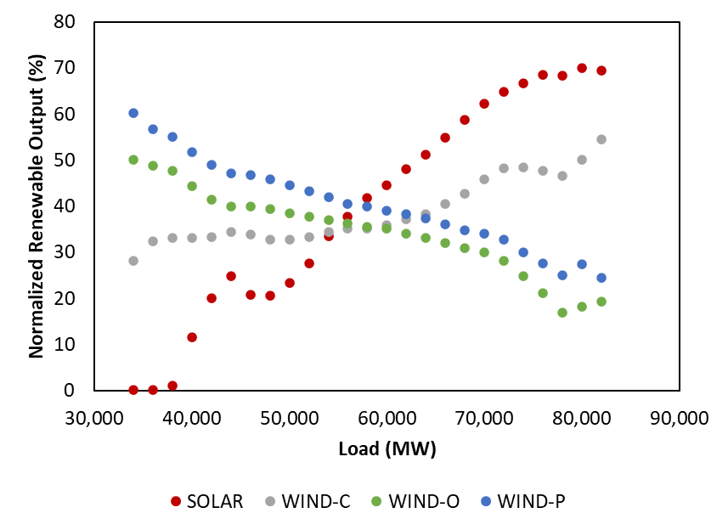
Generation Resources Wind and Solar

Slide 25
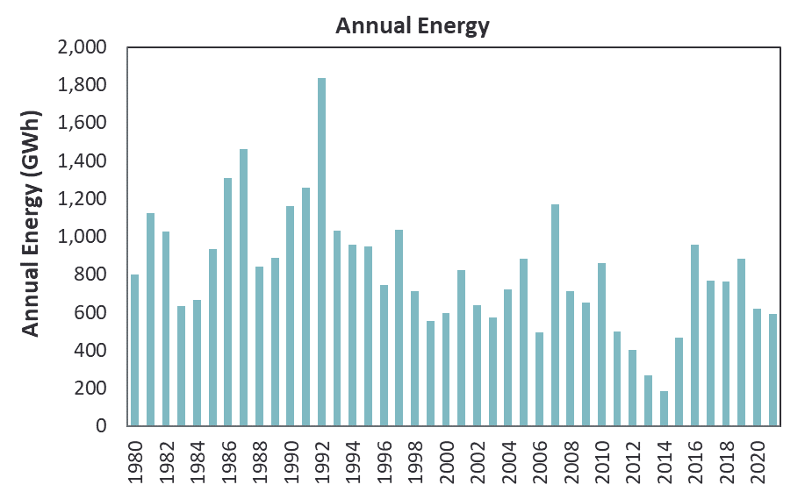
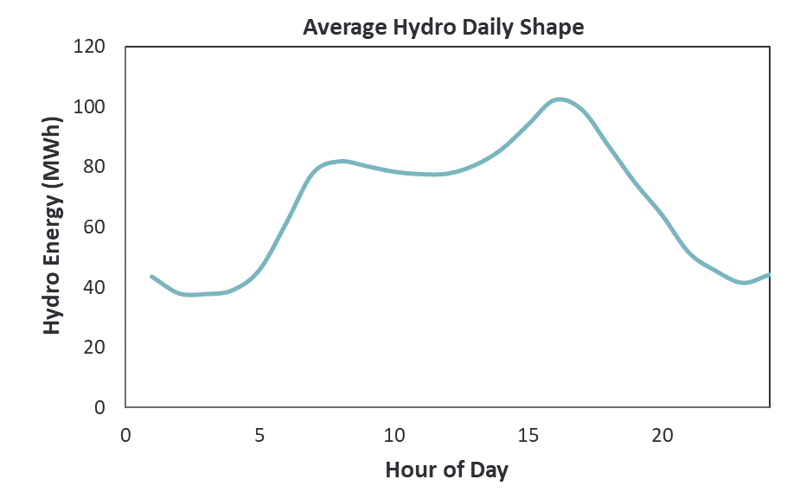
Generation Resources Hydroelectric
557.4 MW nameplate
Characterized resources based on:
8 years of hourly data from ERCOT
41 years of monthly data from EIA 923
Hydro resources modeled with different parameters each month:
Monthly total energy output
Daily maximum output
Daily minimum output
Monthly maximum output
Energy is primarily scheduled to shave peak loads consistent with historical operations
Unscheduled hydro capacity (monthly capacity minus output) counts toward RRS and ORDC x-axis

Slide 26
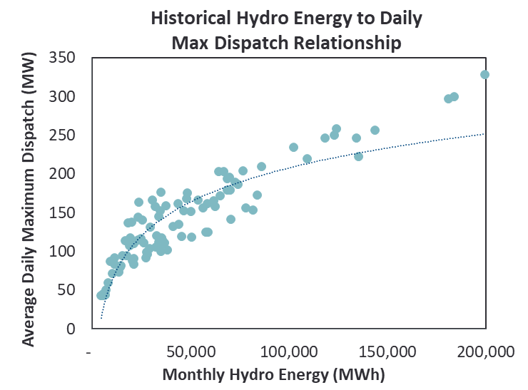
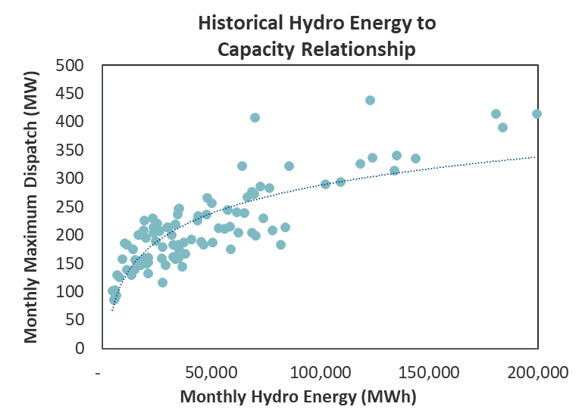
Generation Resources Hydroelectric, continued
Historical Hydro Energy to Daily Max Dispatch Relationship
Curve fit equation used to determine input for each month into SERVM for daily maximum output
Similar curve developed for daily minimum dispatch
Historical Hydro Energy to Capacity Relationship
Curve fit equation used to determine maximum capacity for each month
Emergency capacity of 49.25 MW modeled for drought conditions and 116.15 MW modeled for all other months

Slide 27
Generation Resources Storage
The following assumptions were made for the storage resources:
Economic Commitment and Dispatch
Charges from the Grid
Any Unit Without Provided Charging Capability was Assumed to Have a 1.5 Hour Storage Capability (Assumed to be all 2 Hour for the ELCC Study)
85% Round Trip Efficiency
5% Outage Rate

Slide 28
Generation Resources Inclusion and Exclusion of Resources
In general, we use the 2022 May CDR as the authoritative source, but use the following assumptions for including certain resource types:
Switchable Units: include as internal resources, with the units that are committed off-system excluded from our model
New Units: include starting in the CDR-specified year
Retirements: exclude starting in the CDR-specified year
Permanent Mothballs: exclude from model
Inactive Planned: exclude from model

Slide 29
Demand-Side Resources Cost and Modeling of Demand Resources
Resource Type | Quantity | Modeling Approach | Marginal Curtailment Cost | Adjustments to ERCOT Load Shapes | Reserve Margin Accounting
 | (MW)
TDSP Programs
Energy Efficiency | 3,262 | Not explicitly modeled | n/a | None (ERCOT load shapes already reduced for TDSP EE Programs) | Load reduction
Load Management | 307 | Emergency trigger at EEA Level 1 | $2,543 | None (ERCOT load shapes estimated assuming no LM curtailments) | Load reduction
Emergency Response Services (ERS)
30-Minute ERS | 890 | Emergency trigger at EEA Level 1 | $1,721 | None (ERCOT load shapes estimated assuming no ERS curtailments) | Load reduction
10-Minute ERS | 35 | Emergency trigger at EEA Level 2 | $2,543 |  | Load reduction
Load Resources (LRs)
Non-Controllable LRs | 1,591 | Economically dispatch for RRS (most hours) or energy (few peak hours). Emergency deployment at EEA Level 2 | $2,543 | None (ERCOT load shapes estimated assuming negligible LR curtailments) | Load reduction
 | 0
Controllable LR |  | Currently no controllable LRs modeled in ERCOT | n/a
Voluntary Self-Curtailment
4 CP Reductions | 1,700 | Load shapes grossed up for projected response and corresponding response modeled on the resource side | n/a | None | None. Already excluded from reported peak load
Price-Responsive Demand | Variable | Load shapes explicitly grossed up for expected response. Economic self-curtailment modeled on resource side | $500 - $5,000 /MWh | None | None. Already excluded from reported peak load
Note: The marginal cost of the emergency DR is given by the prices on the dark blue curve corresponding to the reserve levels at the EEAs at which emergency DR is triggered. That assumes the blue curve reflects actual costs (with the red curve shifted right to boost resource adequacy) and that actions are taken at an economically rational point. Prices are set according to the red curve. We observed that modeled prices will tend to cluster around the EEA trigger points on the red curve since a range of net loads and corresponding emergency DR deployments will stay on that shelf.

Slide 30
Demand-Side Resources Emergency Response Service (ERS)
Contract Period | Quantity
 | 10-Min NWS | 30-Min NWS | 30-Min WS | Total
 | (MW) | (MW) | (MW) | (MW)
June - September
TP1: Weekdays HE 6 AM - 9 AM | 47.1 | 991.3 | - | 1,038.4
TP2: Weekdays HE 10 AM - 1 PM | 46.8 | 1,154.3 | - | 1,201.1
TP3: Weekdays HE 2 PM - 4 PM | 38.3 | 1,040.1 | 41.8 | 1,120.2
TP4: Weekdays HE 5 PM - 7 PM | 35.3 | 847.9 | 41.8 | 925.0
TP5: Weekdays HE 8 PM - 10 PM | 42.4 | 985.7 | - | 1,028.2
TP6: Weekend and Holidays HE 6 AM - 9 AM | 45.8 | 823.4 | - | 869.2
TP7: Weekend and Holidays HE 4 PM - 9 PM | 40.8 | 818.8 | - | 859.6
TP8: All Other Hours | 44.2 | 863.5 | - | 907.6
October - November
TP1: Weekdays HE 6 AM - 9 AM | 105.9 | 1,073.5 | - | 1,179.4
TP2: Weekdays HE 10 AM - 1 PM | 95.1 | 1,032.4 | - | 1,127.5
TP3: Weekdays HE 2 PM - 4 PM | 96.3 | 1,038.0 | - | 1,134.4
TP4: Weekdays HE 5 PM - 7 PM | 107.6 | 1,109.1 | - | 1,216.8
TP5: Weekdays HE 8 PM - 10 PM | 105.6 | 1,089.0 | - | 1,194.6
TP6: Weekend and Holidays HE 6 AM - 9 AM | 103.2 | 956.8 | - | 1,060.0
TP7: Weekend and Holidays HE 4 PM - 9 PM | 105.2 | 971.7 | - | 1,077.0
TP8: All Other Hours | 57.6 | 900.1 | - | 957.8
December - March
TP1: Weekdays HE 6 AM - 9 AM | 97.8 | 994.7 | 5.5 | 1,098.0
TP2: Weekdays HE 10 AM - 1 PM | 98.5 | 1,004.1 | - | 1,102.6
TP3: Weekdays HE 2 PM - 4 PM | 99.8 | 1,010.9 | - | 1,110.7
TP4: Weekdays HE 5 PM - 7 PM | 97.4 | 1,014.2 | 5.5 | 1,117.2
TP5: Weekdays HE 8 PM - 10 PM | 96.7 | 996.5 | 5.5 | 1,098.8
TP6: Weekend and Holidays HE 6 AM - 9 AM | 32.4 | 764.0 | 5.5 | 802.0
TP7: Weekend and Holidays HE 4 PM - 9 PM | 33.8 | 802.6 | - | 836.4
TP8: All Other Hours | 92.2 | 887.8 | - | 979.9
April - May
TP1: Weekdays HE 6 AM - 9 AM | 386.3 | 736.3 | 2.2 | 1,124.7
TP2: Weekdays HE 10 AM - 1 PM | 345.7 | 771.5 | - | 1,117.3
TP3: Weekdays HE 2 PM - 4 PM | 342.5 | 770.6 | 19.9 | 1,133.1
TP4: Weekdays HE 5 PM - 7 PM | 375.4 | 752.5 | 27.7 | 1,155.6
TP5: Weekdays HE 8 PM - 10 PM | 378.1 | 733.9 | 19.9 | 1,132.0
TP6: Weekend and Holidays HE 6 AM - 9 AM | 332.5 | 530.6 | - | 863.1
TP7: Weekend and Holidays HE 4 PM - 9 PM | 327.0 | 536.5 | 22.2 | 885.6
TP8: All Other Hours | 336.5 | 643.3 | - | 979.9
Sources and Notes:
Total available ERS MW for 2024 June-Sept. TP4 provided by ERCOT staff.
ERS 10-min and 30-min MW for other contract periods scaled proportionally to the 2022 May CDR summer quantity
(925 MW), based on availability in 2022.
Assume an 8-hour call limit applies to both product types, resources not callable outside contracted hours.

Slide 31
Demand-Side Resources Non-Controllable Load Resources (LRs)
Non-controllable LR magnitude varies by season and time of day
Dispatched according to emergency operating procedures
Dispatches during EEA 2 events
Available reserves at 1,750 MW when dispatched
Note: CDR quotes 1,591 MW LRS for 2024

Slide 32
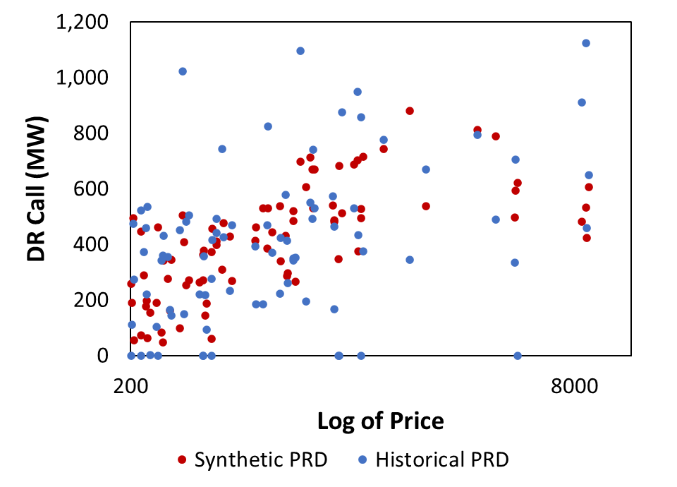
Demand-Side Resources Price-Responsive Demand (PRD)

Slide 33
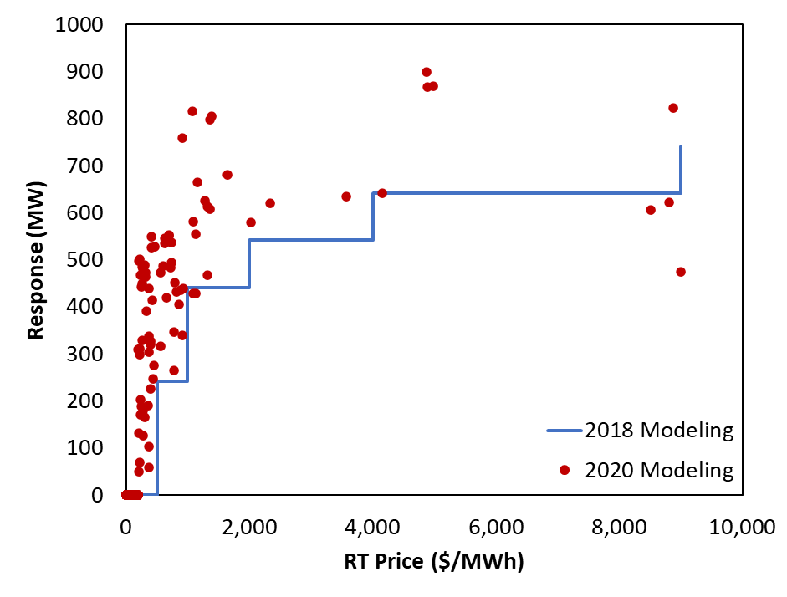
Demand-Side Resources Price-Responsive Demand (PRD)

Slide 34
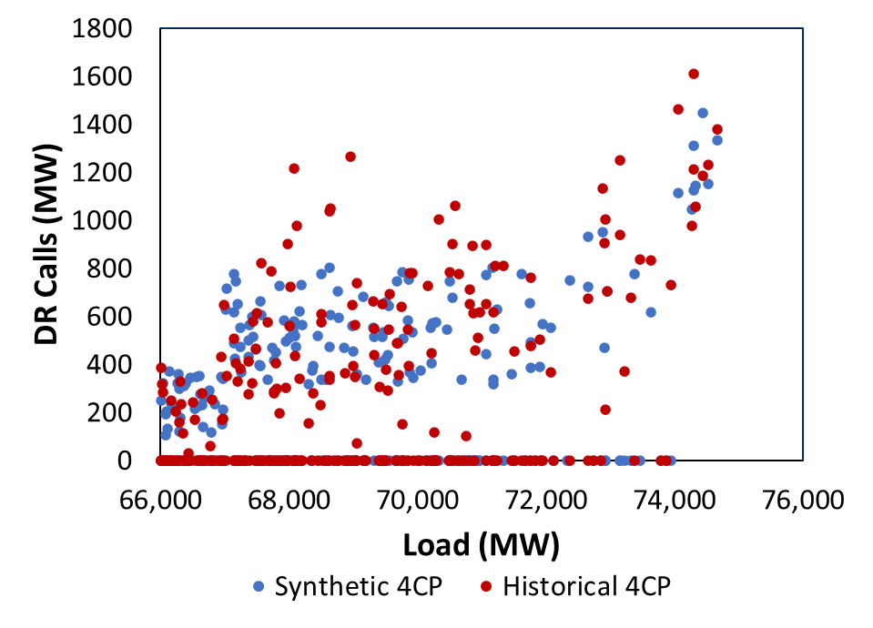
Demand-Side Resources 4CP

Slide 35
System Summary Intertie Availability
We model total intertie capacity in line with ERCOT transmission documents
Intertie availability at summer peak is based on historical availability consistent with the May 2022 CDR
The SPP-Entergy interface availability similarly modeled using a point forecast
Even if transmission is available, ERCOT may not be able to import in emergency if the external region is peaking at the same time
SPP
820 MW
5,180 MW
ERCOT
Entergy
(MISO)
400 MW
Mexico
(Coahuila, Nuevo Leon, & Tamaulipas)
Sources:
ERCOT Ties: http://www.ercot.com/content/wcm/key_documents_lists/90055/ERCOT_DC_Tie_Operations_Document.docx
SPP-Entergy:
www.oasis.oati.com/SWPP/SWPPdocs/Interface_Values.xls

Slide 36
Scarcity Conditions Emergency Procedures and Marginal Costs
Emergency Level | Marginal Resource | Amount of Resource (MW) | Trigger | Price | Marginal System Cost
n/a | Generation | Variable | Price | Approximately $20 - $250 | Same
n/a | Imports | Variable | Price | Approximately $20-$250 Up to $1,000 during load shed | Same
n/a | Non-Spin Shortage | 1,500 | ORDC x-axis = 3,000 MW | $5,000 (from ORDC)* | $1,313*
n/a | Price-Responsive Demand | Variable | Price | $500 - $5,000 | Same
n/a | PBPC | 200 | Price | $1,000 - $5,000 | Same
EEA 1 | 30-Minute ERS | 890** | Spin ORDC x-axis = 2,300 MW | $5,000 (from ORDC) | $1,721
EEA1 | Spin Shortage A | 550 | Spin ORDC x-axis = 2,300 MW | $5,000 (from ORDC)* | $2,079*
EEA 2 | TDSP Load Curtailments | 307 | Spin ORDC x-axis = 1,750 MW | $5,000 (from ORDC) | $2,543
EEA 2 | Load Resources in RRS | 1,591*** | Spin ORDC x-axis = 1,750 MW | $5,000 (from ORDC) | $2,543
EEA 2 | 10-Minute ERS | 35** | Spin ORDC x-axis = 1,750 MW | $5,000 (from ORDC) | $2,543
EEA3 | Spin Shortage B | 750 | Spin ORDC x-axis =1,750 MW | $5,000 (from ORDC)* | $3,115*
EEA 3 | Load Shed | Variable | Spin ORDC x-axis = 1,000 MW | VOLL = $5,000 | Same
*: Price reflects the average price between the upper and lower level of each resource
**: 35 10NWS + 848 30NWS + 42 30WS = 925 total ERS (May 2022 CDR Value for 2023). Both NWS and WS are included in the 30-Minute ERS
***: 60% of RRS

Slide 37
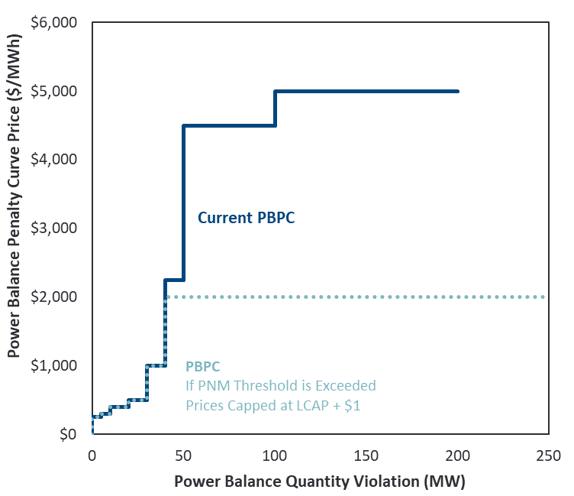
Scarcity Conditions Power Balance Penalty Curve
Implementation
Using PBPC curve as currently set by ERCOT; no expectation for the curve to change in upcoming years.
Treat as a Reg Up shortage when called (can set price)
Incur marginal system cost equal prices implied by PBPC
Model only first 200 MW
Highest price capped at LCAP + $1 if Peaker Net Margin (PNM) threshold is exceeded
Note: Since we model PBPC as a 200 MW resource (when none exists), we need to recognize that dispatching the PBPC depletes actual regulation reserves more than our accounting implies. So the model has to shed load at 1,200 MW apparent reserves instead of 1,000. And the x-axis for determining ORDC prices is given by reserves + any PBPC deployment.
Power Balance Penalty Curve
Sources and Notes:
https://www.ercot.com/files/docs/2021/12/14/037OBDRR_01_Power_Balance_Penalty_Updates_to_%20Align_with_PUCT_Approved_High_System_Wide_Offer_Ca.docx

Slide 38
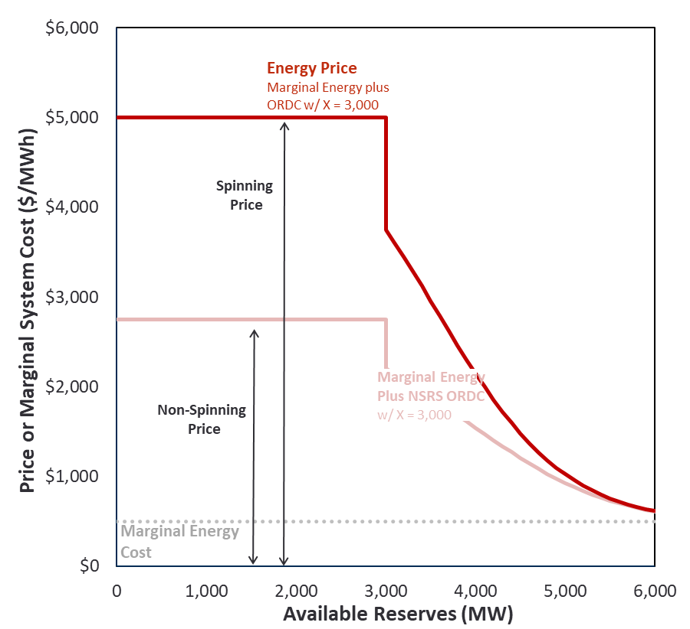
Scarcity Conditions Operating Reserve Demand Curve
Implementation
Price-setting based on curve where X = 3,000 MW; marginal system cost assumes load shed at X = 1,000 MW
Simplifications:
Assume PRC, Spin, and ORDC x-axis are all self-consistent
Do not scale ORDC curves each hour, instead calculate as if marginal energy were fixed at the emergency gen dispatch price of $1,721/MWh
Assume non-spin is depleted before spin (i.e., 1-to-1 correspondence between the x-axes of Spin and Non-Spin ORDC curves)
Day-ahead commitment of spin is equal to the minimum of: (a) ERCOT requirement, and (b) reasonable min ORDC spin price of $3/MWh (i.e., allow self-commitment to prevent very high prices during long conditions)
Operating Reserve Demand Curves

Slide 39
Scarcity Conditions Reserve Requirements
Reserves
Day-ahead commitments to meet ERCOT Reg Up, Reg Down, and RRS requirements (NSRS assumed non-binding)
Shortages relative to requirement only occur when insufficient resources exist
Self-Commitments
Also model economic self-commitments if ORDC spin axis price is very high (still refining approach)
Estimate as quantity of online capacity needed to bring total daily ORDC spin payments down to historical RRS price levels in non-peak conditions
SERVM will commit at least this quantity unless insufficient supply exists
Reserves Requirements
Season and Hours of Day | ERCOT Day-Ahead Procurements
 | Regulation Up (MW) | Regulation Down (MW) | RRS 10 min (MW) | NSRS 30 min (MW)
Winter
1-2 and 23-24 | 202 | 311 | 3,042 | 3,486
3-6 | 342 | 252 | 3,028 | 3,519
7-10 | 435 | 398 | 2,937 | 3,997
11-14 | 375 | 428 | 2,926 | 3,882
15-18 | 528 | 350 | 2,939 | 4,601
19-22 | 256 | 324 | 2,939 | 3,926
Spring
1-2 and 23-24 | 230 | 403 | 3,083 | 3,819
3-6 | 296 | 248 | 3,107 | 4,038
7-10 | 431 | 386 | 3,013 | 4,416
11-14 | 486 | 435 | 2,941 | 4,282
15-18 | 487 | 424 | 2,906 | 4,338
19-22 | 404 | 415 | 2,906 | 3,829
Summer
1-2 and 23-24 | 169 | 462 | 2,555 | 3,913
3-6 | 250 | 218 | 2,634 | 3,300
7-10 | 436 | 252 | 2,522 | 4,053
11-14 | 588 | 266 | 2,350 | 4,460
15-18 | 410 | 364 | 2,800 | 3,374
19-22 | 273 | 452 | 2,800 | 3,962
Fall
1-2 and 23-24 | 184 | 367 | 2,964 | 3,528
3-6 | 269 | 212 | 3,006 | 3,034
7-10 | 398 | 300 | 2,856 | 3,753
11-14 | 466 | 356 | 2,768 | 4,165
15-18 | 456 | 344 | 2,845 | 3,989
19-22 | 252 | 399 | 2,861 | 3,742

