Slide 1
PDCWG Report to ROS
Chair: Jimmy Jackson, CPS
Vice Chair: Chad Mulholland, NRG
ROS
Nov 7th, 2022

Slide 2
Report Overview & Notes
Report Overview
  Meeting Minutes
  BAL-001-TRE-2 FMEs and IMFR
    1 FME in the month of Sep
  Frequency Control Report

Slide 3
Meeting Minutes
PDCWG Meeting 10/28/2022
  Review of 2023 A/S Methodology
  NPRR1143 Discussion
  Addition of Inertia data to the ROS report Discussion
  ERCOT Reports
  TRE Report

Slide 4
Frequency Measurable Events Performance

Slide 5
Frequency Measurable Events
There was 1 FME in September
  9/5/2022 23:48:10
    Loss of 1208 MW of generation
    Interconnection Frequency Response: 1610 MW/0.1 Hz
    91 Resources were evaluated. These includes,
      38 Generation Resources
      1 Controllable Load Resource
      52 Energy Storage Resources
    6 of 91 Evaluated Resources had less than 75% of their expected Initial Primary Frequency Response.
    5 of 91 Evaluated Resources had less than 75% of their expected Sustained Primary Frequency Response.

Slide 6
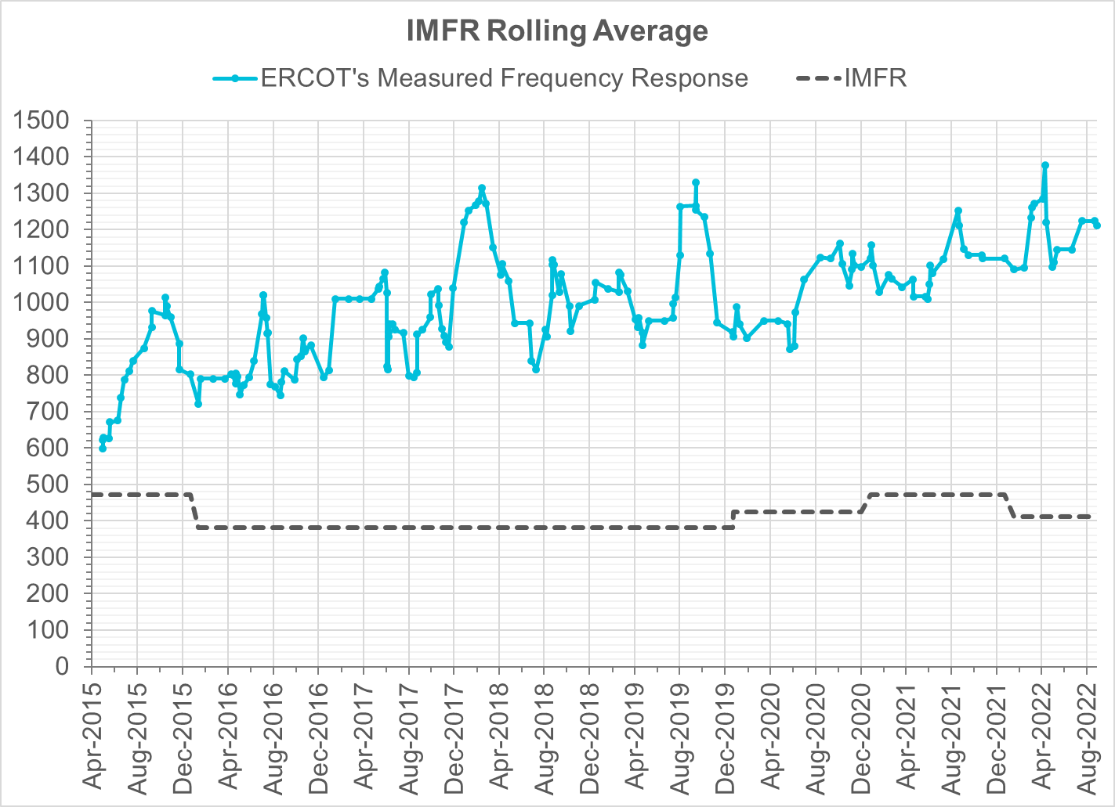
Interconnection Minimum Frequency Response (IMFR) Performance
IMFR Performance currently
1210.77 MW/0.1HZ
Frequency Response Obligation (FRO): 412 MW/0.1 Hz

Slide 7
Questions?

Slide 8
Frequency Control Report
Sep 2022

Slide 9
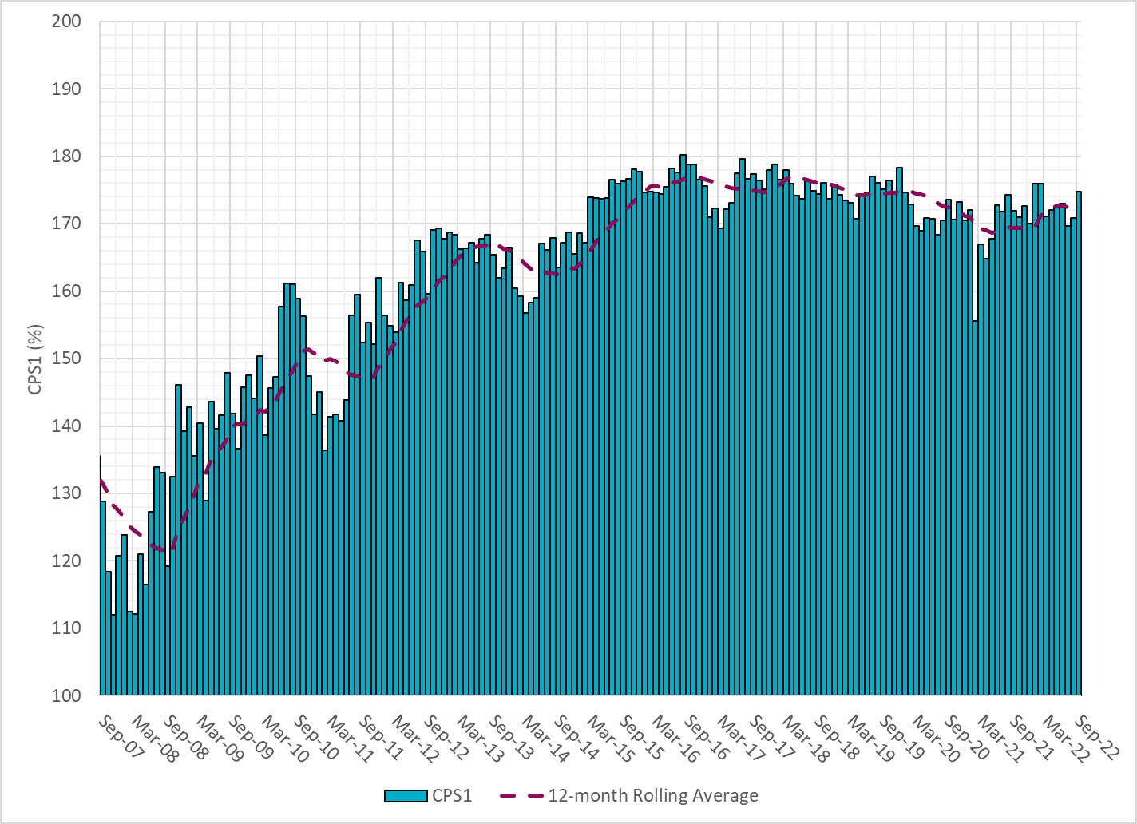

CPS1 Performance

Slide 10
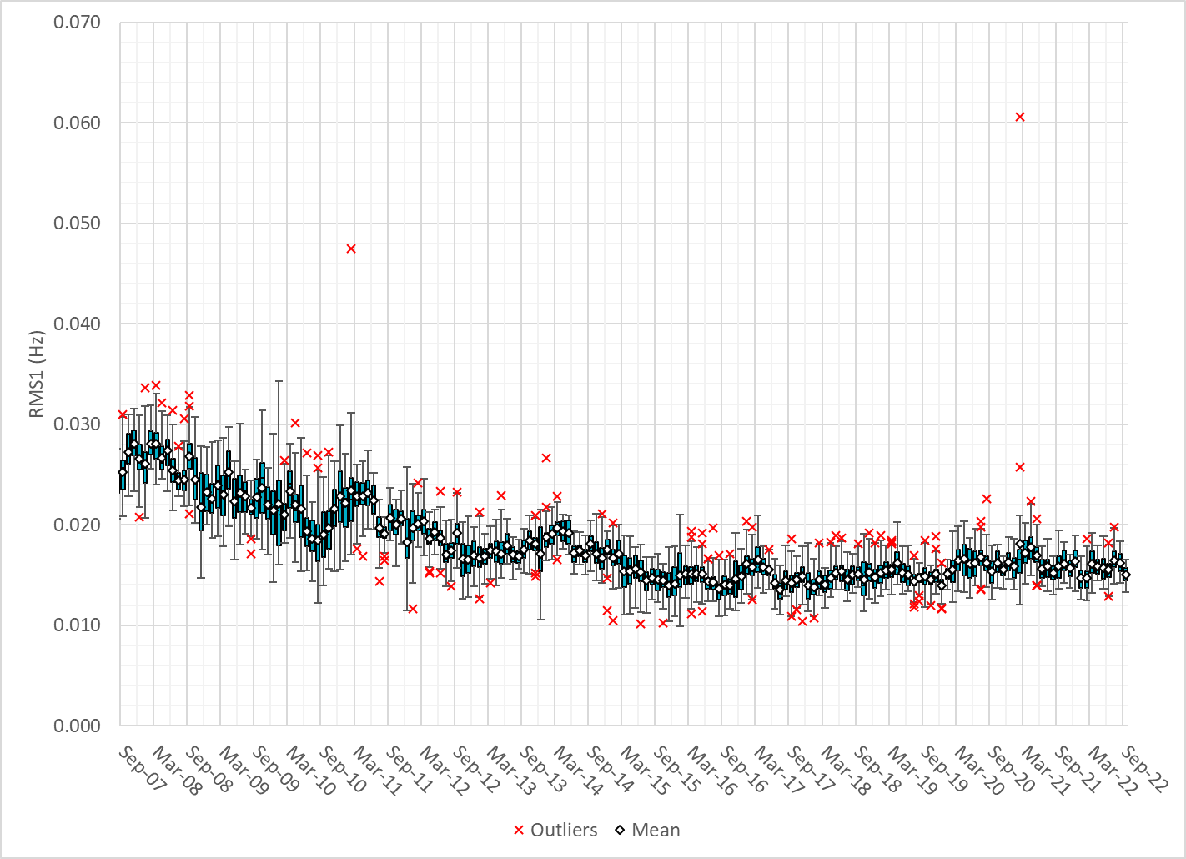
RMS1 Performance of ERCOT Frequency
Notes:
15.03Mhz on avg for Sep 2022

Slide 11
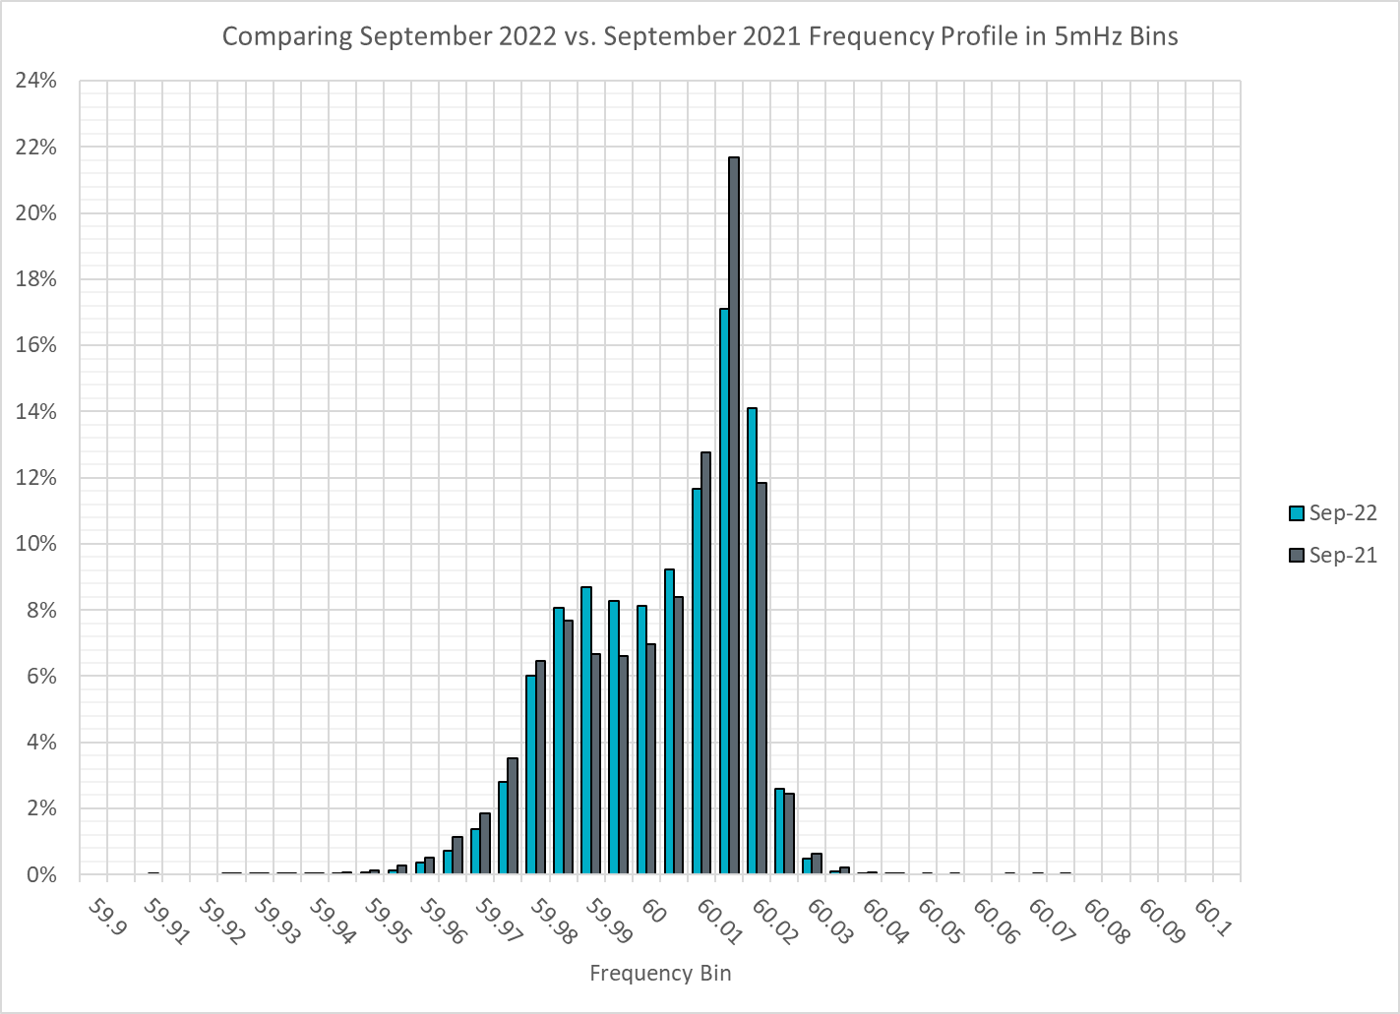
Frequency Profile Analysis

Slide 12
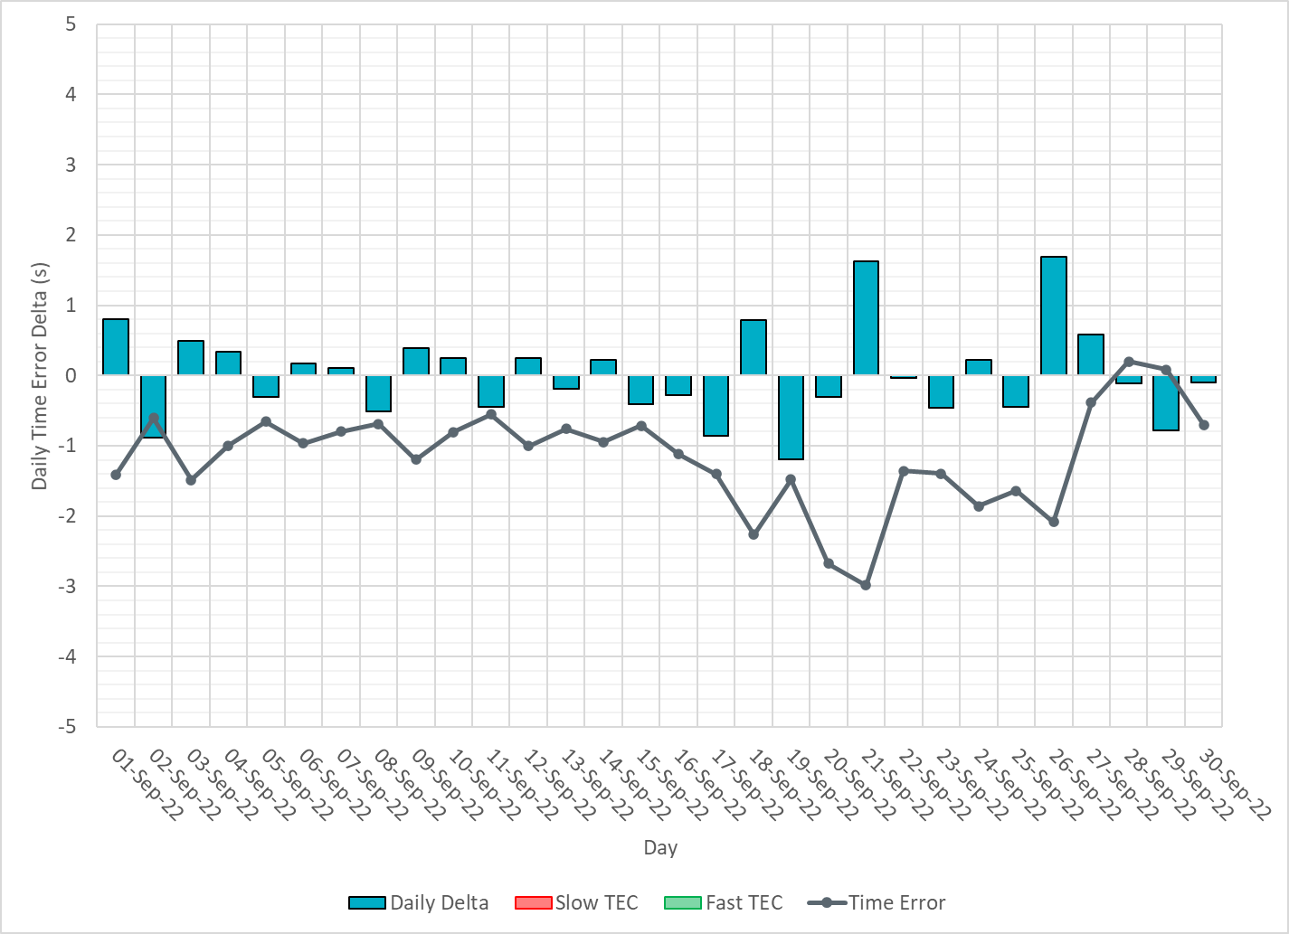
Time Error Corrections

Slide 13
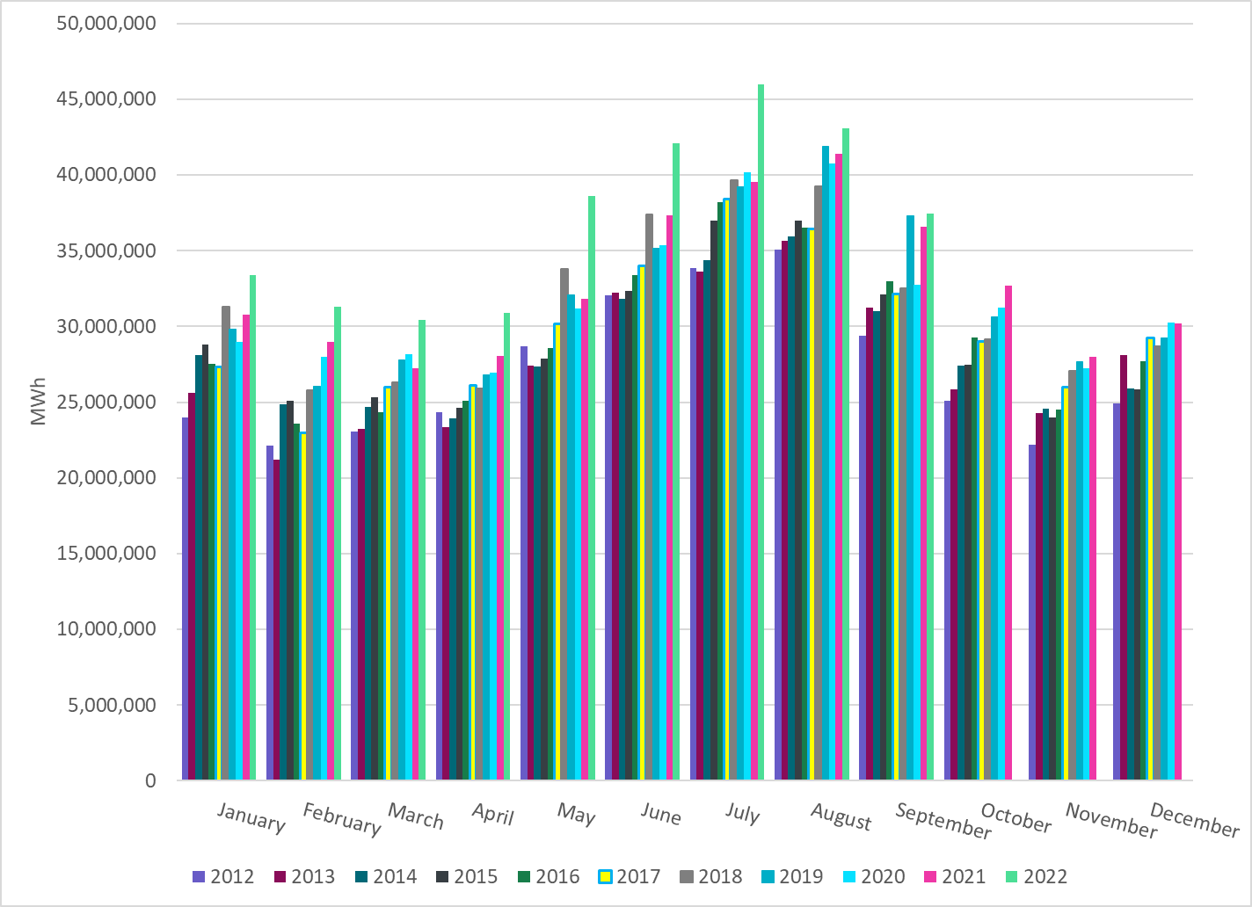
ERCOT Total Energy
Notes:
37,464,823 MWh

Slide 14
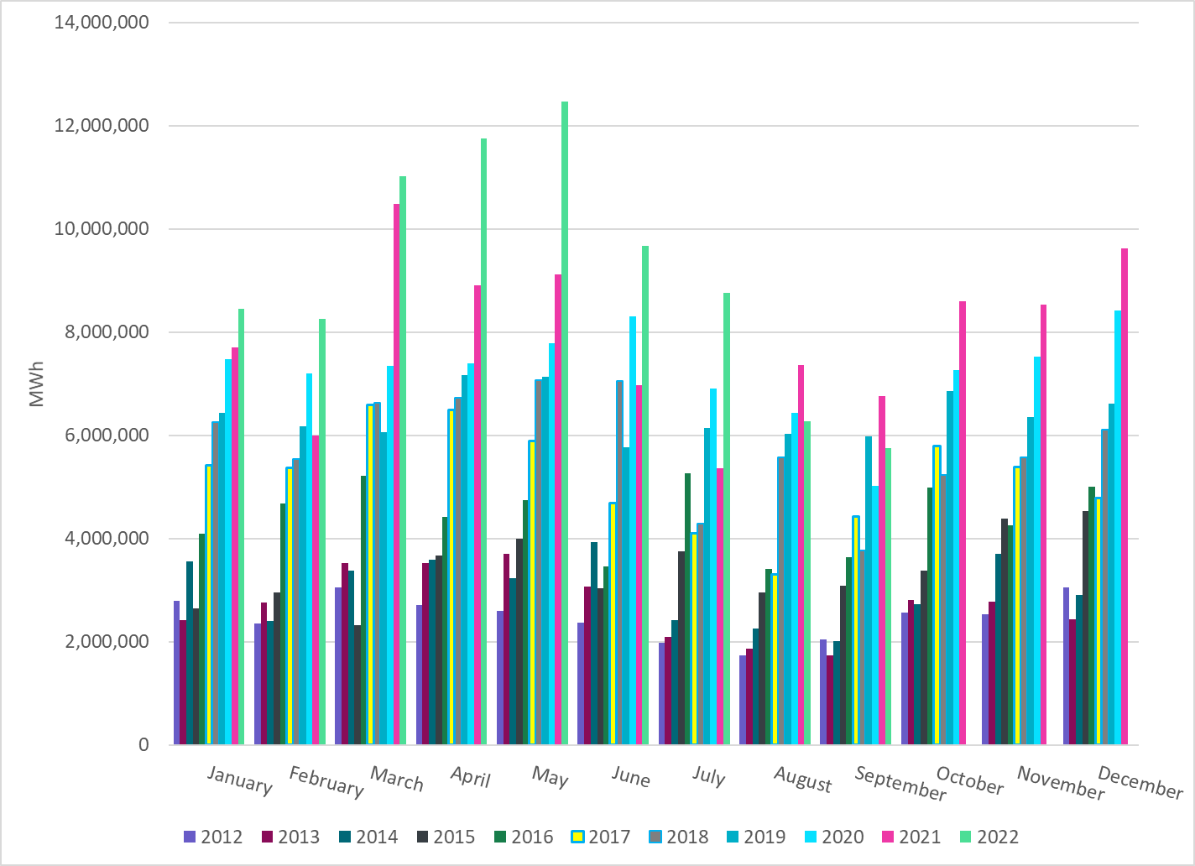
ERCOT Total Energy from Wind Generation
Notes:
5,755,040 MWh

Slide 15
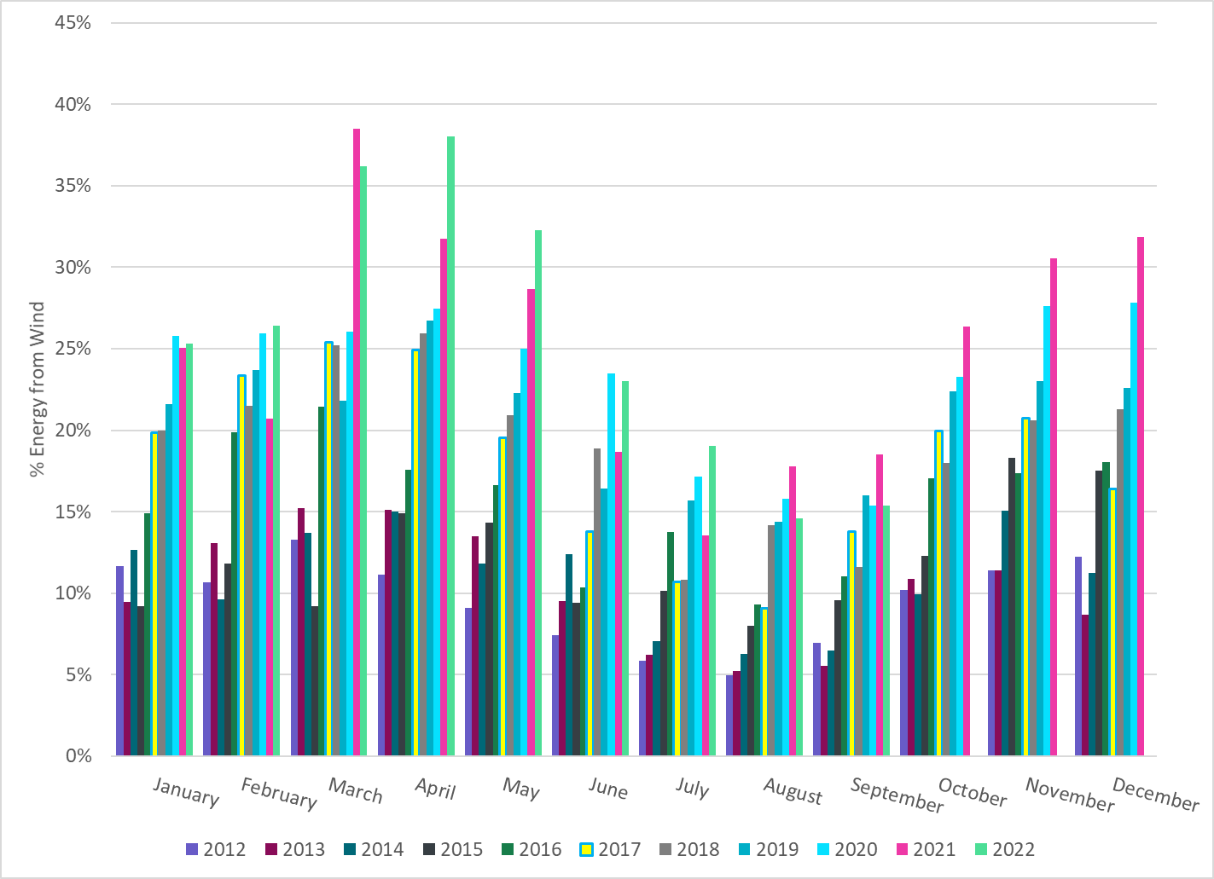
ERCOT % Energy from Wind Generation
Notes:
15.36%

Slide 16
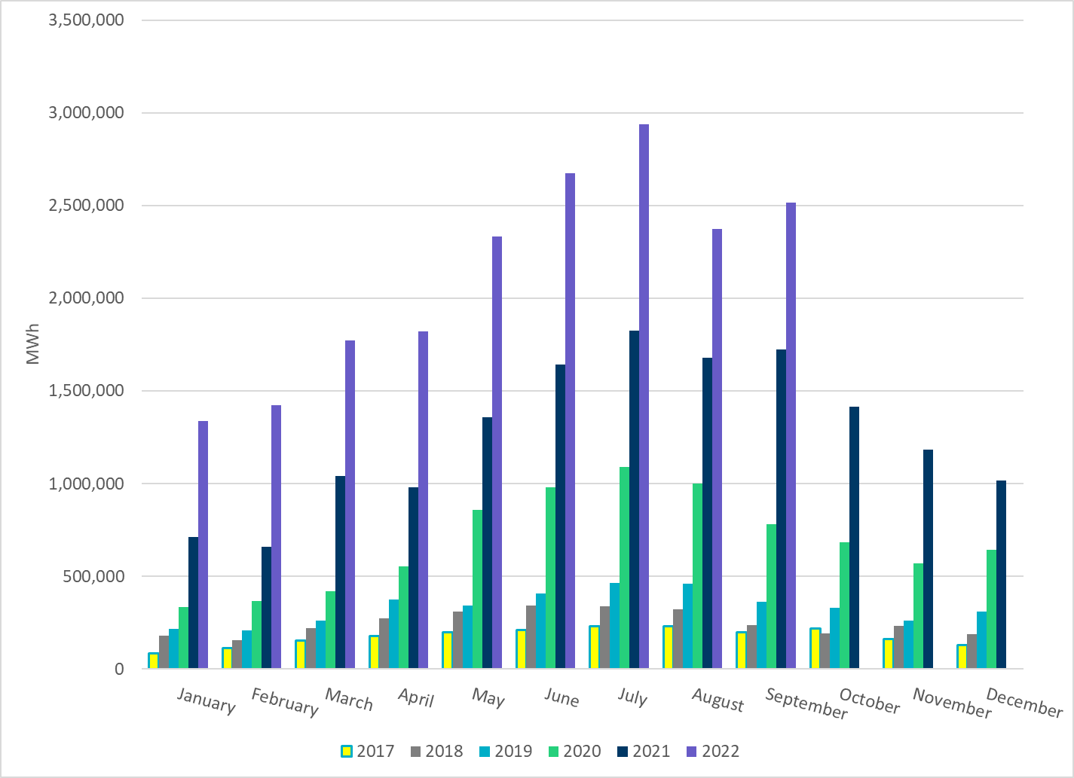
ERCOT Total Energy from Solar Generation
Notes:
2,516,064 MWh

Slide 17
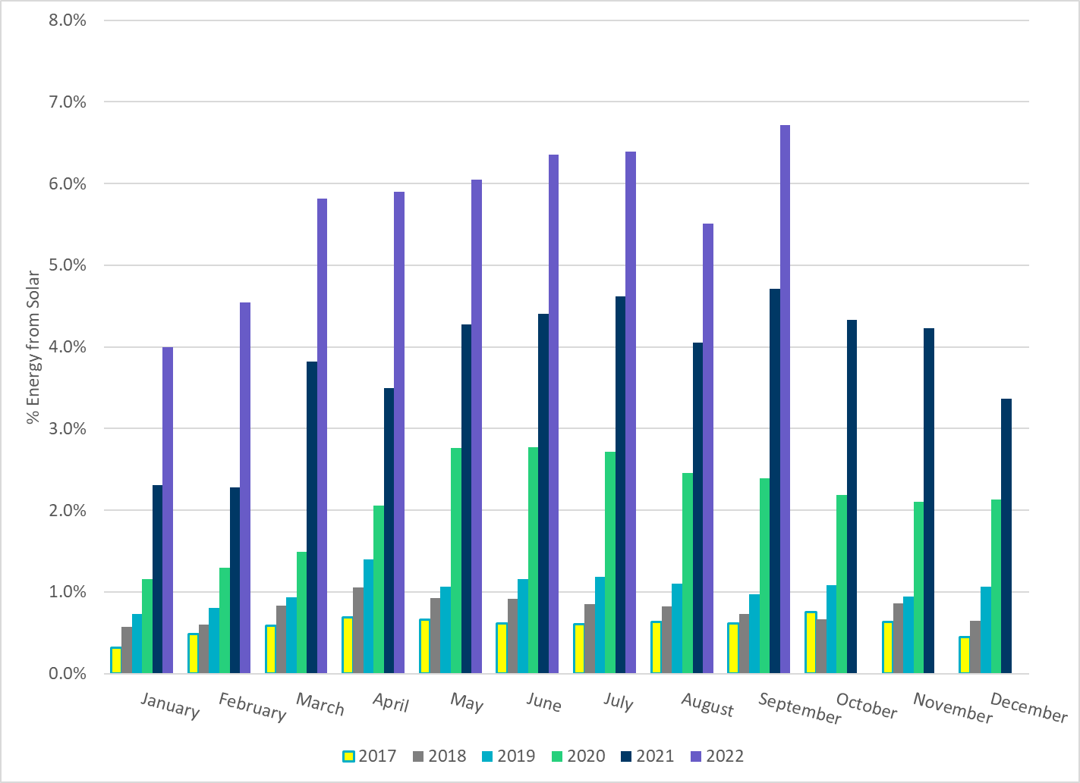
ERCOT % Energy from Solar Generation
Notes:
6.72%

Slide 18
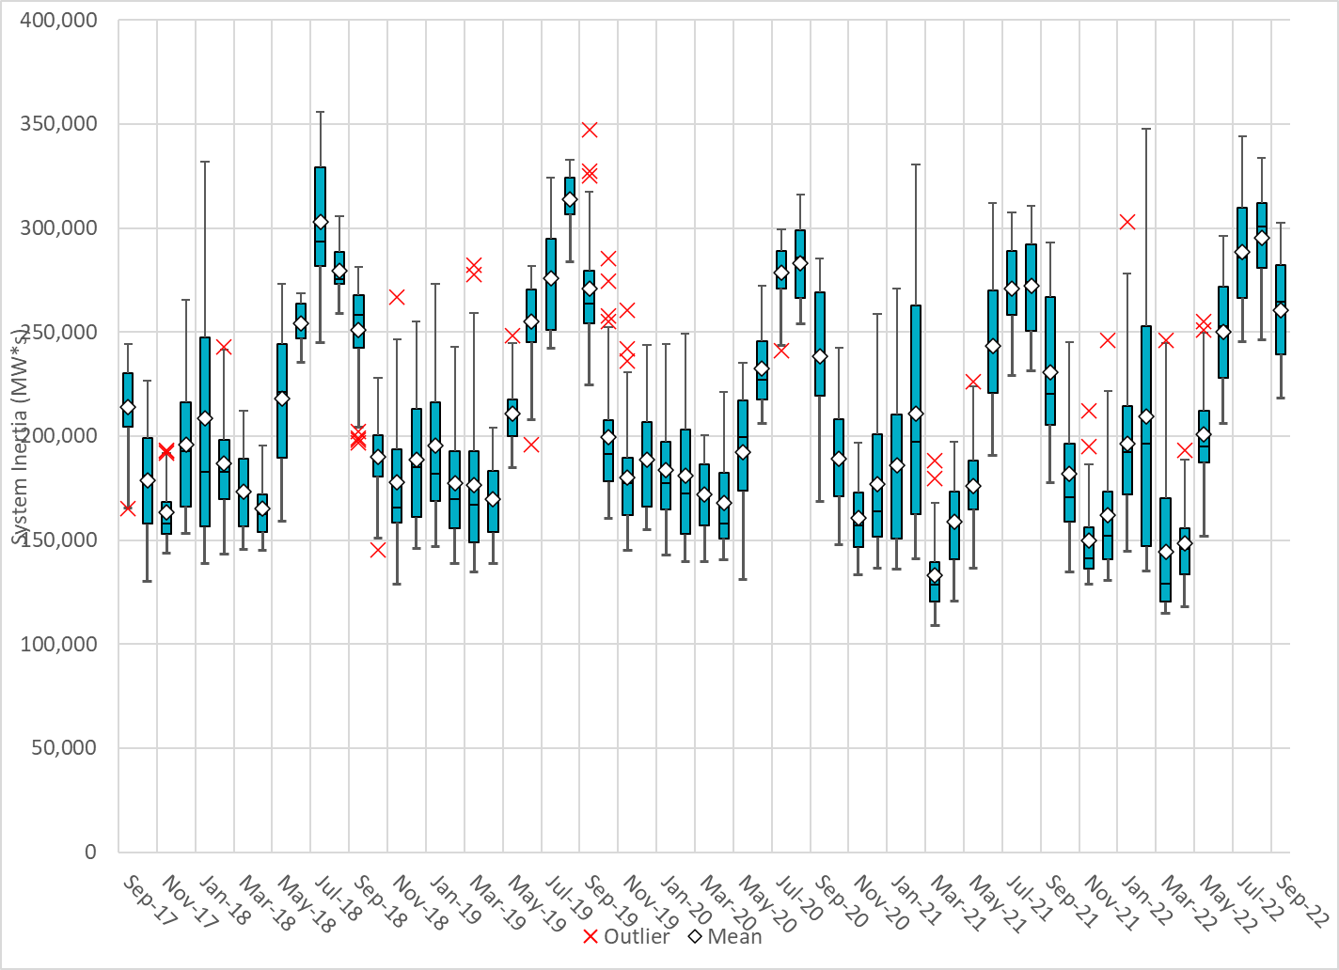
ERCOT Daily Minimum System Inertia
Notes:
Previous Minimum was 109,029 MW*s on 3/22/2021
Sep Data:
Mean: 260,395 MW*s
Max: 302,440 MW*s on Sep 22th
Min: 218,205 MW*s on Sep 30th

Slide 19
ERCOT Inertia Trend
Date and Time | 2013 3/10 3:00 AM | 2014 3/30 3:00 AM | 2015 11/25 2:00 AM | 2016 4/10 2:00 AM | 2017 10/27 4:00 AM | 2018 11/03 3:30 AM | 2019 3/27 1:00 AM | 2020 05/01 2:00 AM | 2021 03/22 00:00 AM | 2022 03/21 01:00 AM
Min synch. Inertia (GW*s) | 132 | 135 | 152 | 143 | 130 | 128.8 | 134.5 | 131.1 | 109 | 115
System load at minimum synch. Inertia (MW) | 24,726 | 24,540 | 27,190 | 27,831 | 28,425 | 28,397 | 29,883 | 30,679 | 32,599 | 33,365
Non-synch. Gen. in % of System Load | 31 | 34 | 42 | 47 | 54 | 53 | 50 | 57 | 65 | 66
Notes:
For each box, the central mark (red line) is the median, the edges of the box (in blue) are the 25th and 75th percentiles, the whiskers correspond to +/- 2.7 sigma (i.e., represent 99.3% coverage, assuming the data are normally distributed. The corresponding lowest inertia in each year is given in the table.
The circle on each boxplot is showing inertia during time when highest portion of load was served by wind/solar generation in that year.

