Slide 1
Supply Analysis Working Group Update
Nov 2, 2022, report to WMS
Caitlin Smith, Chair
Pete Warnken, Co-Vice Chair
Ian Haley, Co-Vice Chair

Slide 2
Zonal Supply Deliverability Study – Astrape Consulting
Proof of concept type study for use in 2023 Reserve Margin Study
Background
Determine base reliability assuming full transmission deliverability, and then coal capacity was retired until the system reached ~.1 LOLE
Then switched out full transmission deliverability group for a more constrained grou
Study Approaches
Perfect Capacity
Starting with the constrained group results, perfect capacity was added to each zone iteratively with the objective of adding the minimal net capacity in aggregate across ERCOT to achieve 0.1 LOLE in all zones
Meeting this objective required reducing capacity in some zones
Transmission
Starting with the constrained group results, transmission limits were relaxed on each internal ERCOT transmission tie iteratively with the objective of minimal net adjustments to transmission capability across all zonal ties to meet 0.1 LOLE in all zones

Slide 3
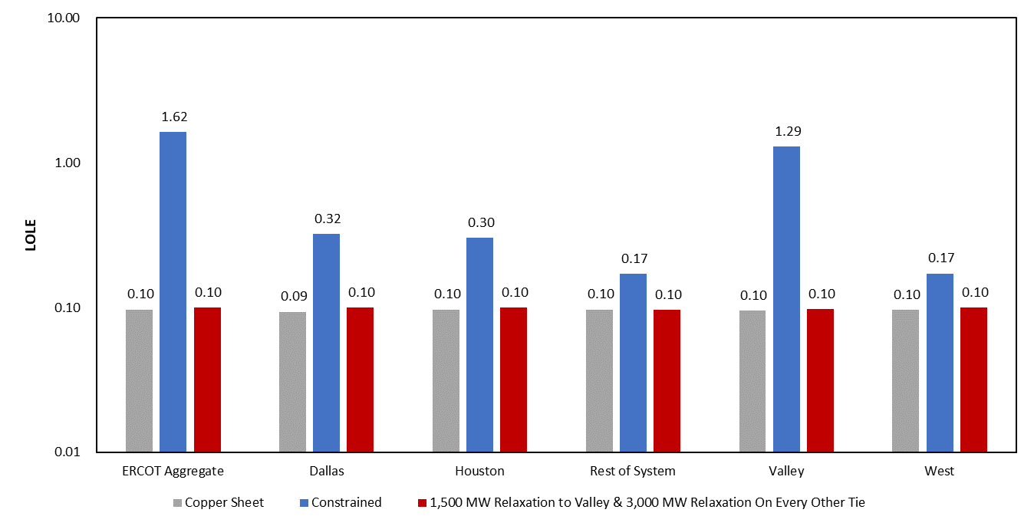
Zonal Supply Deliverability Study – Astrape Consulting – 2026 Perfect Capacity Results

Slide 4
Zonal Supply Deliverability Study – Astrape Consulting – 2026 Transmission Capability Results

Slide 5
ELCC Study – Astrape Consulting
ELCC Study SERVM Simulations
Solar 0 – 40 GW
Wind 0 – 50 GW
Storage 0 – 12 GW
Analyze 2,4,8-hour durations
Location Effects of Wind
Location Effects of Solar
Technology Effects of Solar
ELCC Finding Summary (see next slide)
Solar
Initially (5-10 GW) solar flattens net load shape and has antagonistic relationship with storage. At higher penetrations solar ELCC is higher with more storage. Solar also exhibits a persistent, but much smaller synergistic relationship with wind penetration.
Wind
Wind has consistent synergy with solar driven by profile differences in wind and solar. Wind pushes net load earlier in the day. Solar pushes net load later in the day. These effects allow the other technology to provide more reliability value.
Minimal interactive effects are seen between wind and storage with a small antagonistic effect at low storage penetration.
Storage
Storage ELCC has a strong synergy with solar particularly at high solar penetration (>20 GW).

Slide 6
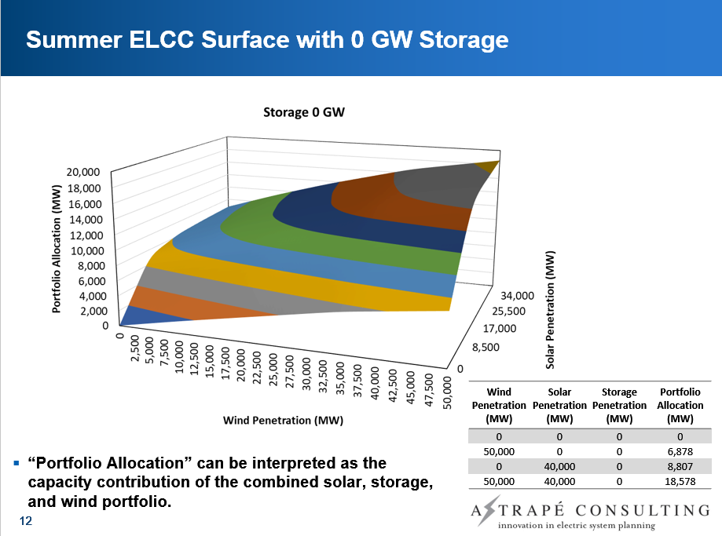
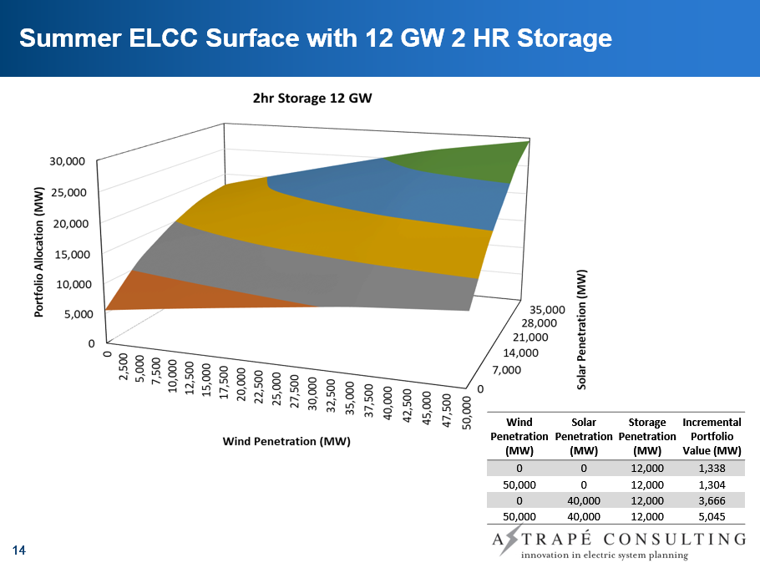
ELCC Study - Astrape Consulting - Summer ELCC Surface

Slide 7
ELCC Study – Astrape Consulting - Winter ELCC Surface

Slide 8
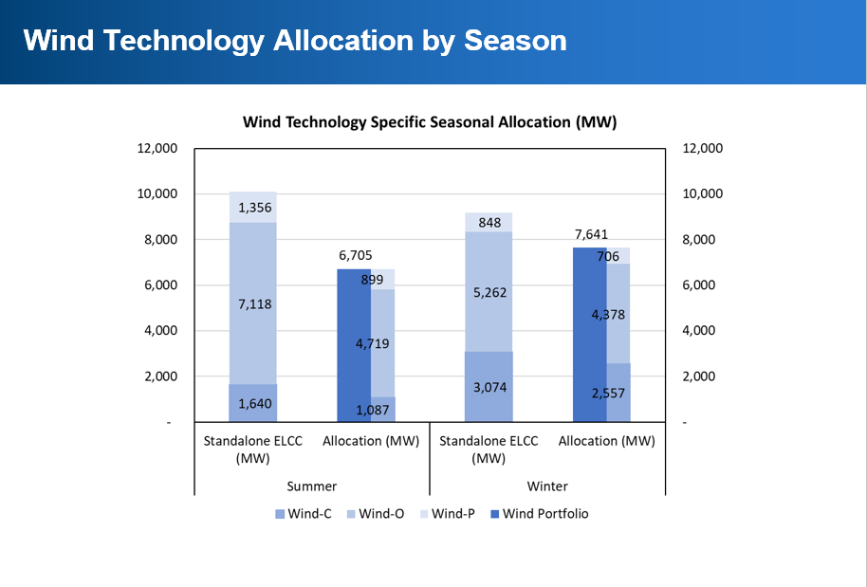
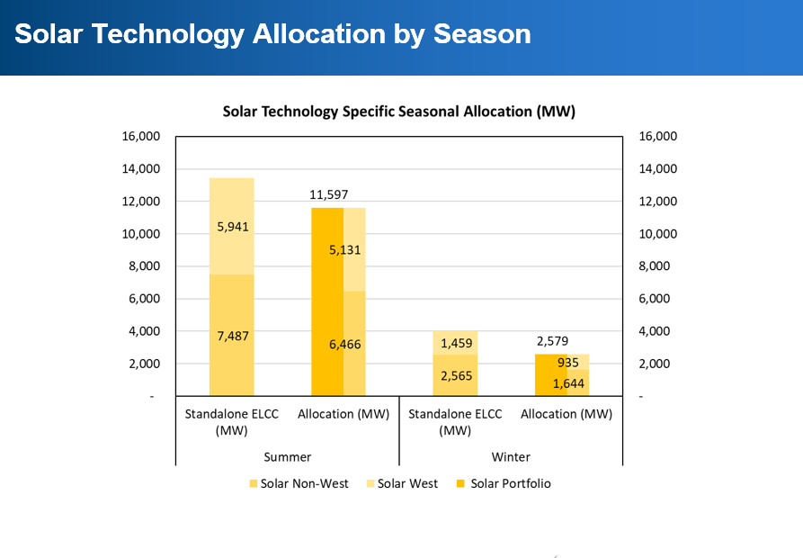
ELCC Study – Astrape Consulting - Location Effects of Wind & Solar

Slide 9
ELCC Study - Astrape Consulting - Resource ELCC by Technology Type (2024 Summer Portfolio)
Next Steps
j

Slide 10
ELCC Study - Astrape Consulting - Resource ELCC by Technology Type (2024 Winter Portfolio)
Next Steps
j

Slide 11
ELCC Study – Next Steps
Final ELCC Report
To include also:
Storage Combinations
Thermal ELCCs
ELCC Workshop
Likely in mid November

Slide 12
2023 Reserve Margin Study
Update:
ERCOT and Astrape currently working on scope of work
Winter 2022 CDR will be used as the input
Kickoff study in early 2023
Sensitivities:
Zonal Impact
Estimate the impact of zonal constraints on EORM, MERM, and 0.1 LOLE RM.
Renewable Penetration
Higher underlying wind and solar penetration
Energy Storage Participation
Review market outcomes without the projected battery storage fleet
EFOR
Review market outcomes of varying the forced outage rates of the thermal units
Solar-Battery Storage Reference Resource
Solar-battery storage system used as the reference resource
Non-Simulation Sensitivities
VOLL
Reference Resource Carrying Cost
Weather Weightings
Load Forecast Error Distribution

Slide 13
2023 Reserve Margin Study
ERCOT looking for input at November 9th SAWG on additional sensitivities
Joint SAWG/ERCOT Sensitivity Selection
Retirement Risk
Electrification
Operating Reserves
Co-Optimization
Other SAWG Suggestion

Slide 14
CDR Modification Plan Initiatives
Quarterly Release
Post CDR reports on a quarterly basis that provide resource adequacy summaries as of the start of each future season (spring, summer, fall, winter) going out five years.
Requires NPRR
Separate Main and Data Reports
Reconstitute the CDR into a main report in PowerPoint that features charts, tables, highlight text, and a link to the supporting data report. The data report consists of a dynamic dashboard using the Tableau Public data visualization platform, with access to detailed data tables.
Resource Adequacy Scorecard
The main report includes a resource adequacy scorecard that shows how the forecasted resource portfolio performs on a range of forward-looking measures. Examples include:
Capacity Reserve Margin relative to EORM, MERM, and reliability-based levels.
Energy adequacy measures, such as (1) seasonal Expected Unserved Energy (EUE) as a percentage of total energy relative to a standards-based level, (2) EUE depth
Extreme net load risk measures for both capacity and energy. Examples of capacity measures include resource capacity margins needed to cover an extreme seasonal net load ramp and a worst-case net load scenario. An example of an energy measure is the Expected Unserved Ramp (EUR) for given periods.
Requires PUCT rulemaking and approval

Slide 15
CDR Modification Plan Initiatives
ELCC/UCAP
Switch to Effective Load Carrying Capability (ELCC) values for inverter-based resources (wind, solar, energy storage).
Switch to Unforced Capacity (UCAP) values for thermal resources, which involves lowering the seasonal sustained capacity ratings based on actual forced outage rates.
Requires PUCT Rulemaking and rule language pertaining to capacity accreditation
Reporting of Reserve Margins for Multiple Hours
Report Reserve Margins for selected hours for each season that have the highest net load risks.
Requires PUCT Rulemaking and approval of the multiple hour approval
Reserve Margin Scenarios
For risk assessment purposes, include scenarios with different Reserve Margin outcomes. Scenario assumption examples include the following:
Use alternative load forecasts.
Modify the forecasted planned resource capacity based on different sets of eligibility criteria.
Incorporate the capacity impacts of Unconfirmed Retirements as defined in the current CDR reports.
Need NPRR if not part of a PUCT Rulemaking

Slide 16
CDR Modification Plan Initiatives
Modify CDR Inclusion Eligibility for Planned Projects
Add an additional criterion for including planned capacity in the CDR: Receipt of a TSP written notice from the Interconnecting Entity that the IE has provided a notice to proceed with the interconnection facility construction and has proof of financial security to fund the facility construction.
Requires NPRR
Include Unconfirmed Retirements in Reserve Margins
Include Unconfirmed Retirement capacity as a resource line item that impacts the CDR Reserve Margin and other measures.
Requires NPRR
Multiple Solar Regions
Develop two or three Solar Regions for ELCC estimation and geographical reporting (e.g., Far West, West and non-West).
Requires NPRR
LFL Reporting
Incorporate Large Flexible Load information in the CDR per the LFL white paper approved by the LFL Task Force (Issue number LFL-49).
Require NPRR

Slide 17
CDR Modification Plan Initiatives
Report Total Unregistered DG
Include a new demand adjustment line item for Unregistered Distributed Generation (principally rooftop solar). Unregistered DG is accounted for in the Long-Term Load Forecast, and there is an Unregistered DG report that captures most of the capacity. This initiative is intended to consolidate and expand the reported capacity amounts.
May need NPRR language that addresses DG forecasting if stakeholders want that formally included in the CDR.
Requires NPRR language to remove the facility reporting size threshold in the Unregistered DG report, or establish another data collection mechanism in lieu of the one used for the Unregistered DG report (load profile submissions from competitive areas, and Excel form submissions from NOIEs.
Capacity contribution for fossil fueled SODGs
Assign a capacity contribution for fossil fueled Settlement Only Distributed Generators (SODGs). These SODGs are currently identified in the CDR report, but are not included in the Reserve Margin calculation.
Requires an NPRR (preliminary draft NPRR was prepared and presented to SAWG in May 2021).
DG breakout of ERS Generator and Load capacity
Divide the current single “Emergency Response Service” capacity line item into two items distinguishing capacity associated with Distributed Generators and Load Resources.
May require NPRR

Slide 18
Other Business
Next SAWG: November 9th
Long Term Load Forecast Presentation
Feedback on 2023 Reserve Margin Sensitivities
Astrape ELCC Report
ELCC Workshop
~November 14th-16th
CDR & SARA Release
Plan to release both at same time
~Last week of November

