Slide 1
ERCOT Frequency Control Report
September 2022
ERCOT
Operations Planning
PDCWG | Oct 28th, 2022

Slide 2
Summary of September 2022
CPS1: 174.79%
Current CPS1 12-Month Rolling Average: 172.45%
0 BAAL Exceedance(s)
1 hourly CPS1 score below 100%
BAAL-003 Events have updated through 2020
2020 BAAL-003 FRM Performance: -789.34
2022 RMS1 Statistics
  Mean: 15.59 mHz
  Min: 12.43 mHz
  Max: 19.70 mHz
Energy Statistics
  Total Energy: 37,464,823 MWh
  Wind Energy: 5,755,040 MWh
  Percent Energy from Wind: 15.36 %
  Solar Energy: 2,516,064 MWh
  Percent Energy from Solar: 6.72%
Minimum System Inertia
  Mean: 260,395 MW*s
  Max: 302,440 MW*s on Sep 22th
  Min: 218,205 MW*s on Sep 30th
Notes:
Data:
Mean: 260,395 MW*s
Max: 302,440 MW*s on Sep 22th
Min: 218,205 MW*s on Sep 30th

Slide 3
Frequency Control
CPS1, BAAL, & RMS1

Slide 4
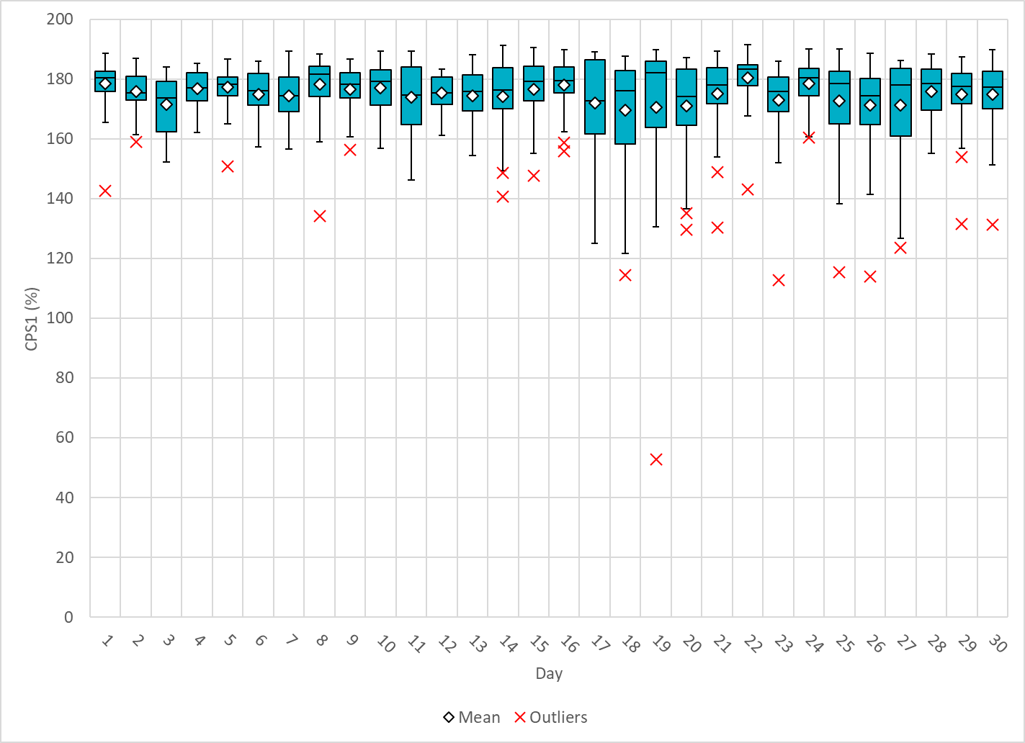
Hourly CPS1 by Day
Sep-22 CPS1 (%): 174.79
Notes:
1. 52.81%@ 9/19/2022 HE 19:00
Expected Generation Deviation
Between 18:00-19:00 the Expected gen dev remained negative. The largest expected gen dev was -2290MW @ 6:20 PM with signification contribution from solar and wind generation.
IRR Ramps
Between 18:00-18:20 wind ramped down by ~250 MW
Between 18:00-19:00 solar ramped down by ~5235 MW
Steel load increase of approximately 360MW
A thermal unit had a ~200MW runback due to emission issues
Regulation: Regulation up was exhausted for most part of this hour. Multiple manual SCED offset of 100MW - 350 MW was applied.

Slide 5
BAAL Exceedances & Violations
There is 0 BAAL exceedance(s) in September.

Slide 6
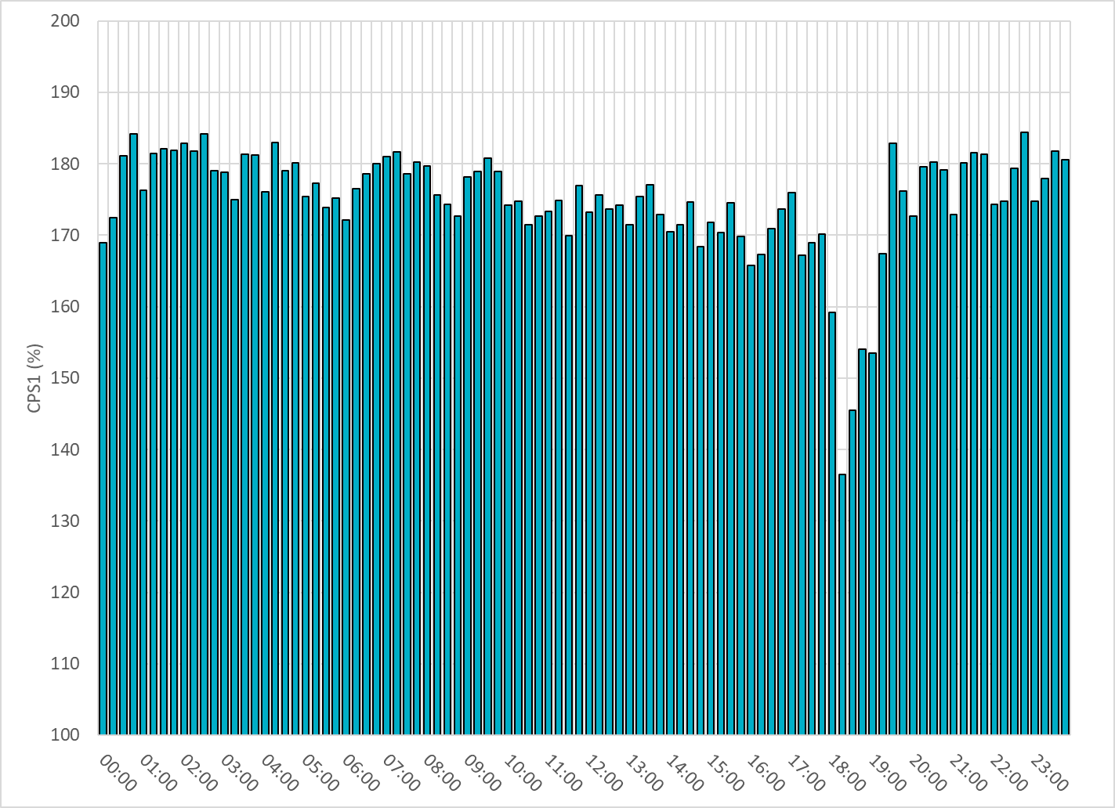
15-Minute Average CPS1%
Sep-22 CPS1 (%): 174.79
Notes:
Overall the 15 min CPS1 score is above 160, Between 18:00 and 19:00 ,the CPS1 is between 130 to 150 due to solar down ramps.

Slide 7
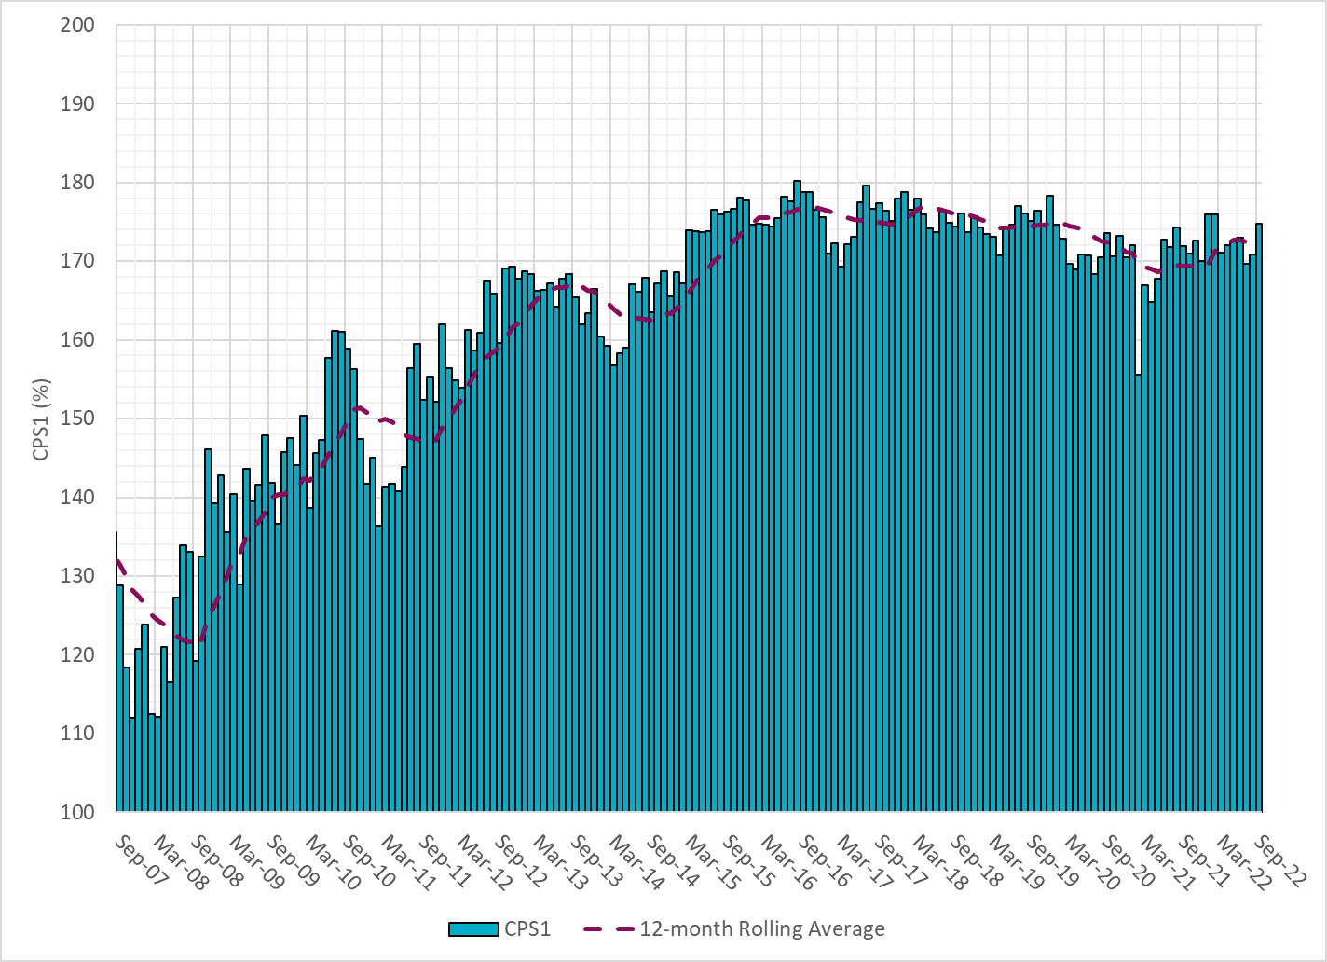
12-Month Rolling Average CPS1
Current 12-Month Rolling Average: 172.45%
Notes:
12 month rolling average CPS1 score is 172.45, which is good and CPS1 score for Sep is slightly higher than the last month.

Slide 8
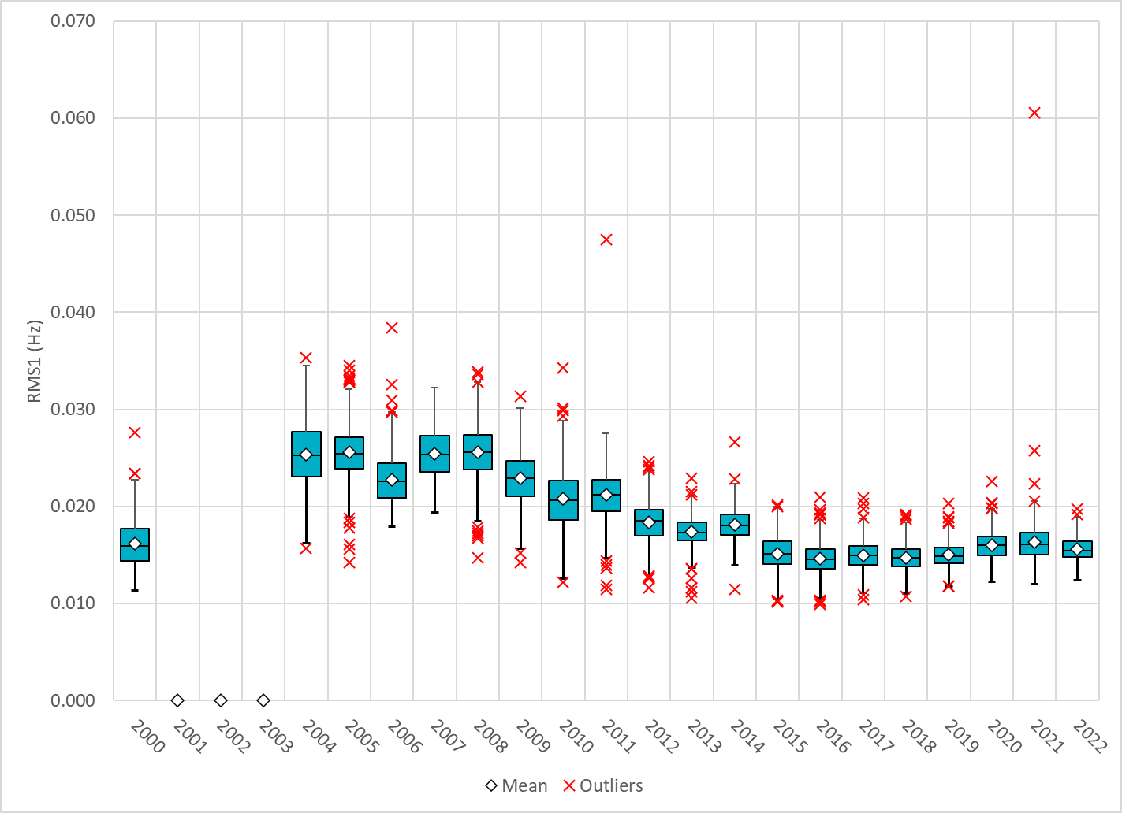
Daily RMS1 of ERCOT Frequency by Year
Notes:
Daily RMS1 frequency by year is so far slightly smaller overall compared with the 2021.
Mean: 15.59 mHz
Min: 12.43 mHz
Max: 19.7 mHz

Slide 9
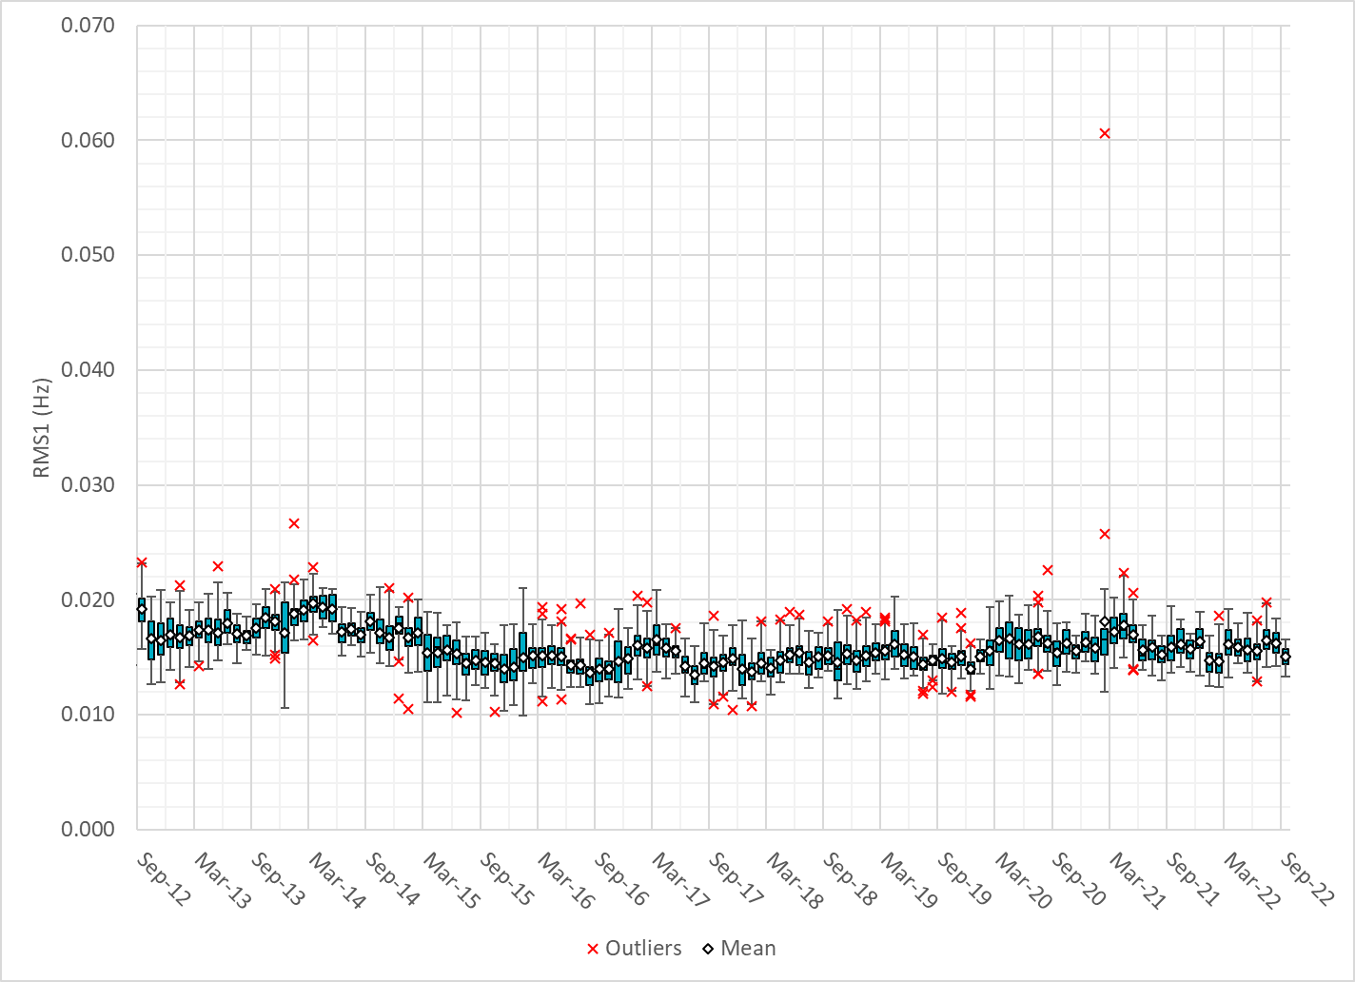
Daily RMS1 of ERCOT Frequency by Month
Notes:
A More granular look at last 15 years of RMS1 by month
15.03Mhz on avg for Sep 2022

Slide 10
Daily RMS1 of ERCOT Frequency by Month
Notes:
Same data with 10 years shown instead of 15

Slide 11
Frequency Profile Comparison

Slide 12
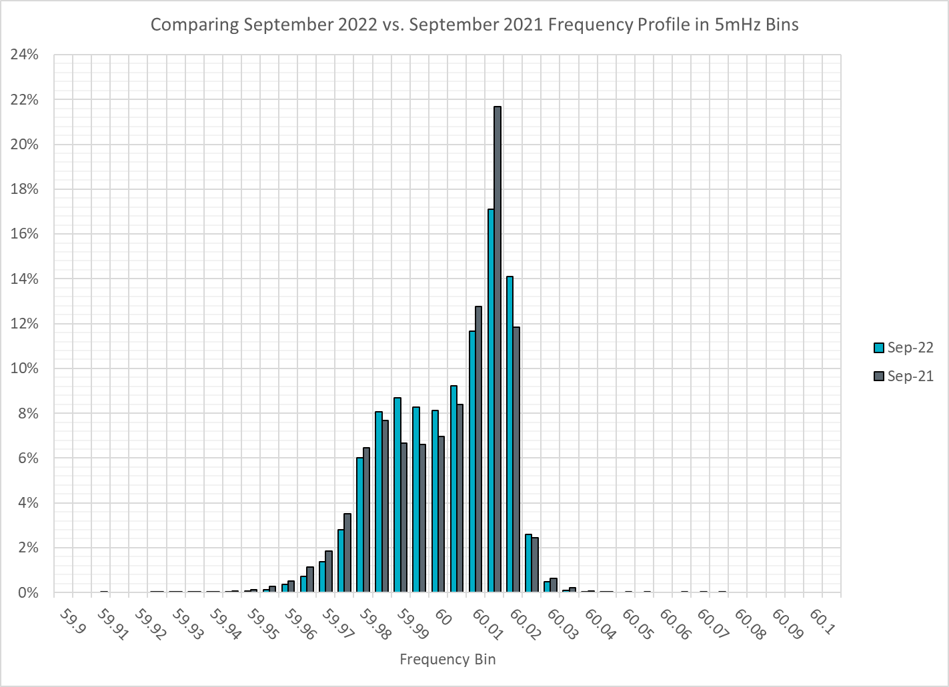
Frequency Profile Comparison
Notes:
Comparison of frequency profile between Sep 2021 and Sep 2022, we see fewer instances of frequency hovering at or below the lower deadband in Sep 2022.

Slide 13
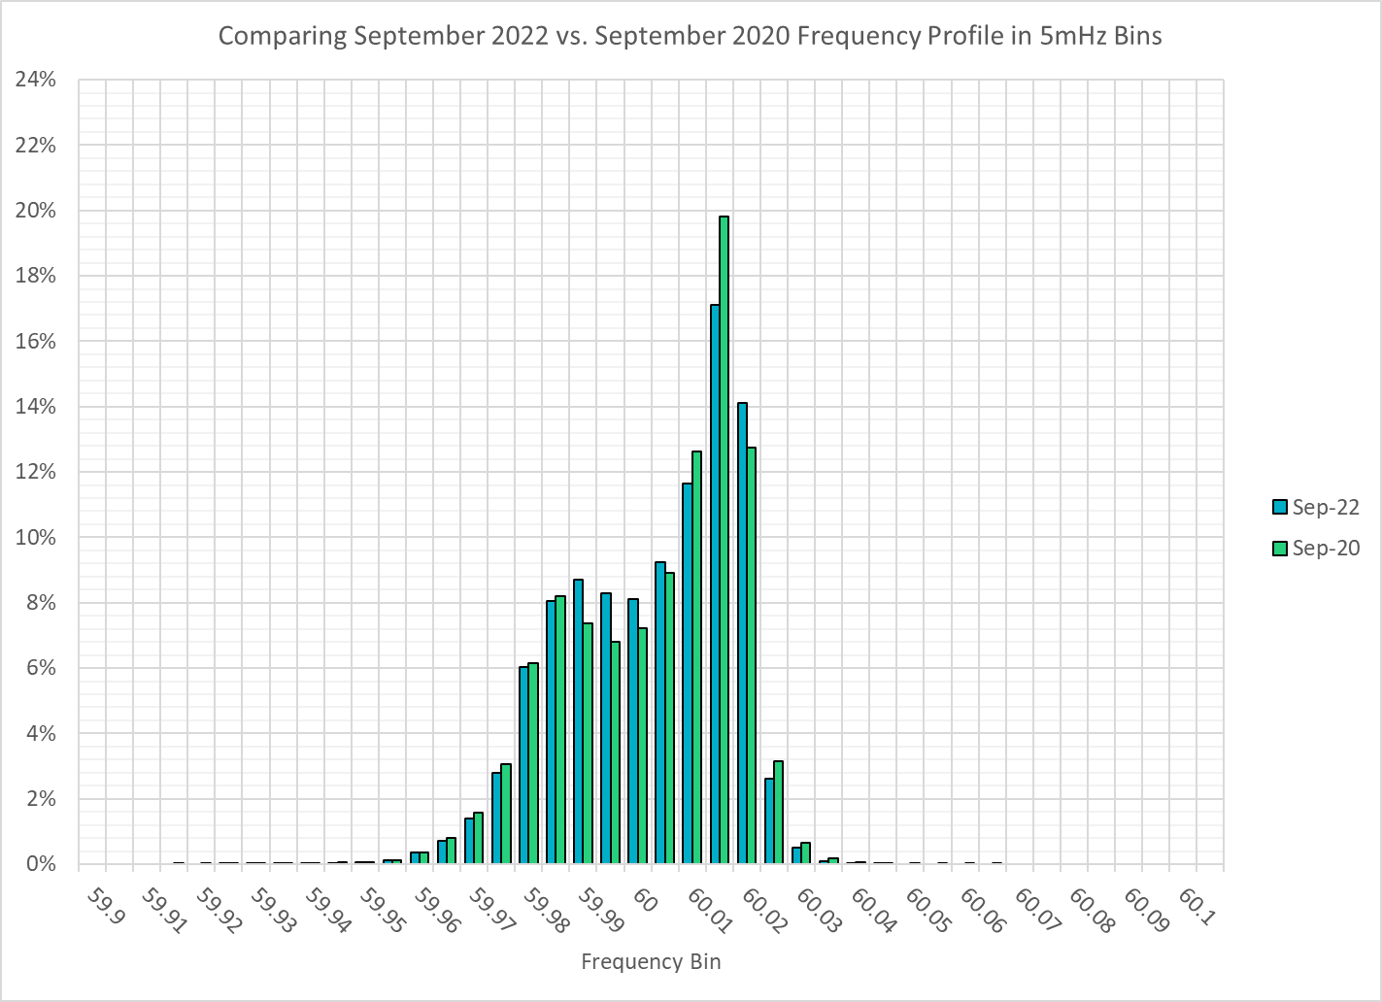
Frequency Profile Comparison
Notes:
Some story when you compare frequency profile between Sep 2021 and Sep 2022, we see fewer instances of frequency hovering at or below the lower deadband in Sep 2022.

Slide 14
Time Error Correction

Slide 15
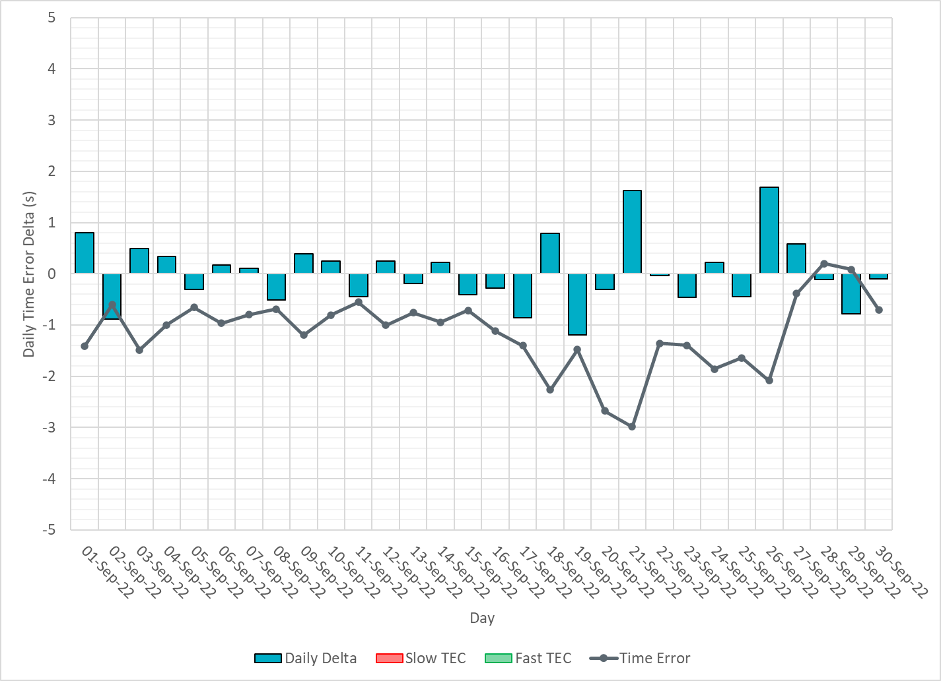
ERCOT Daily Time Error
Notes:
We did not make time error corrections and the time error was fairly small during the entire month of Sep.

Slide 16
Time Error Corrections Log Summary
There have been no time error corrections since December 2016

Slide 17
BAL-003 Performance

Slide 18
Op. Year 2020 BAL-003 Selected Events – Update
Notes:
BAL-003

Slide 19
Op. Year 2020 BAL-003 FRM Performance - Update
Notes:
OP2018: FRO = -381.0, FRM_median = -843.17, FRM_average = -959.7
OP2019: FRO = -381.0, FRM_median = -811.14, FRM_average = -892.5
OP2020: FRO = -425.0, FRM median = -789.34, FRM average = -879.0
OP2021: FRO =

Slide 20
ERCOT Energy Statistics

Slide 21
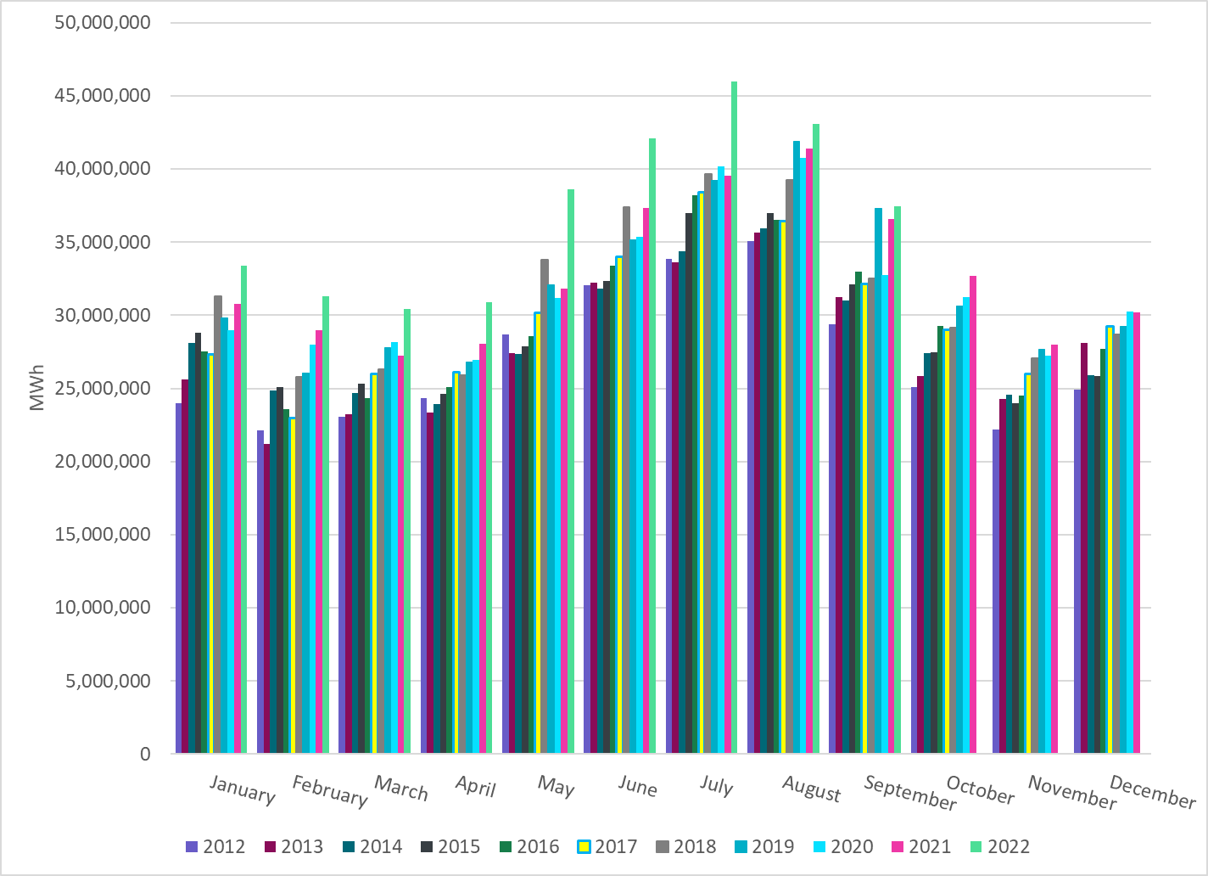
Total Energy
Notes:
37,464,823 MWh
There is an increase in total energy used in Sep compared to last year

Slide 22
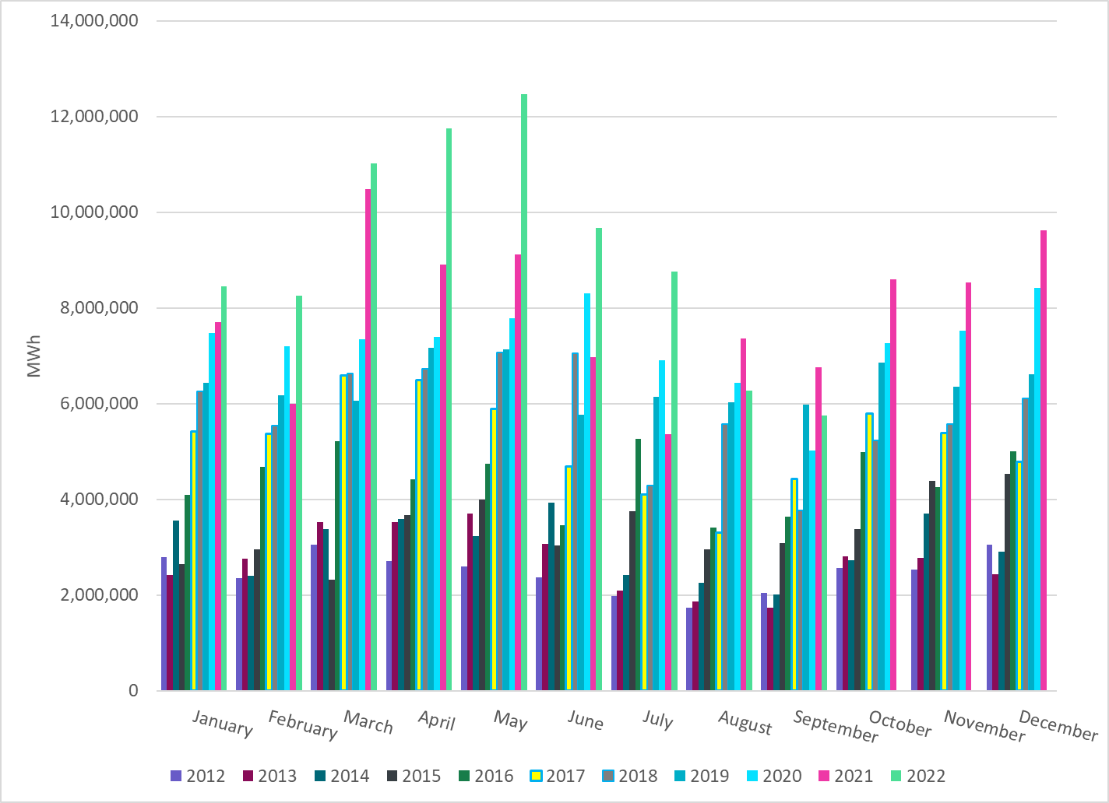
Total Energy from Wind Generation
Notes:
5,755,040 MWH
We see a decrease in the wind energy production in September this year.

Slide 23
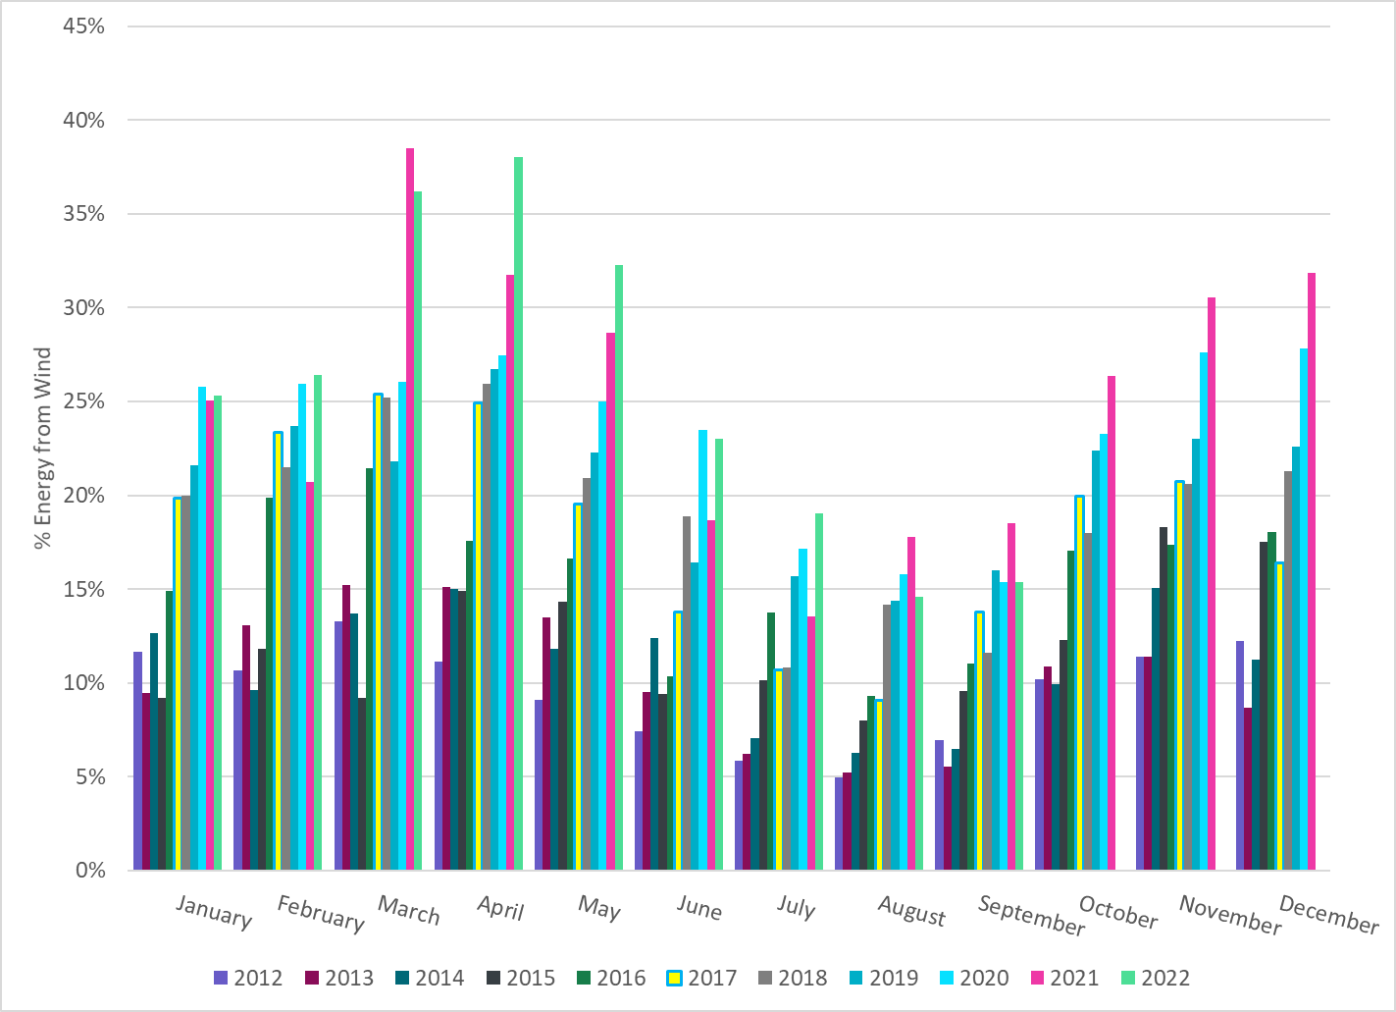
% Energy from Wind Generation
Notes:
15.36%
of total energy was provided by wind generation

Slide 24
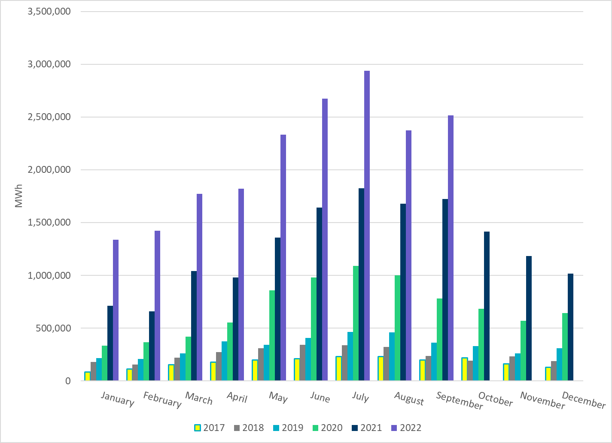
Total Energy From Solar Generation
Notes:
2,516,064 MWh
There is also a notable increase in solar energy production compared to August2022 and Sep 2021.

Slide 25
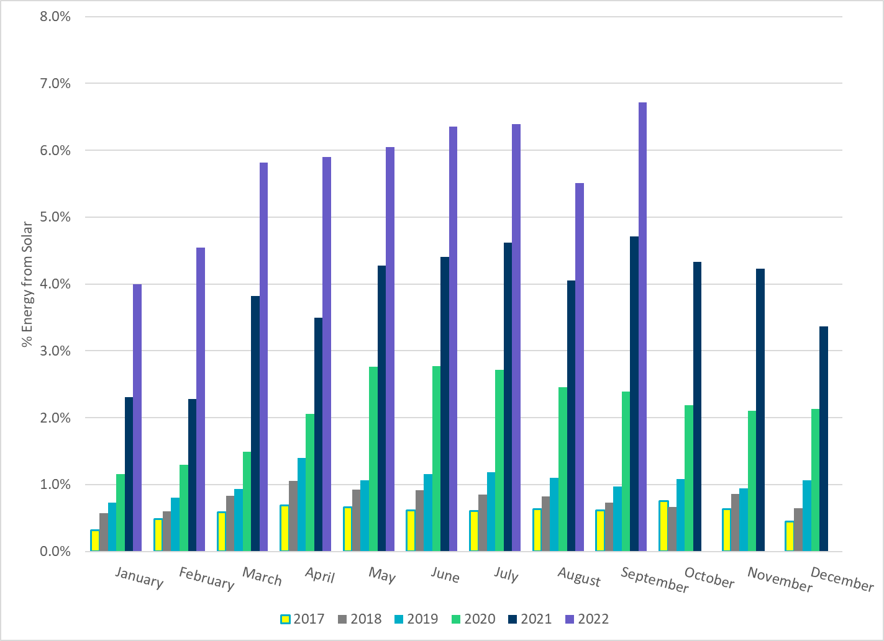
% Energy from Solar Generation
Notes:
6.72% of total
energy was provided by solar generation, which is highest solar penetration level so far.

Slide 26
ERCOT System Inertia

Slide 27
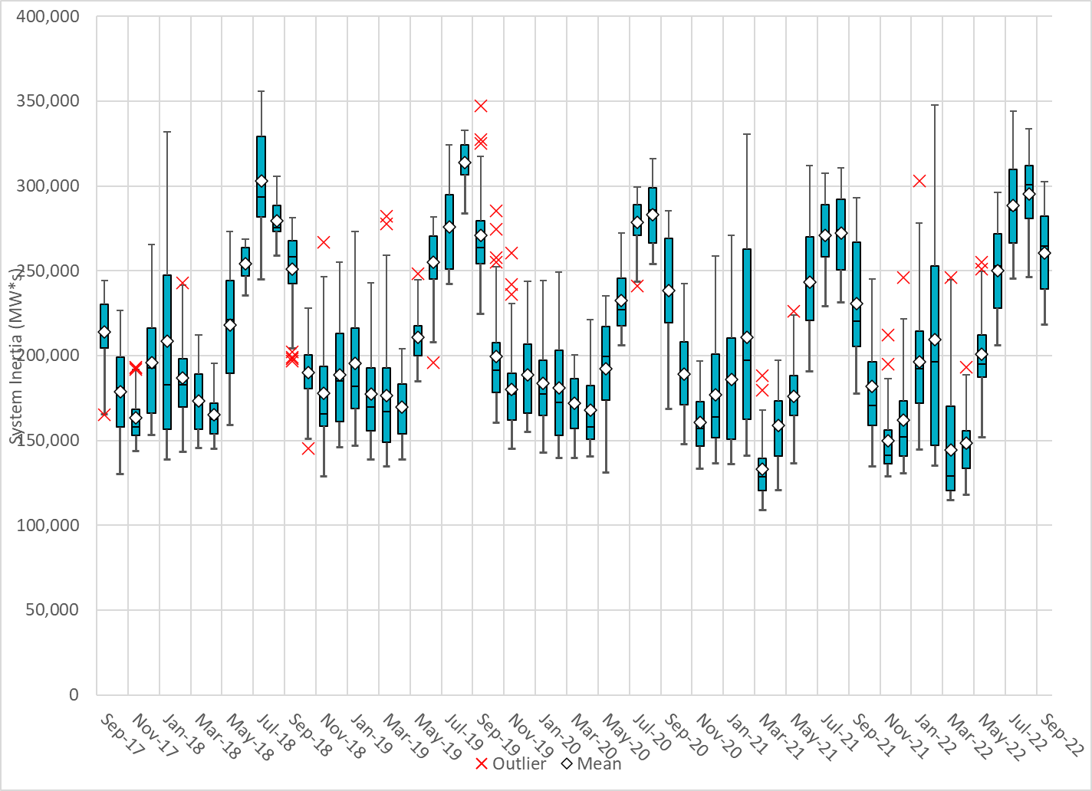
Daily Minimum System Inertia
Notes:
Minimum Inertia =201,953 MW*s on 09/30/2022
Previous Minimum was 109,029 MW*s on 3/22/2021
Data:
Mean: 260,395 MW*s
Max: 302,440 MW*s on Sep 22th
Min: 218,205 MW*s on Sep 30th

Slide 28
Questions?
Thank you!

