Slide 1
ERCOT Frequency Events
September 2022
ERCOT
Operations Planning
PDCWG | October 28th, 2022

Slide 2
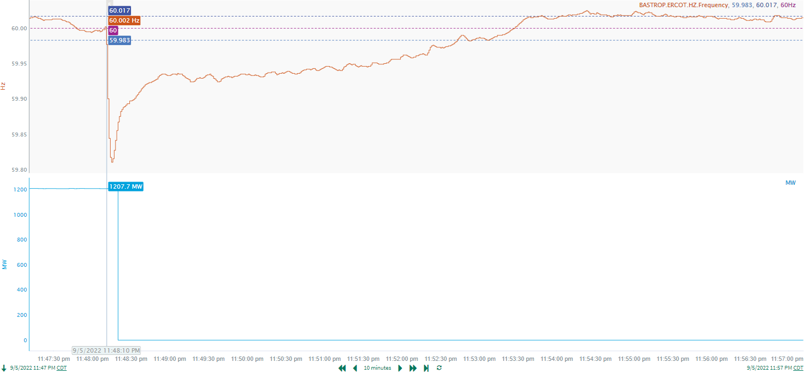
9/5/2022 23:48:10(FME)
Notes:
The unit tripped offline while carrying approximately 1207 MW
Starting Frequency: 60.002 Hz
Minimum Frequency: 59.81 Hz
A-C Time : 5 seconds
Recovery Time(back to deadband): 4 minutes 33 seconds
RRS Released: 1219 MW
Trip Reason: Unknown at this time
Contextual Information: A total of 150 MW of regulation up was deployed and manual offset of 350 MW was applied during this time

Slide 3
Questions?
Thank you!

