Slide 1
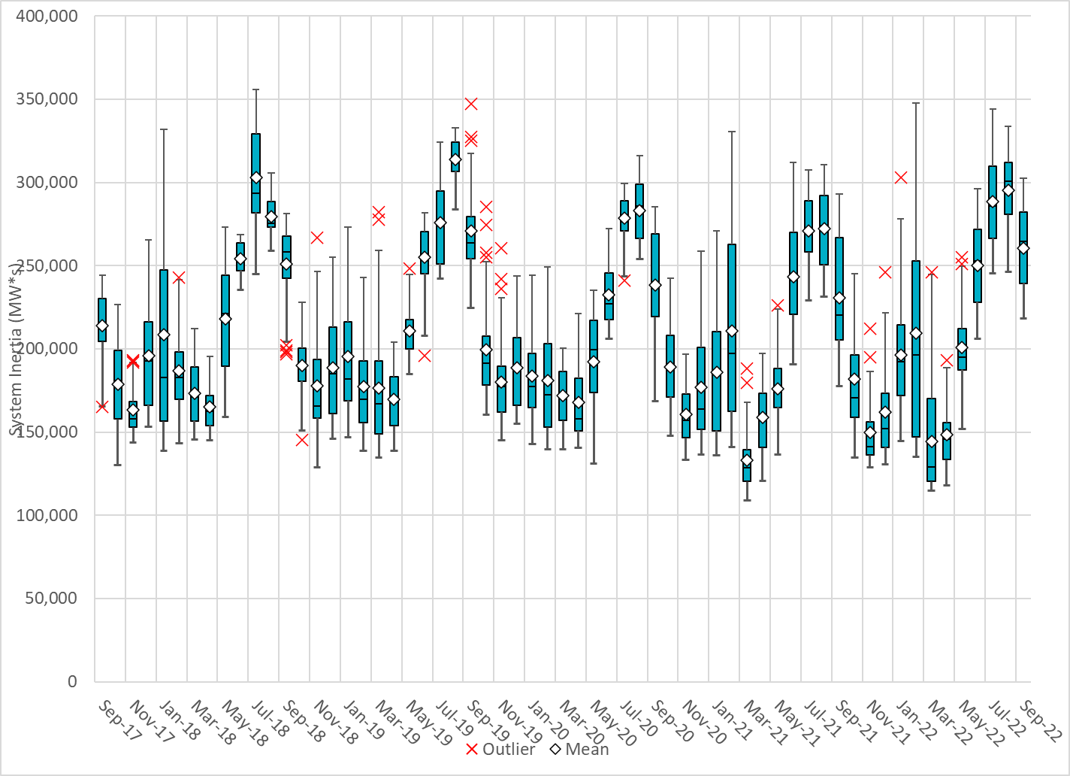
Daily Minimum System Inertia
Notes:
Minimum Inertia =201,953 MW*s on 09/30/2022
Previous Minimum was 109,029 MW*s on 3/22/2021
Data:
Mean: 260,395 MW*s
Max: 302,440 MW*s on Sep 22th
Min: 218,205 MW*s on Sep 30th

Slide 2
ERCOT Inertia 2013-2022(Jan-Sep)
Date and Time | 2013 3/10 3:00 AM | 2014 3/30 3:00 AM | 2015 11/25 2:00 AM | 2016 4/10 2:00 AM | 2017 10/27 4:00 AM | 2018 11/03 3:30 AM | 2019 3/27 1:00 AM | 2020 05/01 2:00 AM | 2021 03/22 00:00 AM | 2022 03/21 01:00 AM
Min synch. Inertia (GW*s) | 132 | 135 | 152 | 143 | 130 | 128.8 | 134.5 | 131.1 | 109 | 115
System load at minimum synch. Inertia (MW) | 24,726 | 24,540 | 27,190 | 27,831 | 28,425 | 28,397 | 29,883 | 30,679 | 32,599 | 33,365
Non-synch. Gen. in % of System Load | 31 | 34 | 42 | 47 | 54 | 53 | 50 | 57 | 65 | 66
Notes:
Numbers in grey on top of the boxplots are showing wind generation capacity synchronized to ERCOT grid by the end of each year.
For each box, the central mark (red line) is the median, the edges of the box (in blue) are the 25th and 75th percentiles, the whiskers correspond to +/- 2.7 sigma (i.e., represent 99.3% coverage, assuming the data are normally distributed. The corresponding lowest inertia in each year is given in the table.
The circle on each boxplot is showing inertia during time when highest portion of load was served by wind/solar generation in that year.

Slide 3
Inertia vs. IRR Penetration

