Slide 1
10/28/2022 ELCC Study Results Discussion
Prepared for Electric Reliability Council of Texas
Notes:
1

Slide 2
Zonal Reliability Study
Notes:
2

Slide 3
Background
A transmission group was created that treated ERCOT as a copper sheet
The base reliability was determined, and then coal capacity was retired until the system reached ~0.1 LOLE
The copper sheet transmission group was then switched out for a more constrained group
Transmission Group | Region | 2023 LOLE | 2026 LOLE
Copper Sheet | Aggregate | 0.102 | 0.097
 | Dallas | 0.102 | 0.093
 | Houston | 0.102 | 0.097
 | Rest Of System | 0.098 | 0.097
 | Valley | 0.101 | 0.095
 | West | 0.101 | 0.096
Constrained | Aggregate | 2.033 | 1.625
 | Dallas | 0.284 | 0.321
 | Houston | 0.172 | 0.304
 | Rest Of System | 0.203 | 0.170
 | Valley | 1.921 | 1.288
 | West | 0.204 | 0.172

Slide 4
Study Topology
SPP
Entergy
5,180 MW
220 MW
DFW
600 MW
West
Rest
Of
Sys
Houston
100 MW
Mexico
Valley
300 MW

Slide 5
Study Approach
Perfect Capacity
Starting with the constrained group results, perfect capacity was added to each zone iteratively with the objective of adding the minimal net capacity in aggregate across ERCOT to achieve 0.1 LOLE in all zones
Meeting this objective required reducing capacity in some zones
Transmission Capability
Starting with the constrained group results, transmission limits were relaxed on each internal ERCOT transmission tie iteratively with the objective of minimal net adjustments to transmission capability across all zonal ties to meet 0.1 LOLE in all zones

Slide 6
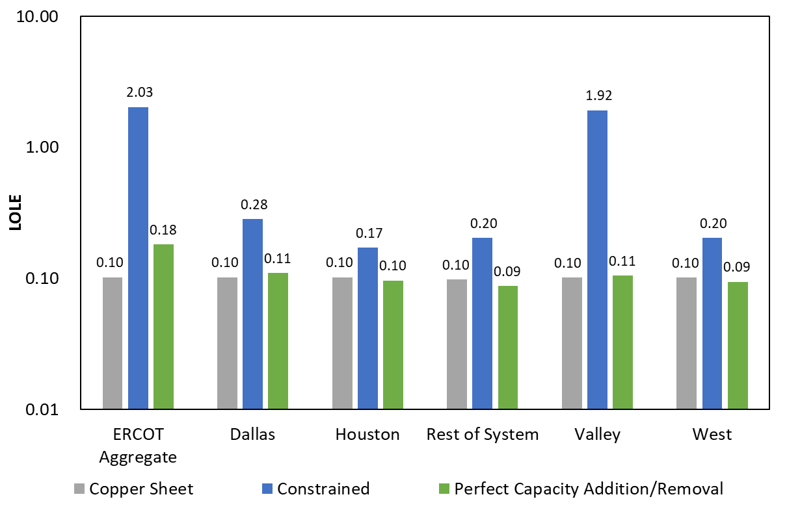
2023 Perfect Capacity Results
Region | Perfect Capacity Addition/Removal (MW)
Dallas | 3,750
Houston | -150
Rest of System | -300
Valley | 500
West | -300
ERCOT Aggregate measures LOLE when any one or more regions sheds firm load. In a constrained scenario, load shed can occur in different days in different zones resulting in an aggregate LOLE > 0.1.

Slide 7
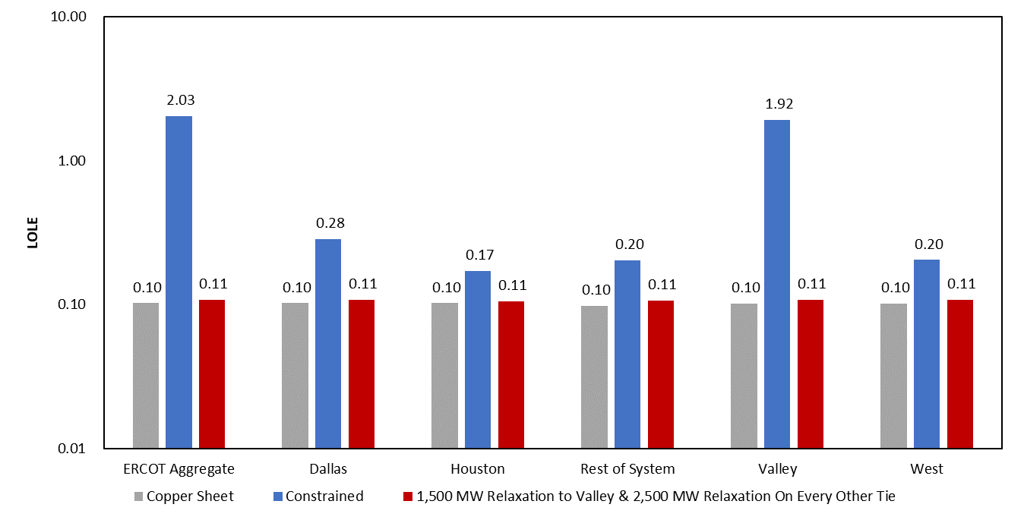
2023 Transmission Capability Results

Slide 8
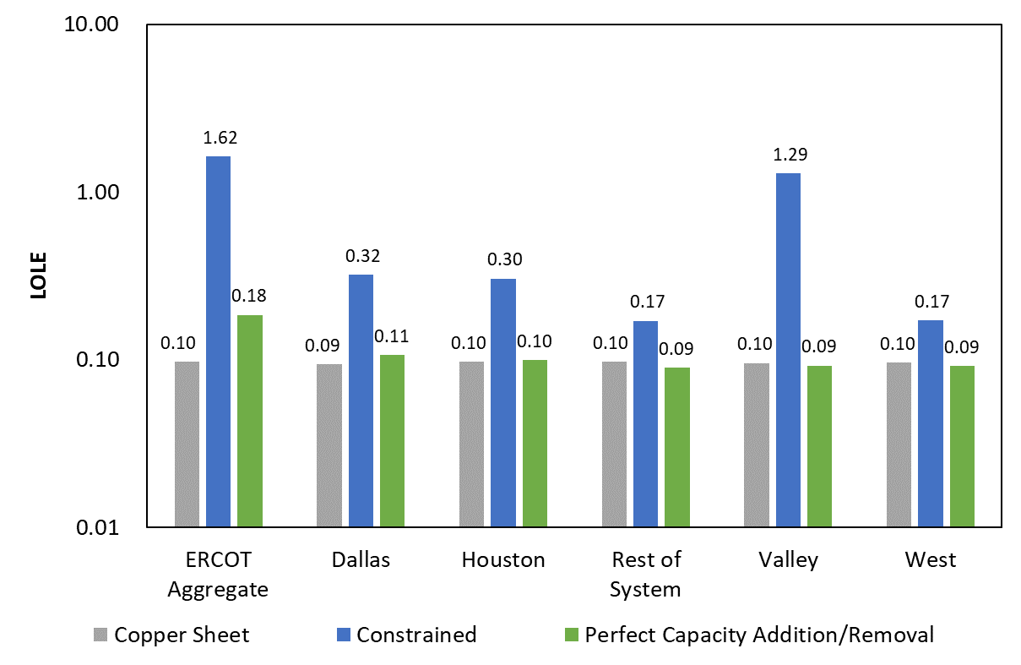
2026 Perfect Capacity Results
Region | Perfect Capacity Addition/Removal (MW)
Dallas | 3,500
Houston | 625
Rest of System | -700
Valley | 500
West | -500
ERCOT Aggregate measures LOLE when any one or more regions sheds firm load. In a constrained scenario, load shed can occur in different days in different zones resulting in an aggregate LOLE > 0.1.

Slide 9
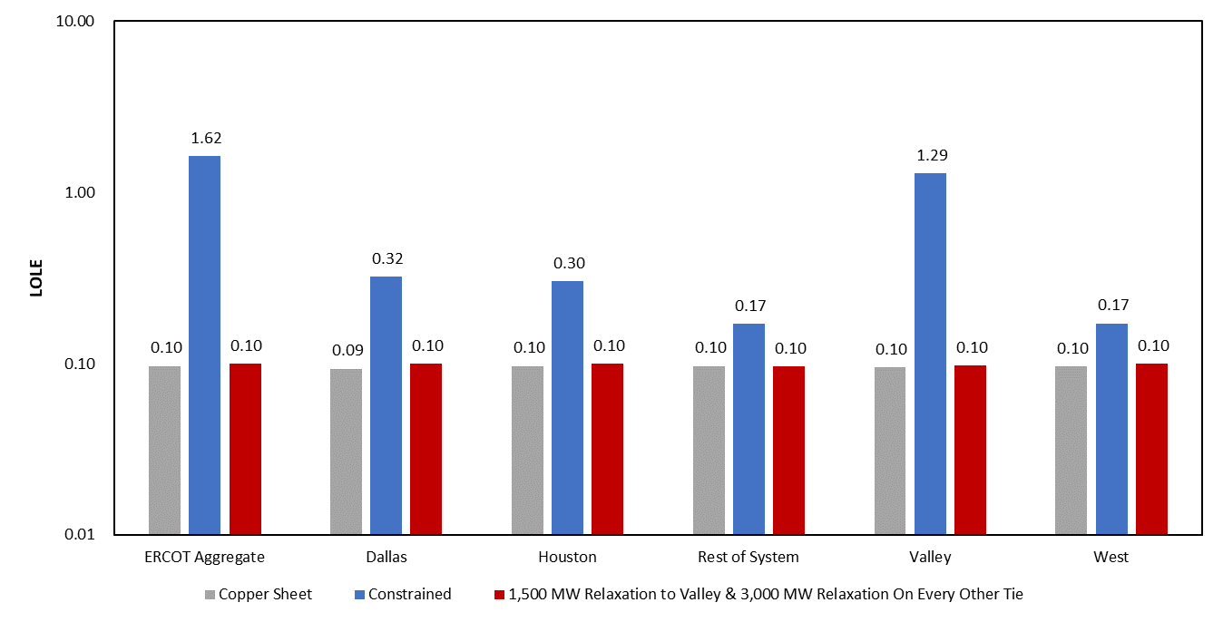
2026 Transmission Capability Results

Slide 10
ELCC Study
Notes:
10

Slide 11
ELCC Study SERVM Simulations
Perform hourly analysis to obtain ELCC values for the following scenarios:
Solar 0 – 40 GW
Wind 0 – 50 GW
Storage 0 – 12 GW
Analyze 2,4,8-hour durations
Location Effects of Wind
Wind-C
Wind-O
Wind-P
Location Effects of Solar
West
Non-West
Technology Effects of Solar
DG
Tracking

Slide 12
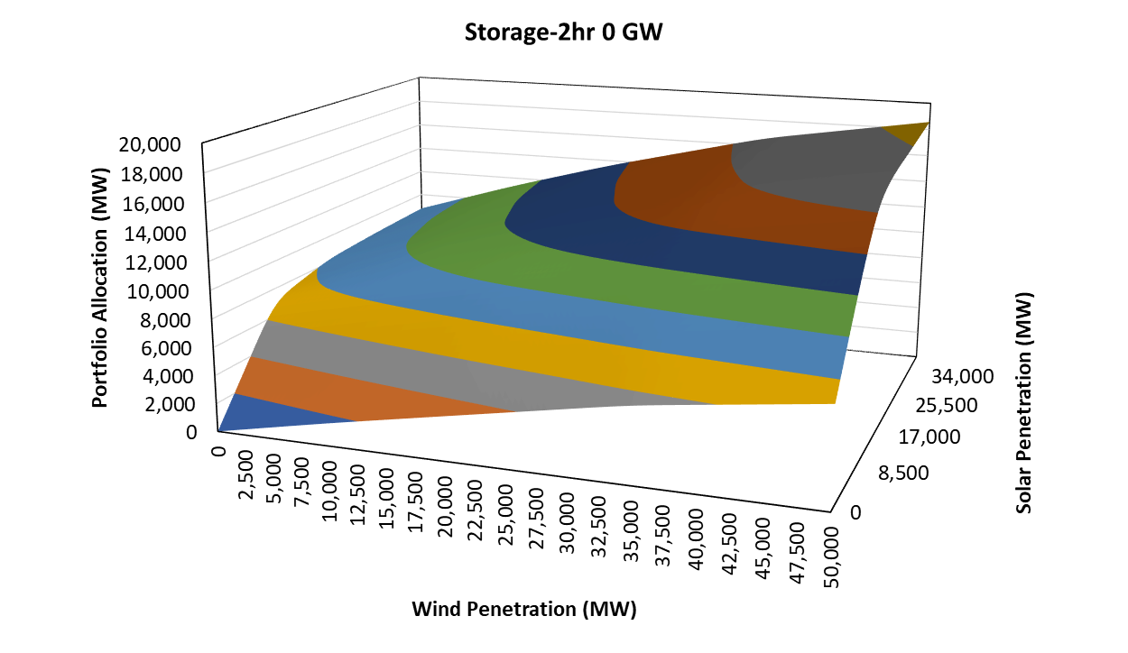
Summer ELCC Surface with 0 GW Storage
Wind Penetration (MW) | Solar Penetration (MW) | Storage-2hr Penetration (MW) | Portfolio Allocation (MW)
0 | 0 | 0 | 0
50,000 | 0 | 0 | 6,878
0 | 40,000 | 0 | 8,807
50,000 | 40,000 | 0 | 18,578
“Portfolio Allocation” can be interpreted as the capacity contribution of the combined solar, storage, and wind portfolio.

Slide 13
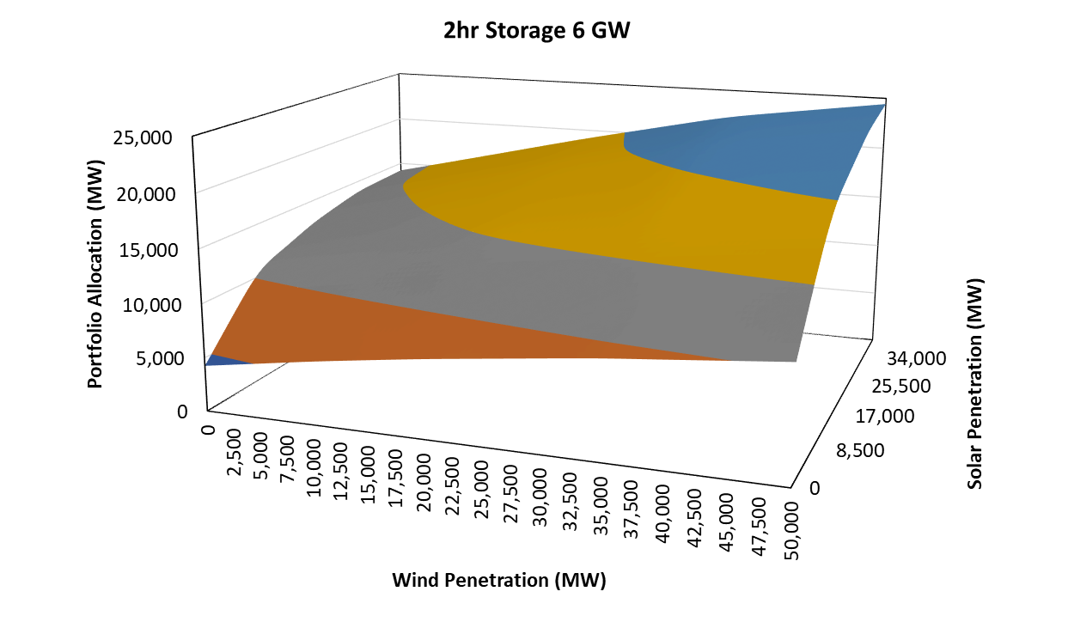
Summer ELCC Surface with 6 GW 2-HR Storage
Wind Penetration (MW) | Solar Penetration (MW) | Storage-2hr Penetration (MW) | Incremental Portfolio Value (MW)
0 | 0 | 6,000 | 4,265
50,000 | 0 | 6,000 | 3,575
0 | 40,000 | 6,000 | 5,401
50,000 | 40,000 | 6,000 | 5,858

Slide 14
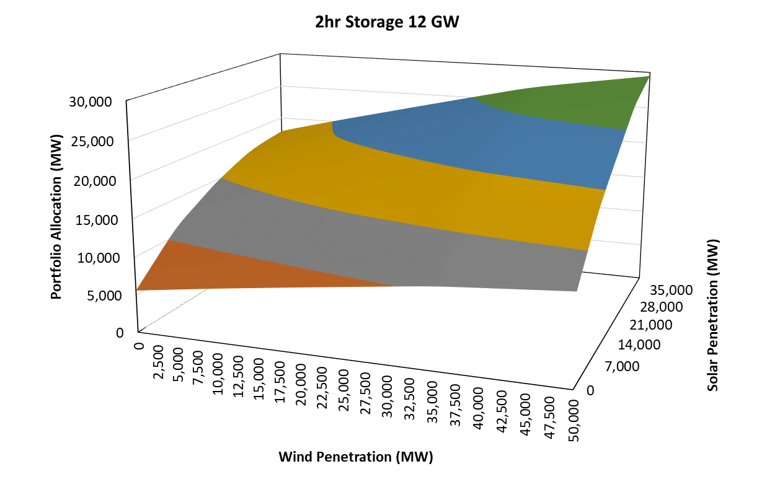
Summer ELCC Surface with 12 GW 2-HR Storage
Wind Penetration (MW) | Solar Penetration (MW) | Storage-2hr Penetration (MW) | Incremental Portfolio Value (MW)
0 | 0 | 12,000 | 1,338
50,000 | 0 | 12,000 | 1,304
0 | 40,000 | 12,000 | 3,666
50,000 | 40,000 | 12,000 | 5,045

Slide 15
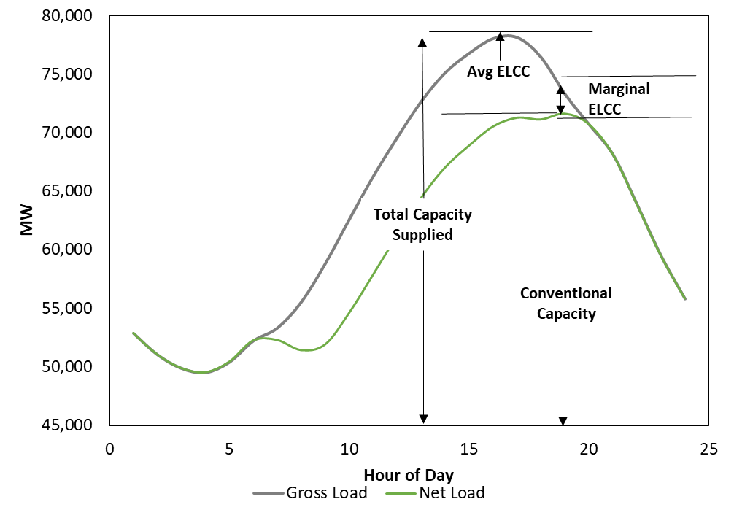
Average vs Marginal ELCC

Slide 16
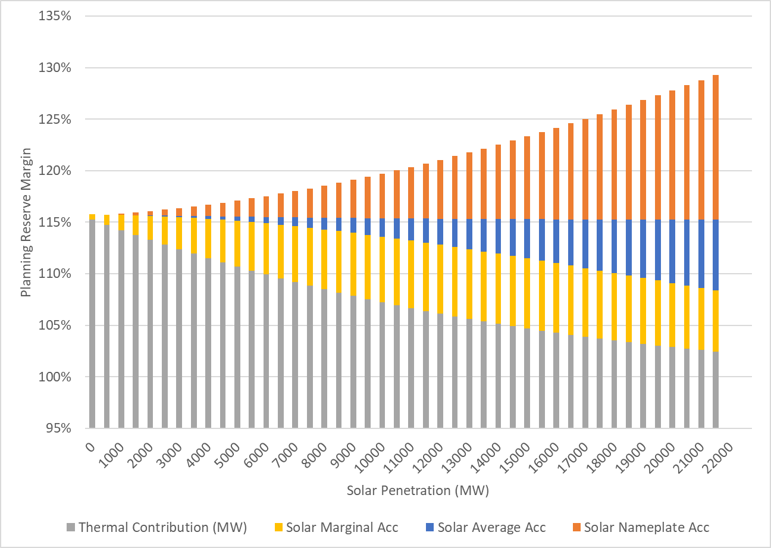
Average vs Marginal ELCC
Marginal ELCC is the reliability contribution of the next MW of a particular technology
Average ELCC is the integration of marginal ELCCs for a given portfolio under study
Marginal accreditation targets the same reliability with the same portfolio as average accreditation
Static Planning Reserve Margin with Average ELCC Accreditation
Total Solar Capacity
Declining Planning Reserve Margin with Marginal ELCC Accreditation

Slide 17
ELCC Findings Summary
Solar
Initially (5-10 GW) solar flattens net load shape and has antagonistic relationship with storage-2hr. At higher penetrations solar ELCC is higher with more storage-2hr. Solar also exhibits a persistent, but much smaller synergistic relationship with wind penetration.
Wind
Wind has consistent synergy with solar driven by profile differences in wind and solar. Wind pushes net load earlier in the day. Solar pushes net load later in the day. These effects allow the other technology to provide more reliability value.
Minimal interactive effects are seen between wind and storage with a small antagonistic effect at low storage-2hr penetration.
Storage
Storage-2hr ELCC has a strong synergy with solar particularly at high solar penetration (>20 GW).

Slide 18
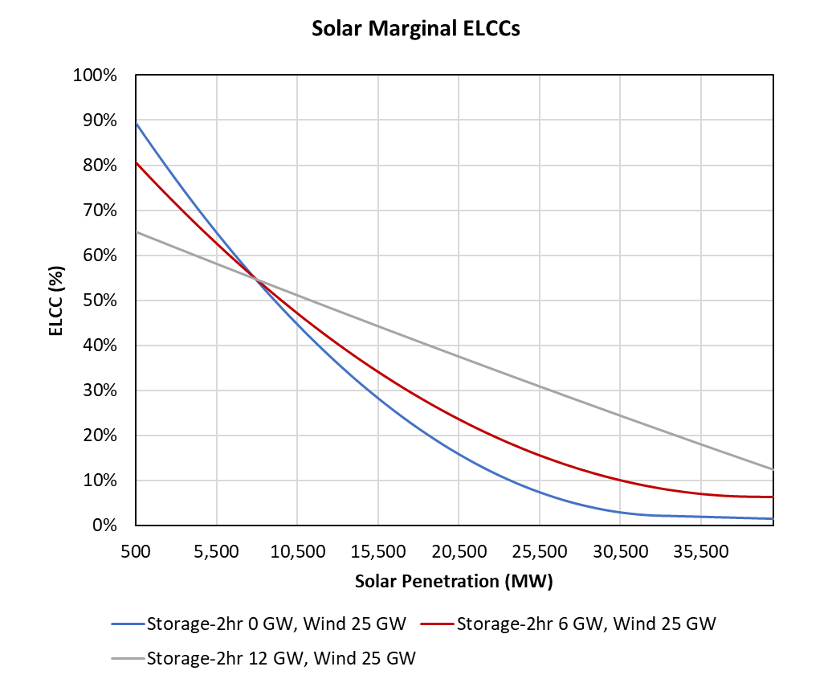
Summer Solar Marginal ELCCs
The first 5-10 GW of solar capacity flattens the net load shape creating an antagonistic reliability value relationship with storage
Above this level, solar has higher ELCCs with increasing storage

Slide 19
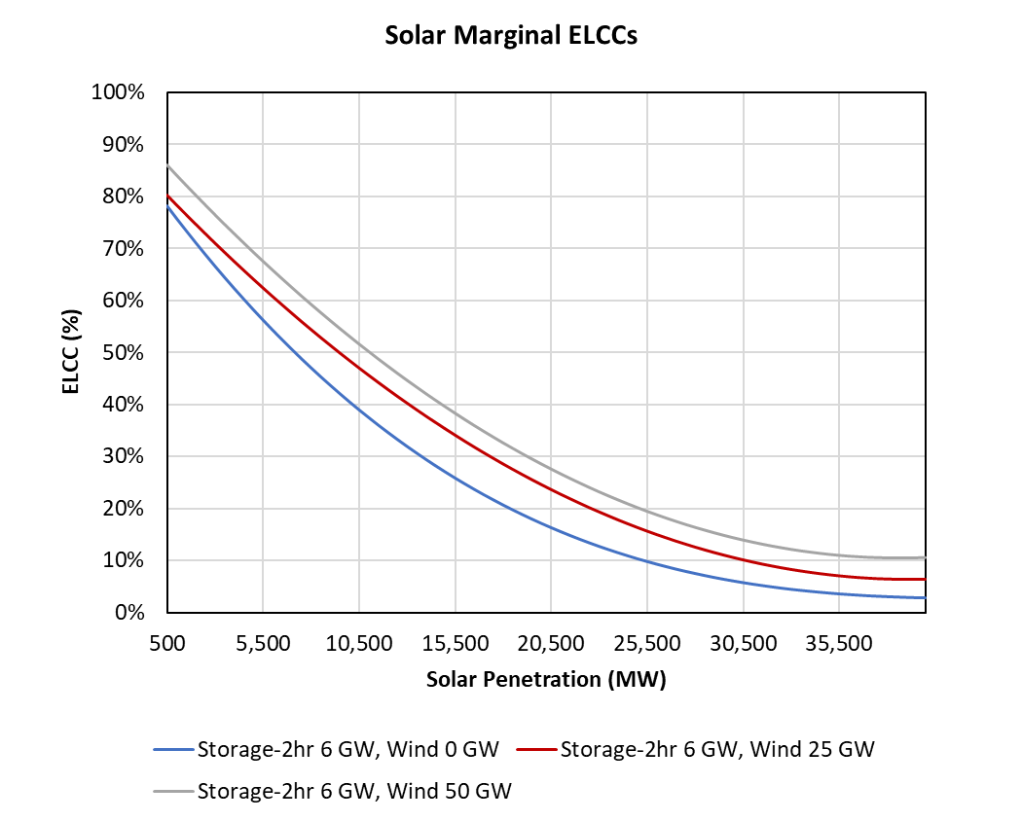
Summer Solar Marginal ELCCs
Solar exhibits consistent small synergistic reliability value relationship wind capacity

Slide 20
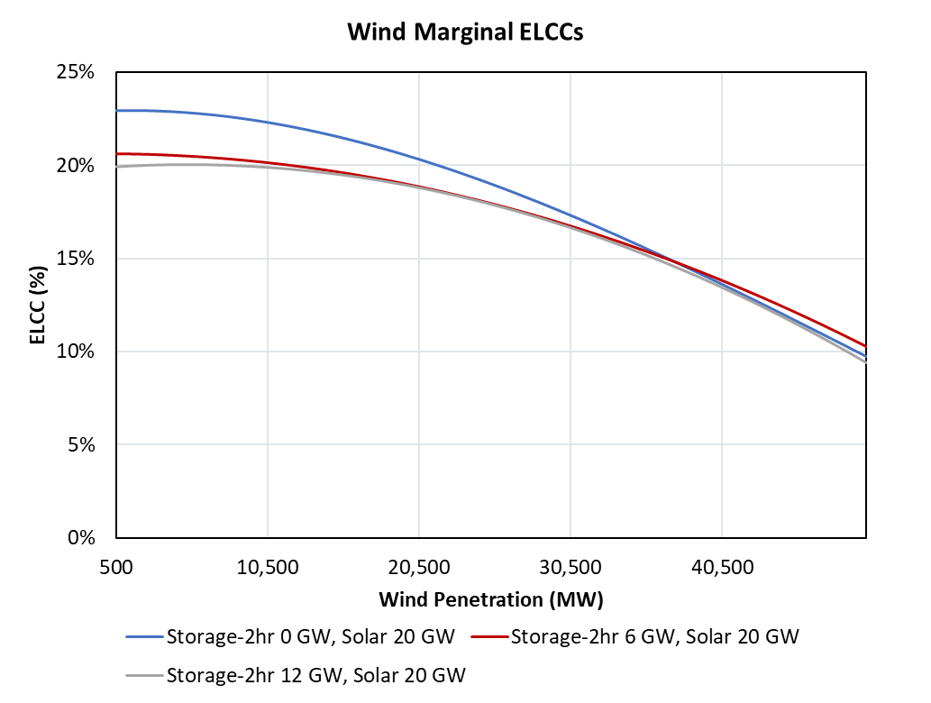
Summer Wind Marginal ELCCs
Wind and storage have minimal interactive effects
Modest antagonistic effect at low storage penetration

Slide 21
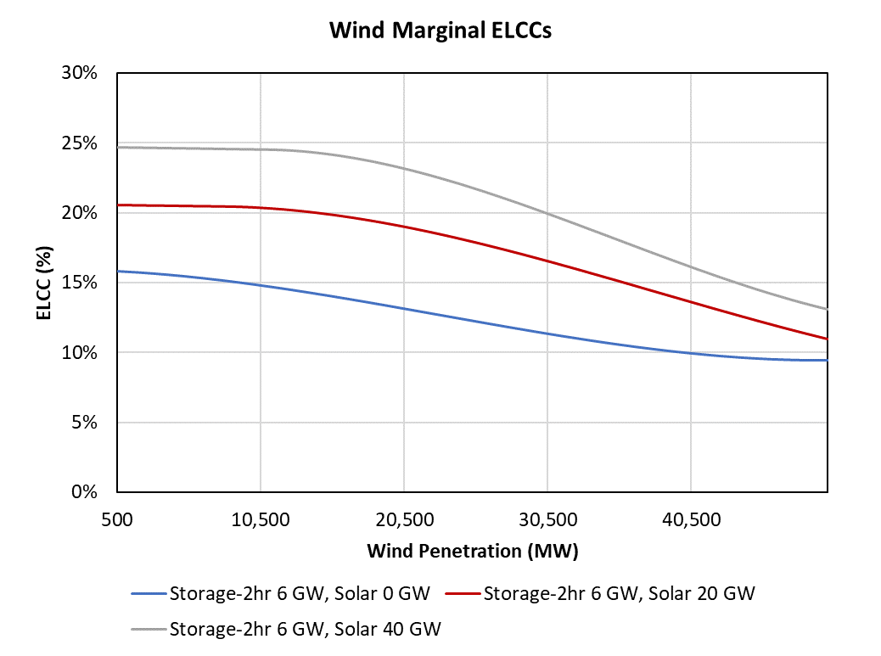
Summer Wind Marginal ELCCs
Consistent synergy between wind and solar

Slide 22
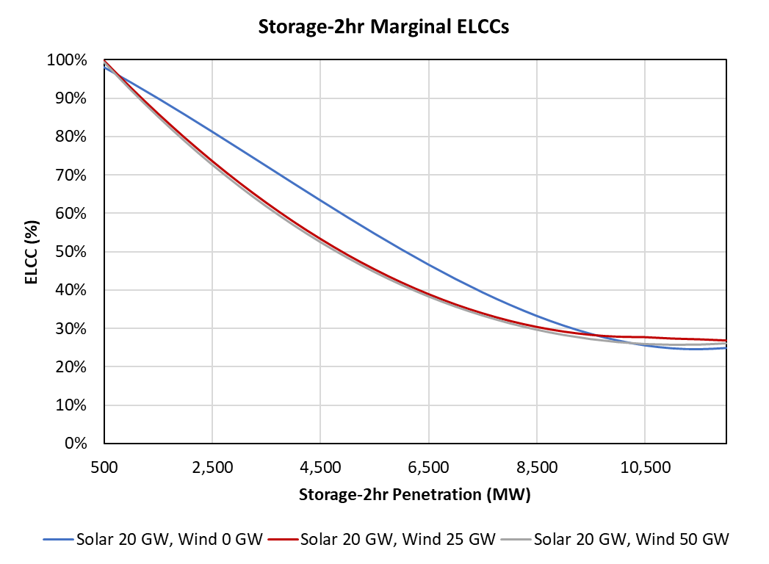
Summer Storage Marginal ELCCs
Wind and storage have minimal interactive effects
Modest antagonistic effect at low storage penetration

Slide 23
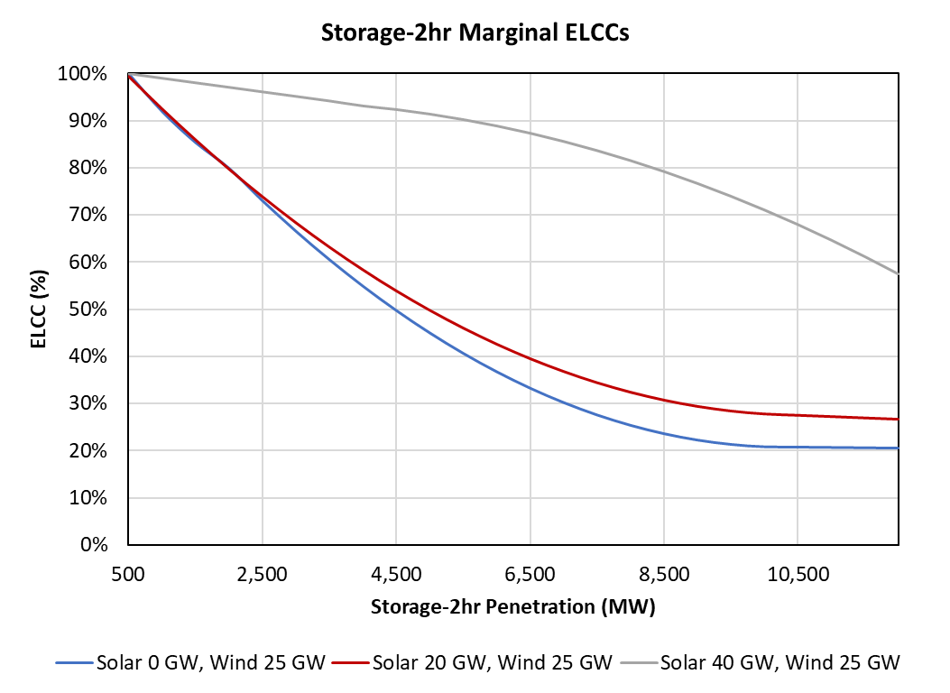
Summer Storage Marginal ELCCs
Significant synergy between solar and storage particularly above 20 GW solar penetration

Slide 24
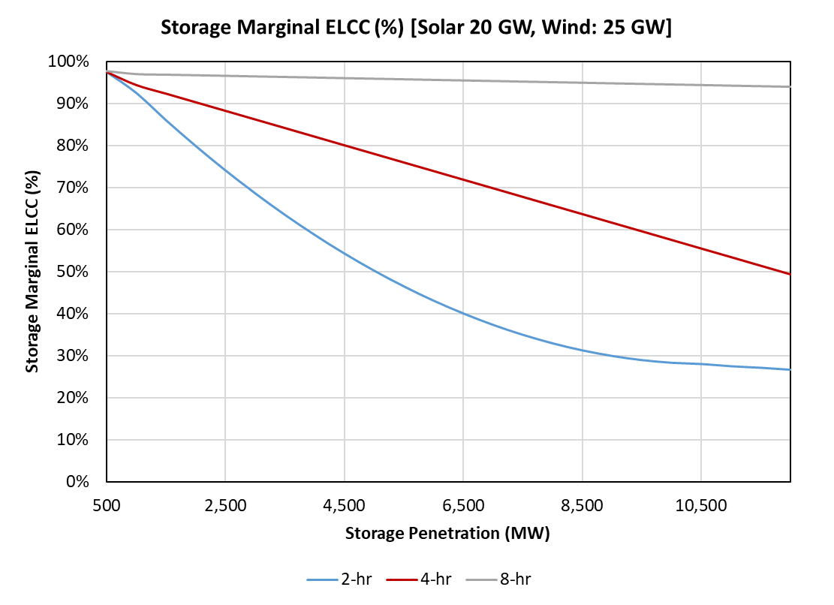
Summer Storage Marginal ELCCs – Duration Effects
Minimal decline in 8-hr storage ELCCs through 12GW penetration

Slide 25
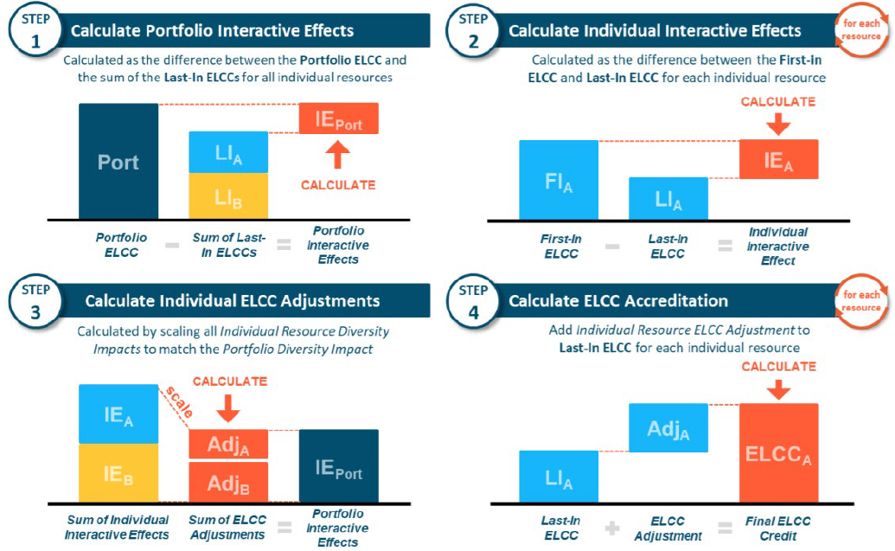
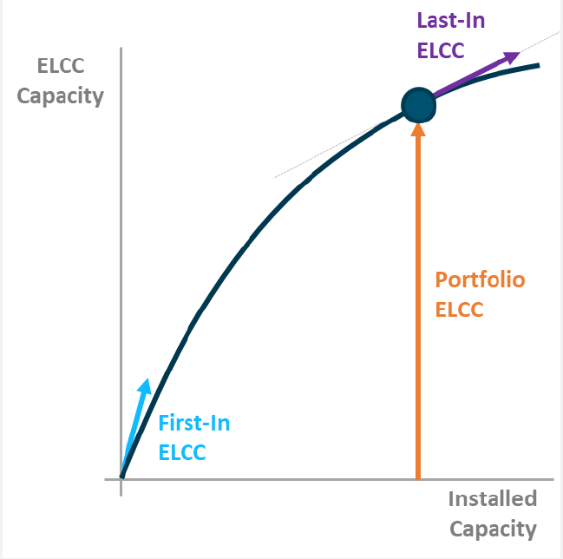
Delta method
Relies on 3 values:
Portfolio ELCC
First-In ELCC
Last-In ELCC
Scales linearly between the first-in and last-in ELCC values
E3-Practical-Application-of-ELCC.pdf (ethree.com)

Slide 26
Integration Method
START
Integrates along the curve of the portfolio ELCC, from origin to installed capacity
Captures the non-linear nature of the ELCC curve as installed capacity rises for different resource classes
Installed Capacities→IC₁,IC₂,IC₃
A = f(IC₁, IC₂, IC₃)
Calc Individual Allocation (A_{i}) for each resource class C_{i}
A₁= A – f(0, IC₂, IC₃)
Increment IC₁,IC₂,IC₃
Calc. A₂ & A₃
Sum = A₁+A₂+A₃
No
IC₁+IC₂+IC₃==Target
Yes
FA₁ = (A₁/Sum)*A
FA₂ = (A₂/Sum)*A
FA₃ = (A₃/Sum)*A
Calc Final Allocation (FA_{i}) for each resource class C_{i}
STOP

Slide 27
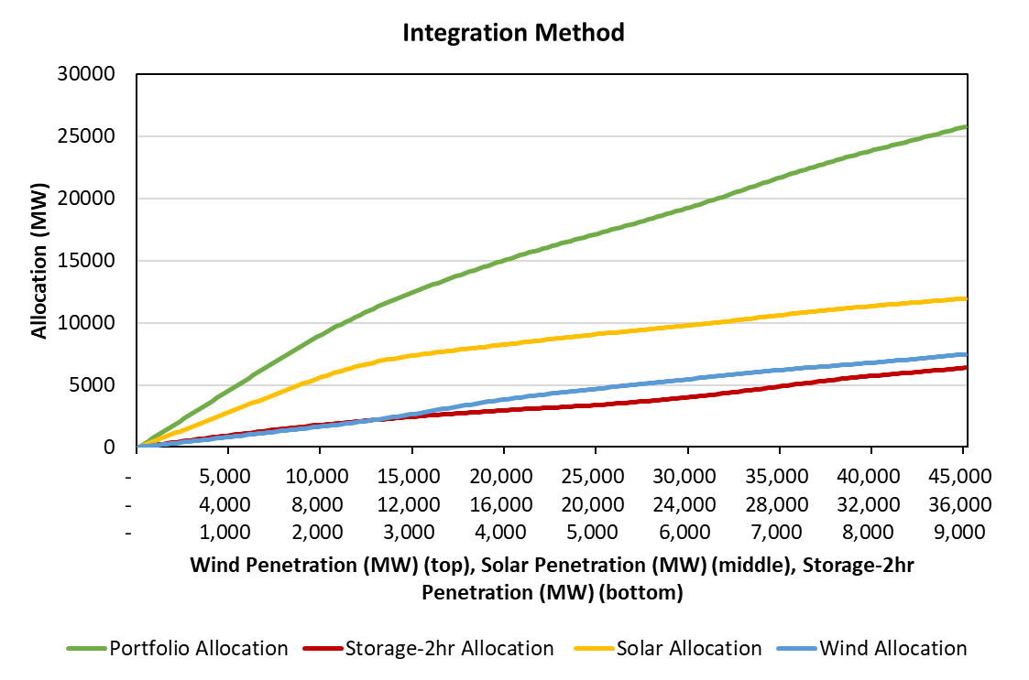
Summer Resource Level Allocation – Integration Method
Integration method calculations for distinct portfolios in 500 MW steps
Calculating contribution for each incremental addition for each portfolio produces more intuitive ELCC curves
Resource Class | Installed Capacity (MW) | Delta Allocation (MW) | Integration Allocation (MW)
Solar | 36,000 | 11,616 | 11,952
Storage-2hr | 9,000 | 7,454 | 6,373
Wind | 45,000 | 6,719 | 7,464
Porfolio | 90,000 | 25,789 | 25,789

Slide 28
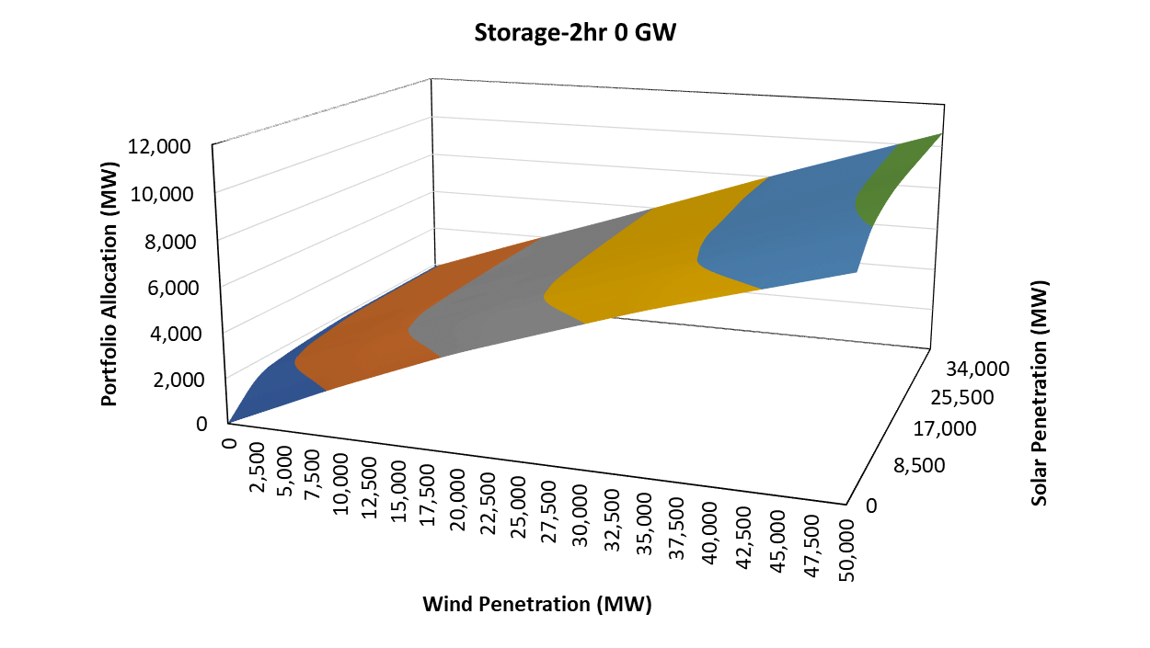
Winter ELCC Surface with 0 GW Storage
Wind Penetration (MW) | Solar Penetration (MW) | Storage-2hr Penetration (MW) | Portfolio Allocation (MW)
0 | 0 | 0 | 0
50,000 | 0 | 0 | 8,942
0 | 40,000 | 0 | 1,898
50,000 | 40,000 | 0 | 10,654

Slide 29
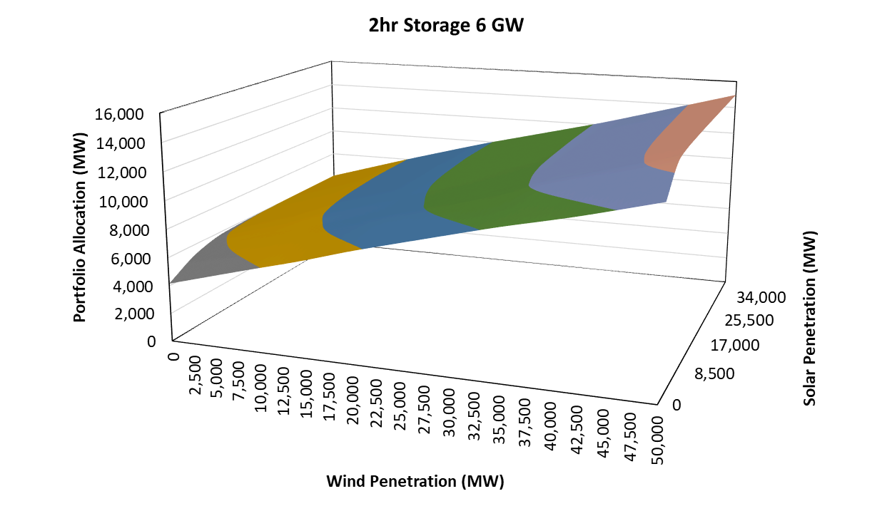
Winter ELCC Surface with 6 GW 2 HR Storage
Wind Penetration (MW) | Solar Penetration (MW) | Storage-2hr Penetration (MW) | Incremental Portfolio Value (MW)
0 | 0 | 6,000 | 4,157
50,000 | 0 | 6,000 | 3,804
0 | 40,000 | 6,000 | 4,174
50,000 | 40,000 | 6,000 | 4,321

Slide 30
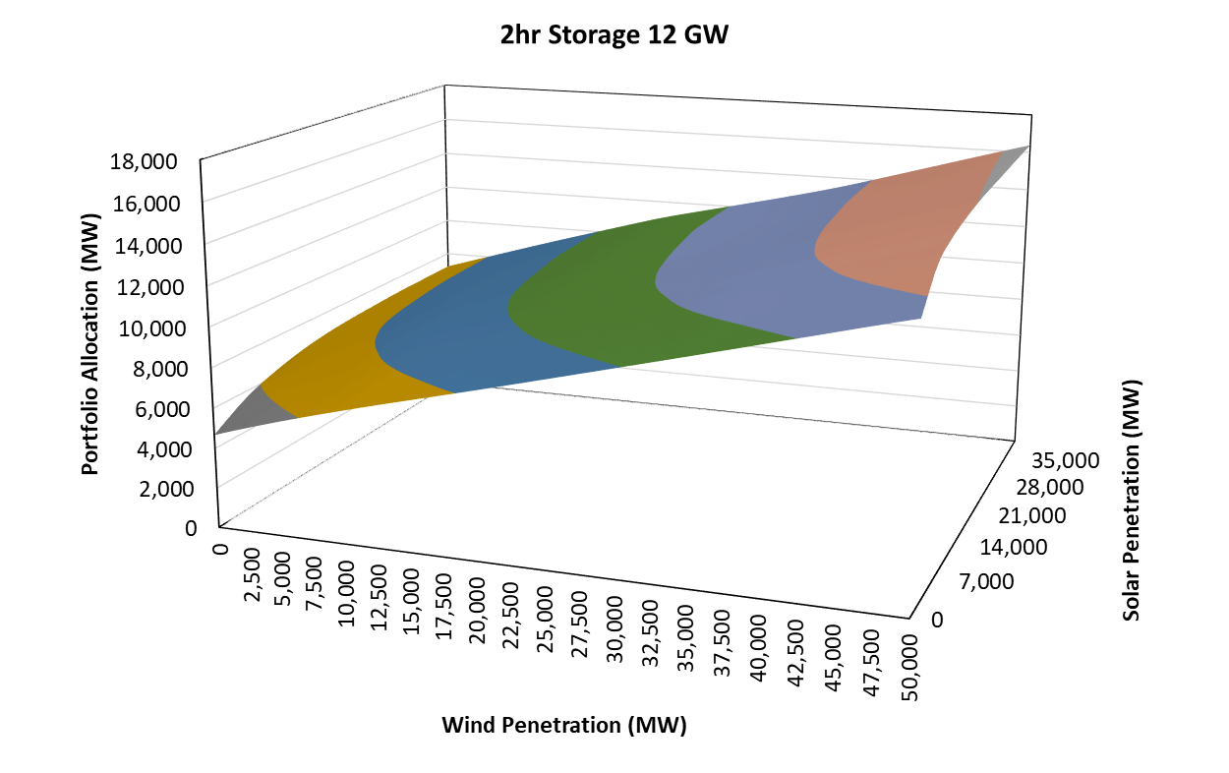
Winter ELCC Surface with 12 GW 2-HR Storage
Wind Penetration (MW) | Solar Penetration (MW) | Storage-2hr Penetration (MW) | Incremental Portfolio Value (MW)
0 | 0 | 12,000 | 511
50,000 | 0 | 12,000 | 584
0 | 40,000 | 12,000 | 1,158
50,000 | 40,000 | 12,000 | 1,411

Slide 31
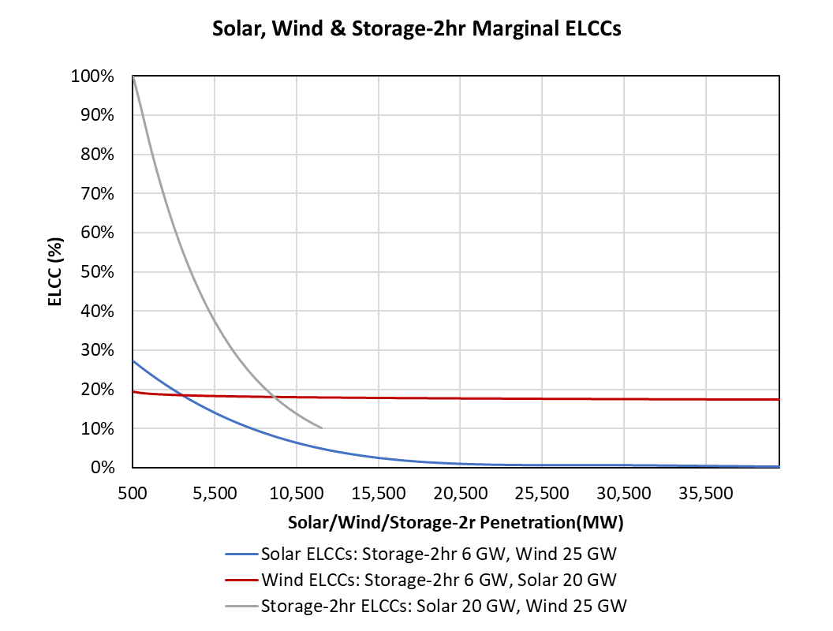
Winter Marginal ELCCs

Slide 32
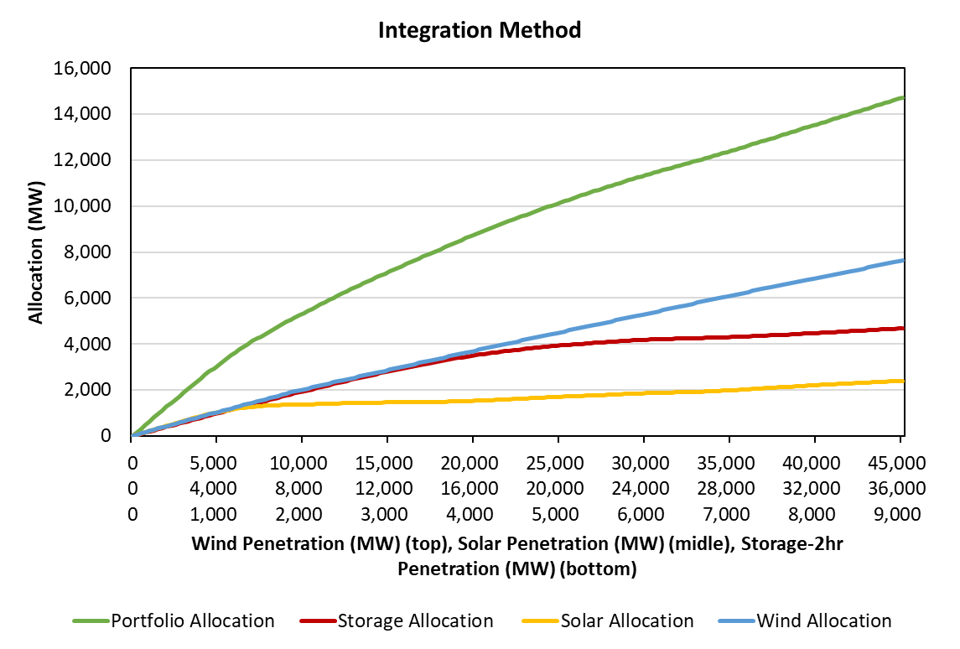
Winter Resource Level Allocation - Integration Method
Integration method calculations for distinct portfolios in 500 MW steps
Calculating contribution for each incremental addition for each portfolio produces more intuitive ELCC curves
Resource Class | Installed Capacity (MW) | Delta Allocation (MW) | Integration Allocation (MW)
Solar | 36,000 | 2,482 | 2,396
Storage-2hr | 9,000 | 3,661 | 4,685
Wind | 45,000 | 8,577 | 7,640
Porfolio | 90,000 | 14,721 | 14,721

Slide 33
Technology/Location Specific Results
 | Technology | Summer ELCC (%) | Winter ELCC (%) | 2024 Penetration (MW)
First In | Wind-C | 33.8% | 55.1%
 | Wind-O | 33.8% | 23.4%
 | Wind-P | 33.5% | 20.7%
 | Solar Non-West | 68.3% | 24.6%
 | Solar West | 75.6% | 20.7%
 | Solar Tracking | 72.3% | 23.5%
 | Solar DGPV | 43.2% | 17.2%
Last In | Wind-C | 21.8% | 49.1% | 5,900
 | Wind-O | 14.9% | 12.6% | 29,233
 | Wind-P | 21.8% | 13.9% | 4,903
 | Solar Non-West | 3.5% | 0.0% | 20,856
 | Solar West | 8.7% | 0.0% | 14,095
 | Solar Tracking | 6.1% | 0.0%
 | Solar DGPV | 2.3% | 0.0%

Slide 34
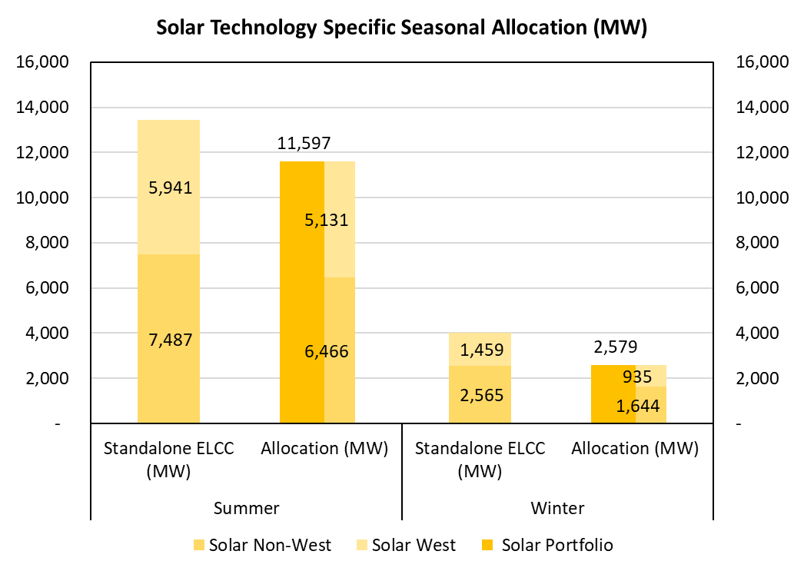
Solar Technology Allocation by Season

Slide 35
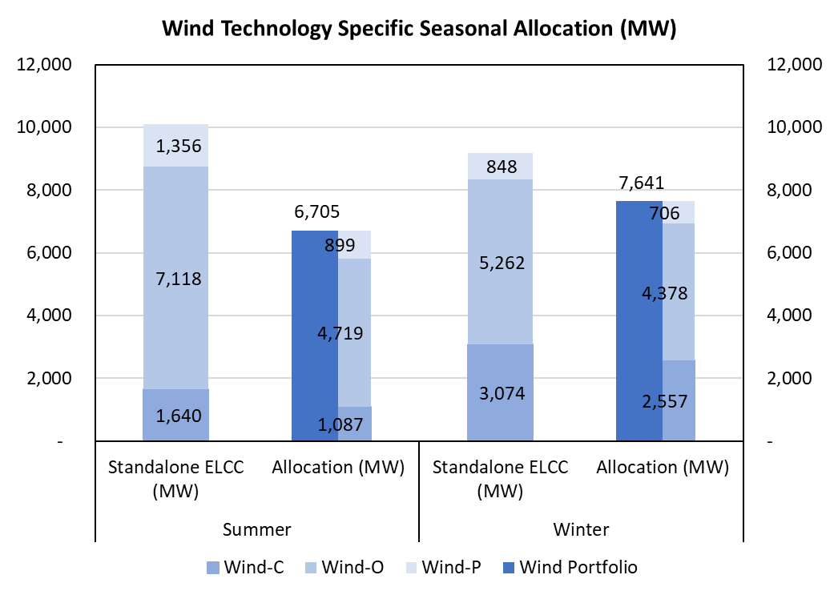
Wind Technology Allocation by Season

Slide 36
Resource ELCC by Technology Type (2024 Summer Portfolio)
Technology | Installed Capacity (MW) [A] | Summer Allocation (MW) [B]
Wind | 40,036 | 6,705
Solar | 34,951 | 11,597
Storage-2hr | 7,620 | 5,637
Technology | Installed Capacity (MW) [C] | First In ELCCs (%) [D] | Last In ELCCs (%) [E] | Average First & Last In ELCCs (%) [F]=([D]+[E])/2 | Standalone Average ELCC (MW) [G]=[C]*[F] | Summer Allocation (MW) [H]** | Summer Allocation (%) [I]=([H]/[C])
Wind-C | 5,900 | 33.8% | 21.80% | 27.80% | 1,640 | 1,087 | 18.43%
Wind-O | 29,233 | 33.8% | 14.90% | 24.35% | 7,118 | 4,719 | 16.14%
Wind-P | 4,903 | 33.5% | 21.80% | 27.65% | 1,356 | 899 | 18.33%
Solar Non-West | 20,856 | 68.30% | 3.50% | 35.90% | 7,487 | 6,466 | 31.00%
Solar West | 14,095 | 75.60% | 8.70% | 42.15% | 5,941 | 5,131 | 36.40%
**$\left[H\right]=\frac{{[G]}_{Wind or Solar Subclass}}{\sum{{[G]}_{All Technologies within Wind or Solar Category }}}∗[B]$

Slide 37
Resource ELCC by Technology Type (2024 Winter Portfolio)
Technology | Installed Capacity (MW) [A] | Winter Allocation (MW) [B]
Wind | 40,036 | 7,641
Solar | 34,951 | 2,579
Storage-2hr | 7,620 | 3,264
Technology | Installed Capacity (MW) [C] | First In ELCCs (%) [D] | Last In ELCCs (%) [E] | Average First & Last In ELCCs (%) [F]=([D]+[E])/2 | Standalone Average ELCC (MW) [G]=[C]*[F] | Winter Allocation (MW) [H]** | Winter Allocation (%) [I]=([H]/[C])
Wind-C | 5,900 | 55.10% | 49.10% | 51.55% | 3,074 | 2,557 | 43.35%
Wind-O | 29,233 | 23.40% | 12.60% | 10.00% | 5,262 | 4,378 | 14.98%
Wind-P | 4,903 | 20.70% | 13.90% | 8.80% | 848 | 706 | 14.39%
Solar Non-West | 20,856 | 24.60% | 0.00% | 12.30% | 2,565 | 1,644 | 7.88%
Solar West | 14,095 | 20.70% | 0.00% | 10.35% | 1,459 | 935 | 6.63%
**$\left[H\right]=\frac{{[G]}_{Wind or Solar Subclass}}{\sum{{[G]}_{All Technologies within Wind or Solar Category }}}∗[B]$

Slide 38
Combinations of Battery Technologies (Example)
Technology | Installed Capacity (GW) | Allocation as a Function of Storage Duration (GW)
 |  | All 2HR | All 4HR | 1/2 2HR & 1/2 4HR
Wind | 40 | 8 | 8 | 8
Solar | 20 | 10 | 10.5 | 10.25
Storage | 7 | 5 | 6 | 5.5

Slide 39
Technology/Location Specific ELCCs
Profiles for each technology/location were created by calculating a weighted average of all the county level profiles used in the base case
For first and last in ELCCs, 5,000 MWs of solar and wind (2,000 MWs for battery storage) was added to the system

Slide 40
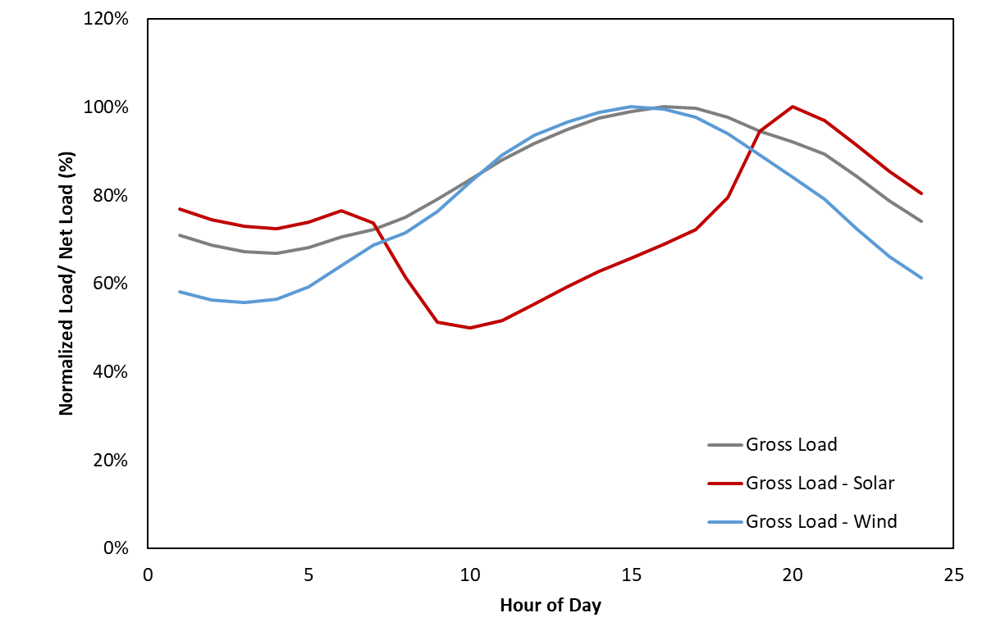
Gross Load & Net Load Comparison

Slide 41
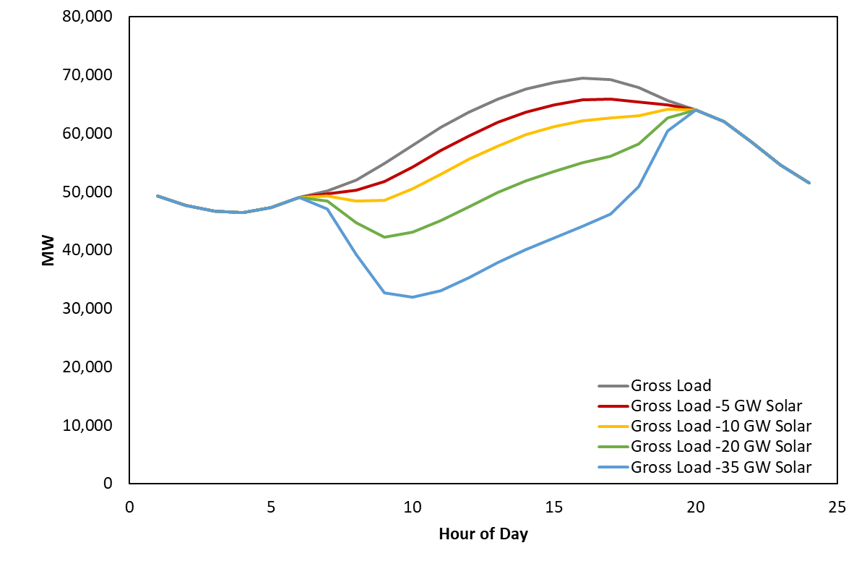
Net Load Shape Change as Solar Penetration Increases

Slide 42
ELCC Study Next Steps
Storage combinations:
Perform interpolations for portfolios of different storage resource mixes
Final Report
Potential ELCC Workshop
CDR:
Capacity contributions towards PRM by technology and zone looking forward in time using CDR and average and marginal seasonal ELCCs
SARA:
Monthly capacity contributions towards PRM using average and marginal seasonal ELCCs

Slide 43
Appendix
Notes:
43

Slide 44
Zonal Load and Resource Mix - 2023
 | ERCOT | DFW | Houston | Rest of System | Valley | West
 | (MW) | (MW) | (MW) | (MW) | (MW) | (MW)
Peak Load | 79,010 | 19,933 | 16,752 | 30,264 | 2,399 | 9,662
Load Reduction | 2,823 | 242 | 740 | 1,207 | 61 | 573
LRs serving RRS | 1,591 | 35 | 418 | 753 | 2 | 383
10-Minute ERS | 35 | 3 | 3 | 28 | 0 | 1
30-Minute ERS | 890 | 135 | 185 | 356 | 55 | 159
TDSP Curtailment Programs | 307 | 70 | 133 | 69 | 4 | 30
Supply | 104,263 | 3,912 | 16,834 | 59,216 | 3,639 | 20,662
Conventional Generation | 61,071 | 3,294 | 12,295 | 41,481 | 777 | 3,035
Hydro | 475 | 3 | 0 | 294 | 26 | 151
Wind | 10,230 | 0 | 0 | 2,478 | 1,684 | 6,260
Solar | 20,708 | 224 | 1,088 | 10,681 | 259 | 8,456
Storage | 6,666 | 391 | 30 | 2,955 | 684 | 2,607
PUNs | 4,262 | 0 | 3,422 | 840 | 0 | 0
Capacity of DC Ties | 850 | 0 | 0 | 488 | 209 | 153
Reserve Margin | 36.9% | -80.1% | 5.1% | 103.8% | 55.6% | 127.3%
*Storage is given a 0% capacity credit in the reserve margin calculation
Note: Energy Efficiency Programs are already removed from the modeled peak load and are not represented in the modeled load reduction programs (ERCOT Aggregate = 3,262 MW in 2023 Study Year)

Slide 45
Zonal Load and Resource Mix - 2026
 | ERCOT | DFW | Houston | Rest of System | Valley | West
 | (MW) | (MW) | (MW) | (MW) | (MW) | (MW)
Peak Load | 82,615 | 20,832 | 17,655 | 31,568 | 2,765 | 9,795
Load Reduction | 2,750 | 231 | 725 | 1,176 | 57 | 561
LRs serving RRS | 1,591 | 35 | 418 | 753 | 2 | 383
10-Minute ERS | 32 | 2 | 3 | 26 | 0 | 1
30-Minute ERS | 820 | 125 | 172 | 328 | 50 | 147
TDSP Curtailment Programs | 307 | 70 | 133 | 69 | 4 | 30
Supply | 115,874 | 4,111 | 16,885 | 65,655 | 4,209 | 25,014
Conventional Generation | 59,726 | 3,294 | 12,305 | 40,446 | 777 | 2,905
Hydro | 475 | 3 | 0 | 294 | 26 | 151
Wind | 10,864 | 0 | 0 | 2,559 | 1,946 | 6,359
Solar | 31,865 | 423 | 1,137 | 17,039 | 566 | 12,700
Storage | 7,832 | 391 | 30 | 3,990 | 684 | 2,737
PUNs | 4,262 | 0 | 3,413 | 840 | 0 | 9
Capacity of DC Ties | 850 | 0 | 0 | 488 | 209 | 153
Reserve Margin | 45.1% | -80.0% | -0.3% | 116.0% | 55.4% | 170.9%
*Storage is given a 0% capacity credit in the reserve margin calculation
Note: Energy Efficiency Programs are already removed from the modeled peak load and are not represented in the modeled load reduction programs (ERCOT Aggregate = 4,517 MW in 2026 Study Year)

Slide 46
ERCOT Resource Mix for ELCC- 2024
Unit Type | Capacity (MW)
4CP | 900
BIOMASS | 163
COAL | 13,568
ERS | 0
GAS-CC | 31,132
GAS-GT | 6,085
GAS-IC | 922
GAS-ST | 10,717
HYDRO | 475
LRs | 1,591
NUCLEAR | 4,973
PBPC | 200
PRD | 1,500
PUNS | 4,262
Reserve Shed | 2,800
SOLAR | 34,951
STORAGE | 7,620
TDSP | 0
WIND-C | 5,900
WIND-O | 29,233
WIND-P | 4,903
Total | 156,563

Slide 47
Overview
Strategic Energy and Risk Valuation Model (SERVM) is a probabilistic multi-area reliability and economic modeling tool, representing:
Demand in ERCOT and external regions
Generation with randomized outages
Demand response of several types with differing availability and emergency or economic triggers
Emergency procedures that ERCOT triggers in shortage conditions
Monte Carlo simulation of 20,500 different annual hourly-sequential simulations at each reserve margin
Primary outputs are reported at each reserve margin, including:
Reliability metrics such as LOLE
Economic costs such as production costs, DR curtailment costs, and emergency intervention costs
Market results including prices and energy margins
41
Weather Years
5
Forecast Error Points
100
Unit Outage Draws
20,500 Simulations per Reserve Margin

Slide 48
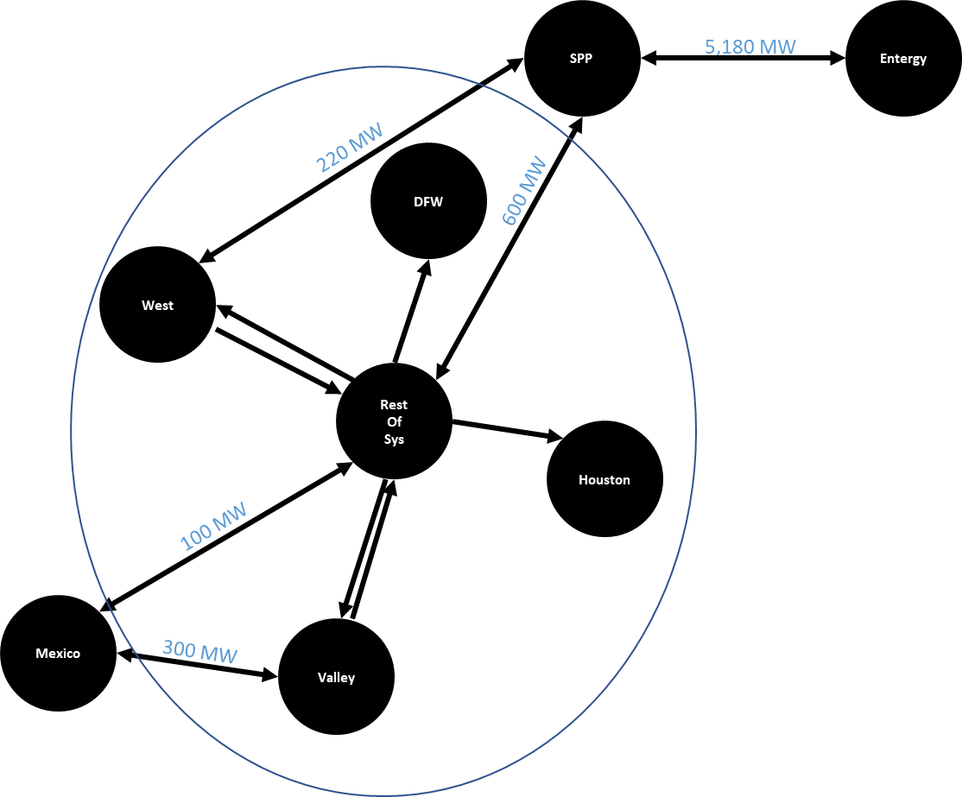
Modeled Interconnection Topology

Slide 49
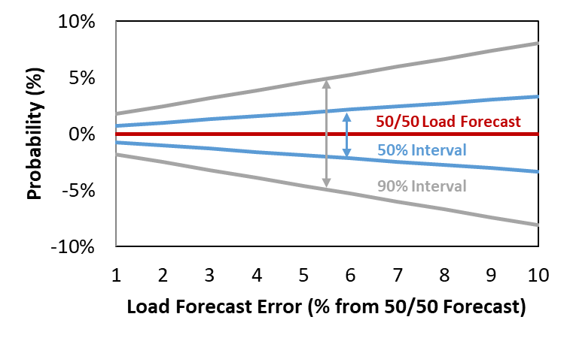
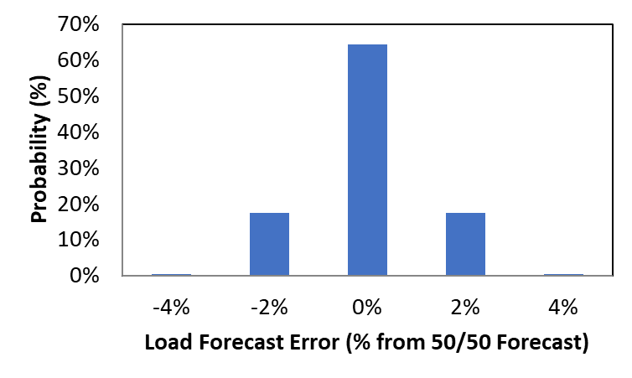
Load Modeling Load Forecast Uncertainty and Forward Period
Non-Weather Forecast Error
With Increasing Forward Period
Non-weather load forecast error increases with forward period:
Assume electric load growth increases at 40% the rate of GDP growth (approximately consistent with ERCOT forecast and national average)
Economic forecast uncertainty increases with forward period, consistent with uncertainty distribution around 28 years of CBO economic forecasts
Modeling approach:
Assume resource decisions and reserve margin must be “locked in” 1 year forward for 2023 (2 for 2024 and 4 for 2026)
1-Year Forward LFE
Discrete LFE Error Points Modeled
Probability by LFE Level by Study Year | ERCOT Fuel Forecast
Study Year | -4% | -2% | 0% | 2% | 4%
2023 | 0.3% | 17.5% | 64.4% | 17.5% | 0.3%
2024 | 2.3% | 23.0% | 49.4% | 23.0% | 2.3%
2026 | 10.2% | 23.4% | 32.8% | 23.4% | 10.2%

Slide 50
Generation Resources Fuel Prices
ERCOT Fuel Forecast | ERCOT Fuel Forecast
Study Year | Coal Fuel Price ($/MMBtu) | Gas Fuel Price ($/MMBtu) | Diesel Fuel Price ($/MMBtu)
2023 | 2.51 | 5.69 | 10.83
2024 | 2.52 | 3.38 | 11.14
2026 | 2.65 | 3.33 | 15.23
NG Price Source for 2024 and 2026 Study Years: https://www.cmegroup.com/markets/energy/natural-gas/natural-gas.quotes.html
NG Price Source for 2023 Study Year: 2022 AEO Reference

Slide 51
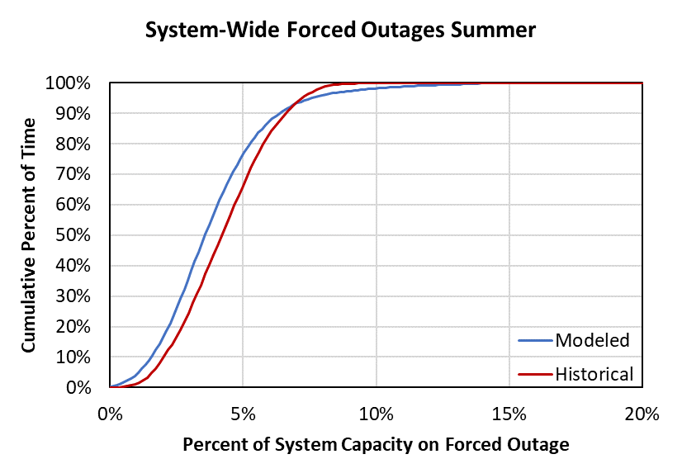
Generation Resources Conventional Generation Outages
Model individual unit outages stochastically, including:
Full Outages: mean time to fail, mean time to repair
Partial Outages: derate percentage, mean time to fail, mean time to repair
Startup Failure: rate
Maintenance Outages: average outage rate with random occurrence and limited scheduling flexibility
Planned Outages: average outage rate with known occurrence and substantial scheduling flexibility in fleet
Distributions of outage parameters created from:
Historical GADS data provided by ERCOT for most of the fleet (2018-2021 excluding Yuri events)
Units without historical GADS data are linked to units with data by unit class and size
Batteries were modeled with a 5% forced outage rate

Slide 52
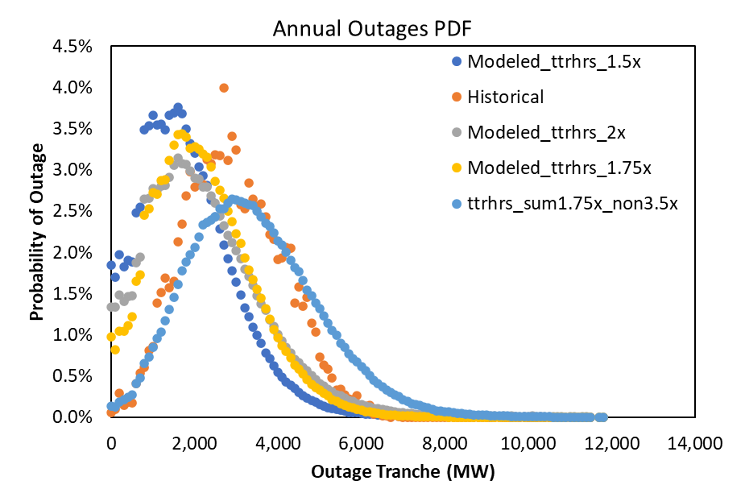
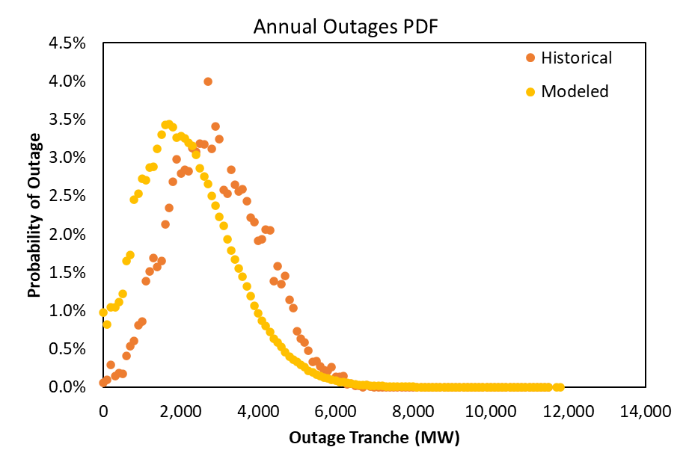
Generation Resources Conventional Generation Outages

Slide 53
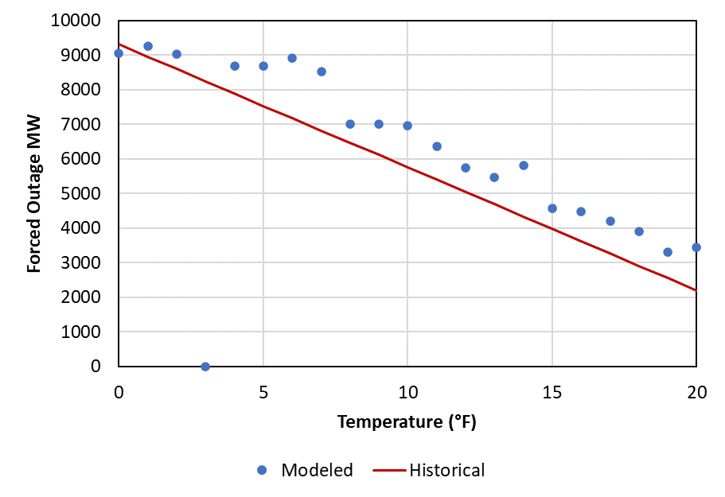
Generation Resources Conventional Generation Outages – Cold Weather
Additional probabilities were modeled for forced outages at temperatures below 20°F
A linear probability was assigned with an hourly incremental forced outage probability of 1.07% at 0°F down to 0% at 20°F leading to an average of ~9,000 total MW being forced offline at 0°F
The impacts of the new weatherization requirements are not being considered in the temperature outage correlation modeling

Slide 54
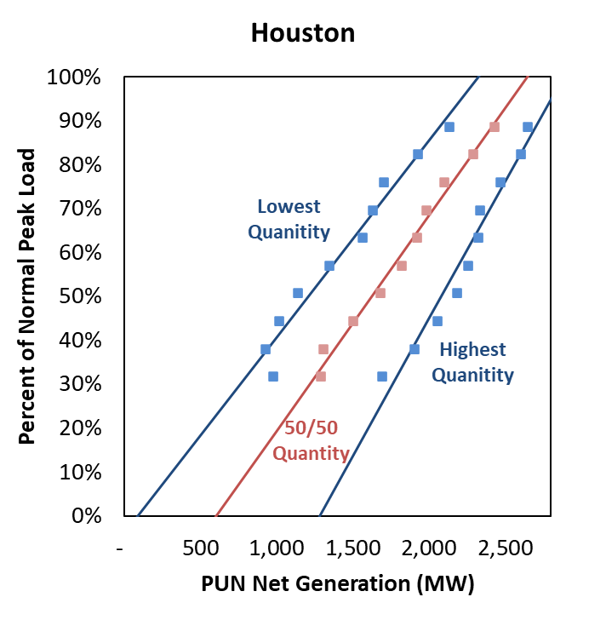
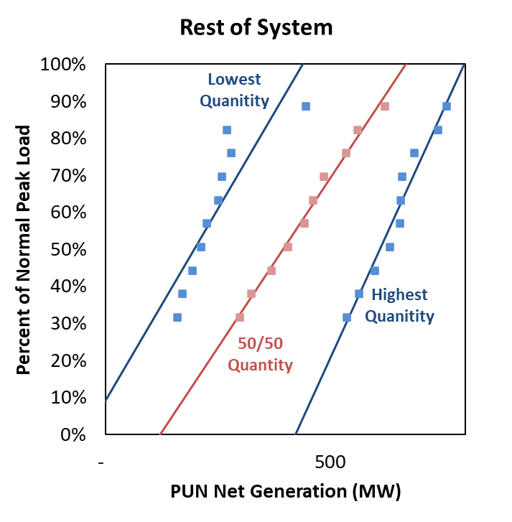
Generation Resources Private Use Networks
Net Gen Supply Curve
Modeled as probabilistic quantity of net output, with 10 different possible quantities at any given load level
Expected quantity increases with load level, based on realized net generation levels at normalized load levels in 2019
Houston modeled as a 9 MW generator

Slide 55
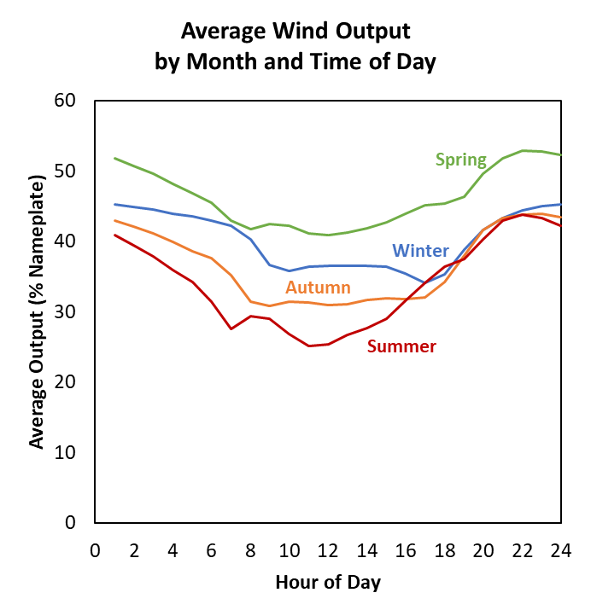
Generation Resources Wind and Solar
Wind
42 years of hourly local wind shapes provided by ERCOT from AWS True Power
Aggregated operational local curves to system-wide
39.3% average capacity factor
30% Wind-P / 57% Wind-C / 20% Wind-O capacity credit (consistent with CDR)
Solar Photovoltaic
42 years of hourly solar county-specific shapes provided by ERCOT
Aggregated operational local curves to system-wide
26.0% average capacity factor
81% capacity credit (consistent with CDR)
Sources and Notes:
Weighted average of 42 years’ hourly wind profiles provided by ERCOT

Slide 56
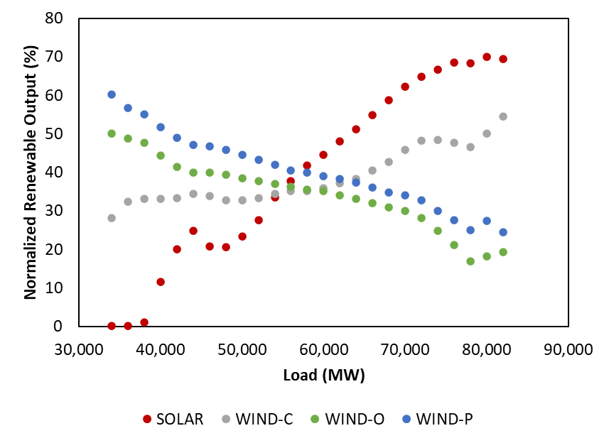
Generation Resources Wind and Solar

Slide 57
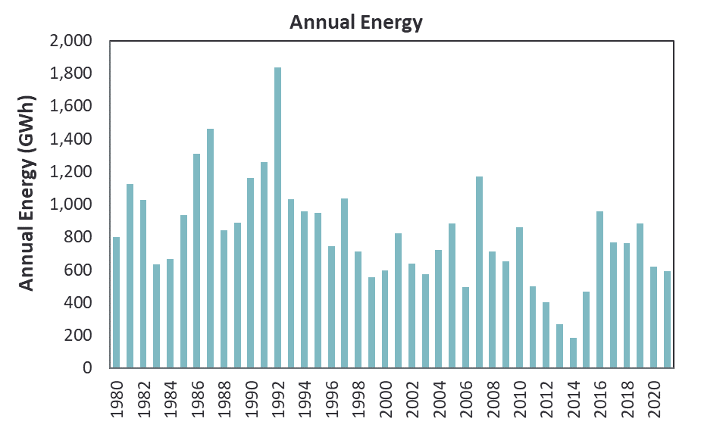
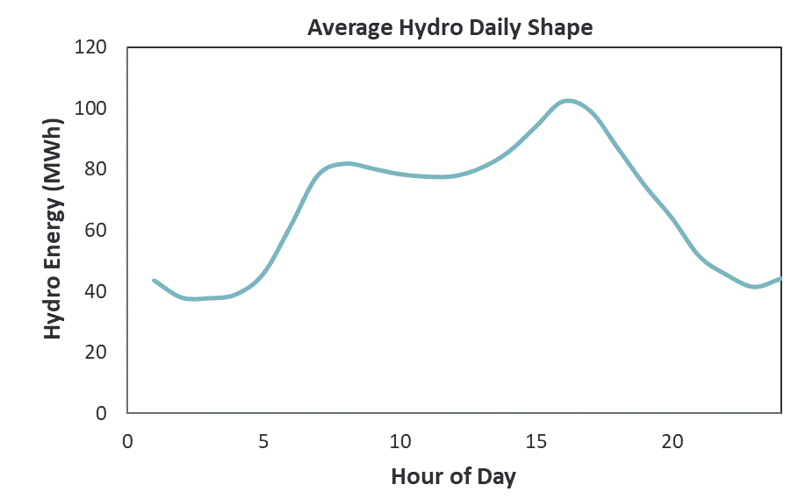
Generation Resources Hydroelectric
557.4 MW nameplate
Characterized resources based on:
8 years of hourly data from ERCOT
41 years of monthly data from EIA 923
Hydro resources modeled with different parameters each month:
Monthly total energy output
Daily maximum output
Daily minimum output
Monthly maximum output
Energy is primarily scheduled to shave peak loads consistent with historical operations
Unscheduled hydro capacity (monthly capacity minus output) counts toward RRS and ORDC x-axis

Slide 58
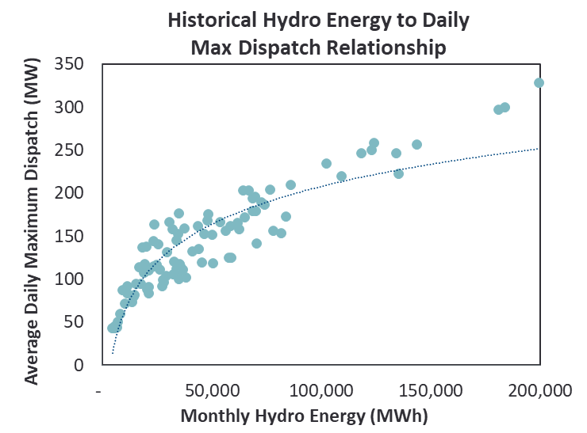
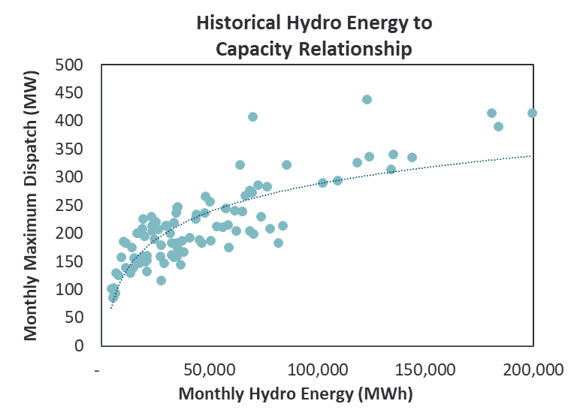
Generation Resources Hydroelectric, continued
Historical Hydro Energy to Daily Max Dispatch Relationship
Curve fit equation used to determine input for each month into SERVM for daily maximum output
Similar curve developed for daily minimum dispatch
Historical Hydro Energy to Capacity Relationship
Curve fit equation used to determine maximum capacity for each month
Emergency capacity of 49.25 MW modeled for drought conditions and 116.15 MW modeled for all other months

Slide 59
Generation Resources Storage
The following assumptions were made for the storage resources:
Economic Commitment and Dispatch
Charges from the Grid
Any Unit Without Provided Charging Capability was Assumed to Have a 1.5 Hour Storage Capability (Assumed to be all 2 Hour for the ELCC Study)
85% Round Trip Efficiency
5% Outage Rate

Slide 60
Generation Resources Inclusion and Exclusion of Resources
In general, we use the 2022 May CDR (2022 LTRA for 2026 source) as the authoritative source, but use the following assumptions for including certain resource types:
Switchable Units: include as internal resources, with the units that are committed off-system excluded from our model
New Units: include starting in the CDR-specified year
Retirements: exclude starting in the CDR-specified year
Permanent Mothballs: exclude from model
Inactive Planned: exclude from model

Slide 61
Demand-Side Resources Cost and Modeling of Demand Resources
Resource Type | Quantity | Modeling Approach | Marginal Curtailment Cost | Adjustments to ERCOT Load Shapes | Reserve Margin Accounting
 | (MW)
TDSP Programs
Energy Efficiency | 3,262 | Not explicitly modeled | n/a | None (ERCOT load shapes already reduced for TDSP EE Programs) | Load reduction
Load Management | 307 | Emergency trigger at EEA Level 1 | $2,543 | None (ERCOT load shapes estimated assuming no LM curtailments) | Load reduction
Emergency Response Services (ERS)
30-Minute ERS | 890 | Emergency trigger at EEA Level 1 | $1,721 | None (ERCOT load shapes estimated assuming no ERS curtailments) | Load reduction
10-Minute ERS | 35 | Emergency trigger at EEA Level 2 | $2,543 |  | Load reduction
Load Resources (LRs)
Non-Controllable LRs | 1,591 | Economically dispatch for RRS (most hours) or energy (few peak hours). Emergency deployment at EEA Level 2 | $2,543 | None (ERCOT load shapes estimated assuming negligible LR curtailments) | Load reduction
 | 0
Controllable LR |  | Currently no controllable LRs modeled in ERCOT | n/a
Voluntary Self-Curtailment
4 CP Reductions | 1,700 | Load shapes grossed up for projected response and corresponding response modeled on the resource side | n/a | None | None. Already excluded from reported peak load
Price-Responsive Demand | Variable | Load shapes explicitly grossed up for expected response. Economic self-curtailment modeled on resource side | $500 - $5,000 /MWh | None | None. Already excluded from reported peak load
Note: The marginal cost of the emergency DR is given by the prices on the dark blue curve corresponding to the reserve levels at the EEAs at which emergency DR is triggered. That assumes the blue curve reflects actual costs (with the red curve shifted right to boost resource adequacy) and that actions are taken at an economically rational point. Prices are set according to the red curve. We observed that modeled prices will tend to cluster around the EEA trigger points on the red curve since a range of net loads and corresponding emergency DR deployments will stay on that shelf.

Slide 62
Demand-Side Resources Emergency Response Service (ERS)
Contract Period | Quantity
 | 10-Min NWS | 30-Min NWS | 30-Min WS | Total
 | (MW) | (MW) | (MW) | (MW)
June - September
TP1: Weekdays HE 6 AM - 9 AM | 47.1 | 991.3 | - | 1,038.4
TP2: Weekdays HE 10 AM - 1 PM | 46.8 | 1,154.3 | - | 1,201.1
TP3: Weekdays HE 2 PM - 4 PM | 38.3 | 1,040.1 | 41.8 | 1,120.2
TP4: Weekdays HE 5 PM - 7 PM | 35.3 | 847.9 | 41.8 | 925.0
TP5: Weekdays HE 8 PM - 10 PM | 42.4 | 985.7 | - | 1,028.2
TP6: Weekend and Holidays HE 6 AM - 9 AM | 45.8 | 823.4 | - | 869.2
TP7: Weekend and Holidays HE 4 PM - 9 PM | 40.8 | 818.8 | - | 859.6
TP8: All Other Hours | 44.2 | 863.5 | - | 907.6
October - November
TP1: Weekdays HE 6 AM - 9 AM | 105.9 | 1,073.5 | - | 1,179.4
TP2: Weekdays HE 10 AM - 1 PM | 95.1 | 1,032.4 | - | 1,127.5
TP3: Weekdays HE 2 PM - 4 PM | 96.3 | 1,038.0 | - | 1,134.4
TP4: Weekdays HE 5 PM - 7 PM | 107.6 | 1,109.1 | - | 1,216.8
TP5: Weekdays HE 8 PM - 10 PM | 105.6 | 1,089.0 | - | 1,194.6
TP6: Weekend and Holidays HE 6 AM - 9 AM | 103.2 | 956.8 | - | 1,060.0
TP7: Weekend and Holidays HE 4 PM - 9 PM | 105.2 | 971.7 | - | 1,077.0
TP8: All Other Hours | 57.6 | 900.1 | - | 957.8
December - March
TP1: Weekdays HE 6 AM - 9 AM | 97.8 | 994.7 | 5.5 | 1,098.0
TP2: Weekdays HE 10 AM - 1 PM | 98.5 | 1,004.1 | - | 1,102.6
TP3: Weekdays HE 2 PM - 4 PM | 99.8 | 1,010.9 | - | 1,110.7
TP4: Weekdays HE 5 PM - 7 PM | 97.4 | 1,014.2 | 5.5 | 1,117.2
TP5: Weekdays HE 8 PM - 10 PM | 96.7 | 996.5 | 5.5 | 1,098.8
TP6: Weekend and Holidays HE 6 AM - 9 AM | 32.4 | 764.0 | 5.5 | 802.0
TP7: Weekend and Holidays HE 4 PM - 9 PM | 33.8 | 802.6 | - | 836.4
TP8: All Other Hours | 92.2 | 887.8 | - | 979.9
April - May
TP1: Weekdays HE 6 AM - 9 AM | 386.3 | 736.3 | 2.2 | 1,124.7
TP2: Weekdays HE 10 AM - 1 PM | 345.7 | 771.5 | - | 1,117.3
TP3: Weekdays HE 2 PM - 4 PM | 342.5 | 770.6 | 19.9 | 1,133.1
TP4: Weekdays HE 5 PM - 7 PM | 375.4 | 752.5 | 27.7 | 1,155.6
TP5: Weekdays HE 8 PM - 10 PM | 378.1 | 733.9 | 19.9 | 1,132.0
TP6: Weekend and Holidays HE 6 AM - 9 AM | 332.5 | 530.6 | - | 863.1
TP7: Weekend and Holidays HE 4 PM - 9 PM | 327.0 | 536.5 | 22.2 | 885.6
TP8: All Other Hours | 336.5 | 643.3 | - | 979.9
Sources and Notes:
Total available ERS MW for 2024 June-Sept. TP4 provided by ERCOT staff.
ERS 10-min and 30-min MW for other contract periods scaled proportionally to the 2022 May CDR summer quantity
(925 MW), based on availability in 2022.
Assume an 8-hour call limit applies to both product types, resources not callable outside contracted hours.

Slide 63
Demand-Side Resources Non-Controllable Load Resources (LRs)
Non-controllable LR magnitude varies by season and time of day
Dispatched according to emergency operating procedures
Dispatches during EEA 2 events
Available reserves at 1,750 MW when dispatched
Note: CDR quotes 1,591 MW LRS for 2023, 2024, and 2026

Slide 64
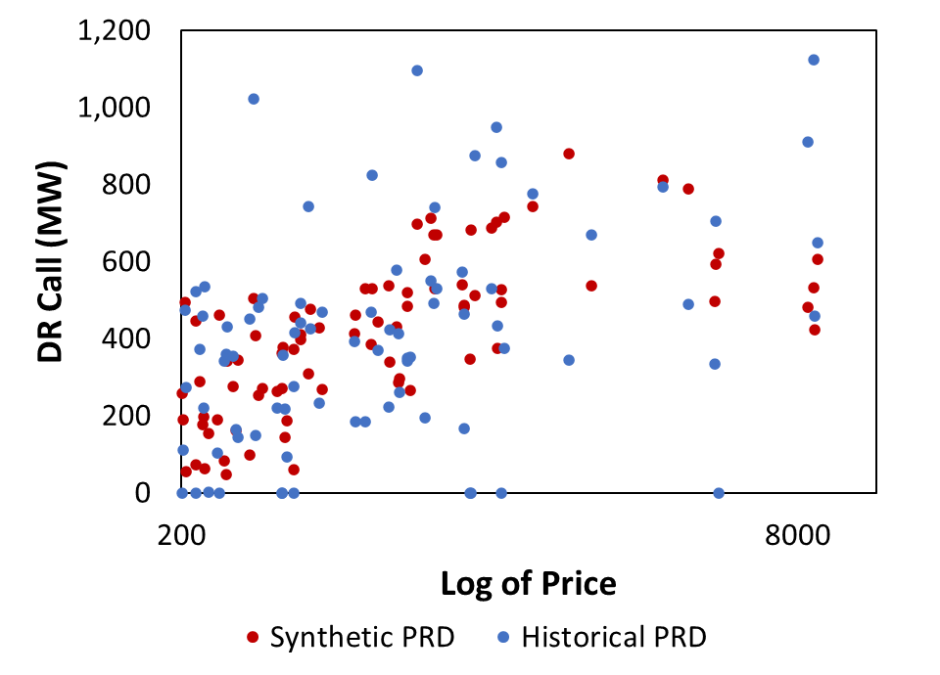
Demand-Side Resources Price-Responsive Demand (PRD)

Slide 65
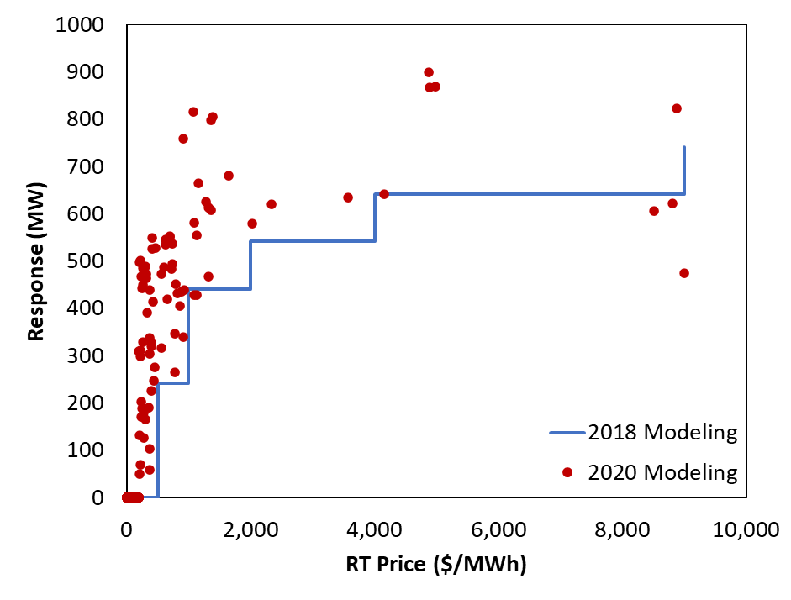
Demand-Side Resources Price-Responsive Demand (PRD)

Slide 66
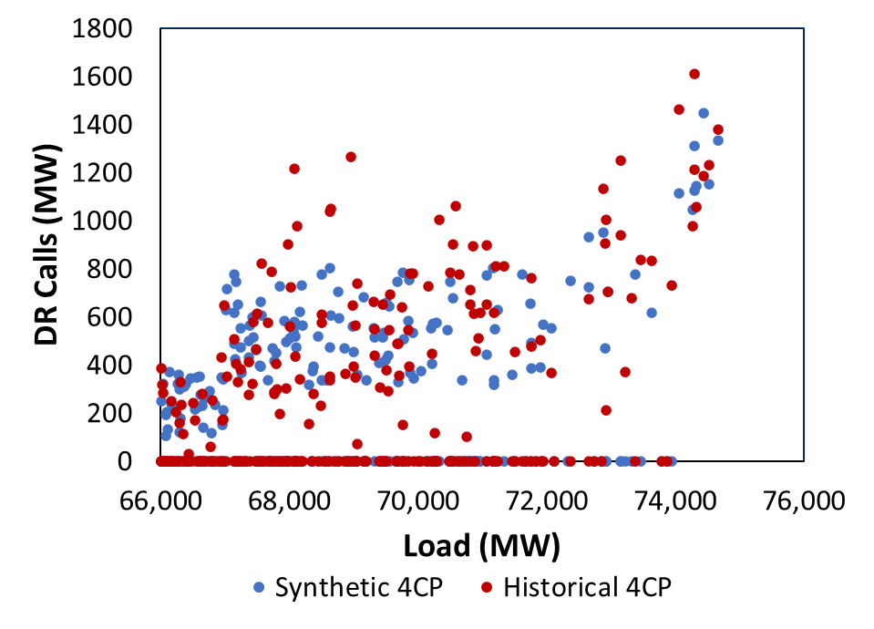
Demand-Side Resources 4CP

Slide 67
System Summary Intertie Availability
We model total intertie capacity in line with ERCOT transmission documents
Intertie availability at summer peak is based on historical availability consistent with the May 2022 CDR
The SPP-Entergy interface availability similarly modeled using a point forecast
Even if transmission is available, ERCOT may not be able to import in emergency if the external region is peaking at the same time
SPP
820 MW
5,180 MW
ERCOT
Entergy
(MISO)
400 MW
Mexico
(Coahuila, Nuevo Leon, & Tamaulipas)
Sources:
ERCOT Ties: http://www.ercot.com/content/wcm/key_documents_lists/90055/ERCOT_DC_Tie_Operations_Document.docx
SPP-Entergy:
www.oasis.oati.com/SWPP/SWPPdocs/Interface_Values.xls

Slide 68
Scarcity Conditions Emergency Procedures and Marginal Costs
Emergency Level | Marginal Resource | Amount of Resource (MW) | Trigger | Price | Marginal System Cost
n/a | Generation | Variable | Price | Approximately $20 - $250 | Same
n/a | Imports | Variable | Price | Approximately $20-$250 Up to $1,000 during load shed | Same
n/a | Non-Spin Shortage | 1,500 | ORDC x-axis = 3,000 MW | $5,000 (from ORDC)* | $1,313*
n/a | Price-Responsive Demand | Variable | Price | $500 - $5,000 | Same
n/a | PBPC | 200 | Price | $1,000 - $5,000 | Same
EEA 1 | 30-Minute ERS | 890** | Spin ORDC x-axis = 2,300 MW | $5,000 (from ORDC) | $1,721
EEA1 | Spin Shortage A | 550 | Spin ORDC x-axis = 2,300 MW | $5,000 (from ORDC)* | $2,079*
EEA 2 | TDSP Load Curtailments | 307 | Spin ORDC x-axis = 1,750 MW | $5,000 (from ORDC) | $2,543
EEA 2 | Load Resources in RRS | 1,591*** | Spin ORDC x-axis = 1,750 MW | $5,000 (from ORDC) | $2,543
EEA 2 | 10-Minute ERS | 35** | Spin ORDC x-axis = 1,750 MW | $5,000 (from ORDC) | $2,543
EEA3 | Spin Shortage B | 750 | Spin ORDC x-axis =1,750 MW | $5,000 (from ORDC)* | $3,115*
EEA 3 | Load Shed | Variable | Spin ORDC x-axis = 1,000 MW | VOLL = $5,000 | Same
*: Price reflects the average price between the upper and lower level of each resource
**: 35 10NWS + 848 30NWS + 42 30WS = 925 total ERS (May 2022 CDR Value for 2023). Both NWS and WS are included in the 30-Minute ERS
***: 60% of RRS

Slide 69
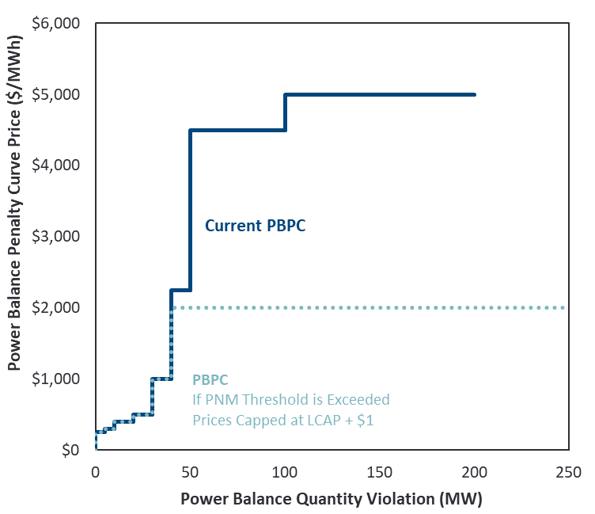
Scarcity Conditions Power Balance Penalty Curve
Implementation
Using PBPC curve as currently set by ERCOT; no expectation for the curve to change in upcoming years.
Treat as a Reg Up shortage when called (can set price)
Incur marginal system cost equal prices implied by PBPC
Model only first 200 MW
Highest price capped at LCAP + $1 if Peaker Net Margin (PNM) threshold is exceeded
Note: Since we model PBPC as a 200 MW resource (when none exists), we need to recognize that dispatching the PBPC depletes actual regulation reserves more than our accounting implies. So the model has to shed load at 1,200 MW apparent reserves instead of 1,000. And the x-axis for determining ORDC prices is given by reserves + any PBPC deployment.
Power Balance Penalty Curve
Sources and Notes:
https://www.ercot.com/files/docs/2021/12/14/037OBDRR_01_Power_Balance_Penalty_Updates_to_%20Align_with_PUCT_Approved_High_System_Wide_Offer_Ca.docx

Slide 70
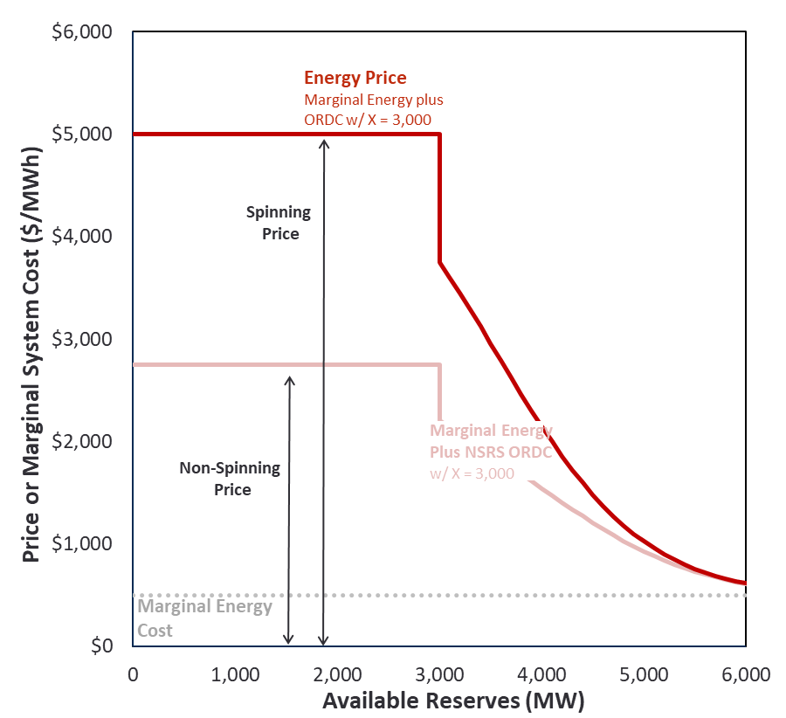
Scarcity Conditions Operating Reserve Demand Curve
Implementation
Price-setting based on curve where X = 3,000 MW; marginal system cost assumes load shed at X = 1,000 MW
Simplifications:
Assume PRC, Spin, and ORDC x-axis are all self-consistent
Do not scale ORDC curves each hour, instead calculate as if marginal energy were fixed at the emergency gen dispatch price of $1,721/MWh
Assume non-spin is depleted before spin (i.e., 1-to-1 correspondence between the x-axes of Spin and Non-Spin ORDC curves)
Day-ahead commitment of spin is equal to the minimum of: (a) ERCOT requirement, and (b) reasonable min ORDC spin price of $3/MWh (i.e., allow self-commitment to prevent very high prices during long conditions)
Operating Reserve Demand Curves

Slide 71
Scarcity Conditions Reserve Requirements
Reserves
Day-ahead commitments to meet ERCOT Reg Up, Reg Down, and RRS requirements (NSRS assumed non-binding)
Shortages relative to requirement only occur when insufficient resources exist
Self-Commitments
Also model economic self-commitments if ORDC spin axis price is very high (still refining approach)
Estimate as quantity of online capacity needed to bring total daily ORDC spin payments down to historical RRS price levels in non-peak conditions
SERVM will commit at least this quantity unless insufficient supply exists
Reserves Requirements
Season and Hours of Day | ERCOT Day-Ahead Procurements
 | Regulation Up (MW) | Regulation Down (MW) | RRS 10 min (MW) | NSRS 30 min (MW)
Winter
1-2 and 23-24 | 202 | 311 | 3,042 | 3,486
3-6 | 342 | 252 | 3,028 | 3,519
7-10 | 435 | 398 | 2,937 | 3,997
11-14 | 375 | 428 | 2,926 | 3,882
15-18 | 528 | 350 | 2,939 | 4,601
19-22 | 256 | 324 | 2,939 | 3,926
Spring
1-2 and 23-24 | 230 | 403 | 3,083 | 3,819
3-6 | 296 | 248 | 3,107 | 4,038
7-10 | 431 | 386 | 3,013 | 4,416
11-14 | 486 | 435 | 2,941 | 4,282
15-18 | 487 | 424 | 2,906 | 4,338
19-22 | 404 | 415 | 2,906 | 3,829
Summer
1-2 and 23-24 | 169 | 462 | 2,555 | 3,913
3-6 | 250 | 218 | 2,634 | 3,300
7-10 | 436 | 252 | 2,522 | 4,053
11-14 | 588 | 266 | 2,350 | 4,460
15-18 | 410 | 364 | 2,800 | 3,374
19-22 | 273 | 452 | 2,800 | 3,962
Fall
1-2 and 23-24 | 184 | 367 | 2,964 | 3,528
3-6 | 269 | 212 | 3,006 | 3,034
7-10 | 398 | 300 | 2,856 | 3,753
11-14 | 466 | 356 | 2,768 | 4,165
15-18 | 456 | 344 | 2,845 | 3,989
19-22 | 252 | 399 | 2,861 | 3,742

Slide 72
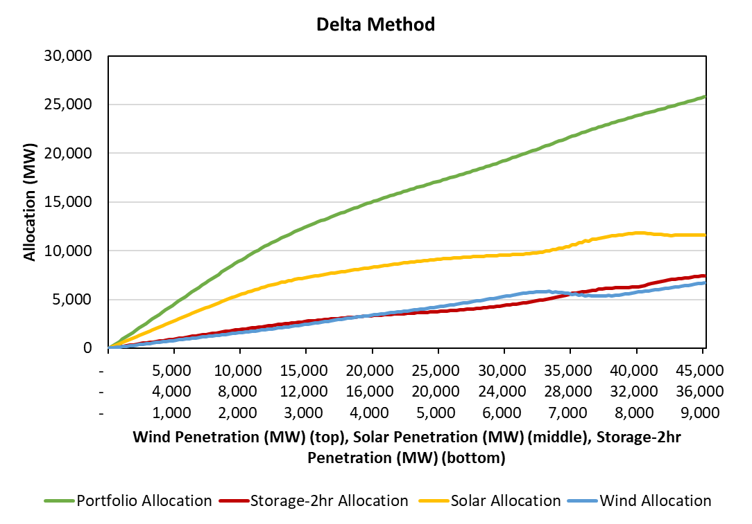
Summer Resource Level Allocation - Delta Method
Delta method calculations for distinct portfolios in 500 MW steps
Only utilizing first-in and last-in ELCC produces unrealistic movement as portfolio grows
Resource Class | Installed Capacity (MW) | Delta Allocation (MW) | Integration Allocation (MW)
Solar | 36,000 | 11,616 | 11,952
Storage -2hr | 9,000 | 7,454 | 6,373
Wind | 45,000 | 6,719 | 7,464
Porfolio | 90,000 | 25,789 | 25,789

Slide 73
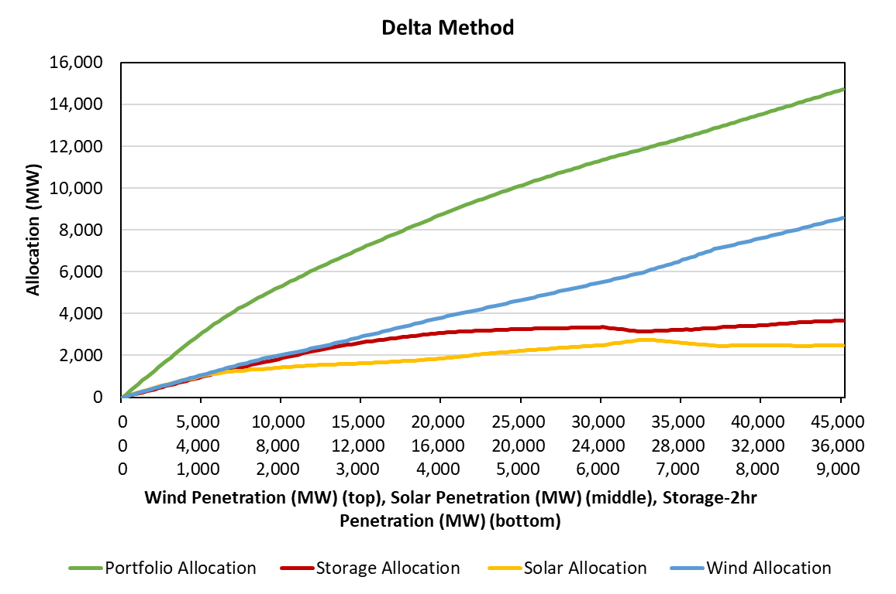
Winter Resource Level Allocation - Delta Method
Delta method calculations for distinct portfolios in 500 MW steps
Only utilizing first-in and last-in ELCC produces unrealistic movement as portfolio grows
Resource Class | Installed Cap (MW) | Delta Allocation | Integration Allocation
Solar | 36,000 | 2,482 | 2,396
Storage-2hr | 9,000 | 3,661 | 4,685
Wind | 45,000 | 8,577 | 7,640
Porfolio | 90,000 | 14,721 | 14,721

Slide 74
Average Load and Solar Daily Shapes during top 5% of Summer Gross Daily Load Peaks

Slide 75
Average Load and Wind Daily Shapes during top 5% of Summer Gross Daily Load Peaks

Slide 76
Average Load and Wind Daily Shapes during top 5% of Winter Gross Daily Load Peaks

Slide 77
Average Load and Wind Daily Shapes during top 5% of Winter Gross Daily Load Peaks

