Slide 1
Communication of Voltage Reduction Deployment
OWG
Freddy Garcia
October 27, 2022

Slide 2
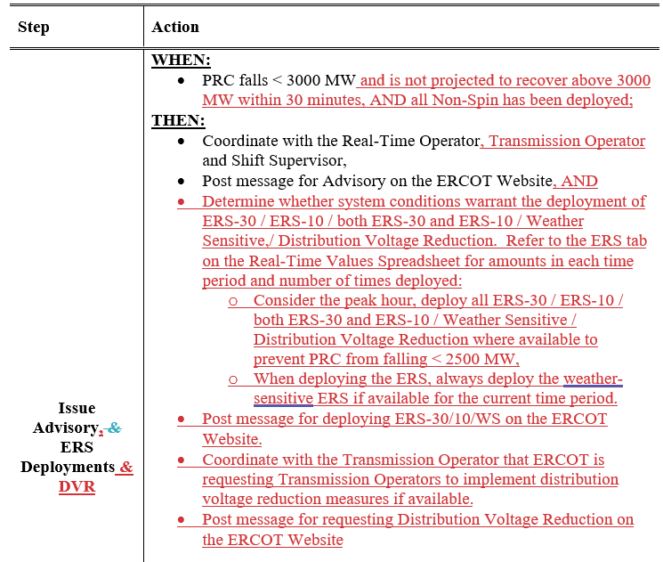
Power Operations Bulletin #1050
Resource Desk Operating Manual
3.3 Notifications for Diminishing Reserves, Deploying Non-Spin and ERS

Slide 3
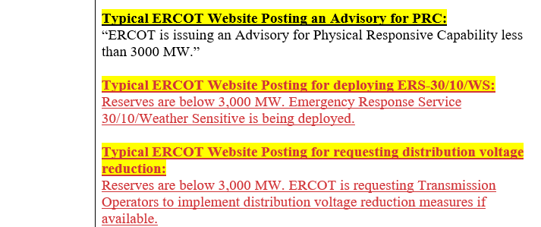
Power Operations Bulletin #1050
Resource Desk Operating Manual
3.3 Notifications for Diminishing Reserves, Deploying Non-Spin and ERS

Slide 4
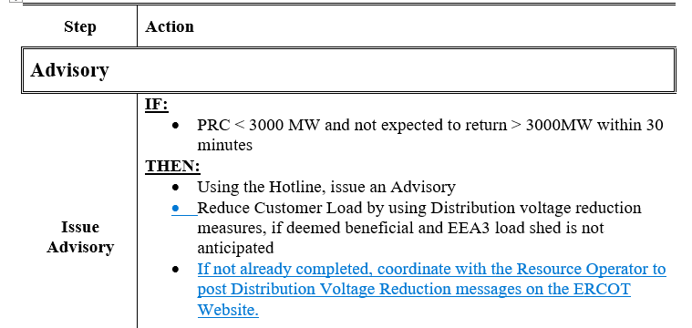
Power Operations Bulletin #1053
Transmission and Security Operating Manual
4.8 Responding to Diminishing Reserves

Slide 5
Power Operations Bulletin #1051
Typical Scripts for QSEs

