Slide 1
Market Credit Working Group update to the Wholesale Market Subcommittee
Brenden Sager, Austin Energy, Chair
Seth Cochran, DC Energy, Vice Chair
2 November 2022

Slide 2
General Update
One NPRR reviewed for credit impacts
NPRR 1146 from Rainbow Energy Marketing Corporation
ERCOT Update on NPRR 1067
Potential Uplift Liability collateral release
Regular update on collateral and exposure

Slide 3
NPRR’s Reviewed
1132 NPRR Communicate Operating Limitations during Cold and Hot Weather Conditions.
Considered operational without credit impacts

Slide 4
NPRR 1146
Example: DC tie transaction importing into ERCOT. URTA Unbilled Real-Time Amount drives credit requirements and when they’re importing power and ERCOT owes them money
EALt = Max [RFAF * Max {RTLE during the previous lrt days}, RTLF] + DFAF * DALE + Max [RTLCNS, Max {URTA during the previous lrt days}] + OUTt
Proposed EALt = Max [RFAF * Max {RTLE during the previous lrt days}, RTLF] + DFAF * DALE + RTLCS + OUTt
Proposal removes Unbilled Real-Time Amount max function
Due to Max functions, RTLF and RTLCNS, which capture recent positive RTM activity, is not taken into account at all. Rather RTLE and URTA, which lag behind by 7 days and have large M1=10 and M2=9 weights, set RTM exposure
Address issue of building collateral obligations when exposure flips from AP to AR in increasing price environment (as occurred during Uri)

Slide 5
NPRR 1146 Developments
Mark Ruane filed comments Sept. 16 but lacked time to present at MCWG. ERCOT does not support NPRR1146.
NPRR 1146 would require QSEs to suspend all RTM activity when the QSE receives notice of suspension from ERCOT. ERCOT notes that this provision requires automation, as there is no system mechanism to temporarily suspend CP’s.
Although an Impact Analysis has not been completed, ERCOT asserts the required system enhancements would bear a substantial cost.
NPRR 1146 eliminates URTA for TAO QSEs. ERCOT does not believe that making credit requirements less conservative for one subset of Counter-Parties is appropriate from an equity perspective.
TAO ability to leverage suspension in lieu of posting required collateral, and not cure collateral requests within two Bank Business Days, would not be available to all Market Participants.
ERCOT will investigate 1146 proposed changes to credit calculations and report back to Credit Working Group
Rainbow Energy Marketing Corporation filed comments on October 13, 2022 to remove the favorable M1 treatment and thus any need to suspend QSE RTM activities

Slide 6
Return of NPRR 1067
NPRR 1067, sponsored by ERCOT, was posted on January 27, 2021. Tabled after Uri.
CWG/MCWG discussions on market entry qualifications began in December 2018, subsequent to the 2018 PJM Greenhat default.
Credit model methodologies to support Unreasonable Credit Risk determinations were reviewed by CWG/MCWG from June 2020 through March 2021.
Note potential interplay with FERC information-sharing NOPR.
ISO/RTO Council supports voluntary credit information sharing
ERCOT is drafting comments to NPRR 1067 to address:
Revise the baseline language to reflect the parts of the proposal that was approved and implemented in NPRR 1073. This includes requirements for QSE/CRRAH applicants with Principals who were Principals of defaulted or terminated Market Participants.
Elimination of unsecured credit, and
Context of Counter-Party suspension.

Slide 7
NPRR 1067 continued
As originally drafted, NPRR 1067 proposed the following:
Background checks for existing and prospective Counter-Parties,
Fee to fund background check processes,
Authorizes ERCOT to review Counter-Parties to determine whether they pose an Unreasonable Credit Risk, as defined, to ERCOT,
Authorizes ERCOT to suspend a QSE or CRRAH if it poses an Unreasonable Credit Risk,
Authorizes ERCOT to terminate a Counter-Party if it is deemed an Unreasonable Credit Risk that cannot be remedied,
Formalizes processes for ERCOT assessment of creditworthiness,
Enables a credit scoring process to provide a consistent framework for review of creditworthiness, and
Provides a means for ERCOT to adjust the Unsecured Credit Limits and/or TPE to ensure that they adequately reflect financial risk created by a Counter-Party.

Slide 8
Potential Uplift Liability collateral release
ERCOT indicated PUL invoice amounts being held for the Brazos short-pay will be released upon the Effective Date of the bankruptcy plan

Slide 9
Monthly Highlights Aug 2022 – Sept 2022
Market-wide average TPE decreased from $2,726.6 million in August to $1,611.8 million in September.
TPE decreased mainly due to lower RT and DA Settlement Point prices as well as lower RT & DA adjustment factors
Discretionary Collateral is defined as Secured Collateral in excess of TPE,CRR Locked ACL and DAM Exposure
Average Discretionary Collateral was relatively flat at $3.252.4 million in September vs. $3,222.5 million in August
No unusual collateral call activity

Slide 10
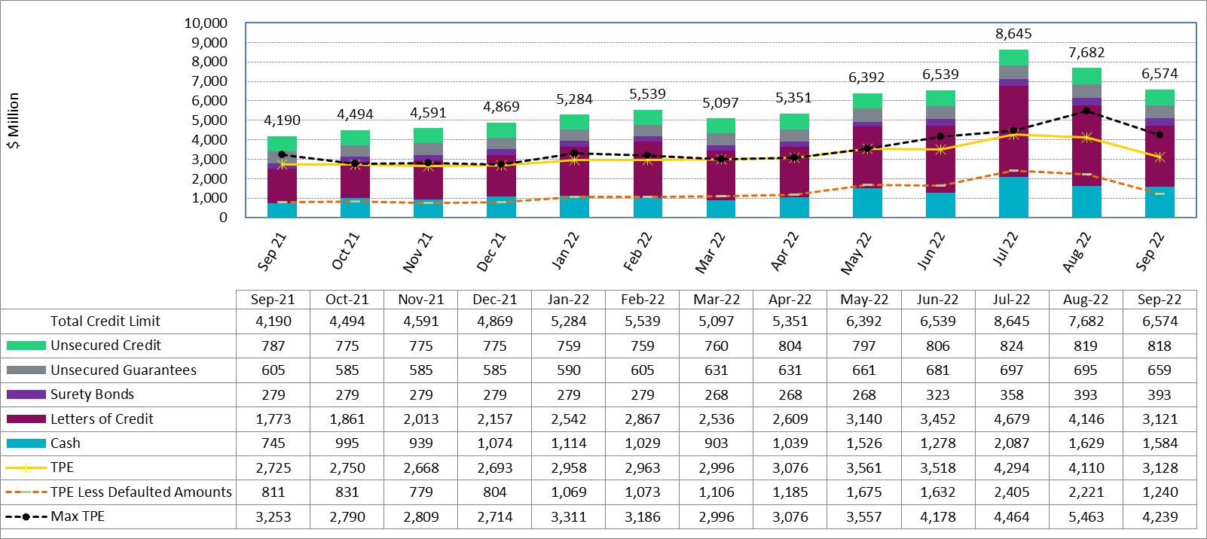
Available Credit by Type Compared to Total Potential Exposure (TPE) Sep 2021- Sep 2022

Slide 11
Discretionary Collateral Aug 2022 - Sept 2022

Slide 12
Questions?

