Slide 1
High Level Discussion on Participating in SCED
From a Load Resource Perspective
ERCOT Staff
LFLTF
October 24, 2022

Slide 2

Energy Market Overview
Market participants bring generation on-line and make resources available; ERCOT may start additional generation if needed to maintain reliability.
Market participants submit offers and bids for resource output/consumption.
ERCOT clears the market every five
minutes, using the lowest cost supply to exactly meet demand, subject to transmission constraints.
Prices received by resources signal the level of output/consumption needed from resources in that area at that time.
In general, this process helps power the ERCOT region in the lowest cost way without overloading the transmission system.
$2.54
$86.46
Prices

Slide 3




Security-Constrained Economic Dispatch (SCED)
Offers and Bids
Telemetry
Real-Time Dispatch
Pricing
SCED
Real-Time Network Security Analysis
Constraints
& Shift Factors
Network
Operations
Model
Dispatch Instructions
Contingencies

Slide 4
Controllable Load Resources (CLRs)
A CLR is a specific sub-type of Load Resource that is able control, reduce or increase, consumption under dispatch control by ERCOT, specifically through SCED.
  These reductions or increases are limited by the Maximum and Low Power Consumption (MPC and LPC) values as well as ramp rate information provided to ERCOT.
  The speed in which consumption changes are instructed will also depend on speed in which other Resources can ramp, e.g., Generation Resources.
This allows the CLR to participate directly in price formation.
  The CLR may actually set the price and be dispatched by SCED accordingly, as opposed to trying to chase prices after the publishing occurs. This type of participation mitigates the potential for price oscillations and frequency concerns for ERCOT.
The participation in SCED and higher level of controllability removes limitations for participation in the Ancillary Service market that exist for other types of Load Resources.
  CLRs are dispatched and provide Ancillary Services in a very similar way as Generation Resources and have similar requirements.
  Other Load may have to participate in a more limited way or cannot participate at all.
All Resources, including CLRs, are represented by a Qualified Scheduling Entity (QSE) who transacts with ERCOT and provides Resource information on behalf of the Resource.
  This includes Ancillary Service Offers in the Day-Ahead Market, bids to buy energy for use by SCED, and the Real-Time information provided about the Resource.

Slide 5
Illustrations of SCED on the Aggregate
Demand and prices are relatively low
CLRs have not been instructed to reduce consumption
Supply and demand are balanced
Dispatch limitations for supply
Demand is largely inelastic
Demand
Price ($/MWh)
Supply
CLRs
Price for electricity
Quantity (MW)

Slide 6
Illustrations of SCED on the Aggregate
Demand and prices increase
Some CLR capacity has been dispatched and CLRs are setting price
Supply and demand are balanced
Dispatch limitations for supply
Demand
Price ($/MWh)
Price for electricity
Supply
CLRs
Quantity (MW)

Slide 7
Illustrations of SCED on the Aggregate
Demand and prices increase even further
All CLR capacity has been dispatched
Supply and demand are balanced
Dispatch limitations for supply
Price for electricity
Demand
Price ($/MWh)
Supply
CLRs
Quantity (MW)

Slide 8
Illustrations of SCED on the Aggregate
Demand increases and supply is unable to keep up
Prices are high and set based on penalty pricing
All CLR capacity has been dispatched
Supply and demand are not in balance and there are reliability concerns
Dispatch limitations for supply
Price for electricity based on penalty pricing
Demand
Price ($/MWh)
Supply
CLRs
Quantity (MW)

Slide 9
Illustrations of SCED on the Aggregate
Demand decreases significantly and supply is unable to keep up
Prices are low and set based on penalty pricing
CLRs are instructed to increase consumption back to normal levels
Supply and demand are not in balance and there are reliability concerns
Dispatch limitations for supply
Price for electricity based on penalty pricing
Demand
Price ($/MWh)
Supply
CLRs
Quantity (MW)

Slide 10
Inputs from Controllable Load Resources (CLRs) used for SCED
SCED establishes Base Points (BPs) using telemetered data from Resources and their Offer/Bid curves. The figures below illustrate how the Resource Limit Calculator (RLC) determines the Resource limits for Load Resources.
Telemetry from CLRs
- Telemetered MPC
MPC = Max Power Consumption
$/MWh
Reg Down
Responsibility
- HASL
HASL = High Ancillary Service Limit
- HDL
HDL = High Dispatch Limit
Bid Curve Load
Current Consumption
NPC = Net Power Consumption
Telemetered
Ramp Rate
- LDL
LDL = Low Dispatch Limit
Quantity
LPC
MPC
- LASL
LASL = Low Ancillary Service Limit
Reg Up, RRS, Non-Spin
Responsibility
- Telemetered LPC
LPC = Low Power Consumption
- 0 MW

Slide 11
Examples of CLR Dispatch through SCED
Bid price not reached, CLR continues to consume as normal at it’s MPC level. Supply is dispatched to exactly meet demand, including the CLR consumption.

Slide 12
Examples of CLR Dispatch through SCED
Bid price reached, CLR is marginal (sets price) for an interval and is dispatched between LPC and MPC. Supply is dispatched to exactly meet demand and reduced CLR consumption is accounted for.

Slide 13
Examples of CLR Dispatch through SCED
Bid price is exceeded, CLR is dispatched down to LPC. Supply is dispatched to exactly meet demand and reduced CLR consumption is accounted for.

Slide 14
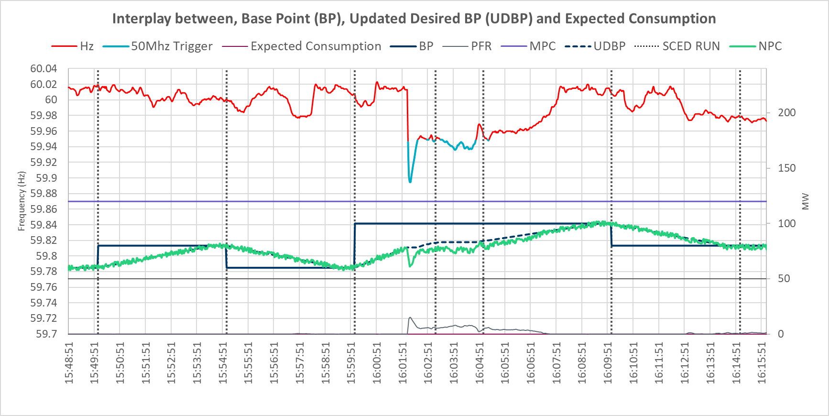
Expectations when ramping to a BP from a CLR perspective
Following SCED execution, Load Frequency Control (LFC) sends an Updated Desired Base Point (UDBP) value every 4seconds that smoothly ramps the CLR from its previous BP to current BP.
  At any instance, the consumption level a CLR is expected to be operating is computed as
  Expected Consumption = UDBP + Primary Frequency Response (PFR) + Regulation Instruction
NP 6.5.7.6.1 (9) LFC’s UDBP “freezes” when frequency deviation is greater than 50mHz and ramping direction will hurt frequency.
LFC’s UDBP ramps from previous BP to current BP over a 4min period.
NP 6.5.7.6.1 (4) LFC sends UDBP every 4s.
NP 8.1.1.4.1 (4) Expected Consumption = UDBP - PFR - Regulation Instruction

Slide 15
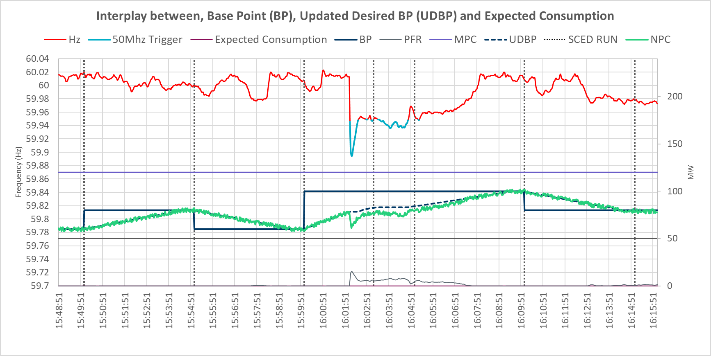

CLR Energy Deployment Performance Measurement
CLR’s Energy Deployment Performance criteria and performance targets are described in Nodal Protocol (NP) Section 8.1.1.4.1(4)
  $\text{CLREPD}\text{ (\%)}=ABS[(\frac{\text{(}\text{Average} \text{Telemetered} \text{Power} \text{Consumption}\text{ (}\text{ATPC}\text{) + }\text{Average} \text{expected} \text{PFR}\text{ (}\text{AEPFR}\text{))}}{\text{(}\text{Average} \text{Base} \text{Point}\text{ (}\text{ABP}\text{) – }\text{Average} \text{Regulation} \text{Instruction}\text{ (}\text{ARI}\text{))}}$ ) – 1]*100
  CLREDP (MW) = ABS(Average Telemetered Power Consumption (ATPC) – (Average Base Point (ABP) –
  Average expected PFR (AEPFR) – Average Regulation Instruction (ARI)))
#1
Interval #3
#8
Interval #2
Interval #4
Interval #6
Interval #7
Notes:
Report:
CLREDP Acceptable Performance Criteria and PRC Variables
https://mis.ercot.com/secure/data-products/services?id=NP8-114-M
CLREDP | 8.1.1.4.1(9) | X(%)=25 | Y(MW) = 2
CLREDP with Ancillary Service Responsibility | 8.1.1.4.1(9) | X(%) = 15 | Y(MW) = 2

Slide 16
Example if Load is not a CLR
Load can respond to prices but does not participate in price formation or receive an instruction from ERCOT. SCED attempts to match supply and demand but reduced load consumption is not accounted for. If this participation is observed at a significant scale, it will most likely create reliability concerns and market oscillations.

Slide 17
Comparison to other Load Resources
Load Resources that are not CLRs are not able to follow 5-minute dispatch signals and are typically controlled through an under-frequency relay.
They do not receive dispatch instructions from ERCOT through SCED and do not actively participate in price formation i.e., they are only able to respond to price passively, after the price has been determined.
With the lower level of controllability and not being dispatched by SCED, these Resources have limitations on the amount of Ancillary Services that they can provided in aggregate.
Because they are not dispatched through SCED, Load Resources that are not CLRs that are providing Ancillary Services are given manual instruction to deploy by ERCOT Operators.
  The Load will not necessarily have control over the price point at which this occurs

