Slide 1
LFLTF: Operations Requirements
Jeff Billo
Operations Planning
October 24, 2022

Slide 2
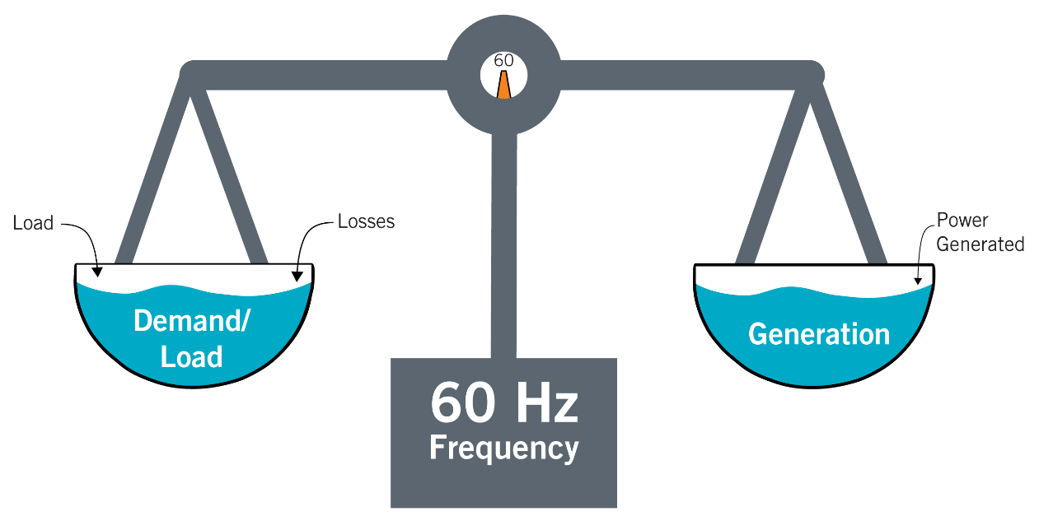
Power Supply (Generation) Must Match Load (Demand)
A fundamental concept behind ERCOT operations is that generation has to match load at all times
A 1 MW reduction in load has the same effect on the grid as a 1 MW increase in generation.

Slide 3
Ancillary Services
Load and generation are constantly changing, due to:
Daily load patterns
Instantaneous changes in variable generation output
Generators tripping offline
Ancillary Services are procured in the Day-Ahead Market to ensure extra capacity is available to address variability that cannot be covered by the five-minute energy market.
Minimum quantities of each type of ancillary service are reviewed annually and can be increased during the year as required
Ancillary Service Products
Regulation Service (Reg)
Reserved capacity that is deployed every 4 seconds to balance supply and demand and maintain frequency close to 60Hz between 5-minute SCED runs.
Responsive Reserve Service (RRS)
Reserved capacity that is procured to respond to low frequency events typically triggered by generating unit trips.
ERCOT Contingency Reserve Service (ECRS) – in development
Capacity that can be started in 10 minutes to cover forecast errors or ramps and replace deployed reserves.
Non-Spin Reserve Service
Capacity that can be started in 30 minutes to cover forecast errors, forced outages or ramps and replace deployed reserves until additional resources can be committed.

Slide 4
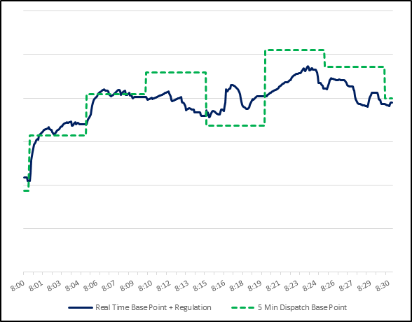
Security Constrained Economic Dispatch (SCED)
SCED produces a Base Point (BP) for resources each 5-minute. However, both load and generation can change minute-by-minute within a SCED time interval, thus requiring Reg resources to be deployed to maintain a balance between demand and supply
Deployment of Reg Resources

Slide 5
Maximum 5-min Change of Load/Wind/Solar (Jan. 1, 2022-Sep. 30, 2022)
The maximum change of net load* within 5 minutes from Jan. 1, 2022 through Sep. 30, 2022 was 1,055 MW (Up) and 1,232 MW (Down)
Max 5-min Change | Load | Wind | Solar | Net load
Up | 791 MW | 808 MW | 752 MW | 1,055 MW
Down | -1,242 MW | -680 MW | -1,020 MW | -1,232 MW
* Net load = Load less wind and solar generation

Slide 6
Regulation Quantities
Month-hour Regulation quantities are calculated on an annual basis
In 2022:
Reg Up ranged from 73 MW to 684 MW
Reg Down ranged from 151 MW to 631 MW
Each year the quantities are adjusted to account for observed net load variability and expected wind and solar generation additions

Slide 7
Frequency Bias
Frequency Bias is the Balancing Authority’s obligation to provide or absorb energy to assist in stabilizing frequency
A common approach is to set frequency bias per the “1% of load method.”¹ Meaning, if load is around 70,000 MW and there were to be a 700 MW imbalance between load and generation and no action was taken*, the frequency would be expected to settle out at 0.1 Hz above or below 60 Hz depending on the direction of the imbalance
Extrapolating this out:
1 NERC Balancing and Frequency Control Technical Document
* In practice, operator action, Ancillary Services, and/or UFLS would work to bring the system back into balance to prevent the system from settling at such a frequency deviation
Imbalance | Frequency Deviation @ 70 GW Load | Frequency Deviation @ 35 GW Load
700 MW | ~0.1 Hz | ~0.2 Hz
3,500 MW | ~0.5 Hz | ~1.0 Hz
5,000 MW | ~0.7 Hz | ~1.4 Hz

Slide 8
Frequency Control

Slide 9
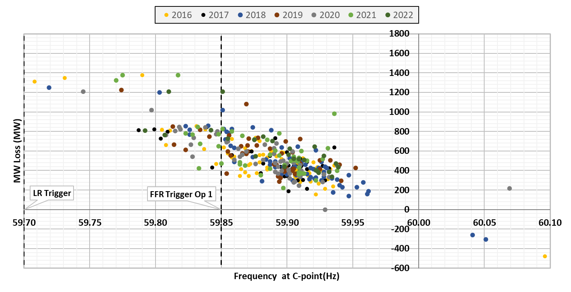
Frequency Events – Historic Trends
* Excludes February 2021

Slide 10
NERC Frequency Control Related Rules
NERC has a series of Standards that enforce frequency control requirements on Balancing Authorities like ERCOT. Some relevant standards are listed below:
BAL-001-2 – Real Power Balancing Control Performance
To control Interconnection frequency within defined limits.
BAL-001-TRE-2 - Primary Frequency Response in the ERCOT Region
To maintain Interconnection steady-state frequency within defined limits.
BAL-002-3 – Disturbance Control Standard – Contingency Reserve for Recovery from a Balancing Contingency Event
To ensure the Balancing Authority balances resources and demand and returns the Balancing Authority's Area Control Error to defined values (subject to applicable limits) following a Reportable Balancing Contingency Event.
BAL-003-2 – Frequency Response and Frequency Bias Setting
To require sufficient Frequency Response from the Balancing Authority (BA) to maintain Interconnection Frequency within predefined bounds by arresting frequency deviations and supporting frequency until the frequency is restored to its scheduled value.
To provide consistent methods for measuring Frequency Response and determining the Frequency Bias Setting.

Slide 11
Putting It All Together
ERCOT maintains frequency close to 60 Hz at all times
ERCOT must follow NERC Reliability Standards regarding frequency control
SCED dispatches generation every 5 minutes to meet forecasted changes in net load
Regulation Up/Down is deployed to maintain frequency between SCED intervals
Regulation quantities are calculated on an annual basis and account for observed net load variation and expected changes in wind and solar generation capacity
Historically, net load changes between 5-minute intervals have typically been below 1,000 MW

Slide 12
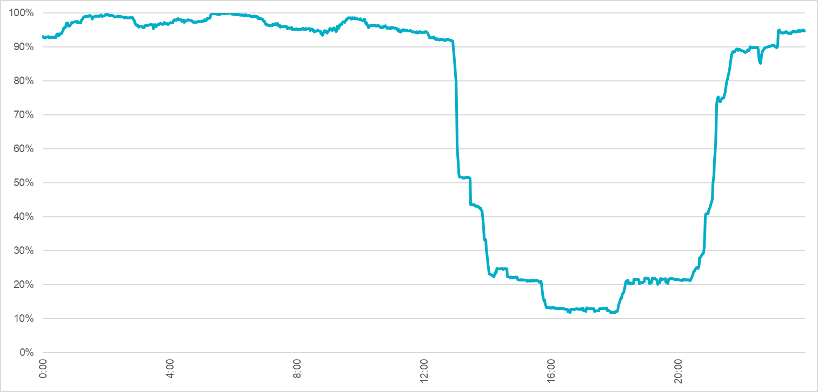
Observations from LFLs’ Summer 2022 Behavior
LFLs (known) not carrying Ancillary Services generally increased/decreased consumption in a similar pattern
The below example illustrates LFL consumption on July 18
Largest 1-min decrease: 11% @ 13:02
Largest 1-min increase: 6% @ 21:11
Largest 5-min decrease: 27% @ 13:05
Largest 5-min increase: 21% @ 21:12
Largest 10-min decrease: 37% @ 13:05
Largest 10-min increase: 30% @ 21:13
*Percentages relative to the maximum aggregate consumption on July 18

Slide 13
LFL Behavior (Jan. 1, 2022-Sep. 30, 2022)
ERCOT has seen large 1-min and 5-min ramp of individual LFLs this year. If not constrained, the magnitude of 1-min and 5-min ramps could increase in proportion to the total capacity of LFLs, which presents a challenge to the frequency control at ERCOT
 | 95th percentile | 99.8th percentile | 100th percentile
1-min change (Up) | 10 MW | 43 MW | 301 MW
1-min change (Down) | -11 MW | -66 MW | -256 MW
5-min change (Up) | 27 MW | 98 MW | 719 MW
5-min change (Down) | -31 MW | -135 MW | -804 MW

Slide 14
Thoughts on Observations from Summer 2022 Behavior
LFLs that are in SCED and have a moderate ramp rate limitation will not cause reliability concerns
i.e. SCED will dispatch resources to meet forecasted net load
Ramp rate requirement should allow 100% change in consumption proportionally over 5-minute interval
If there are thousands of MWs of LFLs that are not in SCED and they exhibit behavior like in the previous graphic, it will lead to sizable generation-load imbalances at times
Diversity in response may help somewhat but will likely not solve the issue
It is likely not practical to just increase Regulation quantities to meet the system needs for these conditions
An LFL ramp rate restriction will be needed to mitigate this concern

Slide 15
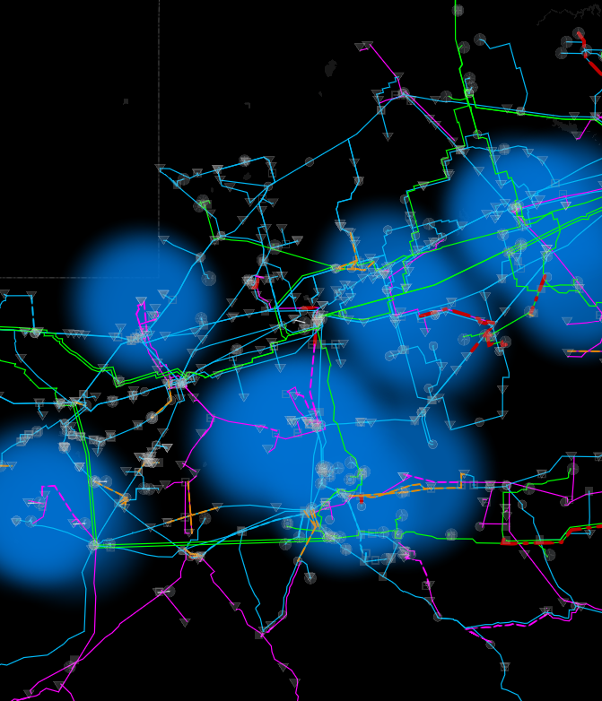
Voltage Ride-Through (VRT)
When there is a fault on the system, voltage at the location of the fault will go to zero volts and voltage in the vicinity of the fault will be depressed
Equipment that is not designed to stay online (“ride-through”) during the depressed voltage can cause or exacerbate reliability problems
Frequency instability
Voltage instability (low or high)
Other issues

Slide 16
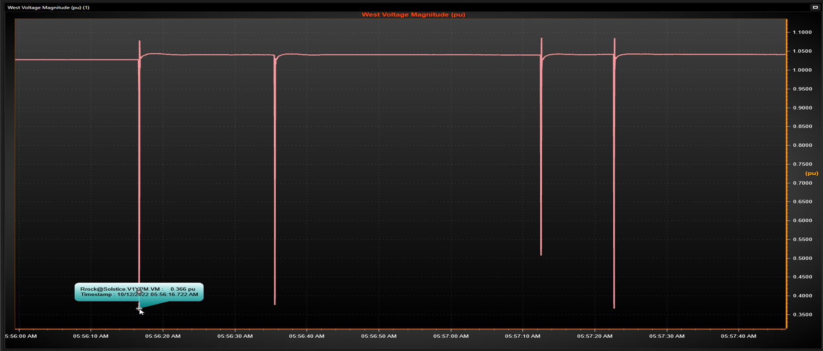
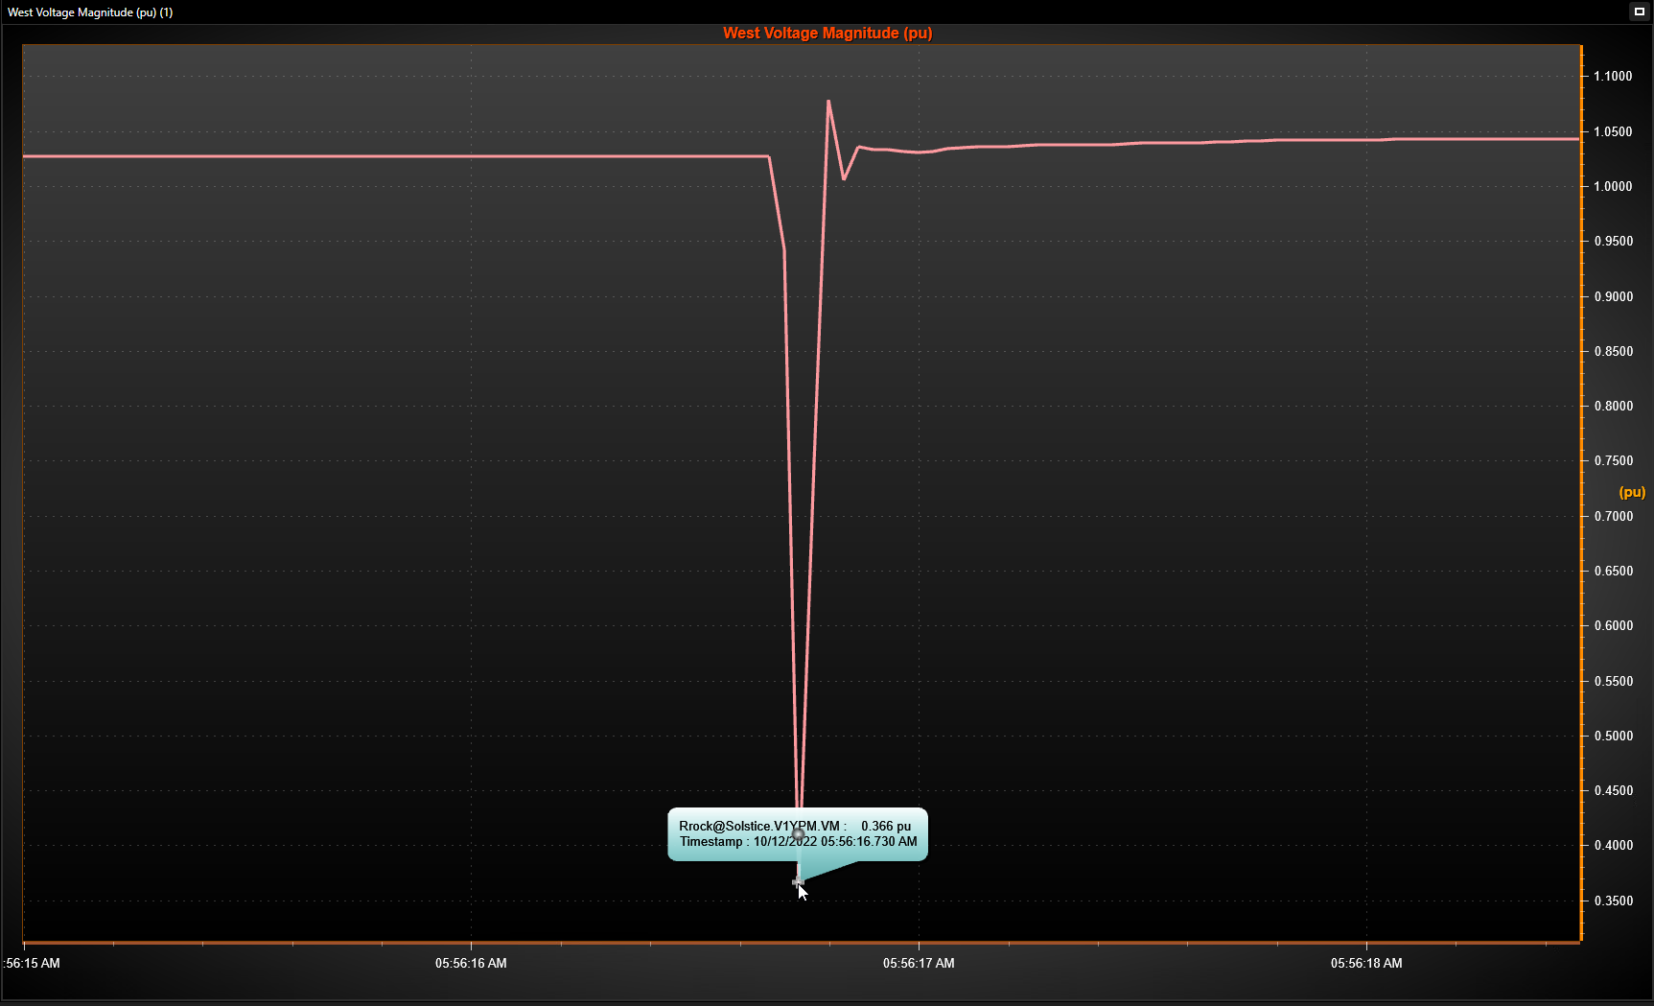
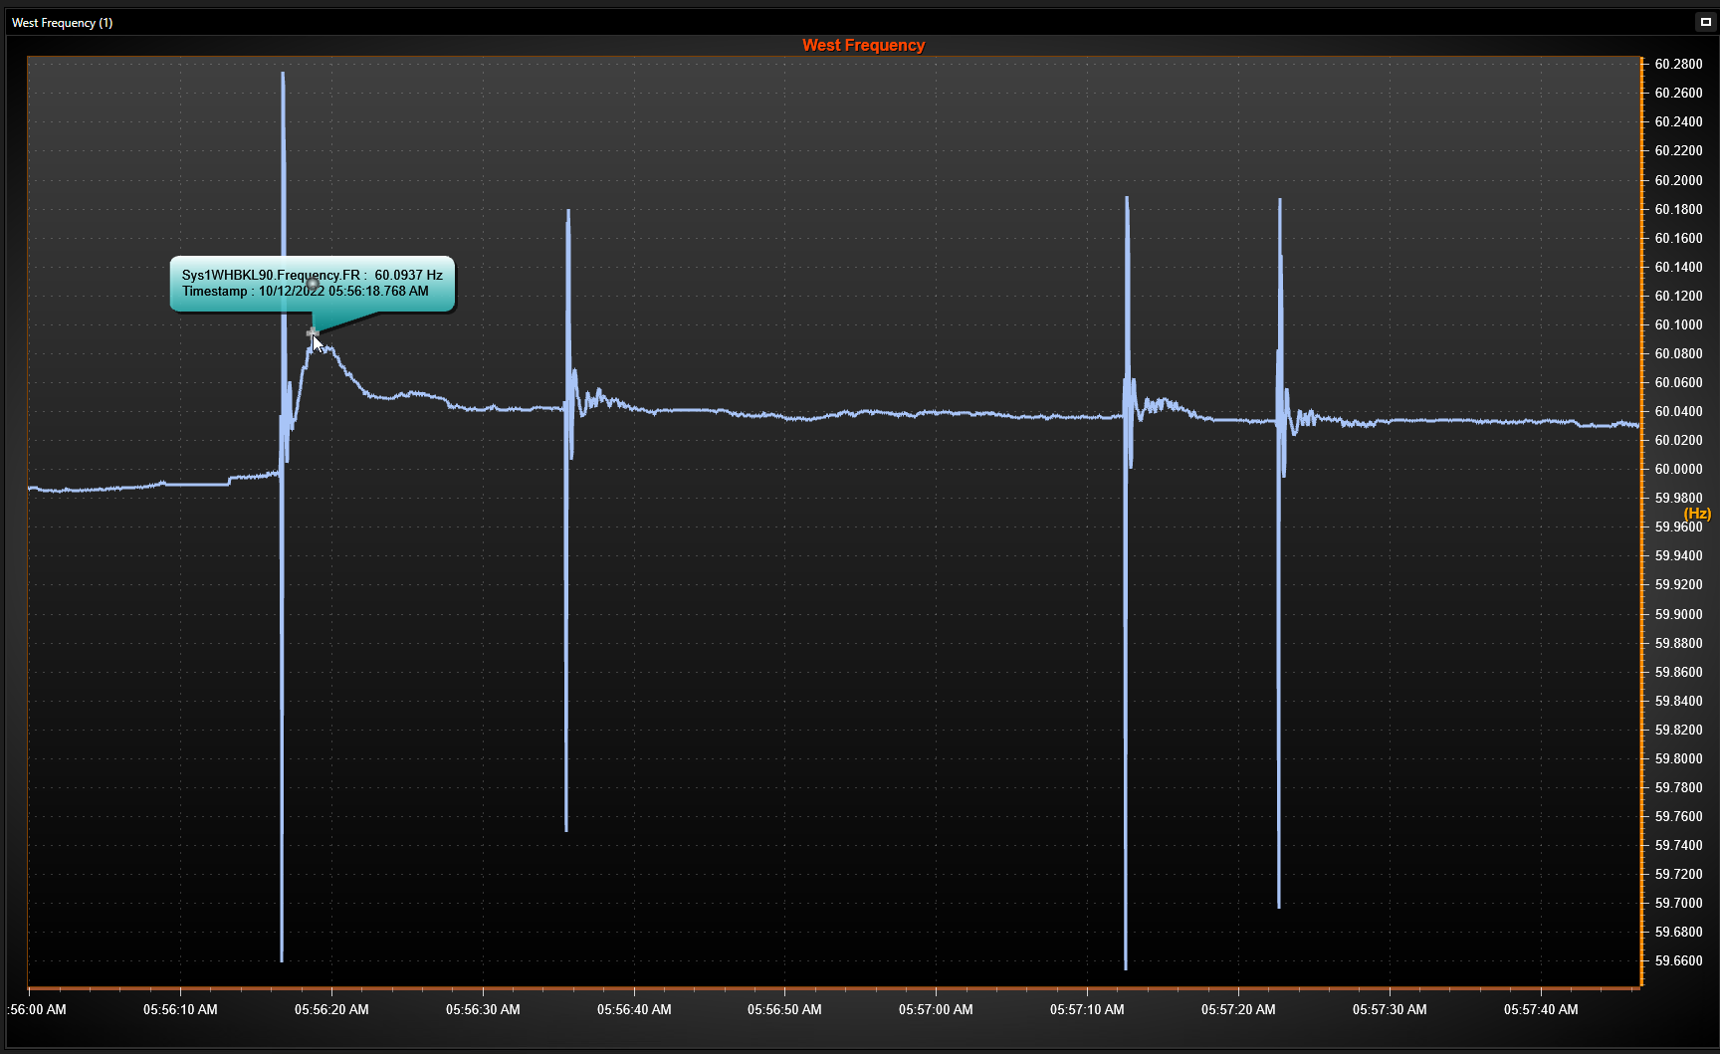
VRT Event
On 10/12/22 at 5:56 am, four faults occurred in the West region
On October 12, there was a load voltage ride-through event in West Texas
Several loads totaling >400 MWs tripped, including LFL
ERCOT is still investigating this event
Lowest recorded voltage was 0.36pu.
Four frequency swings. Highest frequency 60.09 Hz.

Slide 17
For Reference: Nodal Operating Guide 2.9.1
Current Requirement for Intermittent Renewable Resources

Slide 18
Next Steps
ERCOT will work with TDSPs on framework for ramp rate and voltage ride-through requirements
ERCOT will develop draft ramp rate and voltage ride-through requirements

